Slide 1
Unit 15 : When's Children's Day?
Revision
Grade 4
Teacher: Cao Thanh Thuy

Slide 2
GrAMMAR
When is……………………………….?
It’s on……………………………………
new year
the first of January
What do you to at Tet?
I ……………………………………….
make banh chung

Slide 3
1.COMPLETE THE WORDS.
H I
1. C_R_STMAS
2. TEAC_ER_’ DAY
3. _HILDREN’S D_Y
4. LU_KY MO_EY
5. _EW YEA_
6. FI_EWO_K
7. _ECOR_TE
8. SHO_PI_G
9. M_K_
H S
C A
C N
N R
R R
D A
P N
A E

Slide 4
2.Choose the odd one out. (Khoanh tròn vào từ khác loại.)
1. Chrismas | Children’s day | Teacher’s day | festival
2. mooncake | sweet | banana | food
3. get present | eat nice food | make a lantern | Tet
4. happy | cheerful | birthday | funny

Slide 5
3. Make A sENtence.
1, likes/ My/ mooncakes/ grandfather/ ./
...........................................................................................................
2, Mid – Autumn/ I/ festival/ like/ ./
.............................................................................................................
3, got/ I/ a lantern/ have/ ./
.............................................................................................................
4, Children/ and/ wear new clothes/ on Tet festival/ get lucky money/ ./
.............................................................................................................
5, can/ Santa Claus/ You/ see/ at Christmas/ ./
.............................................................................................................
My grandfather likes mooncakes.
I like Mid- Autumn festival.
I have got a lantern.
Children wear new clothes and get lucky money on Tet festival.
You can see Santa Claus at Christmas.

Slide 6
4.Nối câu hỏi với câu trả lời cho đúng.
1, What is Christmas? | a, a big festival in Viet Nam at the beginning of the year.
2, What’s mooncake? | b, a big festival in many countries.
3, What is Tet? | c, a festival for children.
4, What’s children’s day? | d, a cake for Mid – Autumn festival.

Slide 7
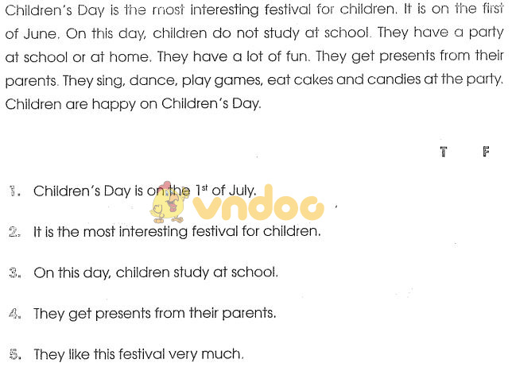
5. Read and tick √ T (True) or F (False).
F
T
F
T
T

