Slide 1
Unit 13 : Would you like some milk ?
Revision
Phuong Liet Primary school
Grade 4
Teacher : Cao Thanh Thuy

Slide 2
Model 1:
What is your favourite ……………………...?
It’s……………………………………………….
food
/drink
/milk
chicken
Model 2 :
Would you like some………………….?
bread
Yes, please.
No, thanks.

Slide 3
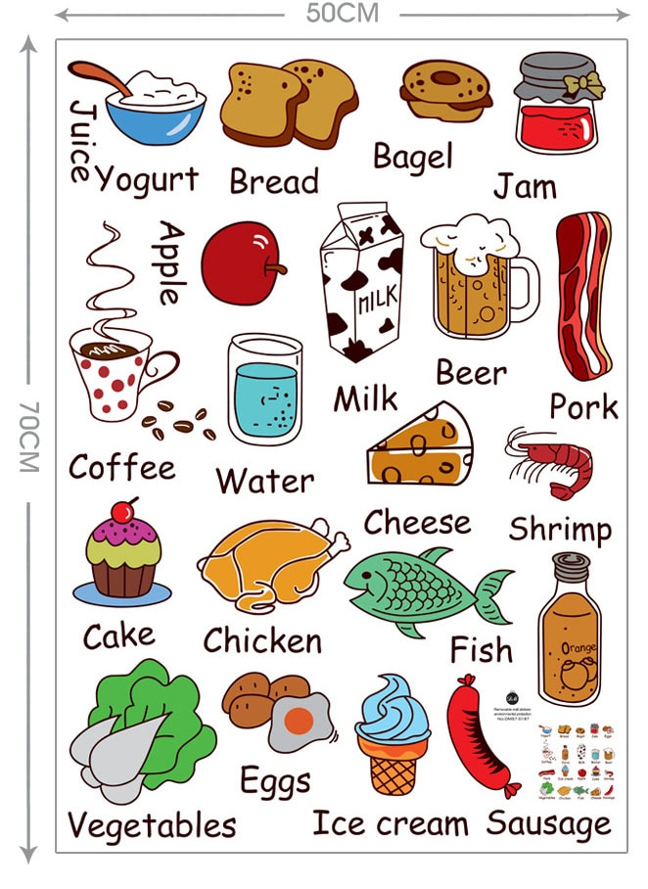
FOOD AND DRINKS

Slide 4
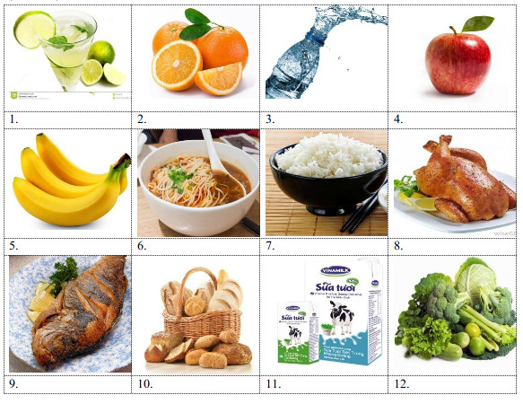
Ex1: Put a word under each picture: Vegetables, lemonade, noodles, apple, orange, rice, fish, bread, water, milk, chicken, banana
Lemonade
Orange
Water
Apple
Banana
Noodles
Rice
Chicken
Fish
Bread
Milk
Vegetables

Slide 5
Ex 2: Odd one out:
1. a. fish | b. pork | c. beef | d. fruitjuice
2. a. bread | b. nurse | c. noodles | d. food
3. a. doctor | b. worker | c. rubber | d. teacher
4. a. clerk | b. field | c. factory | d. office
5. a. drink | b. milk | c. water | d. apple

Slide 6
Ex 3: Put the words in correct order:
1. like/ I/ apple juice/ would/some/
..........................................................................................
2. what/ your/ drink/ favourite/is/ ?
..........................................................................................
3. Mary’s/ food/ is/ what/ favourite/?
..........................................................................................
4. drink/ is/ juice/ favourite/ my/orange/
..........................................................................................
5. parents/ fish/ rice/ like/ my/ and/
..........................................................................................
I would like some apple juice.
What is your favourite drink?
What is Mary’s favourite food?
My favourite drink is orange juice
My parents like fish and rice.

Slide 7
Ex 4: Choose the correct answer:
Would you like ................. beef? (an/ a/ some/ any)
2. My ................. drink is lemonade. (like/ favourite/ love/ drink)
3. His favourite drink is ................ .(chicken/ beef/ fruitjuice/ beef)
4. Sometimes I have some bread with milk for ................. . (school/ breakfast/ class/ friend)
5. I am hungry. I would like some ................. . (water/ milk/ coffee/ noodles)
some
favourite
fruitjuice
breakfast
noodles

