Slide 1

Unit 14: What does he look like?
Revision
Phuong Liet Primary school
Grade 4
Teacher : Cao Thanh Thuy

Slide 2
New word
Tall : Cao
Short : Thấp
Old: Già
Young : Trẻ
Slim: Mảnh dẻ

Slide 3

Model 1 :
What does he/ she look like?
He’s/ She’s ………………………
tall
Model 2:
Who’s …………………………….?
………………..is…………………….
er
tall
Peter
taller
Peter Daisy

Slide 4
EXERCISES
Ex 1: Odd one out:
1. a. old | b. young | c. fish | d. slim
2. a. smaller | b. thinner | c. thicker | d. sister
3. a. banana | b. strong | c. thin | d. thick
4. a. short | b. tall | c. milk | d. weak
5. a. big | b. milk | c. water | d. lemonade
6. a. bigger | b. taller | c. fatter | d. short
7. a. noodles | b. slimmer | c. younger | d. older
8. a. strong | b. brother | c. tall | d. small

Slide 5
Ex 2: Put the words in correct order:
1. like/ mother/ what/ your/ does/ look/?
2. me/ brother/ is/ older/ my/ than/.
3. what/ grandparents/ do/ like/ your/ look/?
4. is/ father/ strong/ my/ and/ big/.
5. slim/ brother/ my/ is/ tall/ and/.
6. parents/ young/ my/ are/ strong/ and/
7. father/ my/ is/ brother/ than/ taller/ my/.
What does your mother look like?
My brother is older than me.
What do your grandparents look like?
My father is big and strong.
My brother is tall and slim.
My parents are young and strong.
My father is taller than my brother.

Slide 6
Ex 3: Translate into English:
1. Quyển sách này dày hơn quyển sách kia.
2. Chị gái tôi cao hơn tôi.
3. Em trai của cô ấy thấp và béo.
4. Mary là một cô gái cao ráo và xinh xắn.
5. Lớp tôi to lớn hơn lớp của bạn.
This book is thicker than that book.
My sister is taller than me.
Her brother is short and big.
Mary is a tall and beautiful girl.
My class is bigger than your class.

Slide 7
Tall : people ex: Peter is taller than Daisy
High : things ex: this tree is higher than that tree your building is higher than mine

Slide 8
Ex 4: Read and write:
Dear Jane,
My name’s Marry. I’m nine years old and I live in Da Nang. There are four people in my family: my father, my mother, my brother and me. My father’s 34 years old. He’s a teacher; and he’s tall and slim. My mother’s 31 years old. She’s a doctor. I think she’s very beautiful. My brother and I are pupils at Hoa Hong Primary School. I’m older than my brother but he’s taller than me.
Best wishes,
Marry
1. What does Marry’s father do?
2. What does her father look like?
3. What does her mother do?
4. What does her mother look like?
5. What do Marry and her brother do?
6. How old is Marry?
7. Who is younger, Marry or her brother?
8. Who is shorter, Marry or her brother?)
-> He’s a teacher.
-> He’s tall and slim.
-> She’s a doctor.
->She’s beautiful.
->They are pupils.
-> She is 9 years old.
-> Her brother is younger.
-> She is shorter.

Slide 9
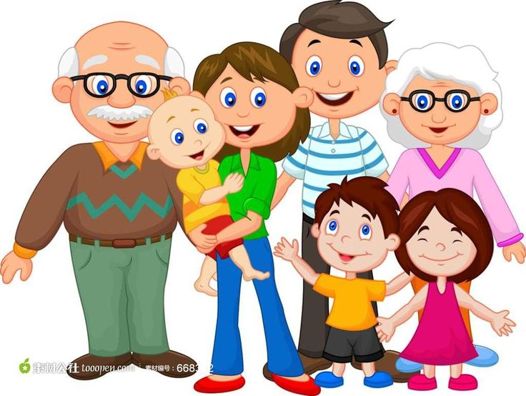
Ex 5: Write a pagragraph to describe your family members ( 5-10 sentences)

