Slide 1
Unit 15: What Would you like to be in the future?
Revision
Grade 5:
Teacher : Cao Thanh Thuy

Slide 2
Grammar
What would you like to be in the future?
I’d like to be a / an ………………………..……….
teacher
/ architect
a nurse
Why would you like to be ………………….?
look after patients
Because I’d like to …………………………….

Slide 3
1.Complete the word. (Hoàn thành các từ sau)
O T
1. D_C_OR
2. _E_TI_T
3. _AR_ER
4.SI_G_R
5. W_I_ER
6. _OR_E_
7. _IL_T
8. NU_S_
D N S
B B
N E
R T
W K R
P O
R E

Slide 4
2.Complete the sentence with words given. (Hoàn thành câu bằng những từ cho sẵn). gym; popular; engineer; working; become;
1.Why do you want to be an (1)...................?
2. Jimmy is practising in the (2) ..................
3. I study hard to (3).................... a doctor.
4. This comic book is very (4) ...................... among children.
5. My brother and sister like (5) ...................... in the countryside.
engineer
gym
become
popular
working

Slide 5
3.Mark the sentence in column A with an appropriate response in column B. ( Nối các câu ở cột A với các câu ở cột B).
1. What would she like to be in the future? | a. Because I want to teach children.
2. What does your father do? | b. They work on a farm.
3. Why would you like to be a teacher? | c. I am reading science
4. What are you reading? | d. She would like to be a doctor.
5. Where do the farmers work? | e. He's an architect.

Slide 6
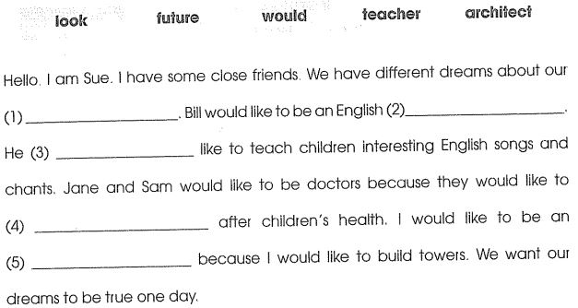
4. Read and complete.
future
teacher
would
look
architect

Slide 7
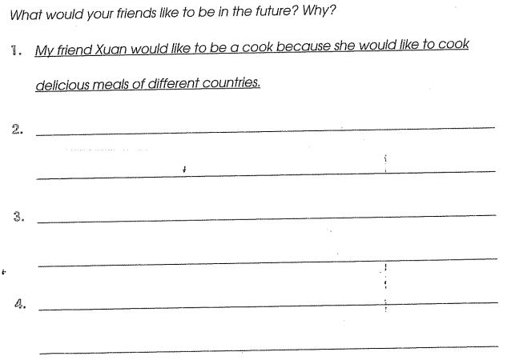
5. Write about your friends

