Slide 1

Unit 1: Animals
Lesson 2.2
Page 10

Slide 2
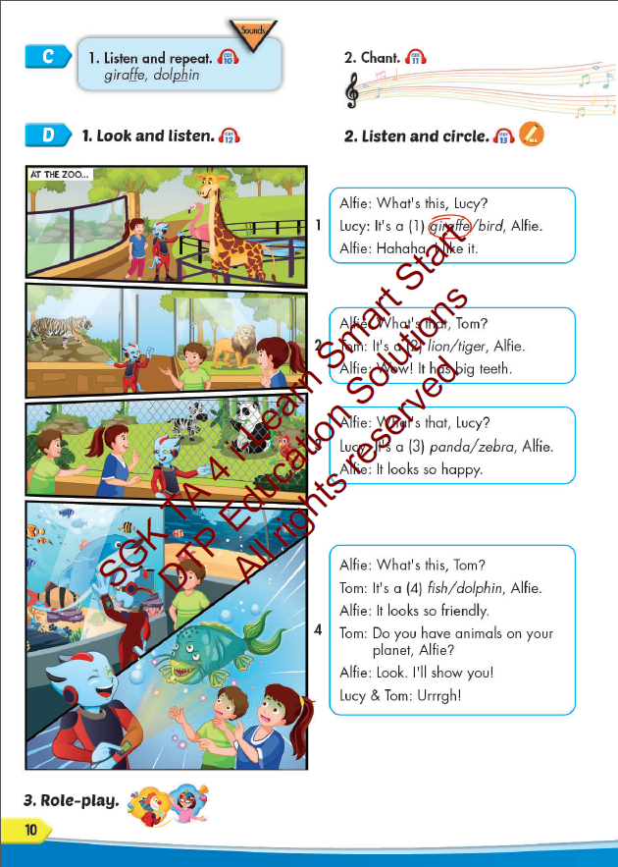
Lesson Outline
Warm-up
Listening
Consolidation
Wrap-up

Slide 3
Objectives
By the end of this lesson, students will be able to…
Vocabulary: Pronounce and use the words related to the topic properly: panda, giraffe, lion, dolphin, tiger, zebra.
Structure: What's this? - It's a panda.
What's that? - It's a dolphin.
Phonics: Draw attention to the initial/f inal/medial /f/ sound. and practice the conversations.

Slide 4

WARM UP

Slide 5
Check your memory

Slide 6
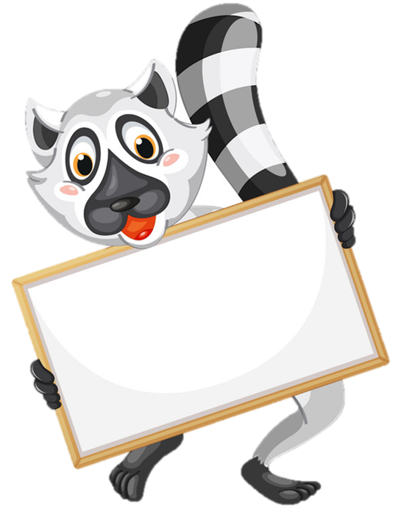

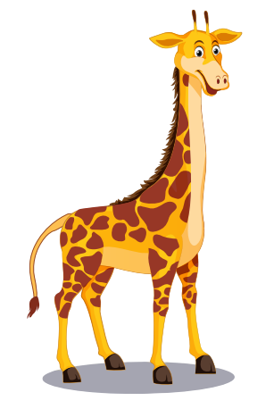
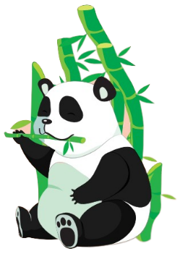

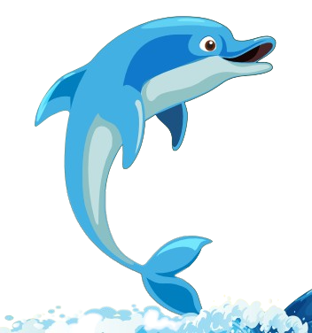
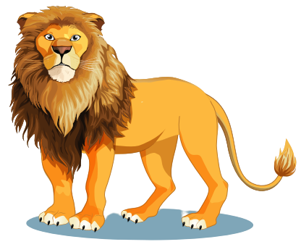
a
b
Next
c
d
lion

Slide 7


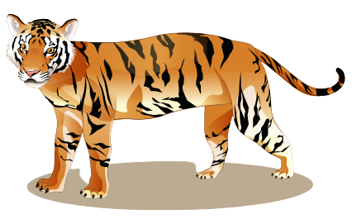
a
b
Next
c
d
giraffe

Slide 8

a
b
Next
c
d
dolphin

Slide 9

a
b
Next
c
d
panda

Slide 10

a
b
DTP education
Next
c
d
tiger

Slide 11

It’s time to learn …

Slide 12

Phonics
/f/

Slide 13
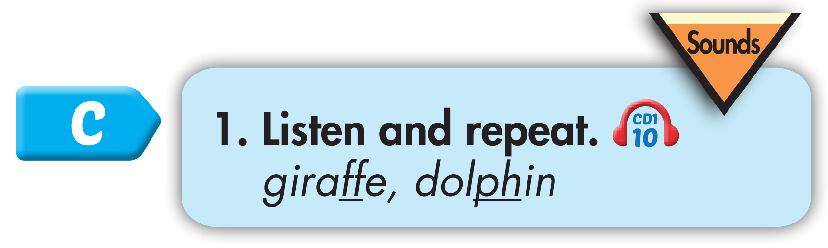
Click CD1 track 10 to hear the sound.
f f giraffe
f f dolphin
Notes:
Bấm vô CD-48 sẽ ra âm thanh

Slide 14
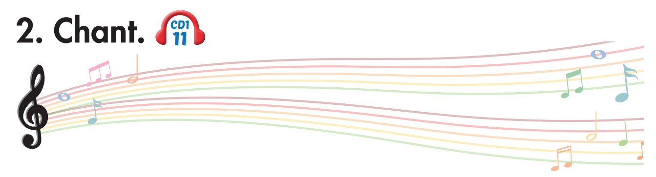
Track 11
Who likes dolphins?
Who likes dolphins?
We like dolphins!
We like dolphins!
Who likes giraffes?
Who likes giraffes?
We like giraffes!
We like giraffes!
We all love friendly animals.
We all love friendly animals.
Click on the music note to hear the sound.

Slide 15

coffee
elephant
List the words with the same sound /f/. Practice saying them with a partner.
off
phone
staff
photo
scoff
alphabet
Notes:
Tìm từ tận cùng bằng ts đã học và tạo chant giống từ donuts

Slide 16

Listening

Slide 17
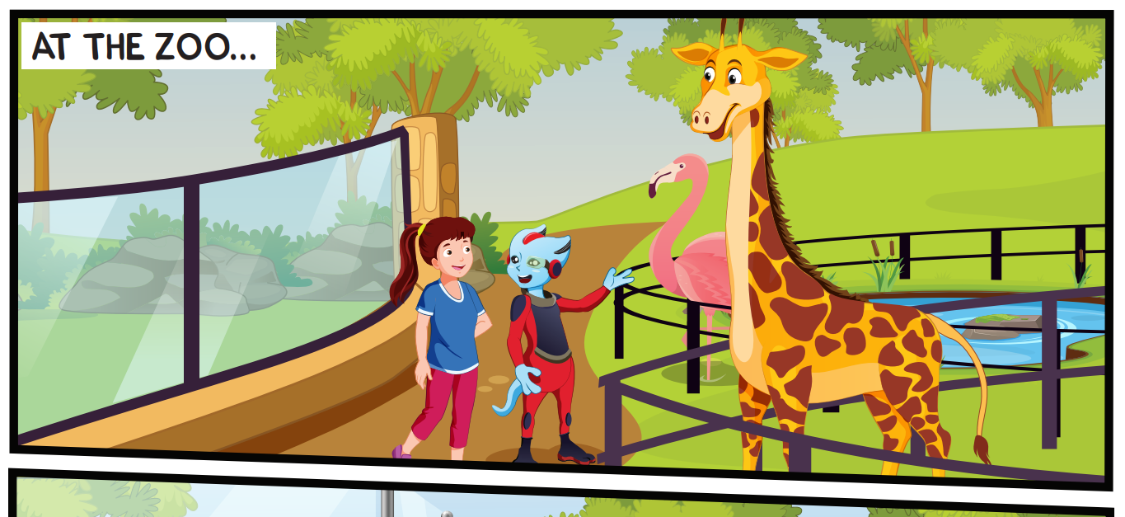
Look at the picture and answer.
Pre-Listening
Who can you see?
Alfie, Tom, and Lucy.

Slide 18
Look at the picture and answer.
Pre-Listening
What is Alfie doing?
He is pointing at a giraffe.

Slide 19
Look at the picture and answer.
Pre-Listening
How many giraffes can you see?
one giraffe.

Slide 20

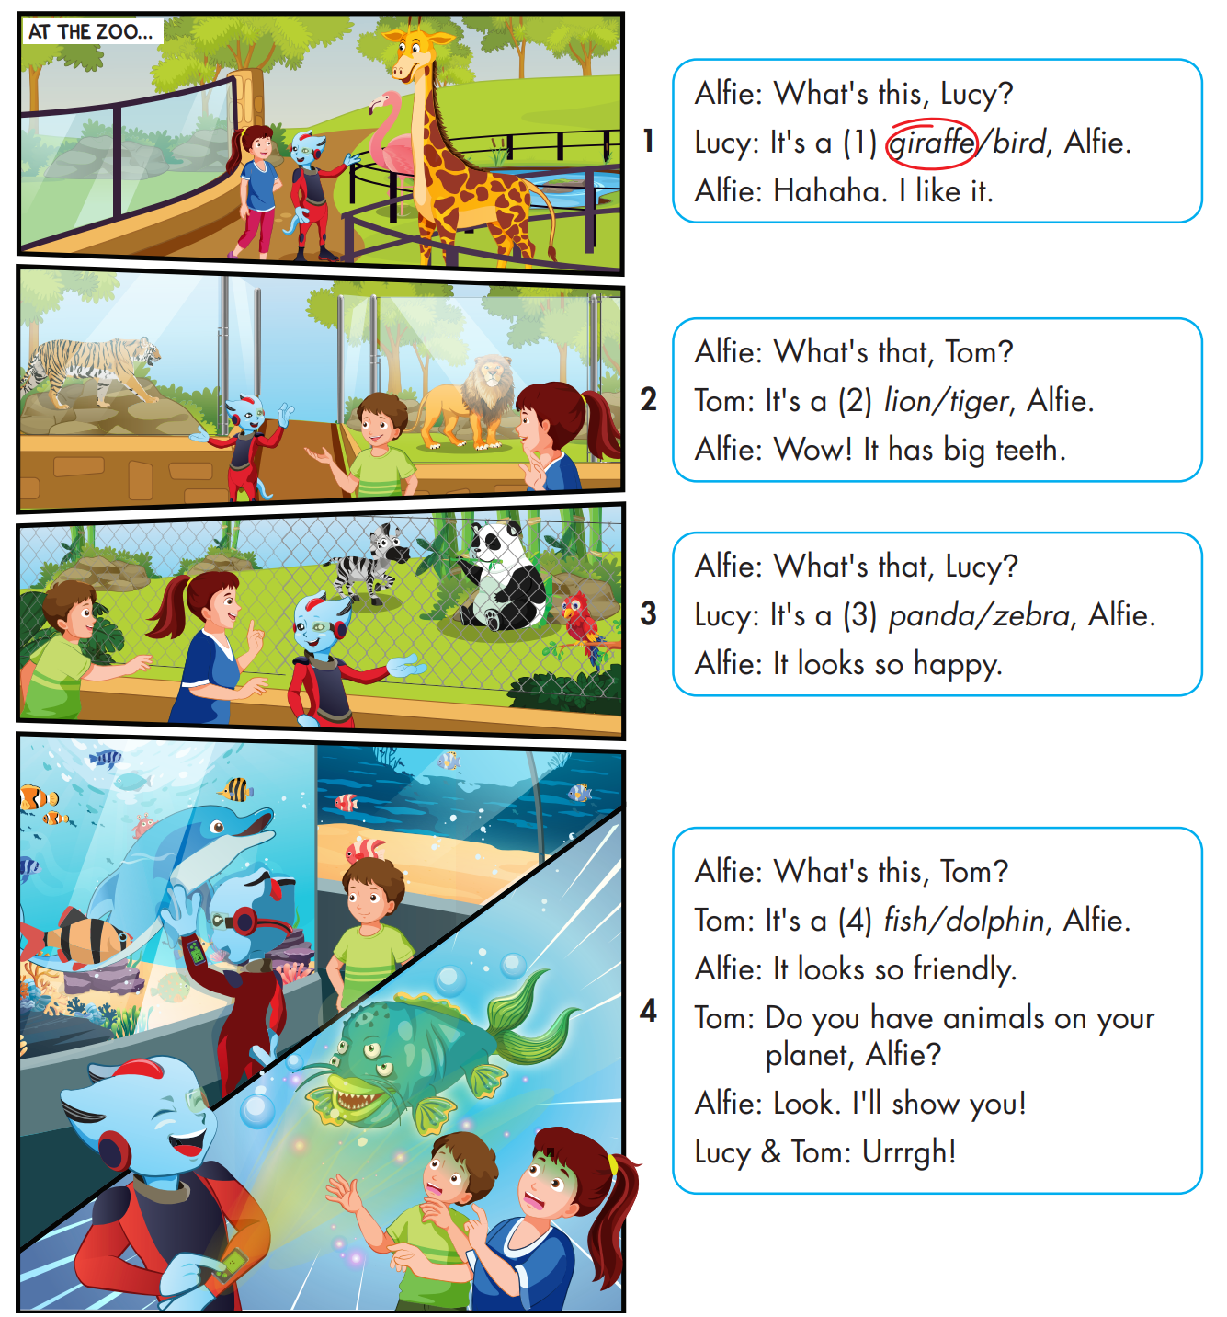

While-Listening

Slide 21
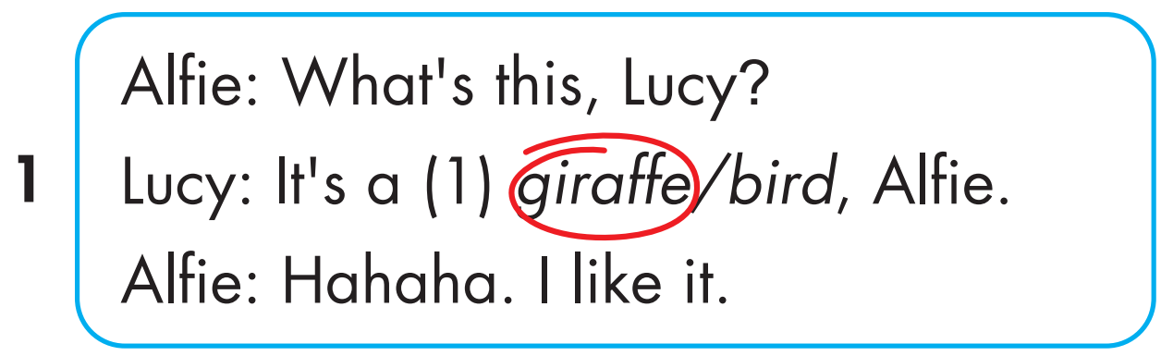
While-Listening
Notes:
Bấm vô chữ listen audio sẽ bật, muốn tắt bấm vô audio lần nữa

Slide 22
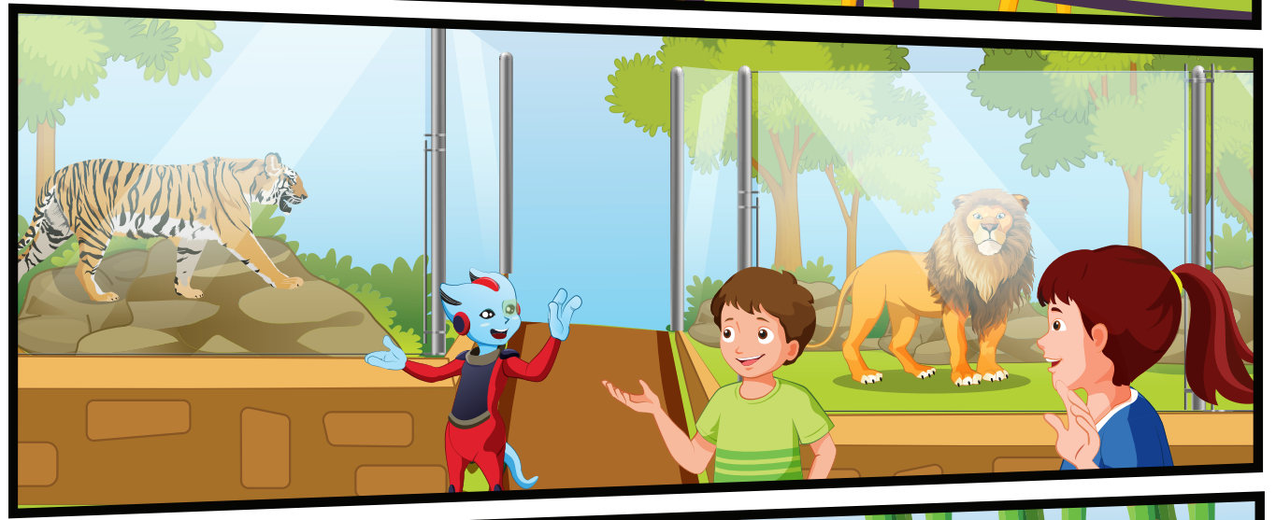
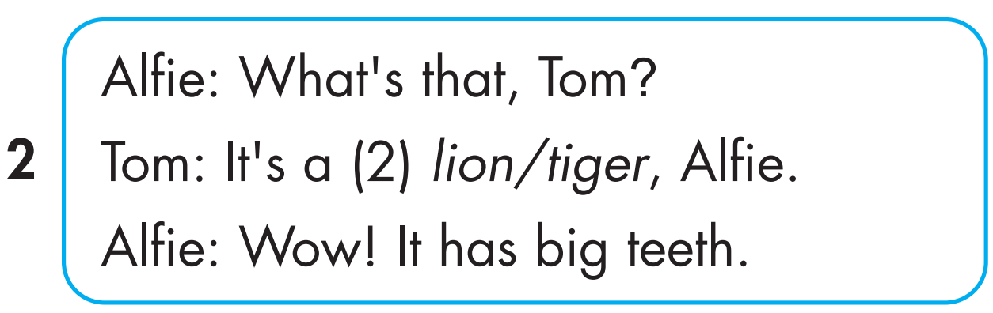
While-Listening

Slide 23
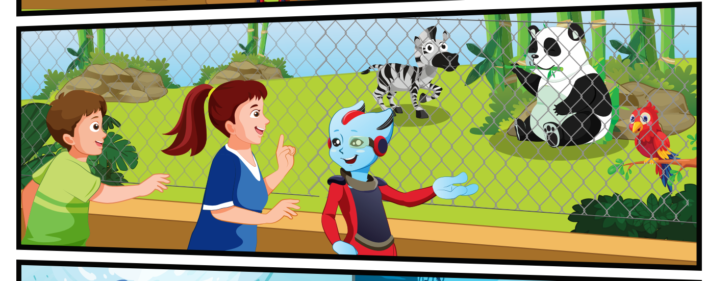
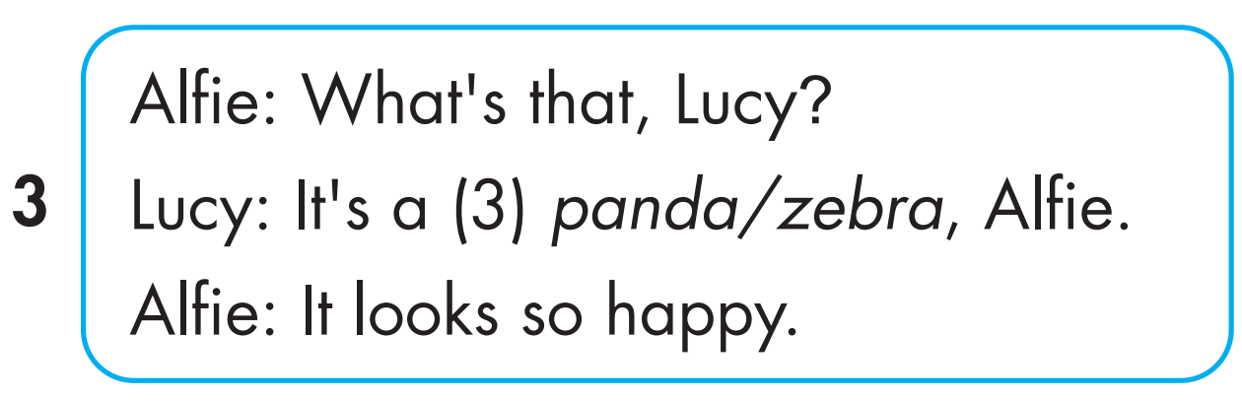
While-Listening
Notes:
Bấm vô chữ listen audio sẽ bật, muốn tắt bấm vô audio lần nữa

Slide 24
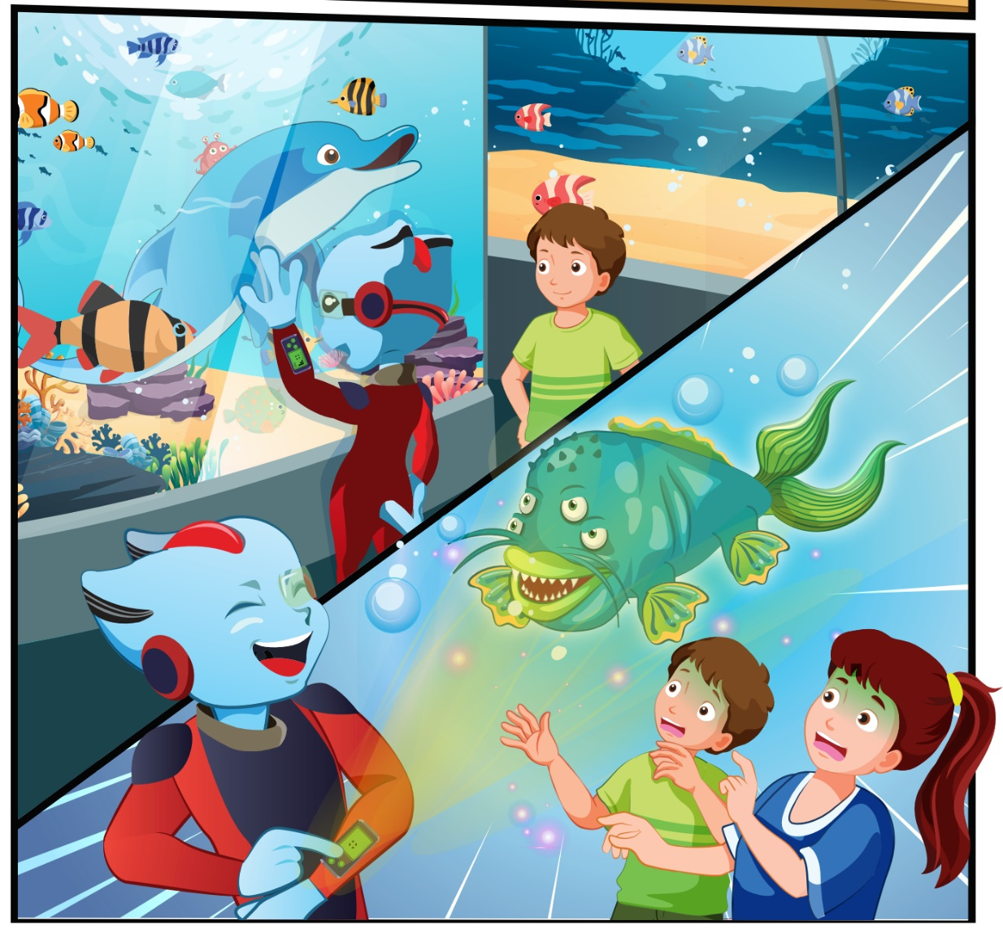
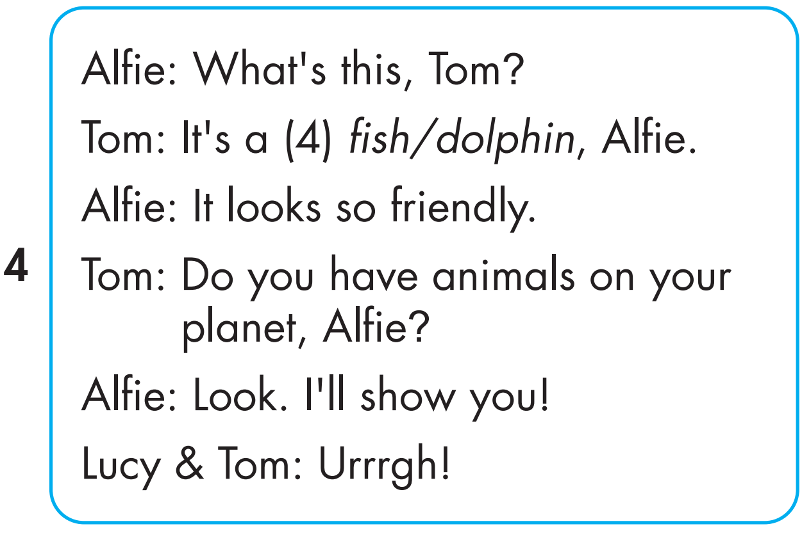
While-Listening

Slide 25


Click on 4 numbers to hear each sentence.
While-Listening
1
3
4
2

Slide 26

Early Production

Slide 27

Post-Listening

Slide 28
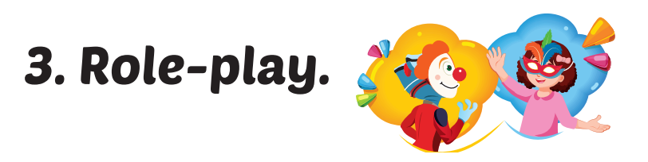
1
3
4
2
Notes:
Bấm vô chữ listen audio sẽ bật, muốn tắt bấm vô audio lần nữa

Slide 29

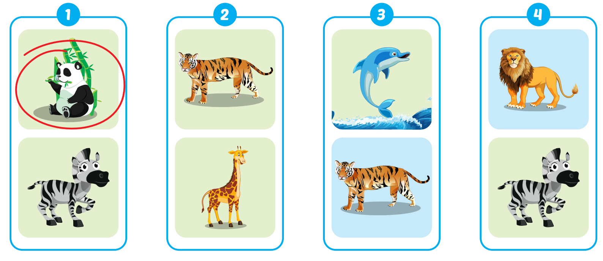
Extra Practice
WB, P. 5

Slide 30

CONSOLIDATION

Slide 31

WRAP-UP

Slide 32
Today’s lesson
Vocabularies
panda, giraffe, lion, dolphin, tiger, zebra.
Structures/ Sentence patterns
What's this? - It's a panda.
What's that? - It's a dolphin.
Phonics
Draw attention to the initial/f inal/medial /f/ sound. and practice the conversations.

Slide 33
Homework
Practice the vocabularies and structure; and make sentences using them.
Do the exercises in Tiếng Anh 4 i-Learn Smart Start WB (page 5)
Do the exercises in Tiếng Anh 4 i-Learn Smart Start Notebook (page 7)
Prepare the next lesson (page 11 SB)
Play the consolidation games in Tiếng Anh 4 i-Learn Smart Start DHA App on www.eduhome.com.vn

Slide 34
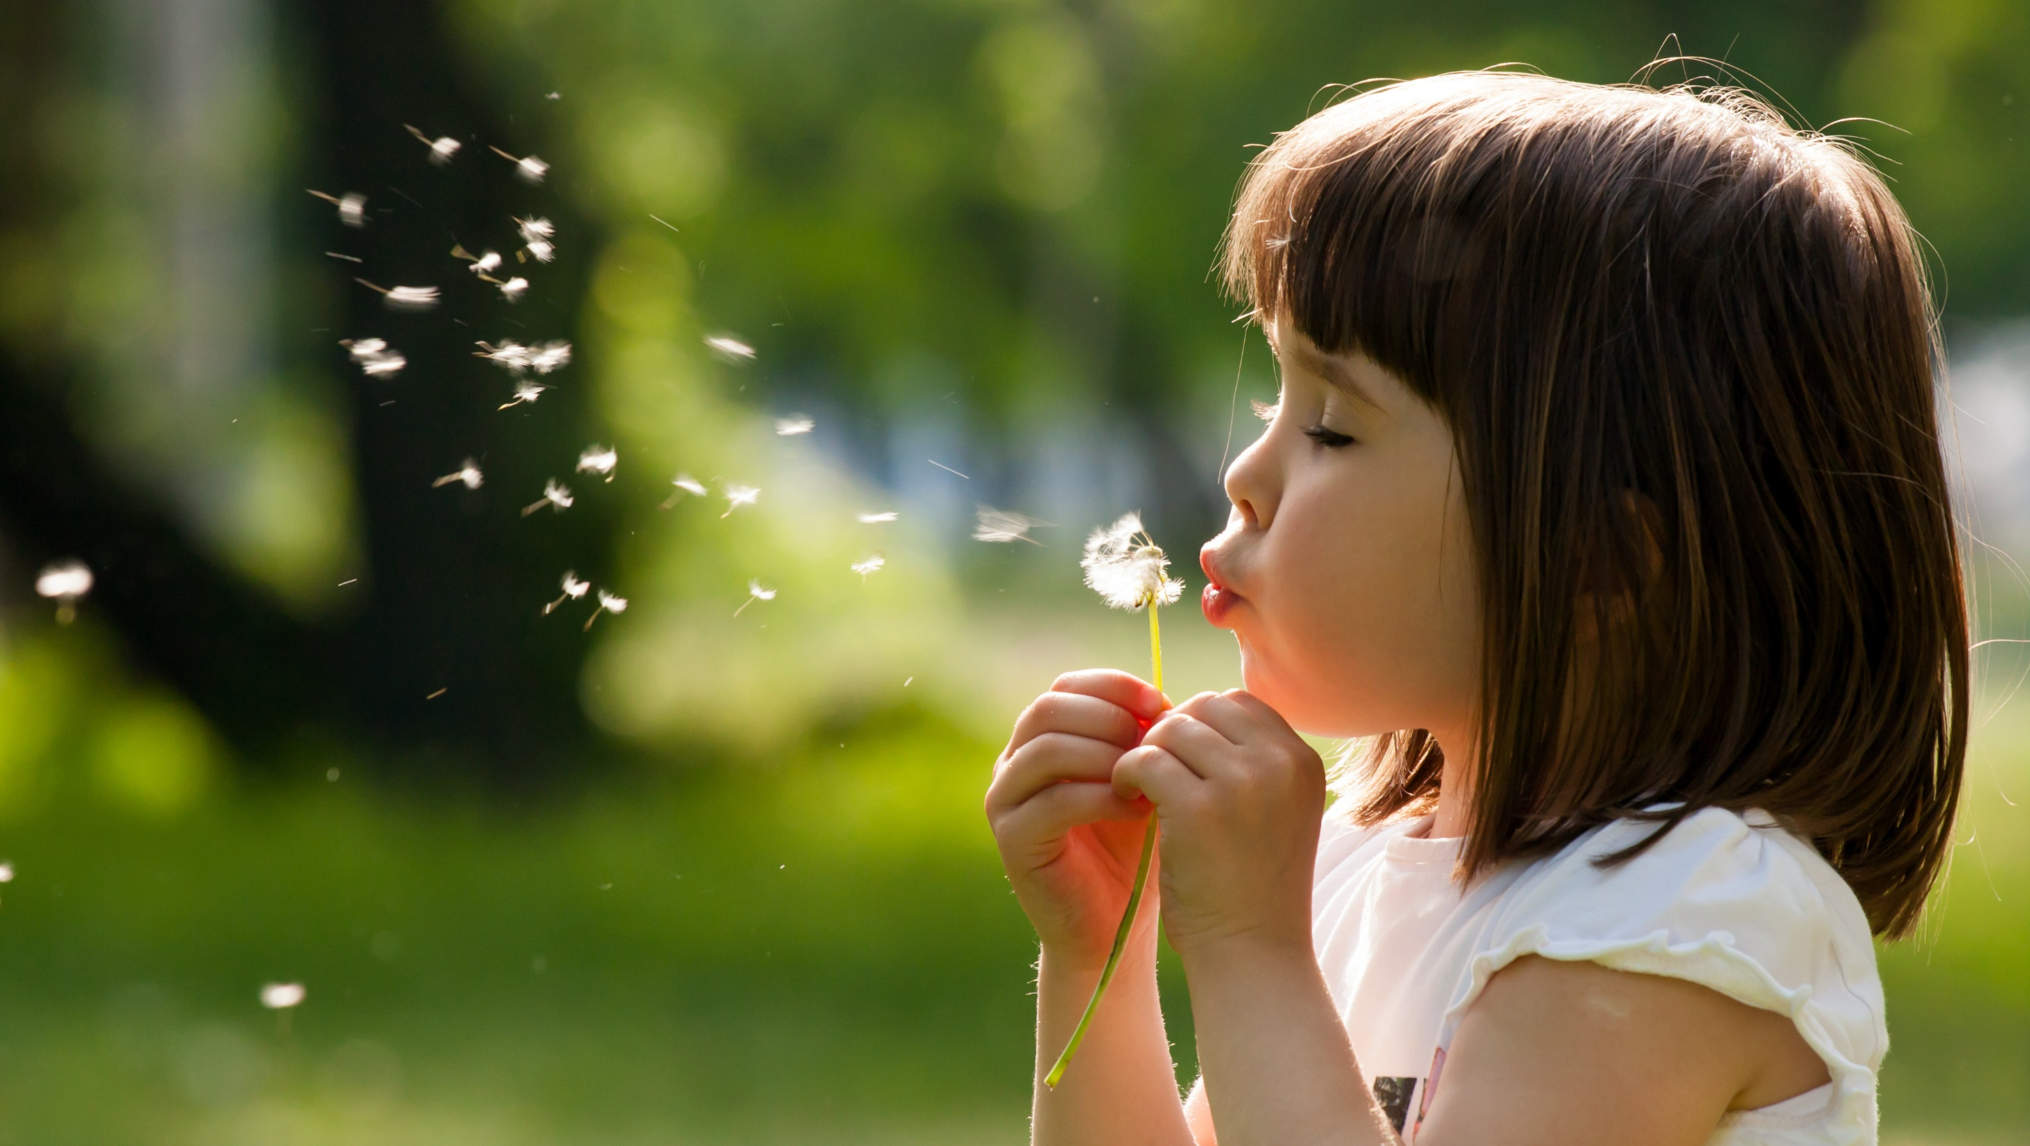
Enjoy your day!

