Slide 1

Unit 1: Animals
Lesson 2.3
Page 11

Slide 2
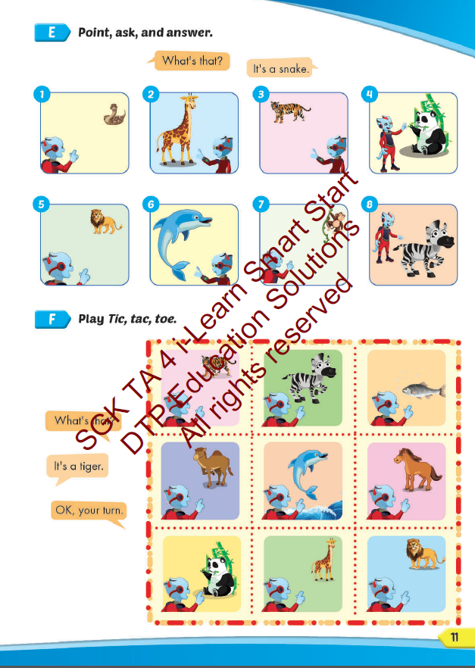
Lesson Outline
Warm-up
Practice
Speaking
Consolidation
Wrap-up

Slide 3
Objectives
By the end of this lesson, students will be able to…
Vocabulary: Pronounce and use the words related to the topic properly: panda, giraffe, lion, dolphin, tiger, zebra.
Structure: What's this? - It's a panda.
What's that? - It's a dolphin.
Phonics: Draw attention to the initial/f inal/medial /f/ sound. and practice the conversations.

Slide 4

WARM UP

Slide 5
Check your memory

Slide 6
QUESTION
DUCKS
START

Slide 7


Look and choose
PANDA
LION
MONKEY

Slide 8
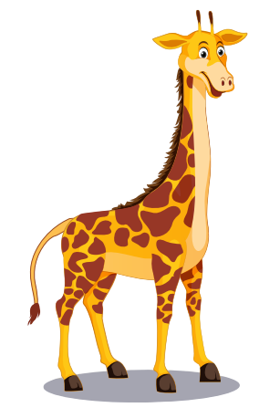
Look and choose
LION
TIGER
GIRAFFE

Slide 9
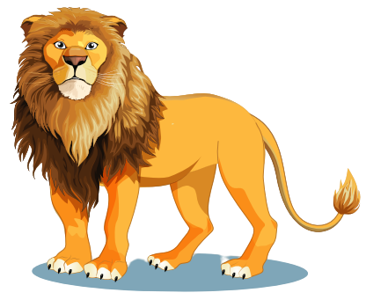
Look and choose
LION
DONKEY
TIGER

Slide 10

Look and choose
TIGER
MONKEY
DOLPHIN

Slide 11

It’s time to learn …

Slide 12

Speaking

Slide 13



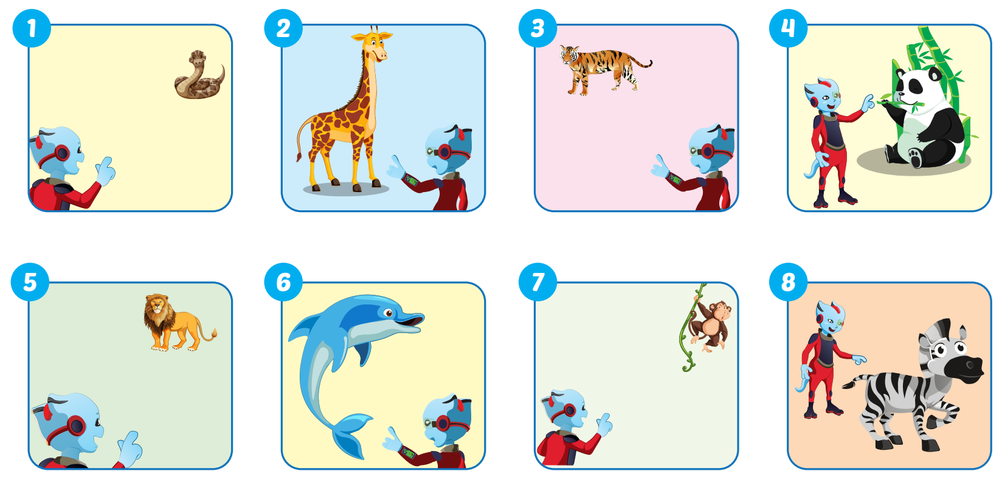

Slide 14

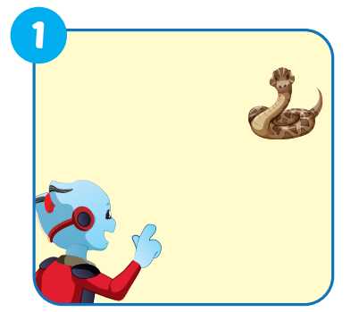


What's that?
It's a snake.

Slide 15
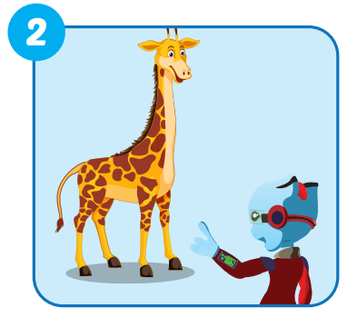
What's this?
It's a giraffe.

Slide 16
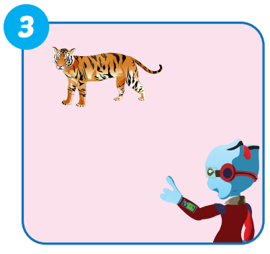
What's that?
It's a tiger.

Slide 17
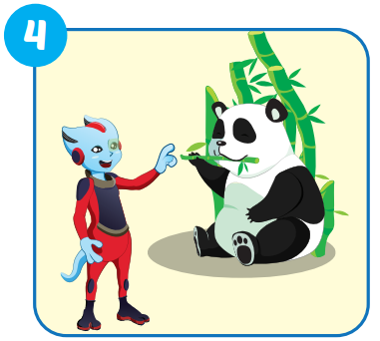
What's this?
It's a panda.

Slide 18
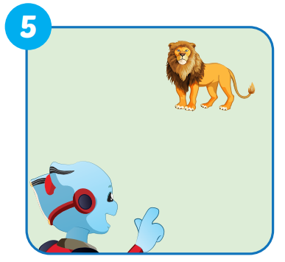
What's that?
It's a lion.

Slide 19
What's that?
It's a lion.

Slide 20
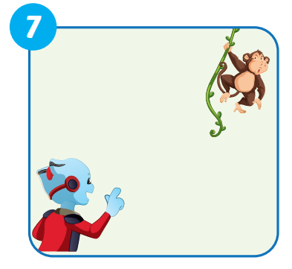
What's that?
It's a monkey.

Slide 21
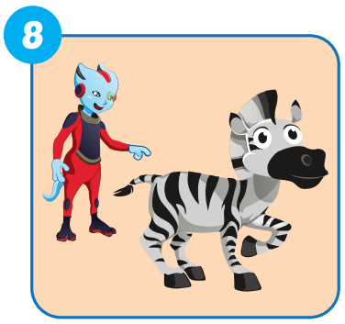
What's this?
It's a zebra.

Slide 22

Production

Slide 23

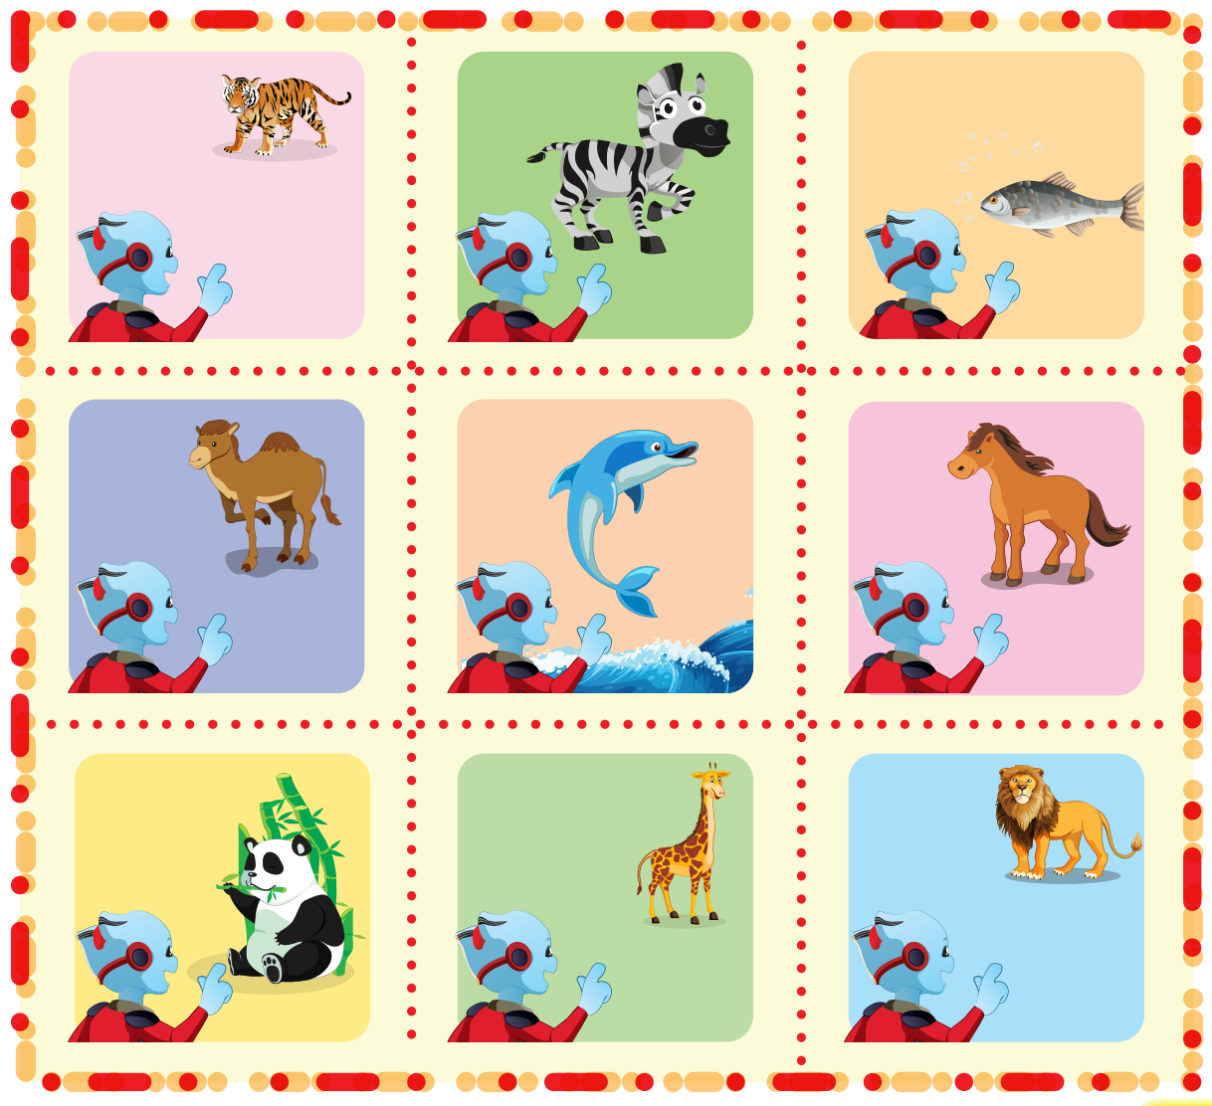
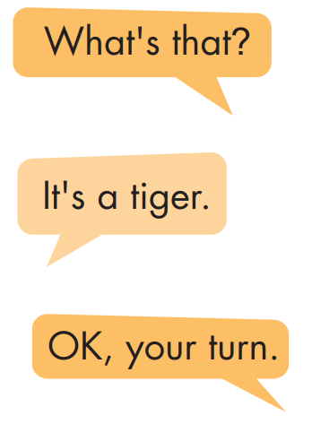

Slide 24
FINDING THE ANIMALS
GAME

Slide 25

Choose the correct answer.

Slide 26




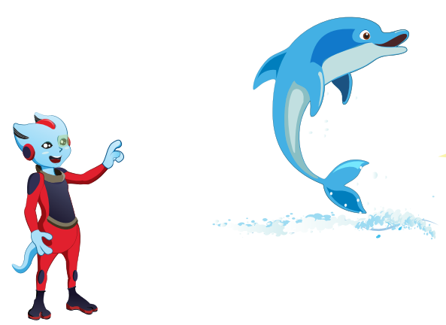
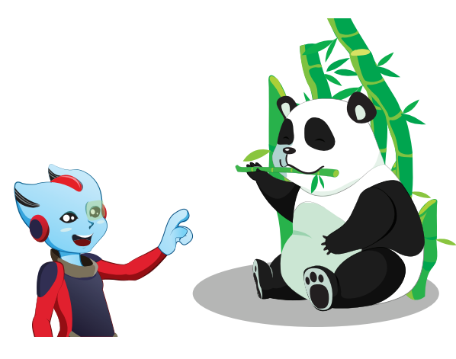
What's this?

Slide 27
What's that?

Slide 28
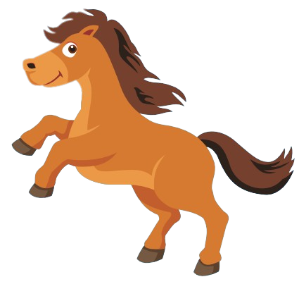

It's a horse.

Slide 29
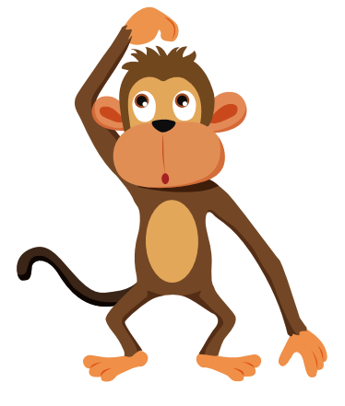
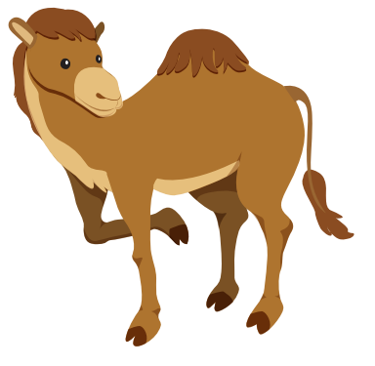
It's a monkey.

Slide 30
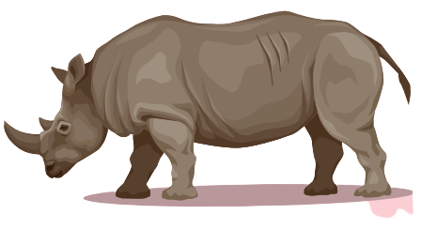
It's a hippo.

Slide 31
It's a giraffe.

Slide 32
It's a dolphin.

Slide 33

CONSOLIDATION

Slide 34

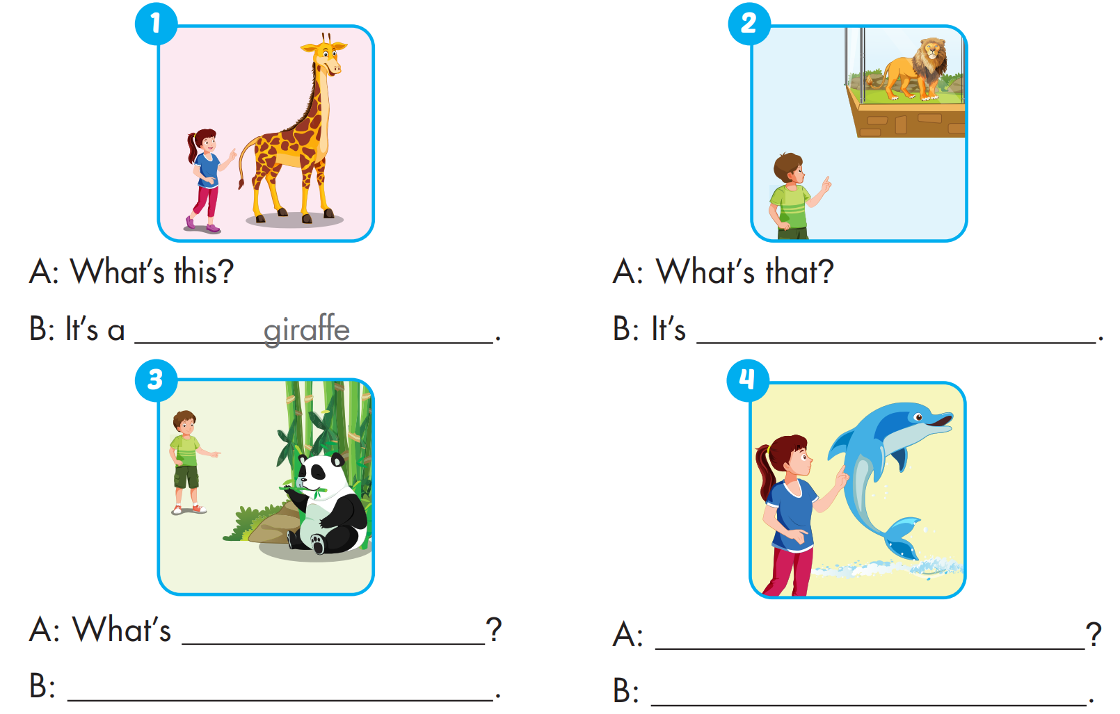
Extra Practice
WB, P. 5
a lion
that
What's this
It's a panda
It's a dolphin

Slide 35

WRAP-UP

Slide 36
Today’s lesson
Vocabularies
panda, giraffe, lion, dolphin, tiger, zebra.
Structures/ Sentence patterns
What's this? - It's a panda.
What's that? - It's a dolphin.
Phonics
Draw attention to the initial/f inal/medial /f/ sound. and practice the conversations.

Slide 37
Homework
Practice the vocabularies and structure; and make sentences using them.
Do the exercises in Tiếng Anh 4 i-Learn Smart Start WB (page 5)
Prepare the next lesson (page 12 SB)
Play the consolidation games in Tiếng Anh 4 i-Learn Smart Start DHA App on www.eduhome.com.vn

Slide 38

Enjoy your day!

