Slide 1

Unit 2
WHAT I CAN DO
LESSON 1.2 - PAGE 21

Slide 2
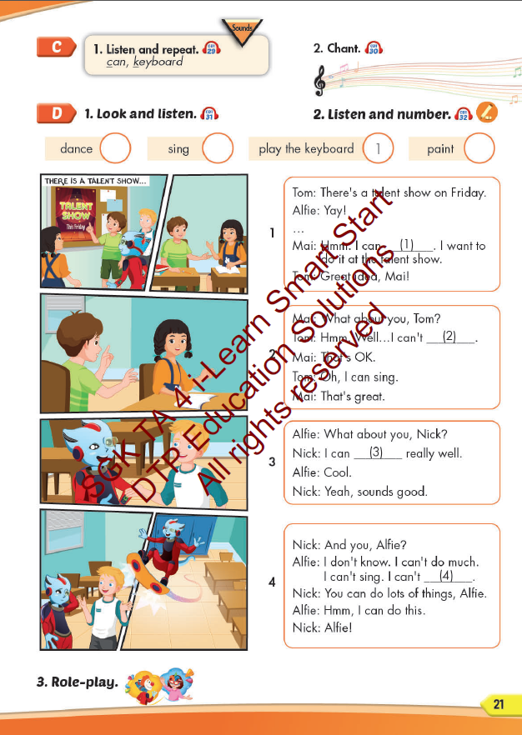
Lesson Outline
Warm-up
Listening
Consolidation
Wrap-up

Slide 3
Objectives
By the end of this lesson, students will be able toto identify the /k/ sound and practice the conversations
Vocabulary: can, keyboard.
Structure: I can dance. / I can't sing.
Phonics: /k/

Slide 4

WARM UP

Slide 5



LISTEN AND CHOOSE

Slide 6
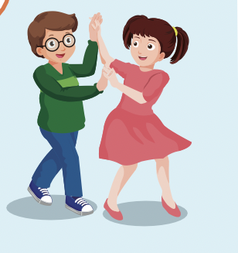
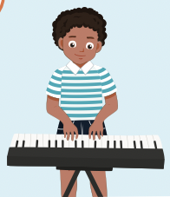
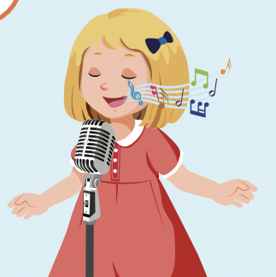


Slide 7
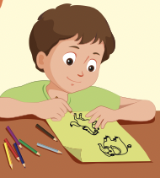
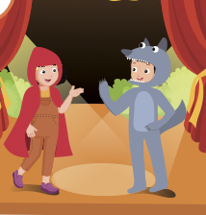
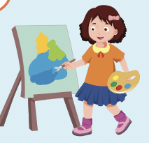

Slide 8
act
paint
dance
Play the keyboard
sing

Slide 11
dance
draw
act
paint
sing

Slide 12

It’s time to learn …

Slide 13
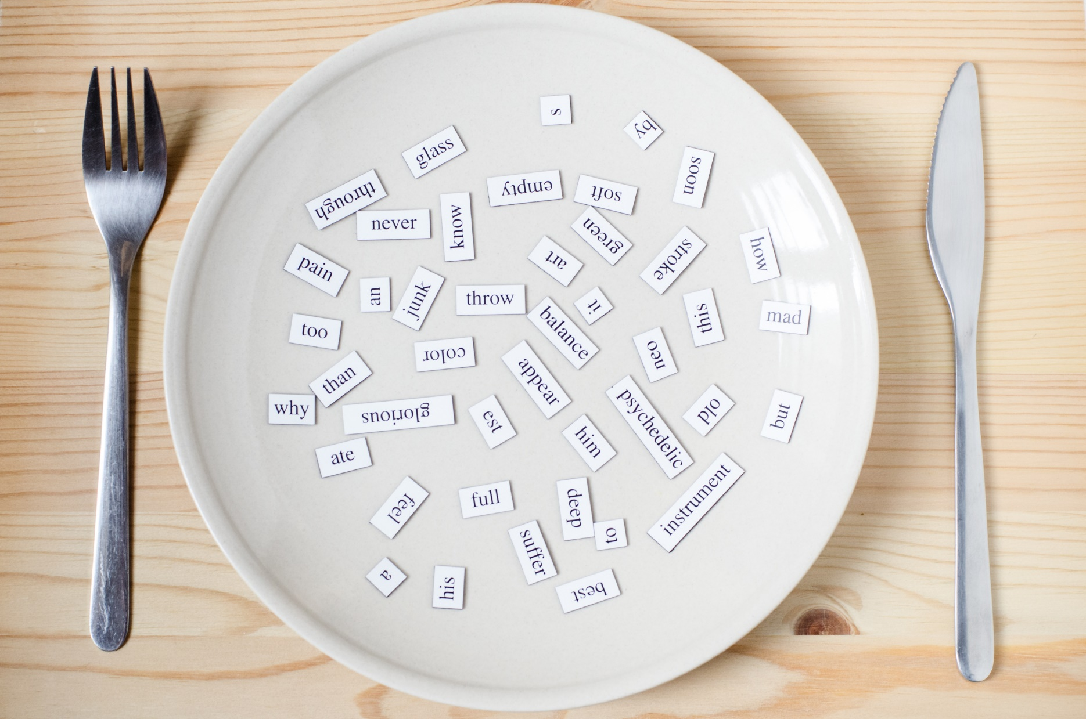
Phonics
/k/
can, keyboard.

Slide 14

Presentation

Slide 15
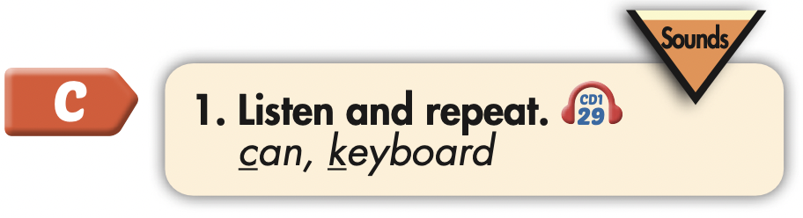
Click each English word to hear the sound.
can
keyboard
/kæn/
/ˈkiːbɔːrd/

Slide 16

Practice

Slide 17



Slide 18
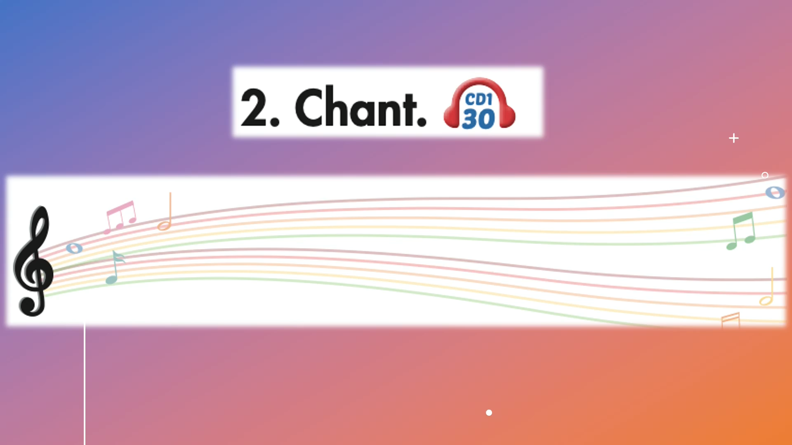

Slide 19
Structures
I can dance.
I can't sing.

Slide 20
WORD QUIZ
Click on the right word

Slide 21



Click on the right word
sing
dance
play the keyboard

Slide 22
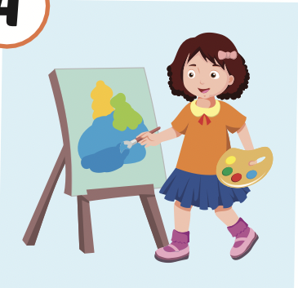
Click on the right word
paint
dance
sing

Slide 23
Click on the right word
sing
dance
draw

Slide 24
Click on the right word
draw
swim
sing

Slide 25

Speaking

Slide 26
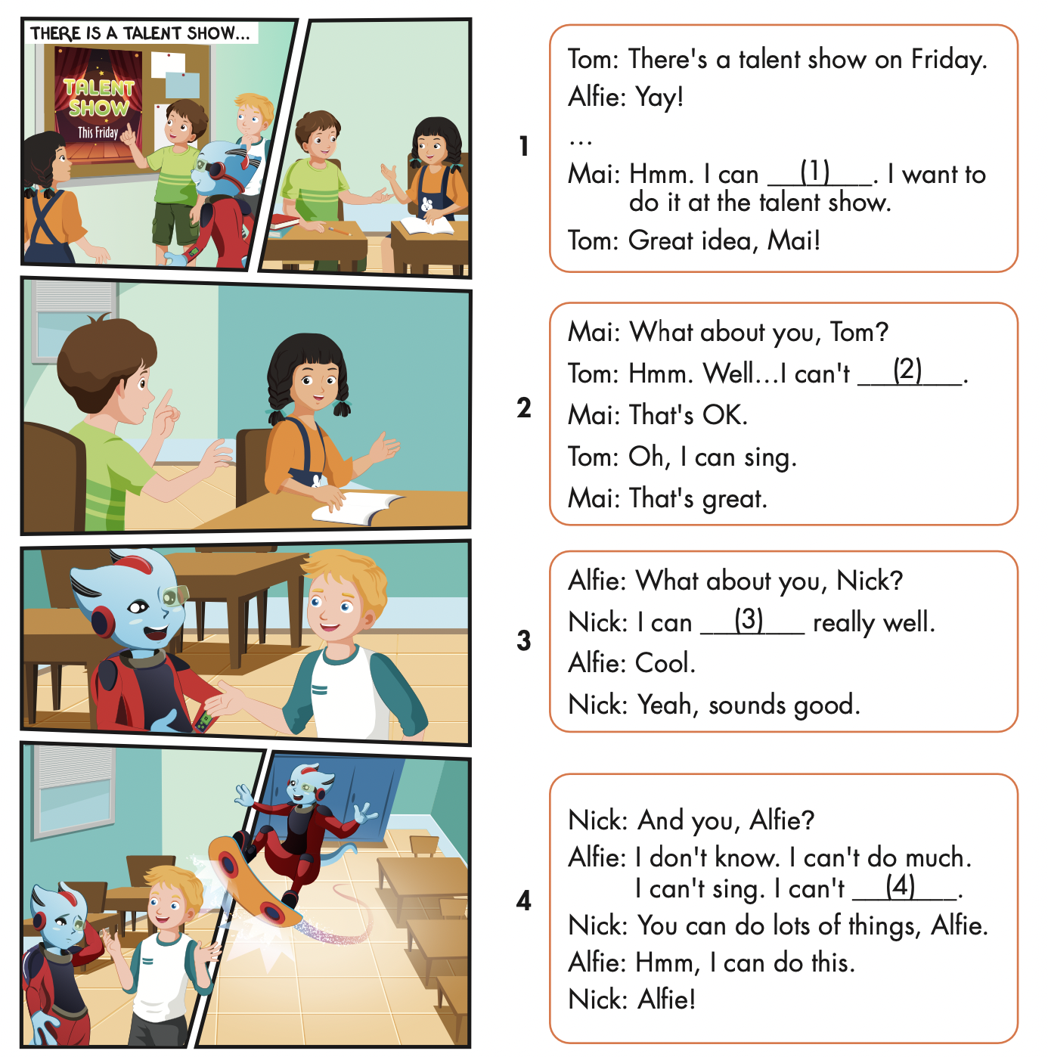
Where are they?
Who is talking?

Slide 27

Listening

Slide 28


Slide 29

2
3
4

Slide 30

Speaking

Slide 31


Slide 32

Production

Slide 33

Writing

Slide 34
MAKE YOUR OWN STORY

Slide 35

CONSOLIDATION

Slide 36
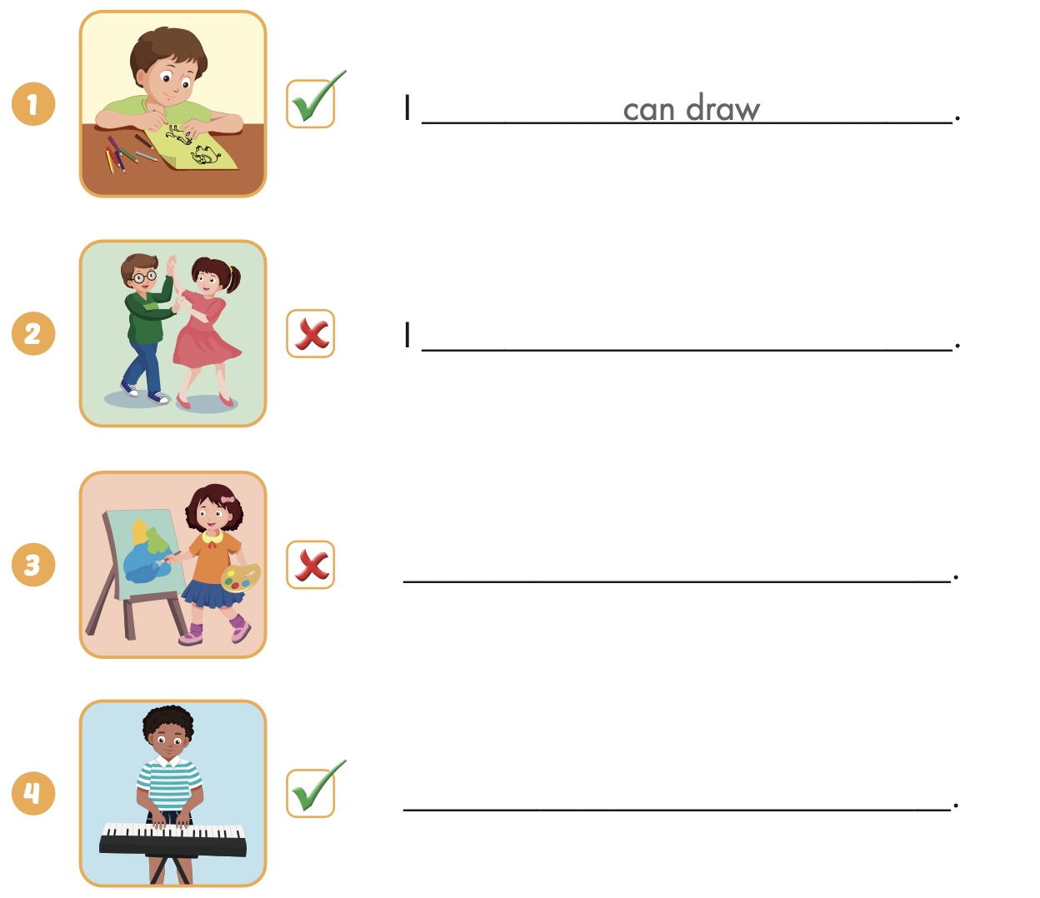

Extra Practice
WB, page 13
can’t dance
I can’t paint
I can play the keyboard

Slide 37

WRAP-UP

Slide 38
Today’s lesson
Phonics
/k/
Structures/ Sentence patterns
I can dance.
I can’t sing.

Slide 39
Homework
Practice the vocabularies and structure; and make sentences using them.
Do the exercises in Tiếng Anh 4 i-Learn Smart Start WB (page 13)
Do the exercises in Tiếng Anh 4 i-Learn Smart Start Notebook (page 10)
Prepare the next lesson (page 22 SB)
Play the consolidation games in Tiếng Anh 4 i-Learn Smart Start DHA App on www.eduhome.com.vn

Slide 40

Enjoy your day!

