Slide 1
Monday, November 22nd 2023
Classroom
instruction
Unit
7
Lesson 2

Slide 2






Contents
Look, listen and repeat.
Listen, point and say.
Let’s talk.
Listen and number.
Look, complete and read.
Let’s sing.
.

Slide 3

Warm-up

Slide 4







A
B
1
5
60
10
2
6
70
45
90
30
3
7
20
100
35
80
4
8
40
50
Click in the wheel to spin.
Chia lớp thành 2 đội.Nhấn vào vòng quay để quay lấy điểm. Sau đó, hs chọn cây dù mình thích, đi đến câu hỏi, trả lời, sau đó nhấn “back” để quay lại vòng quay để nhận điểm. Cô giáo gõ điểm vào ô điểm bên trên.

Slide 5




please!
Open your book, please!
Open
your
Book,
CHECK

Slide 6

please!
your
book,
Close
Close your book, please!
CHECK

Slide 7
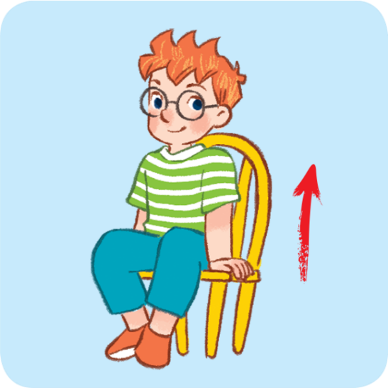
Stand up, please!
Stand
please!
up,
CHECK

Slide 8
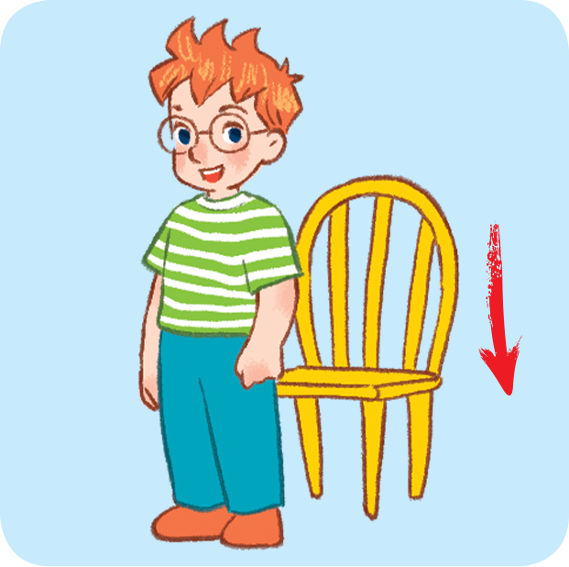
Sit down, please!
Sit
down
please!
CHECK

Slide 9

please!
Close your books, please!
Close
your
books,
CHECK

Slide 10
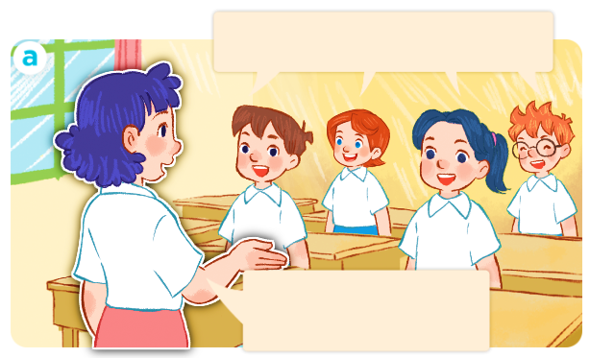
Good morning, Ms Hoa.
Good
morning,
Ms Hoa.
CHECK

Slide 11
Hello, class.
Sit down, please!
Hello,
class.
Sit down,
please!
CHECK

Slide 12
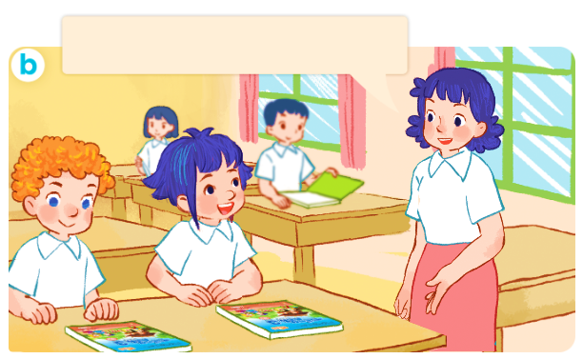
please!
Open your books, please!
Open
your
books,
CHECK

Slide 13
Thank you!

Slide 14
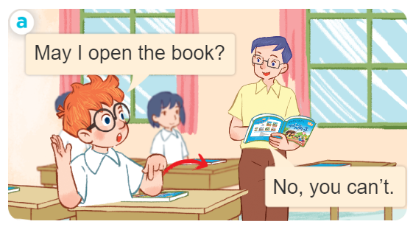
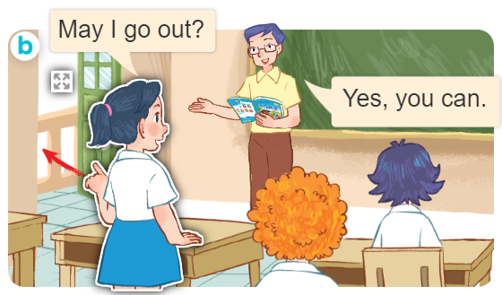
1. Look, listen and repeat.
What are they doing?
Where are they?
Who are they?
Click on the screen to show 3 questions.

Slide 15
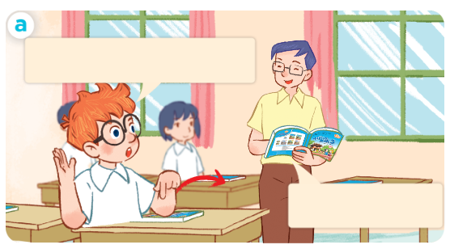
1. Look, listen and repeat.
Click on the sentences to hear the sound.
May I open the book?
No, you can’t.

Slide 16
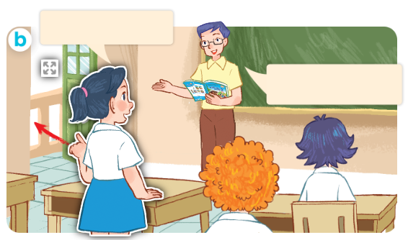
1. Look, listen and repeat.
Click on the sentences to hear the sound.
May I go out?
Yes, you can.

Slide 17
Vocabulary

Slide 18
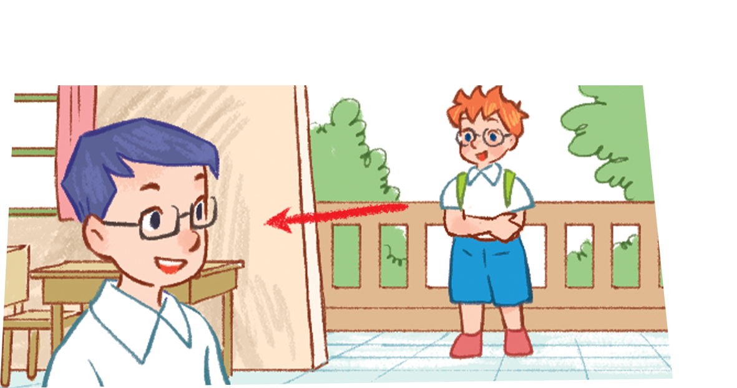

Vocabulary
come in
/kʌm ɪn/
đi vào

Slide 19
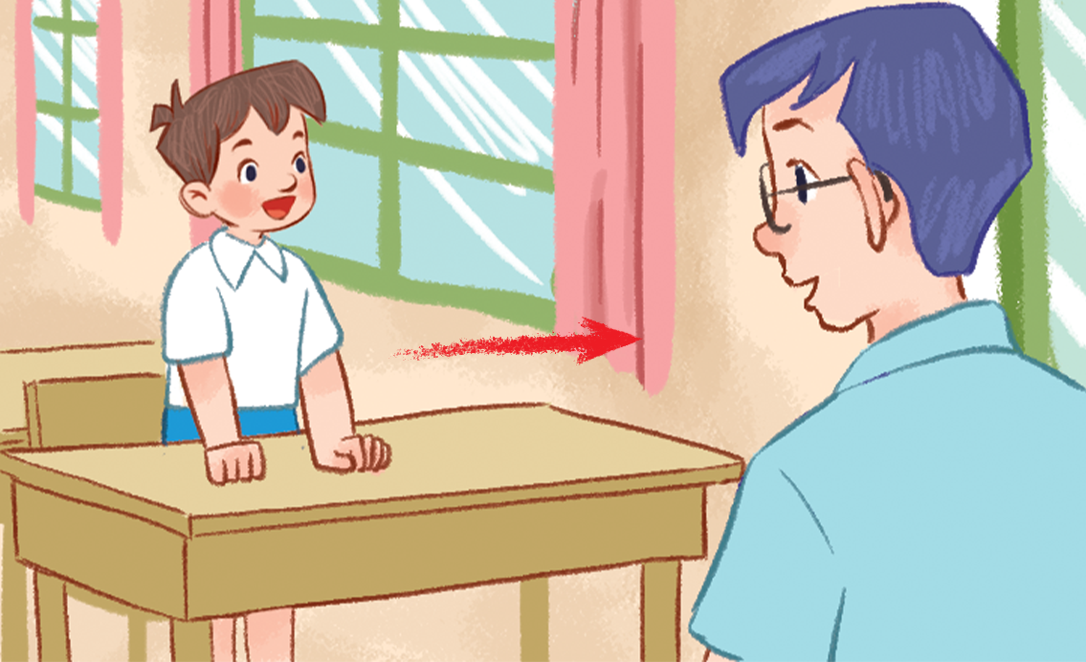
Vocabulary
go out
/gəʊ aʊt/
đi ra ngoài

Slide 20
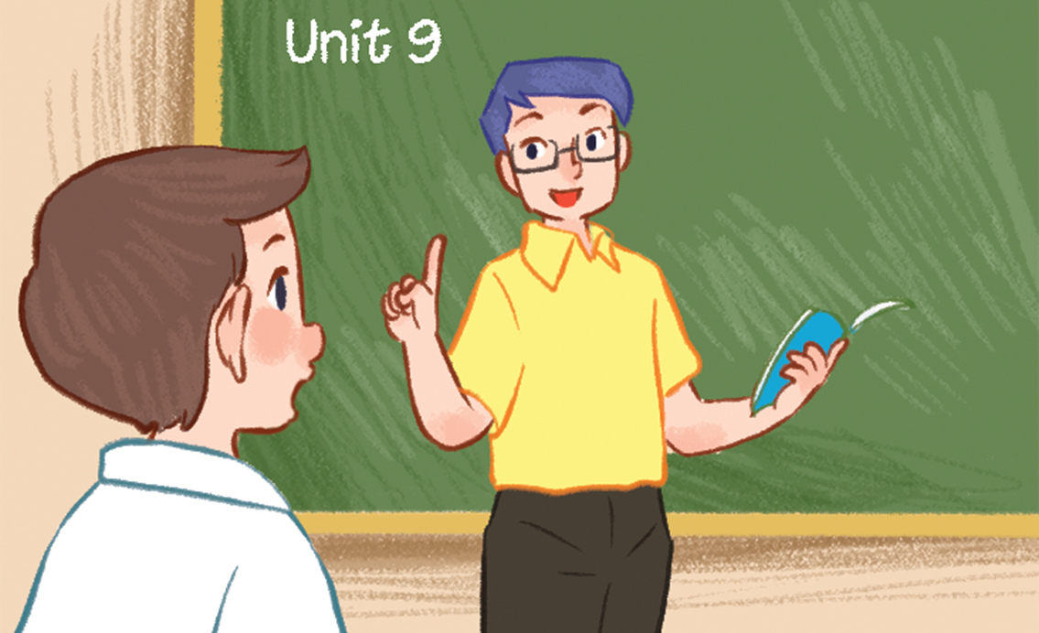
Vocabulary
speak Vietnamese
/spiːk ˌvjetnəˈmiːz/
nói tiếng việt

Slide 21


Review
go out
come in
speak Vietnamese

Slide 22
Vocabulary
- come in: vào trong
- go out : đi ra
- speak Vietnamese : nói Tiếng Việt

Slide 23
Structures

Slide 24


*Xin phép để làm việc gì.
Yes, you can.
May I ____________?
(Ừ, em có thể.)
No, you can’t.
(Em có thể _________ không ạ?
(Không, em không thể.)
Example:
Linh: May I go out?
Mr Long: Yes, you can.

Slide 25


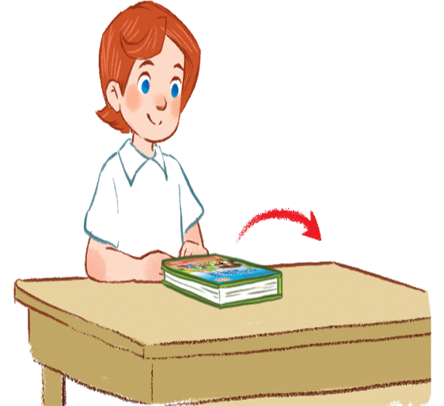
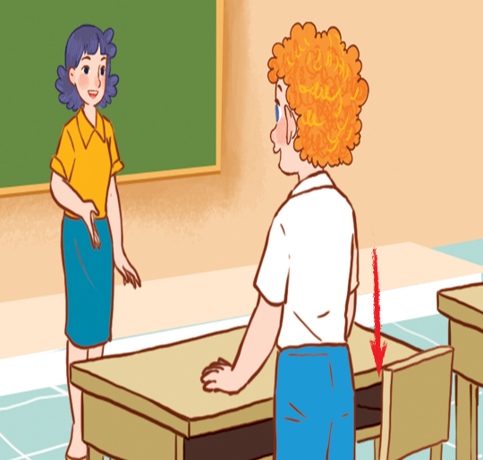
2. Listen, point and say.
May I ________?
a
b
Yes, you can.
go out/yes
speak Vietnamese
No, you can’t.
c
d
can’t = can not
open the book/no
sit down/no

Slide 26
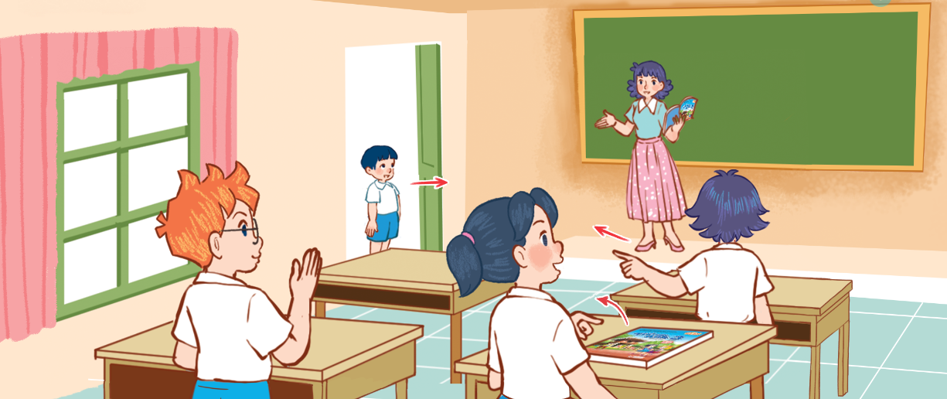
3. Let’s talk.
May I ________?
Yes/No ______.

Slide 27
Let’s play!

Slide 28











Where is Pikachu?

Slide 29


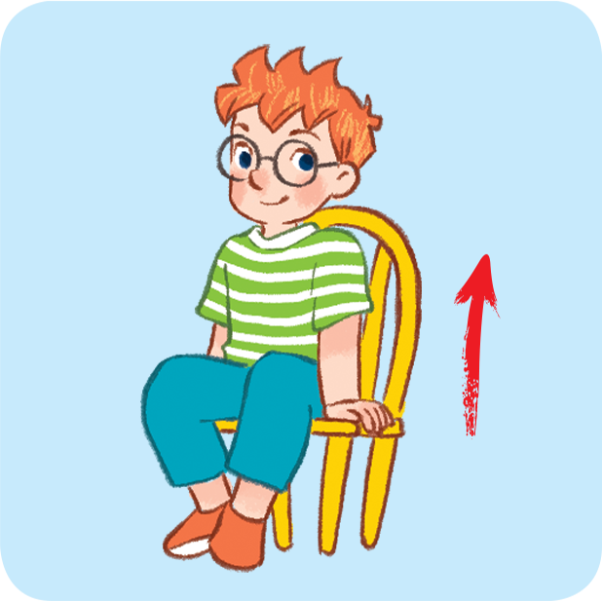


A. May I open the book?
B. Sit down, please!
C. Stand up, please!

Slide 30
A. Close the book, please!
B. May I open the book?
C. Stand up, please!

Slide 31
A. Sit down, please!
B. Open the book, please!
C. May I sit down?

Slide 32
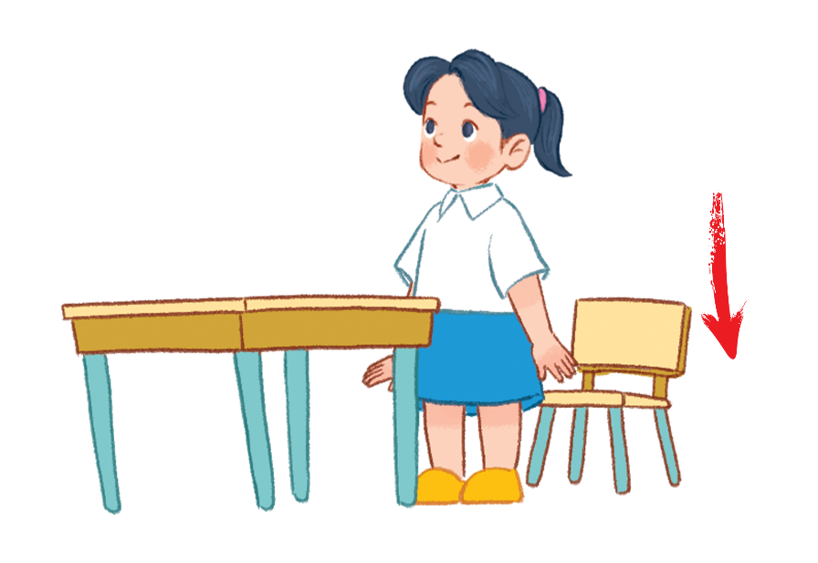
A. Open the book, please!
B. Sit down, please!
C. Close the book, please!

Slide 33

A. May I go out?
B. May I sit down?
C. May I come in?

Slide 34


May I sit down?
A. Yes, it is.
B. Yes, you can.
C. No, you can’t.

Slide 35
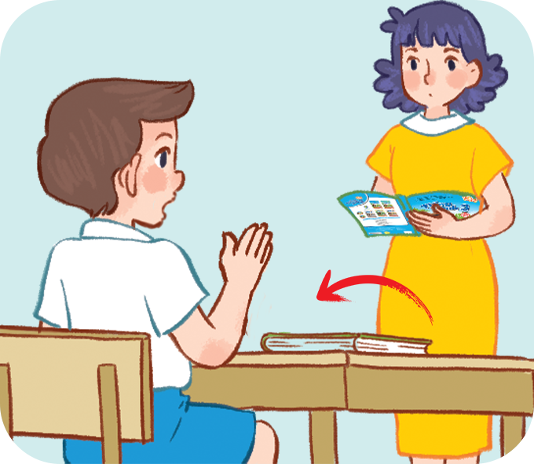

May I open the book?
A. No, you can’t.
B. No, it isn’t.
C. Yes, you can.

Slide 36
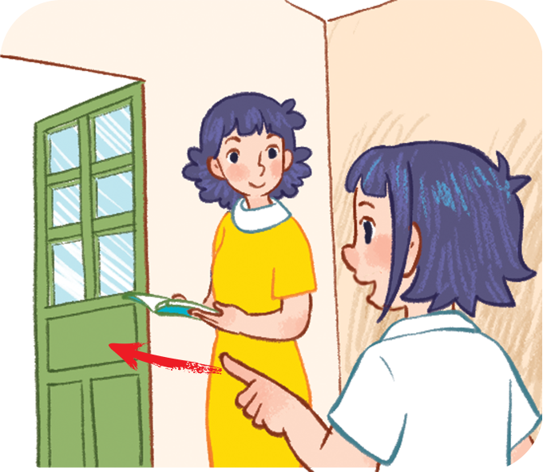
May I ___________?
A. come in
B. speak Vietnamese
C. go out

Slide 37
May I ___________?
A. come in
B. open the book
C. speak Vietnamese

Slide 38


Excellent!

Slide 39
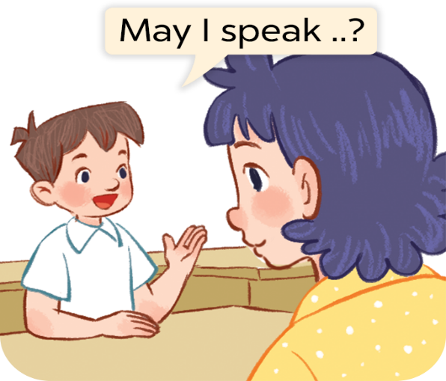
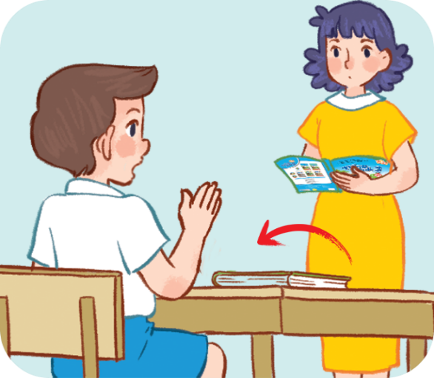
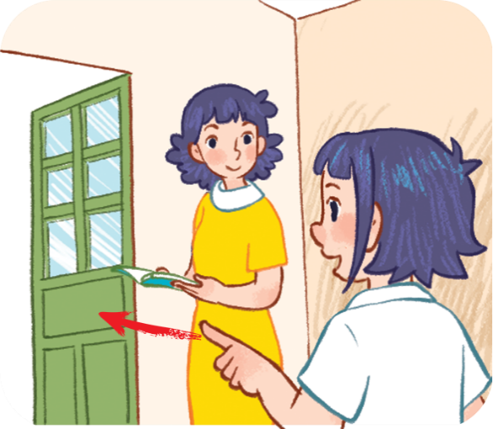
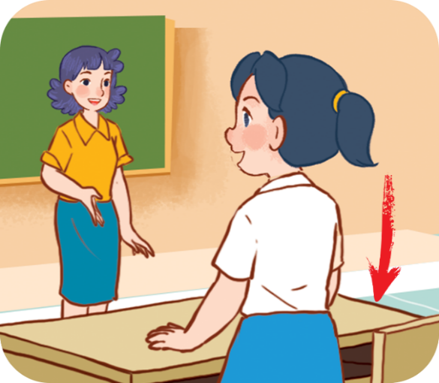




4. Listen and number.
2
1
4
3
a
b
c
d

Slide 40
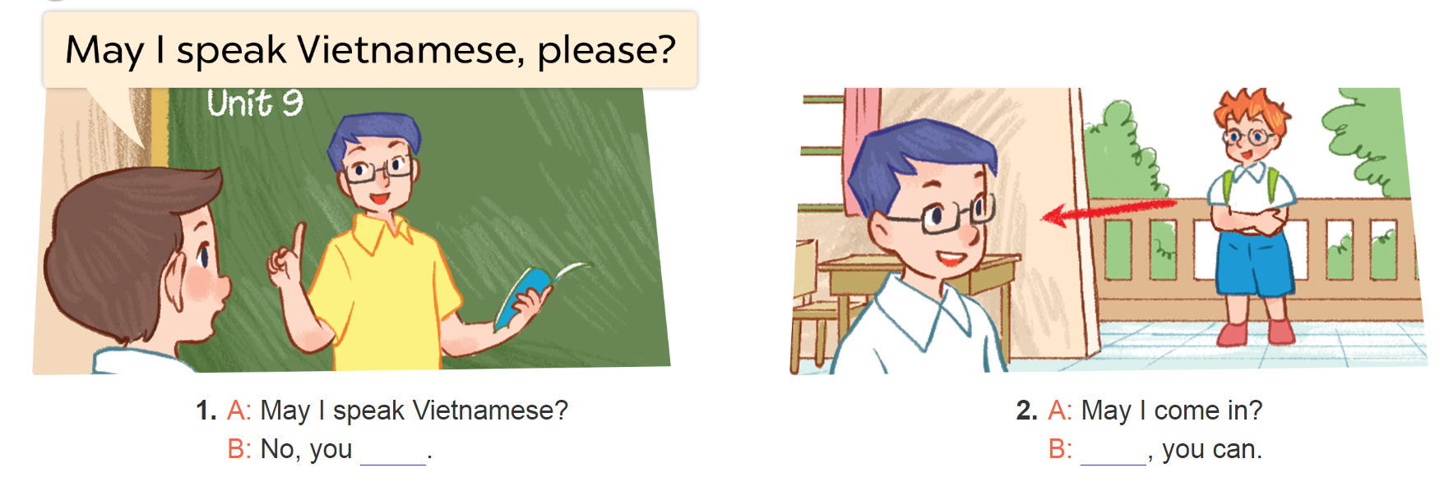
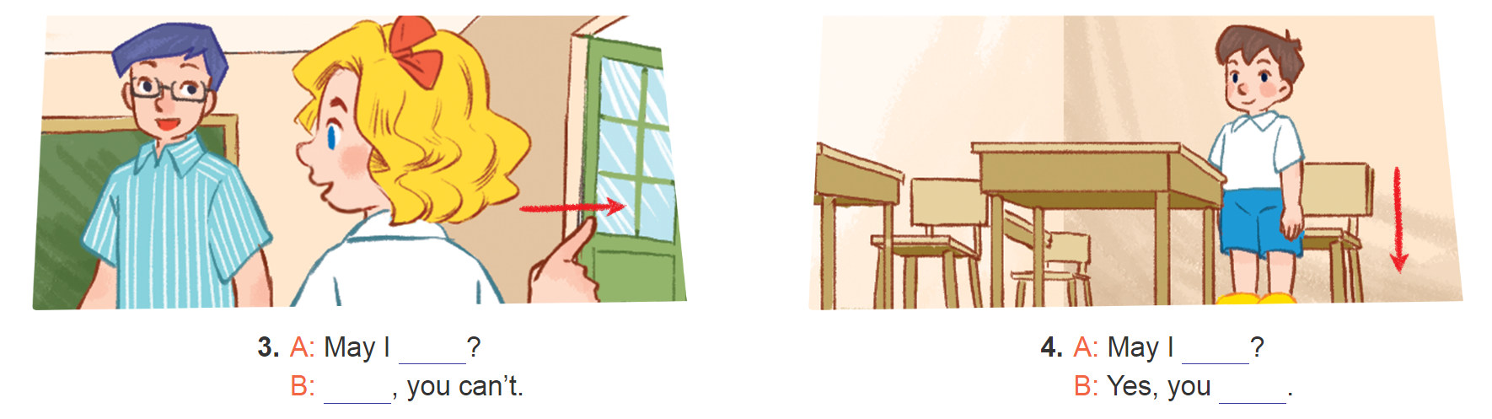
5. Look, complete and read.

Slide 41
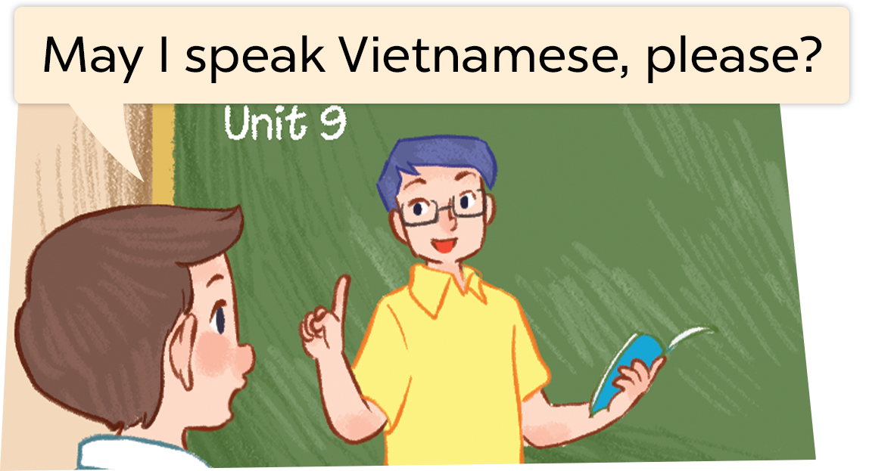
5. Look, complete and read.
1. A: May I speak Vietnamese?
can
B: Yes, you _____.

Slide 42
5. Look, complete and read.
2. A: May I come in?
Yes
B: _____, you can.

Slide 43
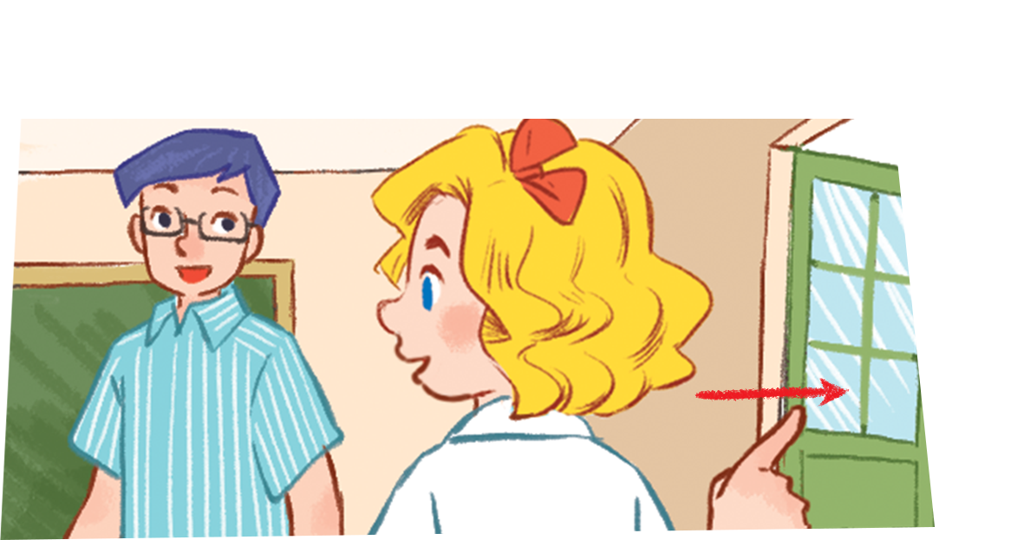
5. Look, complete and read.
go out
3. A: May I _______?
No
B: _______, you can’t.
Notes:
Facebook : Bùi Liễu
Mobile phone: 0968142780

Slide 44
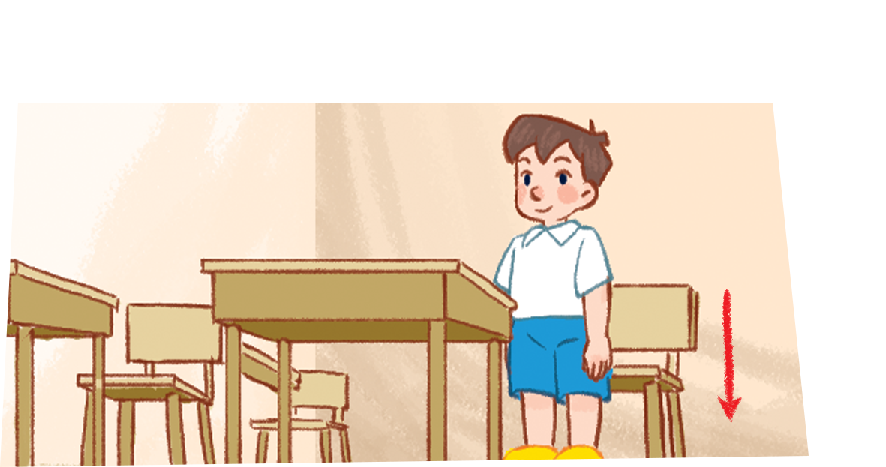
5. Look, complete and read.
sit down
4. A: May I ________?
can
B: Yes, you _____.

Slide 45
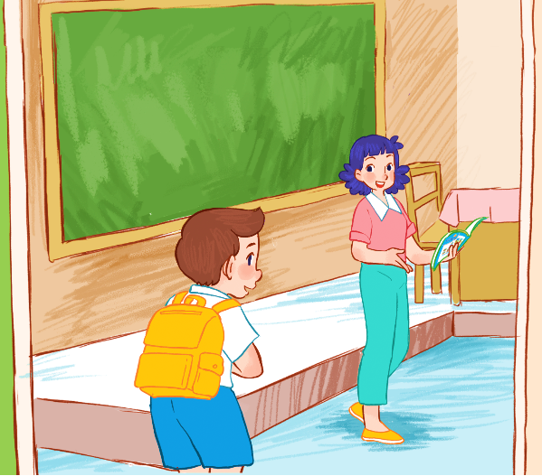
6. Let’s sing.
May I come in and sit down?
Hello, hello, Ms Hoa.
May I come in and sit down?
Hello, hello.
Yes, you can.
Come in, sit down and study.
Open your book and read aloud:
A B C D E F G!

Slide 46

6. Let’s sing.
May I come in and sit down?
Hello, hello, Ms Hoa.
May I come in and sit down?
Hello, hello.
Yes, you can.
Come in, sit down and study.
Open your book and read aloud:
A B C D E F G!

Slide 47
Wrap up

Slide 48
Review
go out
come in
speak Vietnamese

Slide 49
Vocabulary
- come in: vào trong
- go out : đi ra
- speak Vietnamese : nói Tiếng Việt

Slide 50
Structures
*Xin phép để làm việc gì.
Yes, you can.
May I ____________?
(Ừ, em có thể.)
No, you can’t.
(Em có thể _________ không ạ?
(Không, em không thể.)
Example:
Linh: May I go out?
Mr Long: Yes, you can.

Slide 51
Homework
Learn by heart all the new words.
Read again the dialogue in part 1.

Slide 52

Thank you!
Facebook : Bùi Liễu
0968142780

