Slide 1
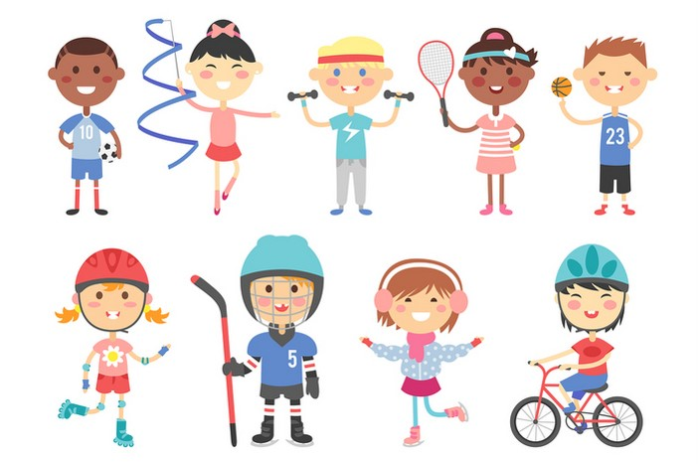
Monday, October 30th 2023
My hobbies
Unit
5
Lesson 2

Slide 2
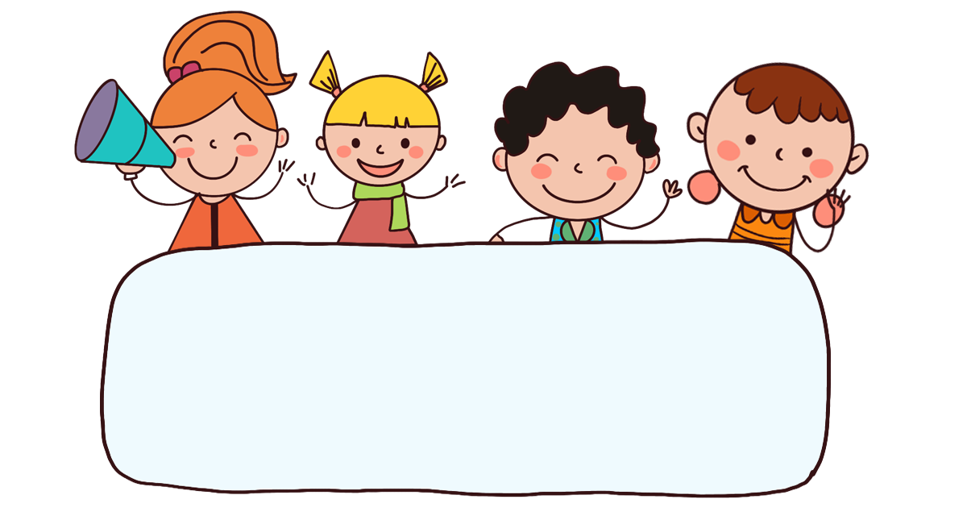
Warm-up

Slide 3


Let’s play!

Slide 4
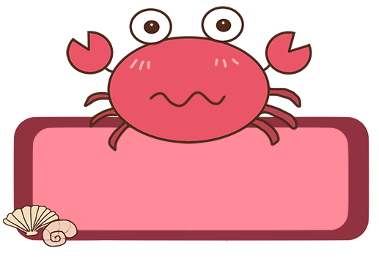


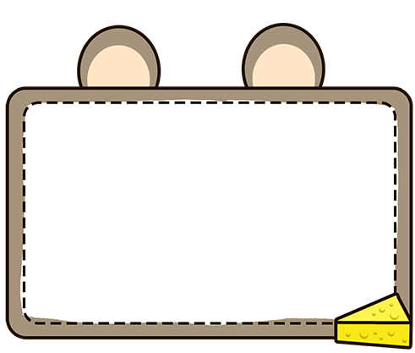



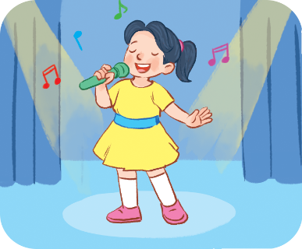
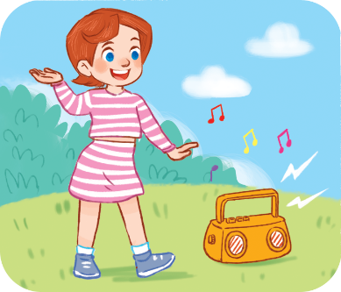

Choose the right answer.
Click on the picture to choose the right answer.
a
b
c

Slide 5
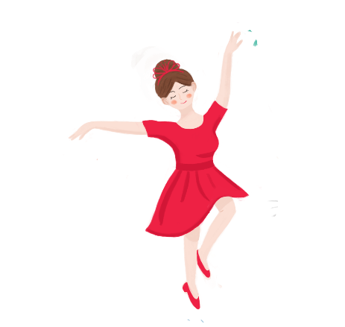
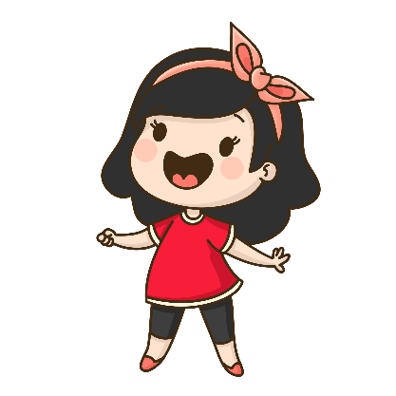

Click on the picture to choose the right answer.
Choose the right answer.
a
b
c

Slide 6
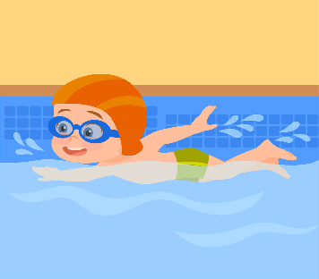
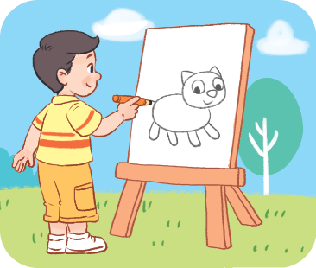
Click on the picture to choose the right answer.
Choose the right answer.
a
b
c

Slide 7
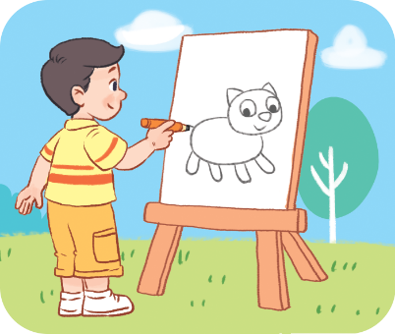
Choose the right answer.
Click on the picture to choose the right answer.
a
b
c

Slide 8
Choose the right answer.
Click on the picture to choose the right answer.
What’s your hobby?
It’s swimming.
a
b
c

Slide 9
Click on the picture to choose the right answer.
Choose the right answer.
What’s your hobby?
It’s singing.
singing
a
b
c

Slide 10
Click on the picture to choose the right answer.
Choose the right answer.
What’s your hobby?
It’s dancing.
dancing
a
b
c

Slide 11

Click on the picture to choose the right answer.
Choose the right answer.
What’s your hobby?
It’s drawing.
drawing
a
b
c

Slide 12
Thank you!

Slide 13






Contents
Look, listen and repeat.
Listen, point and say.
Let’s talk.
Listen and tick.
Look, complete and read.
Let’s sing.

Slide 14
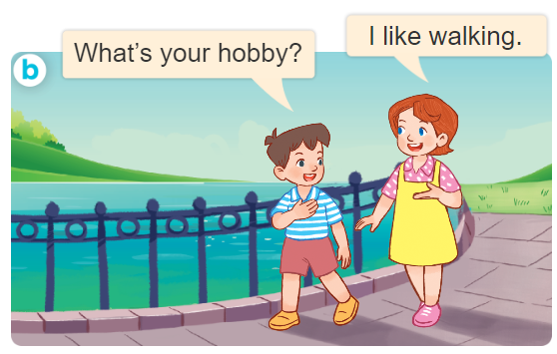
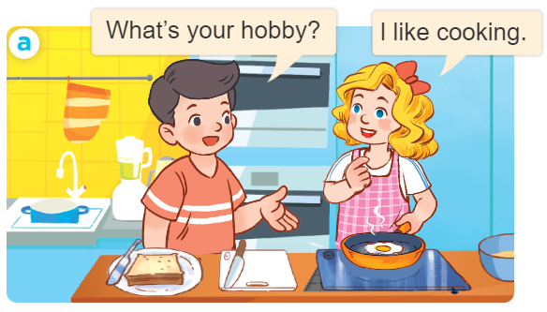
1. Look, listen and repeat.

Slide 15
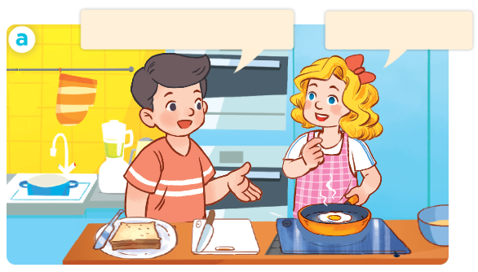
1. Look, listen and repeat.
What’s your hobby?
I like cooking.

Slide 16
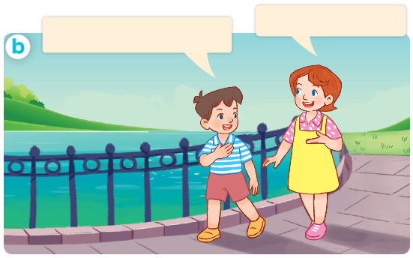
1. Look, listen and repeat.
What’s your hobby?
I like walking.

Slide 17
Vocabulary

Slide 18


Vocabulary
running
/ˈrʌn.ɪŋ/
chạy

Slide 19
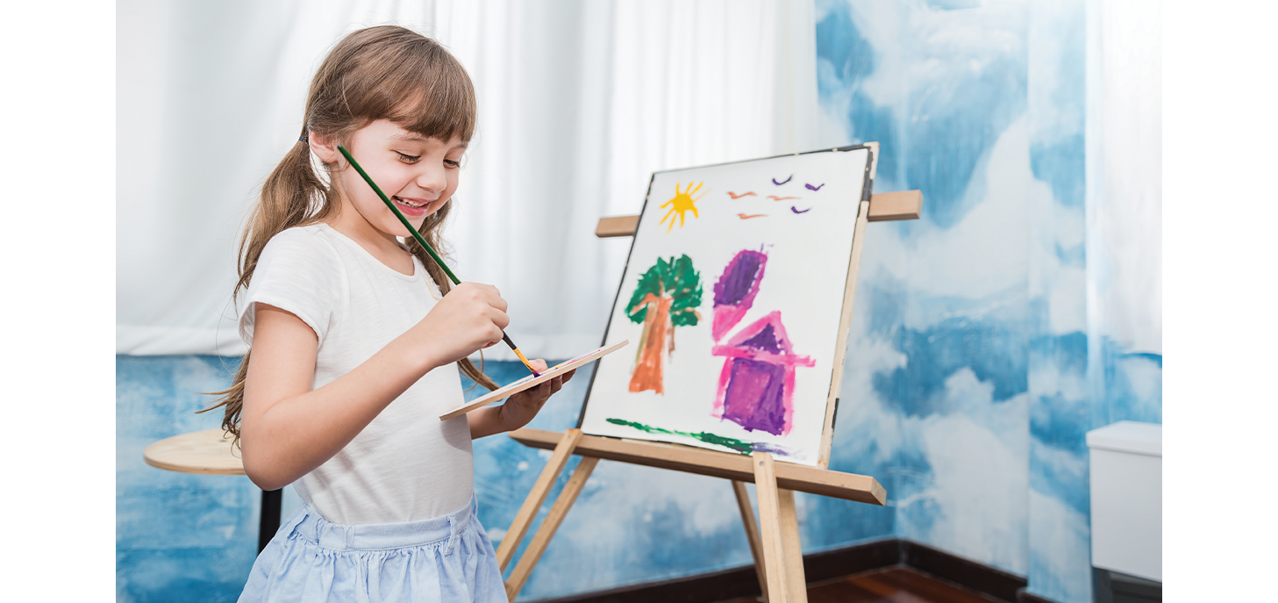
Vocabulary
painting
/ˈpeɪn.tɪŋ/
vẽ, tô vẽ

Slide 20
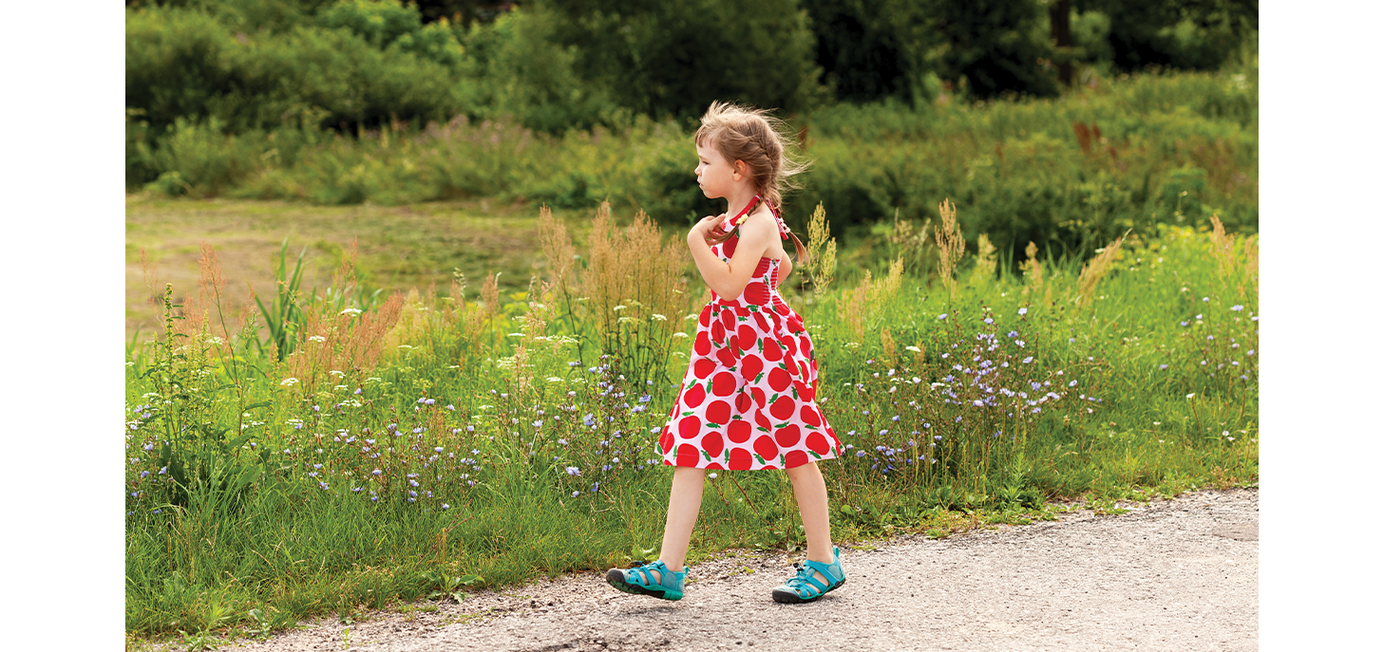
Vocabulary
walking
/ˈwɔː.kɪŋ/
đi, đi bộ

Slide 21
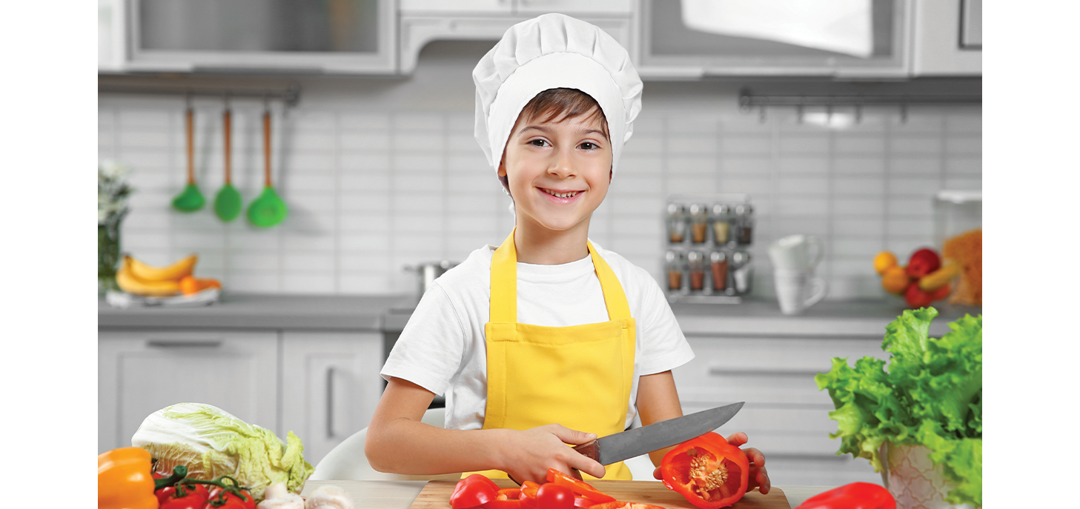
Vocabulary
cooking
/ˈkʊk.ɪŋ/
nấu ăn

Slide 22

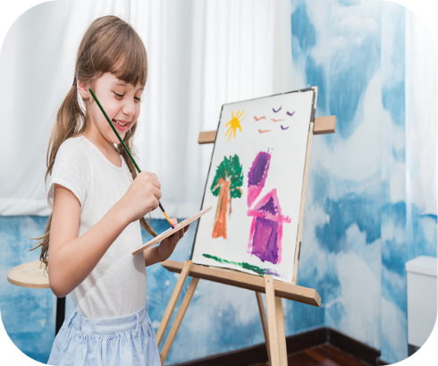
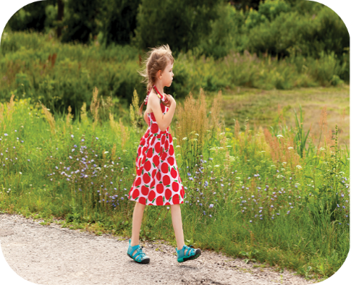
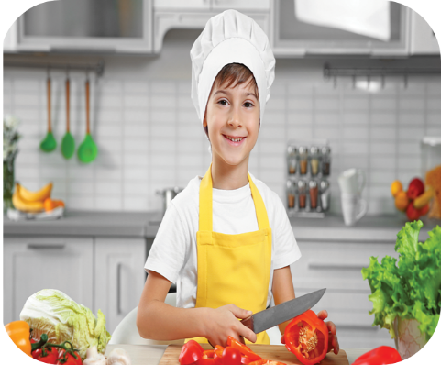
Review
running
painting
walking
cooking

Slide 23
Vocabulary
running: chạy
painting: vẽ, tô vẽ
walking: đi, đi bộ
cooking: nấu ăn

Slide 24
Structures

Slide 25
Structures
Hỏi và trả lời về sở thích.
- What’s your hobby?
I like _______.
(Sở thích của bạn là gì?)
What’s = what is
(Tớ thích ________)

Slide 26
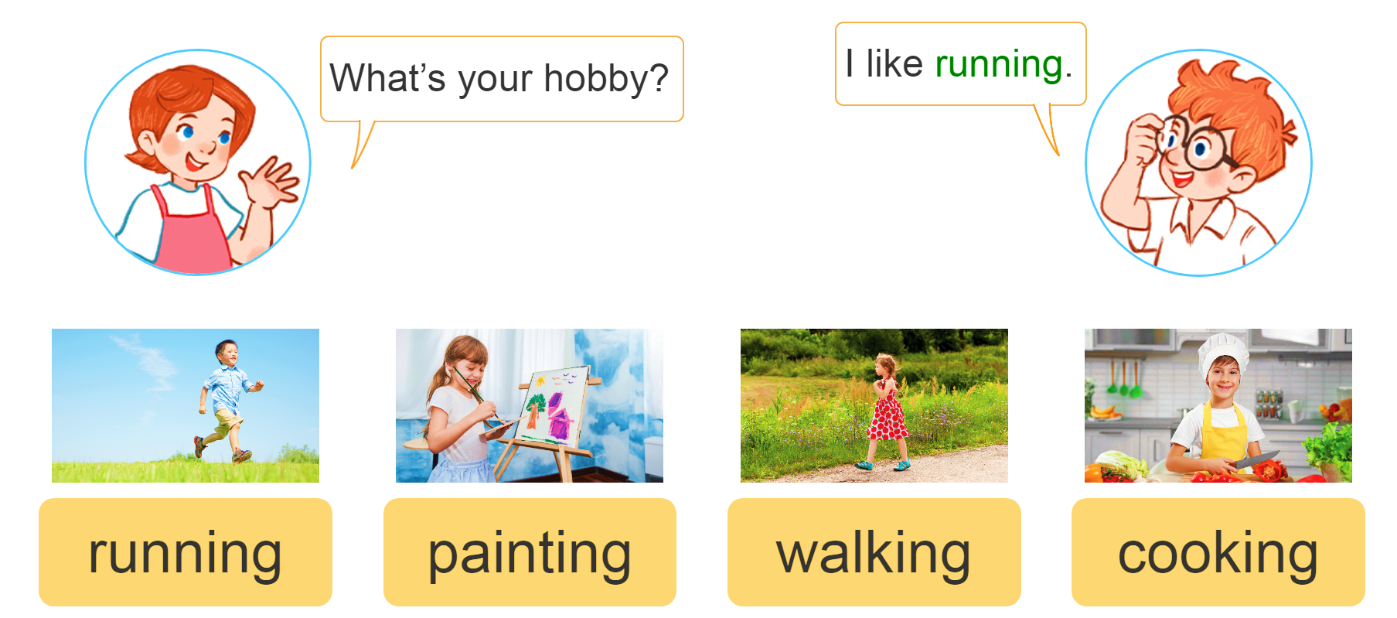
2. Listen, point and say.
a
b
c
d

Slide 27
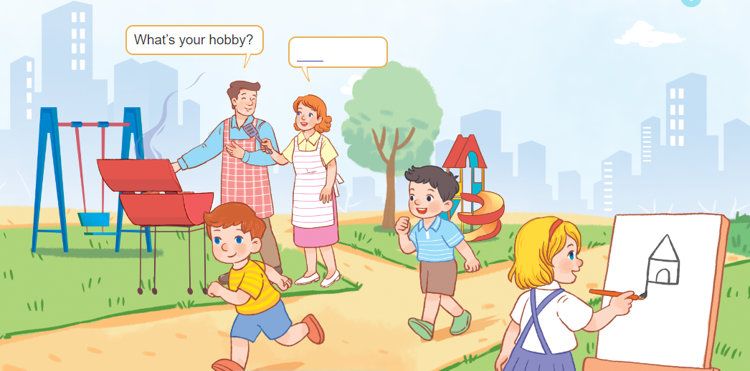
3. Let’s talk.

Slide 28
Let’s play!

Slide 29








Sun flower

Slide 30



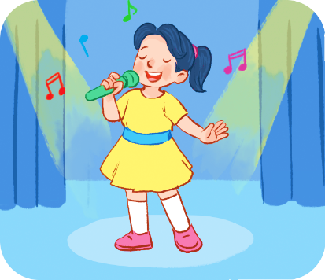
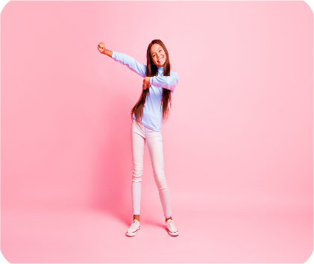
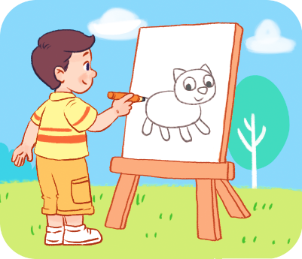
What’s your hobby?
I like running.
Click on the flower to show the right answer.
A
B
C
D

Slide 31

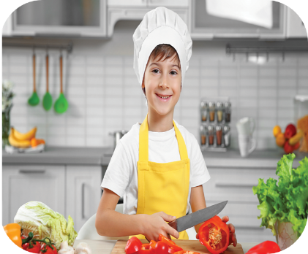
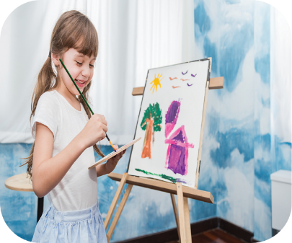
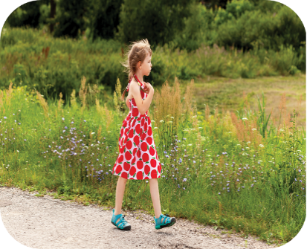
What’s your hobby?
I like painting.
A
B
C
D
Sai
Sai
Đúng
Sai

Slide 32
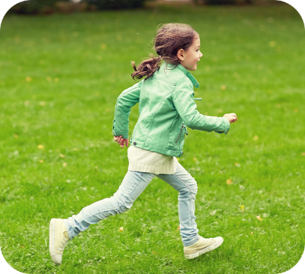
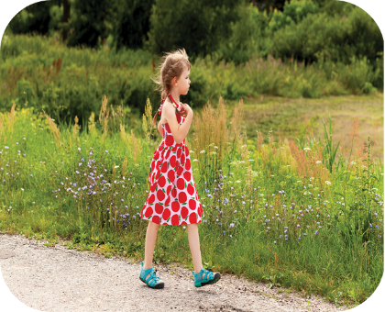
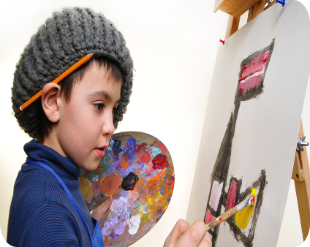
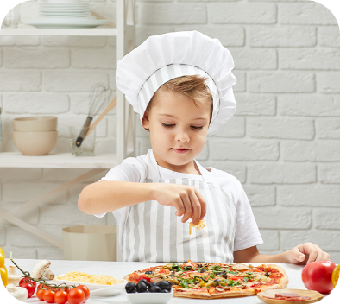
What’s your hobby?
I like walking.
A
B
C
D
Sai
Đúng
Sai
Sai

Slide 33

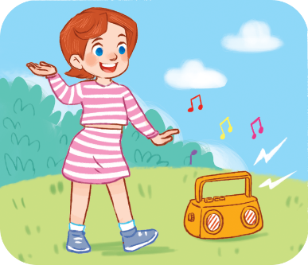


What’s your hobby?
I like cooking.
A
B
C
D
Sai
Sai
Sai
Đúng

Slide 34
_________________?
I like cooking.
A
B
C
D
What’s your hobby?
How are you?
Where are you?
How old are you?

Slide 35
________ your hobby?
I like cooking.
A
B
C
D
Where’s
What’s
Where is
It’s singing

Slide 36
What’s ______?
I like painting.
A
B
C
D
you like
you do
hobby
your hobby

Slide 37
What’s your hobby?
________ walking.
A
B
C
D
I’m
I am
I do
I like

Slide 38
What’s your hobby?
I like _________.
A
B
C
D
walks
walk
walking
I don’t like walk

Slide 39


Slide 40
Thank you!

Slide 41
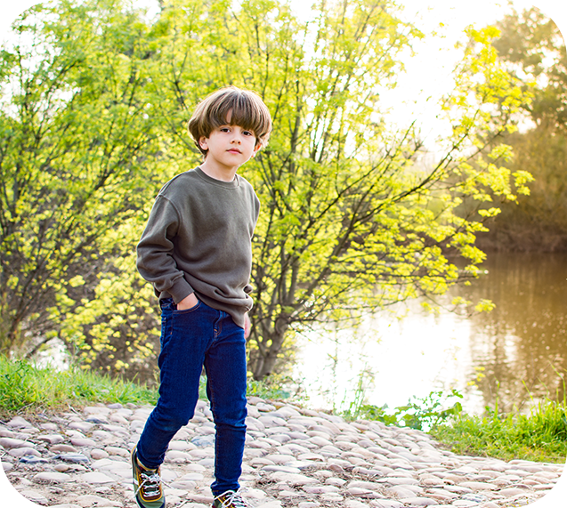
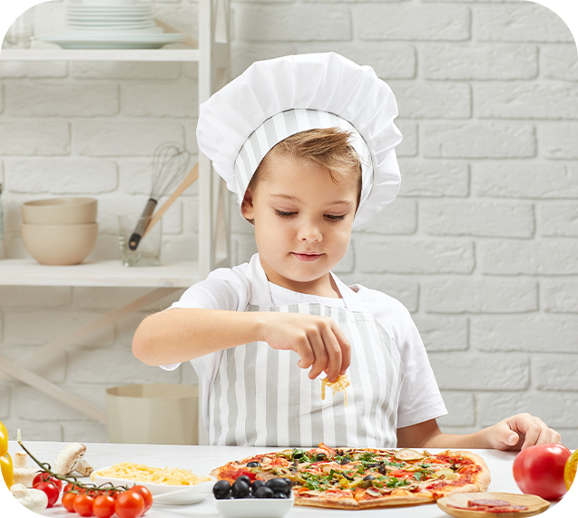
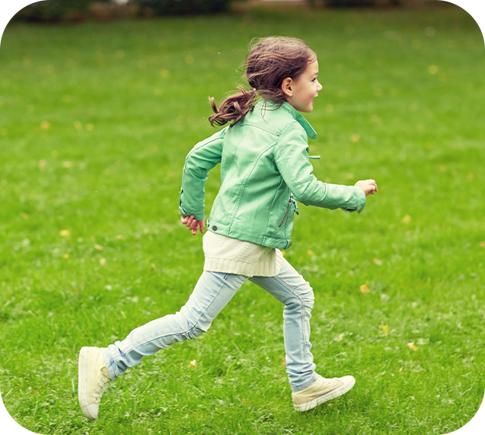
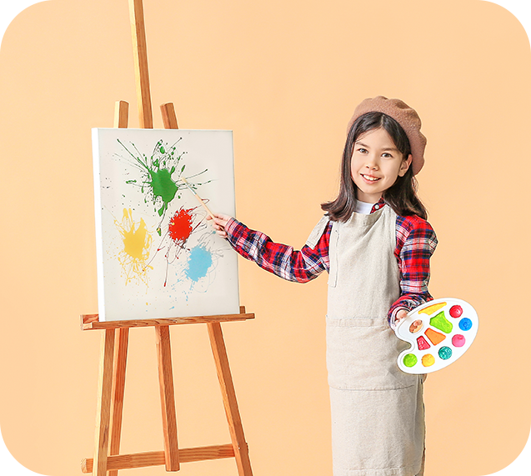
4. Listen and tick.
1
a
b
2
a
b

Slide 42

4. Listen and tick.
a
1
b

Slide 43
4. Listen and tick.
a
2
b

Slide 44
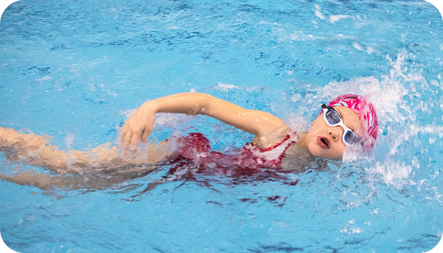

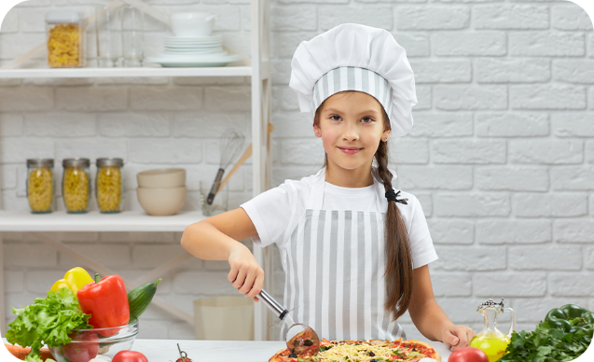

5. Look, complete and read.
1. It’s ________.
2. It’s ________.
3. I like ________.
4. I like ________.

Slide 45
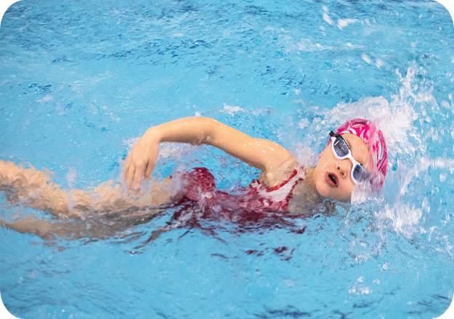
5. Look, complete and read.
1. It’s _________.
swimming

Slide 46

5. Look, complete and read.
2. It’s ________.
singing

Slide 47

5. Look, complete and read.
3. I like ______.
cooking

Slide 48

5. Look, complete and read.
4. I like ________.
painting

Slide 49
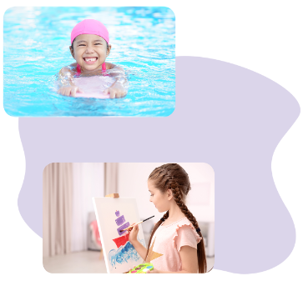
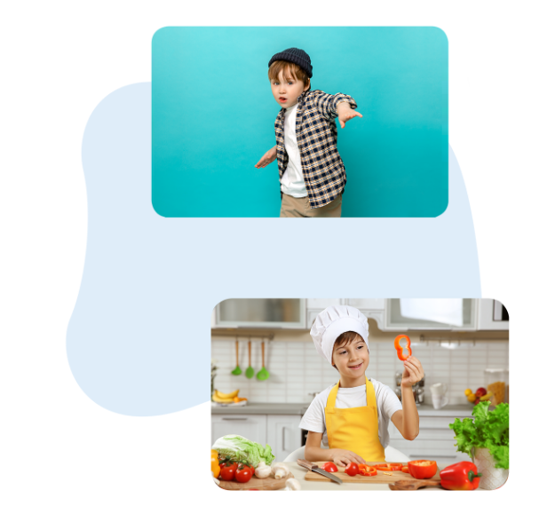
6. Let’s sing.
My hobby
What’s your hobby?
It’s dancing.
What’s your hobby?
It’s swimming.
What’s your hobby?
I like cooking.
What’s your hobby?
I like painting.
Dancing, swimming,
cooking,
and painting.

Slide 50

6. Let’s sing.
My hobby
What’s your hobby?
It’s dancing.
What’s your hobby?
It’s swimming.
What’s your hobby?
I like cooking.
What’s your hobby?
I like painting.
Dancing, swimming,
cooking,
and painting.

Slide 51
Wrap up

Slide 52
Vocabulary
running
painting
walking
cooking

Slide 53
Structures
Hỏi và trả lời về sở thích.
- What’s your hobby?
I like _______.
(Sở thích của bạn là gì?)
What’s = what is
(Tớ thích ________)

Slide 54
Homework
Learn by heart all the new words.
Read again the dialogue in part 1.

Slide 55

Thank you!

