Slide 1
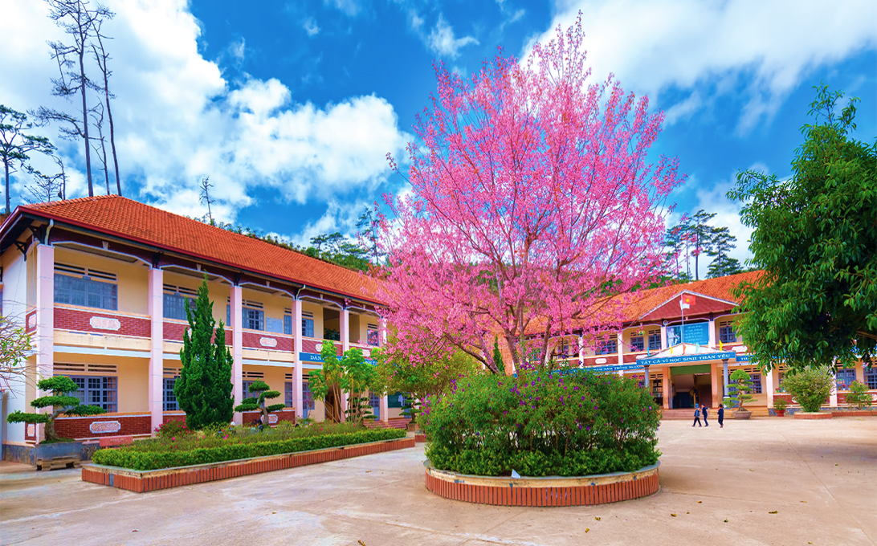
Monday, November 7th 2023
Our school
Unit
6
Lesson 2

Slide 2

Warm-up

Slide 3

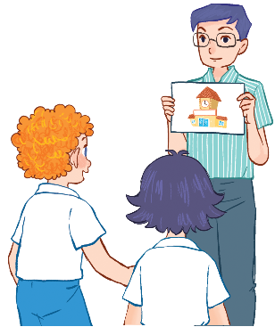

Let’s sing.
Our school
Is this your school?
Yes, it is. Yes, it is.
This is my school.
I like my school.
Is this our school?
Yes, it is. Yes, it is.
This is our school.
We like our school.

Slide 4






Contents
Look, listen and repeat.
Listen, point and say.
Let’s talk.
Listen and number.
Look, match and read.
Let’s play.

Slide 5
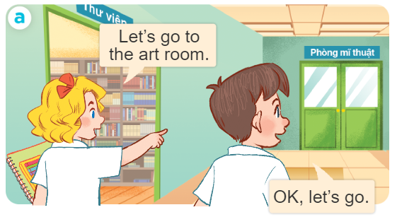
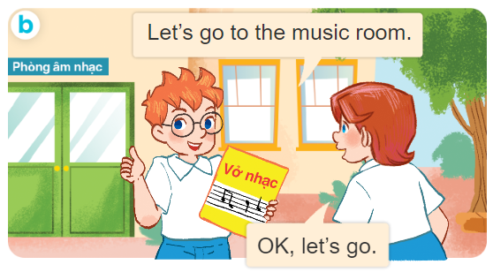
1. Look, listen and repeat.
Who are they?
What are they doing?
Where are they?

Slide 6
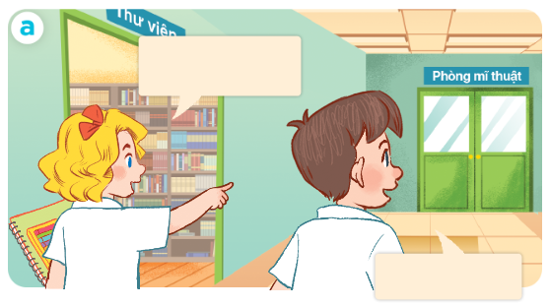
1. Look, listen and repeat.
Click on the sentences to hear the sound.
Let’s go to
the art room.
OK, let’s go.

Slide 7
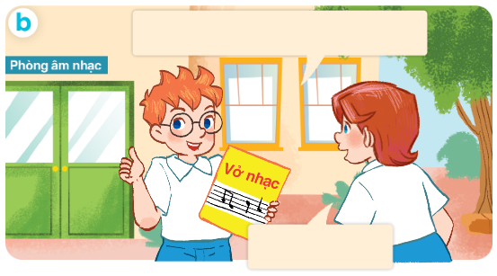
1. Look, listen and repeat.
Let’s go to the music room.
OK, let’s go.

Slide 8
Vocabulary

Slide 9
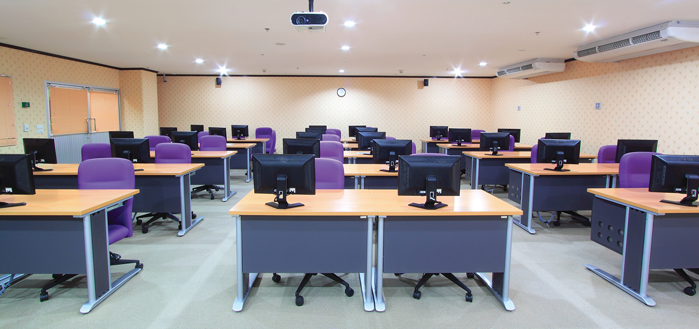

Vocabulary
computer room
//kəmˈpjuː.tər ruːm/
phòng máy tính

Slide 10
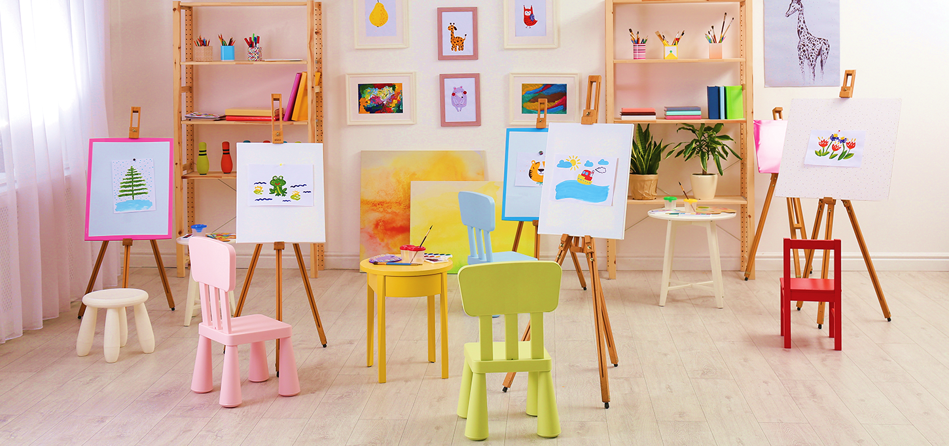
Vocabulary
art room
/ɑːt ruːm/
phòng mĩ thuật

Slide 11
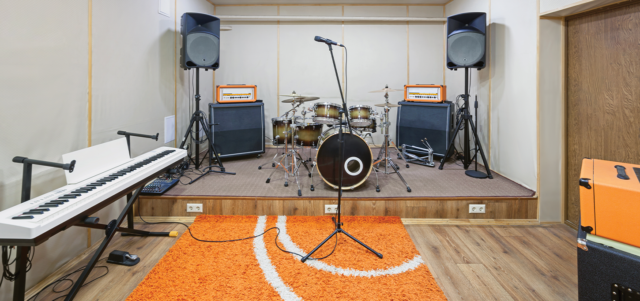
Vocabulary
music room
/ˈmjuː.zɪk ruːm/
phòng âm nhạc

Slide 12
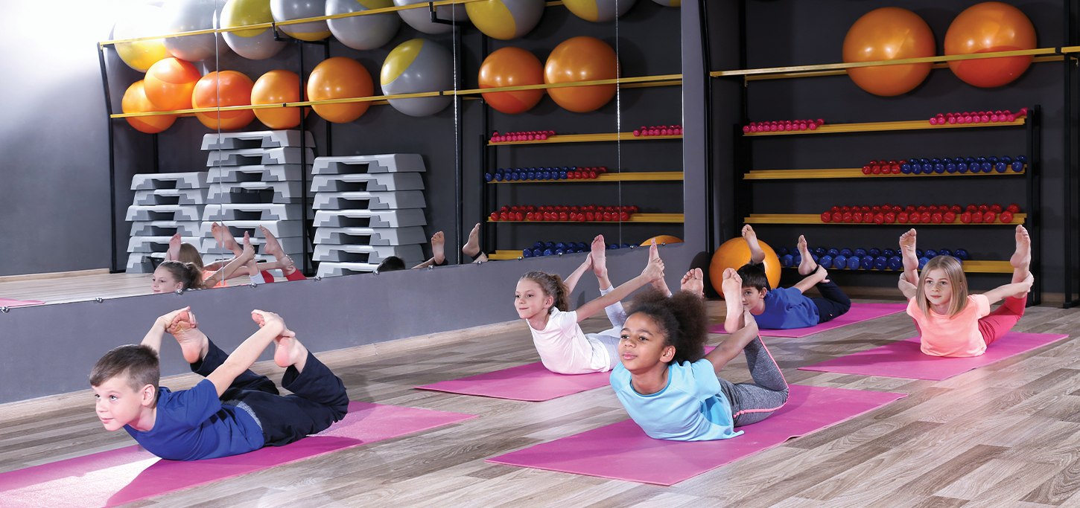
Vocabulary
gym
/dʒɪm/
nhà thể chất

Slide 13

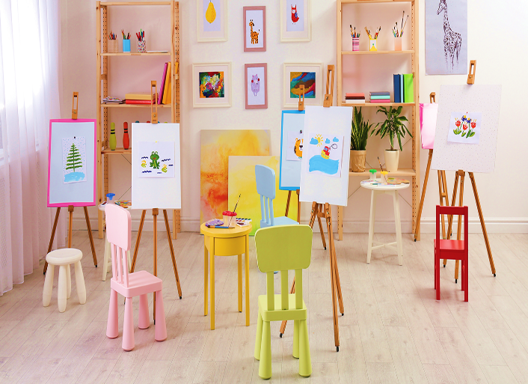


Review
computer room
art room
music room
gym

Slide 14
Vocabulary
- computer room : phòng máy tính
- art room : phòng mĩ thuật
- music room : phòng âm nhạc
- gym : nhà thể chất

Slide 15
Let’s play!

Slide 16
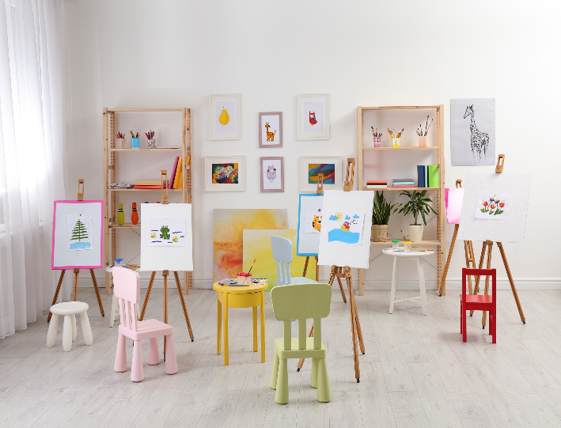
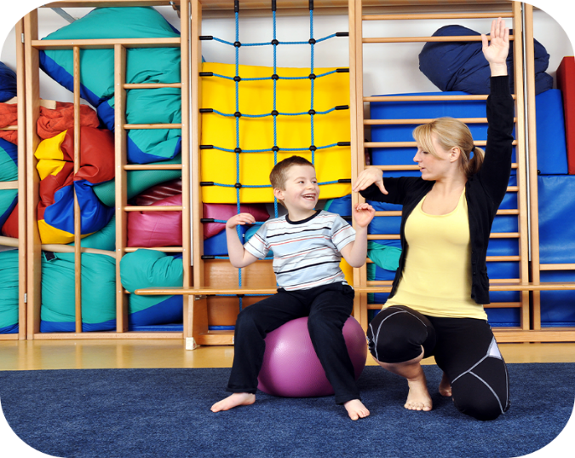

1
2
3
✔
gym

Slide 17
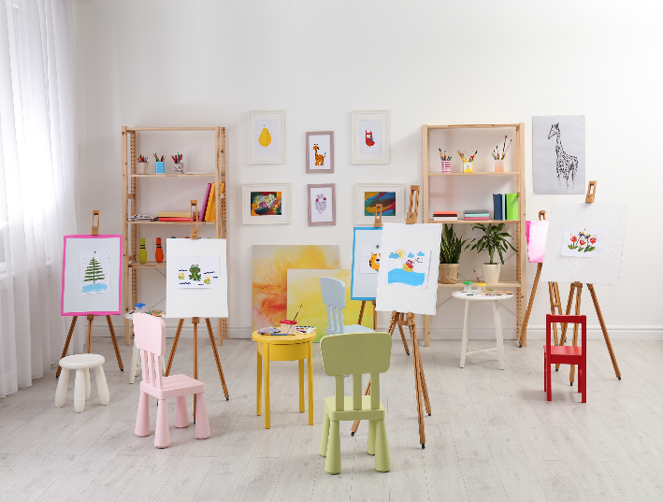
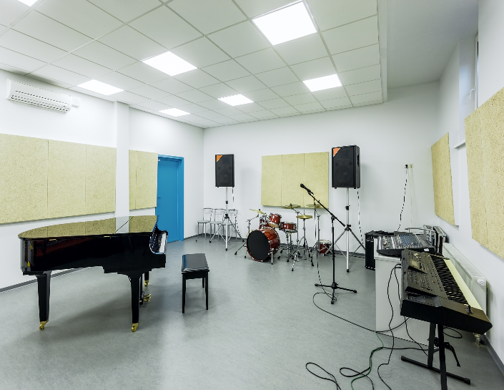

1
2
3
✔
art room

Slide 18
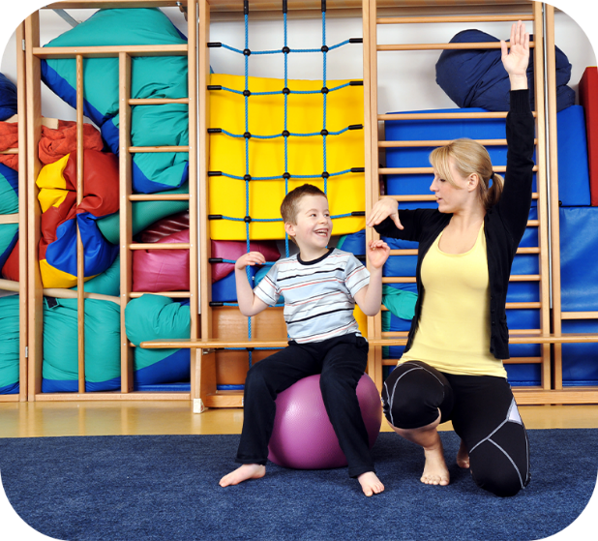
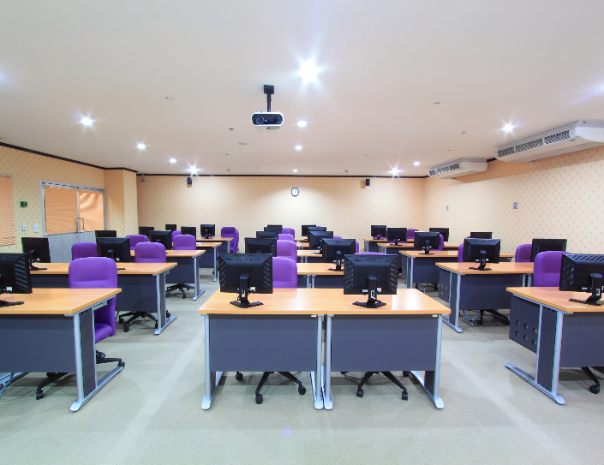

1
2
3
✔
computer room

Slide 19
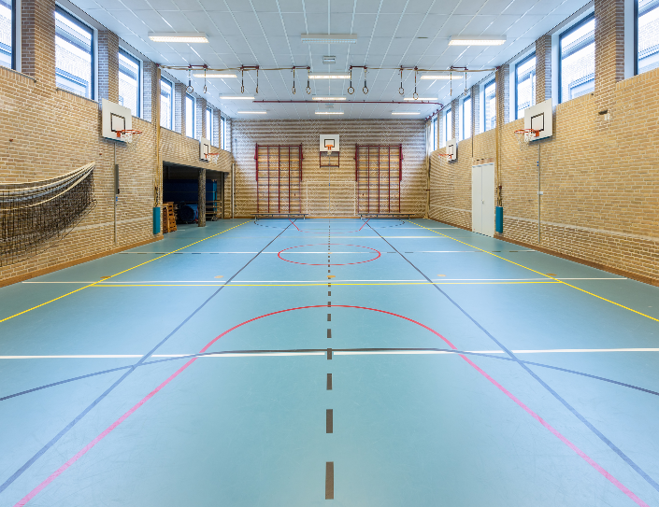

1
2
3
✔
music room

Slide 20
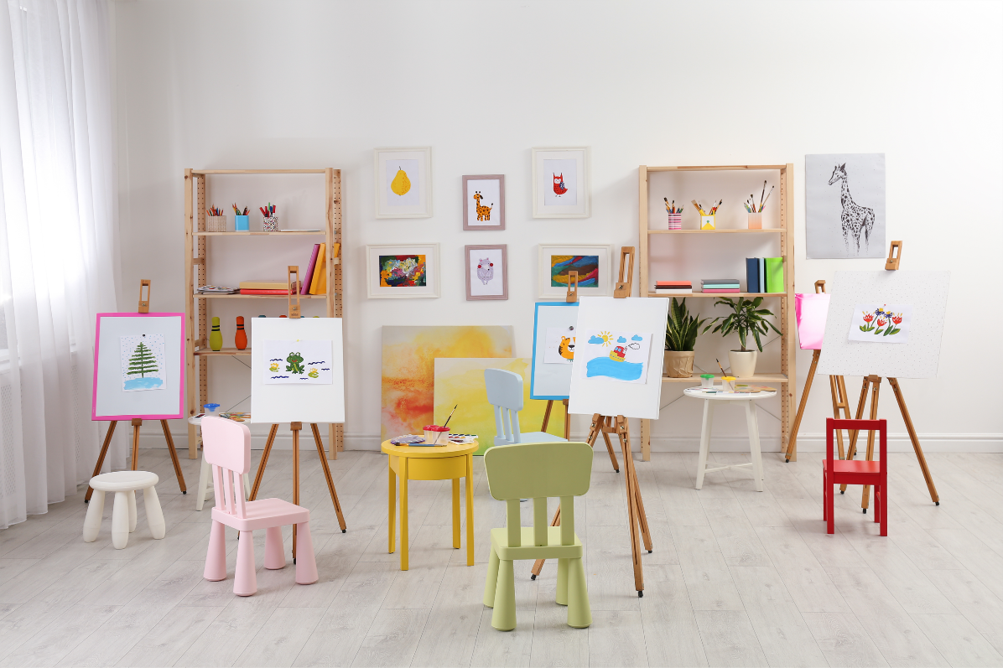
1
a. playground
b. music room
c. art room

Slide 21
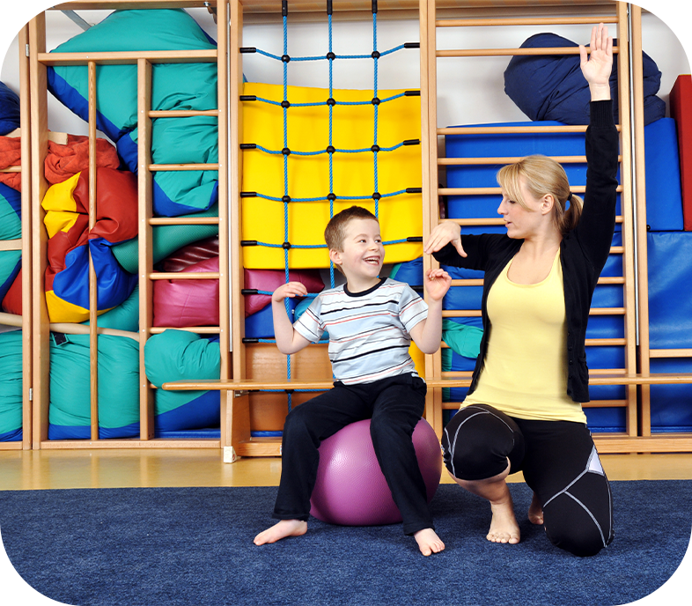
2
a. library
b. gym
c. art room

Slide 22

3
a. classroom
b. school
c. music room

Slide 23
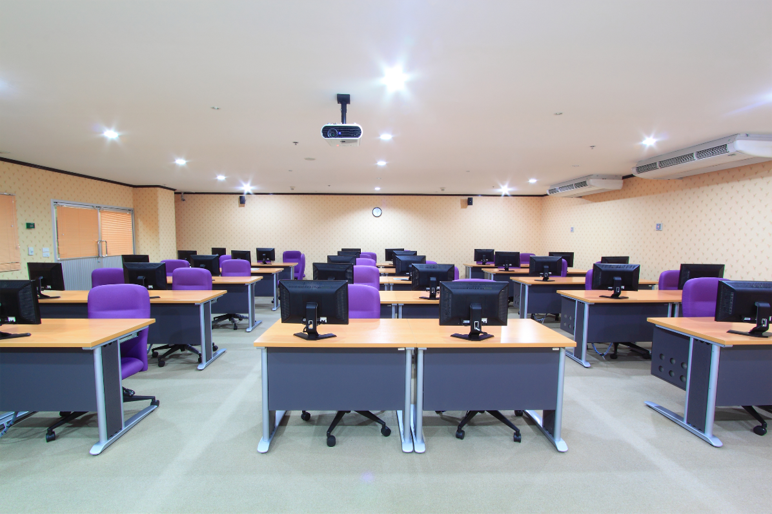

4
a. computer room
b. playground
c. gym

Slide 24

WELL DONE!

Slide 25
Structures

Slide 26
Structures
*Câu gợi ý đi tới một nơi trong ngôi trường và diễn đạt sự đồng ý.
Let’s go to the _______.
- OK, let’s go.
(Chúng ta đi tới _____ nhé.)
(Đồng ý, chúng ta đi thôi.)
Example:
A: Let’s go to the computer room.
B: OK, let’s go.

Slide 27




2. Listen, point and say.
a
b
Let’s go to the ____.
OK, let’s go.
computer room
art room
c
d
music room
gym

Slide 28
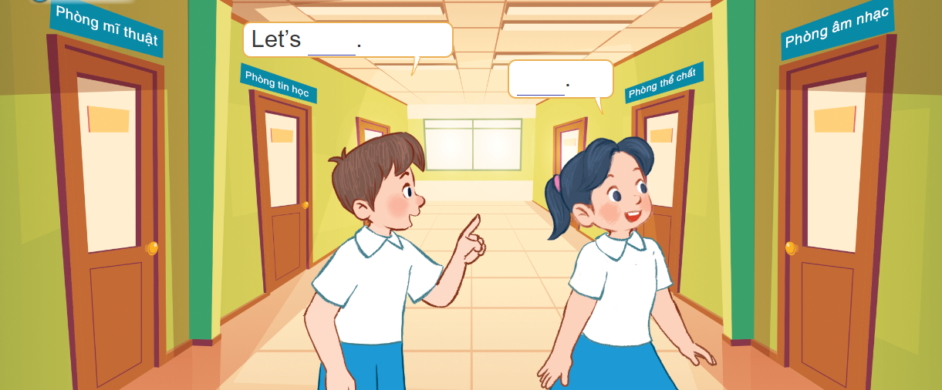
3. Let’s talk.

Slide 29

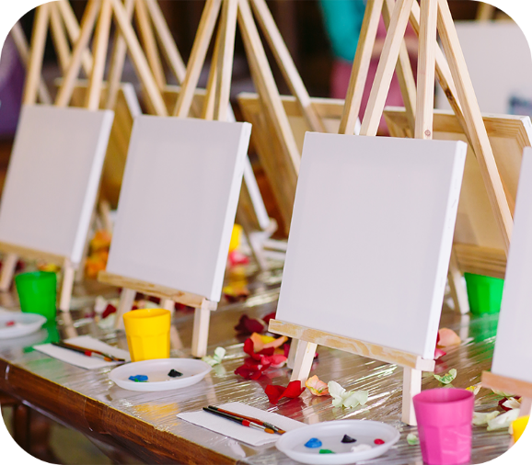
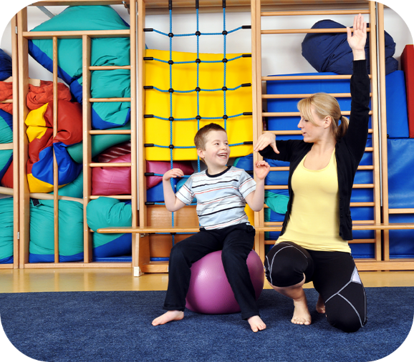





4. Listen and number.
4
2
1
3
a
b
c
d

Slide 30
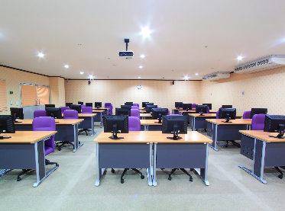


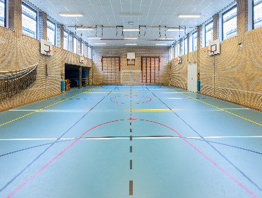
5. Read and match.
a
1. Let’s go the gym.
2. Let’s go to the computer room.
b
3. A: Let’s go to the art room.
B: OK, let’s go. I like drawing.
c
4. A: Let’s go to the music room.
B: OK, let’s go.
d
1 - d
2 - a
3 - b
4 - c

Slide 31
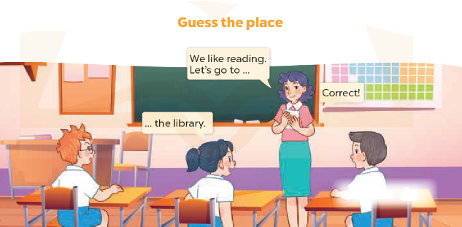
6. Let’s play.

Slide 32
Wrap up

Slide 33
Vocabulary
computer room
art room
music room
gym

Slide 34
Structures
*Câu gợi ý đi tới một nơi trong ngôi trường và diễn đạt sự đồng ý.
Let’s go to the _______.
- OK, let’s go.
(Chúng ta đi tới _____ nhé!)
(Đồng ý, chúng ta đi thôi!
Example:
A: Let’s go to the computer room.
B: OK, let’s go.

Slide 35
Homework
Learn by heart all the new words.
Read again the dialogue in part 1.

Slide 36

Thank you!

