Slide 1
Monday, September 25th 2023
Our names
Unit
2
Lesson 2

Slide 2
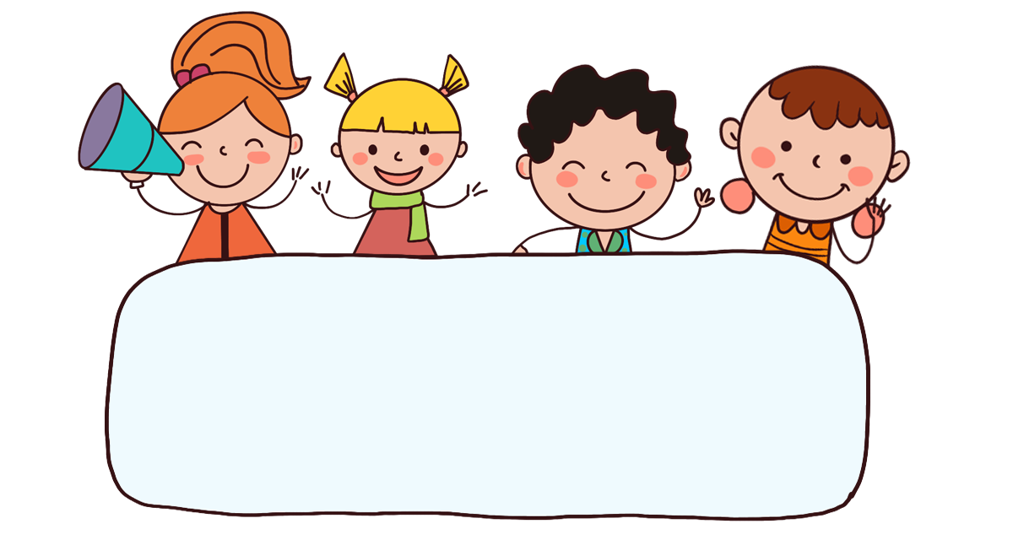
Warm-up

Slide 3

Let’s sing.

Slide 4






Contents
Look, listen and repeat.
Listen, point and say.
Let’s talk.
Listen and number.
Look, complete and read.
Let’s sing.

Slide 5
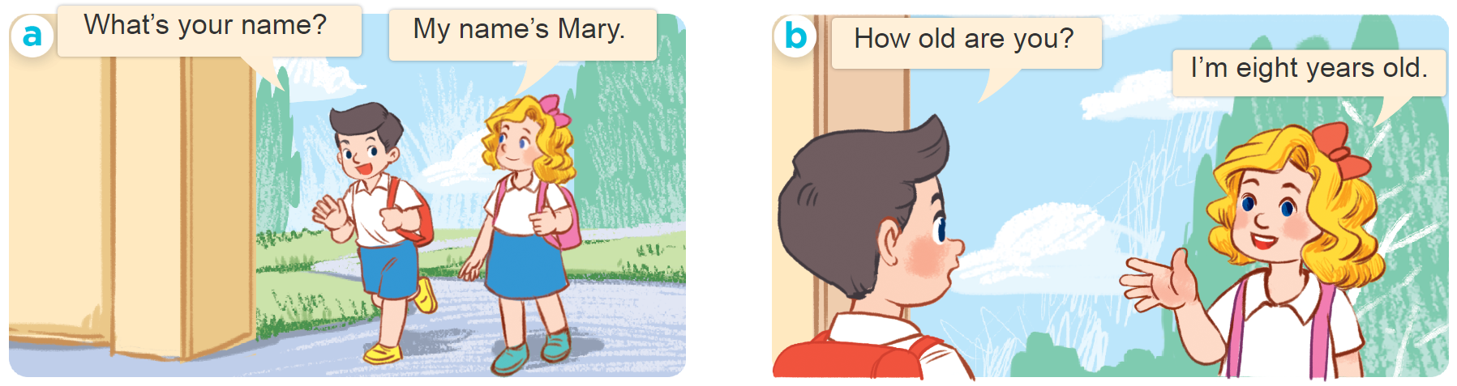
1. Look, listen and repeat.

Slide 6
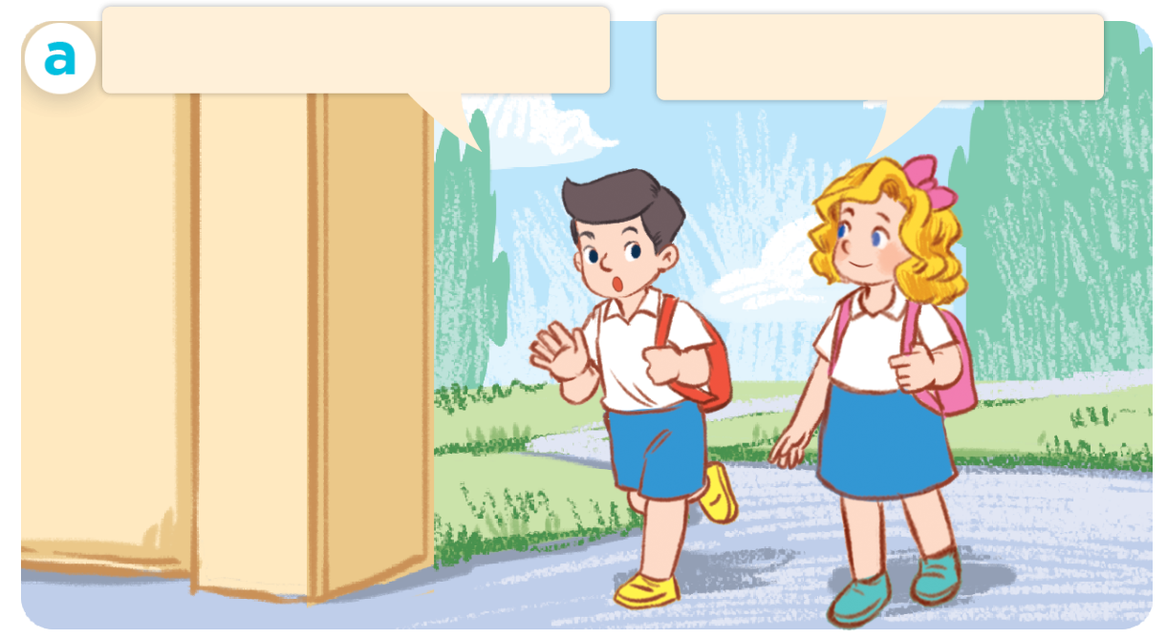
1. Look, listen and repeat.
Click on the sentences to hear the sound.
What’s your name?
My name’s Mary.

Slide 7
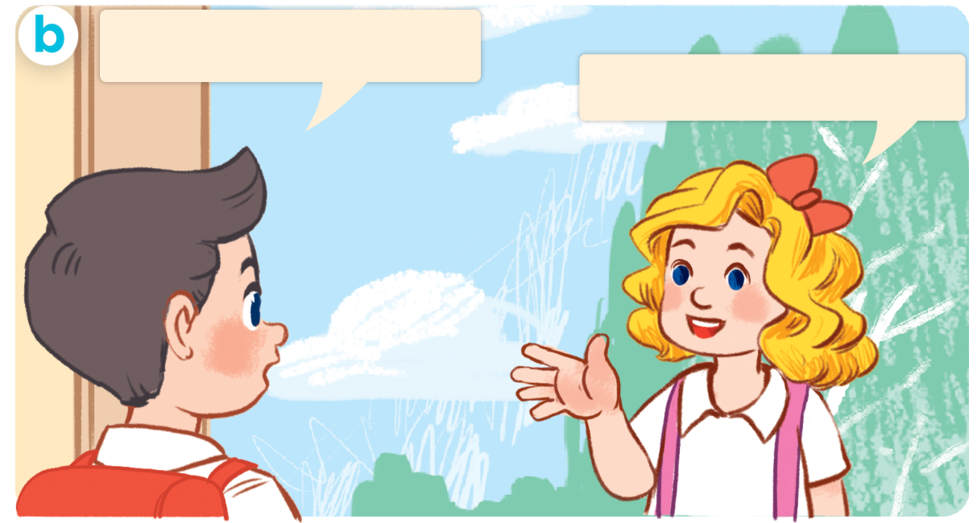
1. Look, listen and repeat.
Click on the sentences to hear the sound.
How old are you?
I’m eight years old.

Slide 8
Vocabulary

Slide 9







Vocabulary
Number
1
2
3
4
5
one
two
three
four
five
6
8
9
10
7
six
seven
eight
nine
ten

Slide 10


Vocabulary
year
/jɪər/
năm

Slide 11
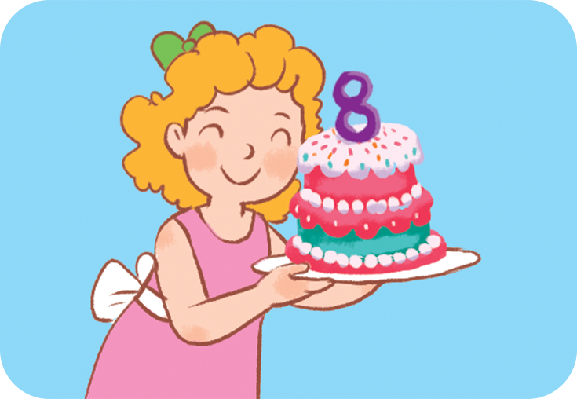

Vocabulary
old
/əʊld/
tuổi

Slide 12
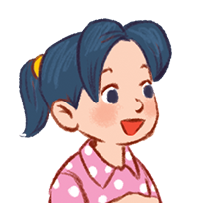

Vocabulary
she
/ʃiː/
cô ấy

Slide 13
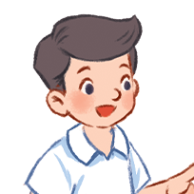
Vocabulary
he
/hi:/
anh ấy, cậu ấy

Slide 14

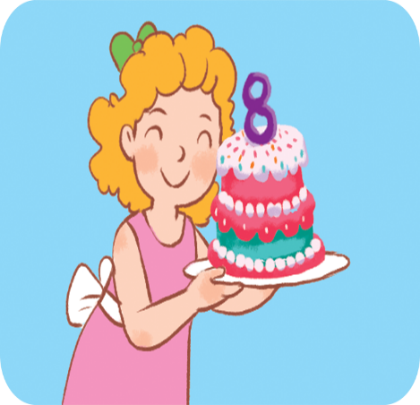
year
old
he
she

Slide 15

Vocabulary
- year : năm
- old : tuổi
- he : anh ấy, cậu ấy
- she : cô ấy

Slide 16
Let’s play!

Slide 17




Slide 18
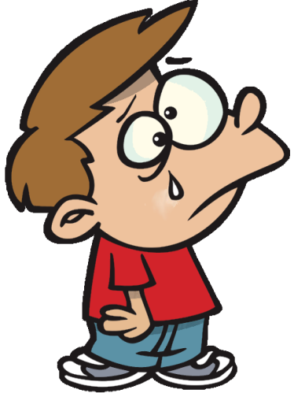
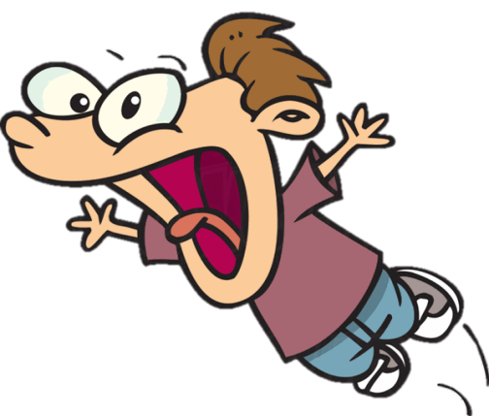
Click on the numbers
five
7
3
5
8

Slide 19
two
2
6
9
1

Slide 20
four
1
4
8
7

Slide 21
eight
6
1
7
8

Slide 22
nine
6
9
7
3

Slide 23
three
6
8
9
3

Slide 24
six
10
8
6
1

Slide 25
one
10
8
7
1

Slide 26
seven
10
7
3
4

Slide 27
ten
10
3
6
4

Slide 28
1
three
six
one
four

Slide 29
7
two
six
seven
eight

Slide 30
4
nine
four
ten
eight

Slide 31
8
eight
nine
ten
six

Slide 32
6
two
nine
ten
six

Slide 33
2
three
nine
two
ten

Slide 34
10
three
ten
five
nine

Slide 35
5
five
three
two
nine

Slide 36
9
seven
eight
four
nine

Slide 37

3
two
three
five
six

Slide 38
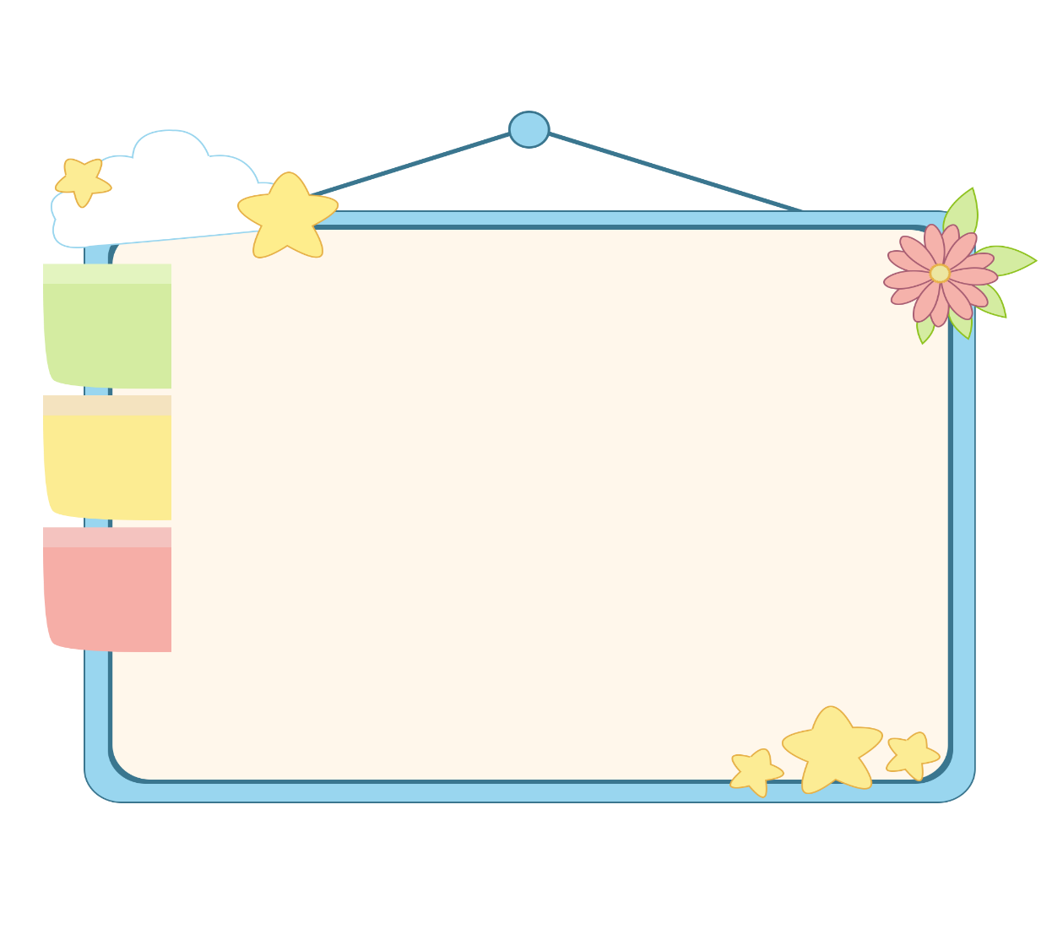
WELL DONE!

Slide 39
Structures

Slide 40
* Hỏi và trả lời về tuổi.
Hỏi: How old are you?
Đáp: I am ...... years old.
(Bạn bao nhiêu tuổi)
(Tớ…. tuổi)
Hỏi: How old is she/he?
Đáp: She/he is ... years old.
(Cô ấy/ anh ấy bao nhiêu tuổi)
(Cô ấy/anh ấy ..... tuổi)

Slide 41
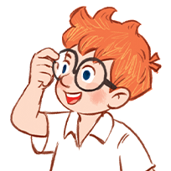
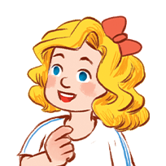
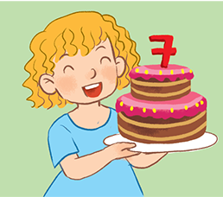
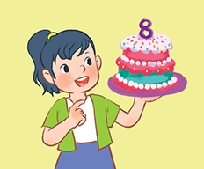
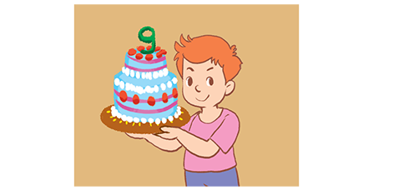
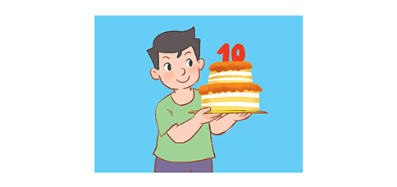
2. Listen, point and say.
I’m _____ years old.
How old are you?
seven
a
b
c
d

Slide 42
2. Listen, point and say.
I’m _____ years old.
How old are you?
seven
a

Slide 43
2. Listen, point and say.
I’m _____ years old.
How old are you?
eight
b

Slide 44
2. Listen, point and say.
I’m _____ years old.
How old are you?
nine
c

Slide 45
2. Listen, point and say.
I’m _____ years old.
How old are you?
ten
d

Slide 46
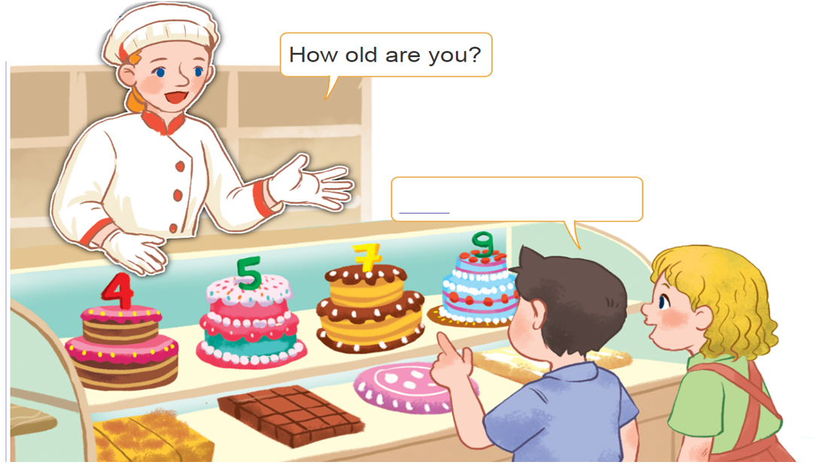
3. Let’s talk.
How old are you?
__________.
___________.

Slide 47
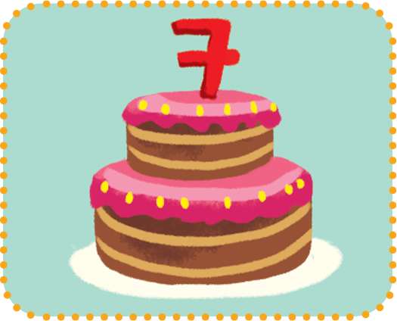
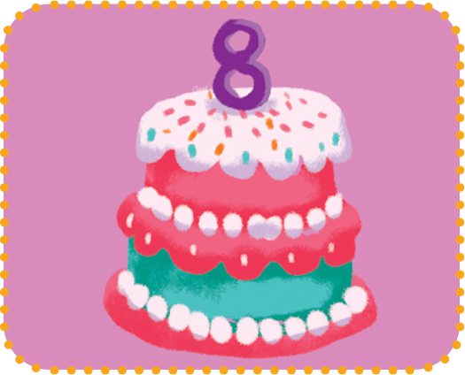
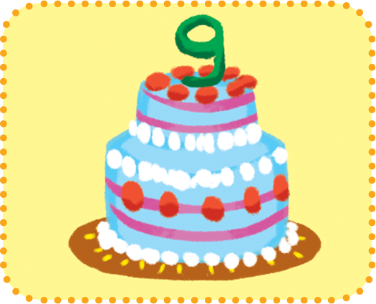





4. Listen and number.
4
1
3
2
a
b
c
d

Slide 48
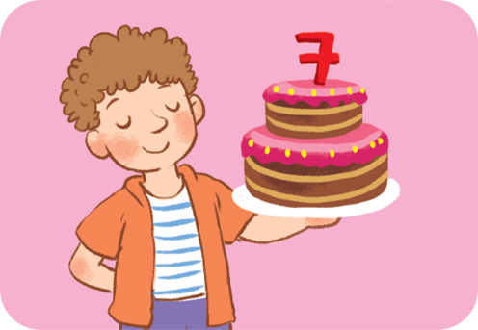

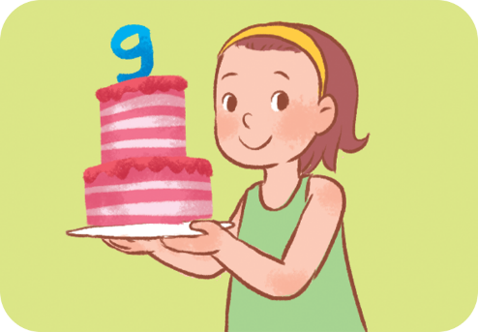
5. Look, complete and read.
1. A: How old are you?
B: I’m _____ years old.
2. A: How old are you?
B: I’m ___________ old.
3. A: How old are ____?
B: I’m _____________.

Slide 49
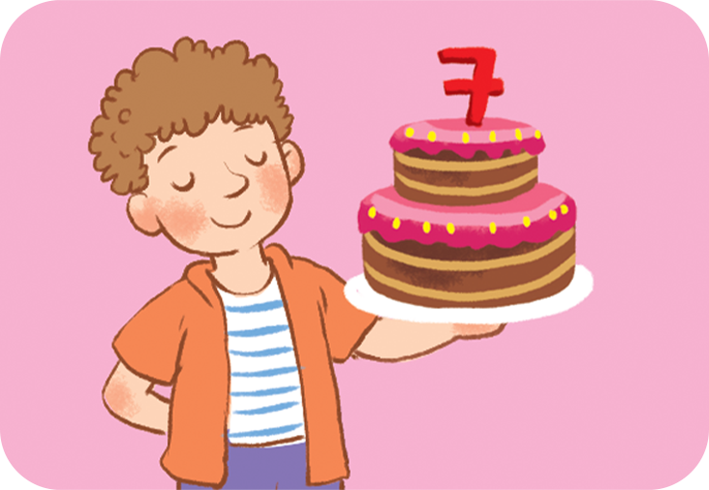
seven
5. Look, complete and read.
1. A: How old are you?
B: I’m _____ years old.

Slide 50
5. Look, complete and read.
2. A: How old are you?
B: I’m ___________ old.
eight years

Slide 51
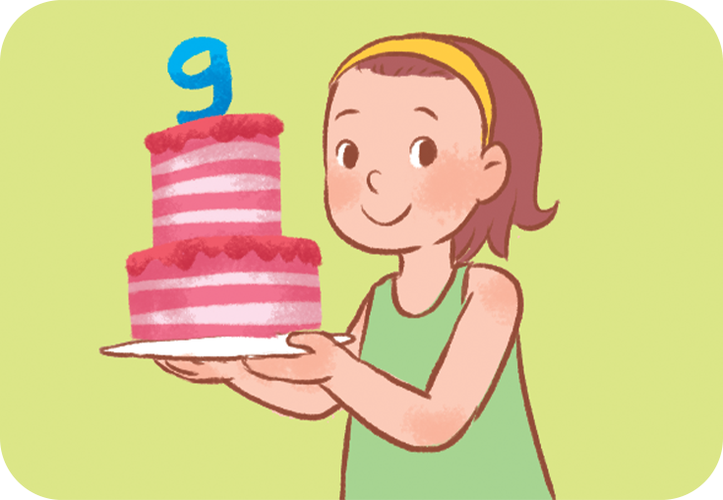
5. Look, complete and read.
you
3. A: How old are ____?
B: I’m _____________.
nine years old

Slide 52
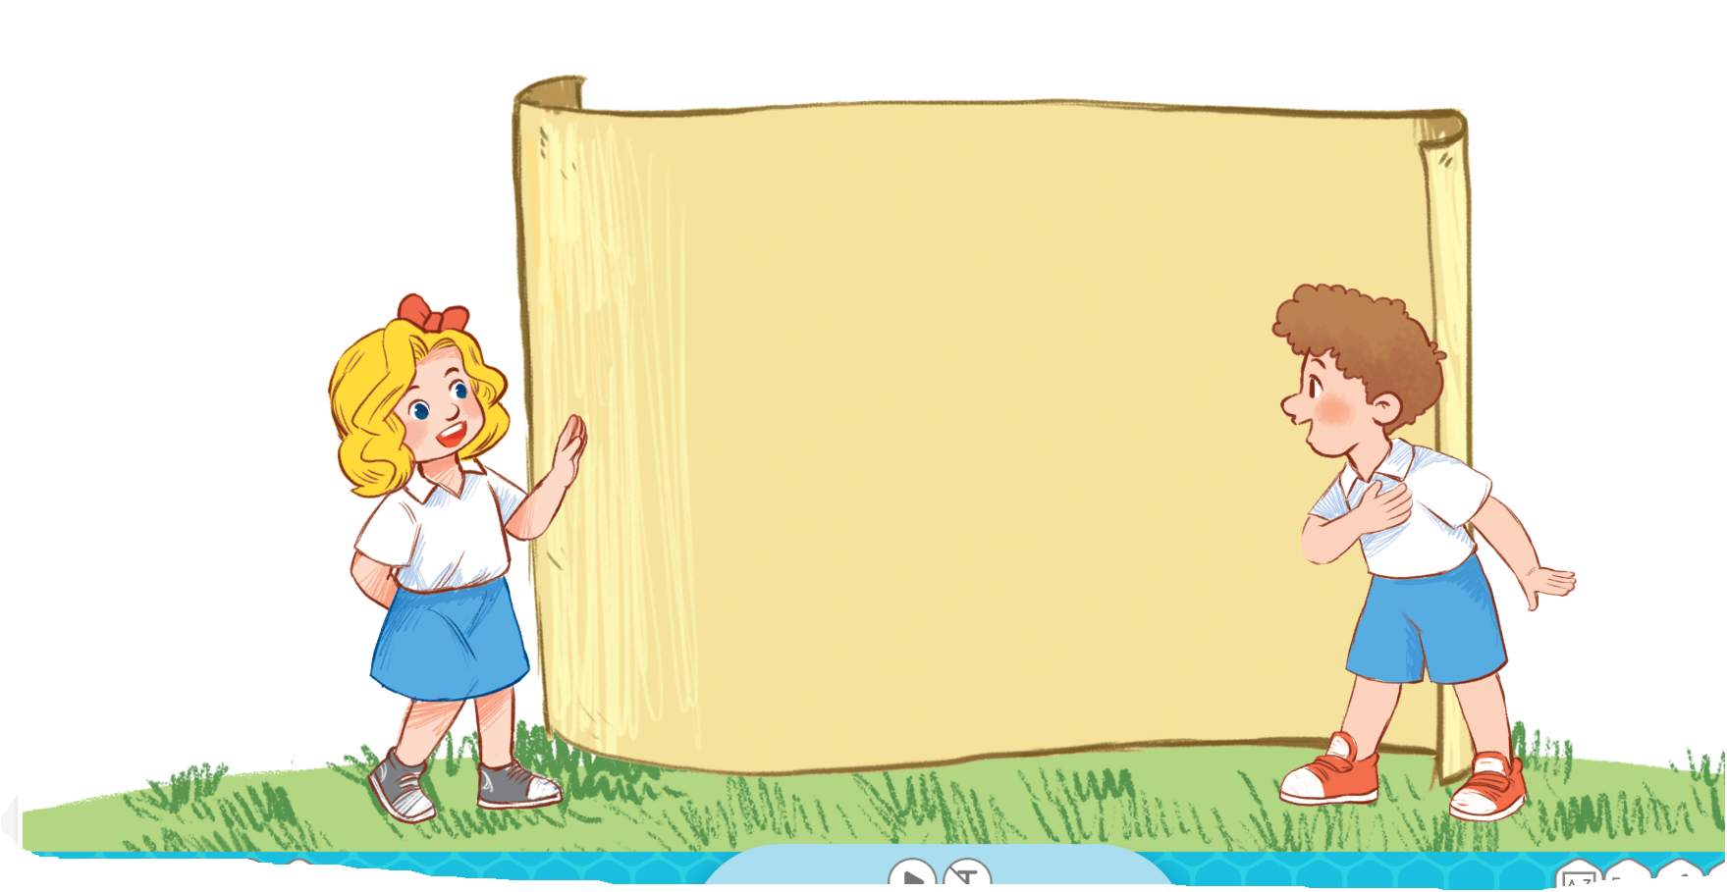
6. Let’s sing.
How old are you?
How old are you?
I’m seven.
I’m seven years old.
How old are you?
I’m eight.
I’m eight years old.

Slide 53
Wrap up

Slide 54
Wrap up
Number
1
2
3
4
5
one
two
three
four
five
6
8
9
10
7
six
seven
eight
nine
ten

Slide 55
Wrap up
year
old
he
she

Slide 56
* Hỏi và trả lời về tuổi.
Hỏi: How old are you?
Đáp: I am ...... years old.
(Bạn bao nhiêu tuổi)
(Tớ…. tuổi)
Hỏi: How old is she/he?
Đáp: She/he is ... years old.
(Cô ấy/ anh ấy bao nhiêu tuổi)
(Cô ấy/anh ấy ..... tuổi)

Slide 57
Homework
Learn by heart all the new words.
Read again the dialogue in part 1.

Slide 58

Thank you!

