Slide 1
Monday, September 25th 2023
Our names
Unit
2
Lesson 3

Slide 2

Warm-up

Slide 3
Let’s play!

Slide 4








FEEDING GOLDFISH
Mỗi câu trả lời đúng là
CÂU THẦN CHÚ giúp cá Vàng
ngoi lên mặt nước nhận thức ăn.
Nào chúng mình cùng giúp
bạn nhỏ cho cá Vàng ăn nhé!
START

Slide 5




Next
A. Hello
B. Goodbye
C. Bye

Slide 6

Hello. ____ Ben.
Next
A. Hello
B. Hi
C. I’m

Slide 7

Hello. I’m ____ .
Next
A. Bill.
B. Minh.
C. Ben.

Slide 8

Hi. How are you?
Next
A. Hello. I’m Linh
B. Fine. Thanks.
C. I’m eight.

Slide 9
Next
What’s _____ name?
A. you
B. my
C. your

Slide 10

Hello. I’m ____.
Next
A. Lucy
B. Linh
C. Mary

Slide 11
Next
Lucy: ______________?
Linh: My name is Linh.
A. What’s your name?
B. How are you?
C. How old are you

Slide 12
Bill: _______________?
Nam: Fine. Thank you.
Next
A. How old are you?
B. What’s your name?
C. How are you?

Slide 13
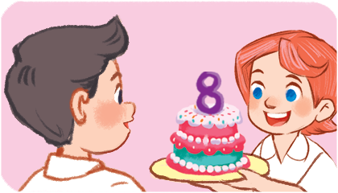
Nam: How old are you?
Lucy: I’m ________.
Next
A. nine
B. eight
C. seven

Slide 14
Mary: What’s your _____?
Linh: My name is Linh
Next
A. you
B. name is
C. name

Slide 15
THANK YOU!
Next

Slide 16






Contents
Listen and repeat.
Listen and circle.
Let’s chant.
Read and match.
Let’s write.
Project.

Slide 17
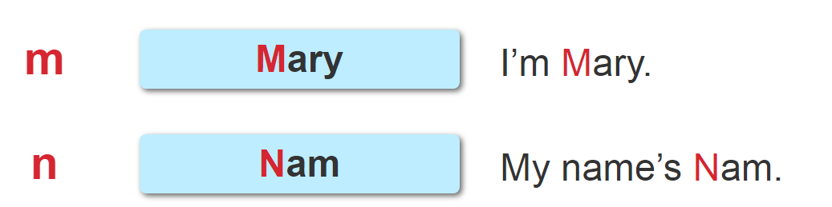

1. Listen and repeat.

Slide 18
2. Listen and circle.
1. Hi. I’m _________________.
A. Mai B. Mary C. Minh
2. Hello. My name’s ______________.
A. Mary B. Mai C. Nam

Slide 19
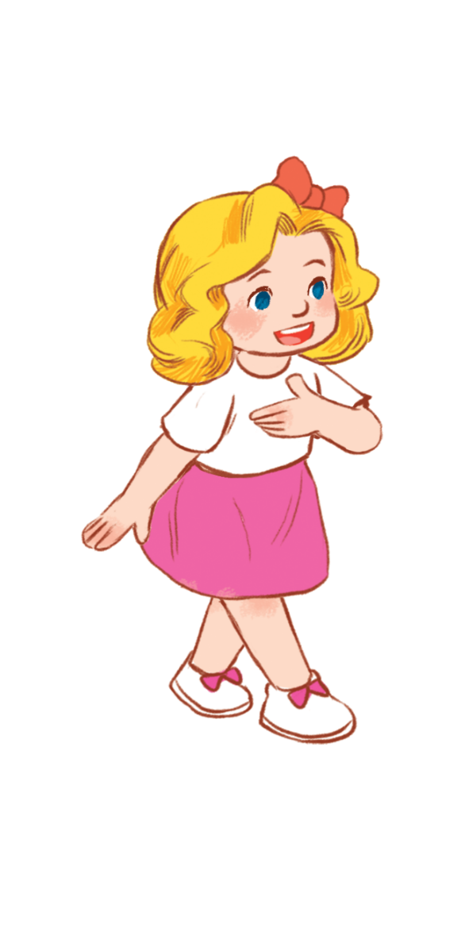

3. Let’s chant.
What’s your name?
My name’s Mary.
Mary,
Mary,
Mary.
What’s your name?
My name’s Nam.
Nam,
Nam,
Nam.

Slide 20

Let’s chant.
What’s your name?
My name’s Mary.
Mary,
Mary,
Mary.
What’s your name?
My name’s Nam.
Nam,
Nam,
Nam.

Slide 21


4. Read and match.
A: Hi. My name’s Linh.
What’s your name?
B: My name’s Mary.
1.
a
2.
A: How old are you, Lucy?
B: I’m eight years old
b
3.
A: Hi. I’m Mai.
B: Hello, Mai. I’m Ben.
1 - b
2 - c
3 - a
c

Slide 22
5. Let’s write.
Minh: Hi. I’m Minh. What’s your name?
You: __________.
Minh: How old are you?
You: ________________.
My name is Mai.
I’m eight years old.

Slide 23
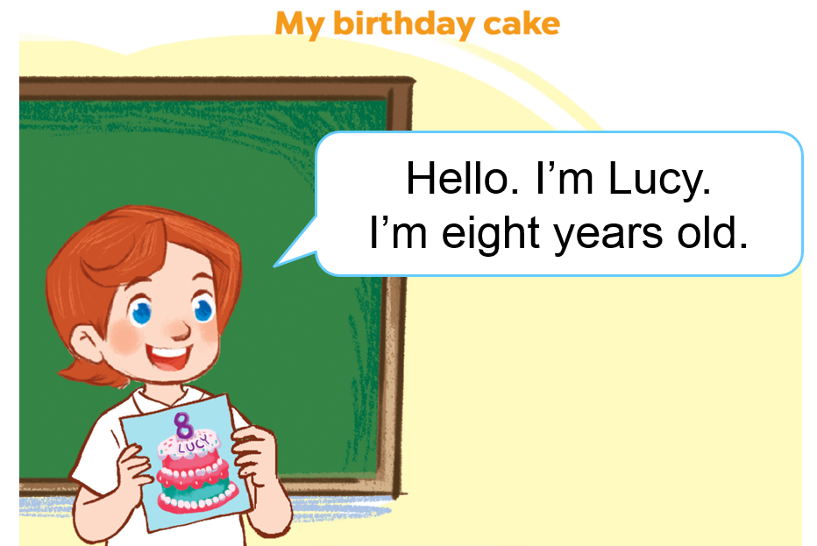
6. Project.

Slide 24
Wrap up unit 2

Slide 25



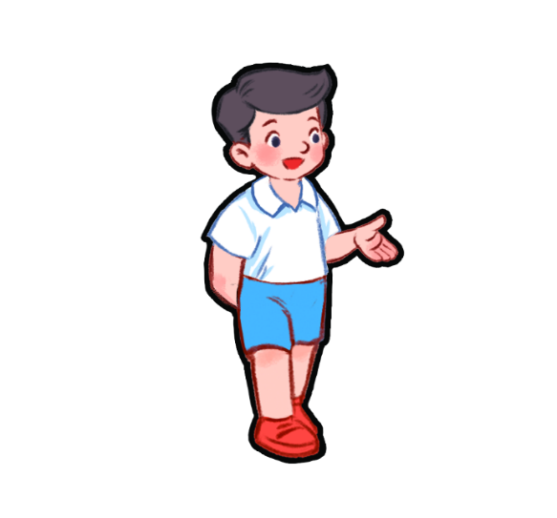
Vocabulary
Bill
Linh
Mary
Nam

Slide 26
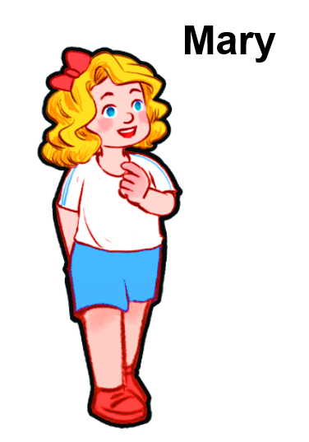
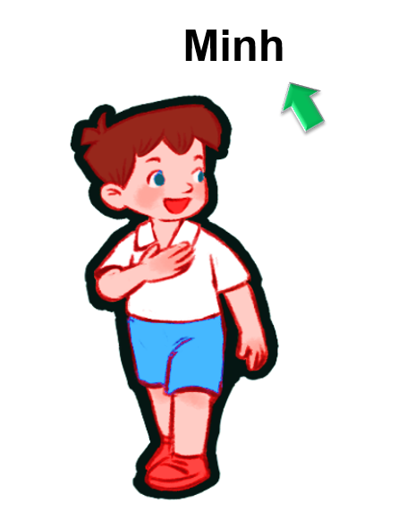


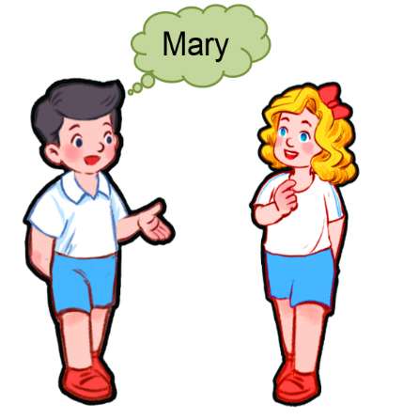
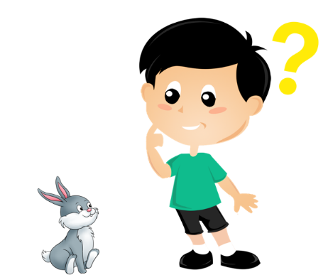
Vocabulary
my
của tôi
name
tên
your
của bạn
what
gì, cái gì

Slide 27
Structures
Hỏi và trả lời về tên.
What’s your name?
I’m _______.
My name’s _______.
(Bạn tên là gì?)
(Tên mình là ….)
what’s = what is
name’s = name is

Slide 28
Structures
Hỏi – trả lời về tên của người khác.
What’s his name?
He is _____.
His name is _______.
(Tên anh ấy là gì?)
(Anh ấy là ….)
What’s her name?
She is _______.
Her name is________.
(Tên cô ấy là gì?)
(Tên cô ấy là ….)

Slide 29







Vocabulary
Number
1
2
3
4
5
one
two
three
four
five
6
8
9
10
7
six
seven
eight
nine
ten

Slide 30

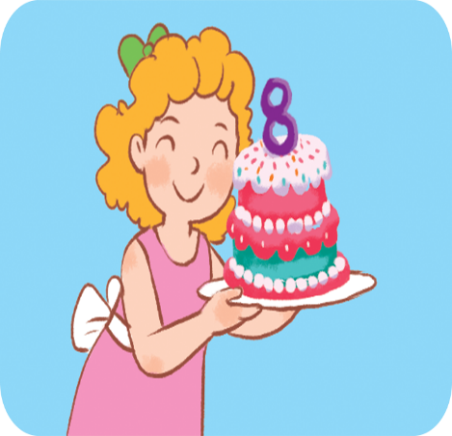
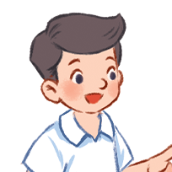



Vocabulary
year
old
he
she

Slide 31
* Hỏi và trả lời về tuổi.
Hỏi: How old are you?
Đáp: I am ...... years old.
(Bạn bao nhiêu tuổi)
(Tớ…. tuổi)
Hỏi: How old is she/he?
Đáp: She/he is ... years old.
(Cô ấy/ anh ấy bao nhiêu tuổi)
(Cô ấy/anh ấy ..... tuổi)

Slide 32
Homelink
Learn by heart all the new words.
Read again the dialogue in part 1.
Do exercises in your workbooks.

Slide 33

Thank you!

