Slide 1
Monday, October 6th 2023
Our friends
Unit
3
Lesson 2

Slide 2






Contents
Look, listen and repeat.
Listen, point and say.
Let’s talk.
Listen and number.
Look, complete and read.
Let’s play.
.

Slide 3

Warm-up

Slide 4

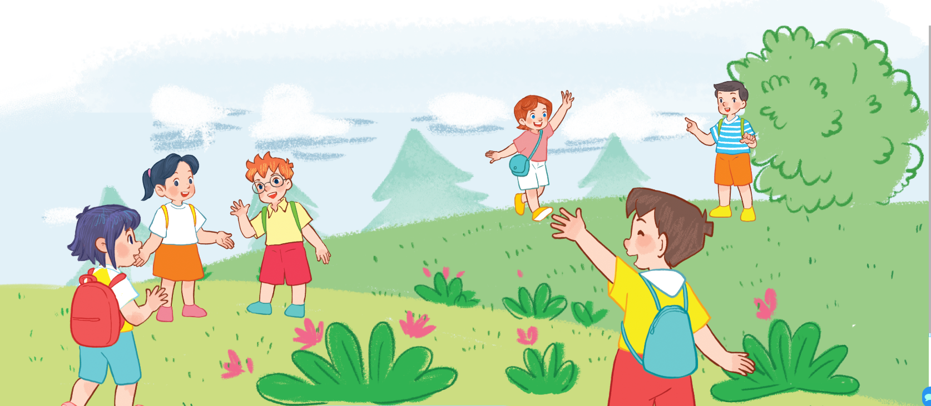
Let’s sing.
This is Linh
This is Linh.
This is Ben.
Hello, Linh.
Hello, Ben
That’s Minh.
That’s Lucy.
Hi, Minh.
Hi, Lucy.

Slide 5
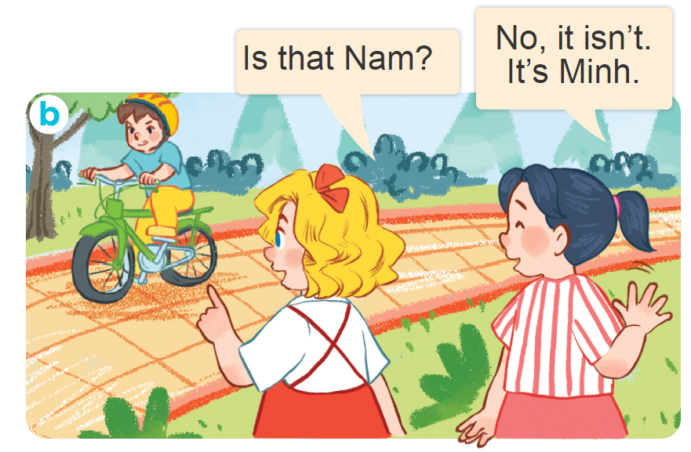
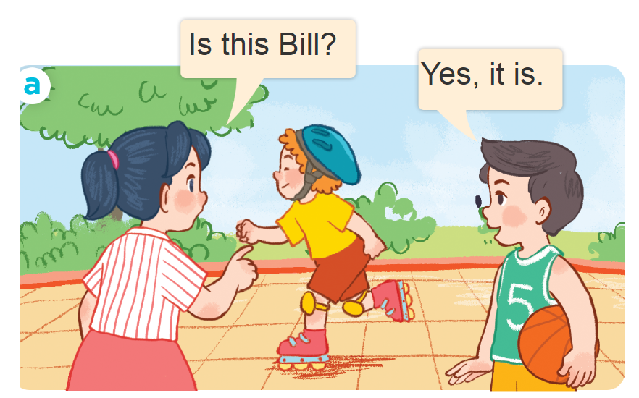
1. Look, listen and repeat.
Where are they?
Who are they?
What are they doing?
Click on the screen to show 3 questions.

Slide 6
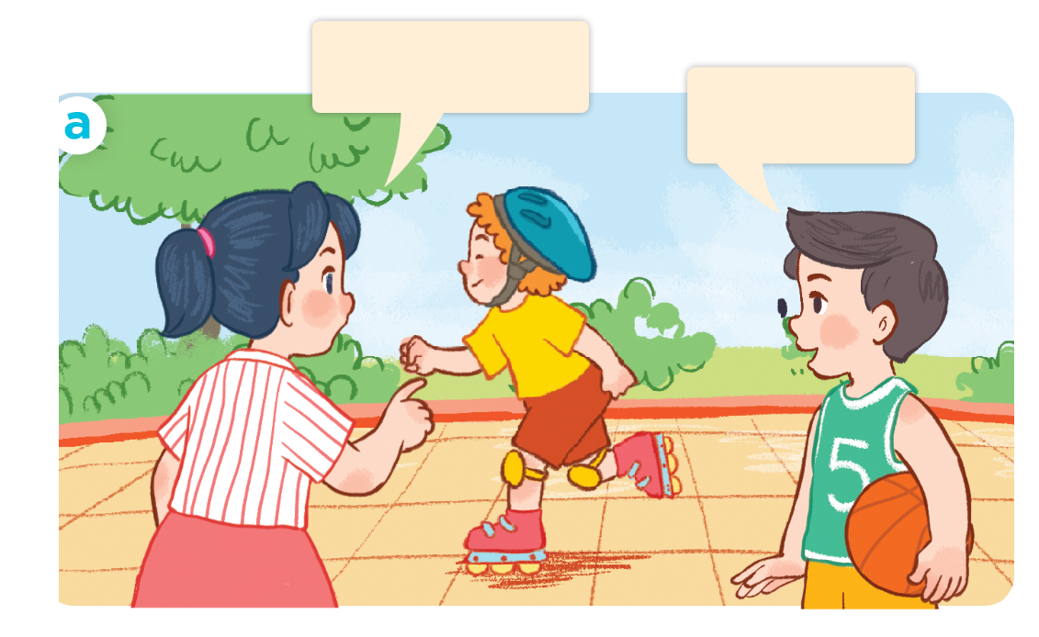
1. Look, listen and repeat.
Click on the sentences to hear the sound.
Is it Bill?
Yes, it is.

Slide 7
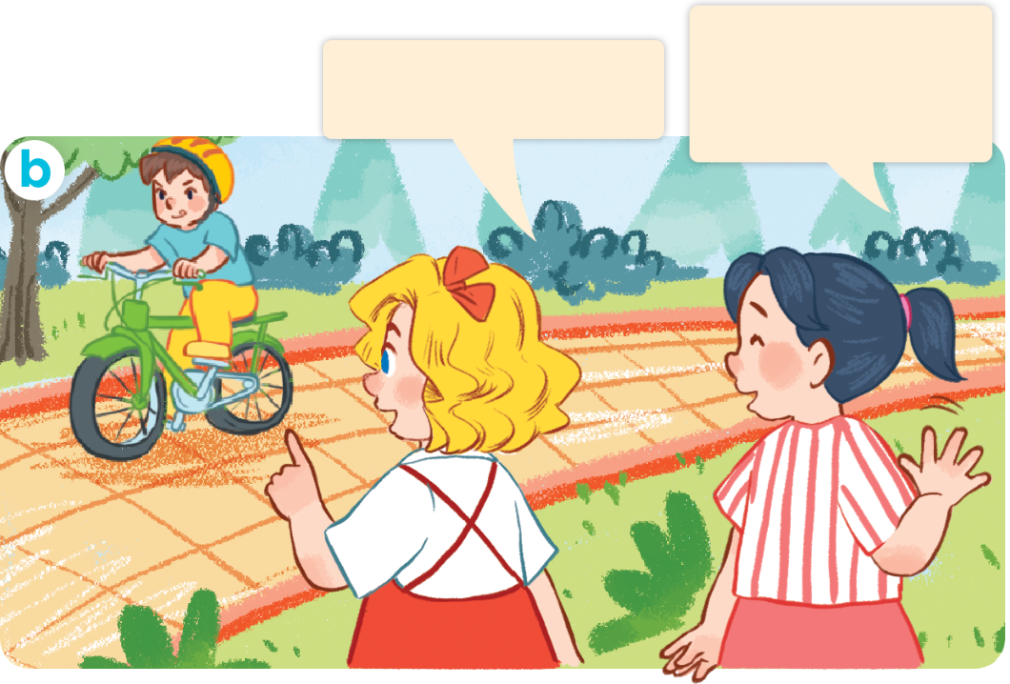
1. Look, listen and repeat.
Click on the sentences to hear the sound.
No, it isn’t.
It’s Minh.
Is that Nam?

Slide 8
Vocabulary

Slide 9


Vocabulary
Yes
/jes/
vâng, ừ

Slide 10

Vocabulary
No
/nəʊ/
không

Slide 11
Vocabulary
- Yes : vâng, ừ
- No : không

Slide 12
Structures

Slide 13


* Hỏi đây/kia là ai đó phải không.
Is this/ that + ______?
(Đây/kia là ___ có phải không?)
Yes, it is.
(Vâng, đúng vậy.)
No, it isn’t.
It’s _____.
(Không, không phải).
Đó là _______.

Slide 14


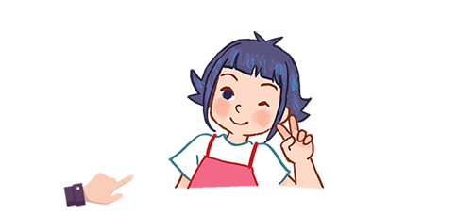
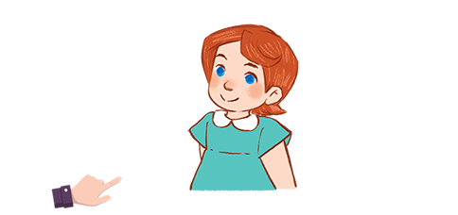
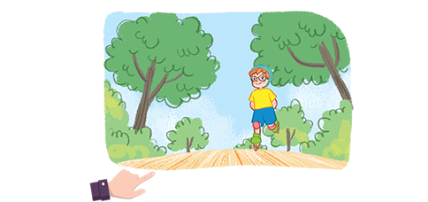
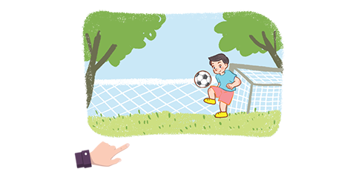
2. Listen, point and say.
Yes, it is.
Is this/ that ____?
No, it isn’t.
It’s___.
Linh/yes
Lucy/yes
Bill/no/Ben
Minh/no/Nam
a
b
c
d

Slide 15

2. Listen, point and say.
Is ____ Linh?
this
_________.
Yes, it is
a
Linh/yes

Slide 16
2. Listen, point and say.
Is ____ Lucy?
this
_________.
Yes, it is
b
Lucy/yes

Slide 17
2. Listen, point and say.
Is ____ Bill?
that
___________________.
No, it isn’t. It’s Ben
c
Bill/no/Ben

Slide 18
2. Listen, point and say.
Is ____ Minh?
__________________.
that
No, it isn’t. It’s Nam
d
Minh/no/Nam

Slide 19
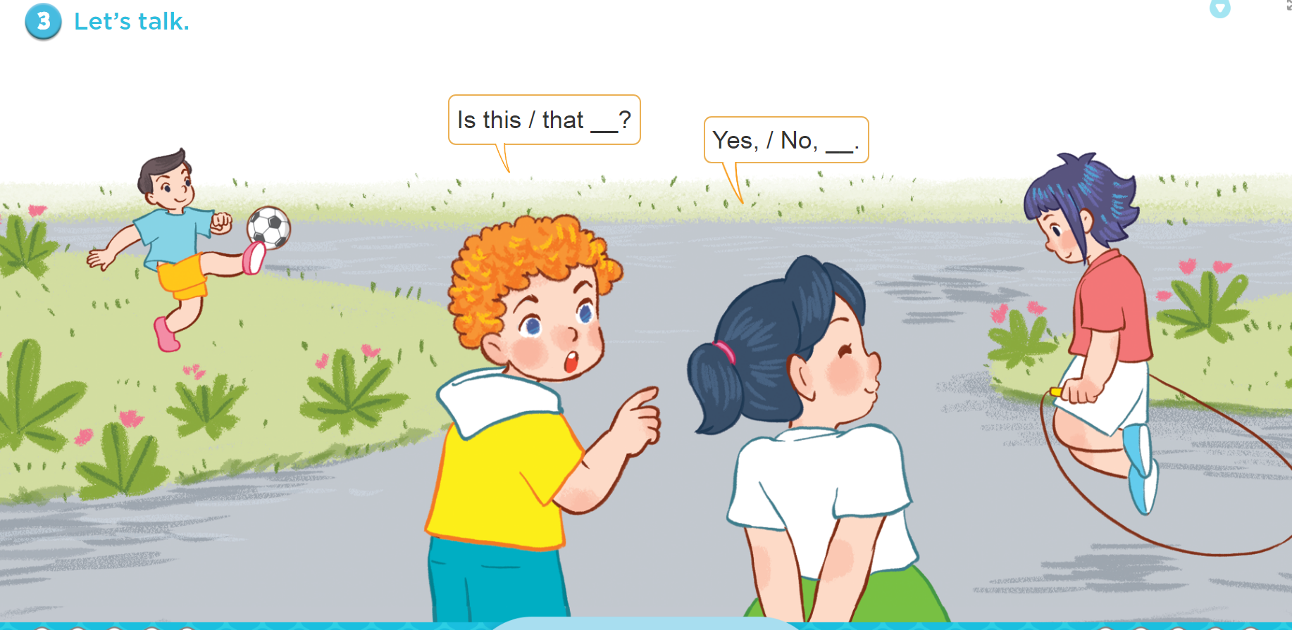
3. Let’s talk.

Slide 20
Let’s play!

Slide 21






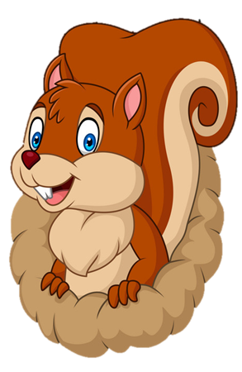
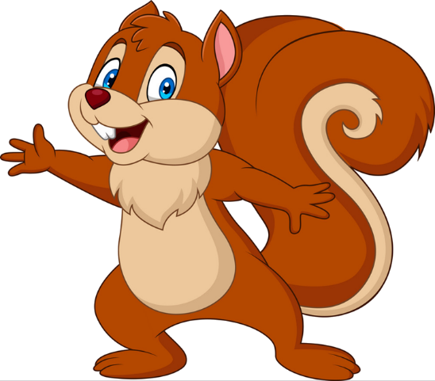
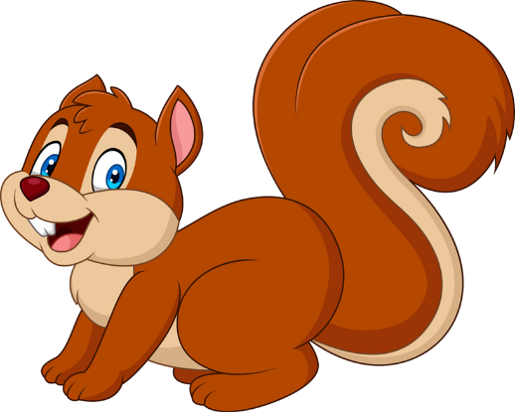
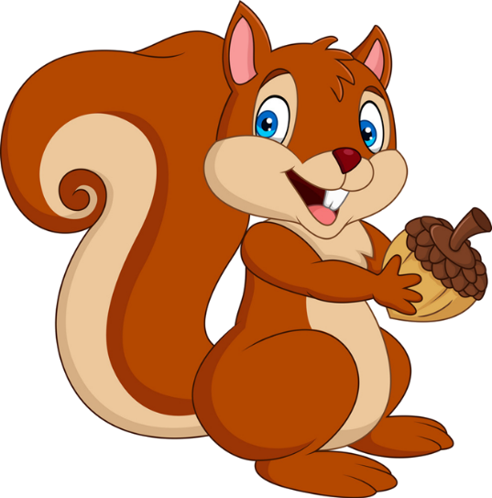


PLAY
NEXT

Slide 22
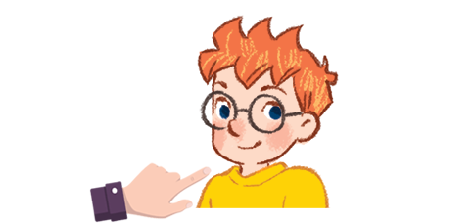


Is this Bill?
A. No, it isn’t. It’s Minh.
B. No, it isn’t. It’s Ben.

Slide 23
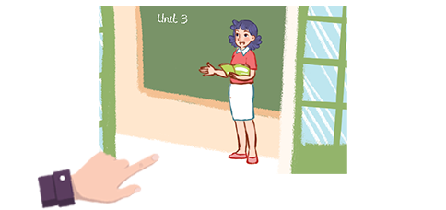
Is that Ms Loan?
A. No, it isn’t. It’s Ms Hoa.
B. No, it isn’t. It’s Ms Lien.

Slide 24
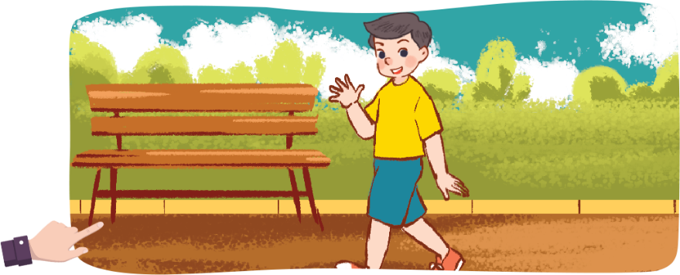
Is ______ Nam?
A. that
B. this

Slide 25
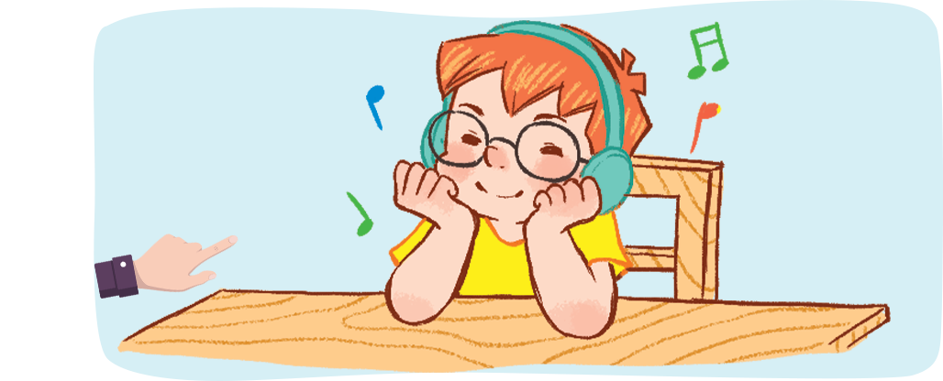
Is________?
A. that Minh
B. this Ben

Slide 26
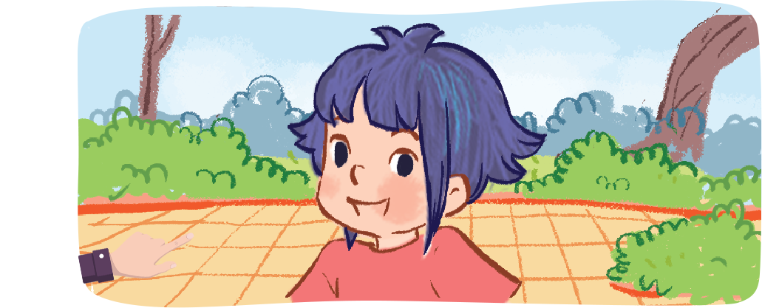
Is this Linh?
A. Yes, it is.
B. No, it isn’t. It’s Linh.

Slide 27
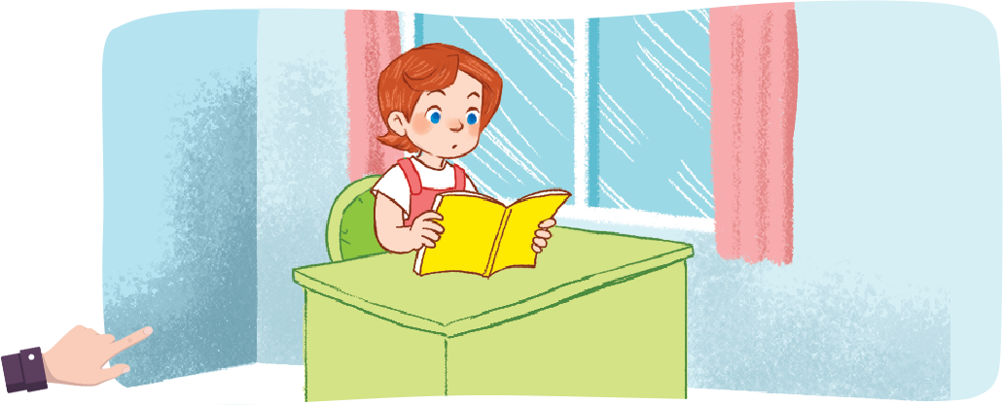
Is ________?
A. this Lucy
B. that Lucy

Slide 28
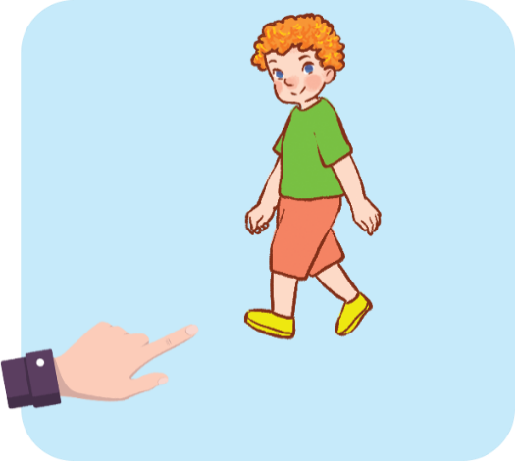
Is __________?
A. that Bill
B. that Ben

Slide 29

Is this Mai?
A. False.
B. True.

Slide 30
Is that Ben?
A. False.
B. True.

Slide 31

Is this Mr Long?
A. True.
B. False.

Slide 32


Good job!

Slide 33

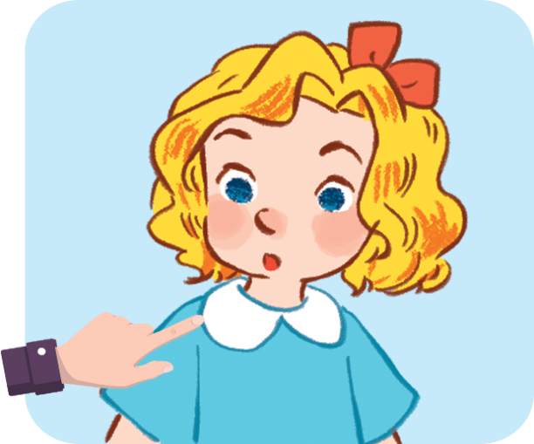
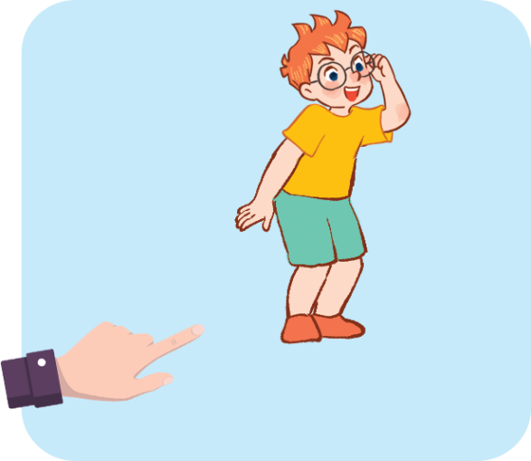




4. Listen and number.
2
1
4
3
a
b
c
d

Slide 34
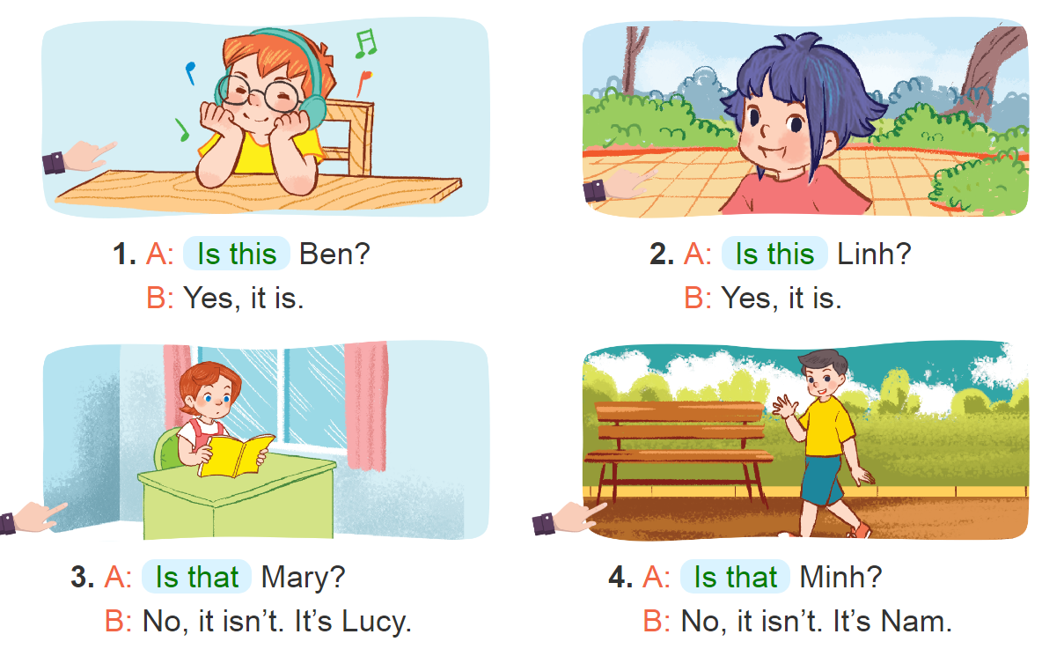
___
5. Look, complete and read.
_____
______
______

Slide 35
5. Look, complete and read.
Is this
1. A: _______ Ben?
B: Yes, it is.

Slide 36
5. Look, complete and read.
Is this
2. A: _______ Linh?
B: Yes, it is.

Slide 37
5. Look, complete and read.
Is that
3. A: _______ Mary?
B: No, it isn’t. It’s Lucy.

Slide 38
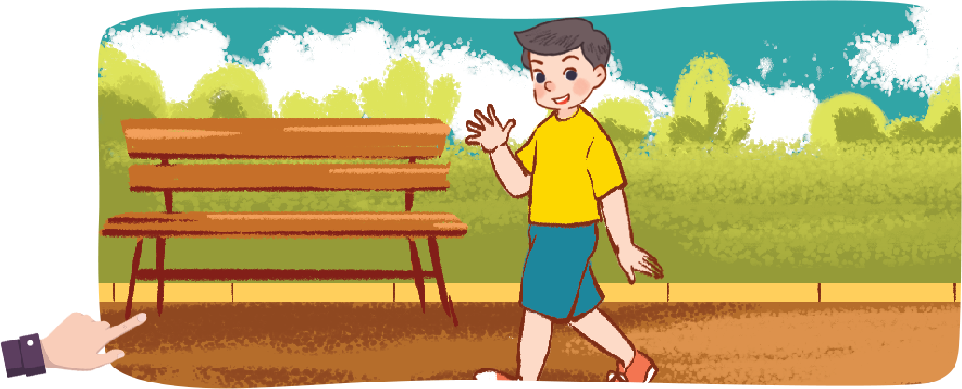
5. Look, complete and read.
Is that
4. A: _______ Minh?
B: No, it isn’t. It’s Nam.

Slide 39
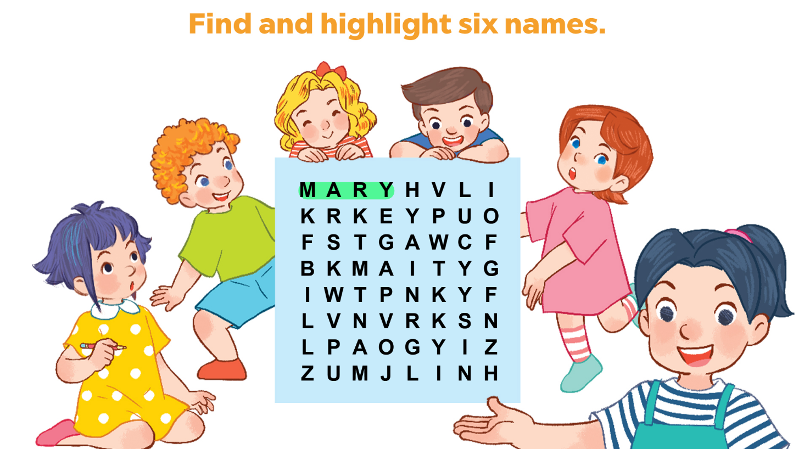
6. Let’s play.

Slide 40
Wrap up

Slide 41
Vocabulary
- Yes : vâng, ừ
- No : không

Slide 42
* Hỏi đây/kia là ai đó phải không.
Is this/ that + ______?
(Đây/kia là ___ có phải không?)
Yes, it is.
(Vâng, đúng vậy)
No, it isn’t.
It’s _____.
(Không, không phải).
Đó là _______/.

Slide 43
Homelink
Learn by heart all the new words.
Read again the dialogue in part 1.

Slide 44

Thank you!

