Slide 1


Slide 2
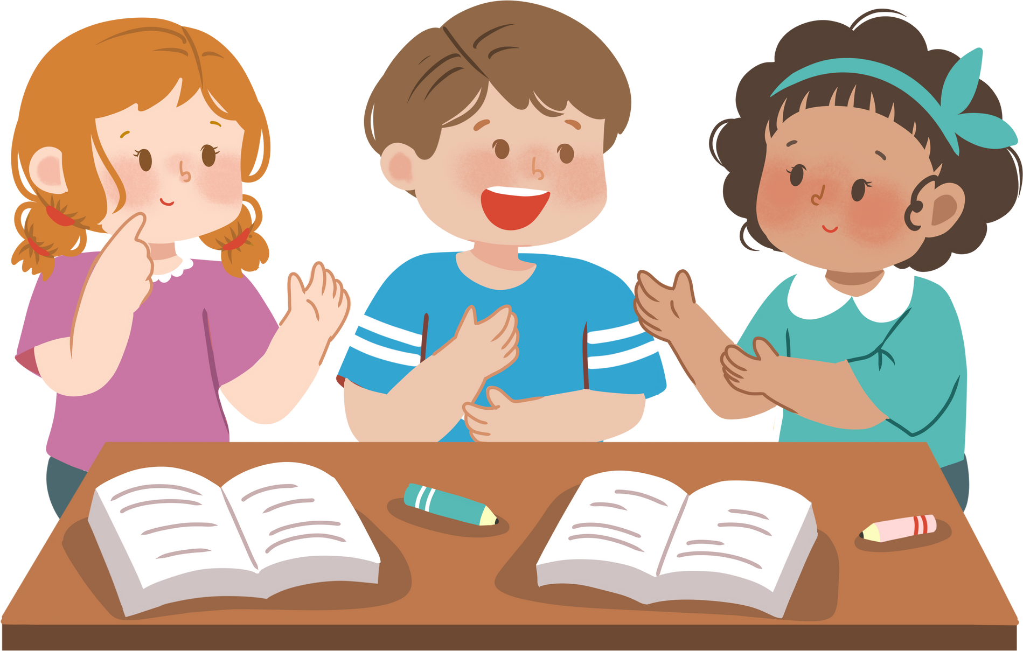
Monday, February 20th 2024
Extension 3

Slide 3
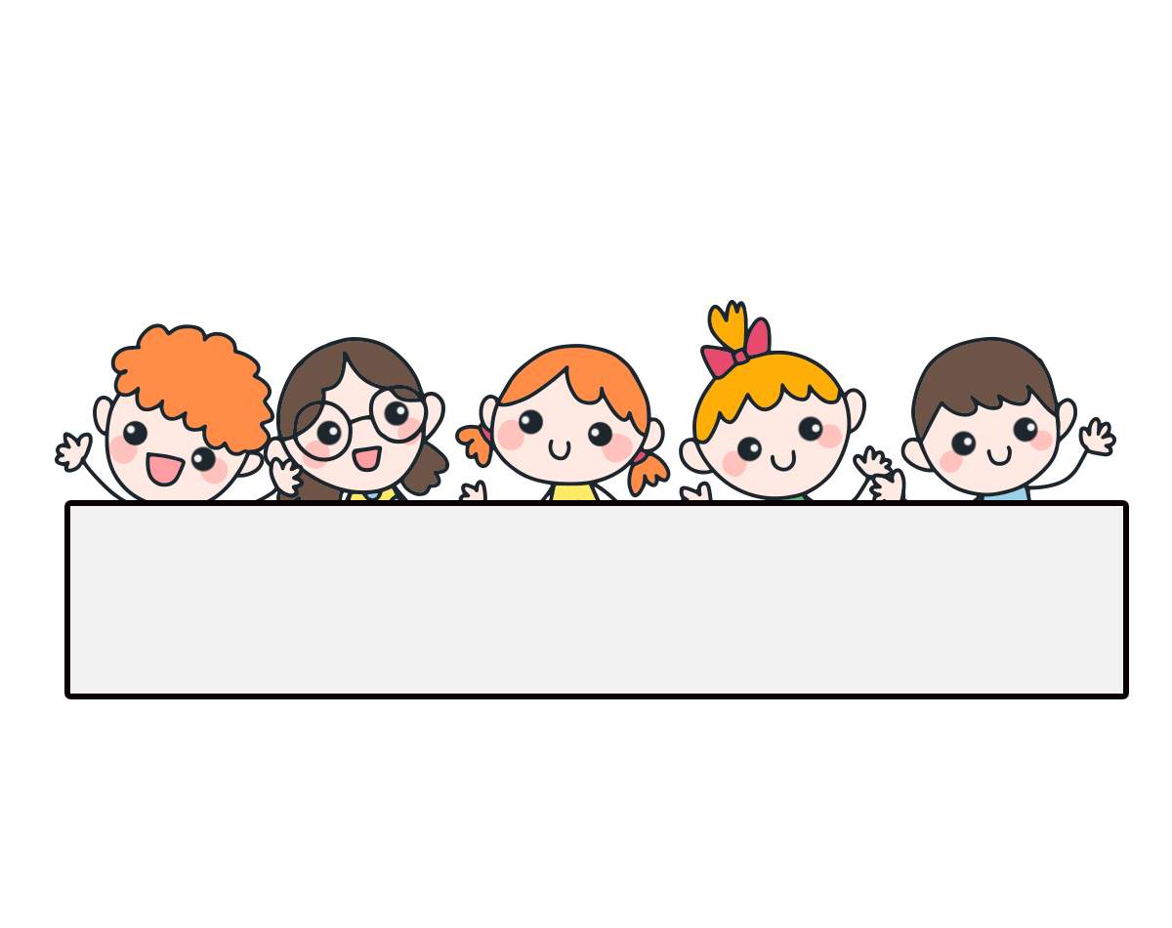
Warm-up

Slide 4

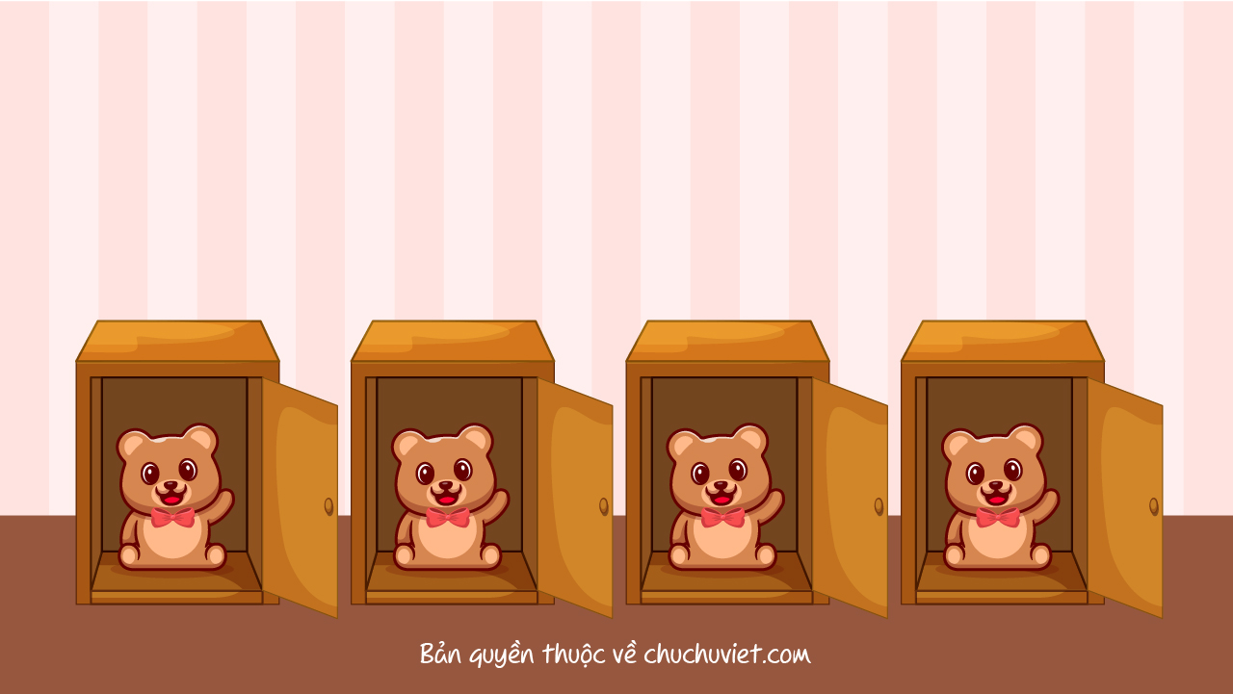



Slide 5






A: Where do you live?
B: I live _____ 81 Tran Hung Dao Street.
at
in
on
A
B
C

Slide 6
A: ______ the road like?
B: It’s a busy road.
Who is
Where is
What is
A
B
c

Slide 7

A: What does she do?
B: She is an _________.
farmer
nurse
actor
A
B
C

Slide 8
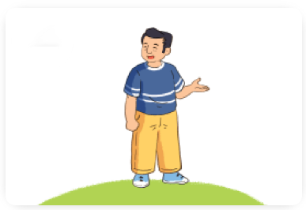
A: What does he look like?
B: He’s ________.
big
tall
short
A
B
c

Slide 9
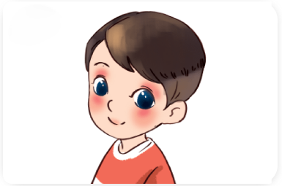
A: What does he look like?
B: He has ________.
short hair
long hair
big eyes
A
B
c

Slide 10
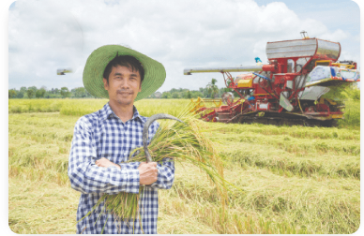
A: Where does he work?
B: He works _________.
at a factory
on a farm
at a school
A
B
C

Slide 11
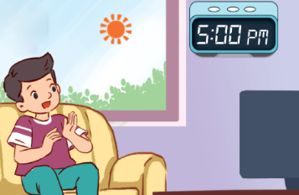
A: When do you watch TV?
B: I watch TV in the __________.
afternoon
morning
evening
A
B
C

Slide 12
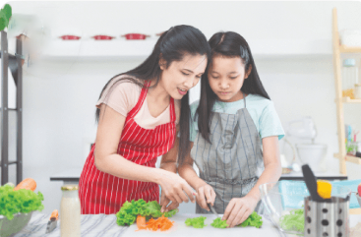
A: ______ do you do in the morning?
B: I help with the cooking.
What
Who
Where
A
B
C

Slide 13
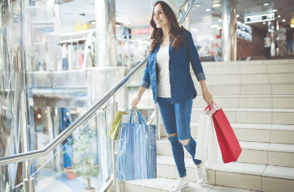
A: Where does she go on Saturdays?
B: She ______ to the shopping centre.
go
goes
A
B

Slide 14
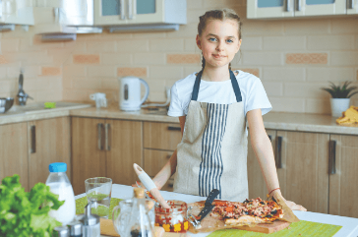
A: What does she do on Saturdays?
B: She is an _________.
plays tennis
cooks meals
does yoga
A
B
C

Slide 15
Thank you!

Slide 16
Contents
1
Work in pairs. Take turns to describe and draw a family member.
2
Tell the class about your partner’s family member.
3
Read and match. Then say what the animals are.

Slide 17
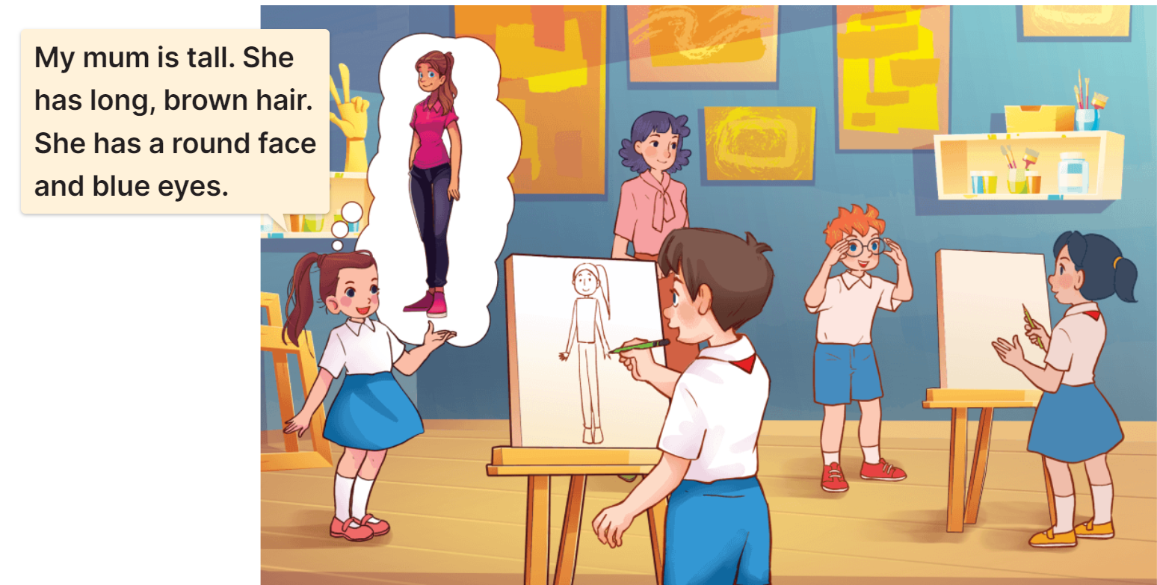
1. Work in pairs. Take turns to describe and draw a family member.

Slide 18
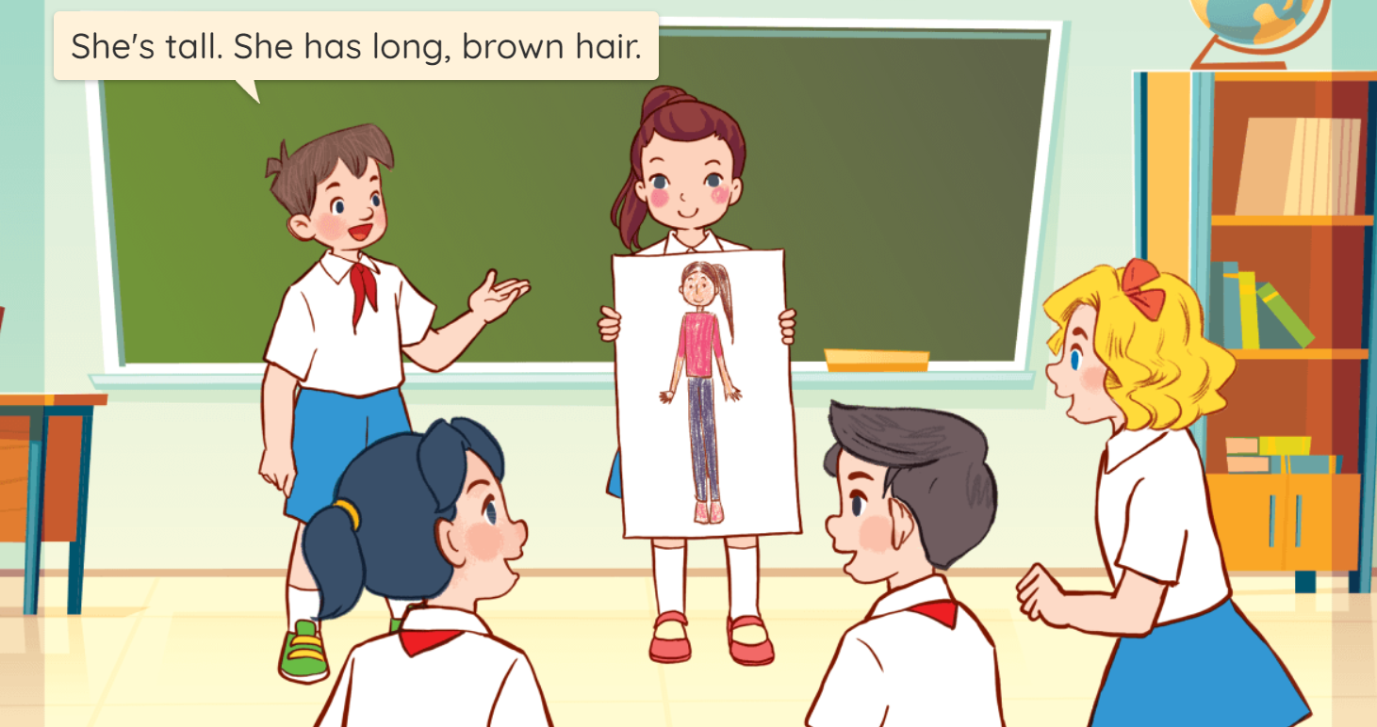
2. Tell the class about your partner’s family member.

Slide 19
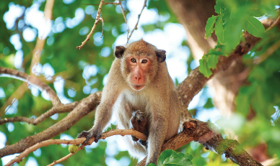
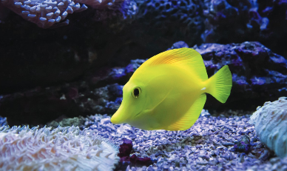
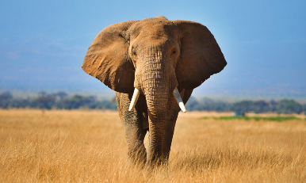
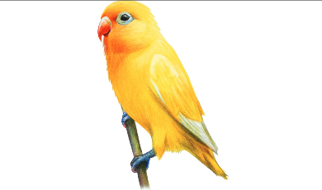
3. Read and match. Then say what the animals are.
a
1. It is big.
It has a long nose.
It has two big ears.
2. It is small.
It is yellow.
It has two legs.
b
3. It is big.
It has brown hair.
It has a round face.
c
4. It is small.
It is yellow.
It has no legs.
d

Slide 20
Homework
……………………………………..
……………………………………...

Slide 21

Thank you!

