Slide 1


Slide 2
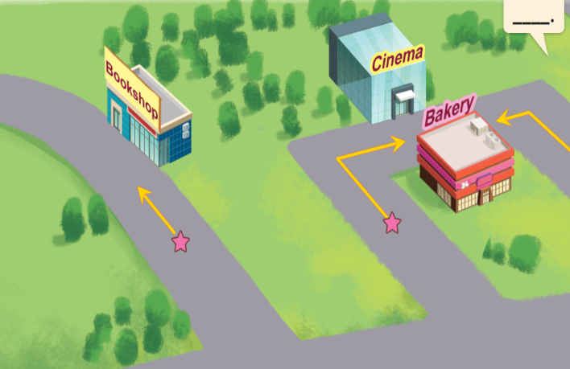
Monday, February 25th 2024
Unit 17
In the city
Lesson 1

Slide 3
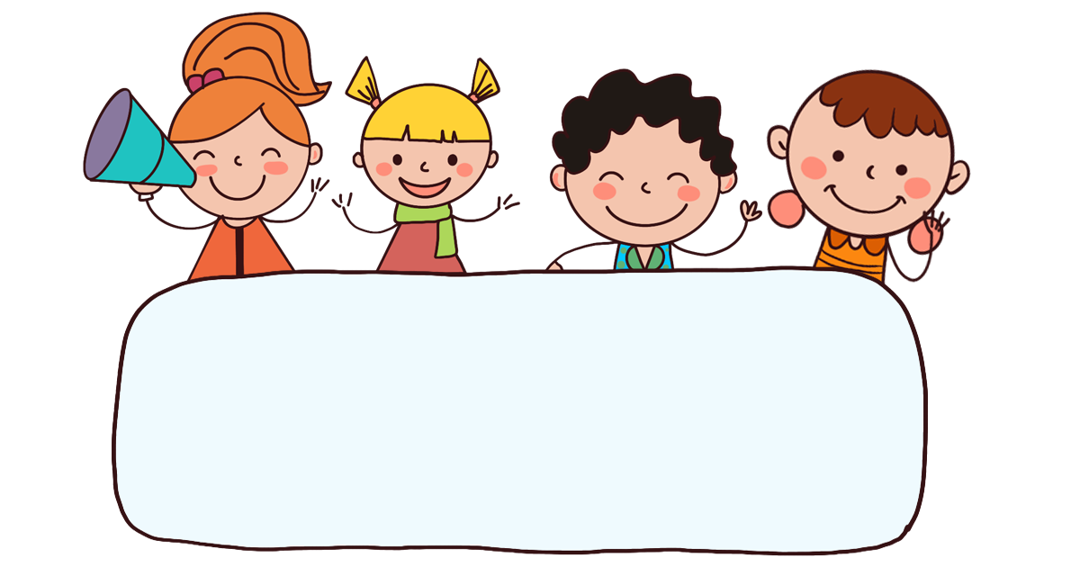
Warm-up

Slide 4

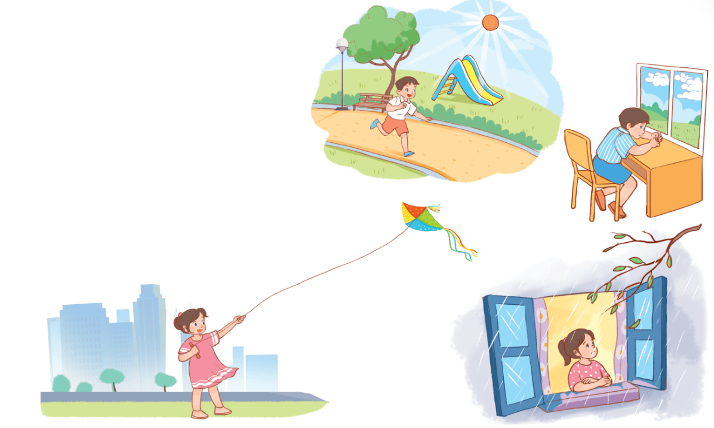
Let’s chant.
Sunny,
sunny,
sunny.
I like sunny days.
Cloudy,
cloudy,
cloudy.
I don’t like cloudy days.
Windy,
windy,
windy.
I like windy days.
Rainy,
rainy,
rainy.
I don’t like rainy days.

Slide 5






Contents
Look, listen and repeat.
Listen, point and say.
Let’s talk.
Listen and tick or cross.
Look, complete and read.
Let’s sing.

Slide 6

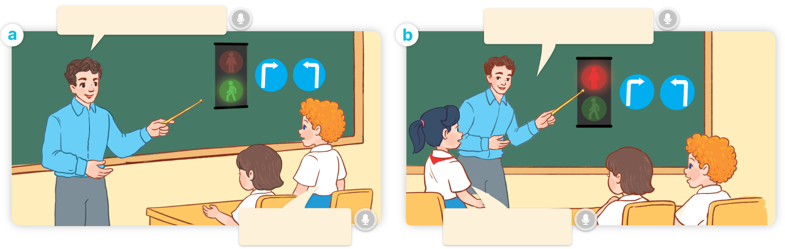
1. Look, listen and repeat.
What does it say?
What does it say?
a
b
It says ‘go’.
It says ‘stop’.
Where are they?
What are they talking about?
Who are they?
Click on the speaker / sentences to listen.

Slide 7
Vocabulary

Slide 8
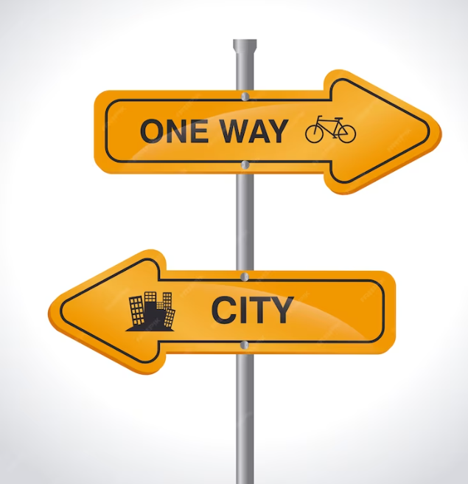
Vocabulary
road sign
/ˈrəʊd saɪn/
biển chỉ đường
Click on the English words to listen.

Slide 9

go straight
/ɡəʊ streɪt/
đi thẳng

Slide 10
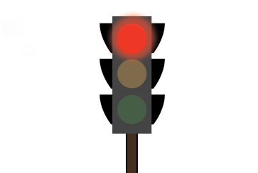
stop
/stɒp/
dừng lại

Slide 11

turn left
/tɜːnˈleft/
rẽ trái

Slide 12

turn right
/tɜːnˈraɪt/
rẽ phải

Slide 13

Review
road sign
stop
go straight
turn left
turn right

Slide 14

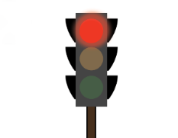



Vocabulary
1. road sign
: biển chỉ đường
2. stop
: dừng lại
3. go straight
: đi thẳng
4. turn left
: rẽ trái
5. turn right
: rẽ phải

Slide 15


Checking vocabulary!

Slide 16

Can you guess?
Nhấn vào ống nhòm lần thứ nhất để chuyển động.
Nhấn lần thứ 2 để hiển thị đáp án.
go straight

Slide 17
Can you guess?
turn left

Slide 18
Can you guess?
road sign

Slide 19
Can you guess?
stop

Slide 20
Can you guess?
turn right

Slide 21
Well done!

Slide 22
2. Listen, point and say.
a
b
What does it say?
stop
go straight
It says ‘_____’.
c
d
turn right
turn left

Slide 23
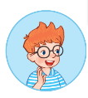

2. Listen, point and say.
a
What does it say?
It says ‘_____’.
stop
What does it say?
It says ‘stop’.
Click on the sentences to listen.

Slide 24
2. Listen, point and say.
b
What does it say?
It says ‘_____’.
go straight
What does it say?
It says ‘go straight’.

Slide 25
2. Listen, point and say.
c
What does it say?
It says ‘_____’.
turn right
What does it say?
It says ‘turn right’.

Slide 26
2. Listen, point and say.
d
What does it say?
It says ‘_____’.
turn left
What does it say?
It says ‘turn left’.

Slide 27
Structures

Slide 28



Cách hỏi biển báo đang chỉ cái gì:
What does it say?
( Biển báo đó nói gì vậy?)
It says ‘_______’.
( Nó có nghĩa là ‘______’.)
Example:
What does it say?
It says ‘stop’.

Slide 29
Unit 17 Lesson 1
What does it say?
It says ‘_______’.
stop
turn left
go straight
turn right

Slide 30
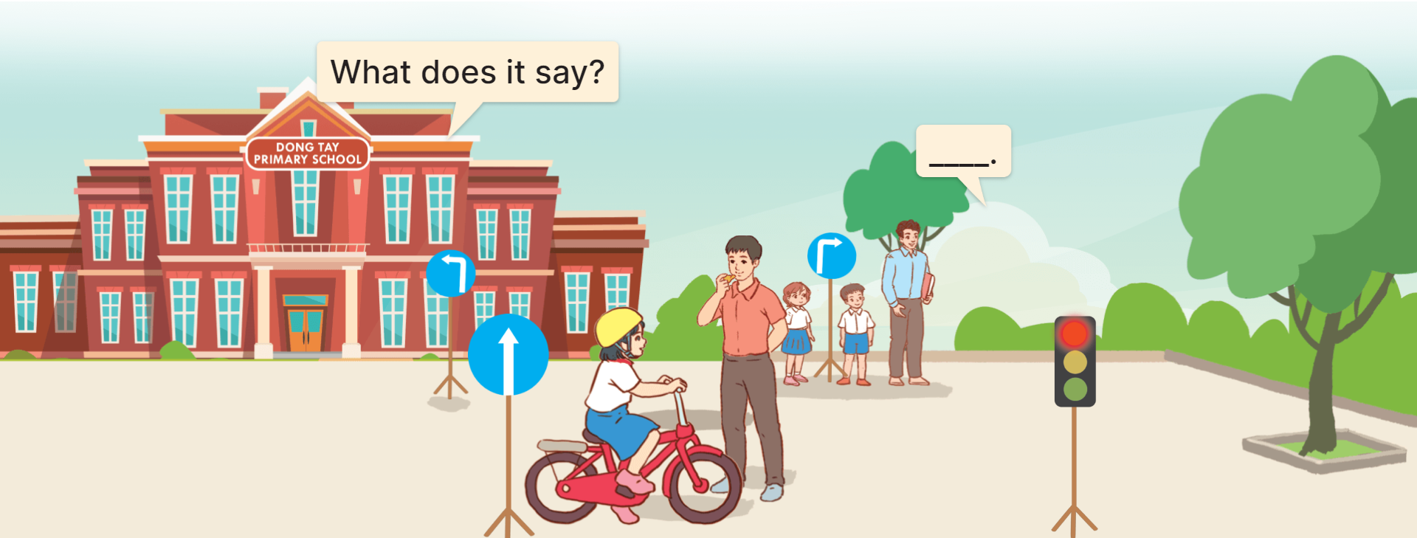
3. Let’s talk.

Slide 31
3. Let’s talk.
What does it say?
_______________.
It says ‘go straight’

Slide 32
3. Let’s talk.
What does it say?
It says ‘turn left’
______________.

Slide 33
3. Let’s talk.
What does it say?
It says ‘turn right’
______________.

Slide 34
3. Let’s talk.
What does it say?
__________.
It says ‘stop’

Slide 35

Facebook: Bùi Liễu
0968142780
Let’s play!

Slide 36

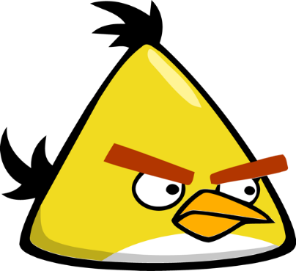



PLAY

Slide 37

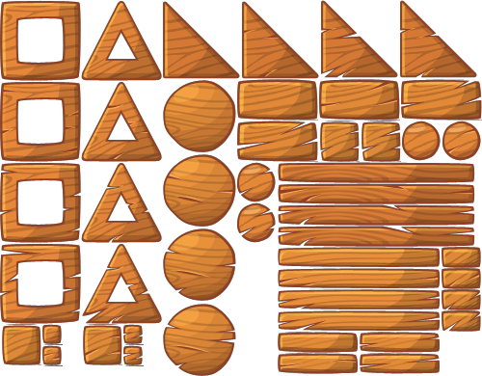





stop
A.
B.
A
B
Click on the pigs to choose.

Slide 38

road sign
A.
B.
A
B

Slide 39


turn left
A.
B.
A
B

Slide 40
A.
B.
A
B

Slide 41
A.
B.
A
B

Slide 42
turn ____
A
A. left
B. right
B

Slide 43
go _____
A. stop
B. straight
A
B

Slide 44
A:___________
B: It says ‘stop’.
A
A.
What does it say?
B.
Where do you live?
B

Slide 45

A.True
B.False

Slide 46

A: What does it say?
B: It says ‘turn left’.
A
A. True
B. False
B

Slide 47
Thank you!

Slide 48



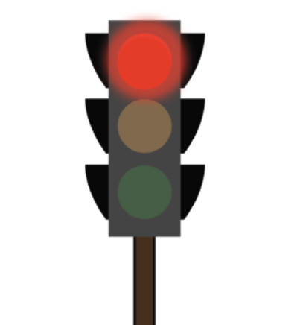





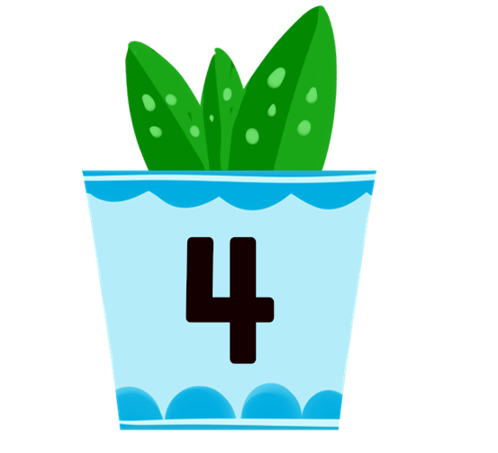
4. Listen and tick and cross.
1
2
3
4
Click on the speaker to listen.

Slide 49
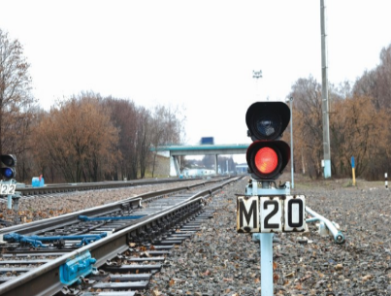
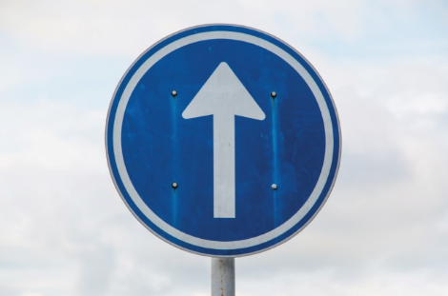
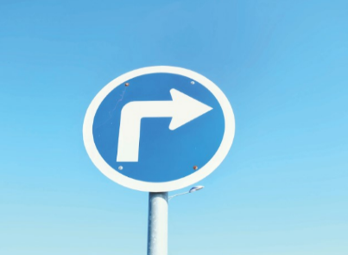

5. Look, complete and read.
1. A: What does it say?
B: It says ‘________’.
2. A: What does it say?
B: It says ‘__________’.
stop
go straight
3. A: _______ does it say?
B: It says ‘_________’.
What
4. A: What does it ______?
B: It says ‘________’.
say
turn right
turn left

Slide 50










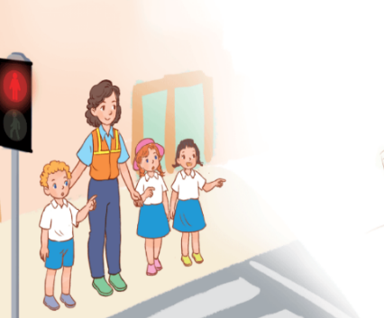

6. Let’s sing.
When I cross the road
When I cross the road,
When I cross the road,
I stop, look, listen and think.
I stop, look, listen and think.
The light is red. The light is red.
The light is green. The light is green.
What does it say?
What does it say?
It says ‘stop’, ‘stop’, ‘stop’.
It says ‘go’, ‘go’, ‘go’.

Slide 51
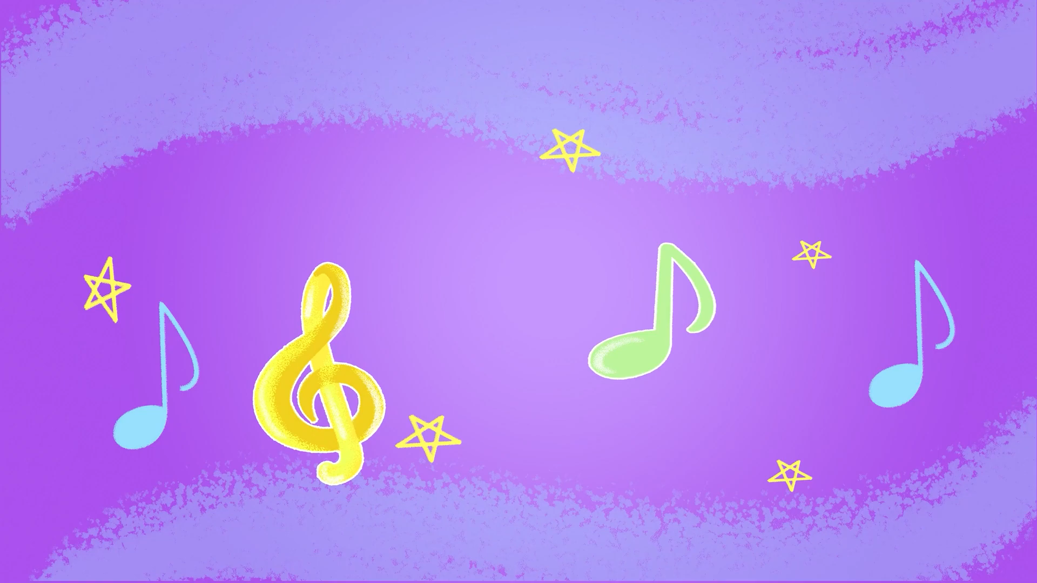
6. Let’s sing.

Slide 52


6. Let’s sing.
When I cross the road
When I cross the road,
When I cross the road,
I stop, look, listen and think.
I stop, look, listen and think.
The light is red. The light is red.
The light is green. The light is green.
What does it say?
What does it say?
It says ‘stop’, ‘stop’, ‘stop’.
It says ‘go’, ‘go’, ‘go’.

Slide 53

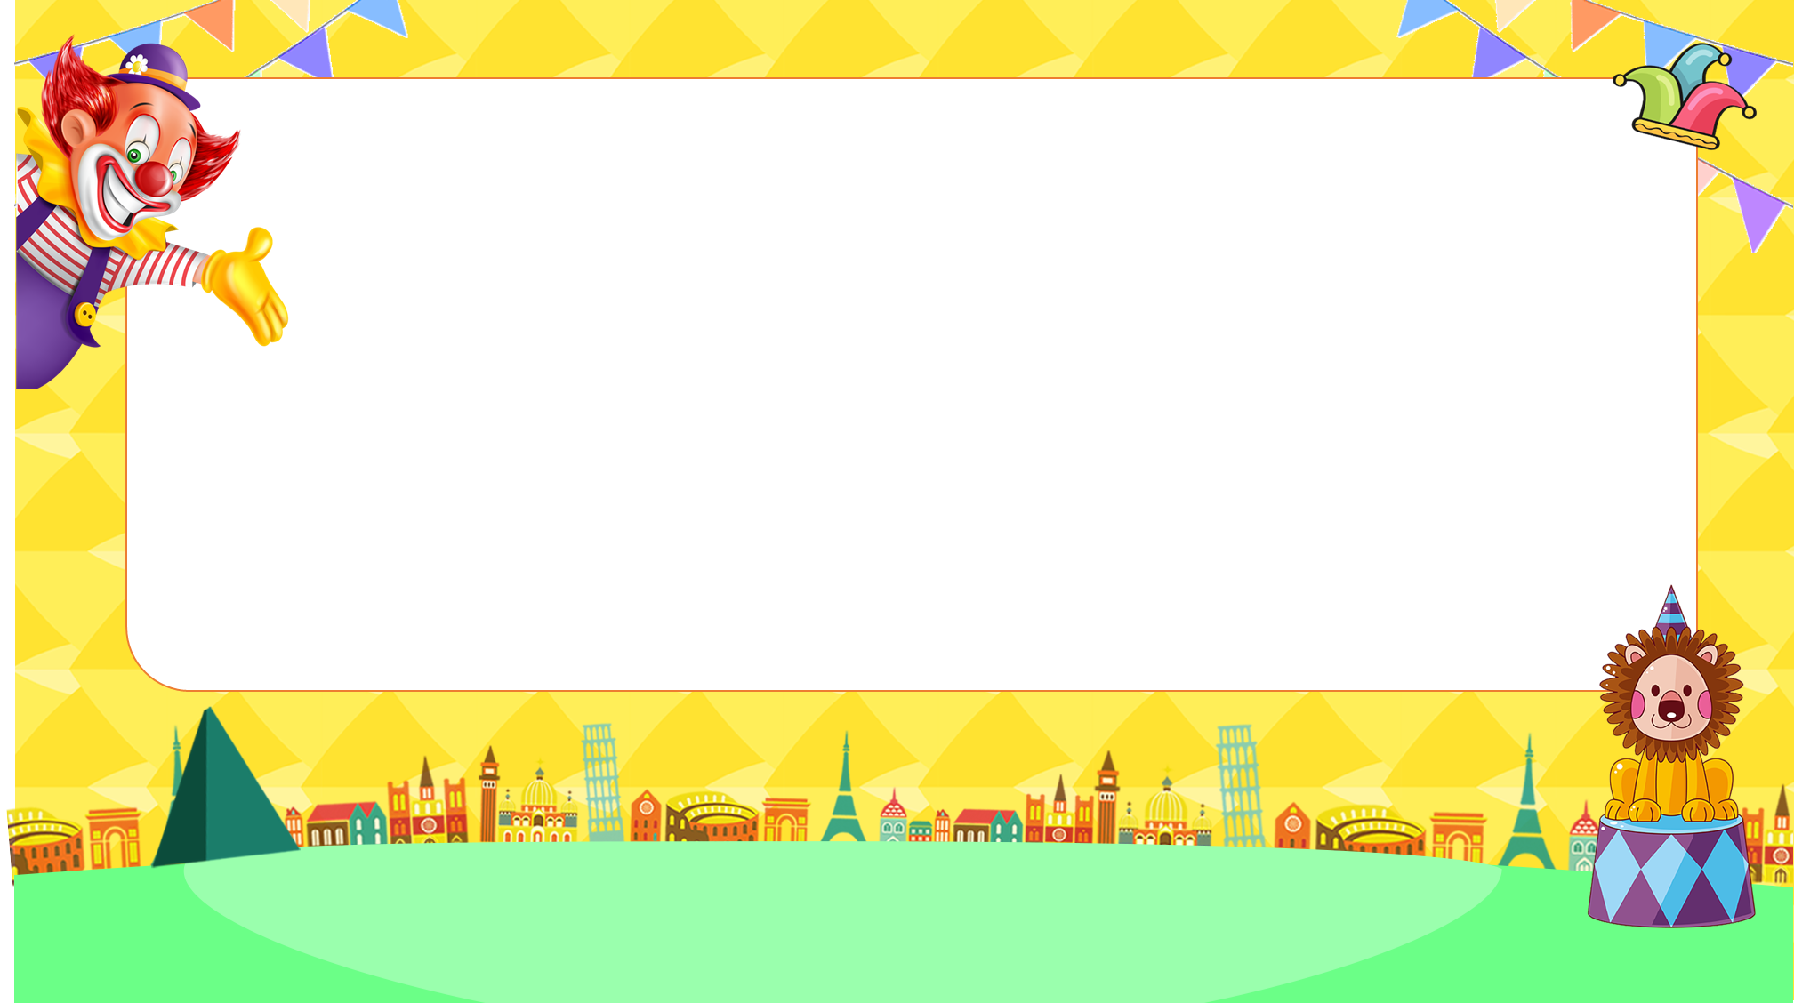
Let’s play!
PLAY

Slide 54

road sign
Answer
Next

Slide 55
A: What does it say?
B: _________.
It says ‘turn left’.
Answer
Next

Slide 56
A: What does it say?
B: _________.
It says ‘go straight’.
Answer
Next

Slide 57
Facebook: Bùi Liễu
0968142780
A: What does it say?
B: _________.
It says ‘stop’.
Answer
Next

Slide 58
A: What does it say?
B: _________.
It says ‘turn right’.
Answer
Next

Slide 59
A: _____ does it say?
B: It says ‘go straight’.
What
Answer
Next

Slide 60
Choose the odd one out.
(Chọn từ khác loại).
stop, go straight, road sign, turn left.
road sign
Answer
Next

Slide 61
A: ___________________.
B: It says ‘turn left’.
What does it say?
Answer
Next

Slide 62
Listen and choose True or False.
False
→ It says ‘go straight’.
Answer
Next

Slide 63
Listen and choose True or False.
True
exit
Answer

Slide 64
Great job!
s
EXIT

Slide 65
Wrap up

Slide 66
Review
What does it say?
It says ‘_______’.
stop
turn left
go straight
turn right

Slide 67
Homework
Learn by heart all the new words.
Read again the dialogue in part 1.

Slide 68

Thank you!

