Slide 1


Slide 2
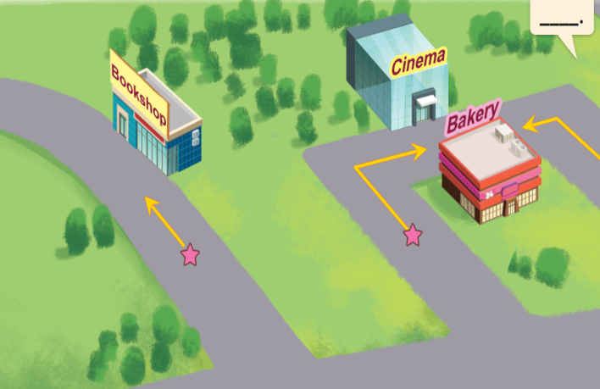
Monday, February 25th 2024
Unit 17
In the city
Lesson 2
Trong game có dùng “hyperlink” để liên kết các slide trong game. ThầY cô lưu ý mỗi khi thầy cô thêm hoặc xóa bớt slide trong bài này.

Slide 3
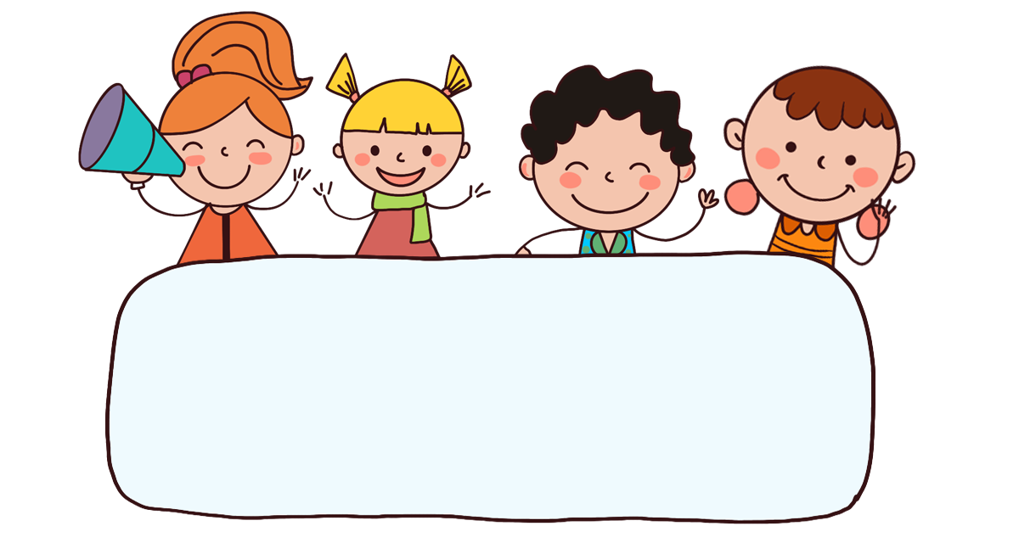
Warm-up

Slide 4

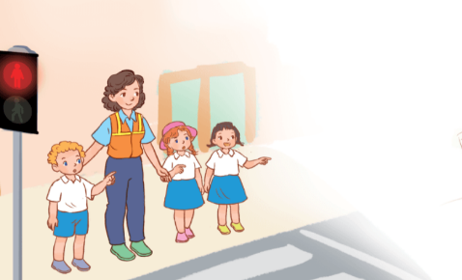

Let’s sing.
When I cross the road
When I cross the road,
When I cross the road,
I stop, look, listen and think.
I stop, look, listen and think.
The light is red. The light is red.
The light is green. The light is green.
What does it say?
What does it say?
It says ‘stop’, ‘stop’, ‘stop’.
It says ‘go’, ‘go’, ‘go’.

Slide 5






Contents
Look, listen and repeat.
Listen, point and say.
Let’s talk.
Listen and tick.
Look, complete and read.
Let’s play.

Slide 6

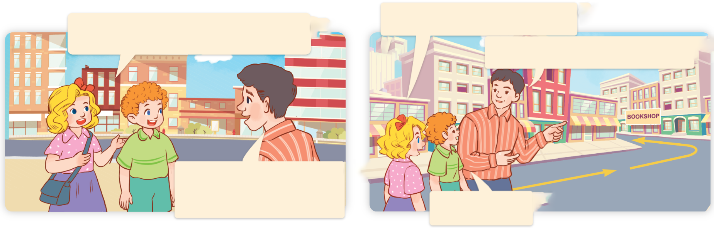
1. Look, listen and repeat.
How can we get there?
We want to buy some books.
a
b
Go straight and turn left.
There’s a bookshop in Hoa Binh Street.
Thank you.
What are they talking about?
Where are they?
Who are they?
Click on the speaker / sentences to listen.

Slide 7
Vocabulary

Slide 8
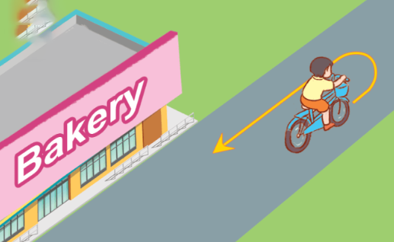
Vocabulary
turn round
/tɜːnˈraʊnd/
quay lại, đổi hướng ngược lại
Click on the English words to listen again.

Slide 9
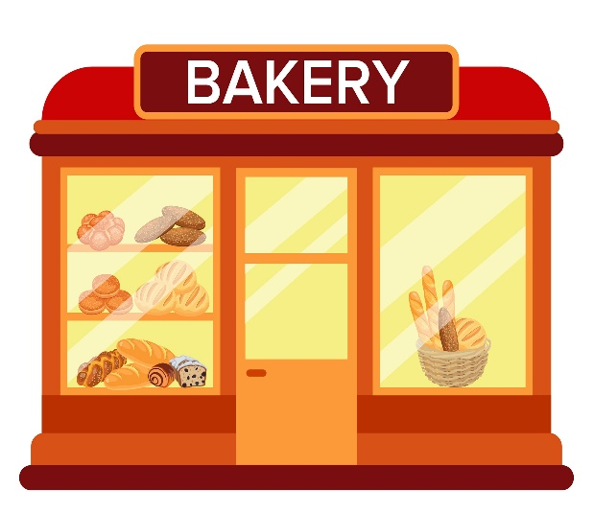
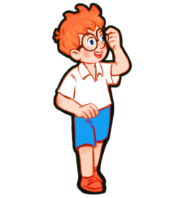
get (to)
/ɡet (tə)/
đến (địa điểm)

Slide 10
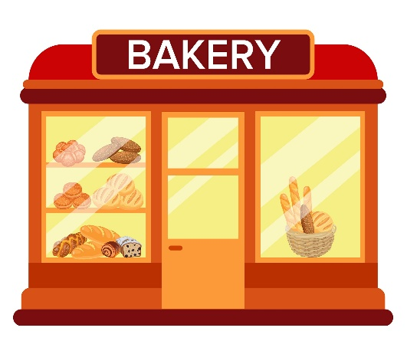

Review
get (to)
turn round

Slide 11
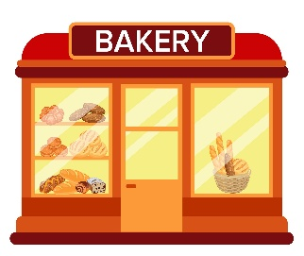

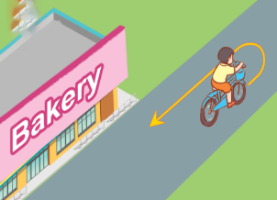
Vocabulary
1. get (to)
: đến (địa điểm)
2. turn round
: quay lại, đổi hướng
ngược lại

Slide 12
Match
turn left
rẽ phải
turn round
đến (địa điểm)
get (to)
rẽ trái
turn right
quay lại

Slide 13
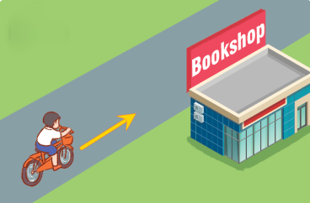
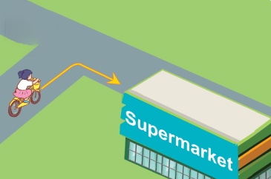
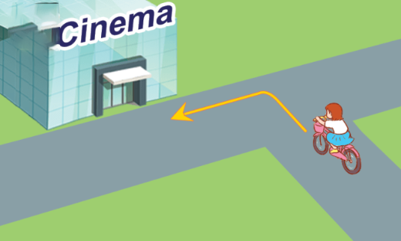
2. Listen, point and say.
a
b
How can I get to the _______?
go straight
turn right
c
d
________.
turn left
turn round

Slide 14


2. Listen, point and say.
a
How can I get to the _____?
________.
go straight
How can I get to the bookshop?
Go straight.
Click on the sentences to listen.

Slide 15


2. Listen, point and say.
b
How can I get to the _____?
________.
turn right
How can I get to the supermarket?
Turn right.

Slide 16
2. Listen, point and say.
c
How can I get to the _____?
________.
turn left
How can I get to the cinema?
Turn left.

Slide 17
2. Listen, point and say.
d
How can I get to the _____?
________.
turn round
How can I get to the bakery?
Turn round.

Slide 18
Structures

Slide 19




Cách hỏi bạn làm cách nào để đi tới một nơi:
How can I get to the ________?
( Mình có thể đi đến ______ bằng cách nào?)
___________.
Ex:
How can I get to the bookshop?
Go straight.

Slide 20


Unit 17 Lesson 2
How can I get to the _______?
__________.
go straight
turn round
turn right
turn left

Slide 21
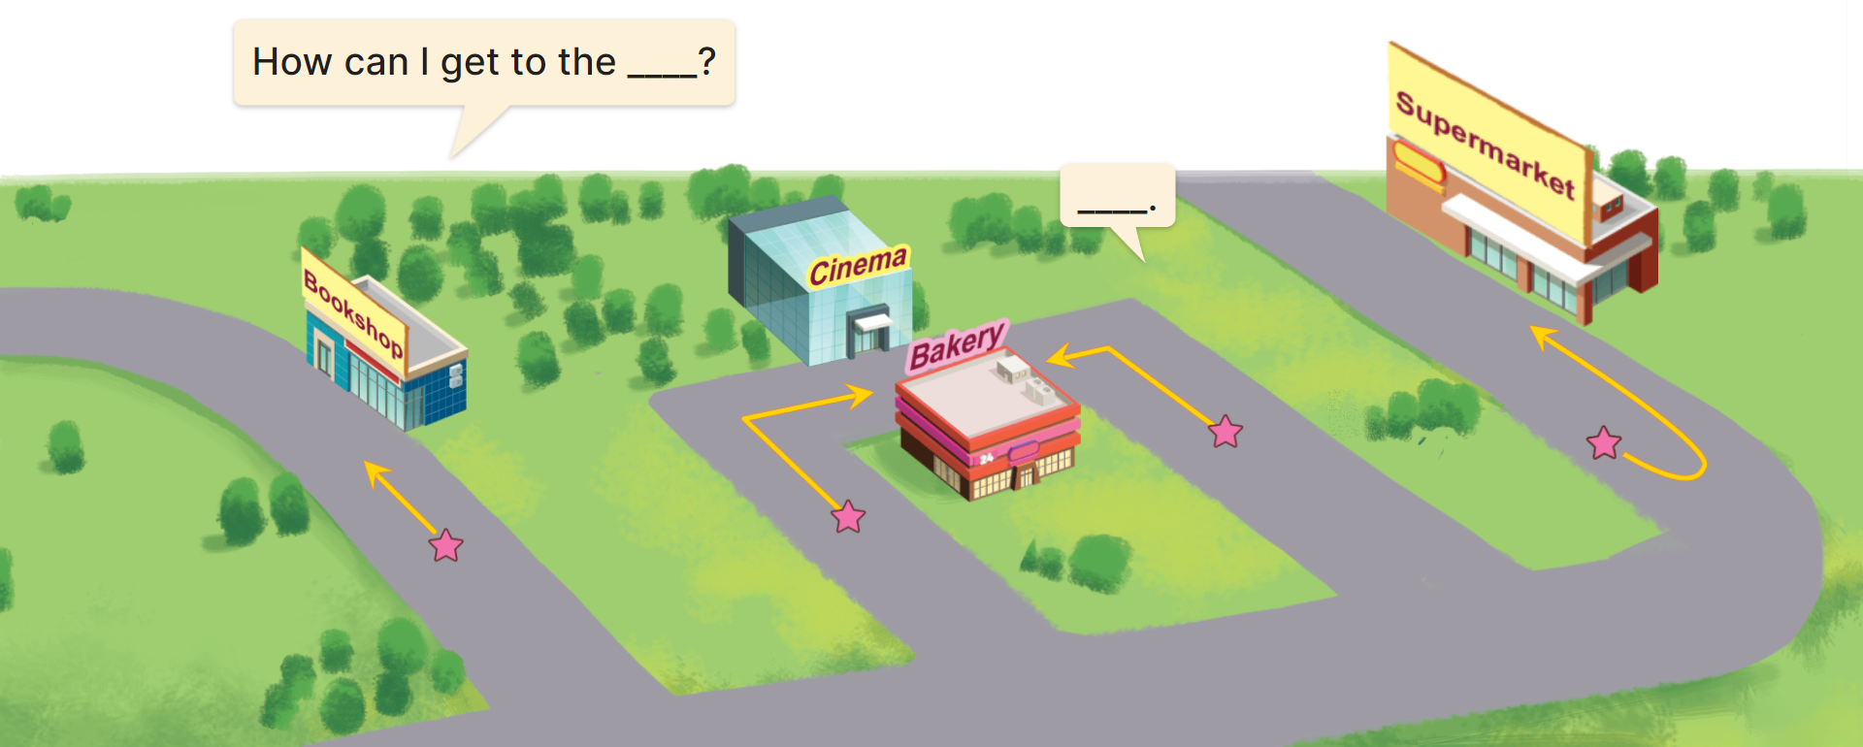
3. Let’s talk.
How can I get to the __________?
__________.

Slide 22
3. Let’s talk.
How can I get to the __________?
bookshop
__________.
Go straight

Slide 23
3. Let’s talk.
How can I get to the _______?
cinema
Turn right
_________.

Slide 24
3. Let’s talk.
How can I get to the _______?
bakery
________.
Turn left

Slide 25
3. Let’s talk.
How can I get to the ___________?
supermarket
__________.
Turn round

Slide 26


Let’s play!

Slide 27


Choose the right answer.
Click the clock to start the timer.
1/10
A
go straight
B
turn left
C
turn round
Next

Slide 28
Click the clock to start the timer.
2/10
A
go straight
B
turn right
C
turn left
Next

Slide 29
Click the clock to start the timer.
3/10
Choose the odd one out.
A
turn right
B
turn round
C
go straight
Next

Slide 30
4/10
Click the clock to start the timer.
A
turn round
B
turn left
C
turn right
Next
Click on the words/sentences to choose.

Slide 31
5/10
Click the clock to start the timer.
Mai: How can I _____ the bookshop?
Nam: Go straight and turn left.
A
turn round
B
get to
C
go straight
Next

Slide 32
6/10
Click the clock to start the timer.
Mai: ____ can I get to the bakery?
Nam: Turn round.
A
What
B
Where
C
How
Next

Slide 33
7/10
Click the clock to start the timer.
Choose the odd one out.
A
road sign
B
turn round
C
turn left
Next

Slide 34
8/10
Click the clock to start the timer.
Choose the odd one out.
A
big
B
get to
C
slim
Next

Slide 35
9/10
Click the clock to start the timer.
Lucy: How can I get to the supermarket?
Minh: Turn round.
A
True
B
False
→ Turn right.
Next

Slide 36

10/10
Click the clock to start the timer.
A
True
B
False

Slide 37
Facebook : Bùi Liễu
0968142780
Good job!

Slide 38


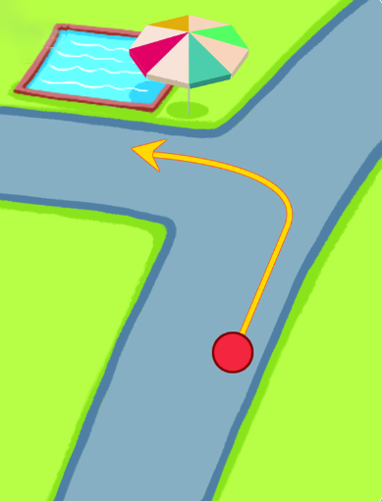
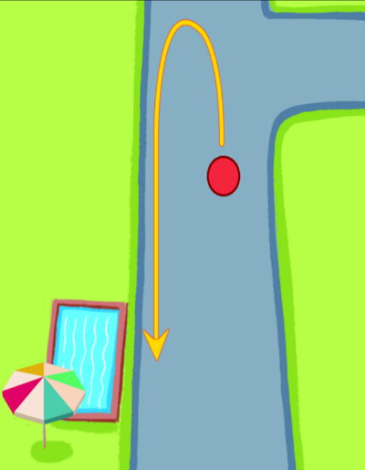
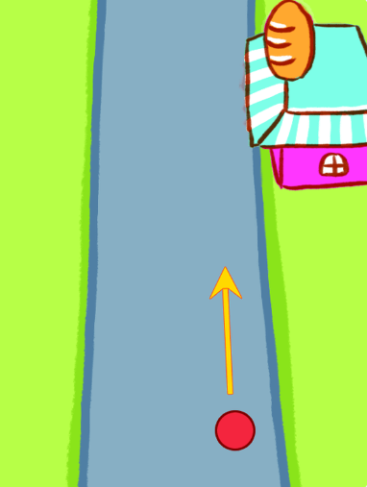
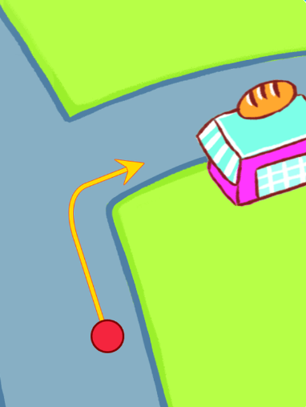

4. Listen and tick.
1.
2.
a
b
a
b
Click on the speaker to listen.

Slide 39
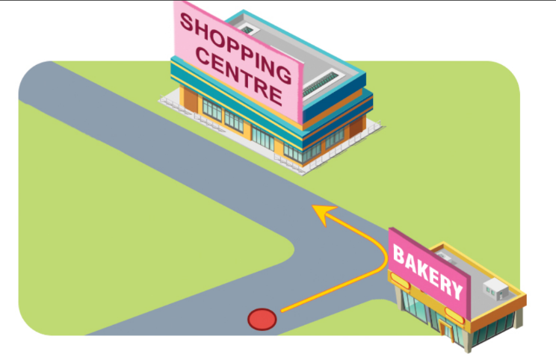
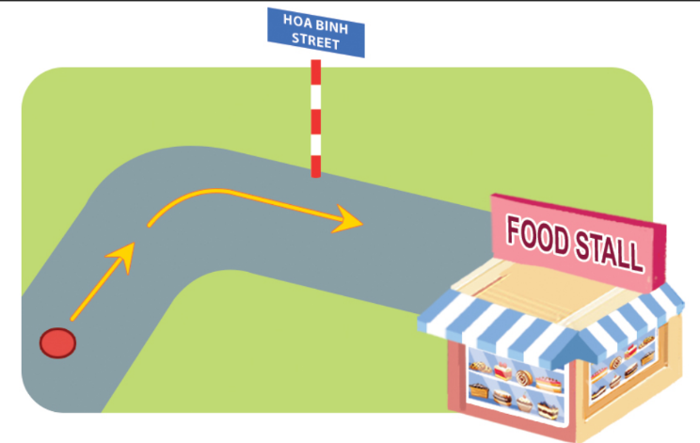
5. Look, complete and read.
1.
A: Excuse me. How can I get to the
shopping centre?
B: The sports centre or the shopping centre?
A: _______________.
B: Turn _______ at the bakery.
A: Thank you very much.
Shopping centre
left
2.
A: Excuse me. Is there a food stall near
here?
B: There’s a food stall on Hoa Binh Street.
A: _______ can I get there?
B: Go straight and turn _______.
A: Thank you very much for your help.
How
right

Slide 40
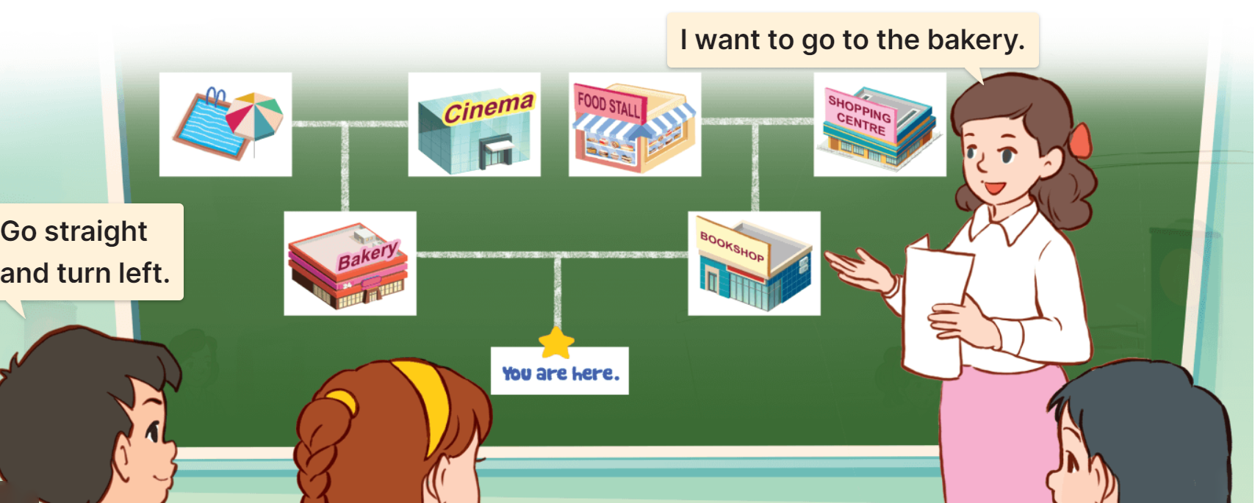
6. Let’s play.
Show me the way

Slide 41
Let’s play!

Slide 42




- Nhấn vào “spin” để quay, nhấn vào mũi tên đỏ để dừng. Sau đó chọn câu hỏi.
Lucky wheel
30
20
1
2
3
40
10
50
80
4
5
6
60
70
7
8
9
Spin

Slide 43






A: How can I get to the supermarket?
B: _______________
A. Turn right.
B. Turn left.
C. Turn round.
D. Go straight.
BACK

Slide 44
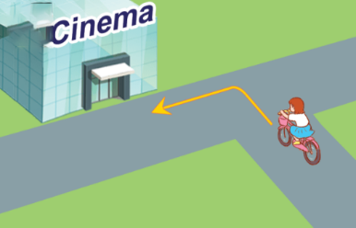



A: How can I get to the cinema?
B: _______________
A. Turn right.
B. Turn left.
C. Go straight.
D. Turn round.
BACK

Slide 45



A: How can I get to the bakery?
B: _______________
A. Turn round.
B. Turn right.
C. Turn left.
D. Go straight.
BACK

Slide 46





A.
B.
C.
D.
BACK

Slide 47


A.
B.
C.
D.
BACK

Slide 48


_____ can I get to the bookshop?
A. What
B. Why
C. How
D. Where
BACK

Slide 49
Chose the odd one out.
A. right
B. turn round
C. straight
D. left
BACK

Slide 50


→ Turn left.
A. True
B. False
BACK

Slide 51


A. True
B. False
QUAY VỀ

Slide 52
Well done!

Slide 53
Wrap up

Slide 54
Review
How can I get to the _______?
__________.
go straight
turn round
turn right
turn left

Slide 55
Homework
Learn by heart all the new words.
Read again the dialogue in part 1.

Slide 56

Thank you!

