Slide 1





Slide 2


Hoa Thach A primary school
Warmly welcome Teachers to our class 4B
Teacher: Nguyen Thi Phuong

Slide 3



Slide 4
Saturday, October 21st 2023
UNIT 4. MY BIRTHDAY PARTY
Lesson 3: 4.5.6 (page 33)

Slide 5
I. Revision
Play a game

Slide 6
My name’s Bill, I’m from Britain.
I am nine, how about you?
My birthday is coming soon.
What do you want to eat and drink?
My birthday is in April.
There’re some chips and some lemonade.
What about you ? When’s your birthday?
What do you want to eat and drink?

Slide 7
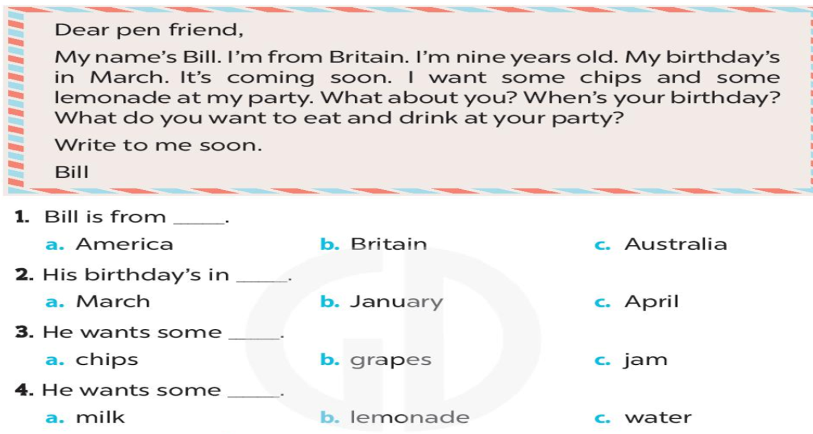
II. Practice
4. Read and circle.

Slide 8
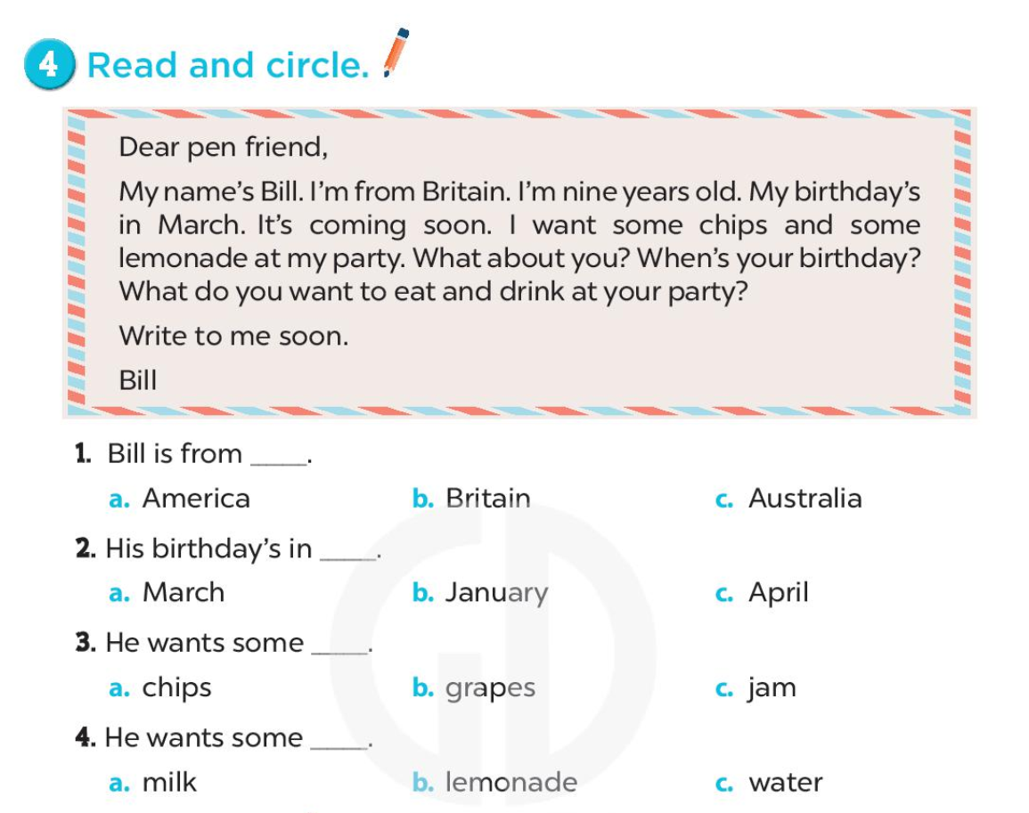

Slide 9
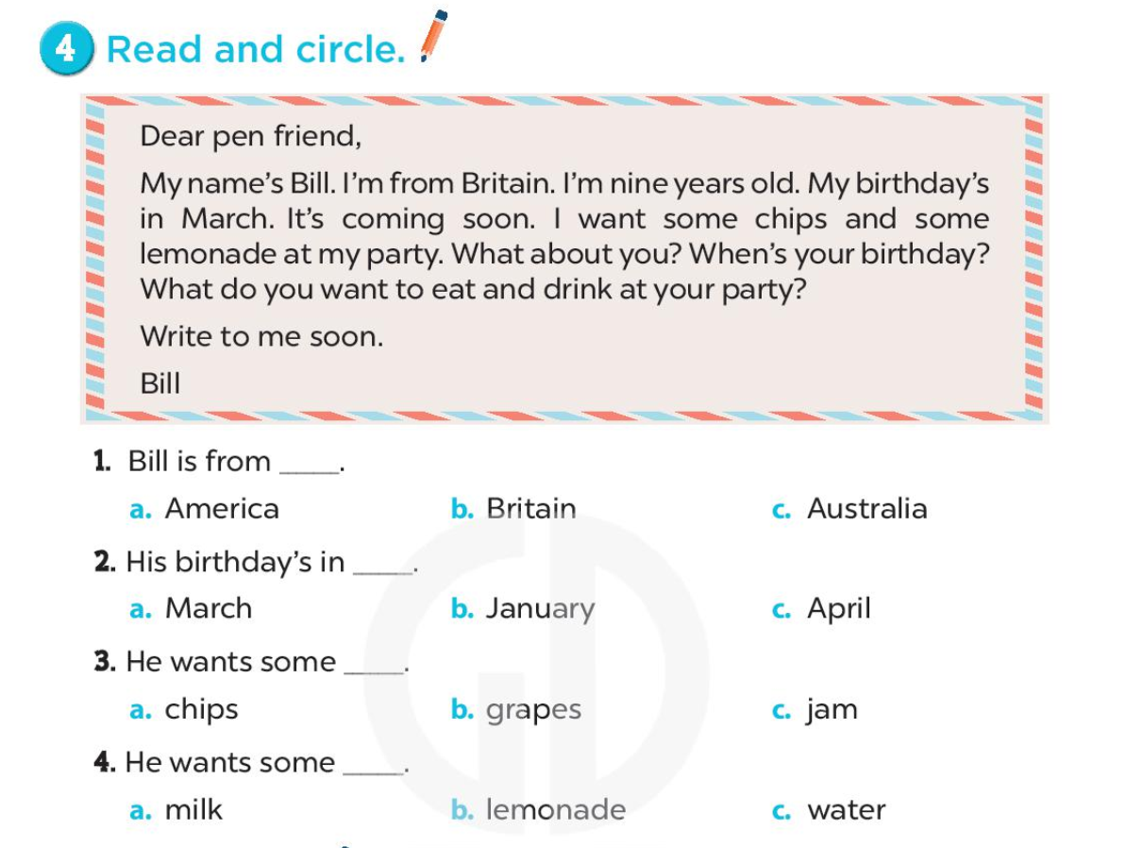
Check

Slide 10
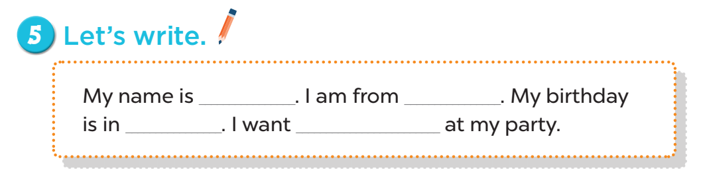

Slide 11
My name is ____.
Phuong

Slide 12
I am from ________.
Ha Noi
Viet Nam

Slide 13
My birthday is in ___.
January February March
April May June July
August September October November December

Slide 14


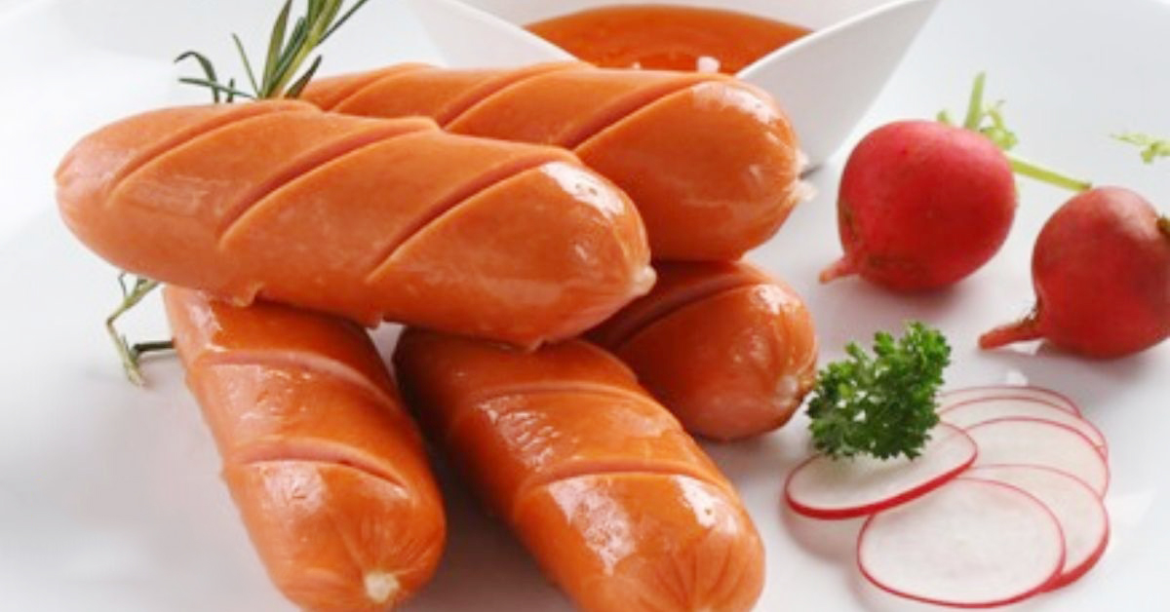
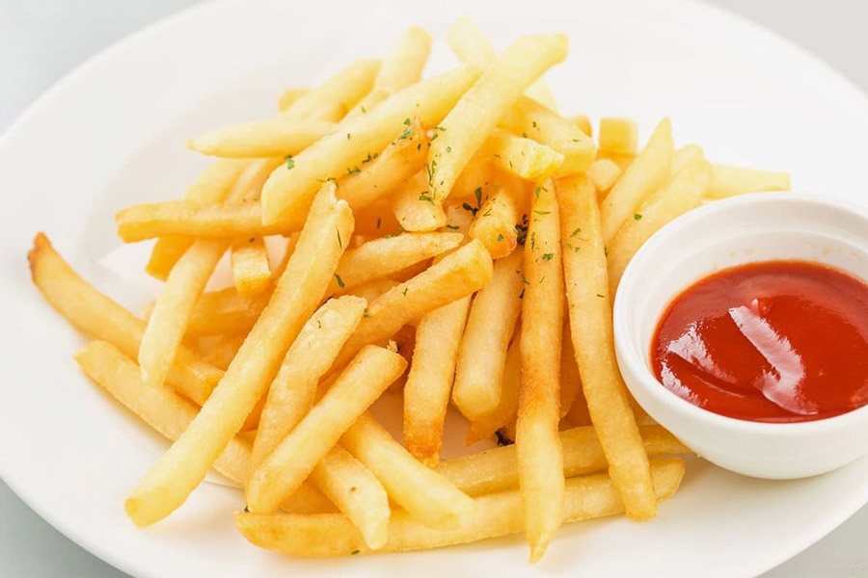
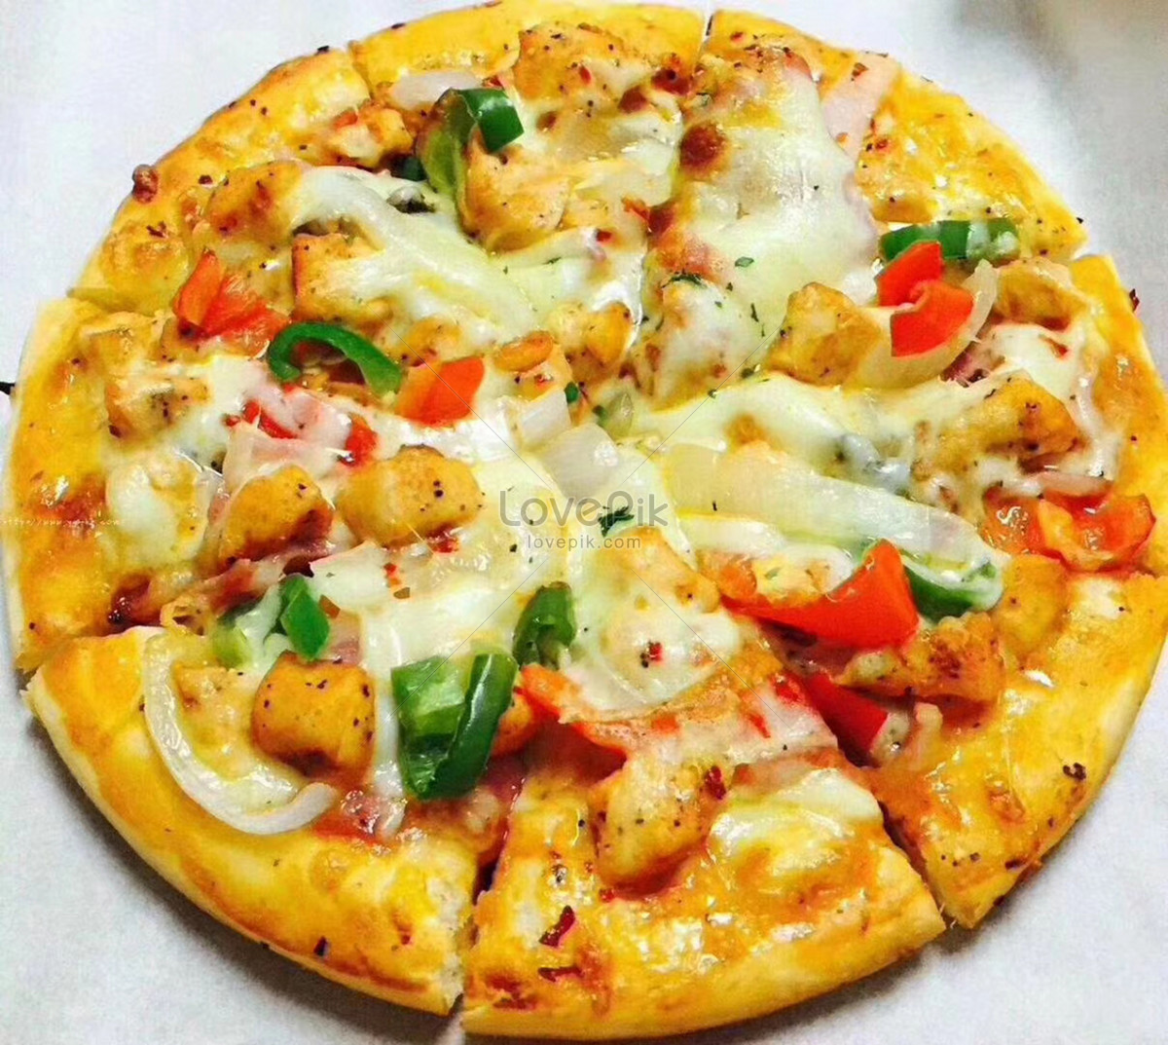
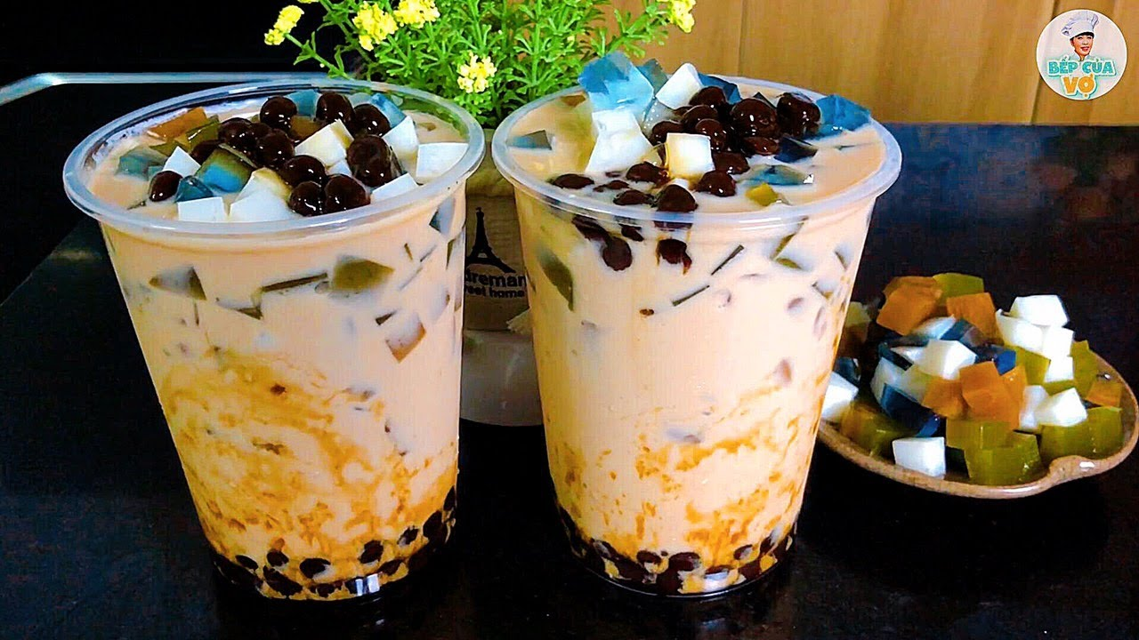

I want ___ at my party.
and
: lemonade, water, milk tea, orange juice, coffee, tea…
drink
Unhealthy food and drink, don’t use too much

Slide 15
Time to write.

Slide 16
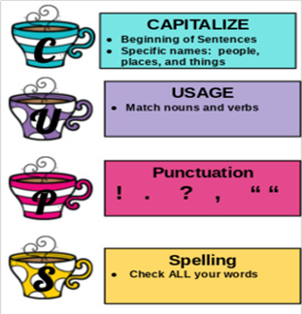

Time to check your writing.
(Self-check
and
peer check)

Slide 17
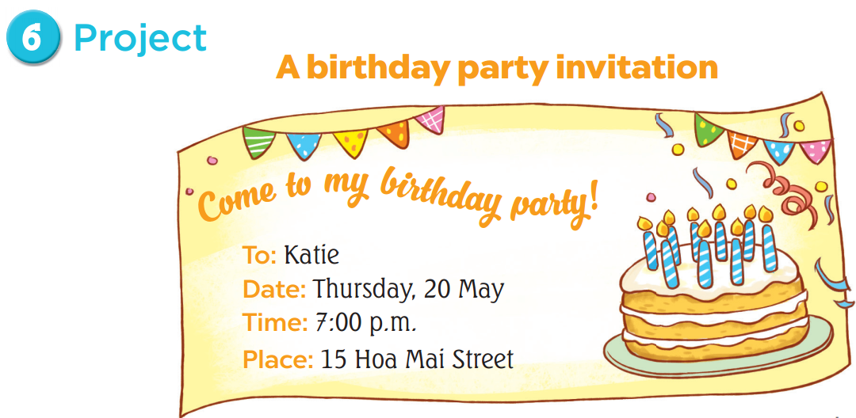

Slide 18
Good morning everyone!
My name’s…………..
Now, I’m going to tell you about my birthday party invitation
………………………..................................................................................
…………………………………….....................................................................
Thanks for your listening!

Slide 19
Work in your team.

Slide 20
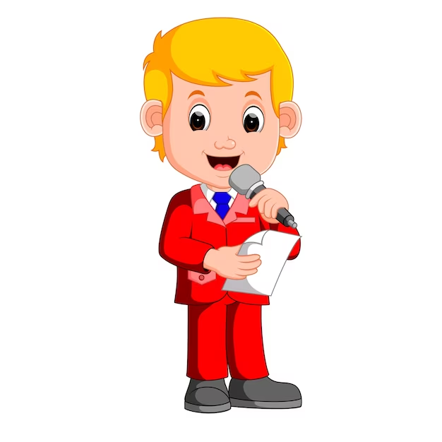
Who’s the best presenter ?

Slide 21
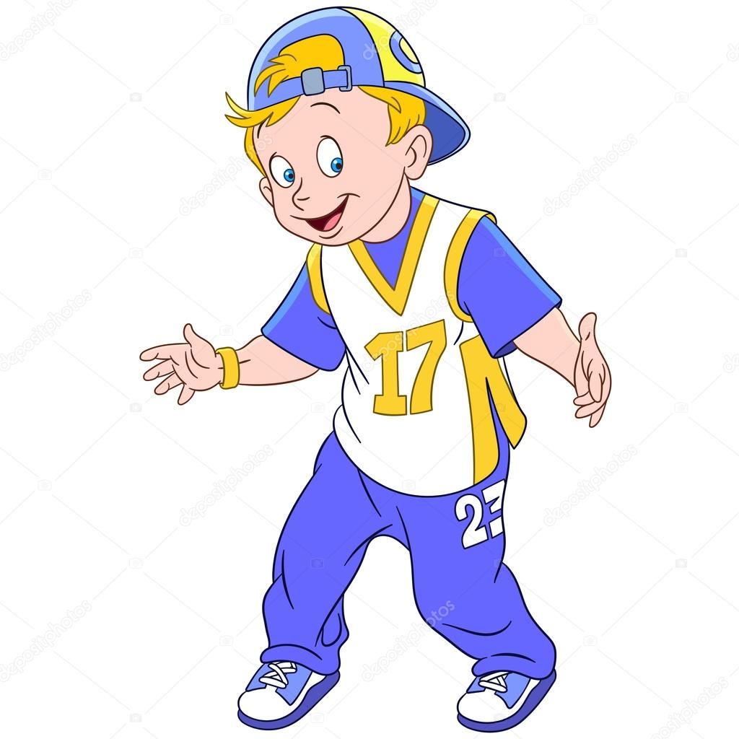
Who can be a Rapper ?

Slide 22

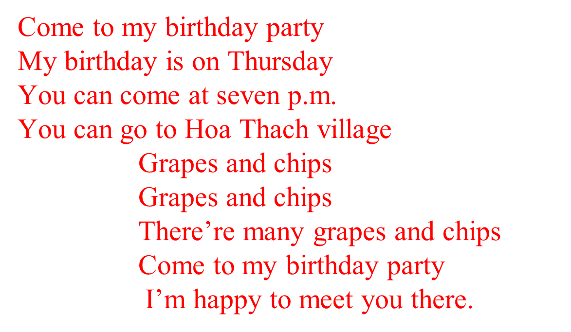
Who can be a singer ?

Slide 23

Today I:
- Read
- Write
- Speak
about birthday party.

Slide 24
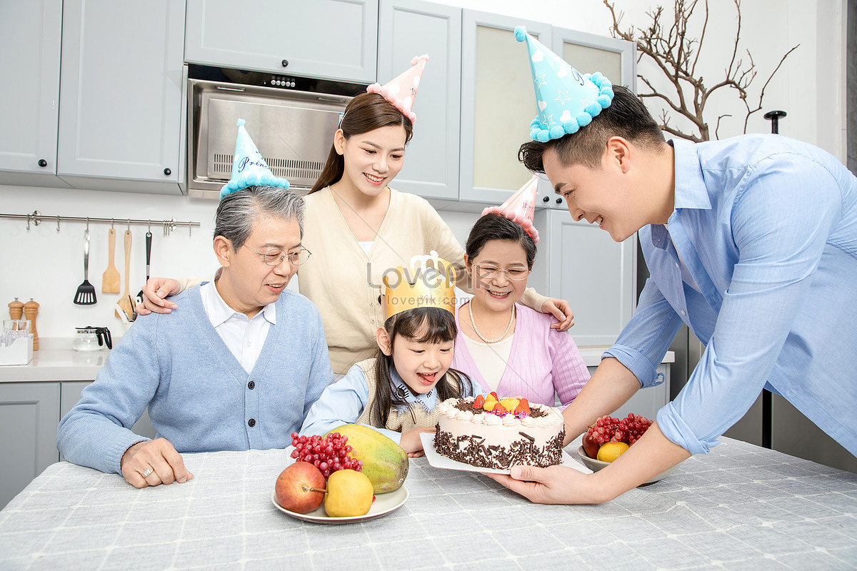
Birthday party is time for family reunion

Slide 25

Love and respect your parents

Slide 26
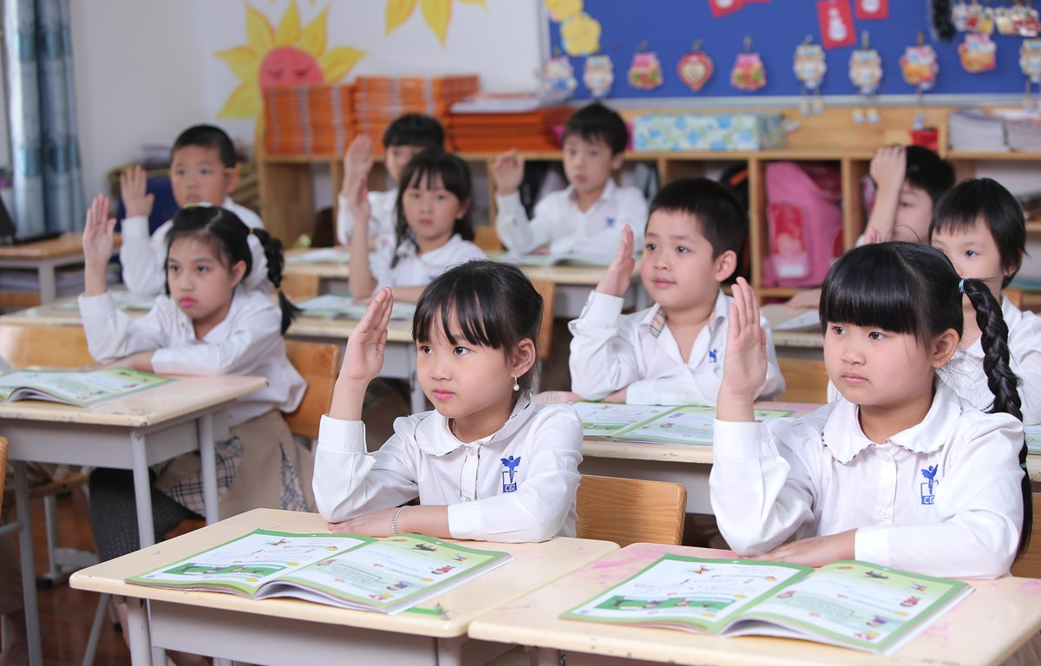
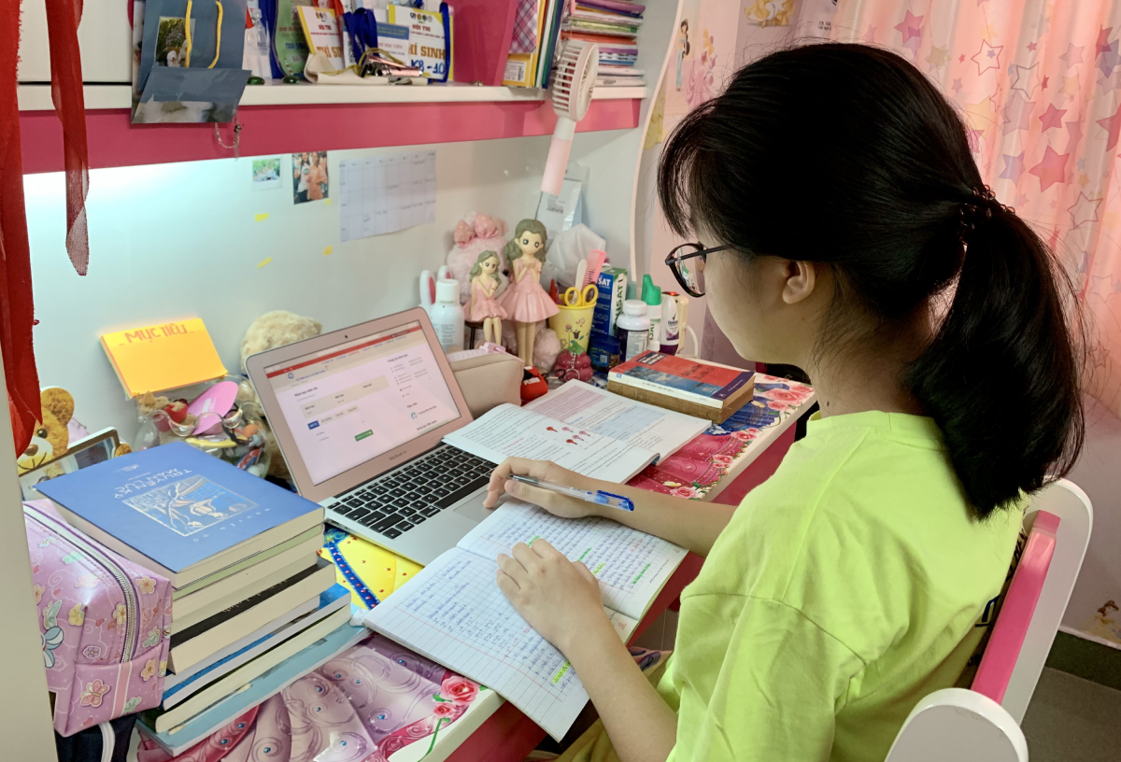
Become a studious student

Slide 27
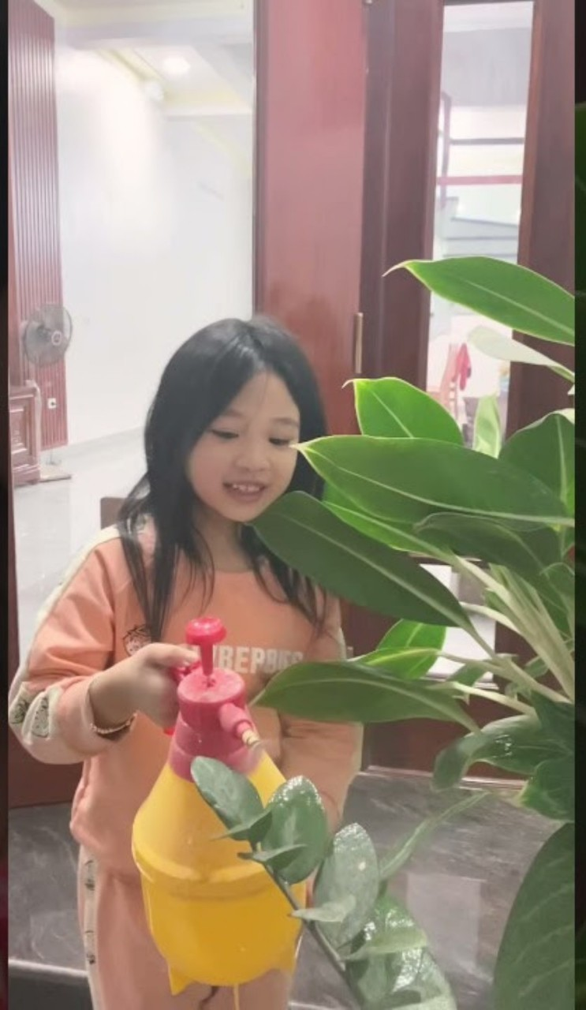
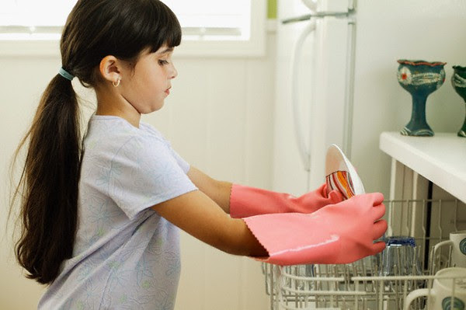
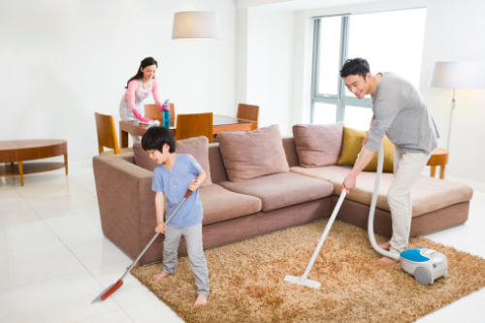
Help your parents with housework

Slide 28
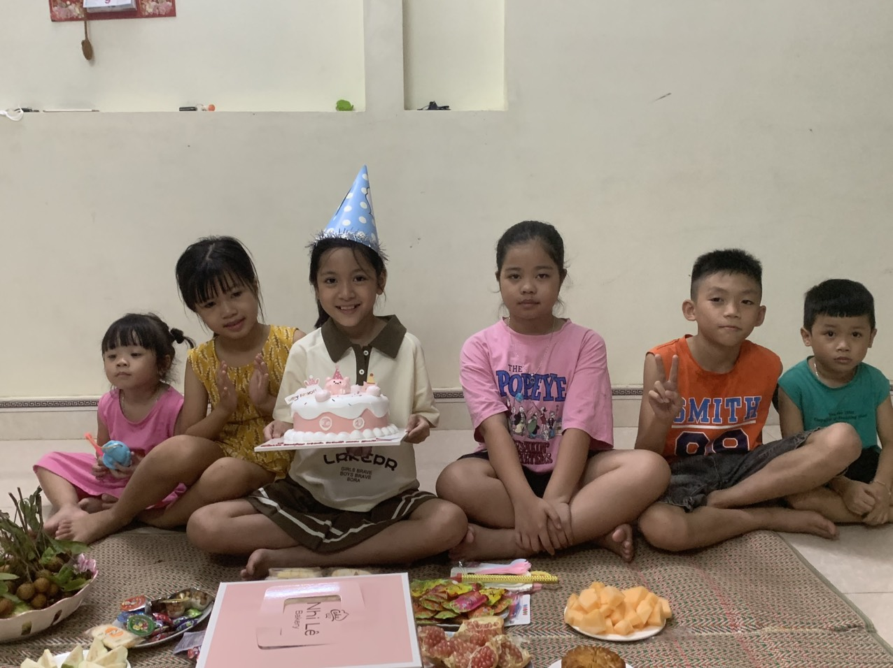
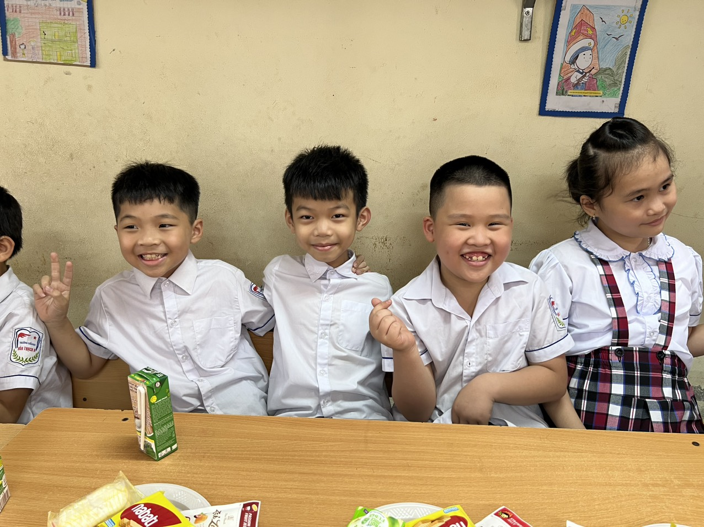
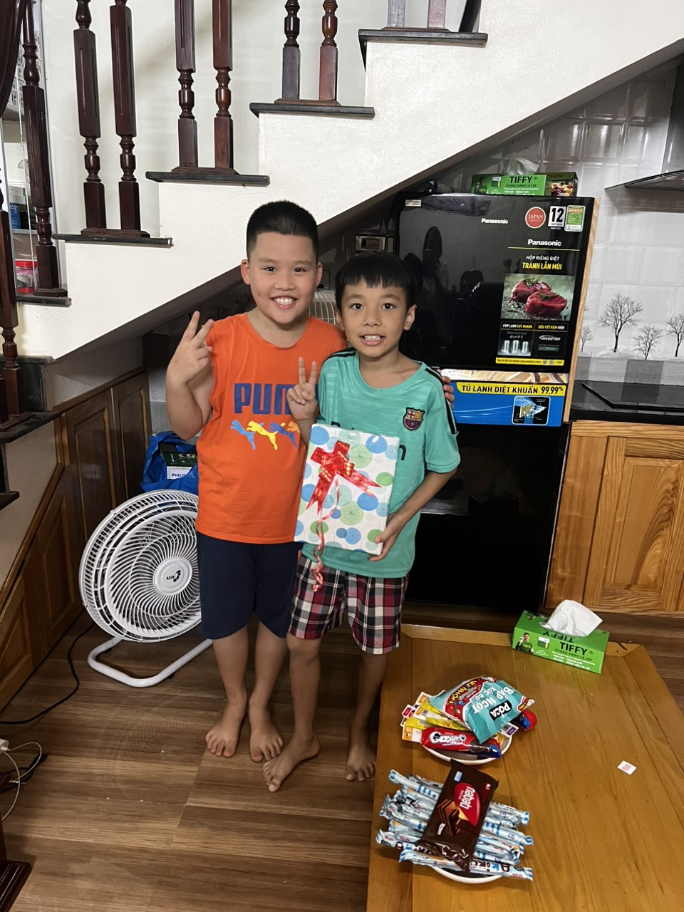
Birthday is also time for friends.
- Show kindness in inviting friends to your birthday party
- Offer your friends food and drink they want

Slide 29
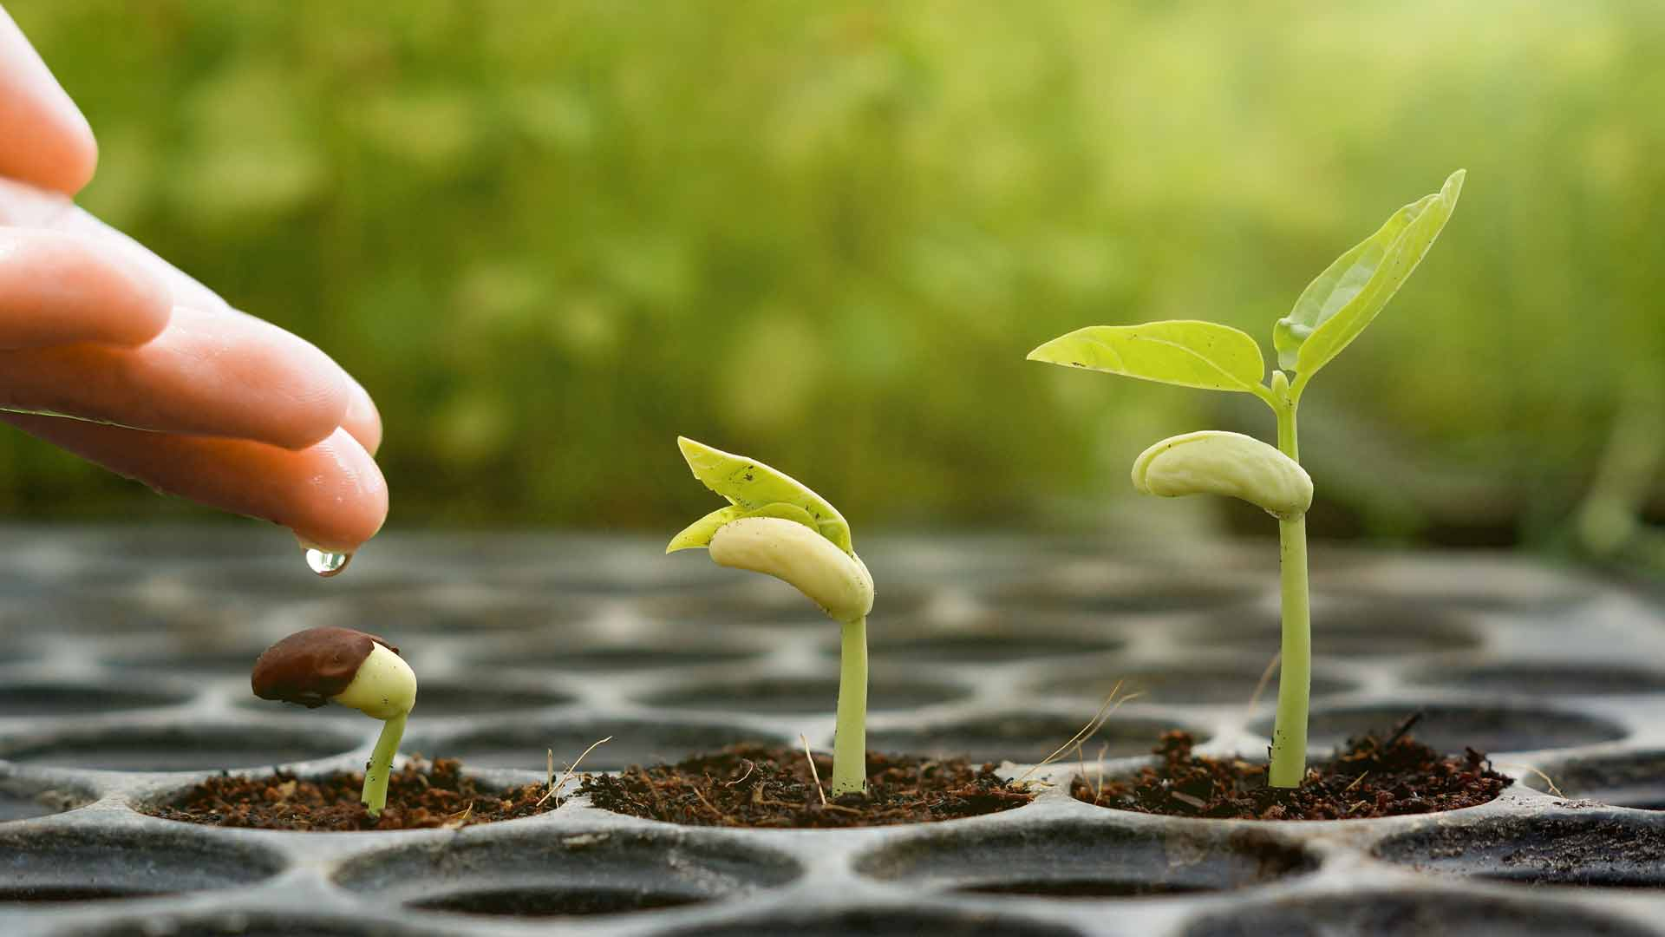
Be positive.
Love your family.
Be kind to everyone.

Slide 30
Homelink:
- Video 5 of your recent birthday photos
- Complete the exercise in workbook of unit 4
- Prepare for the next lesson unit 5. lesson 1 (1.2.3)

