Slide 1


Slide 2


Slide 3
Memory game

Slide 4

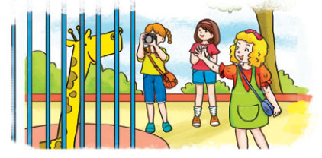
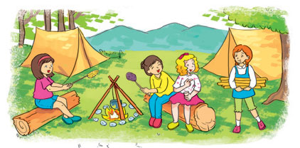

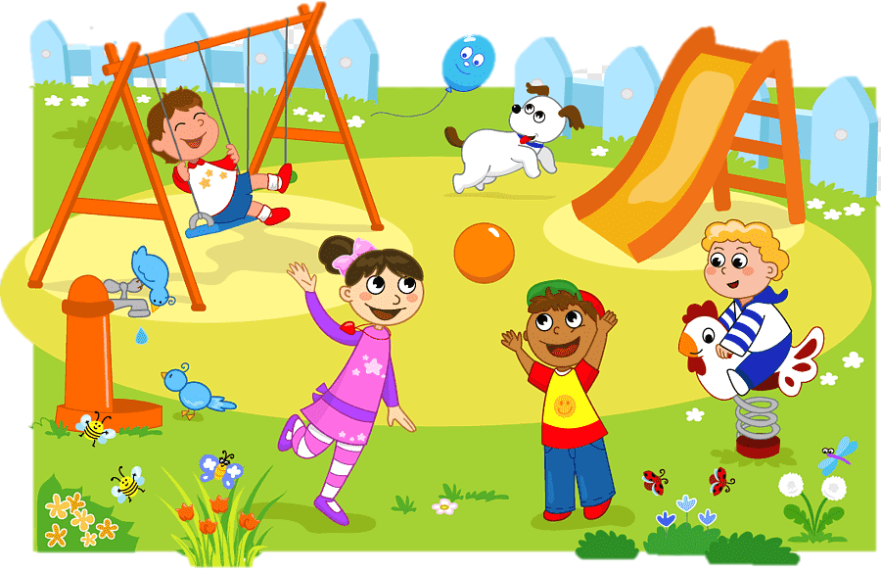

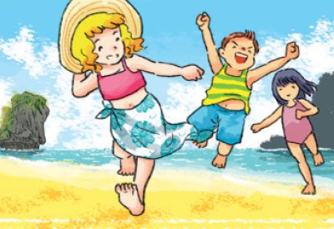
Places
1
2
3
10
1
2
3
4
5
6
7
8
9
Time’s up
at the zoo
in the mountain
at home
4
5
6
in the park
on the beach
in the library

Slide 5
Memory game

Slide 6
Unit 5
Where will you do
this weekend?
Lesson 1

Slide 7
Vocabulary

Slide 8
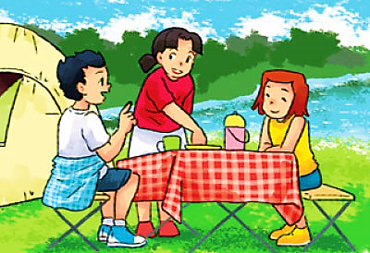
A. Vocabulary
in the countryside
Ở nông thôn

Slide 9
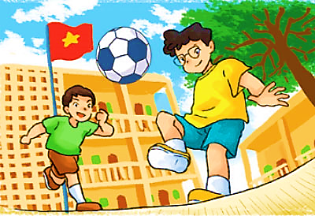
A. Vocabulary
at school
Ở trường

Slide 10
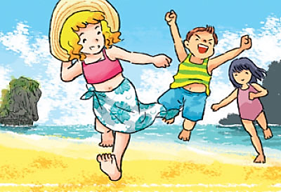
A. Vocabulary
on the beach
Ở trên bãi biển

Slide 11

A. Vocabulary
by the sea
Ở gần biển

Slide 12

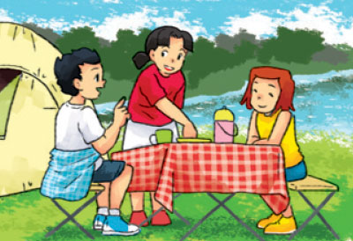
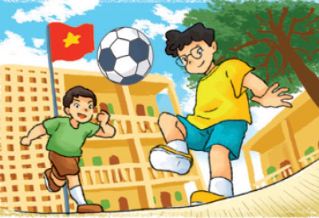

A. Vocabulary
in the country side
at school
on the beach
by the sea

Slide 13
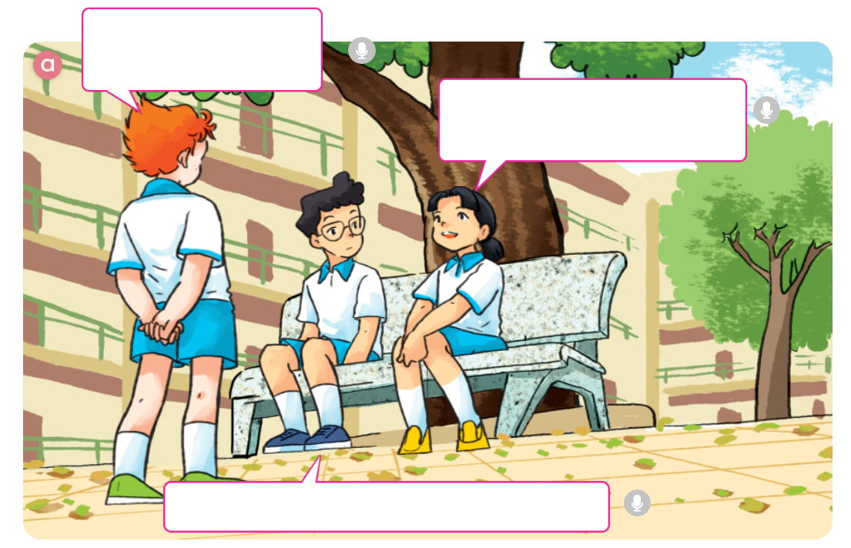
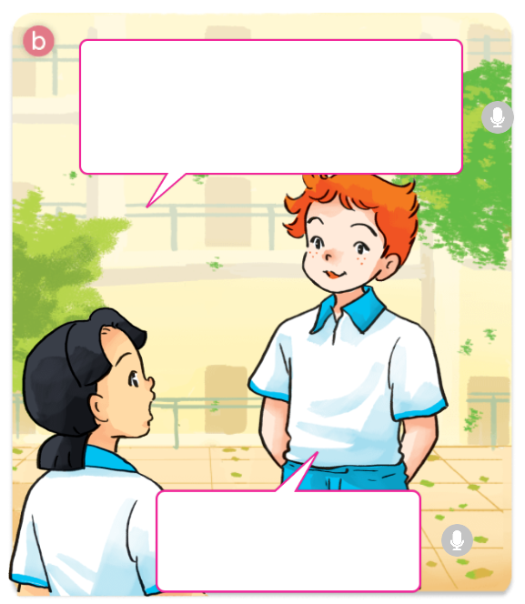
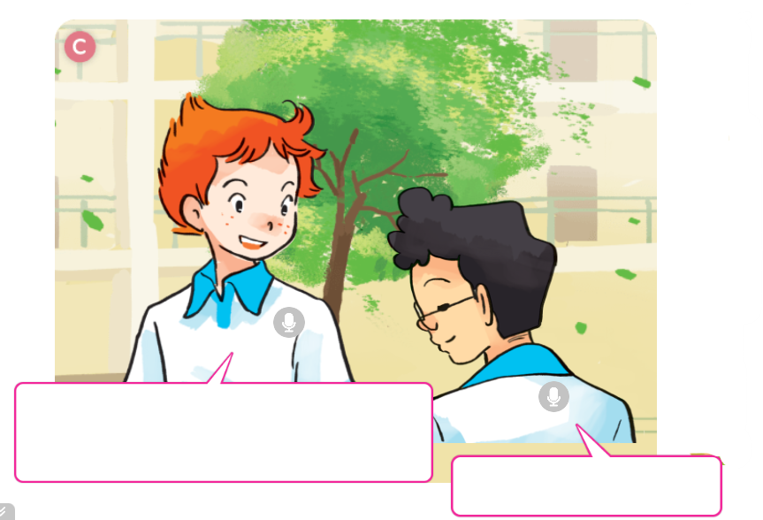
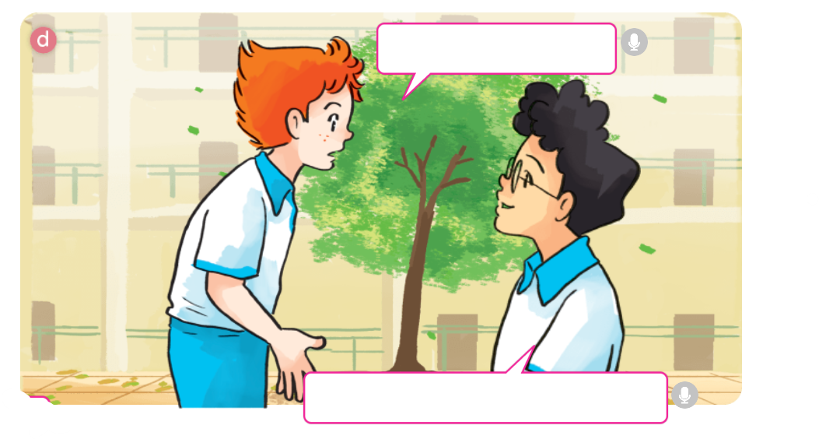

1. Look, listen and repeat

Slide 14
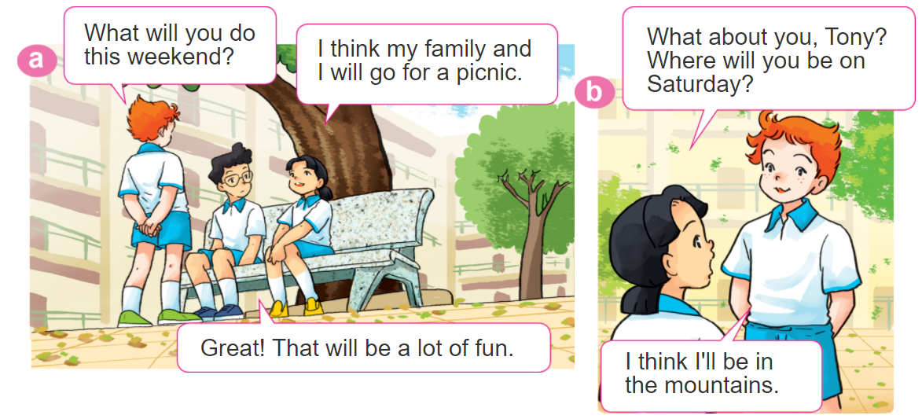
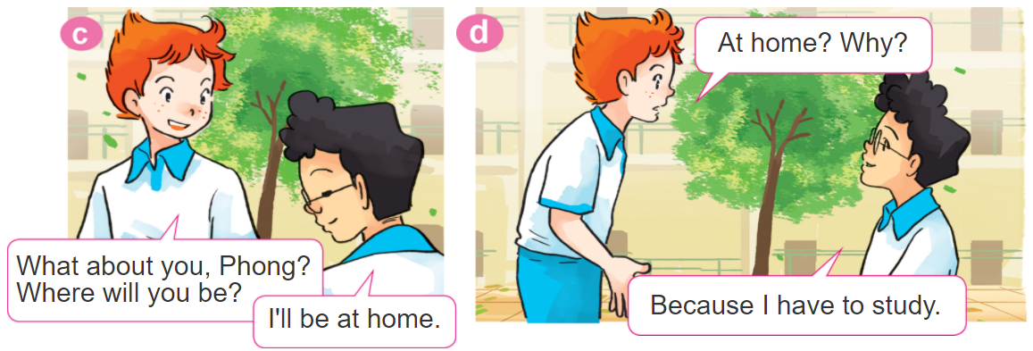
1. Look, listen and repeat

Slide 15
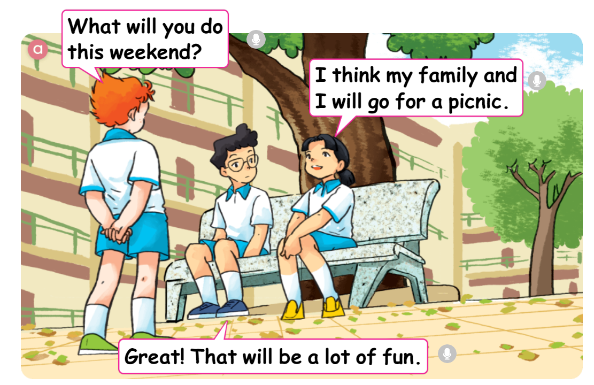
1. Look, listen and repeat

Slide 16
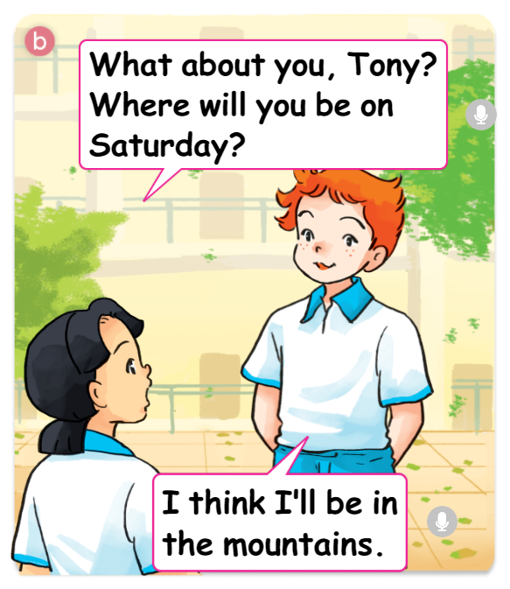
1. Look, listen and repeat

Slide 17
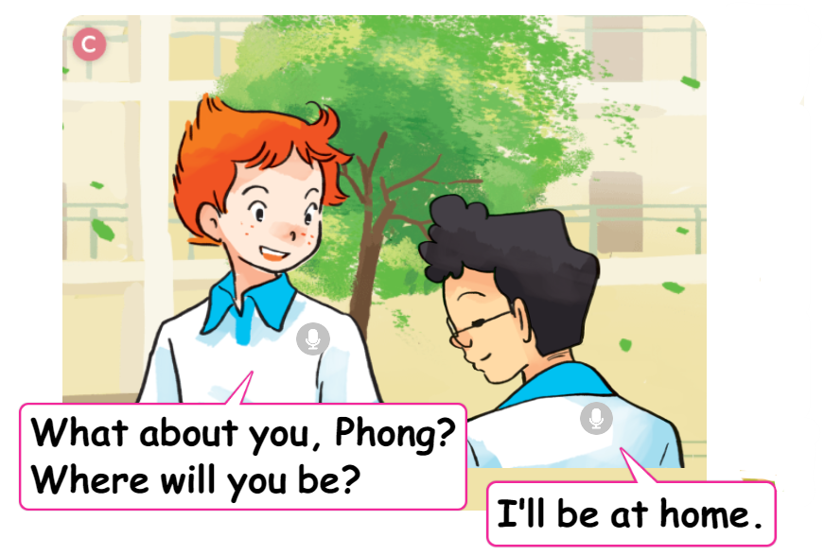
1. Look, listen and repeat

Slide 18
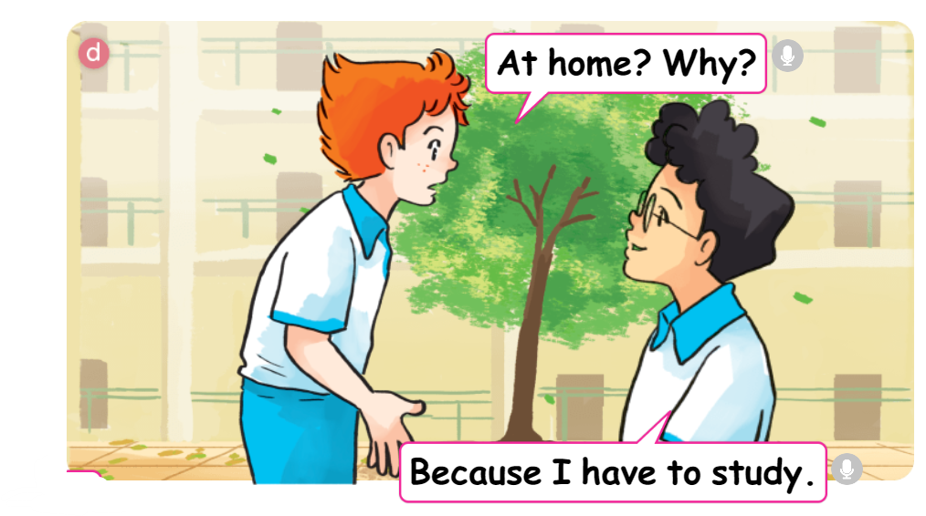
1. Look, listen and repeat

Slide 19
1. Look, listen and repeat

Slide 20

Weekend

Slide 21
Sentence pattern
https://media3.giphy.com/media/osjgQPWRx3cac/giphy.gif?cid=6c09b9527y6is5tllihm1nhi45jkf8jesdys9p5v2u0745ik&ep=v1_gifs_search&rid=giphy.gif&ct=g

Slide 22
Sentence pattern
Where will you be this weekend?
I think I’ll be in the mountain.
➔ I’ll = I will

Slide 23
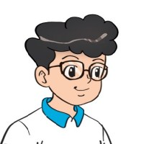
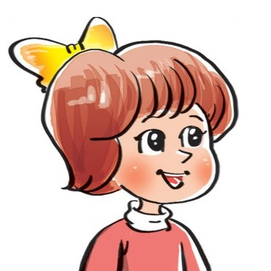
2. Point and say
Where will you be this weekend?
I think I'll be ____________.
in the
countryside
by the sea
on the beach
at school

Slide 24
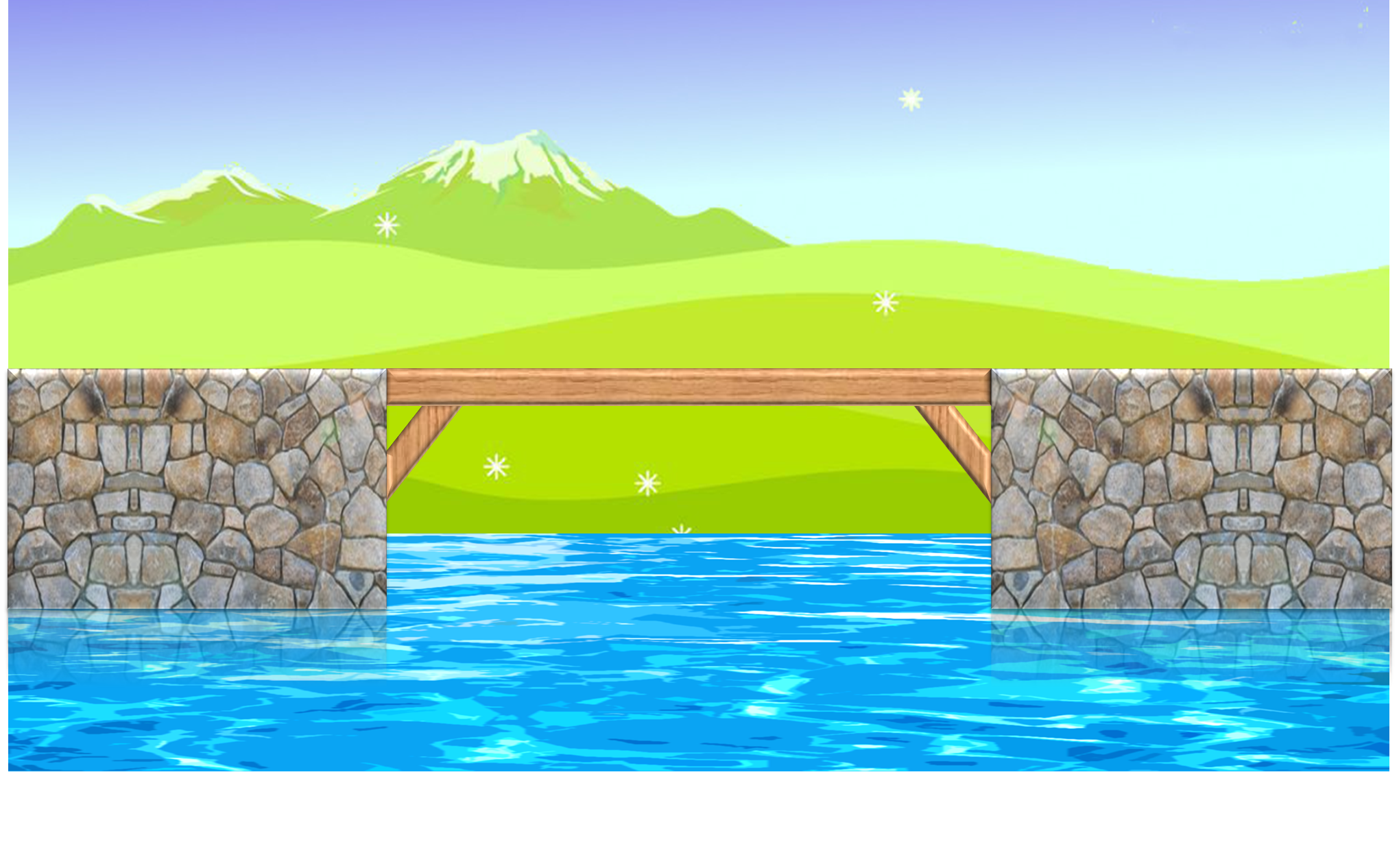
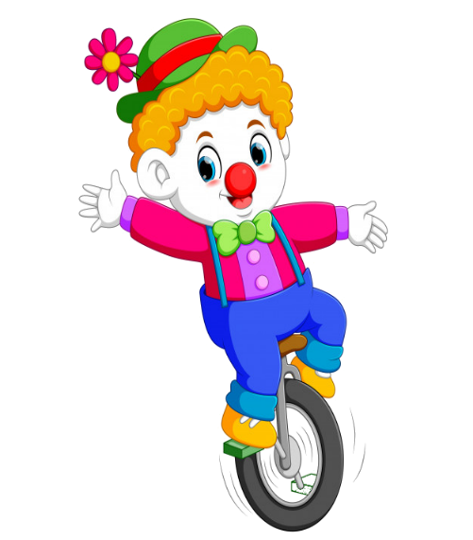



PLAY

Slide 25



Where will you be this weekend?
A. I think I'll be at the seaside.
B. I think I'll be on the beach.
C. I think I'll be at the zoo.
D. I think I'll be in the mountain.

Slide 26
Where will you be this weekend?
A. I think I'll be by the sea.
B. I think I'll be at school.
C. I think I'll be in the mountain.
D. I think I'll be in the countryside.

Slide 27
Where will you be this weekend?
A. I think I'll be at school.
B. I think I'll be by the sea.
C. I think I'll be in the countryside.
D. I think I'll be on the beach.

Slide 28
Where will you be this weekend?
A. I think I'll be at the zoo.
B. I think I'll be in the mountain.
C. I think I'll be by the sea.
D. I think I'll be at school.

Slide 29
Where will you be this weekend?
A. I think I'll be in the countryside.
B. I think I'll be at the zoo.
C. I think I'll be in the park.
D. I think I'll be on the beach.

Slide 30
Where will you be this weekend?
A. I think I'll be in the mountain.
B. I think I'll be at the zoo.
C. I think I'll be by the sea.
D. I think I'll be at the seaside.

Slide 31
Where will you be this weekend?
A. I think I'll be in the mountain.
B. I think I'll be in the countryside.
C. I think I'll be in the park.
D. I think I'll be by the sea.

Slide 32

End

Slide 33
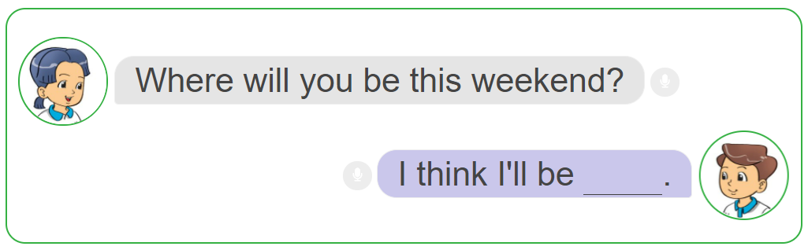
3. Let’s talk.

Slide 34
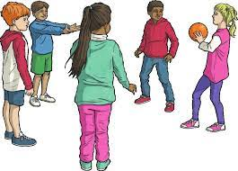
Pass the ball

Slide 35

https://media3.giphy.com/media/osjgQPWRx3cac/giphy.gif?cid=6c09b9527y6is5tllihm1nhi45jkf8jesdys9p5v2u0745ik&ep=v1_gifs_search&rid=giphy.gif&ct=g

