Slide 1
Unit 8
What are
you reading?
Lesson 3

Slide 2
REVIEW

Slide 3


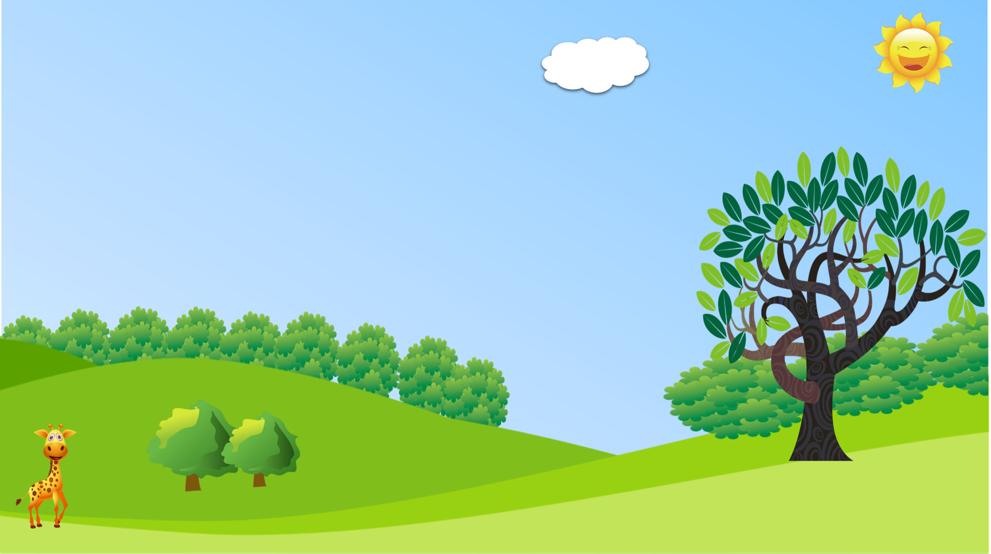



PRERENT WHEEL
10
50
30
30
20
Good job!
SPIN/STOP
SPIN/STOP
SPIN/STOP
SPIN/STOP
SPIN/STOP
SPIN/STOP
SPIN/STOP
SPIN/STOP
SPIN/STOP
SPIN/STOP
SPIN/STOP
SPIN/STOP
SPIN/STOP
SPIN/STOP
SPIN/STOP
40
SPIN/STOP
60
60
40
20
30
10
50
Notes:
Ms Huyền Phạm - 0936.082.789 – YOUTUBE: MsPham. Facebook: Dạy và học cùng công nghệ.

Slide 4
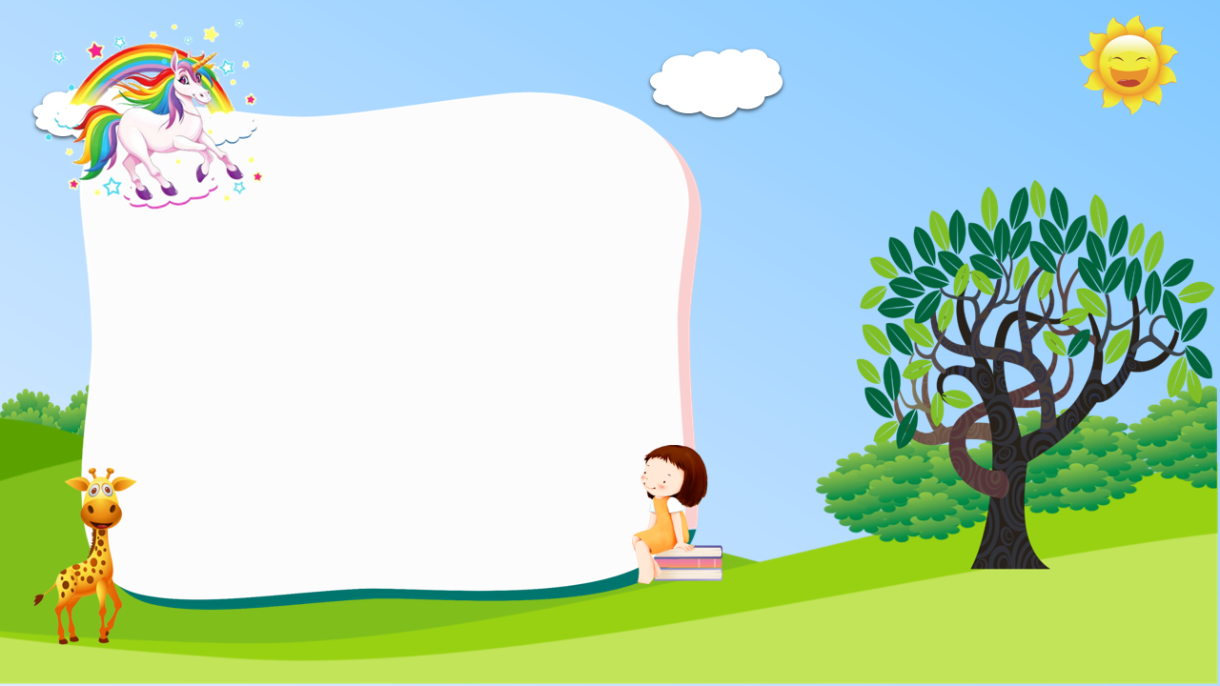

Hard-working
What’s An Tiem like?
He’s ___________ and generous
clever
Notes:
Ms Huyền Phạm - 0936.082.789 – YOUTUBE: MsPham. Facebook: Dạy và học cùng công nghệ.

Slide 5
What’s Tam like?
She’s hard-working and _____.
ugly
gentle
Notes:
Ms Huyền Phạm - 0936.082.789 – YOUTUBE: MsPham. Facebook: Dạy và học cùng công nghệ.

Slide 6
clever
Why do you like the Fox?
- Because the Fox is _______.
kind
beautiful
Notes:
Ms Huyền Phạm - 0936.082.789 – YOUTUBE: MsPham. Facebook: Dạy và học cùng công nghệ.

Slide 7
clever
What’s Snow White like?
She’s beautiful and _____.
kind
Hard-working
Notes:
Ms Huyền Phạm - 0936.082.789 – YOUTUBE: MsPham. Facebook: Dạy và học cùng công nghệ.

Slide 8
likes
What are you reading now?
I ______ reading a comic book.
like
am
Notes:
Ms Huyền Phạm - 0936.082.789 – YOUTUBE: MsPham. Facebook: Dạy và học cùng công nghệ.

Slide 9
likes
Does she ________ the story?
Yes, she does. She likes it very much.
like
Notes:
Ms Huyền Phạm - 0936.082.789 – YOUTUBE: MsPham. Facebook: Dạy và học cùng công nghệ.

Slide 10
She is reading
What are you reading?
___________ the Fox and the Crow.
I am reading
He is reading
Notes:
Ms Huyền Phạm - 0936.082.789 – YOUTUBE: MsPham. Facebook: Dạy và học cùng công nghệ.

Slide 11
What’s story is Linda reading?
____ is reading Aladdin and the Magic Lamp.
She
He
Notes:
Ms Huyền Phạm - 0936.082.789 – YOUTUBE: MsPham. Facebook: Dạy và học cùng công nghệ.

Slide 12
Does Tom like the main character?
Yes, ___ does.
She
He
Notes:
Ms Huyền Phạm - 0936.082.789 – YOUTUBE: MsPham. Facebook: Dạy và học cùng công nghệ.

Slide 13
Answer
What time does she go home?
___________________?
She goes home at four o’clock?
Notes:
Ms Huyền Phạm - 0936.082.789 – YOUTUBE: MsPham. Facebook: Dạy và học cùng công nghệ.

Slide 14
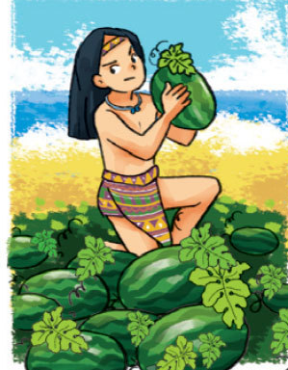
Answer
What are you reading
___________?
I am reading the story of Mai An Tiem.
Notes:
Ms Huyền Phạm - 0936.082.789 – YOUTUBE: MsPham. Facebook: Dạy và học cùng công nghệ.

Slide 15
Answer
What is she reading
___________?
She is reading the Fox and the Crow.
Notes:
Ms Huyền Phạm - 0936.082.789 – YOUTUBE: MsPham. Facebook: Dạy và học cùng công nghệ.

Slide 16

Answer
No, I don’t.
Do you like the Fox?
Notes:
Ms Huyền Phạm - 0936.082.789 – YOUTUBE: MsPham. Facebook: Dạy và học cùng công nghệ.

Slide 17

Answer
Yes, she does.
Does she like reading comic books?
Notes:
Ms Huyền Phạm - 0936.082.789 – YOUTUBE: MsPham. Facebook: Dạy và học cùng công nghệ.

Slide 18
Answer
No, he doesn’t.
Does he read books in his free time?
Notes:
Ms Huyền Phạm - 0936.082.789 – YOUTUBE: MsPham. Facebook: Dạy và học cùng công nghệ.

Slide 19
PRONUNCIATION

Slide 20
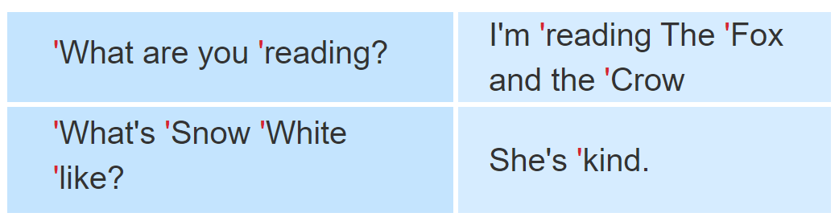

1. Listen and repeat.

Slide 21
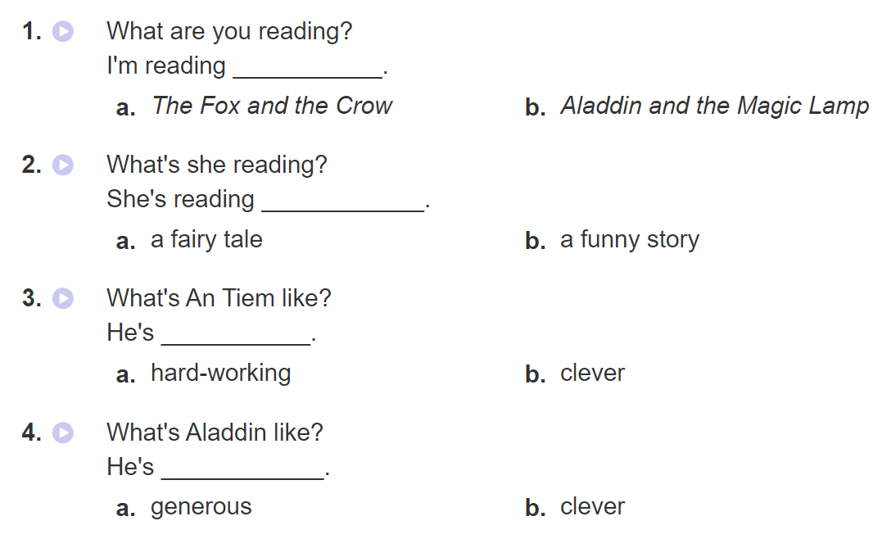

2. Listen and circle a or b. Then say the sentences aloud.

Slide 22
PRACTISE

Slide 23
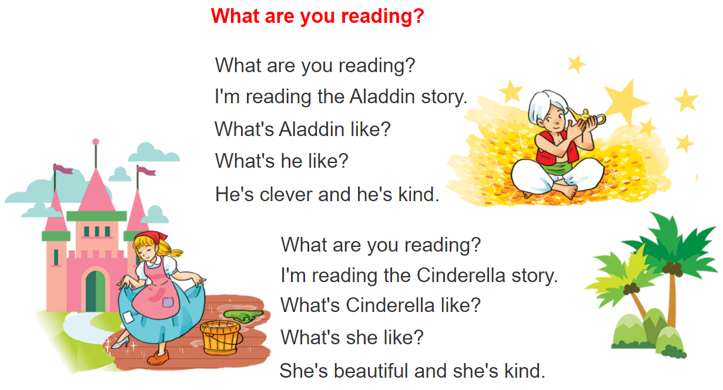


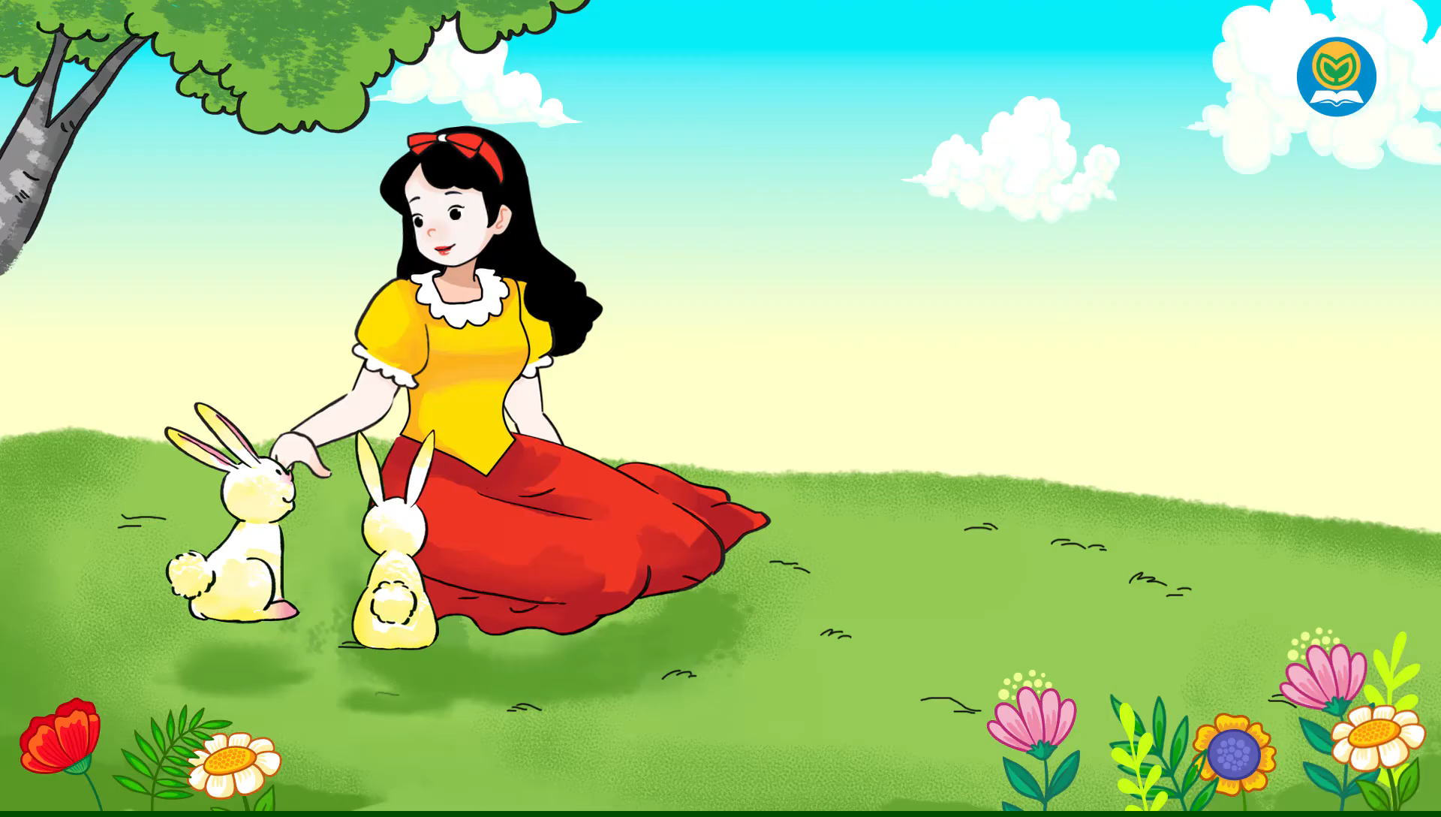
3. Let’s chant

