Slide 1


Slide 2
Unit 10
When will
Sports Day be?
Lesson 1

Slide 3
VOCABULARY

Slide 4


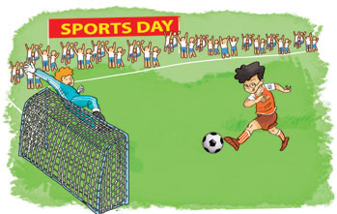
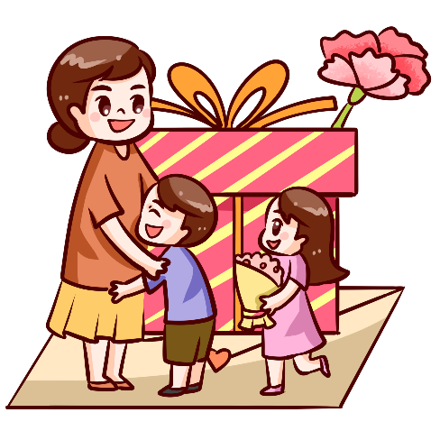

Verd – (v)
A. Vocabulary
Sports Day
Teachers' Day
Children's Day
Ngày hội thể thao
Ngày nhà giáo
Ngày thiếu nhi
Women’s Day
Independence Day
Ngày phụ nữ
Ngày Quốc Khánh

Slide 5


Read and tick
A
Children's Day
B
Sports Day

Slide 6
Read and tick
A
Children's Day
B
Women’s Day

Slide 7
Read and tick
A
Independence Day
B
Children's Day

Slide 8

Read and tick
A
Sports Day
B
Women’s Day

Slide 9
Read and tick
A
Children's Day
B
Teachers' Day

Slide 10

Verd – (v)
Match
Sports Day
Teachers' Day
Children's Day
Independence Day
Women’s Day

Slide 11
GRAMMAR

Slide 12
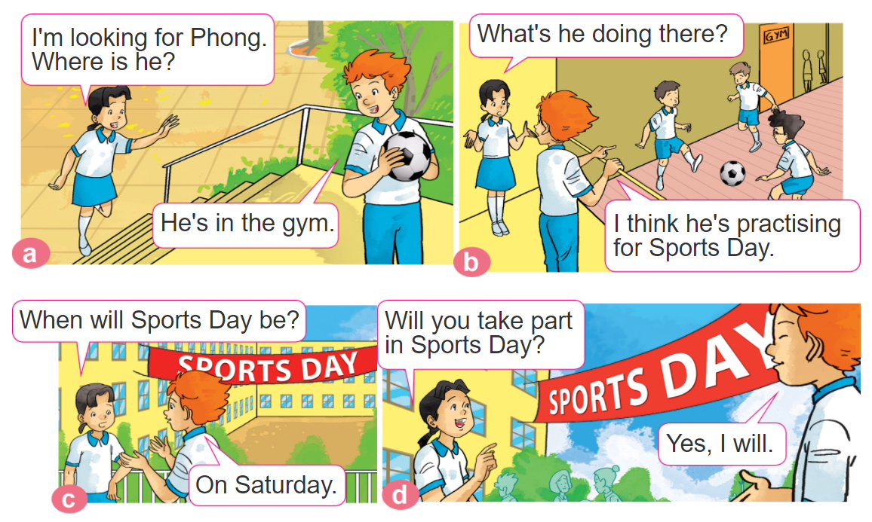

1. Look, listen and repeat.

Slide 13


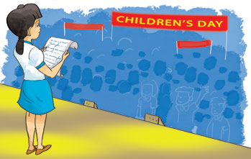

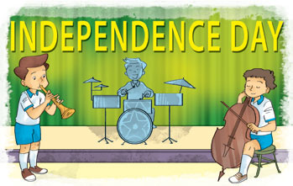
2. Point and say
When will ___________ be?
It'll be on ______.
Sports Day
Saturday
Children's Day
Teachers' Day
Friday
Sunday
Independence Day
Thursday

Slide 14
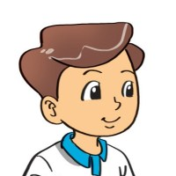
B. Grammar
Hỏi và đáp ngày nào đó sẽ diễn ra vào ngày nào:
(Khi nào sẽ đến ngày ______?)
+ ngày lễ
When will ___________ be?
It'll be on ______.
+ thứ
(Nó vào thứ ____.)

Slide 15


3. Let’s talk
When will______be?
It'll be on _______.

Slide 16
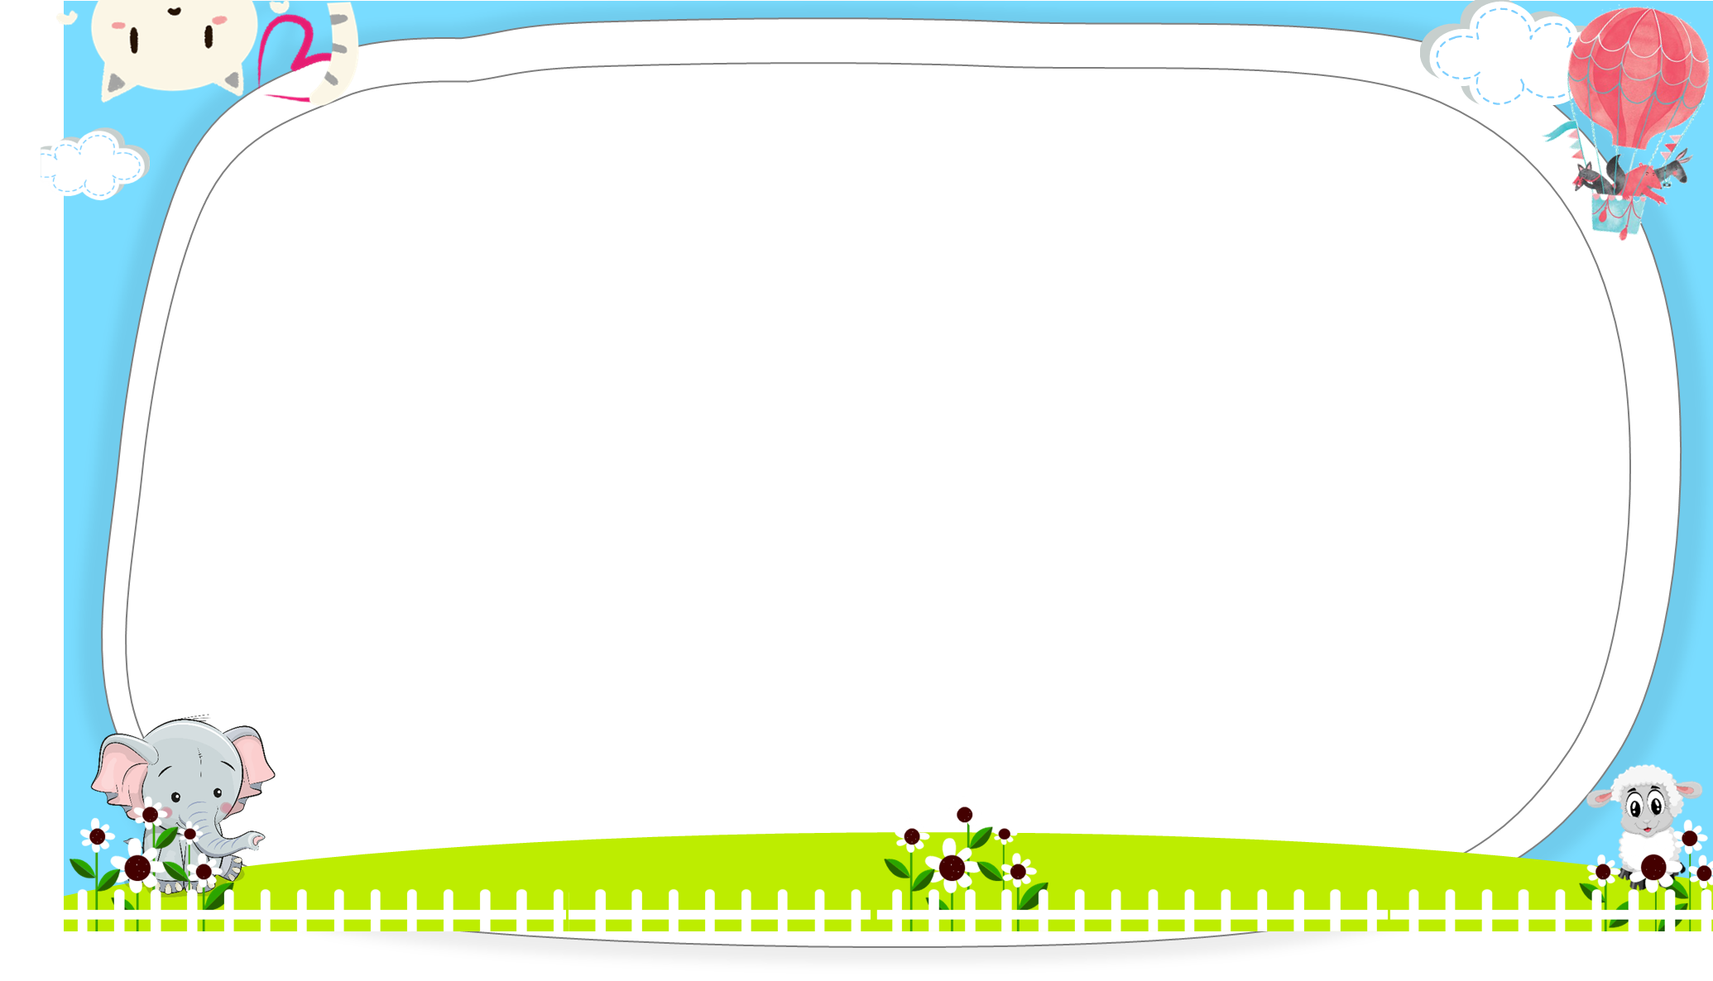
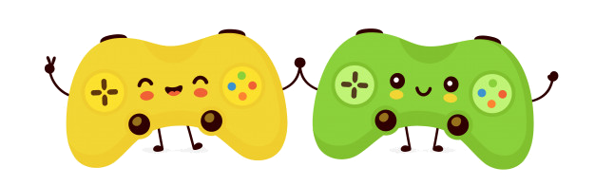



AND
GAME
PLAY

Slide 17



It'll on
Sunday.
It’ll be on
Sunday.
When will Women’s Day be?
Next

Slide 18
It'll be on
Saturday.
It’s on
Saturday.
When will Mother’s Day be?
Next

Slide 19
It'll be on
Tuesday.
It’ll be
Tuesday.
When will Sports Day be?
Next

Slide 20
It be on
Monday.
It’ll be on
Monday.
When will Independence Day
be?
Next

Slide 21
It'll be on
Sunday.
It'll on
Sunday.
When will Teachers’ Day be?
Next

Slide 22
It'll be on
Friday.
It’ll be on
Fridays.
When will Children’s Day be?
Next

Slide 23
What will
When will
_____ ______ Independence Day be?
It'll be on Friday.
Next

Slide 24
be
is
What will Children’s Day ____?
It'll be on Saturday.
Next

Slide 25

Next

Slide 26

https://media3.giphy.com/media/osjgQPWRx3cac/giphy.gif?cid=6c09b9527y6is5tllihm1nhi45jkf8jesdys9p5v2u0745ik&ep=v1_gifs_search&rid=giphy.gif&ct=g

