Slide 1
Unit 15 – Lesson 2
What would you like to be in the future?

Slide 2
VOCABULARY

Slide 3


Vocabulary
write stories for children
/ raɪt ˈstɔːriz fə ˈʧɪldrən/

Slide 4
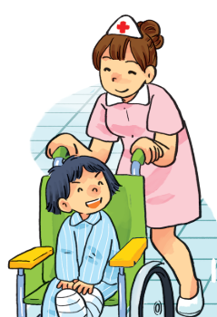
Vocabulary
look after patients
/lʊk ˈɑːftə ˈpeɪʃənts/

Slide 5

Vocabulary
fly a plane
/ flaɪ ə pleɪn/

Slide 6
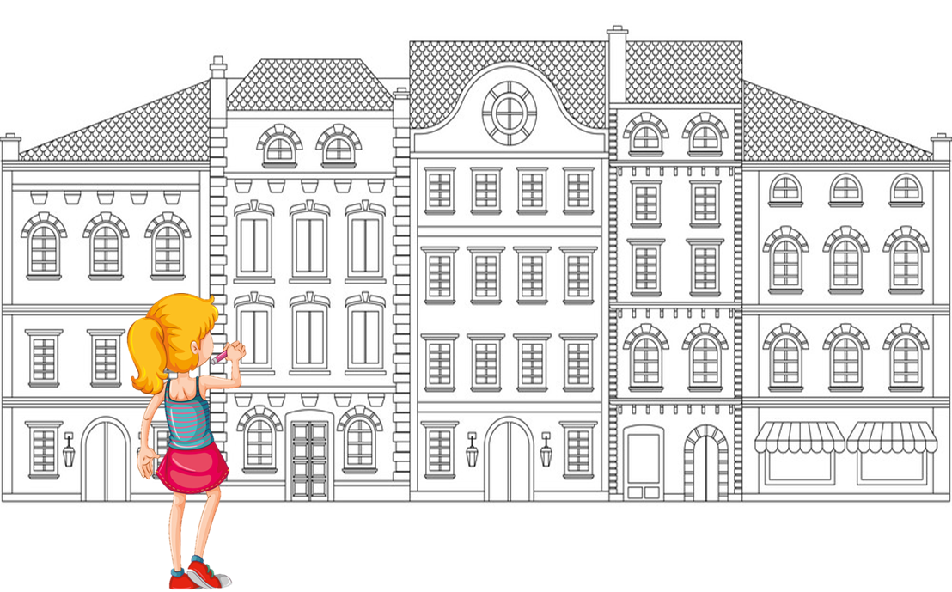
Vocabulary
design buildings
/dɪˈzaɪn ˈbɪldɪŋz/

Slide 7
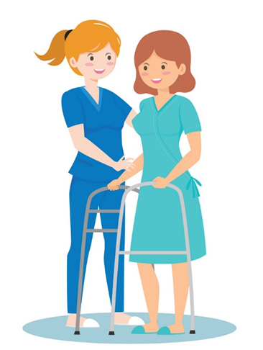

Vocabulary
look after patients
write stories for children
fly a plane
design buildings
/lʊk ˈɑːftə ˈpeɪʃənts/
/raɪt ˈstɔːriz fə ˈʧɪldrən/
/flaɪ ə pleɪn/
/dɪˈzaɪn ˈbɪldɪŋz/

Slide 8










Đi tìm PIKACHU

Slide 9







fly a plane
write stories for children
design buildings

Slide 10
design buildings
fly a plane
look after patients

Slide 11
fly a plane
write stories for children
design buildings

Slide 12
look after patients
design buildings
writer

Slide 13
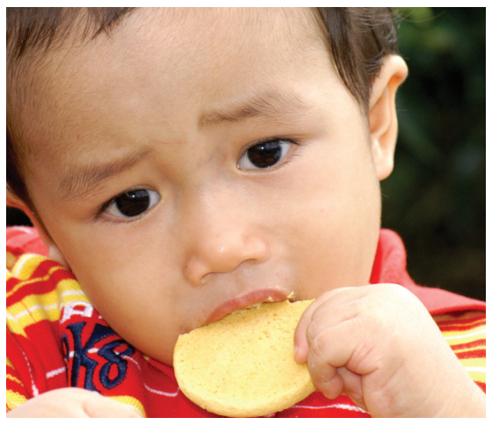
write stories for children

Slide 14
look after patients

Slide 15
design buildings

Slide 16
fly a plane

Slide 17
write stories
___________
patients
design
look after

Slide 18
design
write
______buildings
fly

Slide 19


Excellent!

Slide 20
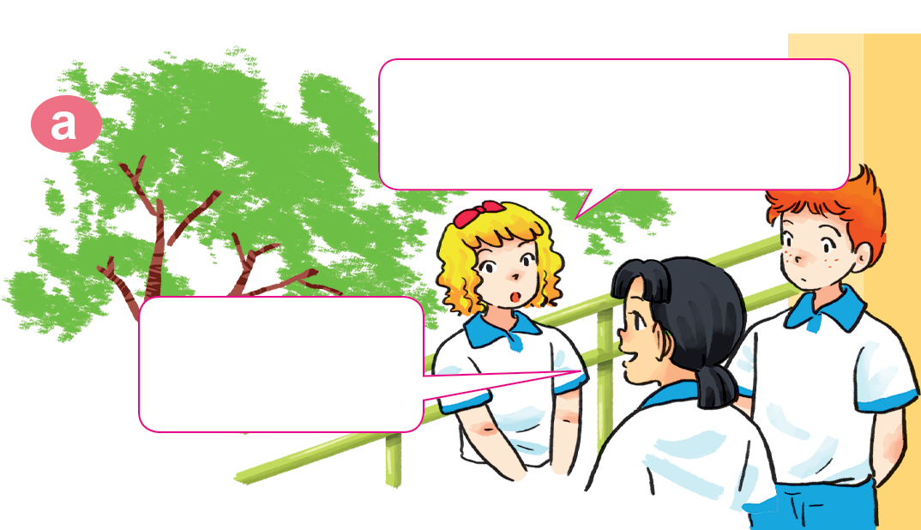
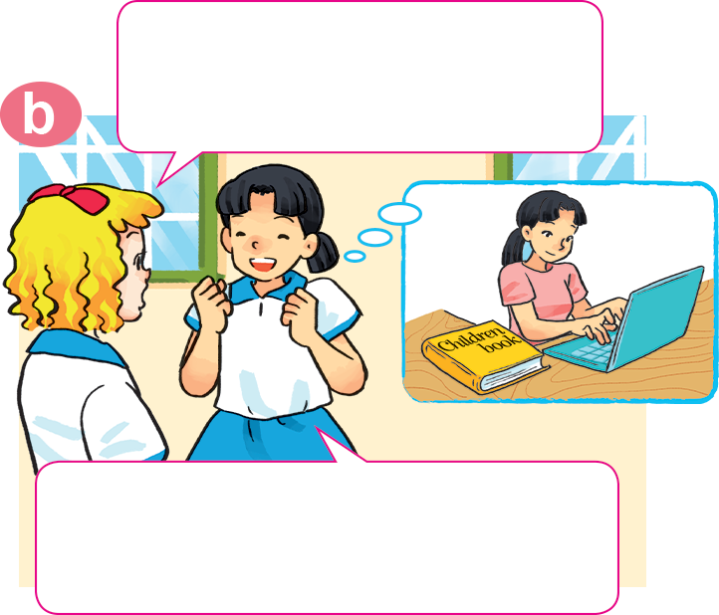

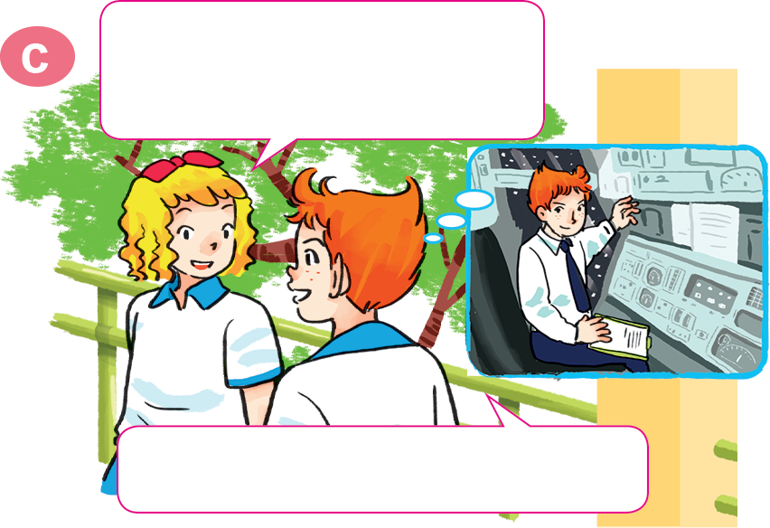
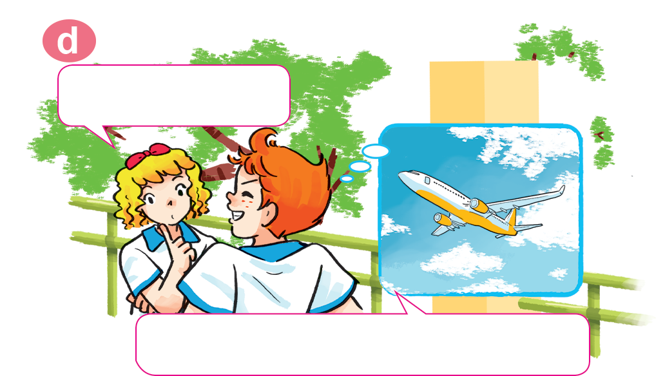
1. Look, listen and repeat
Why would you like to be a writer?
What would you like to be in the future, Mai?
I'd like to be a writer.
Because I'd like to write stories for children.
Would you like to be a writer too, Tony?
A pilot? Why?
No. I'd like to be a pilot.
Because I'd like to fly a plane.

Slide 21
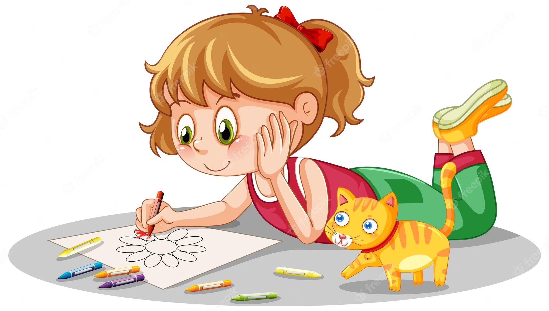
Hỏi và trả lời tại sao bạn muốn làm nghề đó.
Why would you like to be a/an ______?
V (động từ)
Because I’d like to + ____________
Why would you like to be a pilot?
Why would you like to be an artist?
Because I’d like to fly a plane.
Because I’d like to draw pictures.

Slide 22
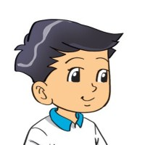

2. Point and say
a nurse
Why would you like to be _________?
Because I'd like to ________________.
look after patients

Slide 23
2. Point and say
a writer
Why would you like to be _________?
Because I'd like to _____________________.
write stories for children

Slide 24
2. Point and say
a pilot
Why would you like to be _________?
Because I'd like to ________________.
fly a plane

Slide 25
2. Point and say
Why would you like to be ___________?
an architect
Because I'd like to ________________.
design buildings

Slide 26
Why would you like to be _________?
Because I'd like to _____________.
look after patients
design buildings
write stories for children
fly a plane

Slide 27
3. Let’s talk
What would you like to be in the future?
I'd like to be a/an_____________.
Why would you like to be _________?
Because I'd like to _____________.

Slide 28




Slide 29
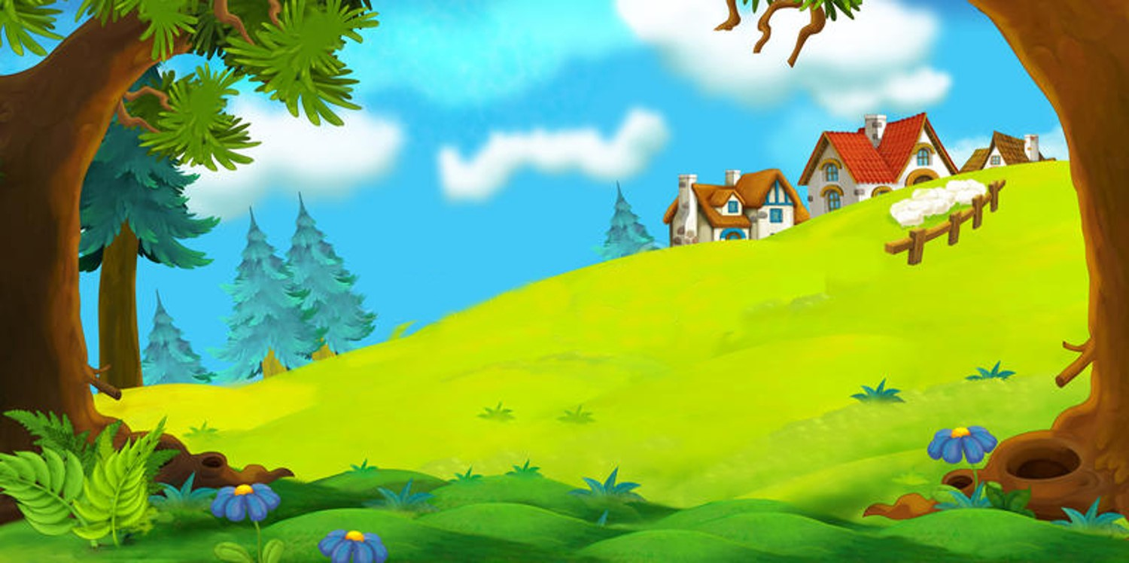

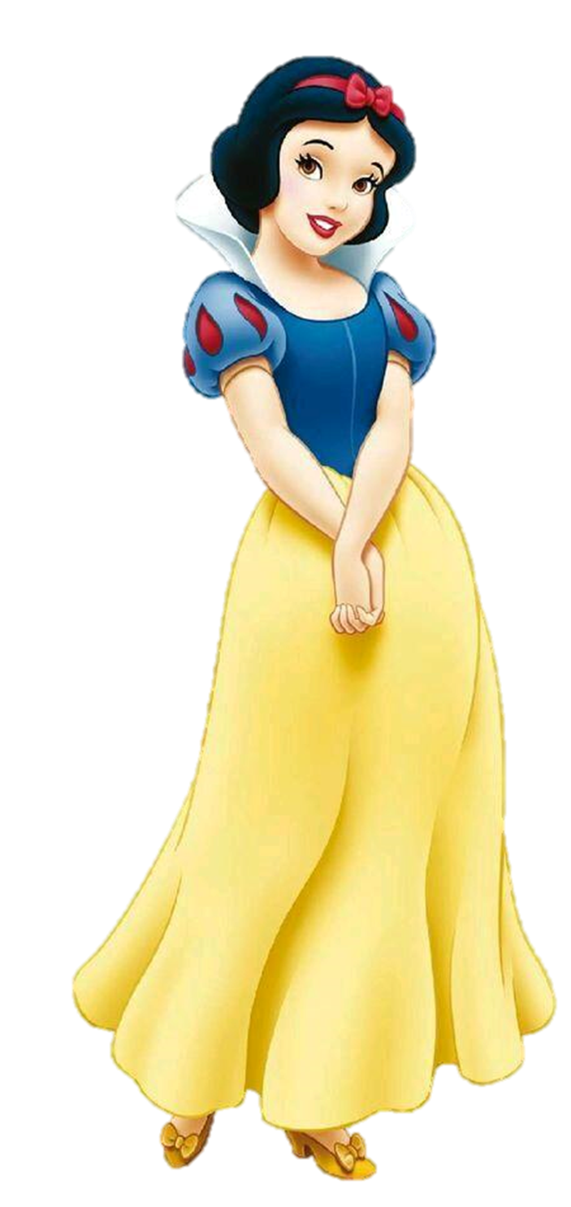
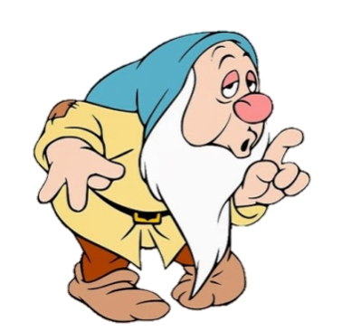
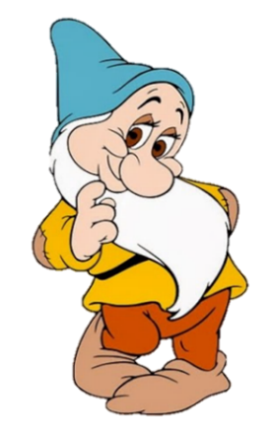
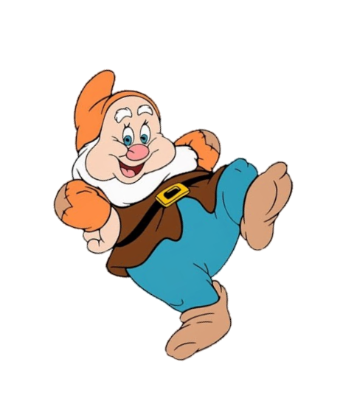
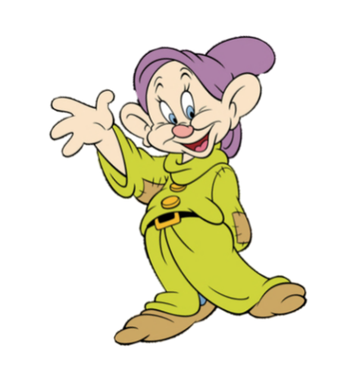
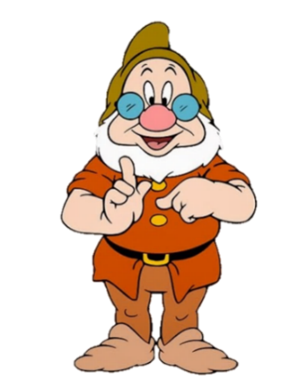
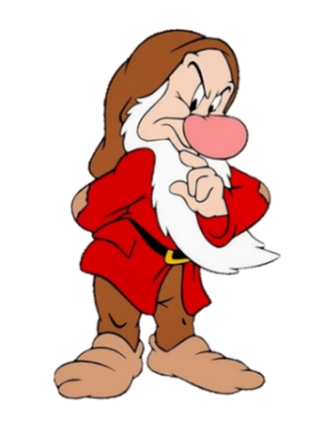
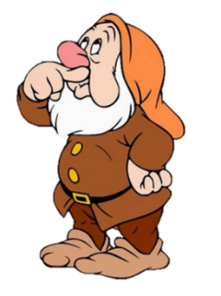

A: What would you like to be in the future?
B: I'd like to be a __________.
nurse
look after patients

Slide 30
A: Why would you like to be a nurse?
B: Because I'd like to __________ patients.
look
look after

Slide 31
A: Where would you like
to work?
B: In a __________.
farm
hospital
sheep
horses
next

Slide 32
A: What would you like to _____ in your free time?
B: I'd like to write comic stories.
go
do

Slide 33
Mai would like
to be a nurse.
True
False

Slide 34
Tom would like to work on a school.
True
False

Slide 35
Phong would like to fly a plane. .
True
False

Slide 36
Trung would like to be an architect.
True
False

Slide 37
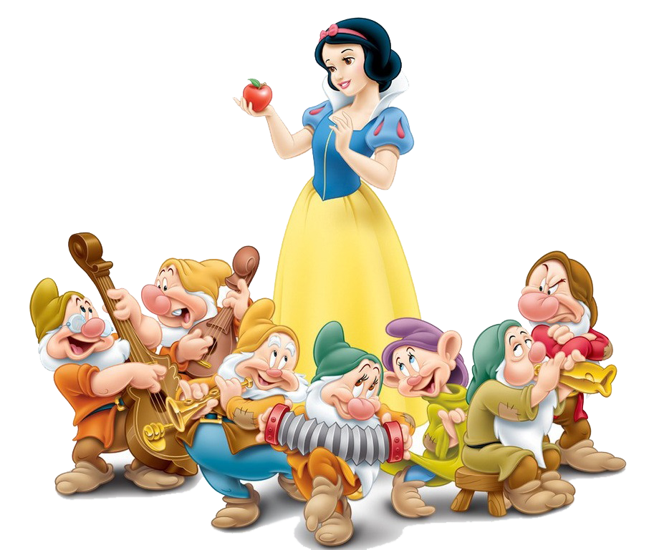
Good job!

Slide 38

https://media3.giphy.com/media/osjgQPWRx3cac/giphy.gif?cid=6c09b9527y6is5tllihm1nhi45jkf8jesdys9p5v2u0745ik&ep=v1_gifs_search&rid=giphy.gif&ct=g

