Slide 1
Unit 17
What would you like to eat?
Lesson 1
(4,5,6)

Slide 2


Slide 3
Memory game

Slide 4


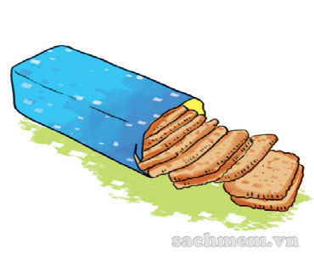


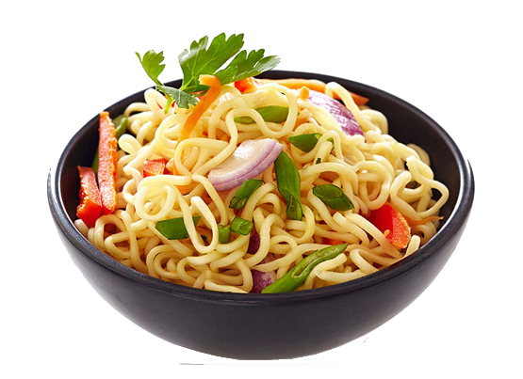
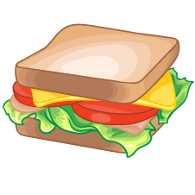
1
2
3
10
1
2
3
4
5
6
7
8
9
Time’s up
4
5
6

Slide 5
Memory game

Slide 6
1
2
3
4
5
6

Slide 7
4. Listen and tick
5. Read and complete
6. Let’s sing

Slide 8


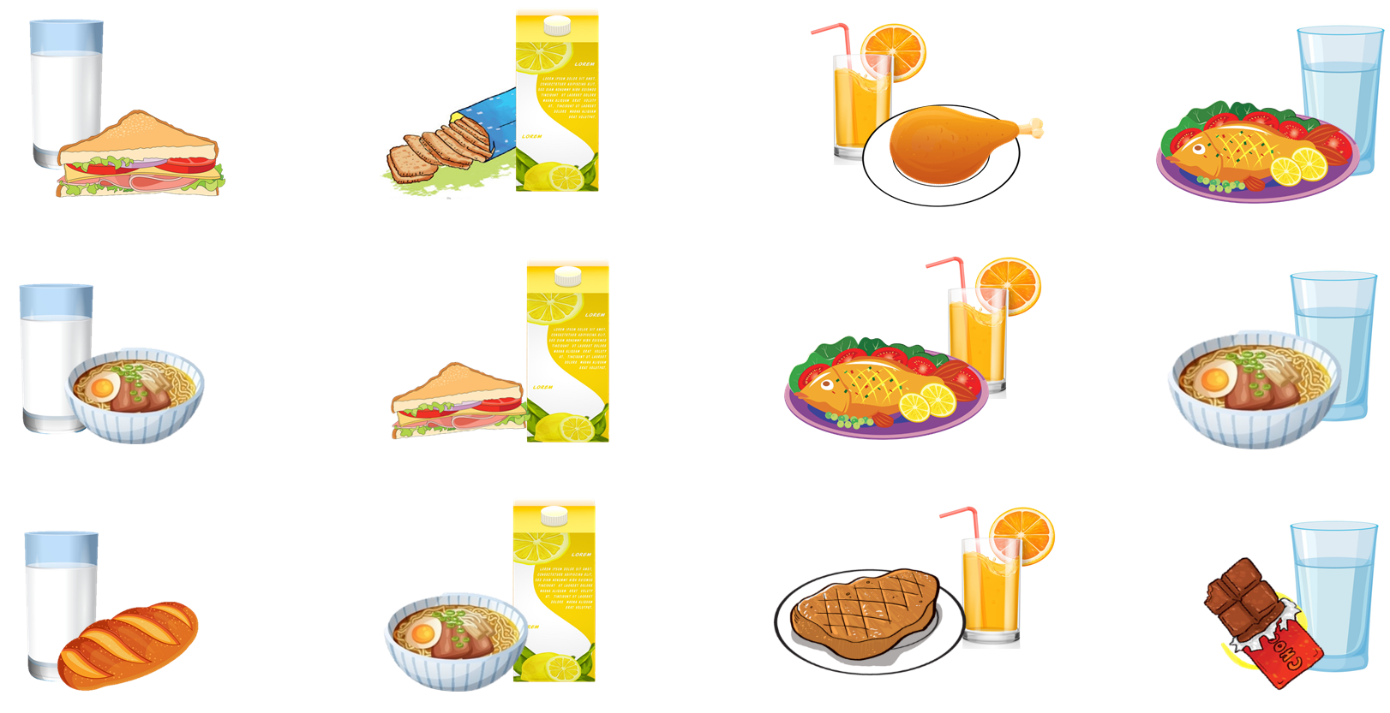




4. Listen and tick.
1.
2.
3.
4.
a
a
a
a
b
b
b
b
c
c
c
c

Slide 9

5. Read and complete.
What do English children usually eat nowadays? At (1) ________, Jim goes to a shop and buys a (2) ________, some chocolate and some milk. Some of his friends buy (3) ________ at the shop, too. Some of the sandwiches are (4) ________, but some aren't. School meals are healthier, but Jim and his friends never (5) ______ at the school canteen.
healthy
lunch
eat
sandwich
lunch
sandwich
food
food
healthy
eat

Slide 10
Answer some questions
What do English children usually eat nowadays? At (1) ________, Jim goes to a shop and buys a (2) ________, some chocolate and some milk. Some of his friends buy (3) ________ at the shop, too. Some of the sandwiches are (4) ________, but some aren't. School meals are healthier, but Jim and his friends never (5) ______ at the school canteen.
lunch
sandwich
food
healthy
eat
When does Jim go to the shop?
_________________________________________________.
At lunch
2. What does Jim buy at the shop? _________________________________________________.
He buys a sandwich, some chocolate and some milk.
3. Do Jim and his friend eat at the school canteen? _________________________________________________.
No, they don’t.

Slide 11
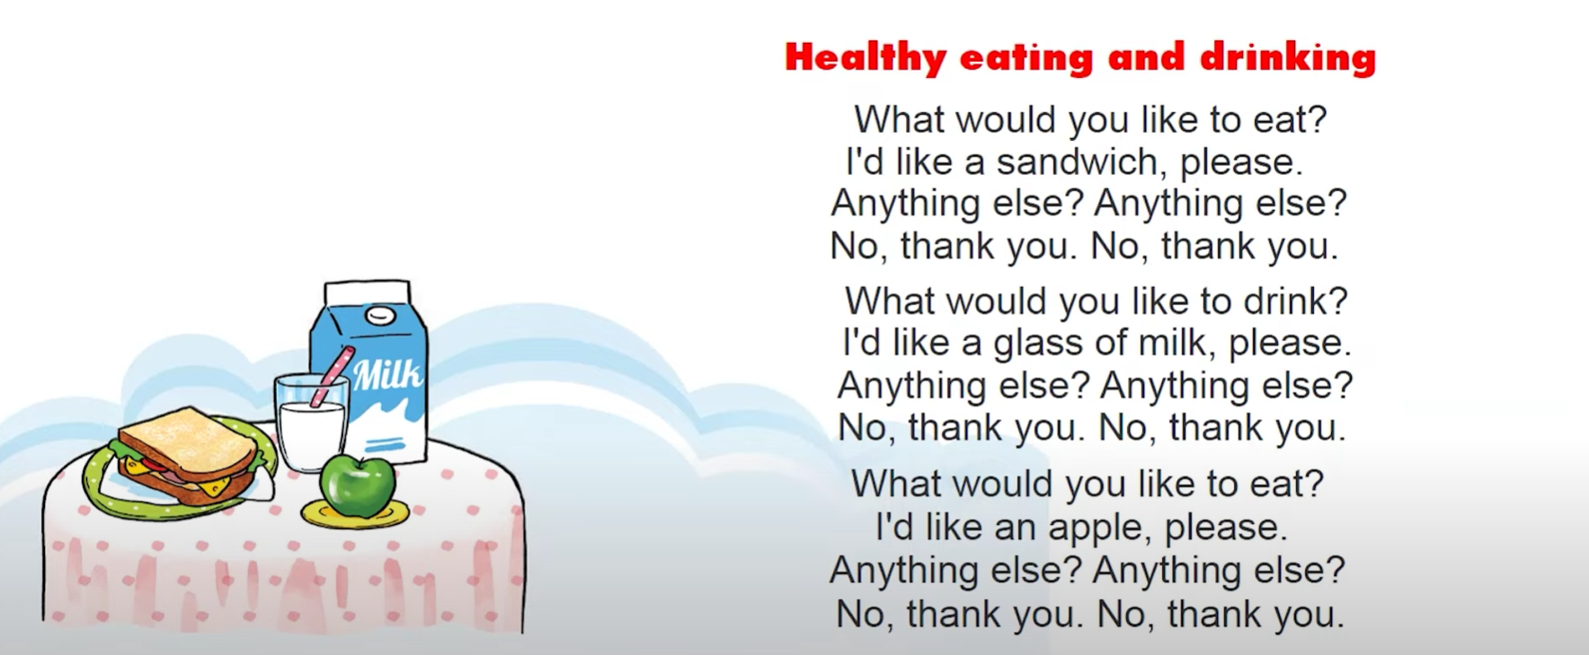


6. Let’s sing

Slide 12
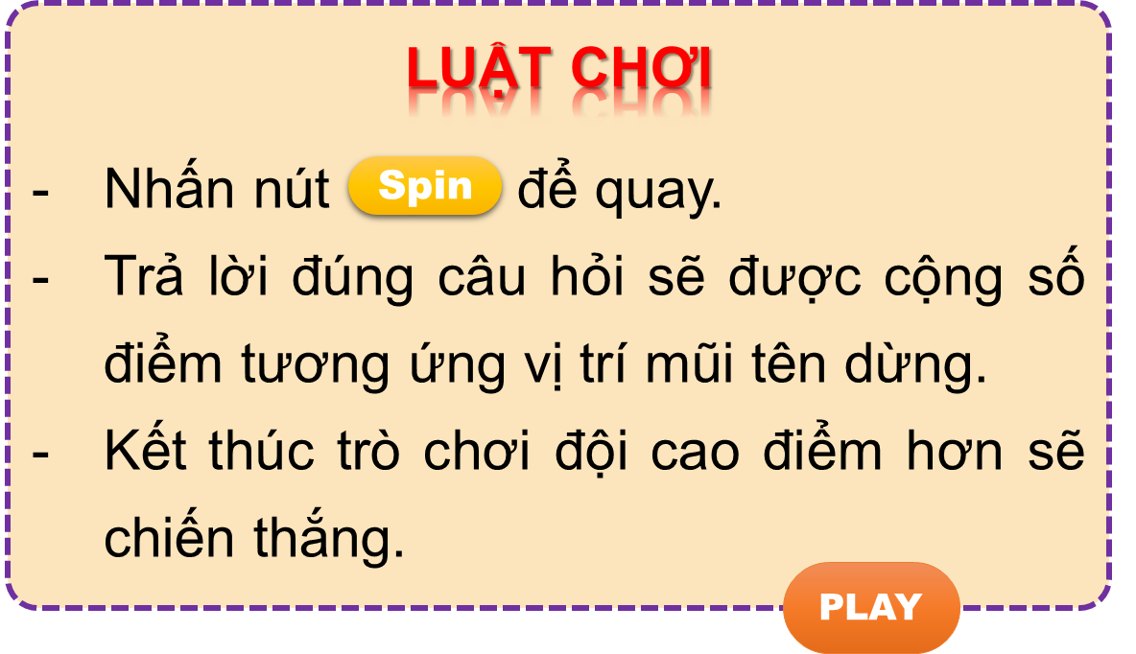


Vòng quay kì diệu
50
10
20
30
10
20
30
40
Spin
PLAY
LUẬT CHƠI
Nhấn nút để quay.
Trả lời đúng câu hỏi sẽ được cộng số điểm tương ứng vị trí mũi tên dừng.
Kết thúc trò chơi đội cao điểm hơn sẽ chiến thắng.
Spin
Notes:
Ms Huyền Phạm - 0936.082.789 – YOUTUBE: MsPham. Facebook: Dạy và học cùng công nghệ.

Slide 13
_______________?
I’d like some biscuits
50
10
20
30
10
20
30
40
What would you
like to eat?
Xem đáp án
Spin
Notes:
Ms Huyền Phạm - 0936.082.789 – YOUTUBE: MsPham. Facebook: Dạy và học cùng công nghệ.

Slide 14
What would you like to eat?
_______ a bar of chocolate.
50
10
20
30
10
20
30
04
I’d like
Xem đáp án
Spin
Notes:
Ms Huyền Phạm - 0936.082.789 – YOUTUBE: MsPham. Facebook: Dạy và học cùng công nghệ.

Slide 15
50
What ____ you like to drink?
I’d like a glass of water.
10
20
30
10
20
30
04
would
Xem đáp án
Spin
Notes:
Ms Huyền Phạm - 0936.082.789 – YOUTUBE: MsPham. Facebook: Dạy và học cùng công nghệ.

Slide 16
What would you ___ to drink?
I’d like a carton of milk.
50
10
20
30
10
20
30
40
like
Xem đáp án
Spin
Notes:
Ms Huyền Phạm - 0936.082.789 – YOUTUBE: MsPham. Facebook: Dạy và học cùng công nghệ.

Slide 17

50
What would you like to eat/drink?
I’d like a bowl of noodles.
10
20
30
10
20
30
40
eat
Xem đáp án
Spin
Notes:
Ms Huyền Phạm - 0936.082.789 – YOUTUBE: MsPham. Facebook: Dạy và học cùng công nghệ.

Slide 18
50
What would you like to eat/drink?
I’d like a carton of lemonade.
10
20
30
10
20
30
40
drink
Xem đáp án
Spin
Notes:
Ms Huyền Phạm - 0936.082.789 – YOUTUBE: MsPham. Facebook: Dạy và học cùng công nghệ.

Slide 19
50
What would you like to eat?
I’d like some chocolate/chocolates.
10
20
30
10
20
30
40
chocolate
Xem đáp án
Spin
Notes:
Ms Huyền Phạm - 0936.082.789 – YOUTUBE: MsPham. Facebook: Dạy và học cùng công nghệ.

Slide 20
50
10
What would you like to drink?
I’d like __________.
a. a packet of biscuits
b. a glass of orange juice
20
30
10
20
30
40
b. a glass of orange juice
Xem đáp án
Spin
Notes:
Ms Huyền Phạm - 0936.082.789 – YOUTUBE: MsPham. Facebook: Dạy và học cùng công nghệ.

Slide 21
What would you like to drink?
I’d like __________.
a. glass of water
b. a glass of water
50
10
20
30
10
20
30
04
b. a glass of water
Xem đáp án
Spin
Notes:
Ms Huyền Phạm - 0936.082.789 – YOUTUBE: MsPham. Facebook: Dạy và học cùng công nghệ.

Slide 22
What would you like to eat?
I’d like __________.
a. a bowl of rice
b. a bowl of noodle
50
10
20
30
10
20
30
04
a. a bowl of rice
Xem đáp án
Spin
Notes:
Ms Huyền Phạm - 0936.082.789 – YOUTUBE: MsPham. Facebook: Dạy và học cùng công nghệ.

Slide 23


50
10
20
30
10
20
30
40
EXIT
Notes:
Ms Huyền Phạm - 0936.082.789 – YOUTUBE: MsPham. Facebook: Dạy và học cùng công nghệ.

Slide 24

https://media3.giphy.com/media/osjgQPWRx3cac/giphy.gif?cid=6c09b9527y6is5tllihm1nhi45jkf8jesdys9p5v2u0745ik&ep=v1_gifs_search&rid=giphy.gif&ct=g

