Slide 1



WELCOME All THE TEACHERS AND MY LOVELY STUDENTS
Teacher : Do Thi Hoa
Class: 4A2
Unit 5: Things we can do
Lesson 1- part ( 1,2,3)

Slide 2
Warm up

Slide 3
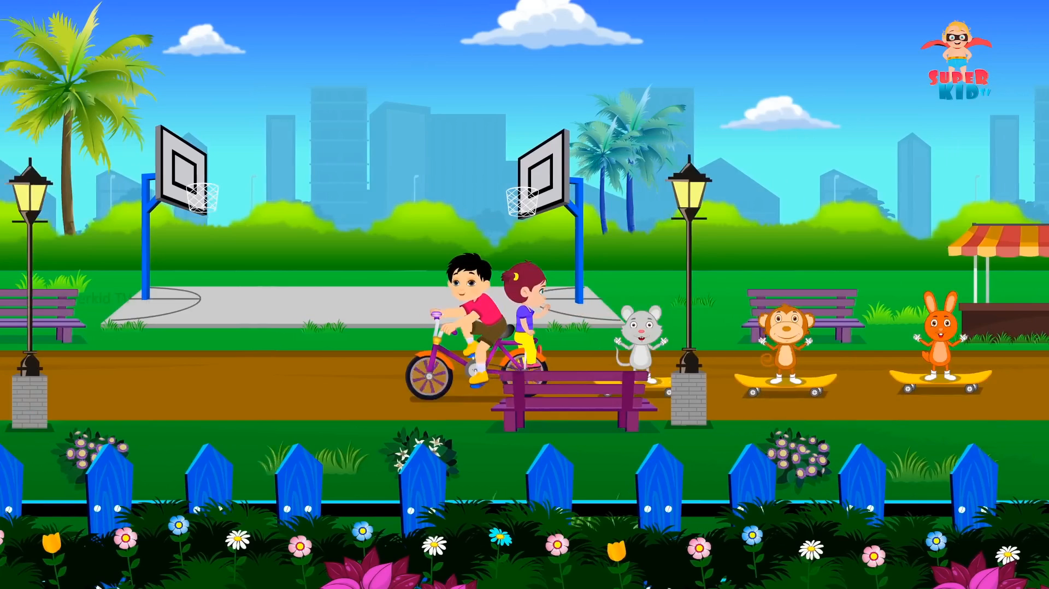

Slide 4



Things we can do
5
LESSON 1 – (1,2,3)

Slide 5
New words:

Slide 6
03
Activity 1
Look, listen and repeat.

Slide 7

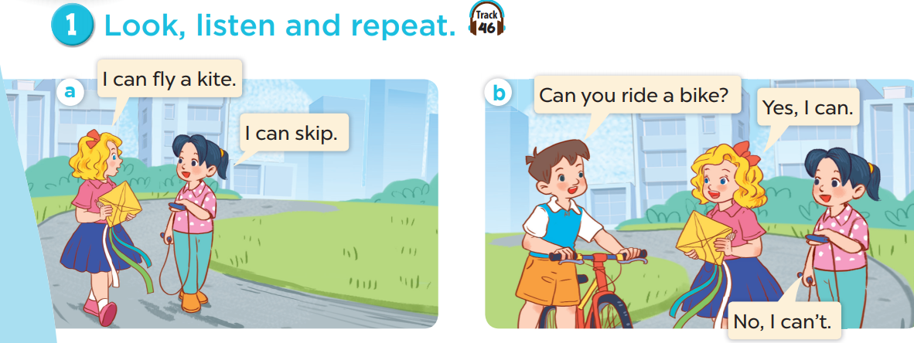

Slide 8
Next

Slide 10
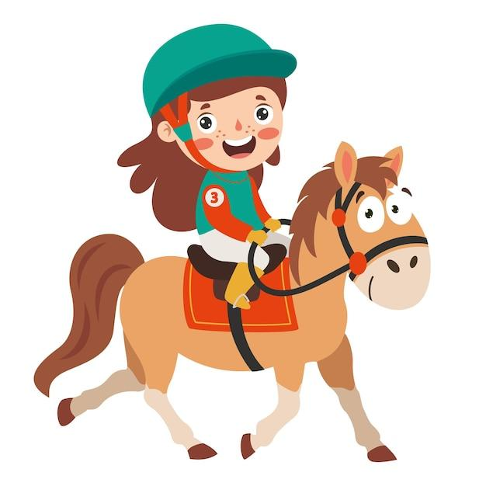
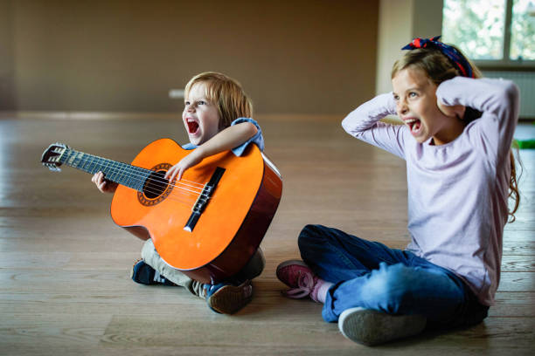
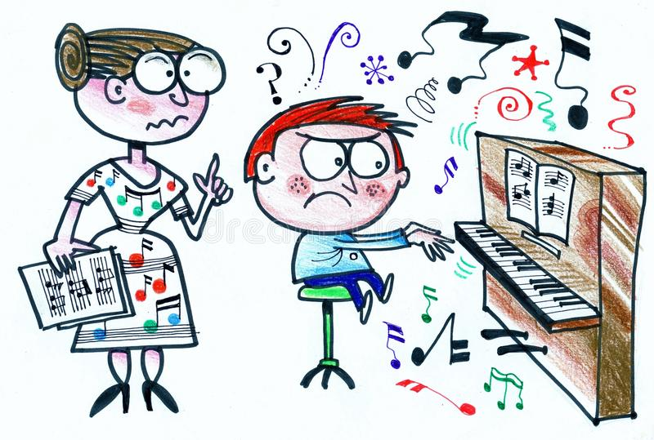
I can ride a bike.
Can- có thể / can’t = can not - không thể
I can ride a horse.
can / can’t
I can’t play the guitar.
I can’t play the piano.

Slide 12
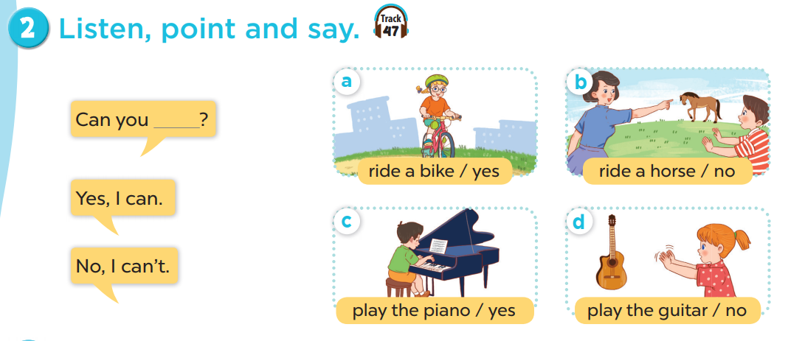

Slide 13
Activity 3
Let’s talk.

Slide 14
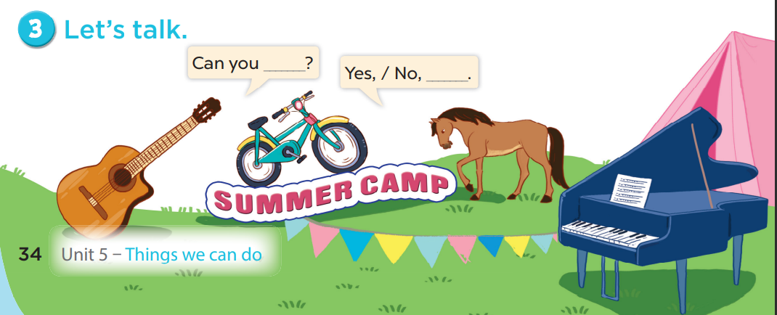

Slide 15
*Do a survey.

Slide 16
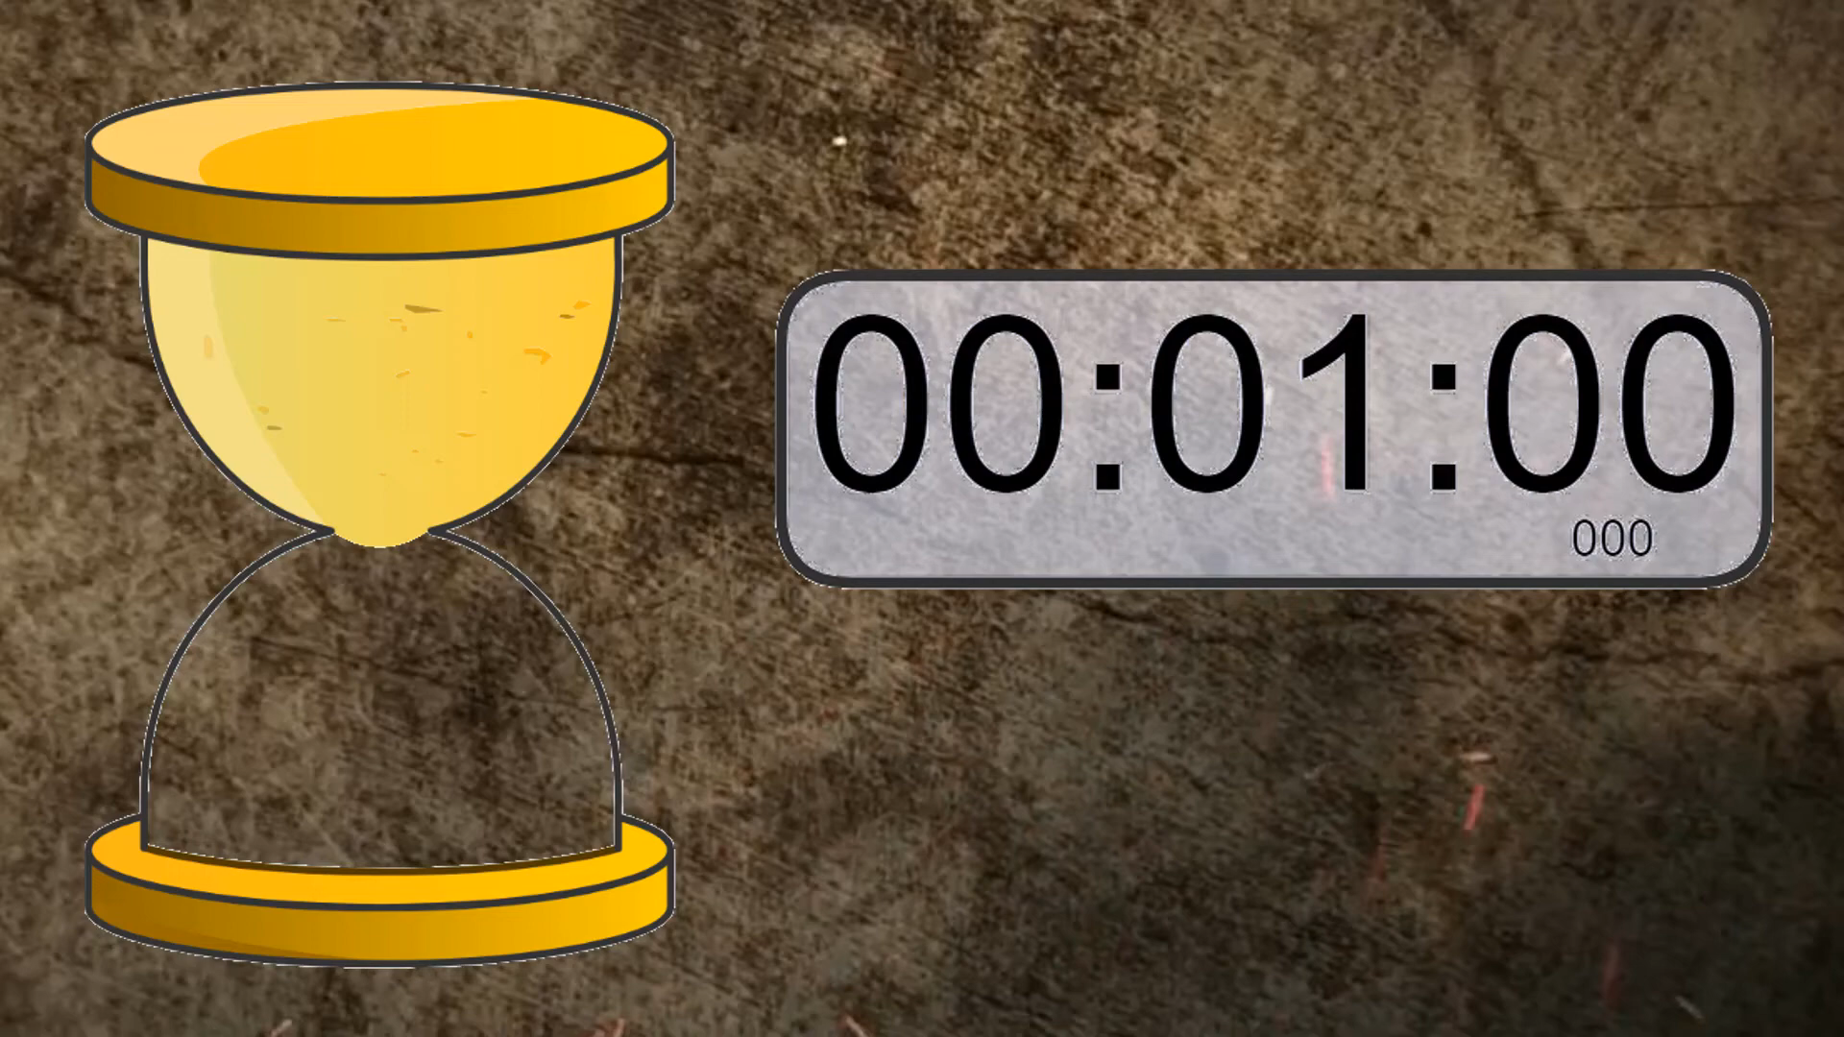
Can you ride a bike ? Name: | Can you play the guitar ? Name:……………………
Can you …………………………………? Name:…………………… | Can you…………………? Name:…………………
Linh
V
Nam
X

Slide 17
Can you ride a bike ? Name: | Can you play the guitar ? Name:……………………
Can you …………………………………? Name:…………………… | Can you…………………? Name:…………………
Linh
V
Nam
X
- Linh can ride a bike.
- Nam can’t ride a horse

Slide 18
Talk about you and your friends’ abilities.

