Slide 1
















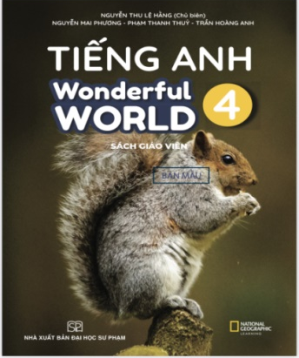




Slide 2

Unit 2: My Home
Lesson 1 – Period 1

Slide 3
1 WARM UP
Notes:
Warm up
Guessing game cho 1 dòng

Slide 4

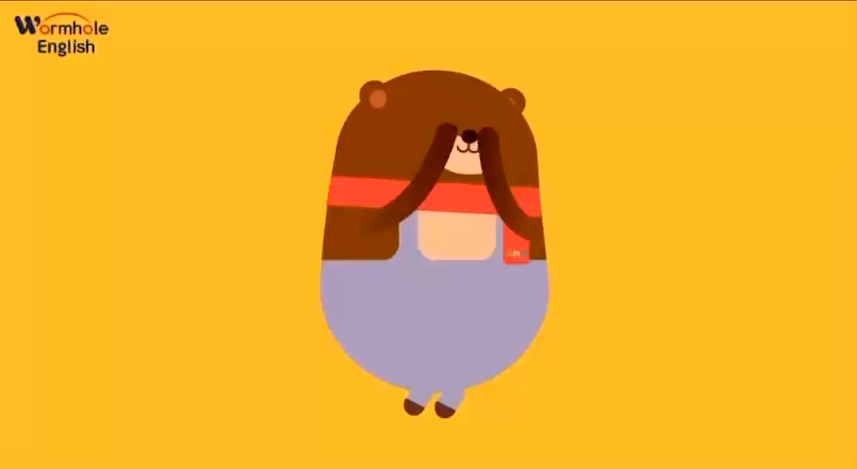



Slide 5

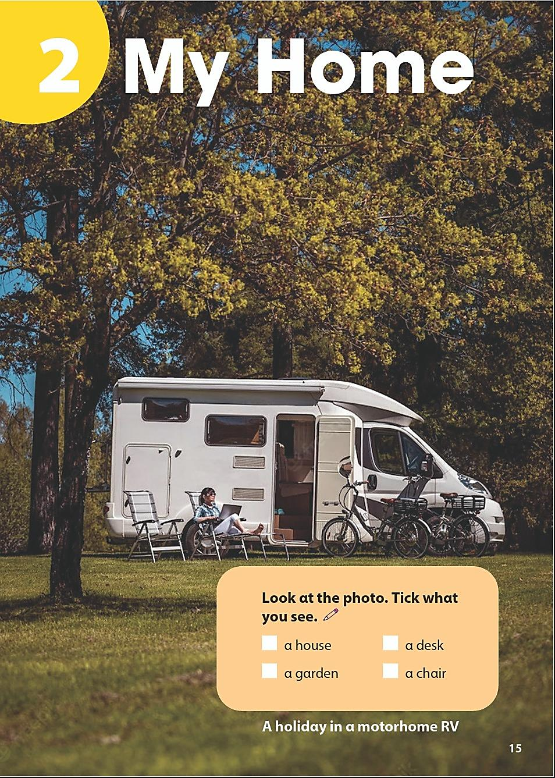
Look at the photo. Tick what you see.
a house a desk
a garden a chair
✓
✓

Slide 6
Presentation
Task 1 Listen and point.
Notes:
Dấu câu

Slide 7
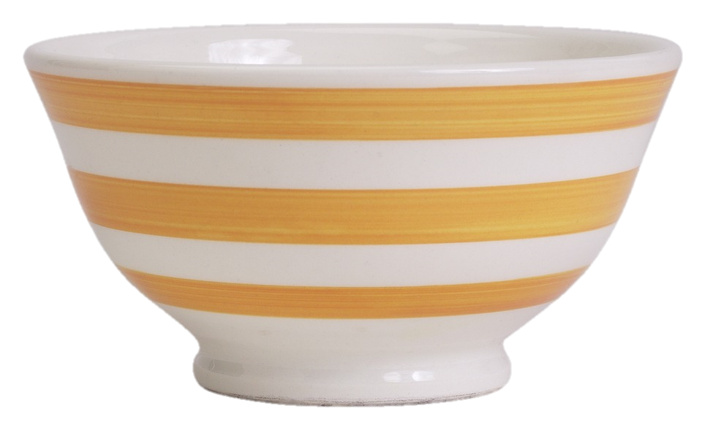
1 Listen and point.
Bowl
What is it?

Slide 8
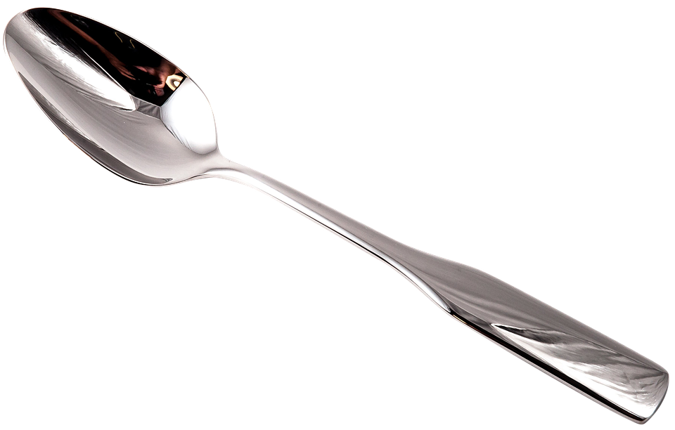
Spoon
What is it?

Slide 9
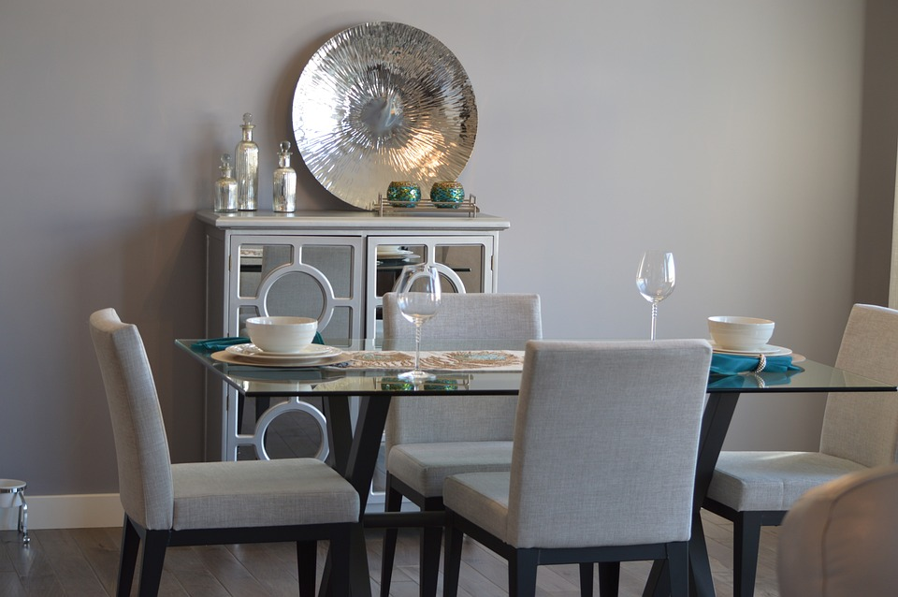
Dining room
What is it?

Slide 10
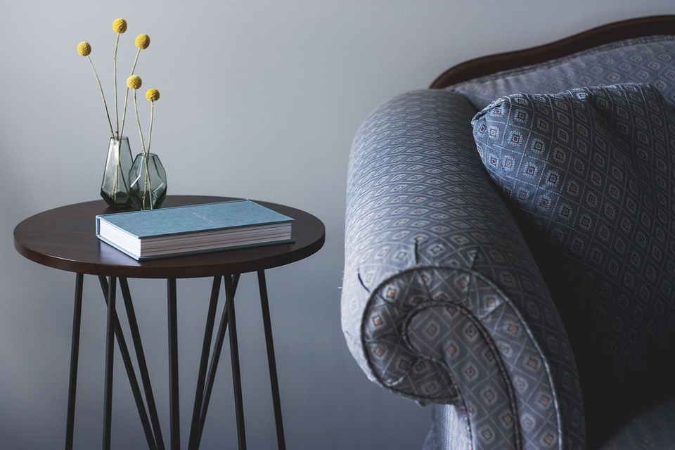
Table
What is it?

Slide 11
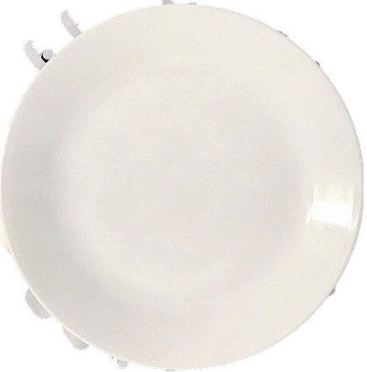
Plate
What is it?

Slide 12
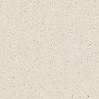
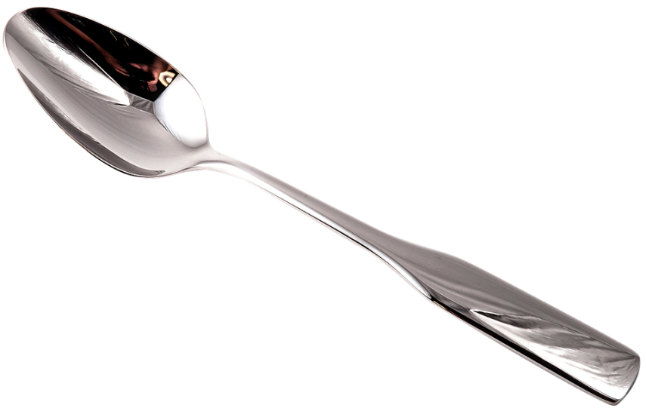
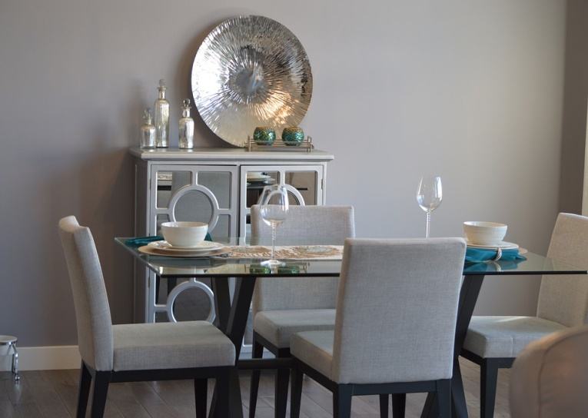
1 Listen and point. Repeat.
bowl
spoon
plate
dining room
table

Slide 13


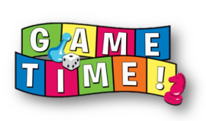



HONEY BEE GAME

Slide 14

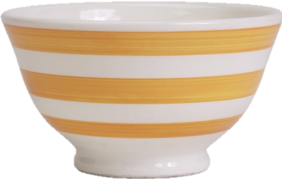


bowl
There is a ______.
10
table
spoon
bowl

Slide 15

spoon
This is my ______.
10
plate
spoon
bowl

Slide 16


plate
Look at my ______.
10
plate
table
spoon

Slide 17
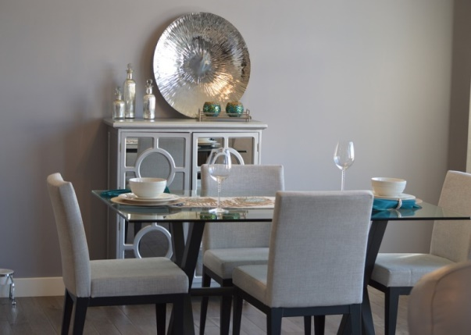
dining room
Look at my ______.
10
plate
dining room
spoon

Slide 18
Practice
Task 2 Listen and tick.
Notes:
Dấu câu

Slide 19

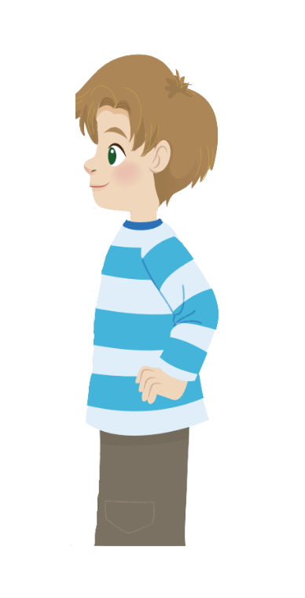
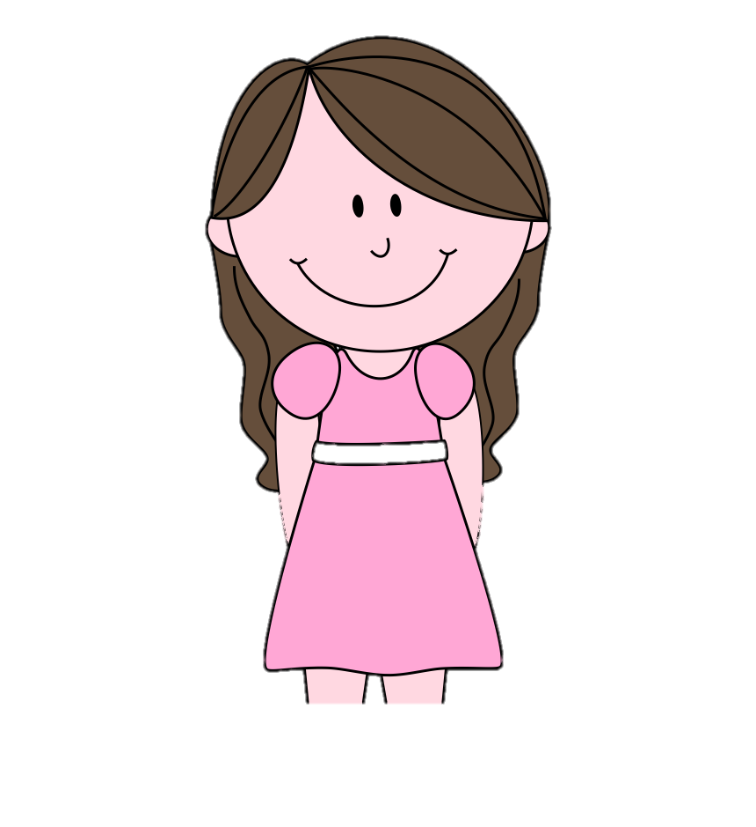
2
Listen and read. Tick.
Your dining room is big. There are many bowls and plates on the table.
It’s my spoon.
Ann
Alex
Look! There’s a spoon. Whose spoon is it?

Slide 20
2
Listen and tick.
Your dining room is big. There are many bowls and plates on the table.
Ann
Andy
The dining room is small.
Yes
✓
No

Slide 21
2
Listen and tick.
Your dining room is big. There are many bowls and plates on the table.
Ann
Andy
2. There are plates and bowls on the table.
✓
Yes
No

Slide 22
2
Listen and tick.
It’s my spoon.
Ann
Look! There’s a spoon. Whose spoon is it?
Alex
Alex’s got a spoon.
✓
Yes
No

Slide 23
Practice
Task 3 Look and say.
Notes:
Dấu câu

Slide 24
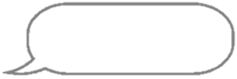


3
Look and say. Use the words in 1.
There is a
dining room
in my house.
There are two
plates in our
dining room.

Slide 25
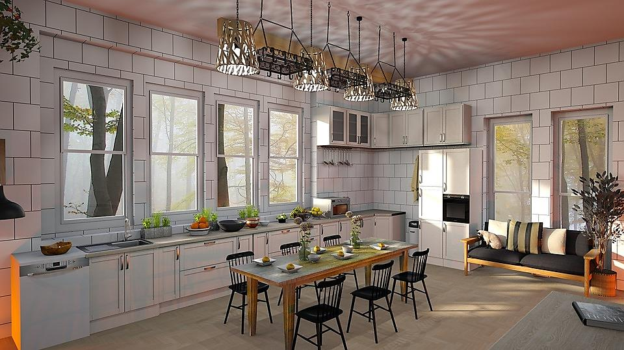
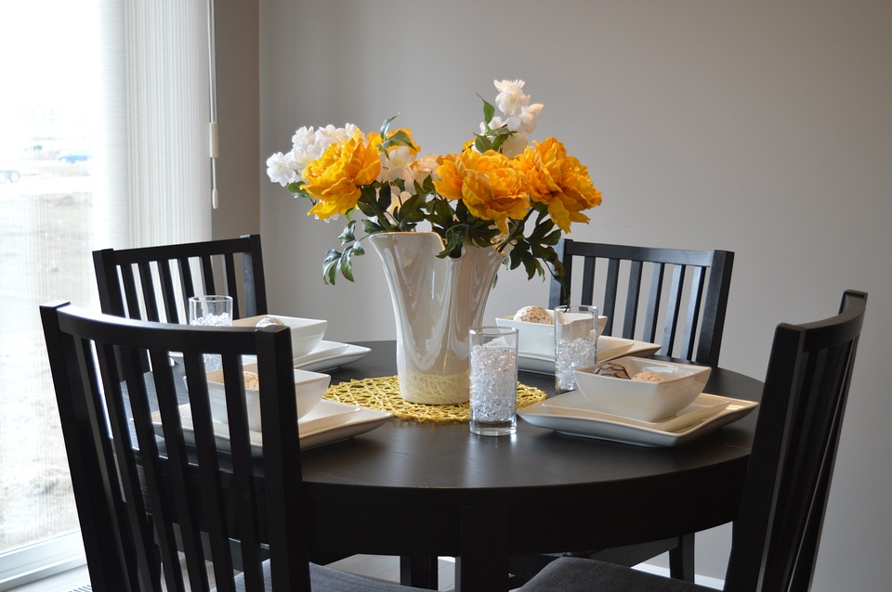
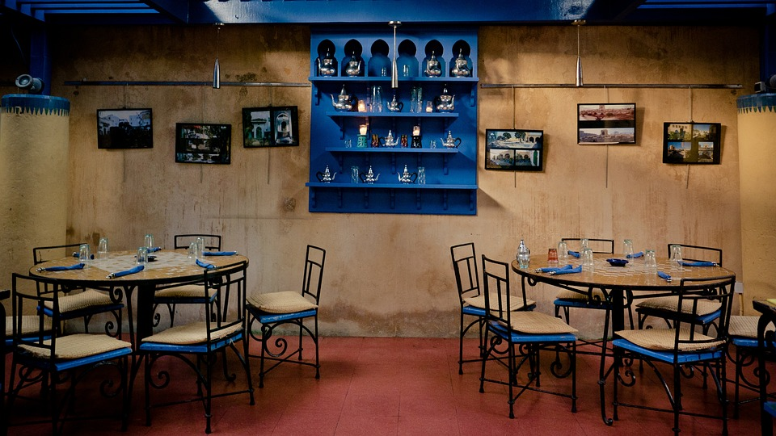
Click to the picture to get the dialogue
1
2
3
NEXT

Slide 26



HOME
Your dining room
is so big!
How many chairs
and plates here?
There are
___ plates
and __ chairs in
my dining room.
6
6
Notes:
Trình bày lại chữ

Slide 27
HOME
How many
bowls are
there?
There are
___ bowls in
our dining room.
4
Notes:
Trình bày lại chữ

Slide 28

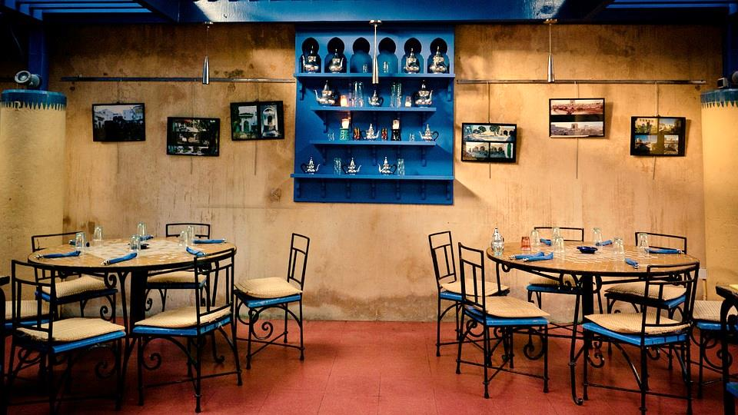
HOME
How many
tables are
there?
My dining room
has ___ tables.
2
Notes:
Trình bày lại chữ

Slide 29
Production
Notes:
Đây k phải là extra, đây là hđ 3 của bài

Slide 30
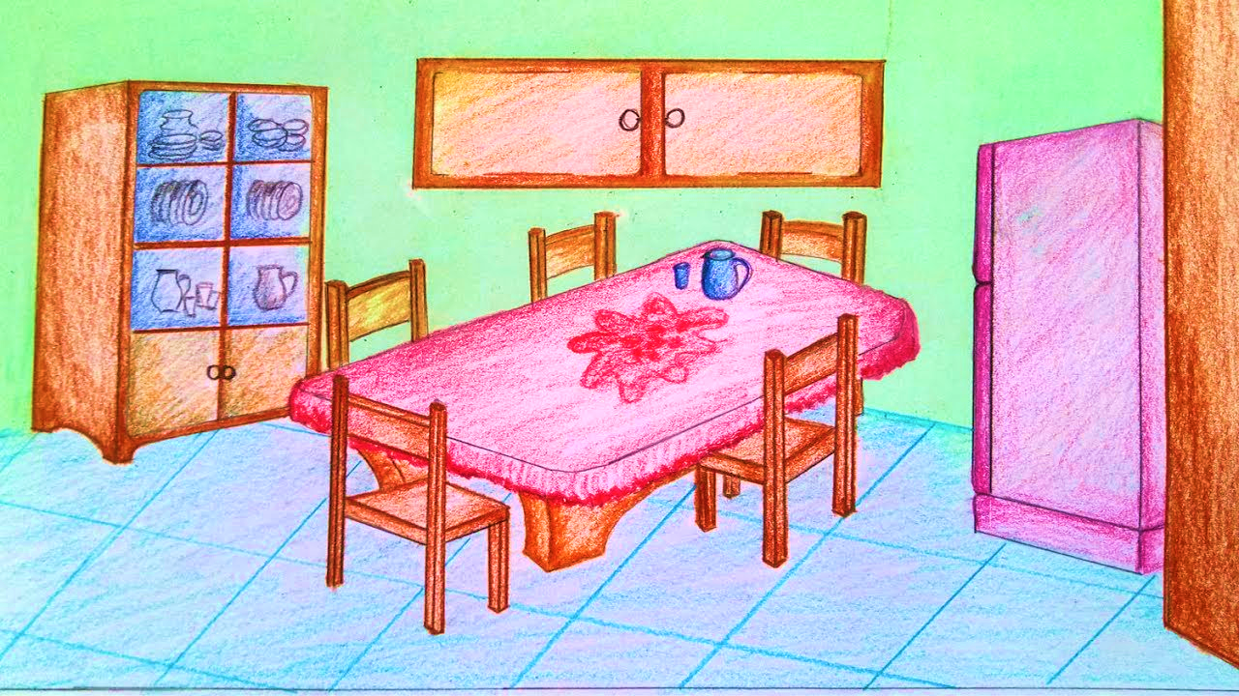
Let’s draw a picture of dining room!

Slide 31
Assessment
Notes:
Đây k phải là extra, đây là hđ 3 của bài

Slide 32

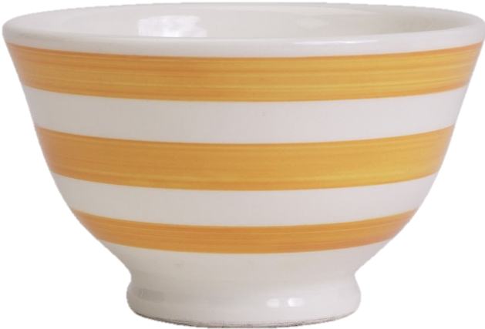

Matching Game
bowl
spoon
1
4
plate
2
table
dining room
3
5

Slide 33
Wrap up
Notes:
Đây k phải là extra, đây là hđ 3 của bài

Slide 34



Vocabulary
Structure
bowl: bát
spoon: thìa
plate: đĩa
table: bàn
dining room: phòng ăn
There is a ....
There are ….

Slide 35




Thank you & goodbye!

