Slide 1






















Slide 2
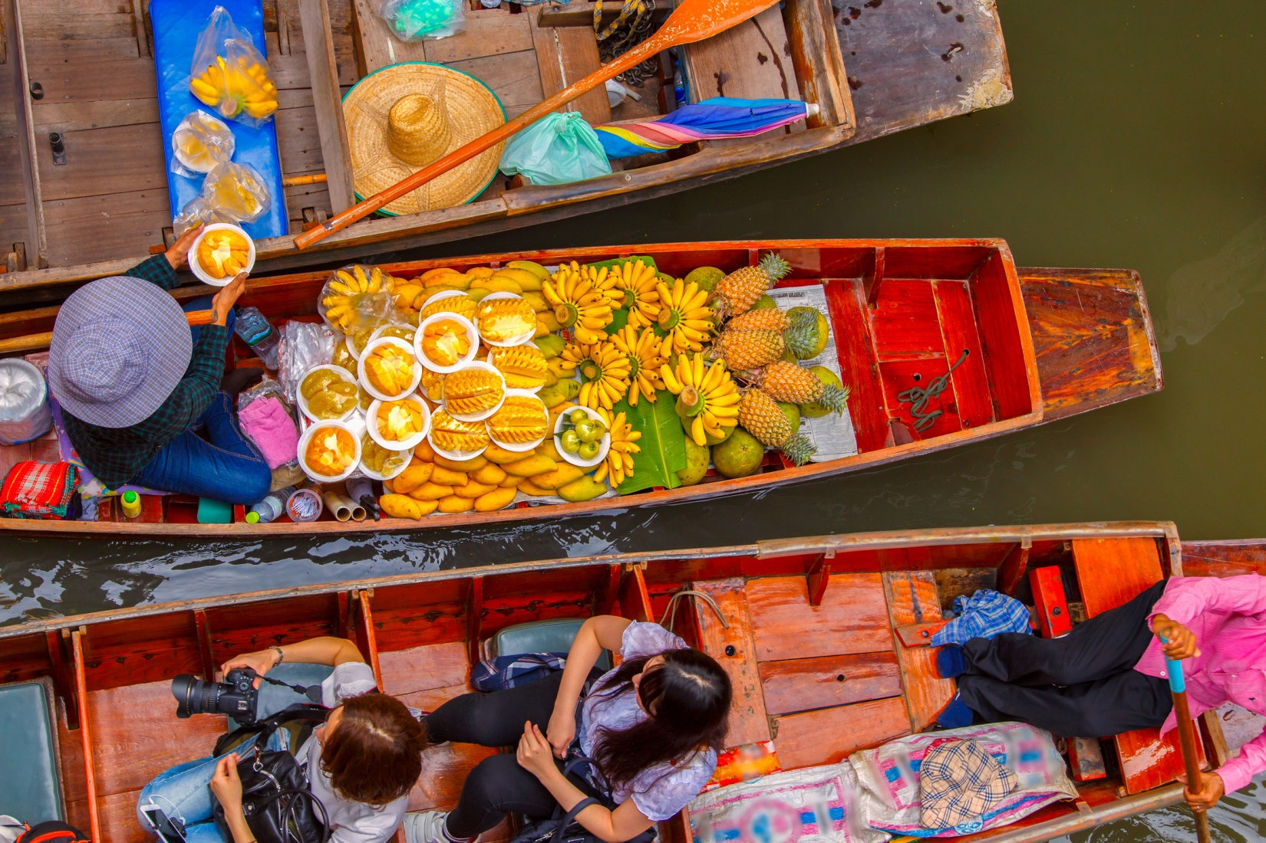

Unit 9:
My Favourite Food
Lesson 1 – Task 1, 2, 3

Slide 3
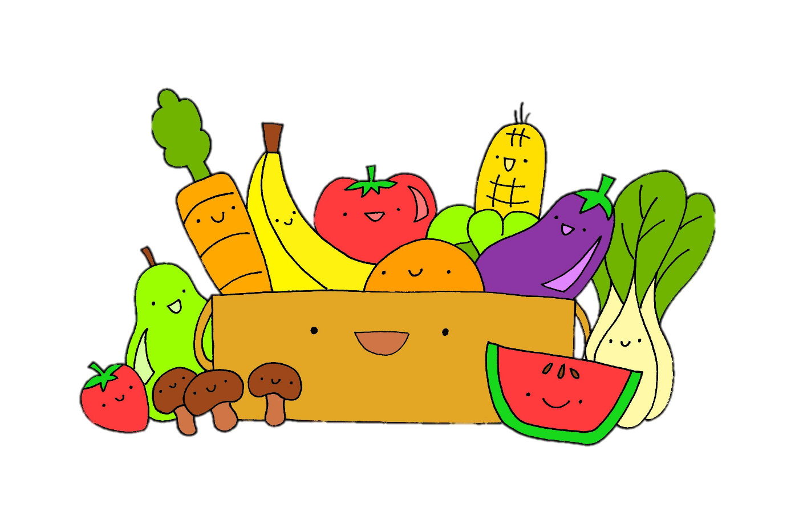
1 WARM UP
Movement Game.

Slide 4
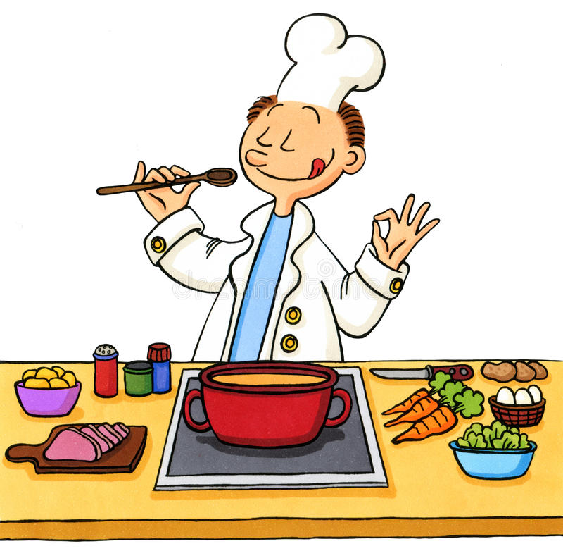
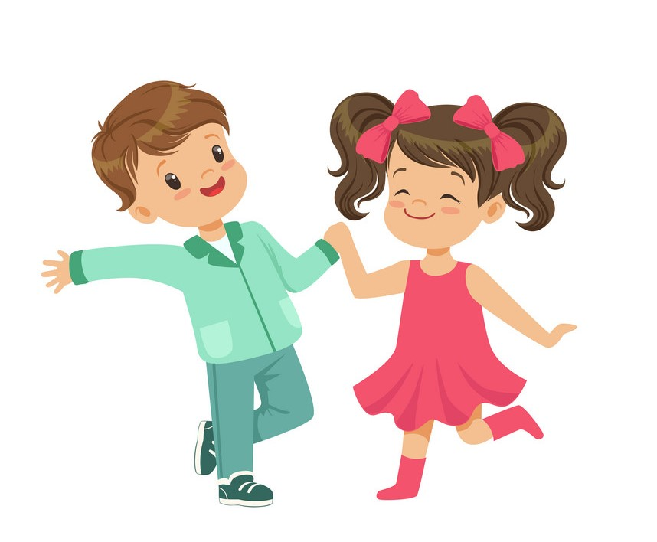


eat
read
cook
dance

Slide 5



Matching
A
B
C
D
book
food
kitchen
music
1
2
3
4
Notes:
Bấm vào tranh để nối

Slide 6
Look. What can you do with these things. Tick.
eat
cook
read
dance
Food market, Bangkok, Thailand

Slide 7




2 PRESENTATION
Task 1 Listen and point. Repeat.

Slide 8
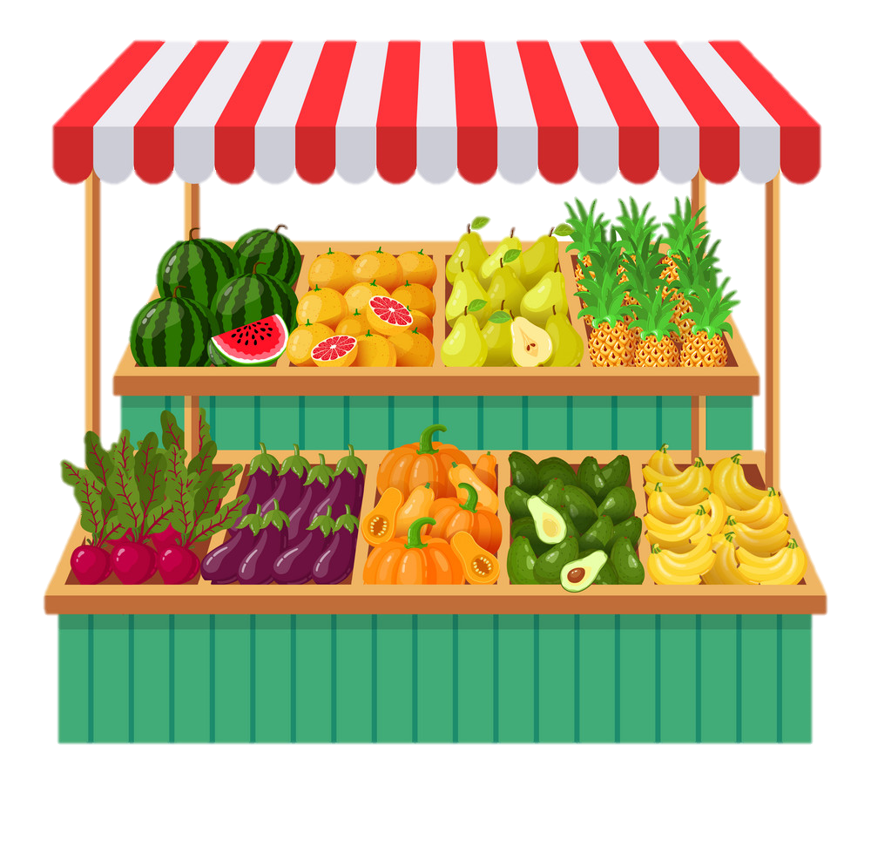
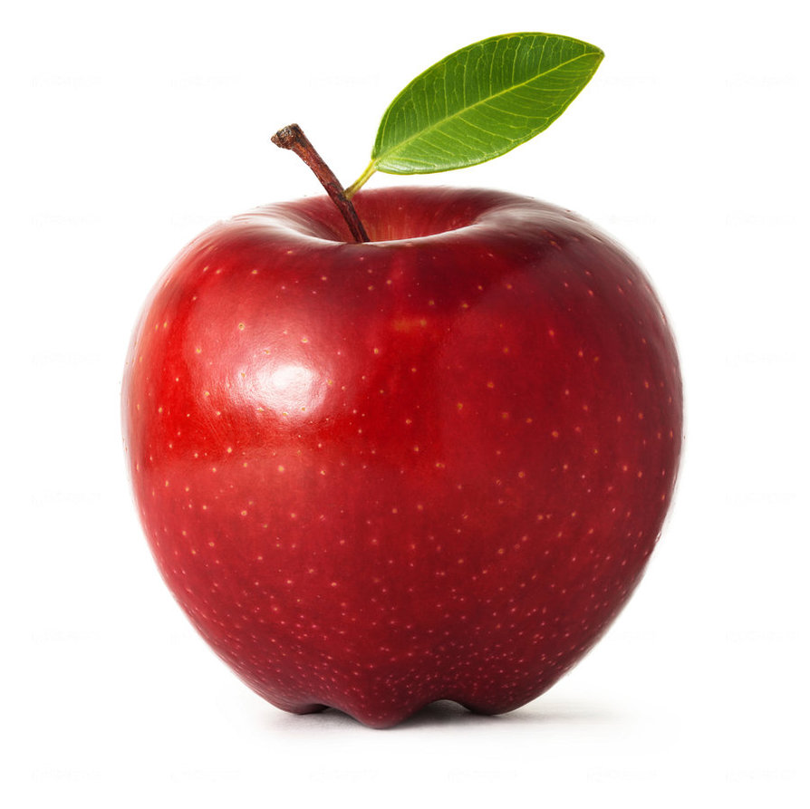

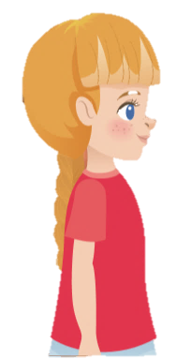
New words
apple
Sophie
Alex

Slide 9
New words
banana
Sophie
Alex

Slide 10
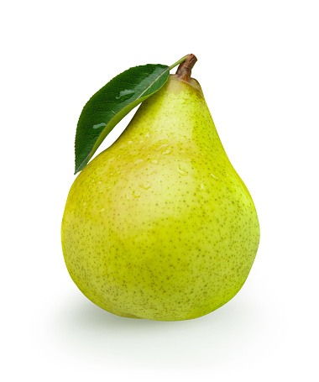
New words
pear
Sophie
Alex

Slide 11
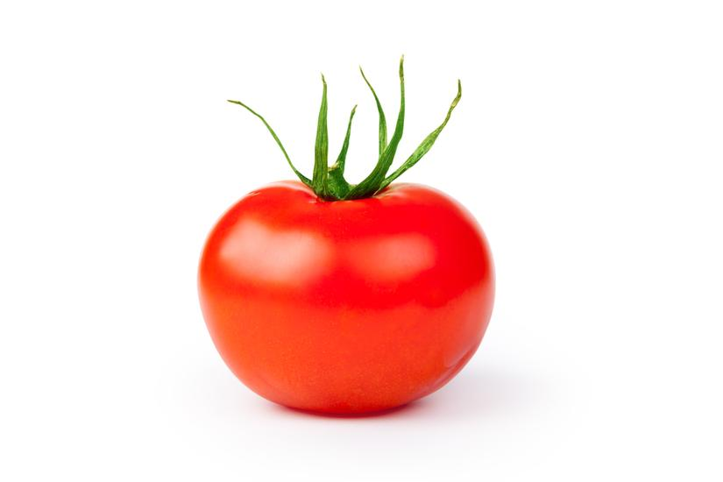
New words
tomato
Sophie
Alex

Slide 12
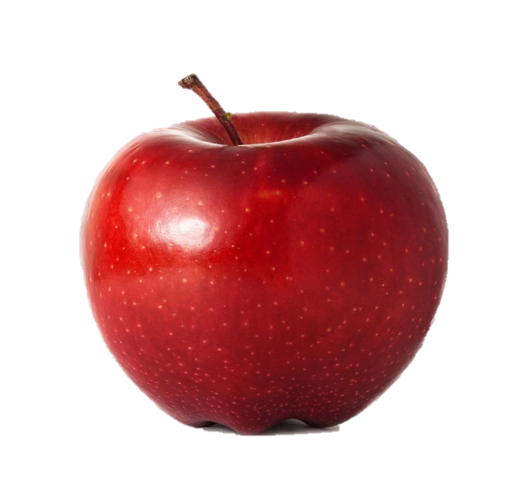
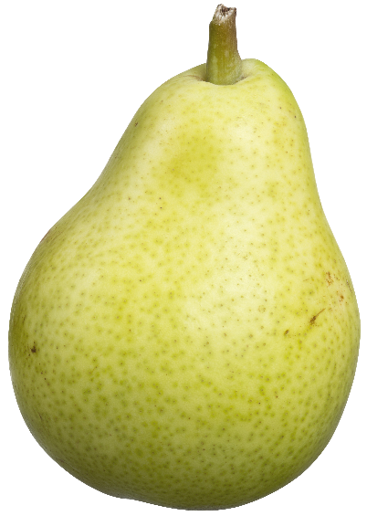

Listen and point. Repeat.
apple
pear
banana
tomato

Slide 13

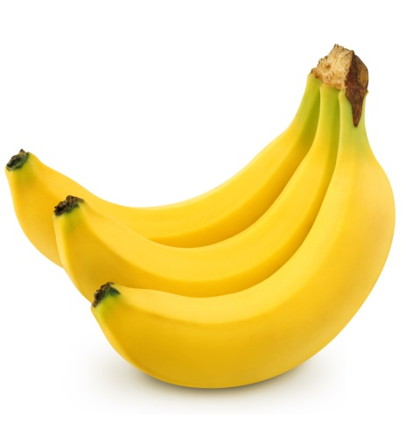



Memory game
Let’s check
1
2
3
4
apple
tomato
5
6
7
8
pear
banana
Notes:
Bấm vào số để mở các mảnh ghép
Bấm vào biểu tượng tròn đỏ để đóng các mảnh ghép nếu mở sai
Bấm vào biểu tượng V để biến mất 2 mảnh ghép đã chọn đúng

Slide 14
3 PRACTICE
Task 2 Listen and write.

Slide 15


Listen and write.
Yes! There are many tomatoes! And look at that man over there. What’s he doing ?
Look! A lot of tomatoes !
He is throwing a tomato!
That man is throwing a __________.
tomato

Slide 16

4.PRODUCTION
Task 3 Look at 1. Draw and guess.
Notes:
(Divide class into 6 groups. A student in each group chooses an action and acts out it for the rest of the group to guess. The rest of group have to say a full sentence He/she can…. )
- Introduce and set game rules
- Do a demo
- Play several rounds.

Slide 17
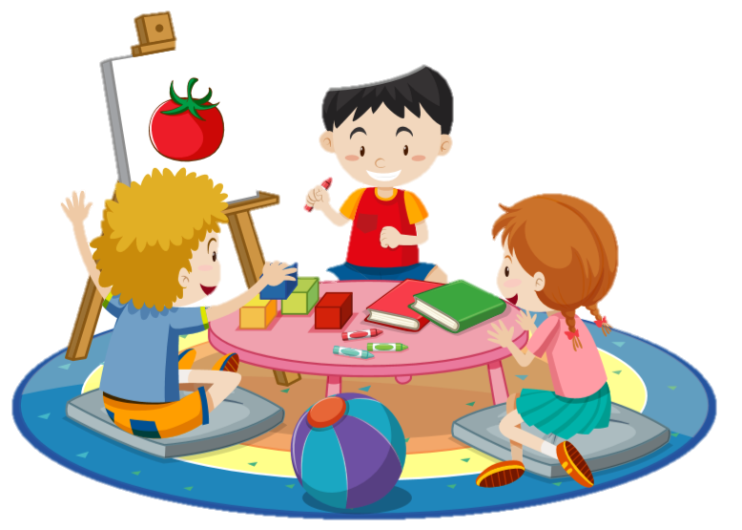
No, I’m not.
Yes, I am.
Are you drawing an apple?
Are you drawing a tomato ?

Slide 18

5.ASSESSMENT

Slide 19




I
T
S
H
P
E
A
R
T
P
E
A
R
M
O
K
U
V
S
P
U
O
X
M
F
O
O
T
A
L
M
A
B
A
N
A
N
A
P
E
B
A
P
A
N
A
N
A
FIND AND CIRCLE
E
T
O
P
A
P
R
T
M
P
A
O
L
O
H
P
O
S
L
S
R
V
N
M
F
E
K
E
E
T
O
M
E
T
O
M
A
Notes:
Teacher click on the first letter of the word to make it change color.

Slide 20




Thank you & goodbye!

