Slide 1









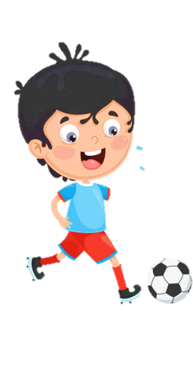
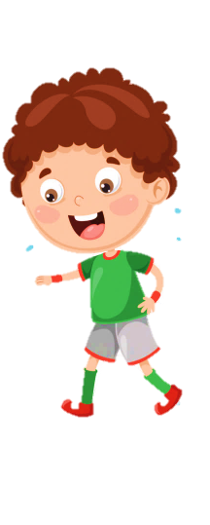












Slide 2


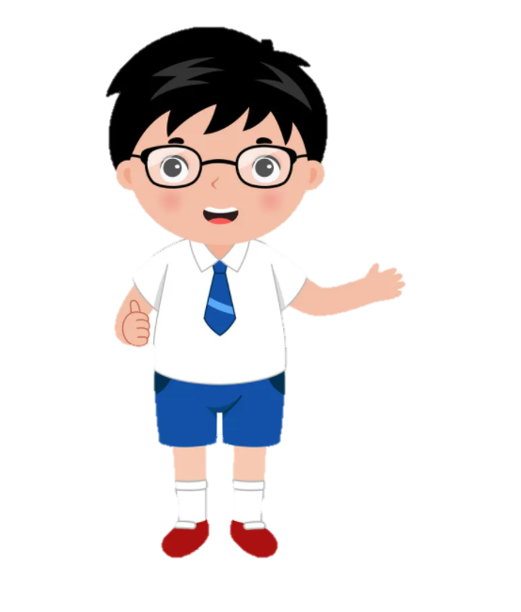



Unit 10
Our World
Lesson 1 – Task 1,2,3

Slide 3

1
Warm Up
Listen to the song

Slide 4
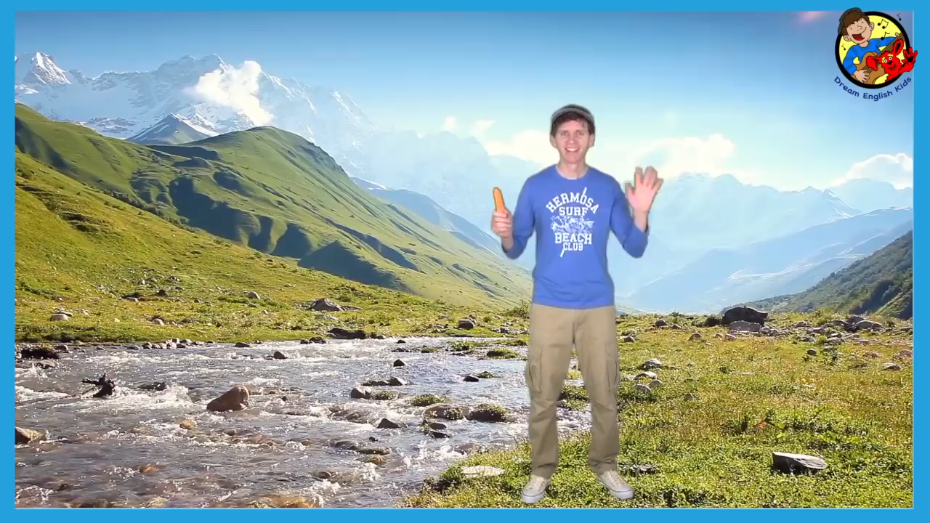

Slide 5

Where do you see?

Slide 6
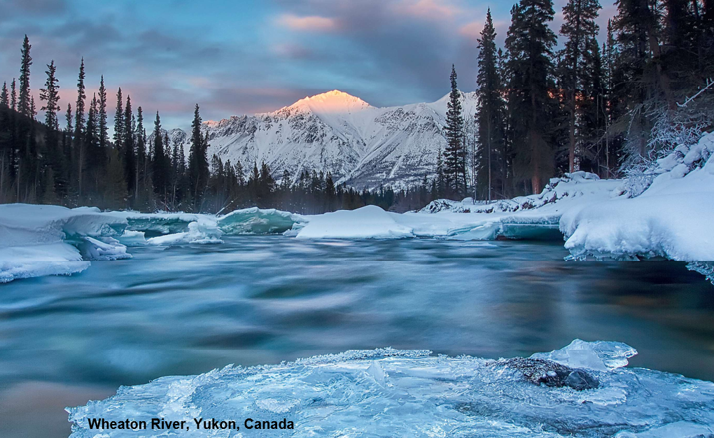
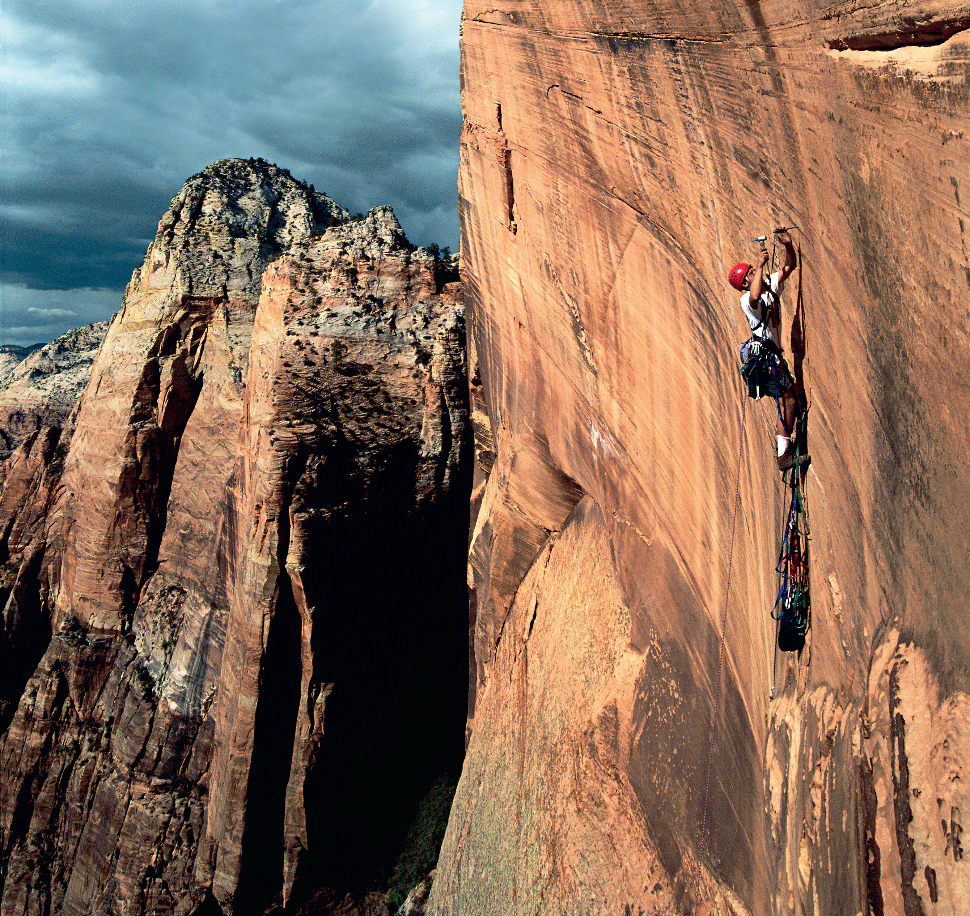
I love skiing. So, where can I go ?
Can you see them in the song ?
river
mountain

Slide 7


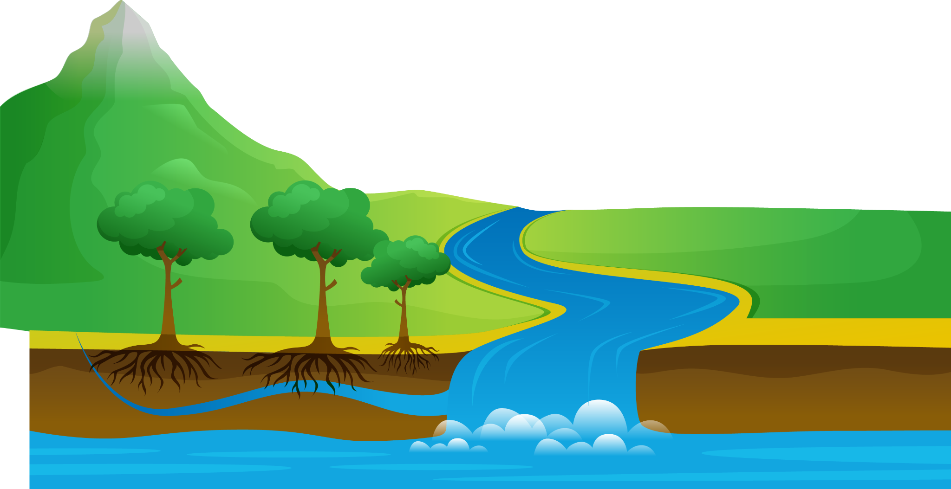

Presentation
2
1
Listen and point. Repeat.

Slide 8

Look at the photo. Tick
✓
nice
ugly
funny
great
Wheaton River , Yukon, Canada

Slide 9


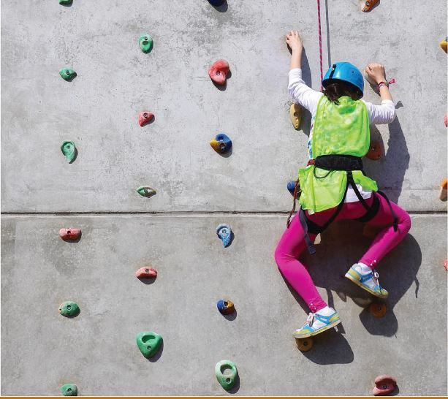
1
Listen and point. Repeat.
climb

Slide 10
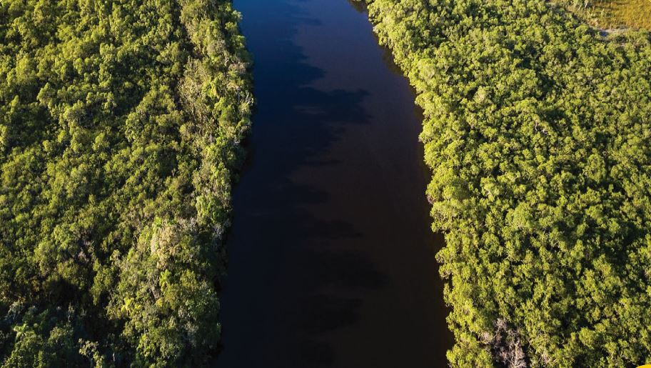
river

Slide 11
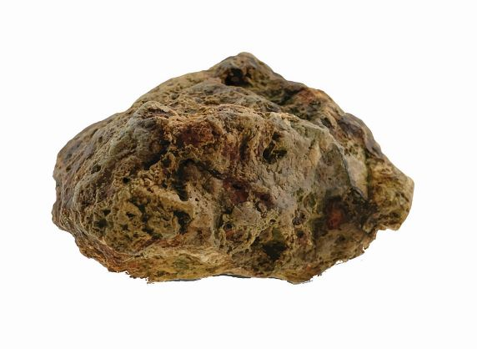
rock

Slide 12
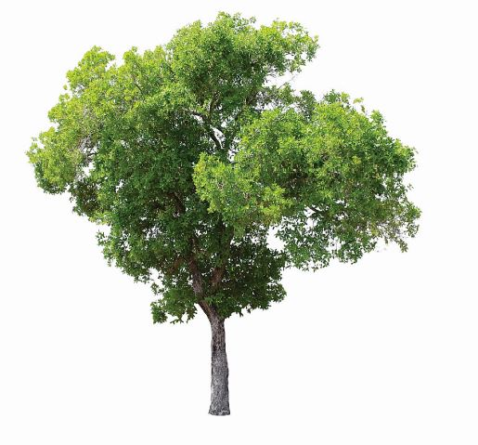
tree

Slide 13

water

Slide 14
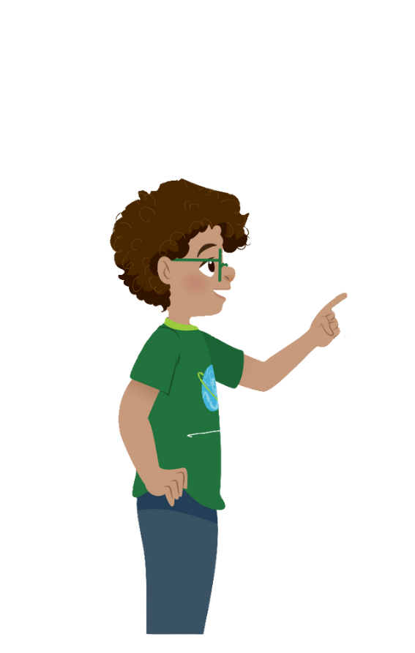
climb
river
rock
tree
water

Slide 15

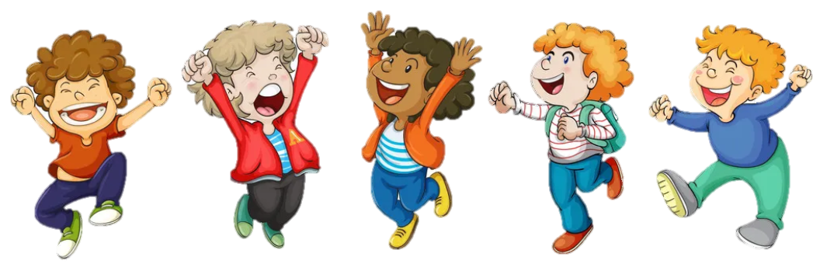
VOCABULARY CHECKING
PASS THE BALL GAME
Notes:
Pass the ball. When the music stops – whoever has the ball must answer the question

Slide 16


Pass the BALL!

Slide 17
It’s a rock.

Slide 18
Pass the BALL!

Slide 19
tree

Slide 20
Pass the BALL!

Slide 21
water

Slide 22
Pass the BALL!

Slide 23
river

Slide 24
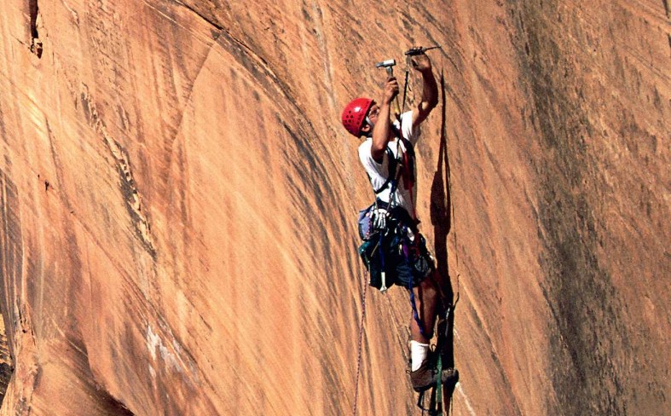

1. Listen and point. Repeat.
nature
climb
river
rock
tree
water

Slide 25


3
Practice
2
Listen and tick

Slide 26
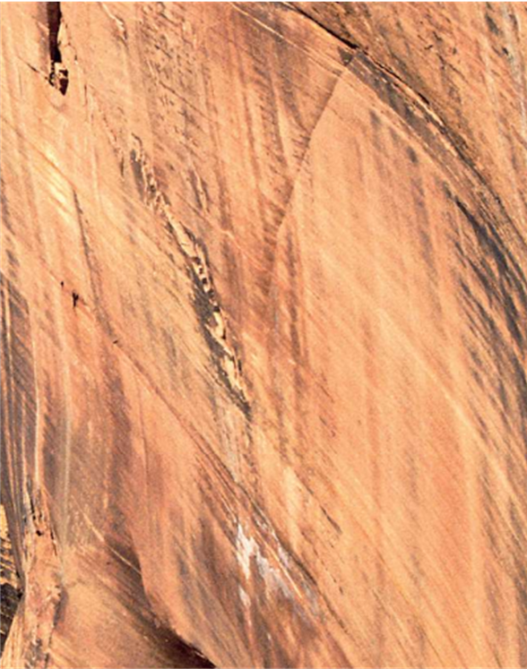


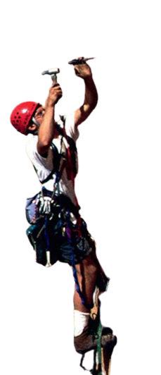
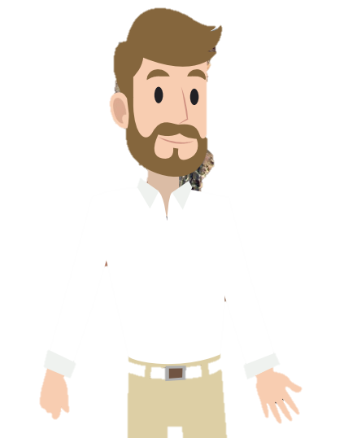
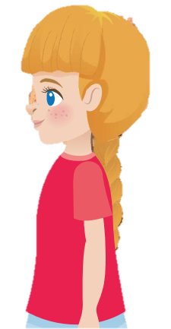
2. Listen and tick.

Slide 27
2. Listen and tick.

Slide 28
2. Listen and tick.
Yes, Uncle John.
Wow! You can climb
the rock!
Look! Can you see
me in the photo?
Yes. And I climb
big rocks with my friends!

Slide 29
2. Listen and tick.
Yes, Uncle John.
Wow! You can climb
the rock!
Look! Can you see
me in the photo?
Yes. And I climb
big rocks with my friends!
Can Uncle John climb the rock?
✓
Yes, he can.
No, he can’t.

Slide 30
Listen and Match

Slide 31

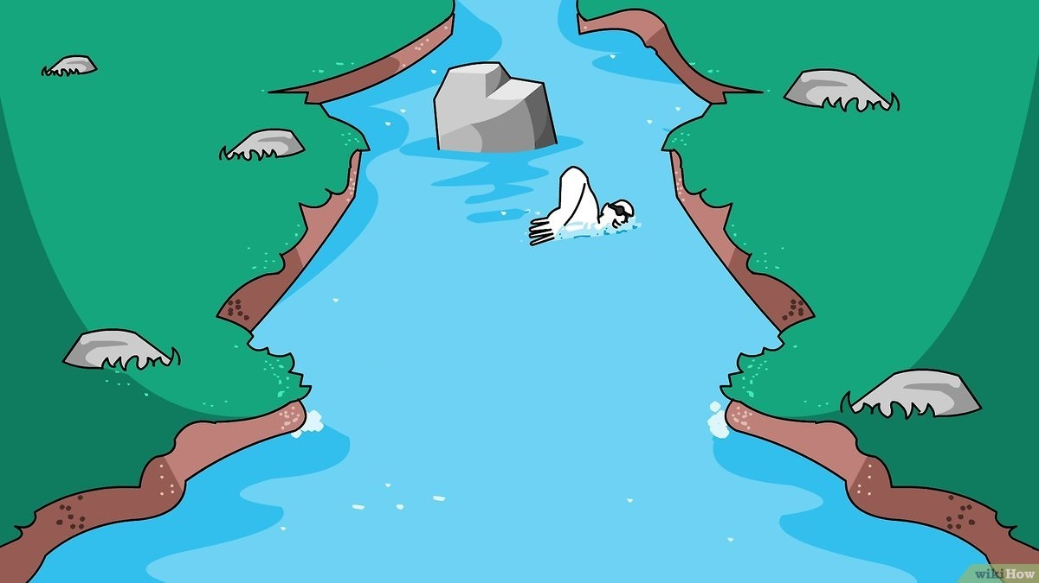
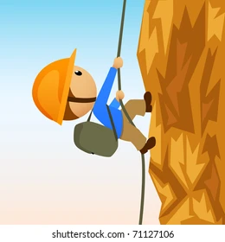
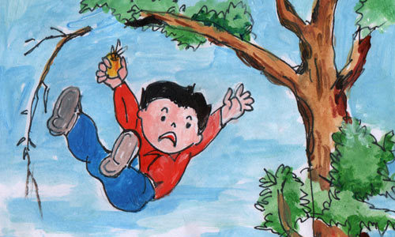
a. Yes, I can.
1.
b. Yes, I can.
2.
c. No, I can’t.
3.
d. No, I can’t.
4.

Slide 32
Can you drink cold water?

Slide 33
Can you swim in the river?

Slide 34
Can you climb the rock?

Slide 35
Can you climb the tree?

Slide 36
4
Production
3
Ask and answer. Tick.

Slide 37
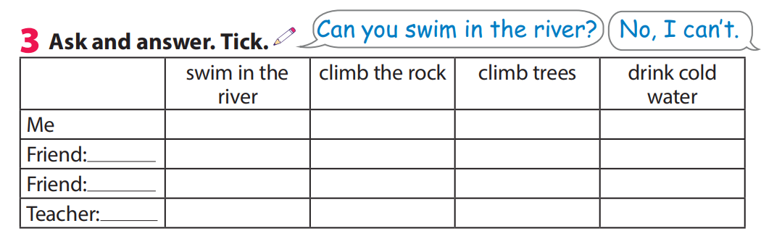

3 Ask and answer. Tick .

Slide 38



5
Assessment
Match

Slide 39
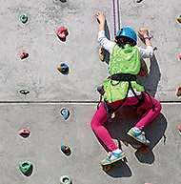
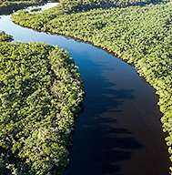
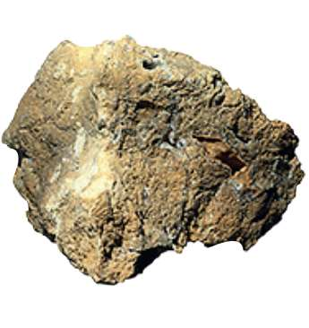
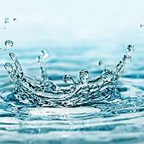
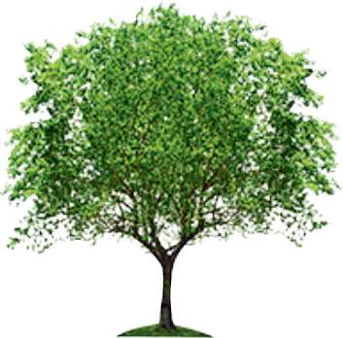
Match
1.climb
2.rock
a
b
3.river
4.tree
c
d
e
5.water
Notes:
HOẠT ĐỘNG TƯƠNG TÁC

Slide 40



See you next time!

