Slide 1





















Unit 1
My family
Lesson 2 – Task 1,2,3
Notes:
Để nguyên trang bìa như này, chỉ thay đổi tên bài trong quá trình làm. Logo của sách Wonderful World

Slide 2







Warm up
Review: My Family.

Slide 3

Notes:
https://www.youtube.com/watch?v=FHaObkHEkHQ&t=65s

Slide 4


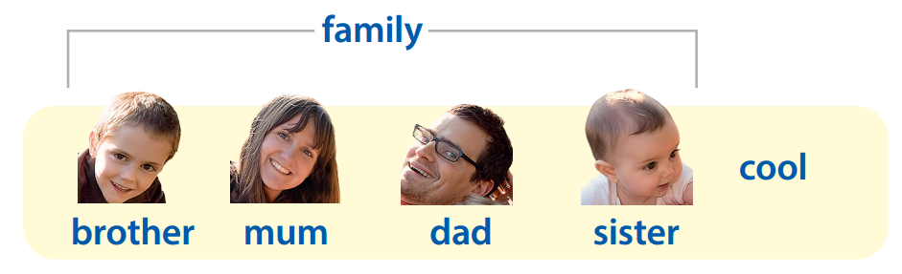
Review

Slide 5

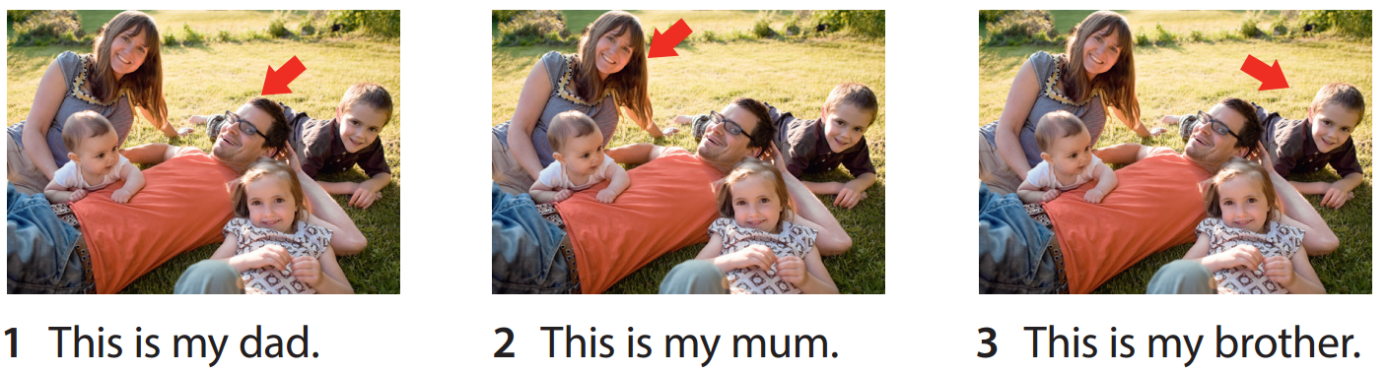

Notes:
Listen and repeat

Slide 6










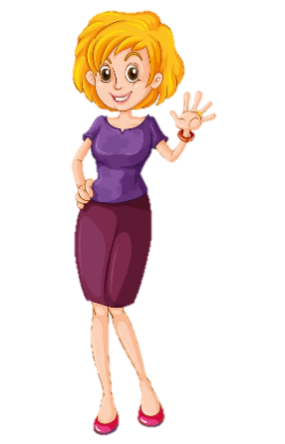
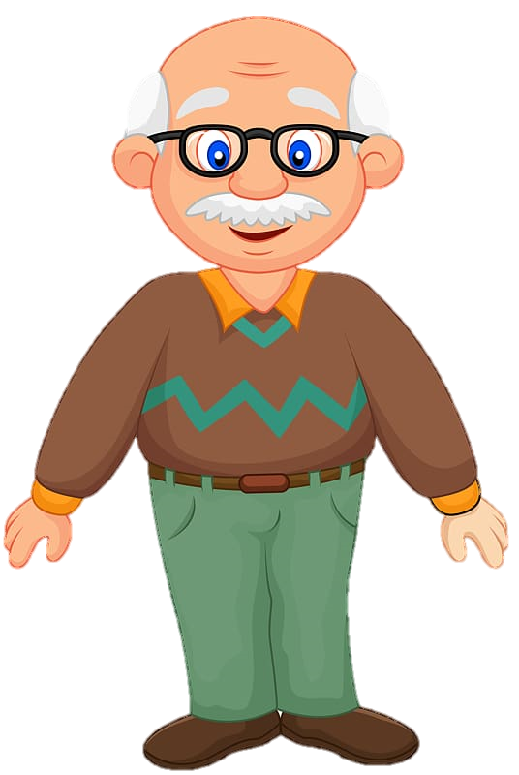
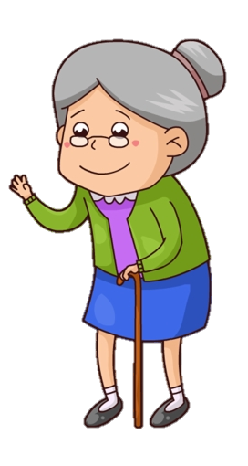





Notes:
Game: Family at home “Who is in the room?
- Revise the words from Lesson 1 with the flashcards.
- Divide class into 2 groups: Boys and Girls.
- Ask students to look at the picture. Then each group will answer who is in the room.
- Read out loud the sentence.

Slide 7



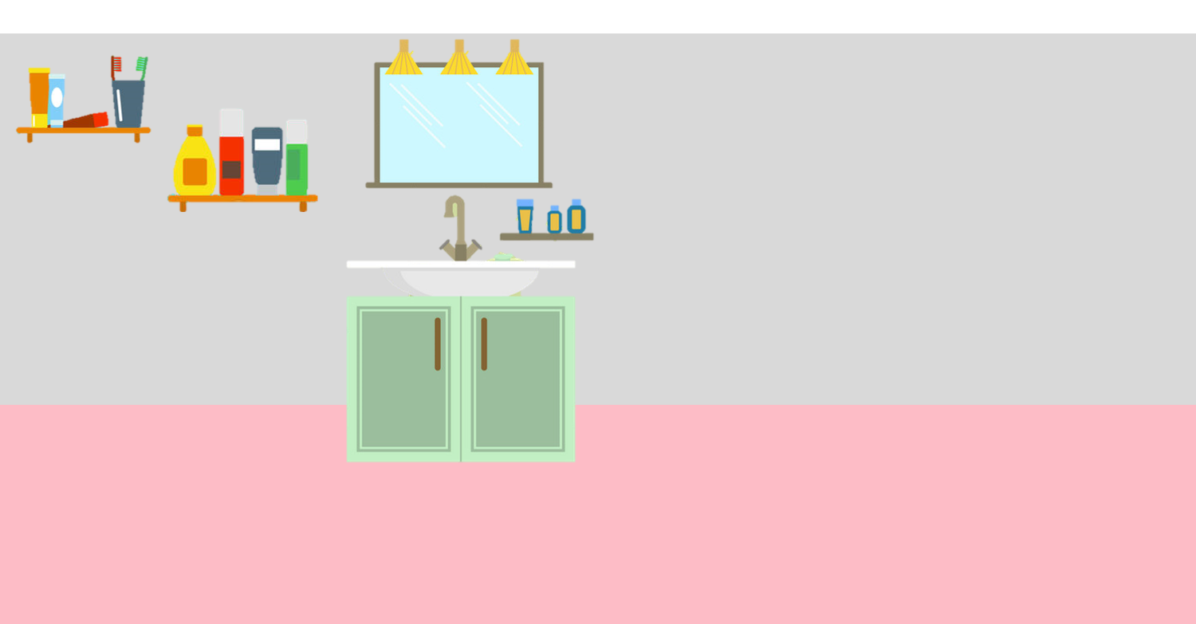


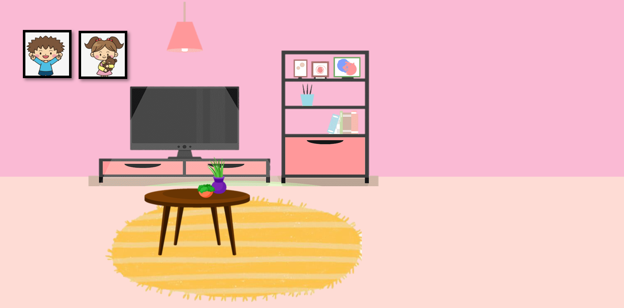
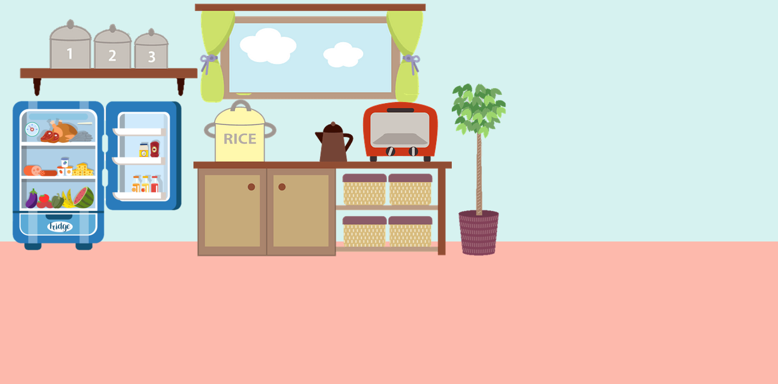
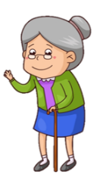
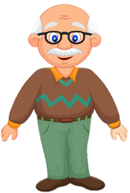
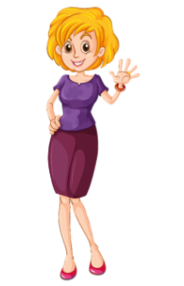


Brother
_______ is in the bedroom.
Notes:
Gv đặt câu hỏi “ Who is in the bedroom?
Note : Khi đáp án phải click rõ vào ảnh nhân vật (thành viên).
Đáp án Brother

Slide 8
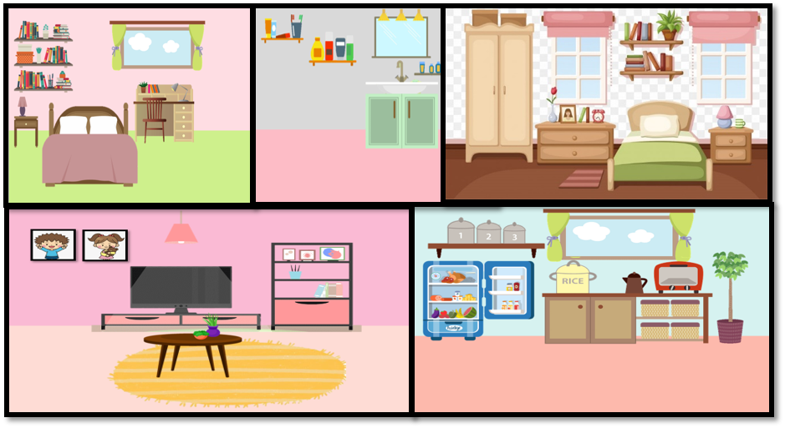


Mum
_____ is in the kitchen.
Notes:
Gv đặt câu hỏi “ Who is in the bedroom?
Note : Khi đáp án phải click rõ vào ảnh nhân vật (thành viên).
Đáp án Mum

Slide 9
Dad
____ is in the bathroom.
Notes:
Gv đặt câu hỏi “ Who is in the bedroom?
Note : Khi đáp án phải click rõ vào ảnh nhân vật (thành viên).
Đáp án Dad

Slide 10



Grandpa
________ is in the living room.
Notes:
Gv đặt câu hỏi “ Who is in the bedroom?
Note : Khi đáp án phải click rõ vào ảnh nhân vật (thành viên).
Đáp án Grandpa

Slide 11
Grandma
_______ is in the garden.
Notes:
Gv đặt câu hỏi “ Who is in the bedroom?
Note : Khi đáp án phải click rõ vào ảnh nhân vật (thành viên).
Đáp án Grandma

Slide 12

Presentation
Task 1: Listen and point. Repeat.

Slide 13

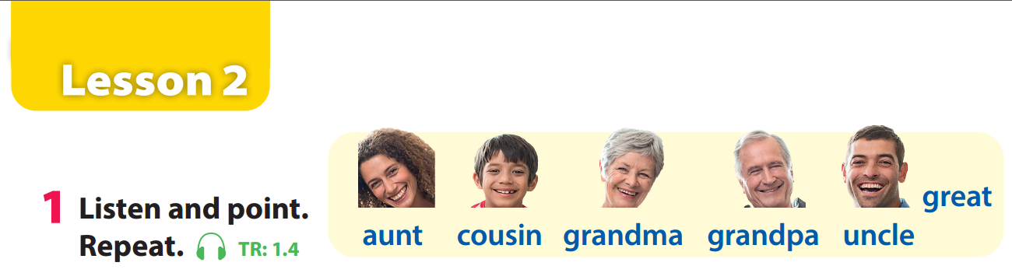


Notes:
GV click audio trước nghe tới đâu thì click point vào.
Task 1: Listen and point. Repeat. (Track 1.4)
- Use flashcards to introduce the vocabulary and structure of lesson.
- Say the words for students to repeat in chorus.
- Play the recording for the students to listen to, point to, and repeat the words.
- Read out the new picture words in the vocabulary box in random order and ask students to point to the correct pictures.
- Read out the word great. Explain the meaning. Then say a student’s name, e.g. Bao’s great! and ask students to repeat. Ask volunteers to stand at the front and do the same with any name they like.

Slide 14







Touch the board
Notes:
Mini game: Touch the board
- Have 4 -5 students come to the board.
- Teacher calls out a word. Once the word has been called, have the students turn around and touch the correct picture.

Slide 15

Practice
Task 2: Listen and write.

Slide 16

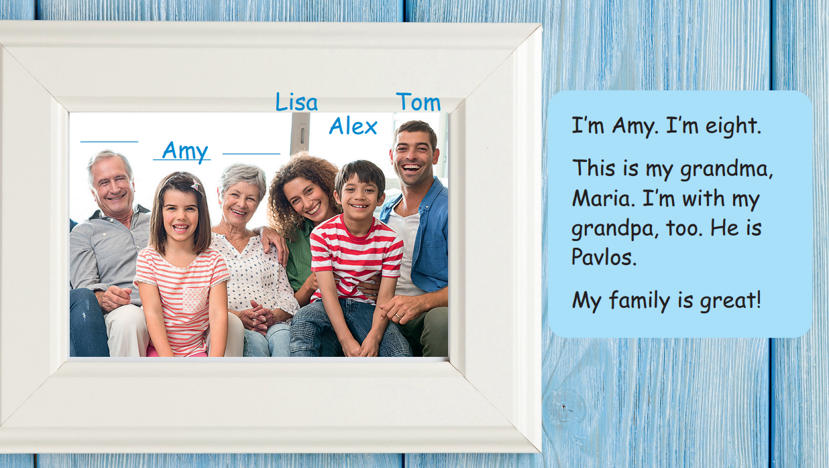
Pavlos
Maria
Notes:
Task 2: Listen and write. (Track 1.2)
- Ask students to look at the family photo and count the number of members.
- Point to the names in the text. Read them out and ask students to repeat.
- Play the recording. Tell students to look at the picture and follow the text with their fingers.
- Play the recording again, pause after each sentence and ask students to repeat.
- Ask students to practice reading out the text individually and in pairs. Ask some volunteers to read it out in front of the whole class.
- Tell students to look at the photo and ask what should be filled in the gaps. Elicit “names”. Ask students to read the text again to find out information to fill in the gaps.
- Check answers as the whole class.

Slide 17



How old is Amy?
How is her family?

Slide 18
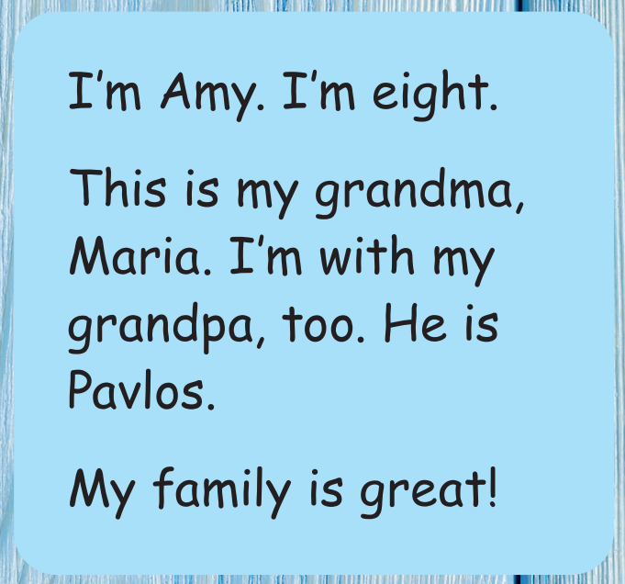
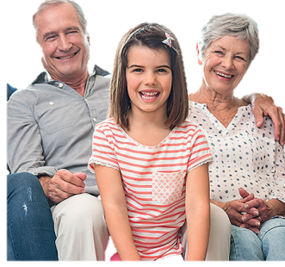
Notes:
T asks Ss to listen and look at the text. Then, Ss will write their family.

Slide 19
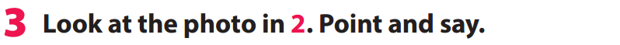

This is me, Amy.
This is my aunt, Lisa.
Notes:
Task 3: Point and say.
- Ask students to work pairs. Tell them they are going to say sentences based on the photo in Activity 2.
Ask students to look back at the photo in Activity 2 and the sample sentences in Activity 3.
Hs có thể thay thế tên mình & tên các thành viên của con.

Slide 20






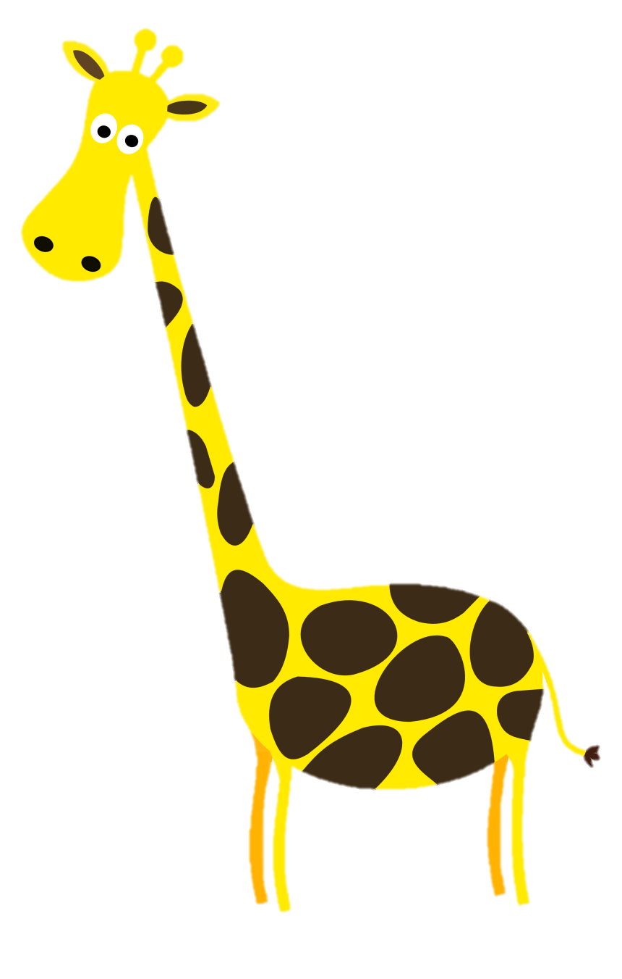







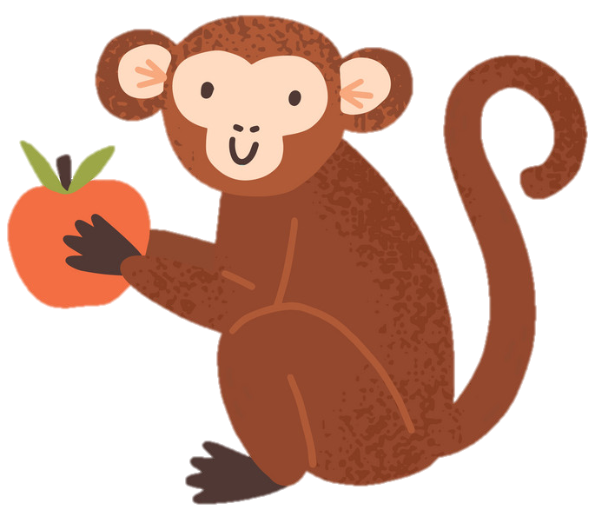

Picking apples
Notes:
GV chọn bất kỳ 1 quả táo. Mỗi quả táo tượng trưng cho câu hỏi

Slide 21


This is me, Amy.

Slide 22
This is my aunt, Lisa.

Slide 23
This is my cousin, Alex.

Slide 24
This is my uncle, Tom.

Slide 25

Production
My family tree

Slide 26

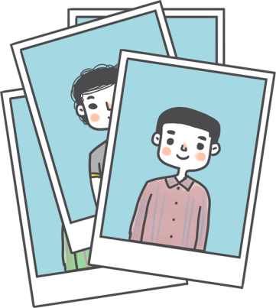

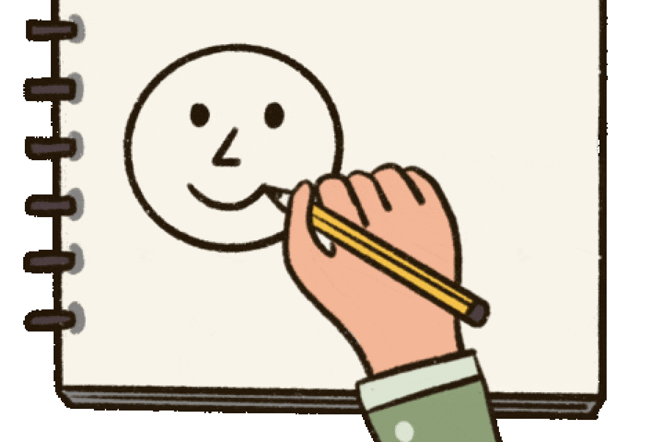
tree
1
draw
2
Notes:
Make "My Family Tree" Posters.
- Give out a piece of colored paper to each student.
- Write in large letters "My family " at the top. Then students draw pictures of members in their family (grandparents at the top, next parents and he/she and siblings at the bottom).
- Finally, under each family member photo/picture write the vocab (grandpa, grandma, etc.).

Slide 27






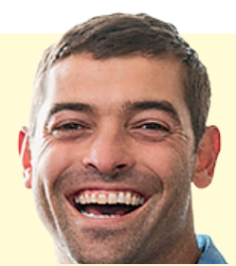

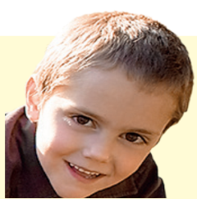
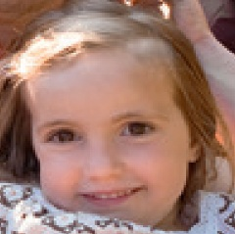


3
My family
grandma
grandpa
mum
dad
uncle
ant
brother
me
sister
cousin
Notes:
Make "My Family Tree" Posters.
- Give out a piece of colored paper to each student.
- Write in large letters "My family " at the top. Then students draw pictures of members in their family (grandparents at the top, next parents and he/she and siblings at the bottom).
- Finally, under each family member photo/picture write the vocab (grandpa, grandma, etc.).

Slide 28

Assessment
Notes:
Mỗi hs phải mang ảnh gia đình để chơi game này.

Slide 29
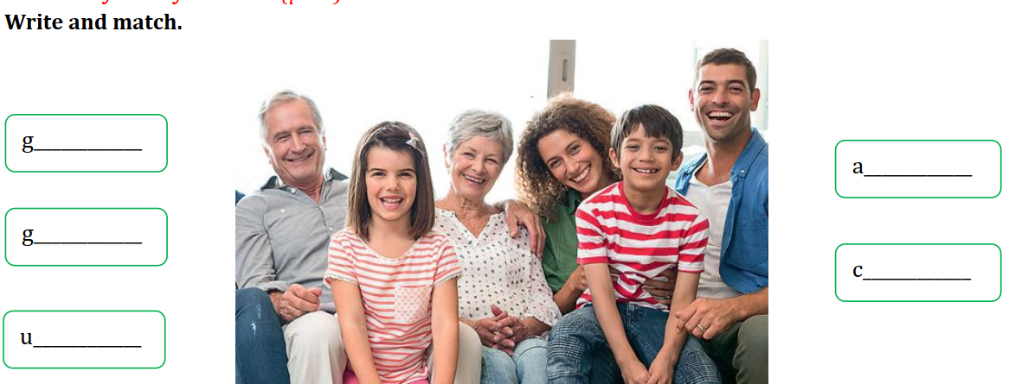
randma
unt
randpa
ousin
ncle
Notes:
Option 1: write and match
Sts look at the picture and say the words, one by one. Then write and match.

Slide 30



Good bye.
See you again!

