Slide 1




















Notes:
Để nguyên trang bìa như này, chỉ thay đổi tên bài trong quá trình làm. Logo của sách Wonderful World

Slide 2
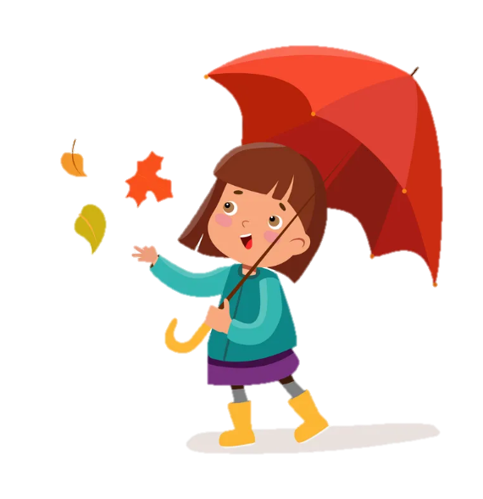
Unit 10
Funtime and Project
R
R
A
W
A
W
I
N
B
O
I
N
B
O

Slide 3
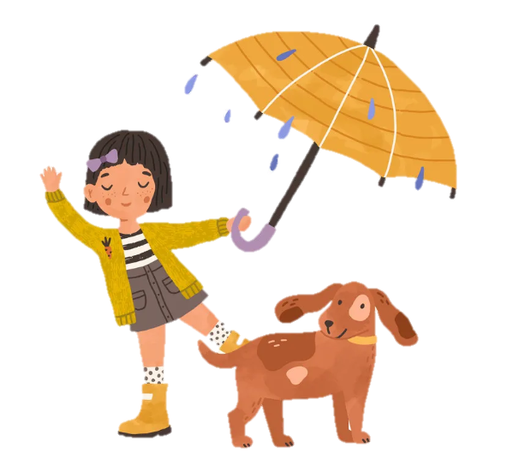
1
Warm Up
MAGIC WHEEL GAME

Slide 4
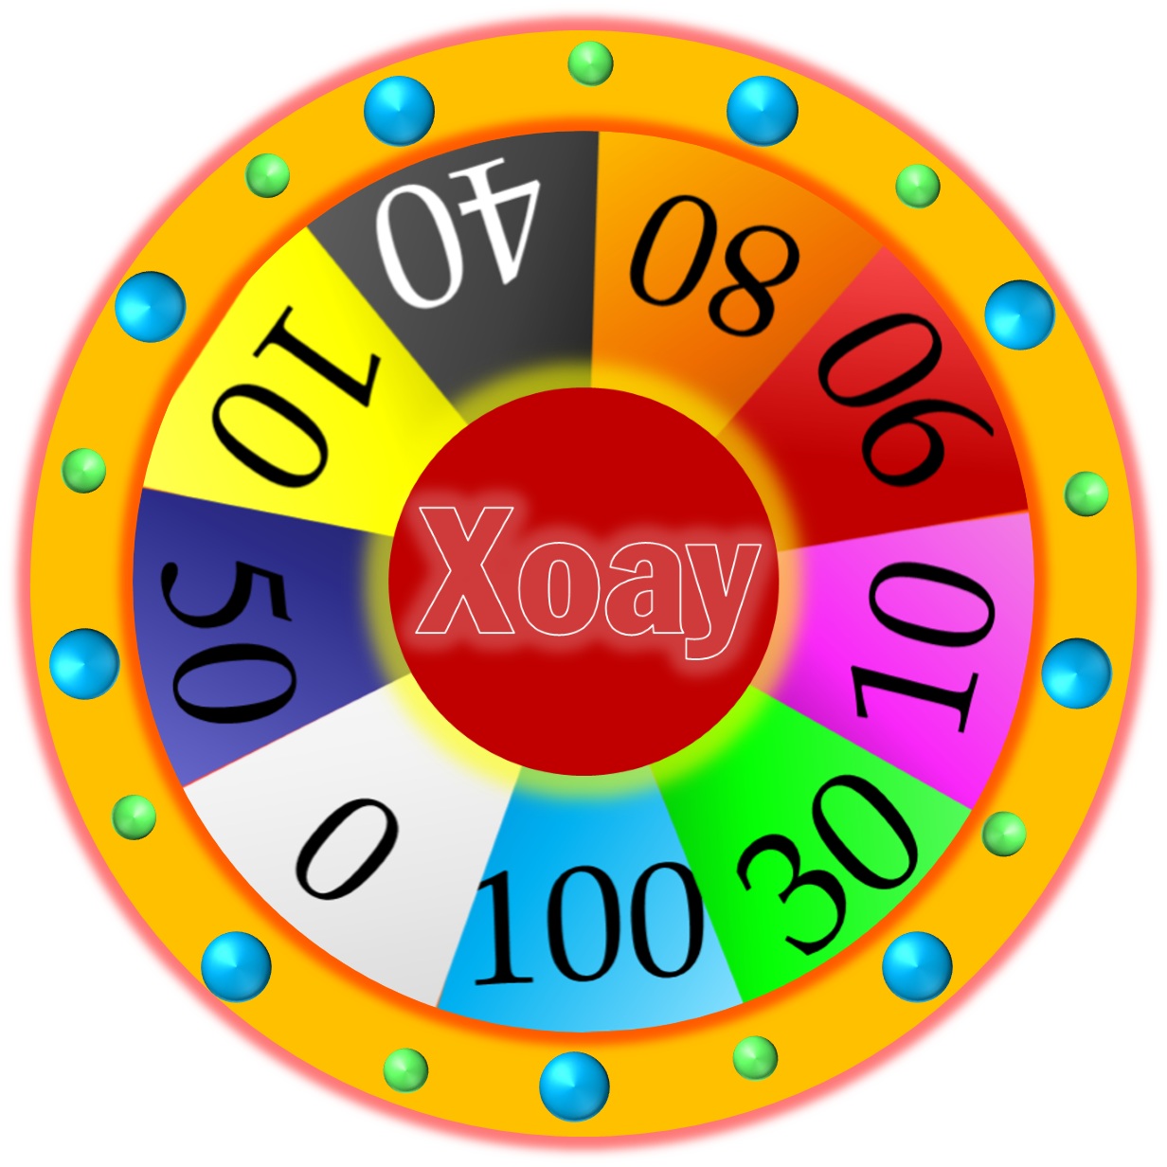

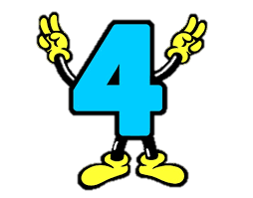


QUESTION
1
1
4
2
2
5
5
1
3
3
6
Lost
Next

Slide 5
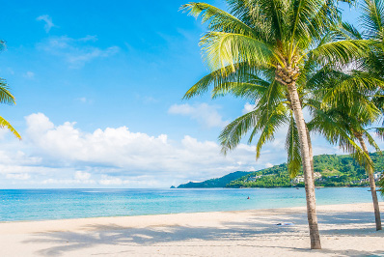
SUMMER

Slide 6

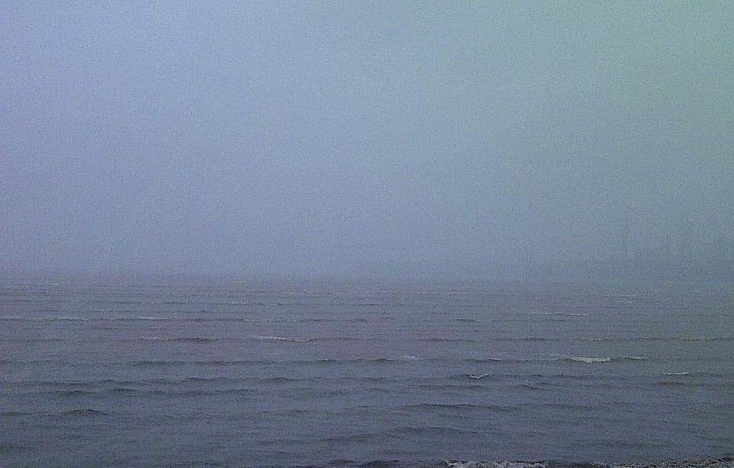

What’s the weather like today?
It’s rainy.

Slide 7
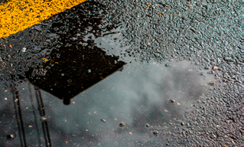
It’s dry.
It’s wet.

Slide 8
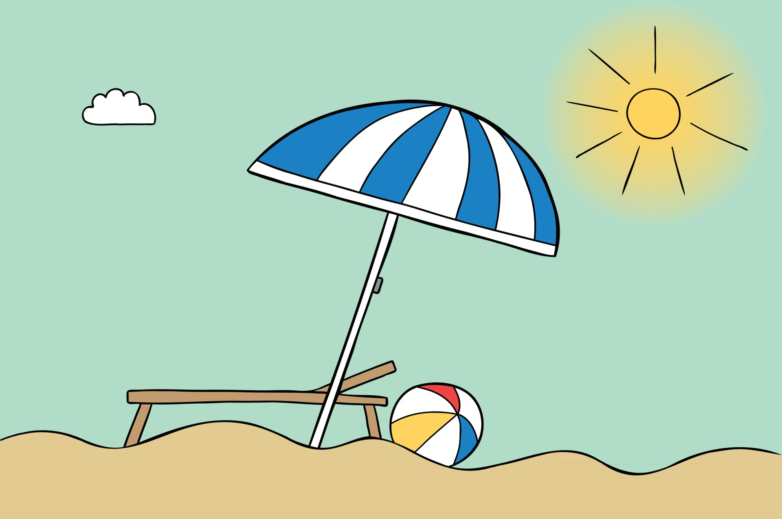
What’s the weather like today?
It’s sunny.

Slide 9
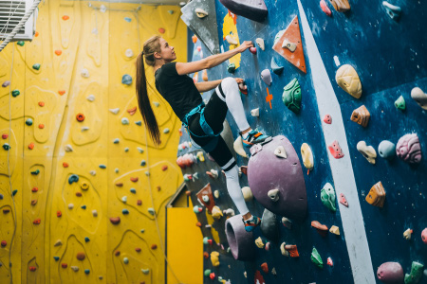

climb

Slide 10
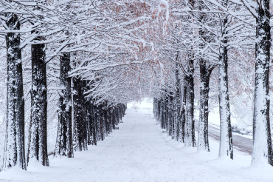
Winter
Autumn

Slide 11
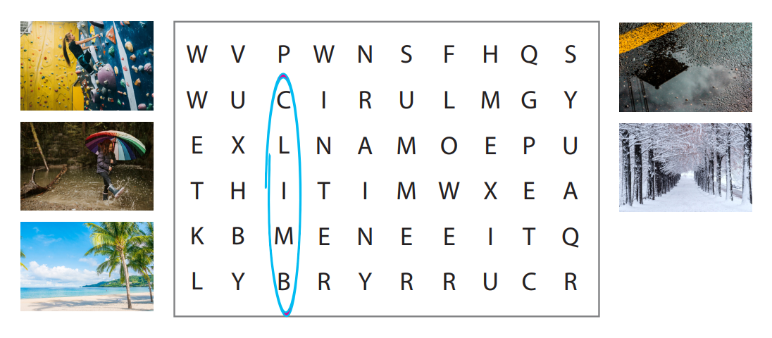
Find and Circle
Notes:
HOẠT ĐỘNG TƯƠNG TÁC

Slide 12
2
Project

Slide 13
Project animals

Slide 14
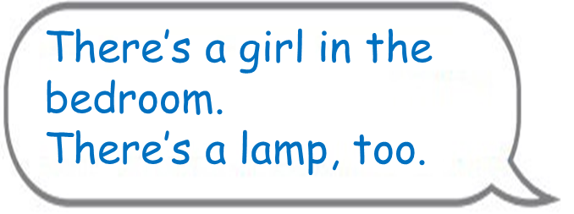

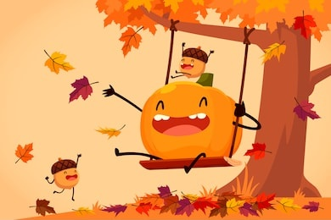
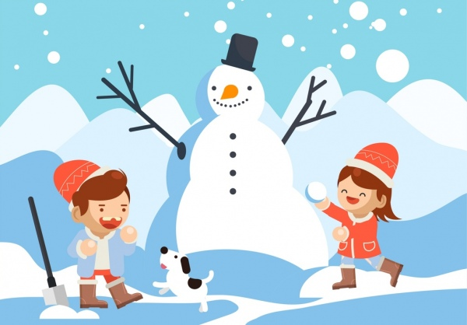
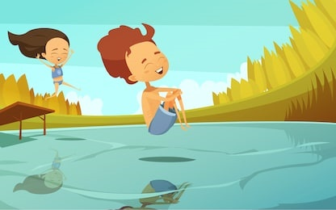
What are the four seasons of the year?
How is the weather in spring/ autumn/ summer /winter?
What do you do in spring/ autumn/ summer /winter?
What’s your favourite season?

Slide 15
It’s autumn.
It’s spring.
3.
1.
It’s summer.
It’s winter.
2.
4.

Slide 16
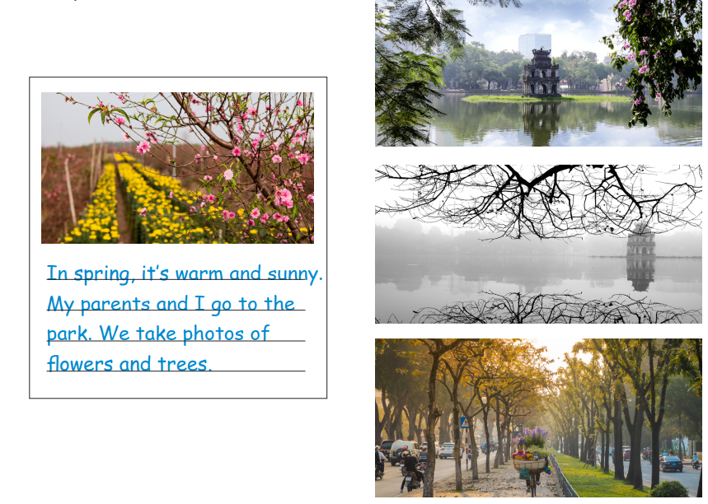
Write about the weather and what you do in different seasons.
Tell your class about it.

Slide 17
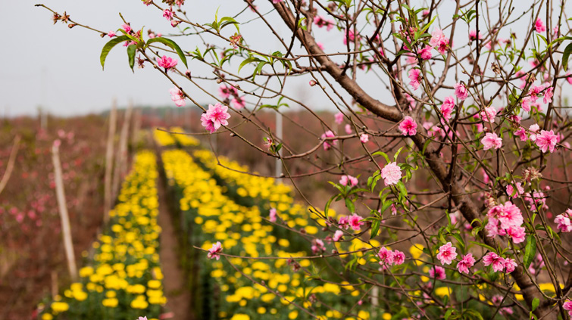
In spring, it’s warm and sunny. My parents and I go to the park. We take photos of flowers and trees.

Slide 18
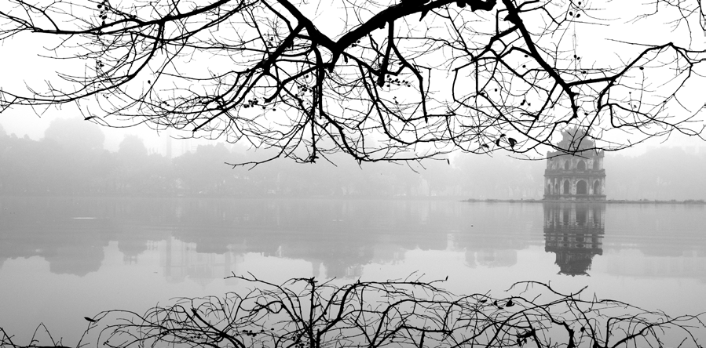
In winter, it’s cold and snowy. I make snowman with my sister. We love winter.
…………………………………………………………………………………………………………

Slide 19
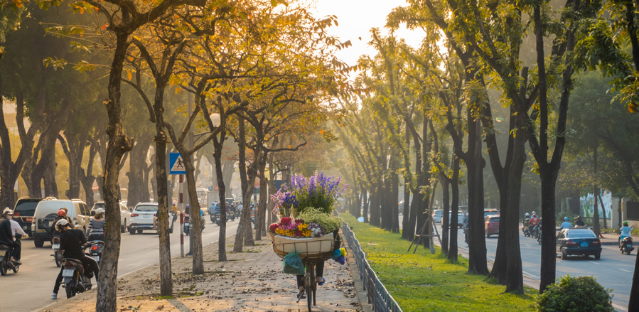
I love autumn. It’s cloudy and windy. I love flying a kite with my friends.
…………………………………………………………………………………………………………

Slide 20
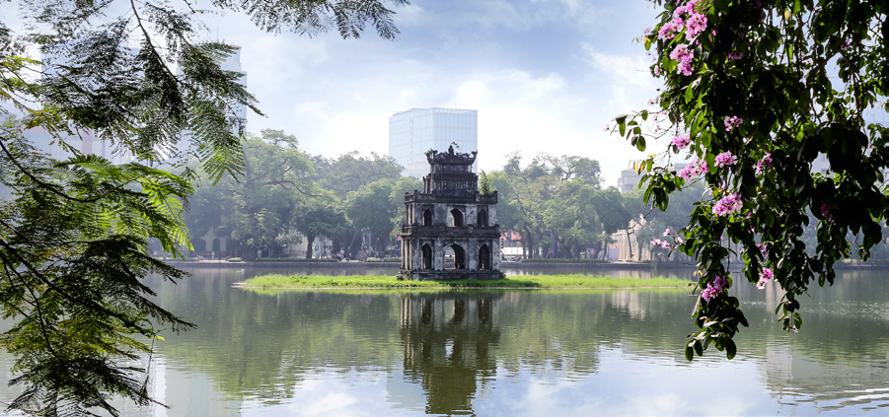
…………………………………………………………………………………………………………

Slide 21

My favourite season is ……………..
SAY IT

Slide 22
3
Assessment

Slide 23
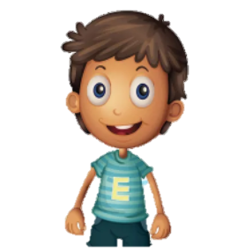
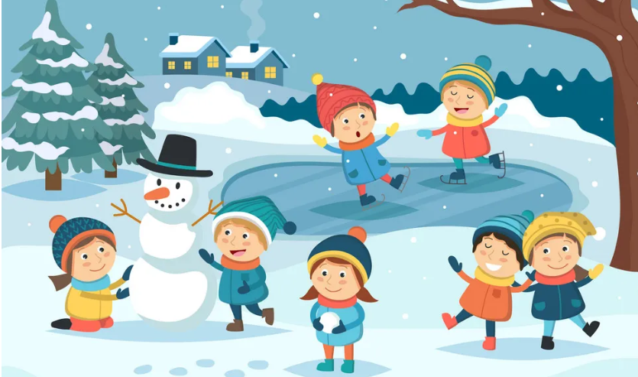
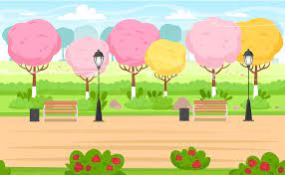

LISTEN AND MATCH
Mary
Alex
Anna
Notes:
HOẠT ĐỘNG TƯƠNG TÁC

Slide 24
Goodbye!

