Slide 1










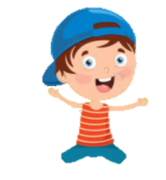

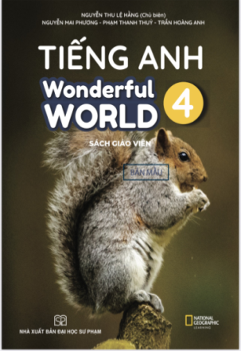








Slide 2

Unit 2: My House
Lesson 2 – Period 3- Task 7,8,9

Slide 3


1 WARM UP
Choose correct answer
Notes:
(Teacher shows a black and white picture. Ss have to guess what colour it is.)
- Divide the class into 4 groups
- Set the game rules.
- Ask students to look and guess.
- Award the best groups

Slide 4
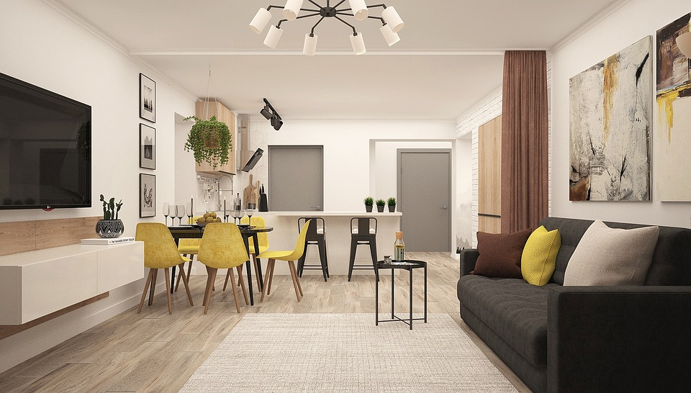
The TV is ________ the sofa.
in
in front of

Slide 5
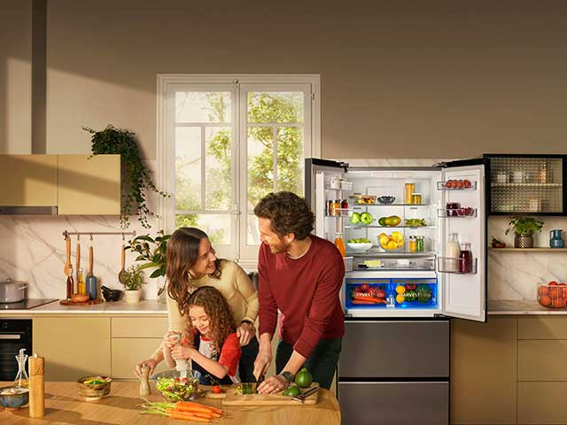
The fridge is _______ the table.
behind
under

Slide 6
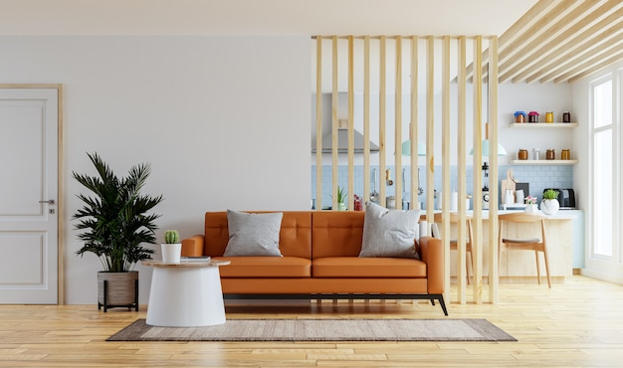
The kitchen is _____ the living room.
under
behind

Slide 7
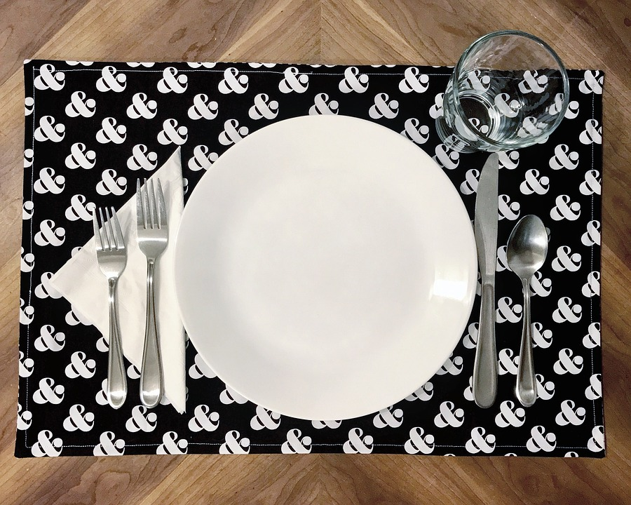
The plate is next to the ____ .
fork
bowl

Slide 8
2 PRESENTATION
Task 7 Listen and tick
T for True and F for False.
Notes:
Dấu câu

Slide 9
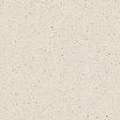
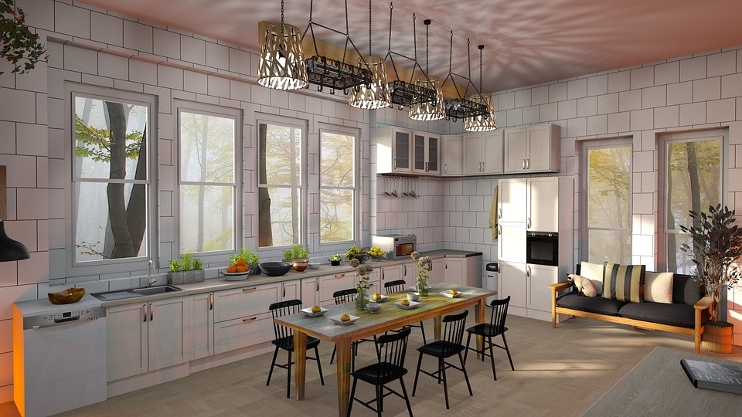

7. Listen and tick T or F.
1.The fridge is next to the table.
True
✓
False

Slide 10

2. The sofa is in front of the TV.
✓
True
False

Slide 11
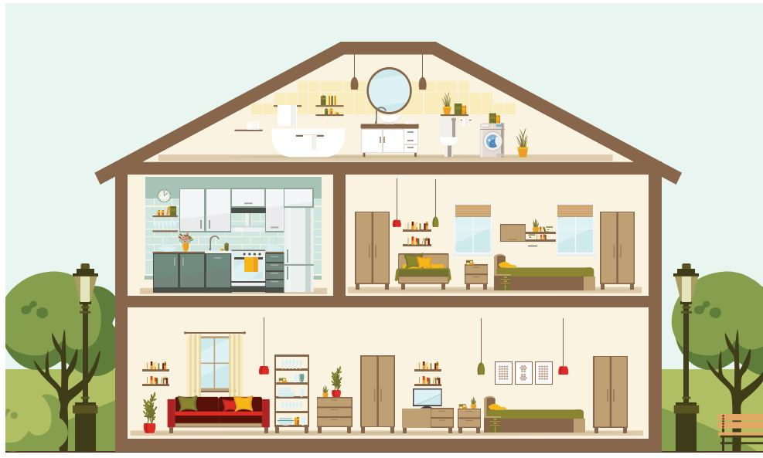
3. The bedroom is between the living room and the bathroom.
✓
True
False

Slide 12
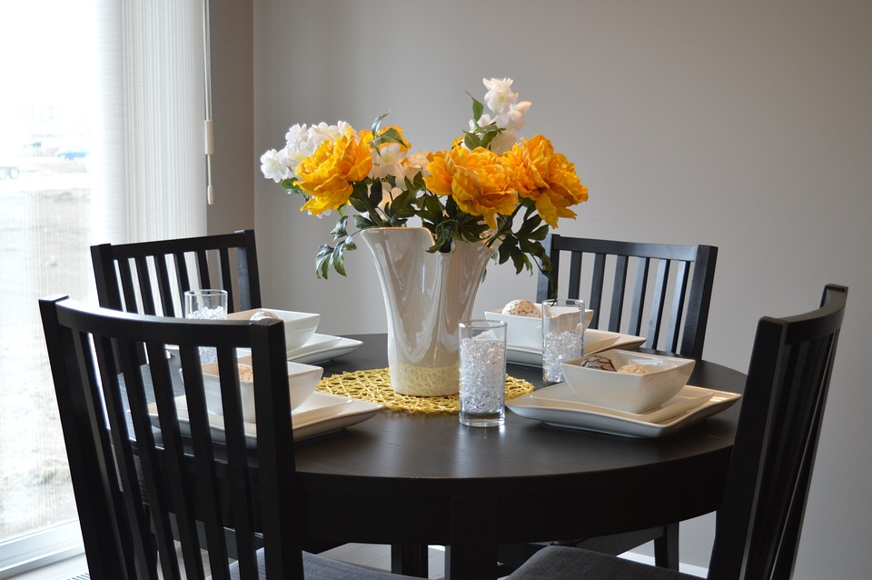
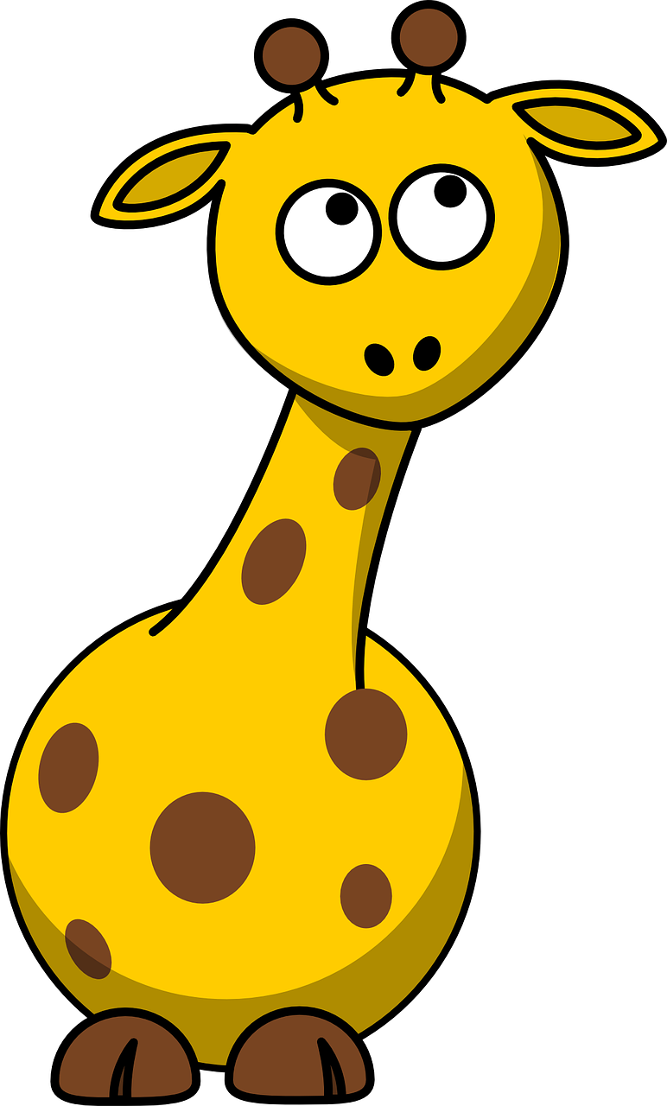
4. The plates are next to the mugs.
✓
False
True

Slide 13
5.The kitchen is behind the living room.
✓
True
False

Slide 14
3 Practice
Task 8 Look and say.
Notes:
Dấu câu

Slide 15

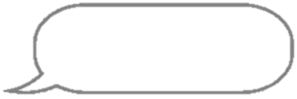
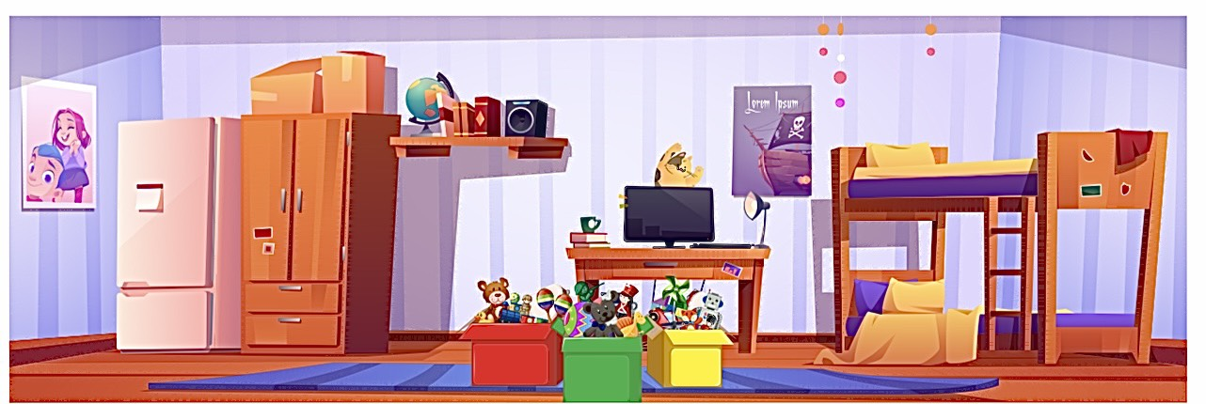
Look at my room. What can you see in my room?

Slide 16


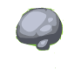







1
4
HELP THE POOH
2
5
3
Notes:
Ấn vào Help the pooh để tắt tiêu đề, sẽ hiện ra số 1. Ấn số theo thứ tự để trả lời câu hỏi
Sang slide 22 Look and say, ấn vào bình Honey

Slide 17
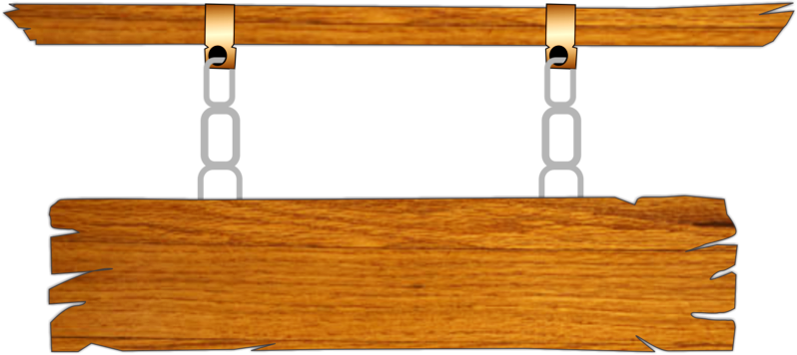




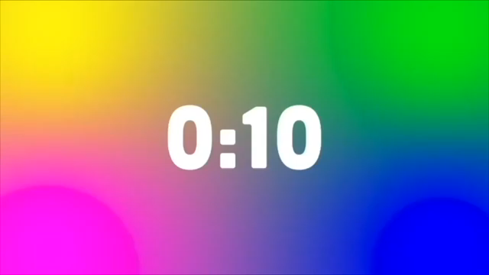



1. The toys are ____ the boxes.
in
A
on
B
between
C
in front of
D
BACK

Slide 18
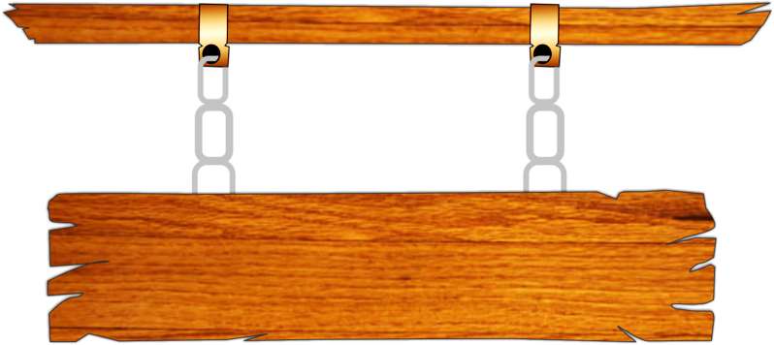

2.The boxes are
on the ______.
A
table
B
floor
C
chairs
D
sink
BACK

Slide 19
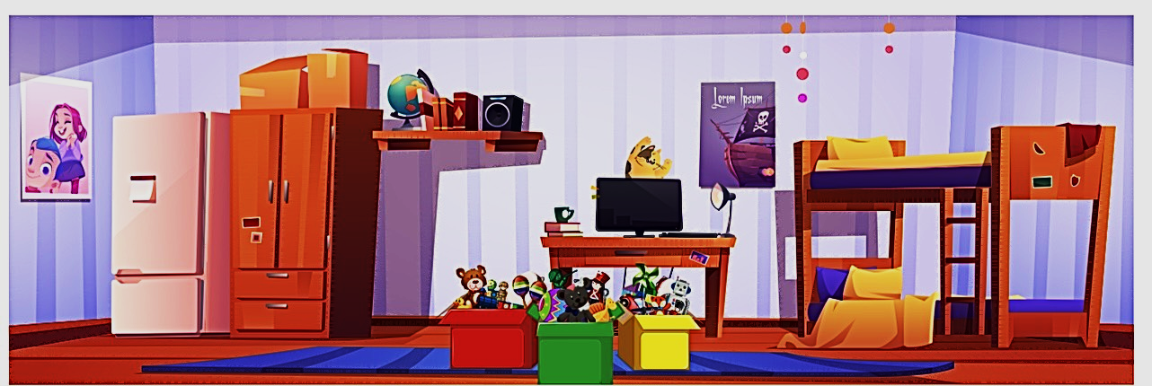
3. The _______ is next to the desk.
A
box
B
pillow
C
toys
D
bed
BACK

Slide 20
4. The toys are ____ the desk.
in front of
A
on
B
between
C
under
D
BACK

Slide 21
5.Are the bowls on the table?
A
Yes, they is.
B
Yes, they are.
C
No, they are.
D
No, they aren’t.
BACK

Slide 22


8. Look and say.
1. The boxes/on/ floor.
The boxes are on the floor.
2. The cat/ behind/ the computer
The cat is behind the computer.
3.The bed/ next to/ the desk
The bed is next to the desk.
Notes:
Trình bày lại chữ

Slide 23
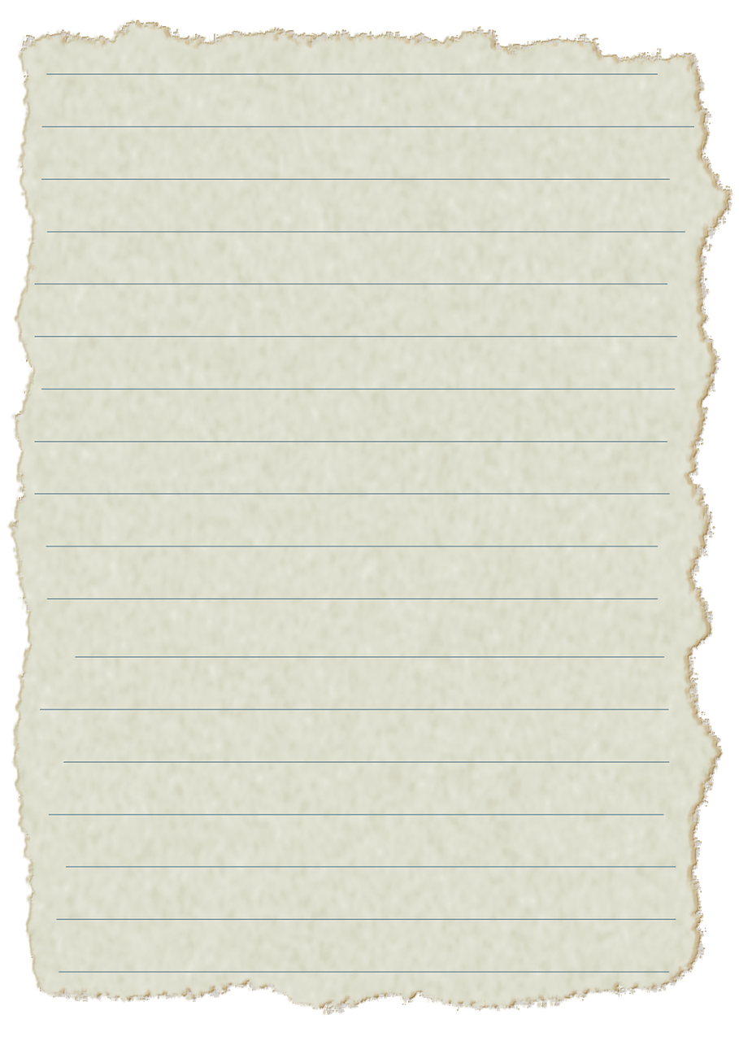
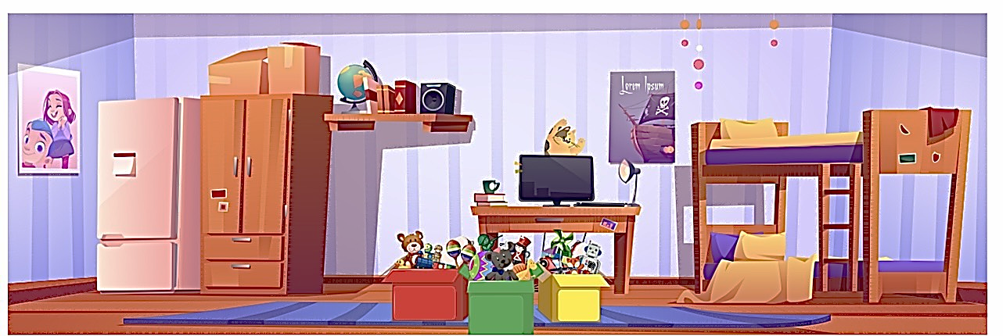
4. The boxes/ in front of/ the desk.
The boxes are in front of the desk.
5. The green box/between/ the red box and the yellow box.
The green box is between the red box and the yellow box.

Slide 24
4 Production
Task 9 Let’s talk.
Notes:
Dấu câu

Slide 25
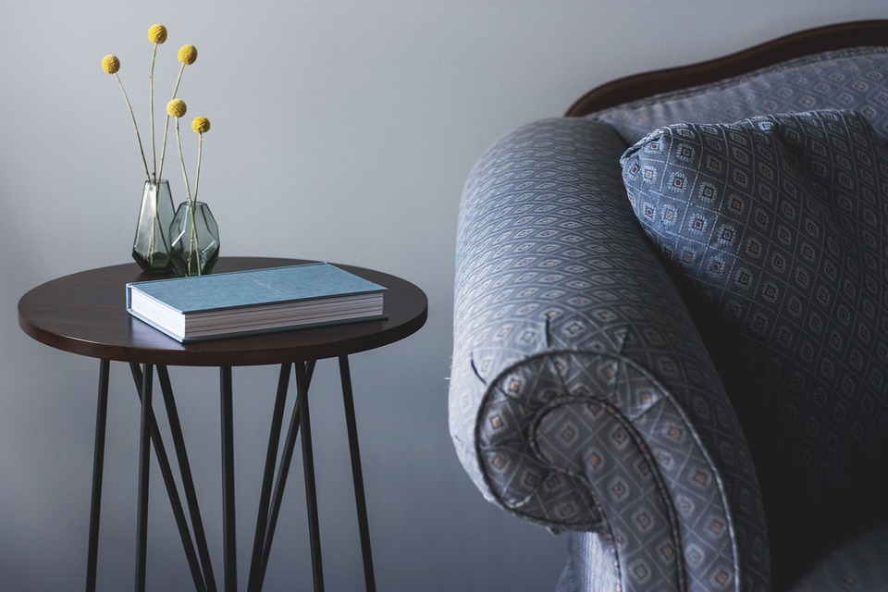
9
Let’s talk.
It’s next to
our living
room.
Where’s
your room?
Where’s
the table?
It’s next to
the sofa.

Slide 26

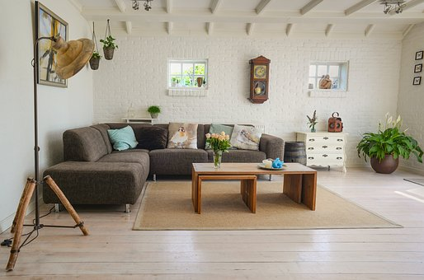
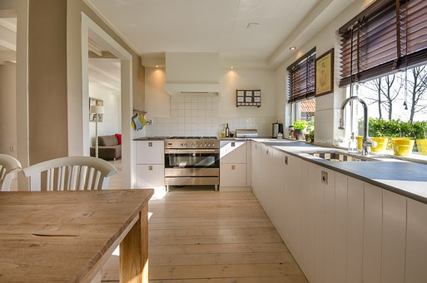
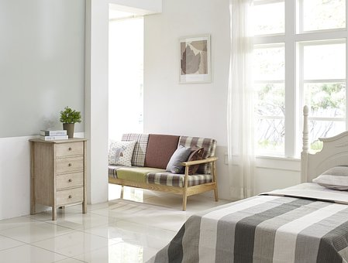
Drawing

Slide 27
5 Assessment
Notes:
Đây k phải là extra, đây là hđ 3 của bài

Slide 28

Matching Game
1. There are two
a.plates on the table.
2.The cat is
b.in the box?
3.Is the toy
c.favourite rugs?
4.Where are your
d.lying on the bed.
1
A
2
D
3
B
4
C

Slide 29
6 Wrap up
Notes:
Đây k phải là extra, đây là hđ 3 của bài

Slide 30
REMEMBER
VOCABULARY:
Living room
Bedroom
Kitchen
Dining room
STRUCTURE:
Where is the rug?
- The rug is in front of the fridge.
30

Slide 31




Thank you & goodbye!

