Slide 1





















Unit 1
My family
Lesson 2 – Task 7,8,9
Notes:
Để nguyên trang bìa như này, chỉ thay đổi tên bài trong quá trình làm. Logo của sách Wonderful World

Slide 2


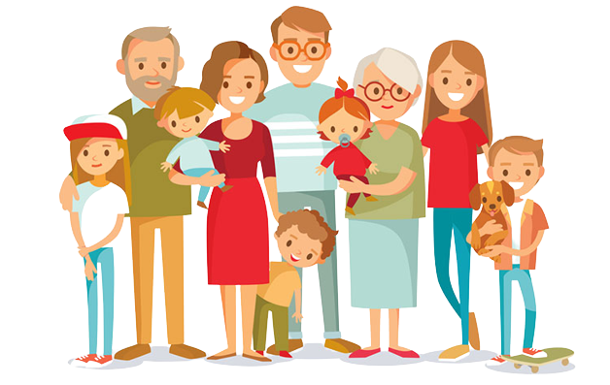

Slide 3






Warm up
Song: Move and freeze

Slide 4

Notes:
Turn on the music and let the sts follow

Slide 5
Who is this?
GAME
Hidden pictures
Guessing pictures of family members
Notes:
-Divide class into 2 teams-Boys and Girls
Let the sts look at 1 of the pieces and guess the picture behind

Slide 6
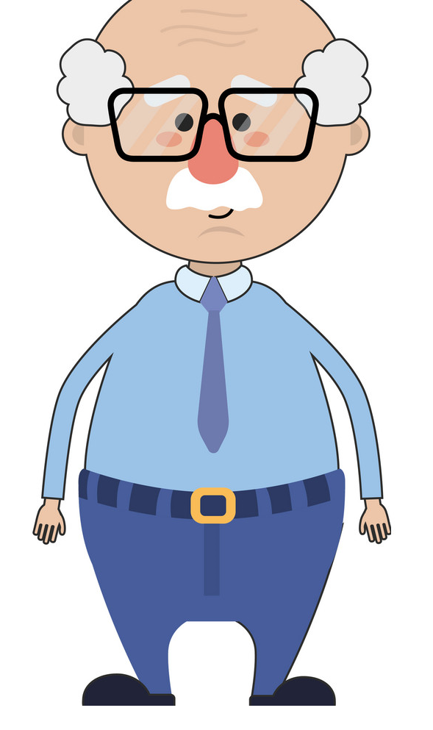
grandpa
SHOW

Slide 7

aunt
SHOW
Notes:
Answer: aunt

Slide 8
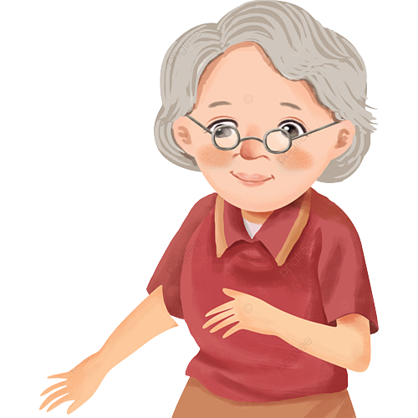
grandma
SHOW
Notes:
Answer: grandma

Slide 9

uncle
SHOW
Notes:
Answer: uncle

Slide 10

cousin
SHOW
Notes:
Answer: cousin

Slide 11

Presentation
Task 7: Listen and tick.

Slide 12
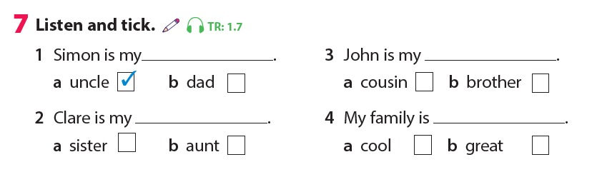


Notes:
Let the sts 1 by 1 read again the answers

Slide 13
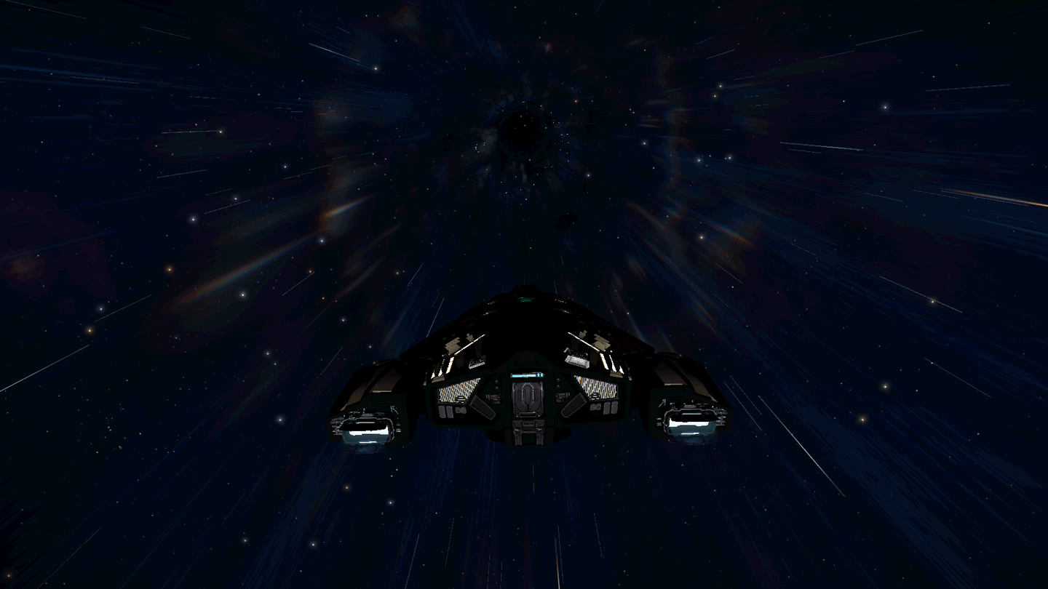
Notes:
Game: Save the world.
-T divides class into 2 teams: Boys and Girls.
1 boy and 1 girl take turn to answer 1 question by listening and choosing the correct pictures.
-After choosing the correct pictures, T asks 1 student to write the answers(words) on the board.

Slide 14
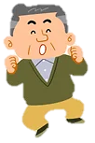




uncle
1) Simon is my………………
Notes:
Game: Save the world.
-T divides class into 2 teams: Boys and Girls.
1 boy and 1 girl take turn to answer 1 question by listening and choosing the correct pictures.
-After choosing the correct pictures, T asks 1 student to write the answers(words) on the board.
THIẾT KẾ HOẠT ĐỘNG TƯƠNG TÁC CHO SLIDE 14->17 KÈM THEO FILE NGHE
-Click Audio, khi trọn ảnh đúng sau đó click chuột sẽ xuất hiện từ đúng

Slide 15



aunt
2) Clare is my…………………….
Notes:
THIẾT KẾ HOẠT ĐỘNG TƯƠNG TÁC CHO SLIDE 14->17 KÈM THEO FILE NGHE
-Click Audio, khi trọn ảnh đúng sau đó click chuột sẽ xuất hiện từ đúng

Slide 16
cousin
3) John is my…………………….
Notes:
THIẾT KẾ HOẠT ĐỘNG TƯƠNG TÁC CHO SLIDE 14->17 KÈM THEO FILE NGHE
-Click Audio, khi trọn ảnh đúng sau đó click chuột sẽ xuất hiện từ đúng

Slide 17



great
4) My family is ……………….
Notes:
THIẾT KẾ HOẠT ĐỘNG TƯƠNG TÁC CHO SLIDE 14->17 KÈM THEO FILE NGHE
-Click Audio, khi trọn ảnh đúng sau đó click chuột sẽ xuất hiện từ đúng

Slide 18

Practice
Task 8: Write on the family tree.

Slide 19
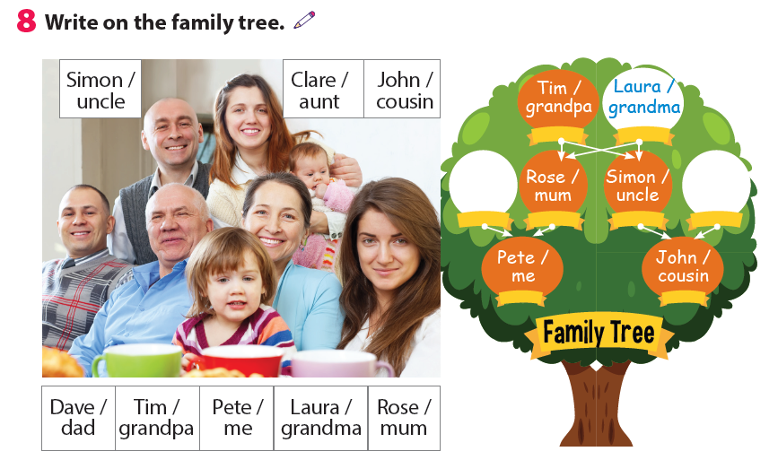
Dave/dad
Clare/aunt
Notes:
-Let the sts write the names and titles of each one.

Slide 20

Who is he?
He is my uncle, Simon
+5
Notes:
Game: Who is who?
Divide the class into 4 groups.
Teacher calls a name of a member of the family member in the picture.
Teacher hides a name of a family member.
Sts have to say the name or who the person is.
Who says it fast will get points for the groups.

Slide 21
Who is she?
+3
She is my……,………
Notes:
Game: Who is who?
Divide the class into 4 groups.
Teacher calls a name of a member of the family member in the picture.
Teacher hides a name of a family member.
Sts have to say the name or who the person is.
Who says it fast will get points for the groups.

Slide 22
Who is he?
He is my……,………
+5
Notes:
Game: Who is who?
Divide the class into 4 groups.
Teacher calls a name of a member of the family member in the picture.
Teacher hides a name of a family member.
Sts have to say the name or who the person is.
Who says it fast will get points for the groups.

Slide 23
Who is she?
She is my……,………
+3
Notes:
Game: Who is who?
Divide the class into 4 groups.
Teacher calls a name of a member of the family member in the picture.
Teacher hides a name of a family member.
Sts have to say the name or who the person is.
Who says it fast will get points for the groups.

Slide 24
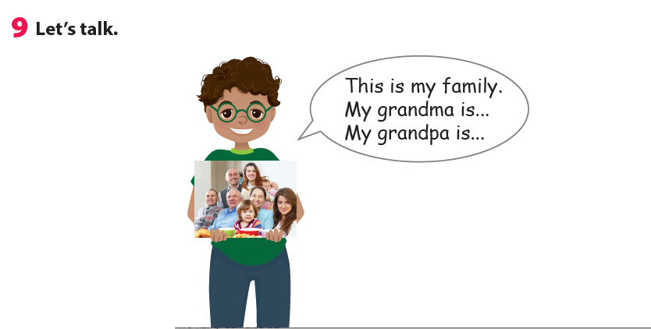
Tom

Slide 25

Production
My family tree

Slide 26
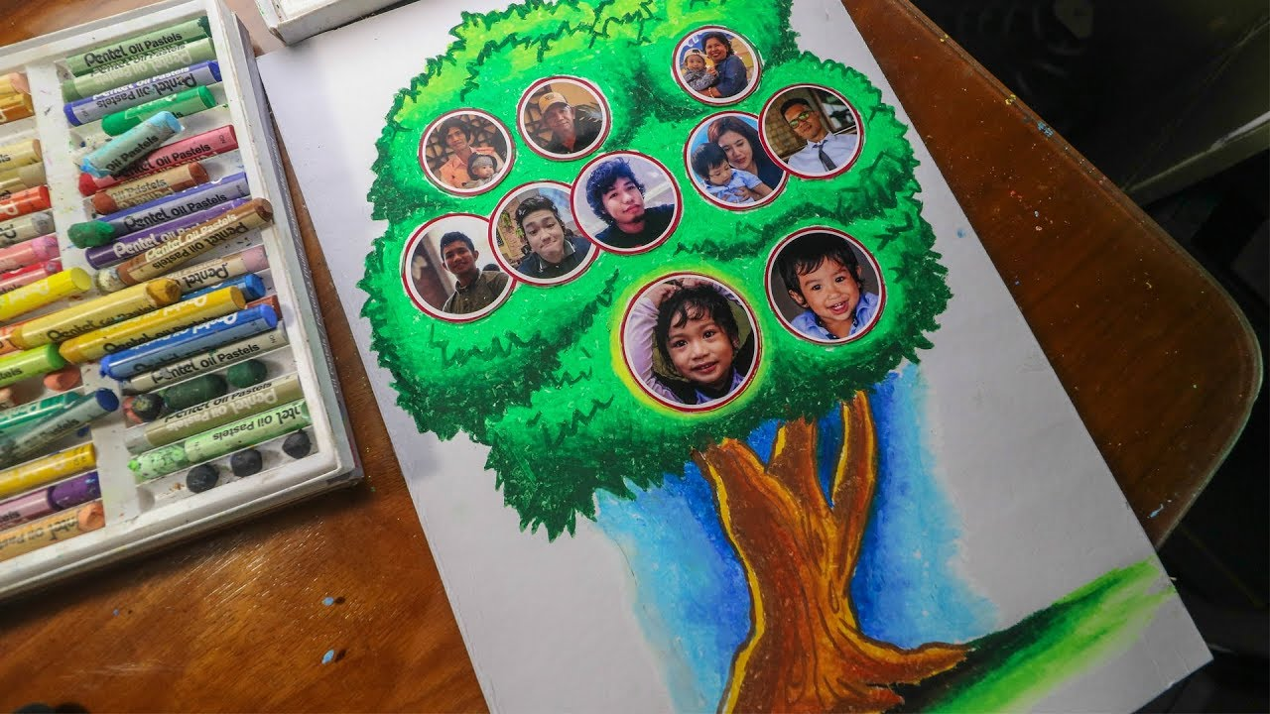
Notes:
Students stick the pictures they bring from home and present in group the in front of class.
Extension:
Game: Memorization
-Let the sts show their picture of family they bring from home.
-Let the others listen and remember.
-Let other students talk about their friend ‘s family tree.

Slide 27

Assessment
Look at picture and choose
the correct answer.

Slide 28
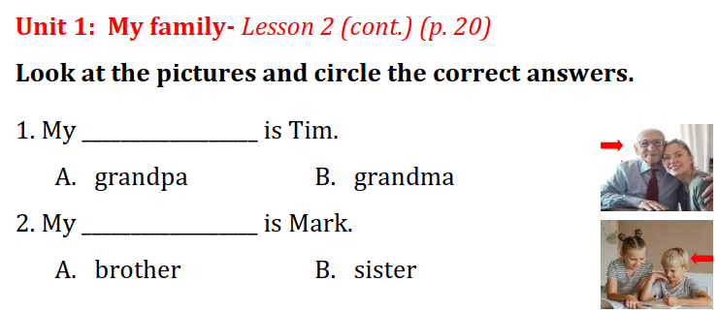
Notes:
Look at the pictures and circle the correct answers.

Slide 29
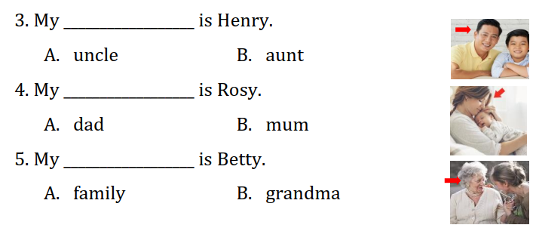
Notes:
Look at the pictures and circle the correct answers.

Slide 30



Good bye.
See you again!

