Slide 1












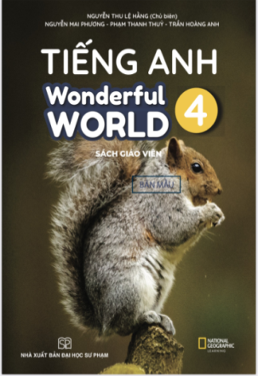








Slide 2

UNIT 2: MY HOUSE
Lesson 3 – Period 3- Task 7,8,9

Slide 3


Warm up
Listen to a song
Notes:
(Teacher shows a black and white picture. Ss have to guess what colour it is.)
- Divide the class into 4 groups
- Set the game rules.
- Ask students to look and guess.
- Award the best groups

Slide 4


Slide 5
1.Presentation
Task 7
Listen and repeat.
Notes:
Dấu câu

Slide 6






7. Listen and repeat.
/ʊ/
bookshelf
bookshelf

Slide 7
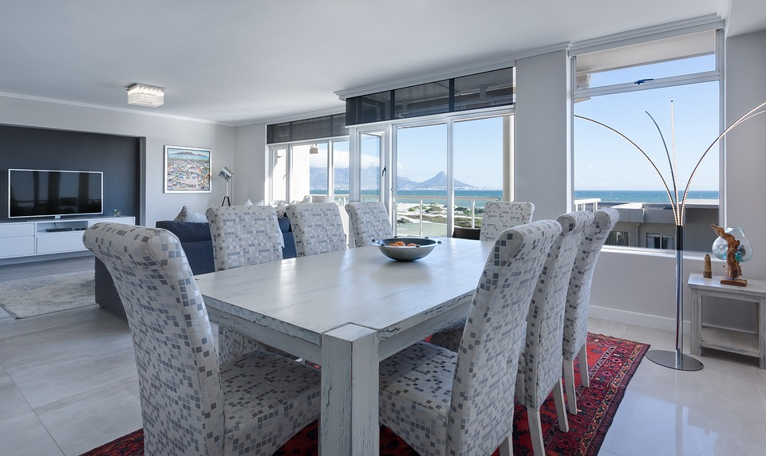
7. Listen and repeat.
/n/
dining room
dining room

Slide 8
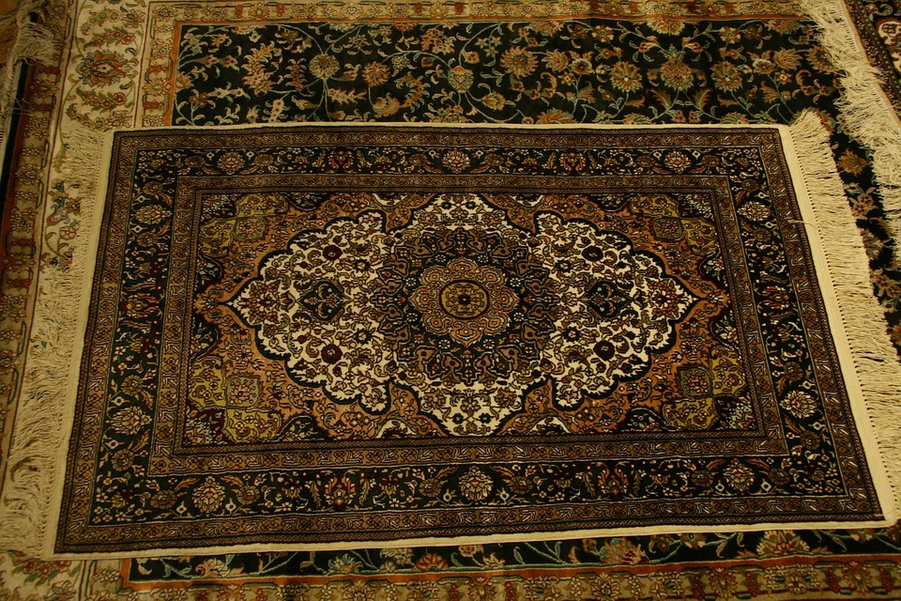
7. Listen and repeat.
/r/
rug
rug

Slide 9
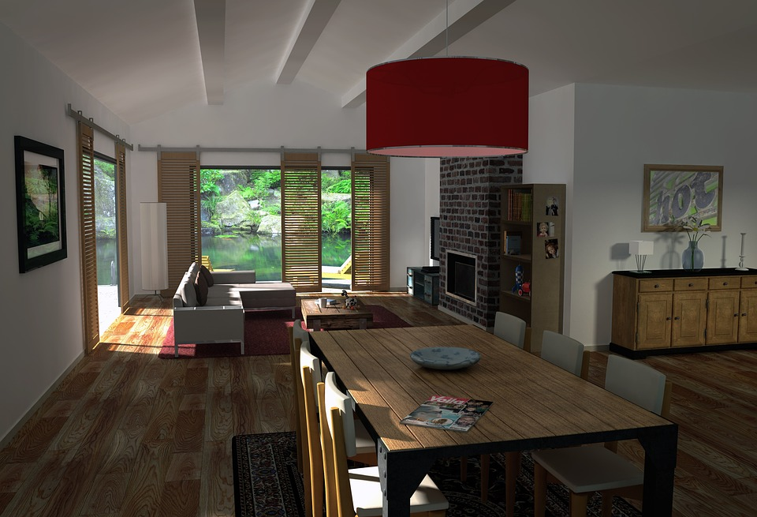
7. Listen and repeat.
We’ve got a big dining room, a new bookshelf and a new rug.
We’ve got a big dining room, a new bookshelf and a new rug.

Slide 10
! Game time !
Choose correct answer
Notes:
Sts choose the correct answer

Slide 11
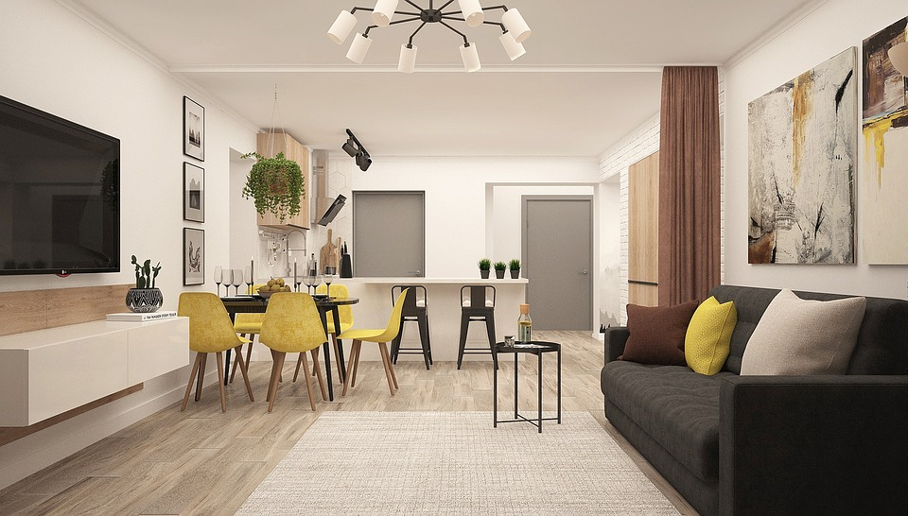
The ____in front of the sofa.
door
rug

Slide 12
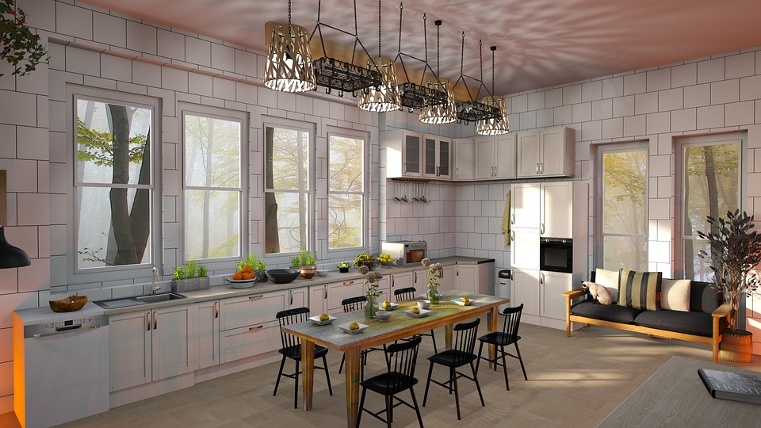
The _______ is so big.
dining room
bedroom

Slide 13
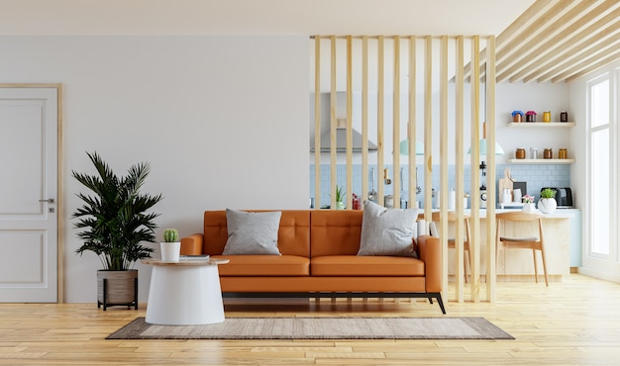
The sofa is _____ the living room.
under
in

Slide 14
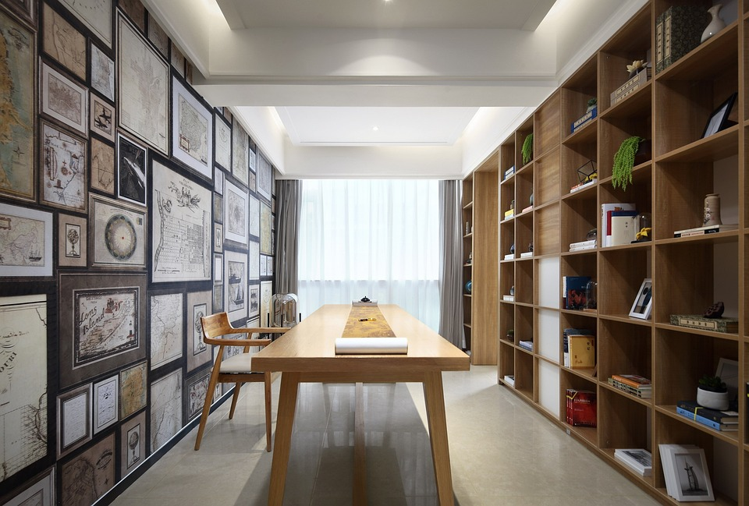
The window is next to the ____.
bookshelf
clock

Slide 15
2.Practice
Task 9 Say it.
Notes:
Dấu câu

Slide 16






WHEEL OF FORTUNE
30
20
1
2
40
10
50
80
3
4
60
70
Next
START
Notes:
CLICK Start để quay => click vào vòng quay để dừng.

Slide 17

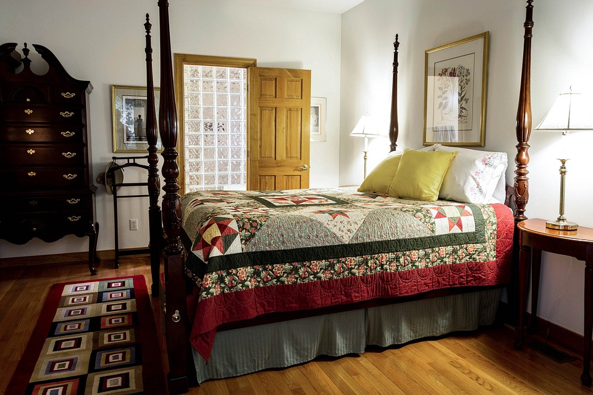
Look and Say.
Where is the rug?
BACK
A. It’s next to the bed. B. It’s behind the bed.
-It’s next to the bed.

Slide 18

Look and Say.
The rug is ____the bookshelf.
BACK
A. next to B. in front of
The rug is in front of the bookshelf.

Slide 19
Look and Say .
They ____ got a new dining room.
BACK
A. have B. has
They have got a new dining room.

Slide 20
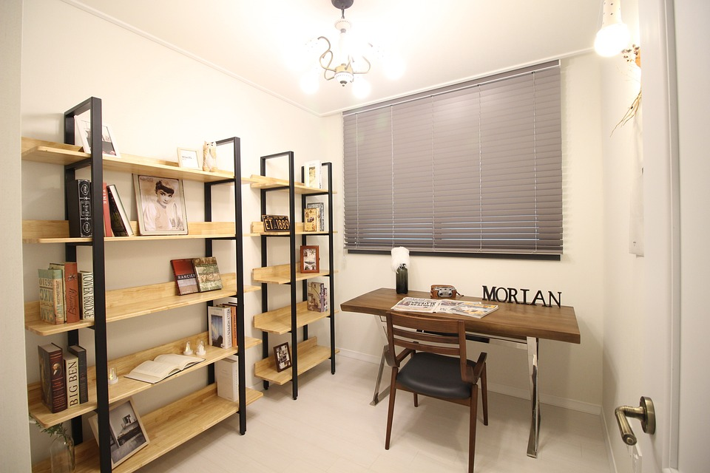
Look and Say.
Where is the new bookshelf?
BACK
A. It’s on the bed. B. It’s next to the window.
It’s next to the window

Slide 21
Production
Task 8 Listen and chant.
Notes:
Dấu câu

Slide 22
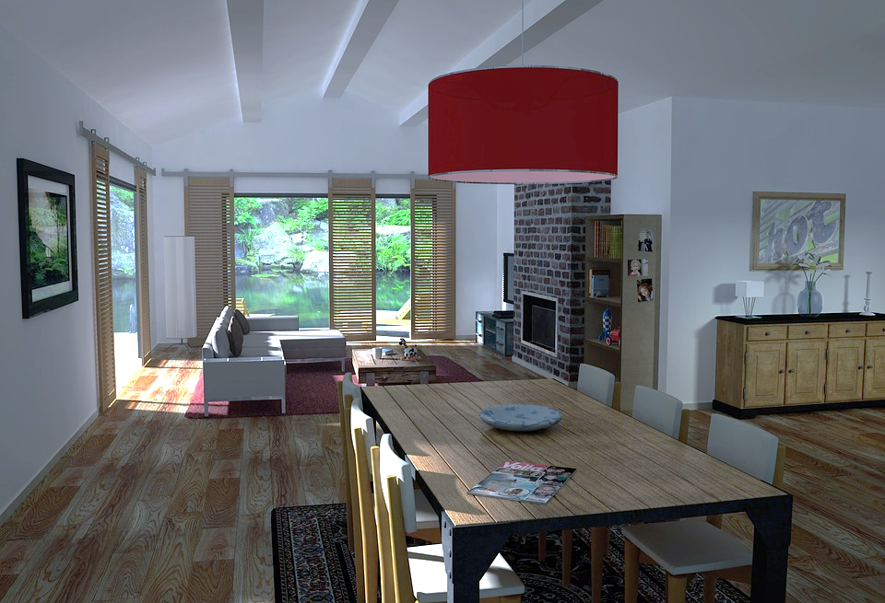


8
Listen and chant.
Notes:
Nghe chant và nhìn slide trong sách

Slide 23

Bookshelf,
bookshelf,
bookshelf!
Rug, rug, rug!
We have got
a new rug.
We have got a new bookshelf.
Dining,
dining,
dining room!
We have got a
big dining room.
Notes:
Nghe chant và học từng câu

Slide 24




Let’s chant!
Bookshelf, bookshelf, bookshelf!
We have got a new bookshelf.
Rug, rug, rug!
We have got a new rug.
Dining, dining, dining room!
We have got a big dining room.

Slide 25
Assessment

Slide 26
Matching Game
1. There are two
a.rugs under the table.
2.The bookshelf’s
b.a big dining room.
3.We have got
c.my chairs.
4.It’s under
d.next to the door.
1
A
2
D
3
B
4
C

Slide 27
Wrap-up
Notes:
Đây k phải là extra, đây là hđ 3 của bài

Slide 28

VOCABULARY:
Bookshelf: /ʊ/
Rug: /r/
Dining room: /n/
STRUCTURE
We have got a big dining room and a new bookshelf.

Slide 29




Thank you & goodbye!

