Slide 1





















Unit 2
My school
Lesson 2 – Task 4,5,6
Notes:
Để nguyên trang bìa như này, chỉ thay đổi tên bài trong quá trình làm. Logo của sách Wonderful World

Slide 2







Warm up
Game: Magic wheel

Slide 3





MAGIC WHEEL
Next
100
BOOM
1
2
3
40
10
50
80
4
5
6
STAR
70
7
8
9
SPIN
Notes:
Bấm vào số để xuất hiện câu hỏi
Bấm vào spin để quay, bấm vào ô tròn màu cam ở giữa để dừng lại
Bấm vào next để chuyển đến phần tiếp theo
THIẾT KẾ HOẠT ĐỘNG TƯƠNG TÁC Ở SLIDE 5 ĐẾN 11

Slide 4



What color is the board ?
It’s white.
Back

Slide 5
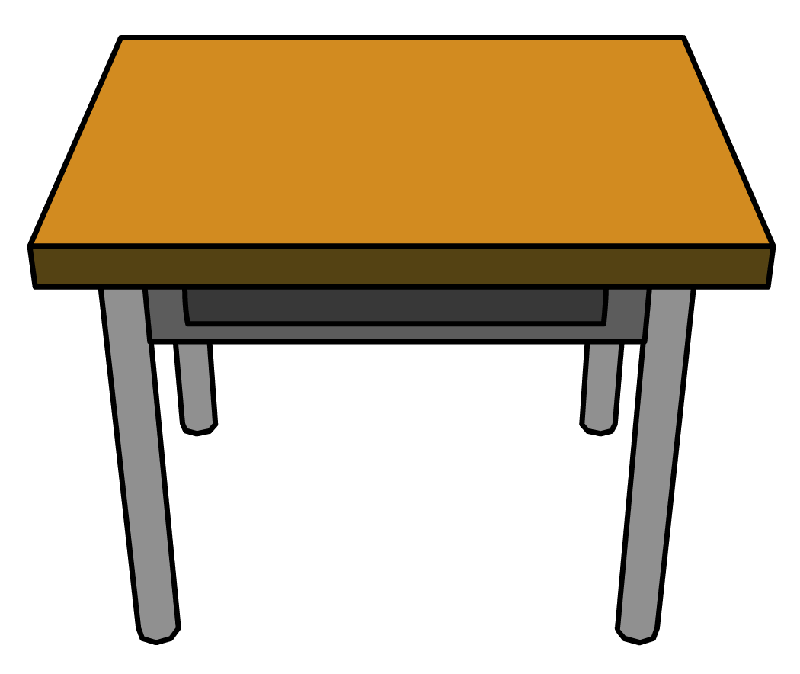
What’s it?
It’s a desk.
Back

Slide 6
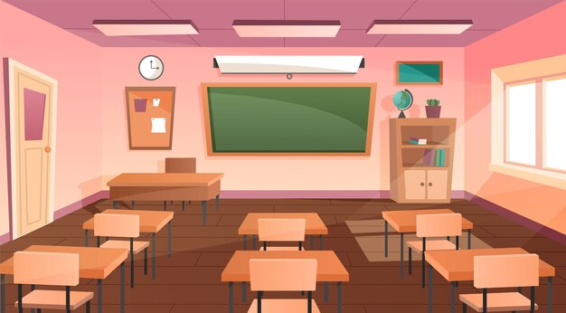
This is my….
classroom
Back

Slide 7

This clock is….
yellow
Back

Slide 8

She’s ….
a teacher
Back

Slide 9

He’s ….
a student
Back

Slide 10
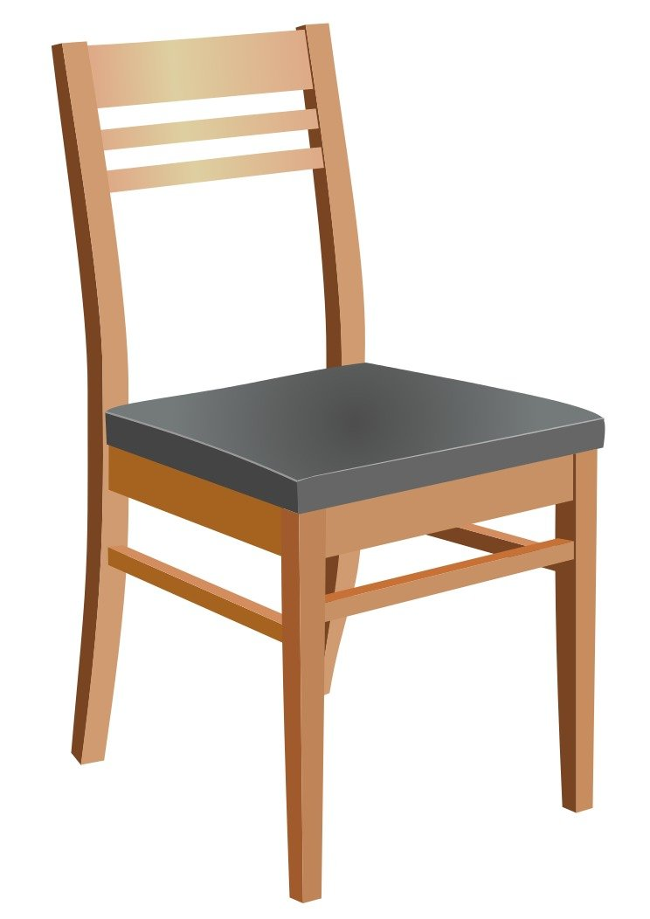
It’s ….
a chair
Back

Slide 11
+ 50
Back

Slide 12
- 50
Back

Slide 13

Presentation
Task 4: Listen

Slide 14

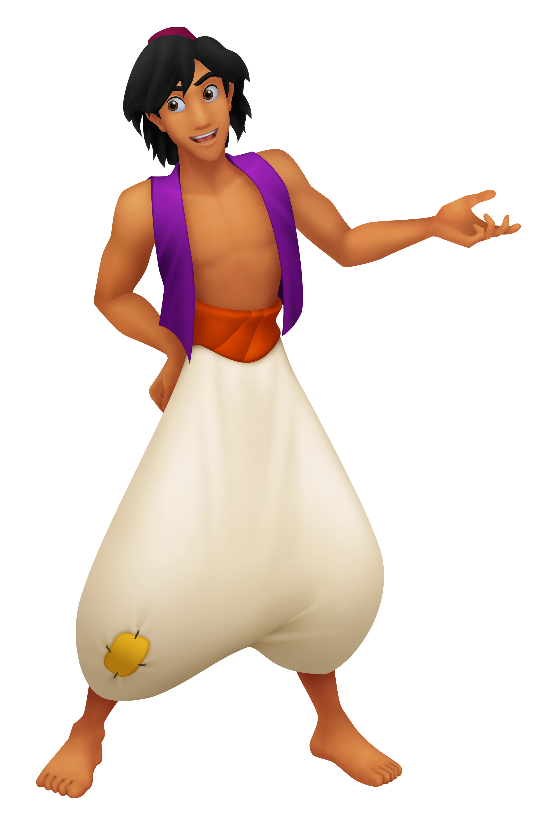
Aladdin wants to get the magic lamp from the uncle.
He locks the magic lamp with some sound. Please help him to open the password by circling the correct sound.
We are = We’re
They are = They’re

Slide 15
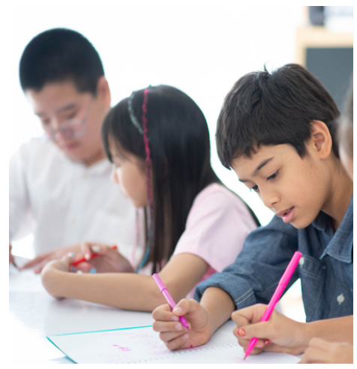
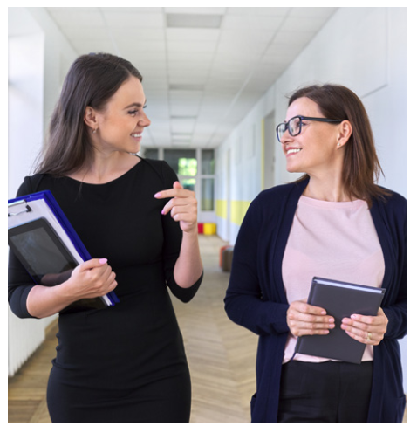

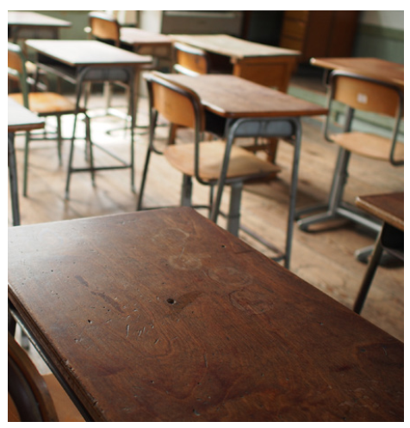
Listen and circle.
1. a. We’re students.
b. They’re students.
2. a. We’re teachers.
b. They’re teachers.
3. a. We’re desks.
b. They’re desks.
Notes:
Bấm biểu tượng âm thanh để nghe

Slide 16
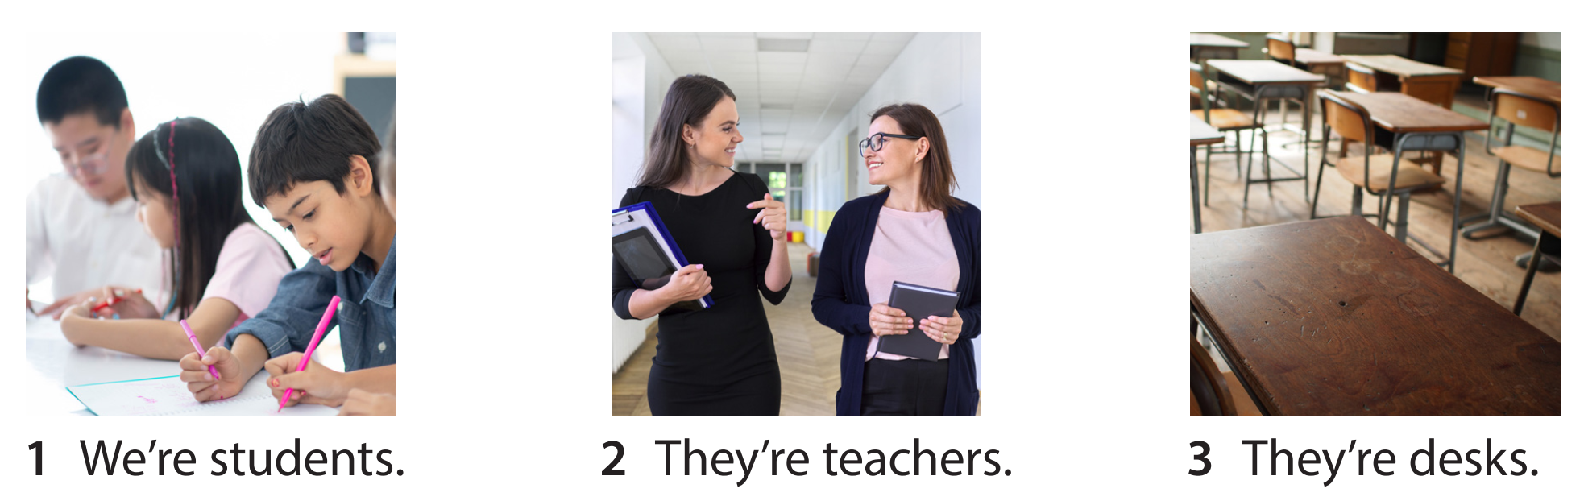
Listen and repeat

Slide 17

Practice
Task 5: Look and say

Slide 18
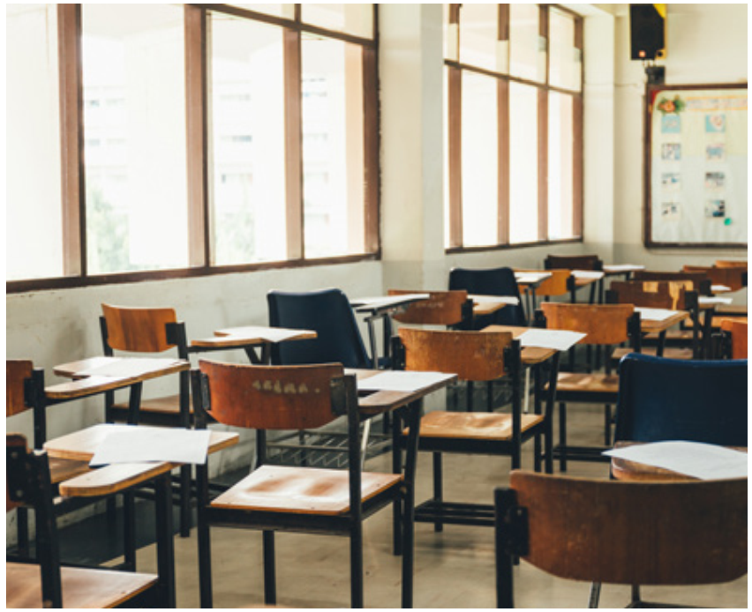
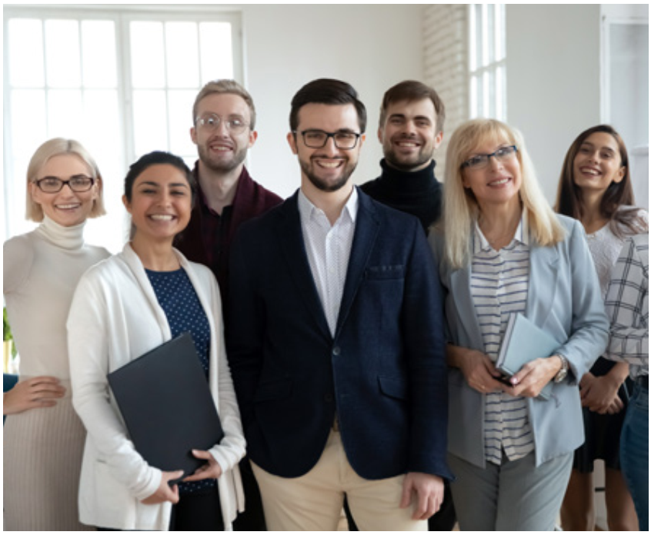
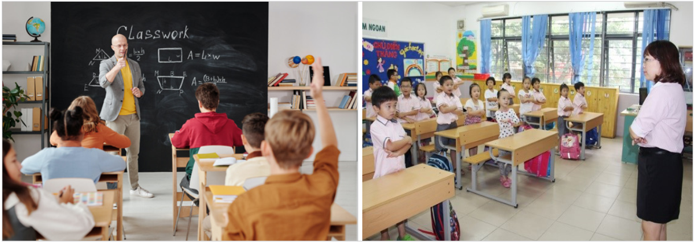



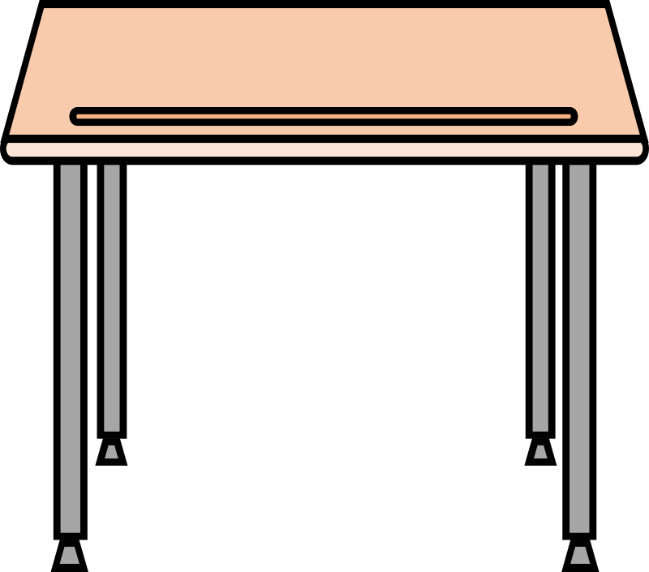
5. Look and say
They’re chairs.
They’re teachers.
They’re classrooms.
They’re boards.
They’re desks.
They’re clocks.

Slide 19
Game: fast speed
- Work in group.
- Look at the words, pick up the equivalent pictures.
- Say out loud the sentence.

Slide 20
Fast Speed
They/chairs.
They’re chairs.

Slide 21
Fast Speed
They/teachers.
They’re teachers.

Slide 22
Fast Speed
They/clocks.
They’re clocks.

Slide 23
Fast Speed
They/classrooms.
They’re classrooms.

Slide 24
Fast Speed
They/boards.
They’re boards

Slide 25
Fast Speed
They/desks.
They’re desks

Slide 26
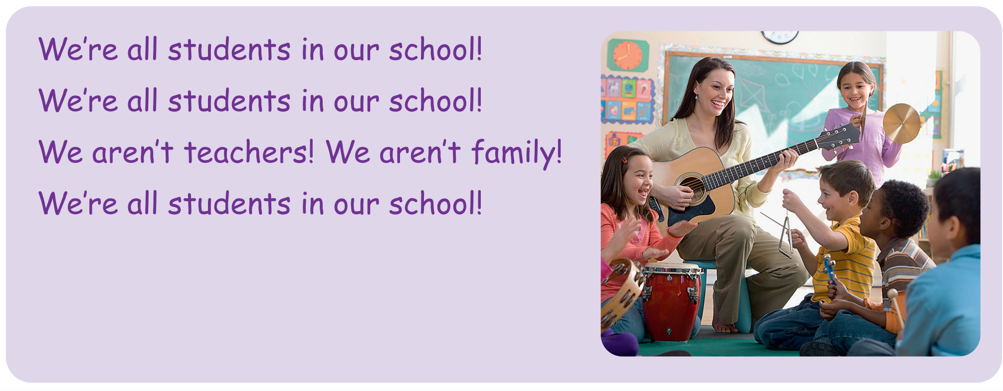
We’re all students in our school!
6. Listen and sing
We’re all students in our school!
We aren’t teachers!
We aren’t family!
We’re all students in our school!

Slide 27

Production
Compose and sing

Slide 28
We’re all students in our school!
Compose and sing
We’re all students in our school!
We aren’t teachers!
We aren’t family!
We’re all students in our school!

Slide 29

Assessment
Read and draw

Slide 30
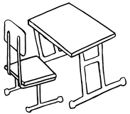
Read and draw
1. They’re desks.
2. They’re clocks.
3. We’re students.
4. We’re teachers

Slide 31




Good bye.
See you again!

