Slide 1








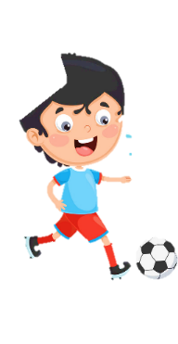












Unit 2
My school
Lesson 3 – Task 1,2,3
Notes:
Để nguyên trang bìa như này, chỉ thay đổi tên bài trong quá trình làm. Logo của sách Wonderful World

Slide 2







Warm up
Song: Walking walking

Slide 3
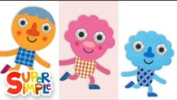

Slide 4

Presentation
Task 1: Listen and point. Repeat

Slide 5
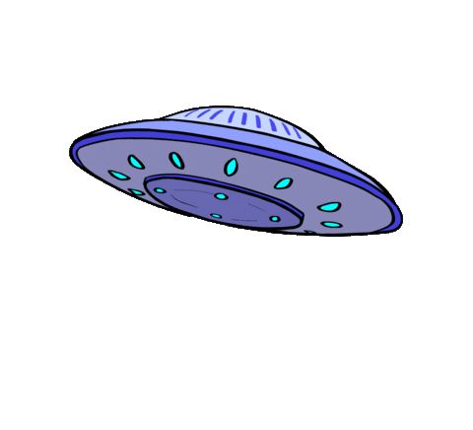
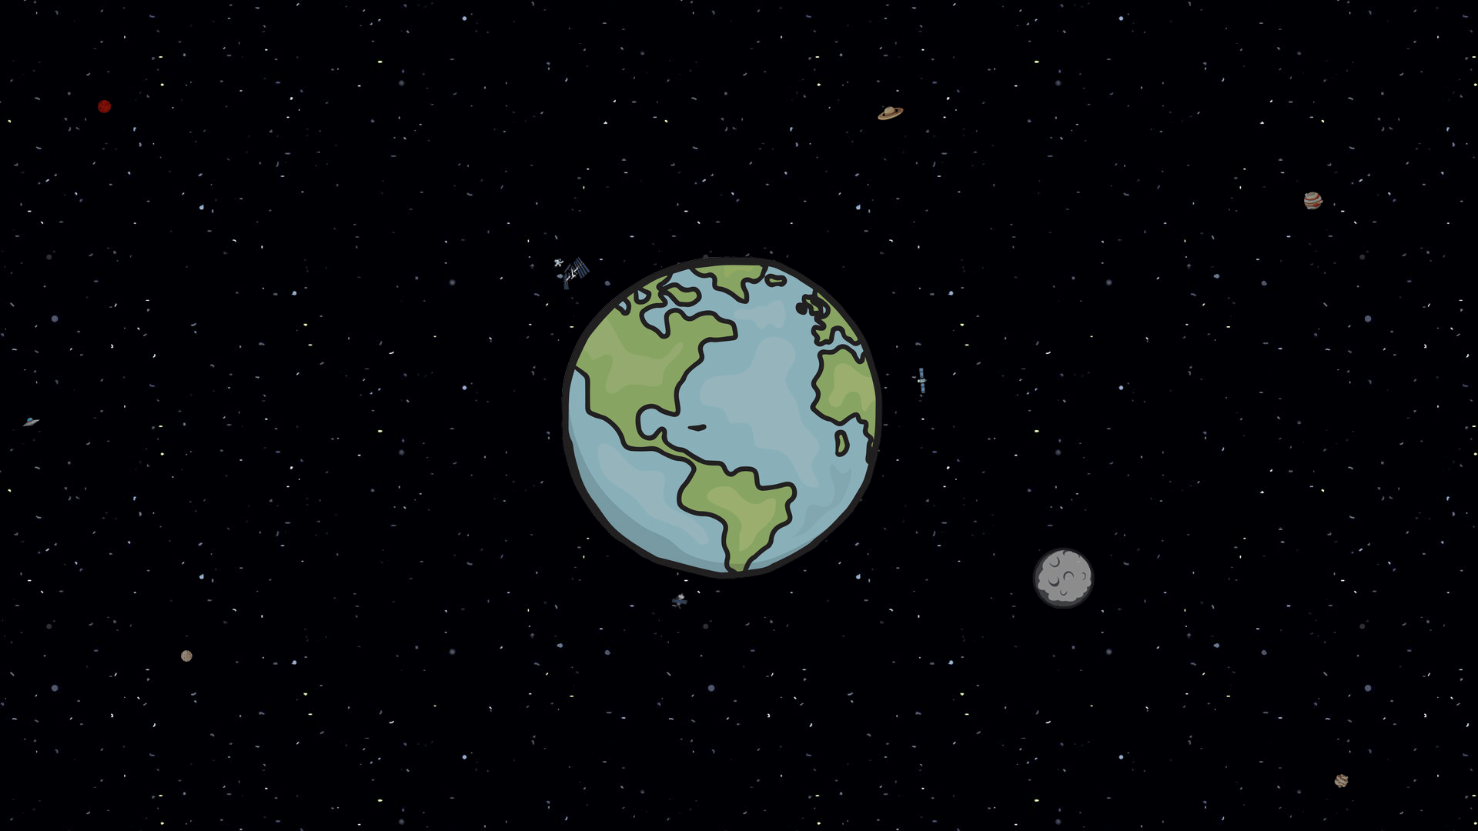
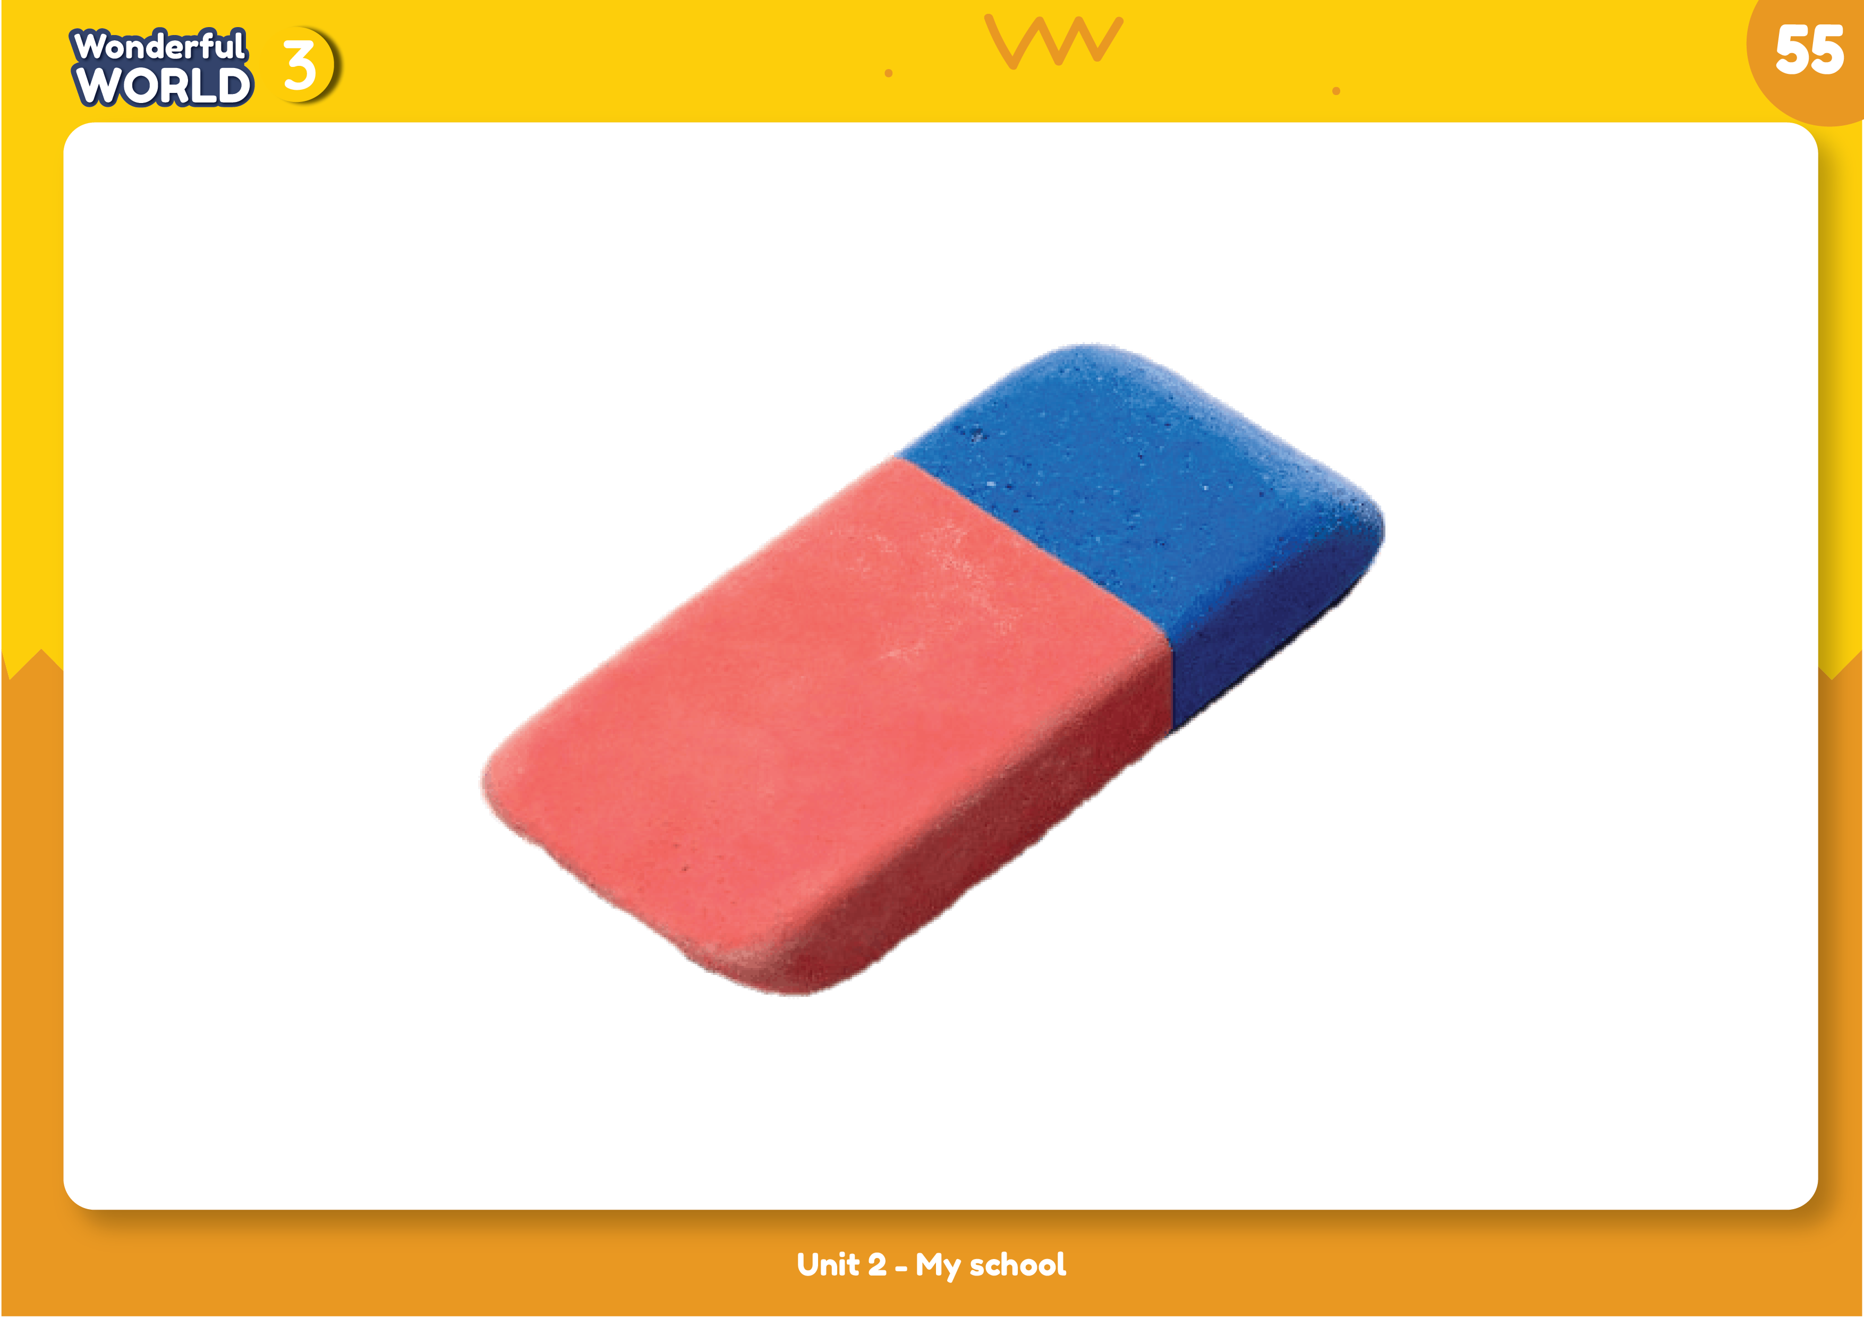
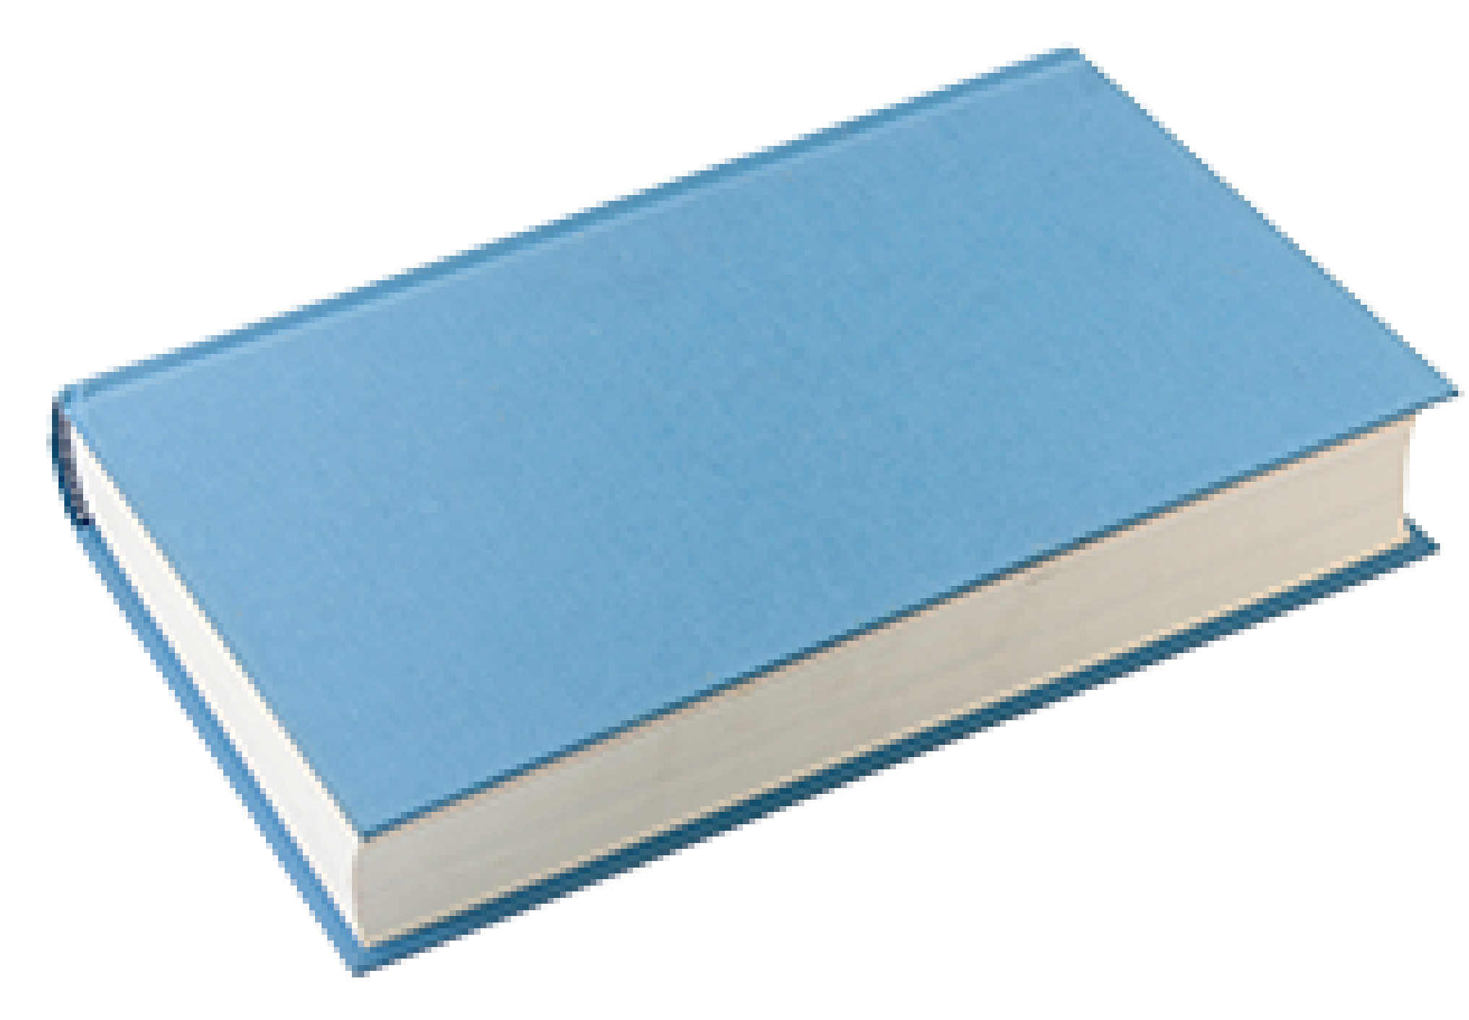
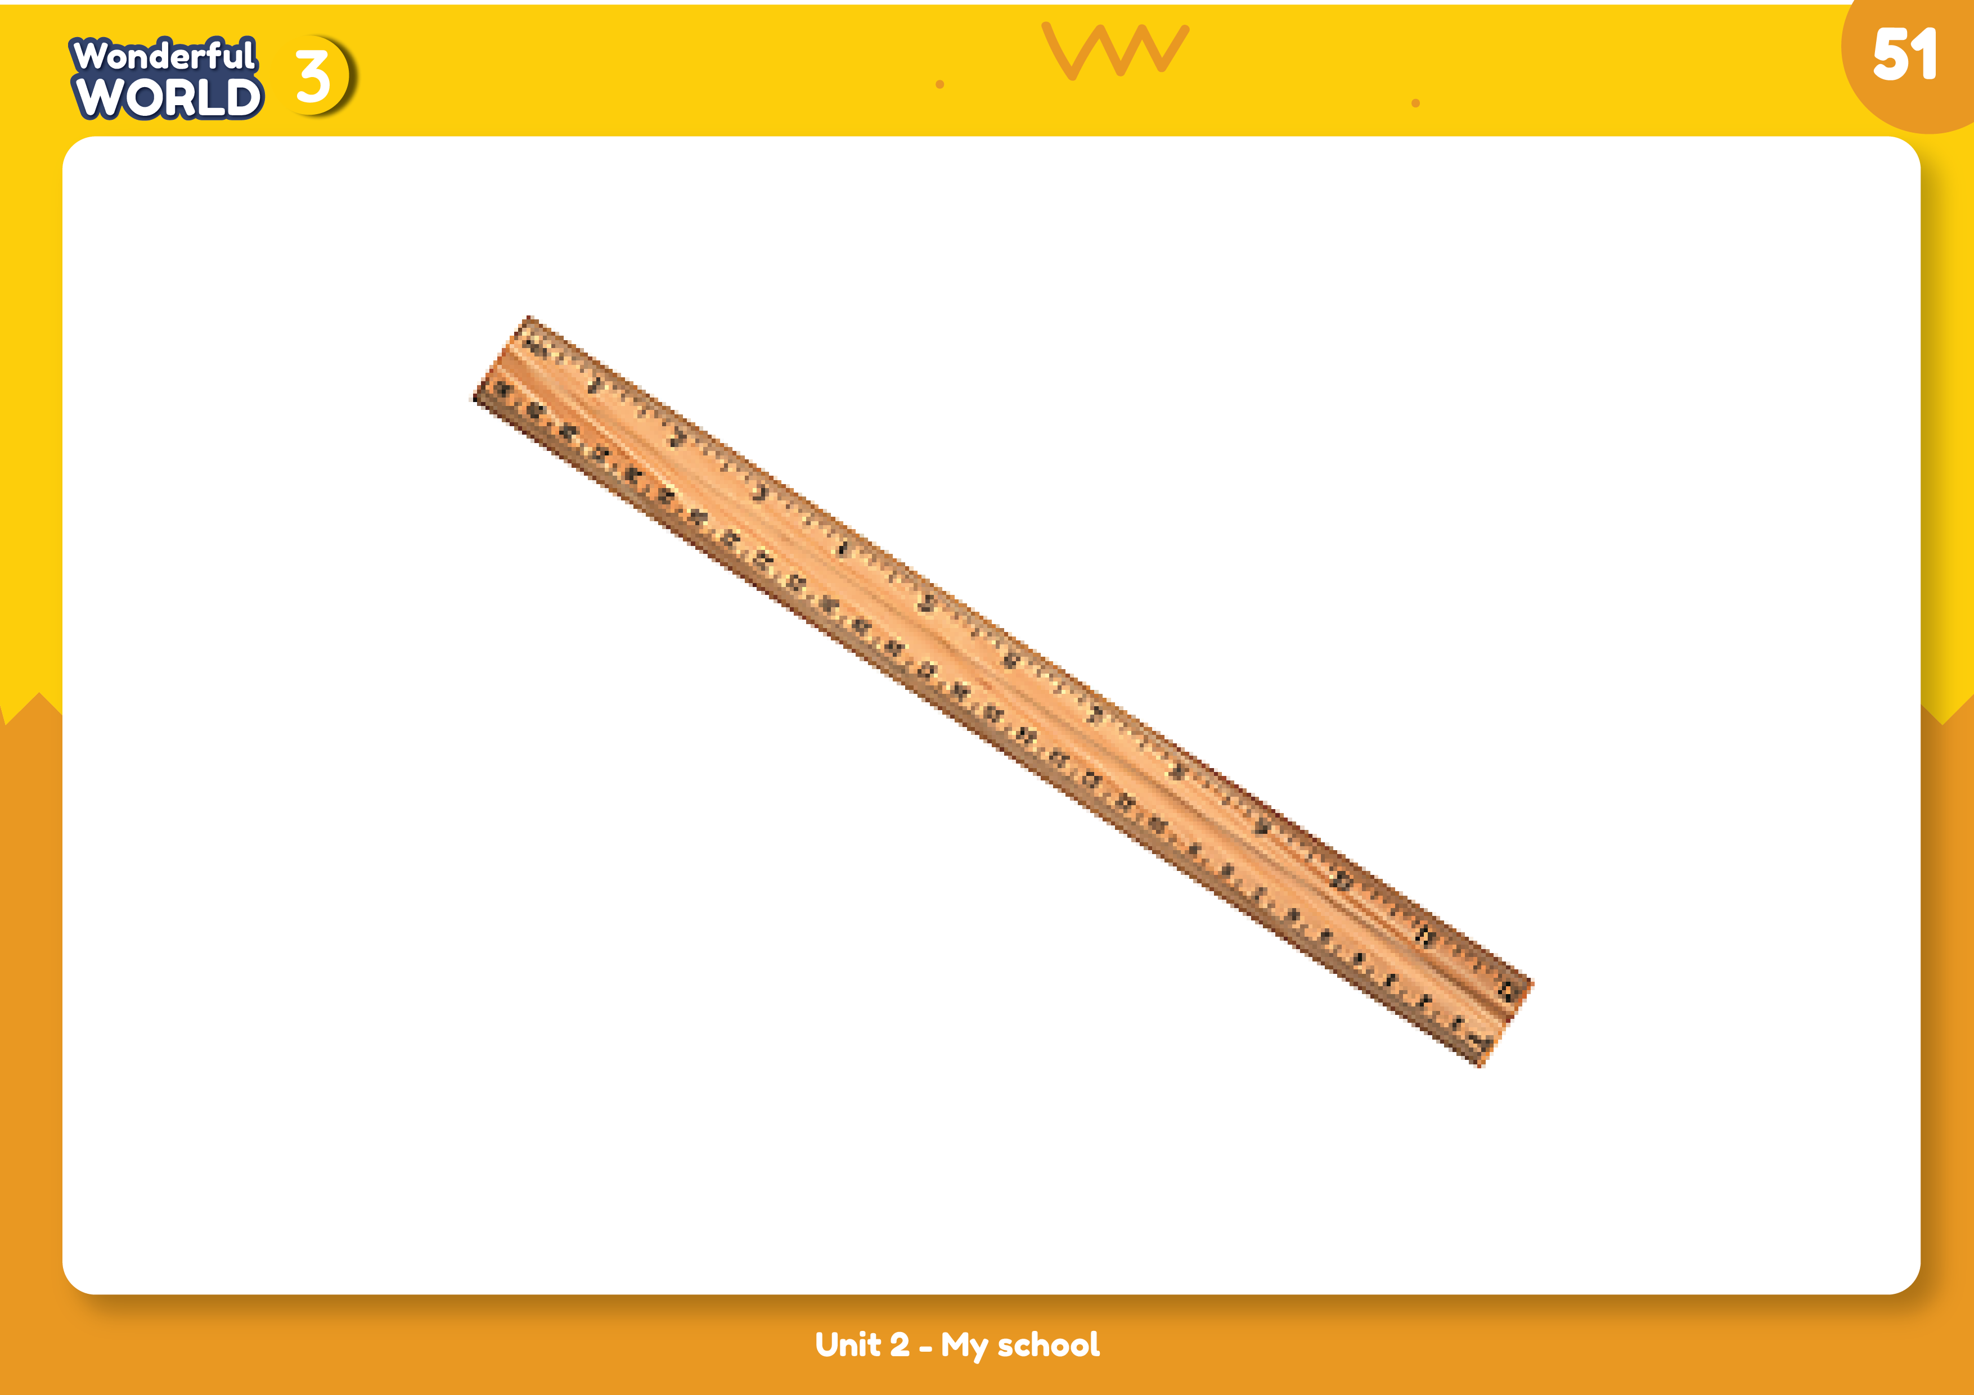

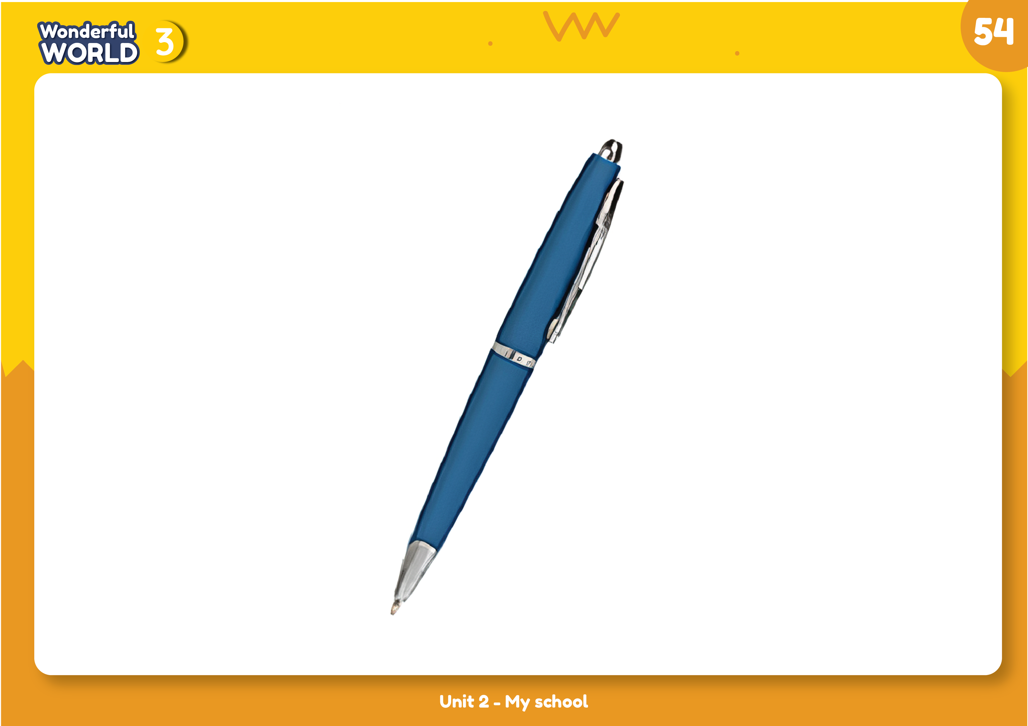
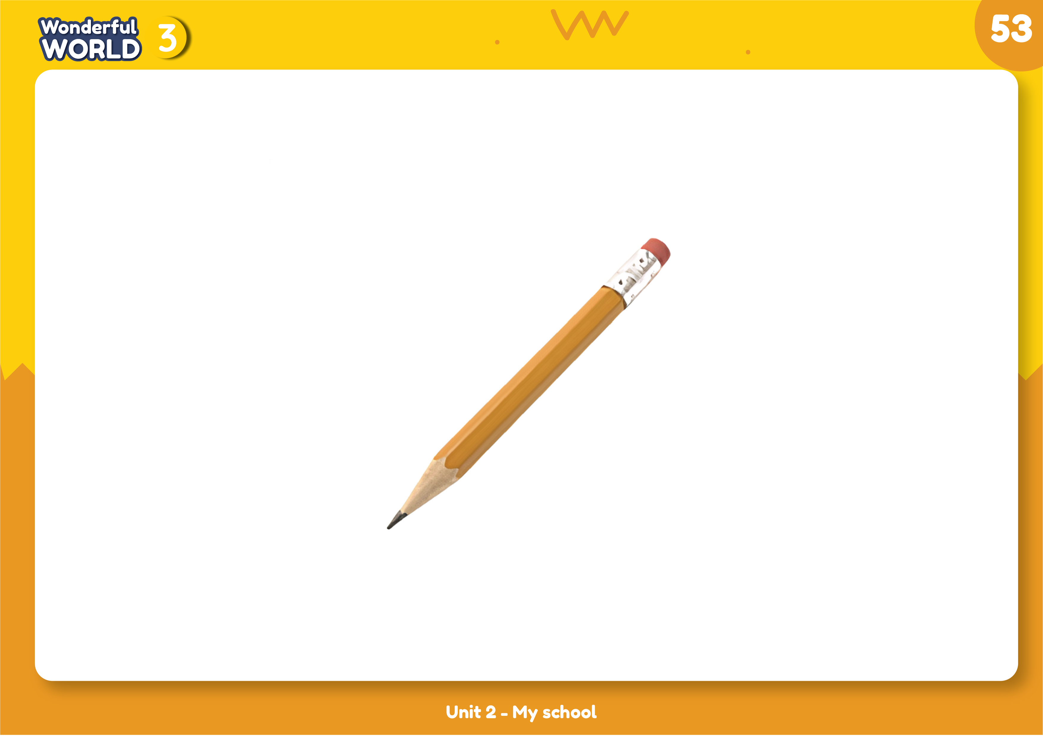
1. Listen and point. Repeat
book
ruler
rubber
pen
pencil

Slide 6
ruler

Slide 7
book

Slide 8
pencil

Slide 9
pen

Slide 10
rubber

Slide 11

Practice
Task 2 and task 3

Slide 12
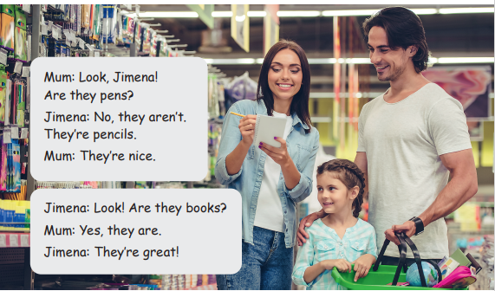
2 Listen and match

Slide 13
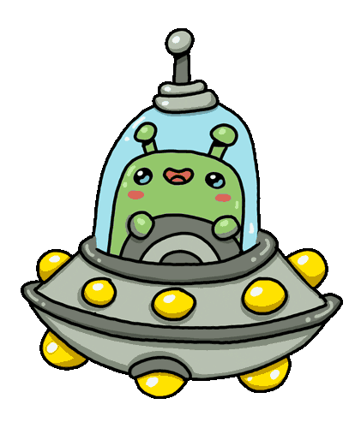

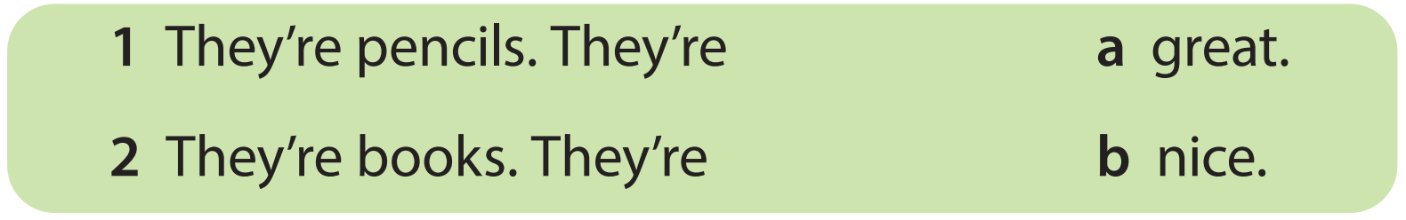
2 Listen and match
Notes:
THIẾT KẾ HOẠT ĐỘNG TƯƠNG TÁC CHO 2 CÂU NÀY KÈM THEO FILE NGHE:
They’re pencils. They’re ____.
a.nice
b.great
2. They’re books. They’re ____.
great
nice

Slide 14


My school things
They’re books.
They’re blue.
They’re nice.
Tom

Slide 15

Production

Slide 16

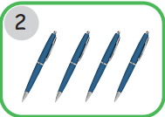
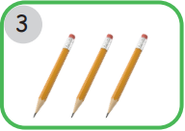
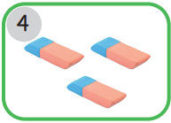
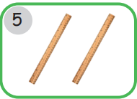
My school thing poster
blue nice

Slide 17


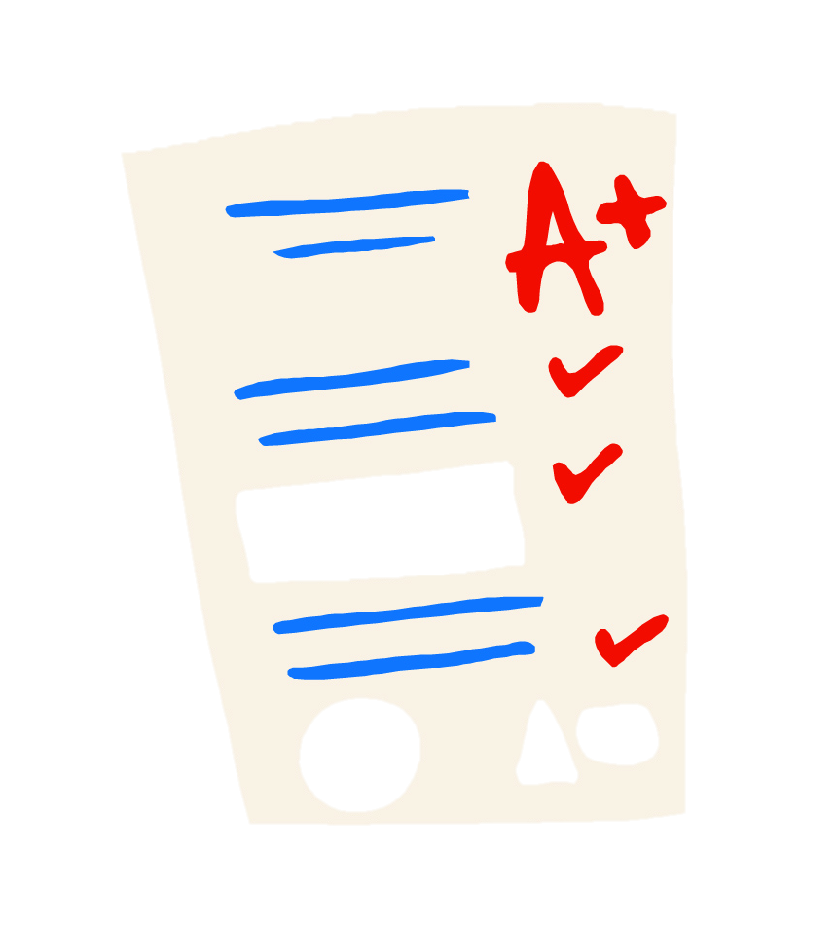
5 ASSESSMENT

Slide 18
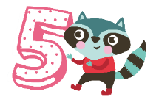
Assessment
Crossword

Slide 19
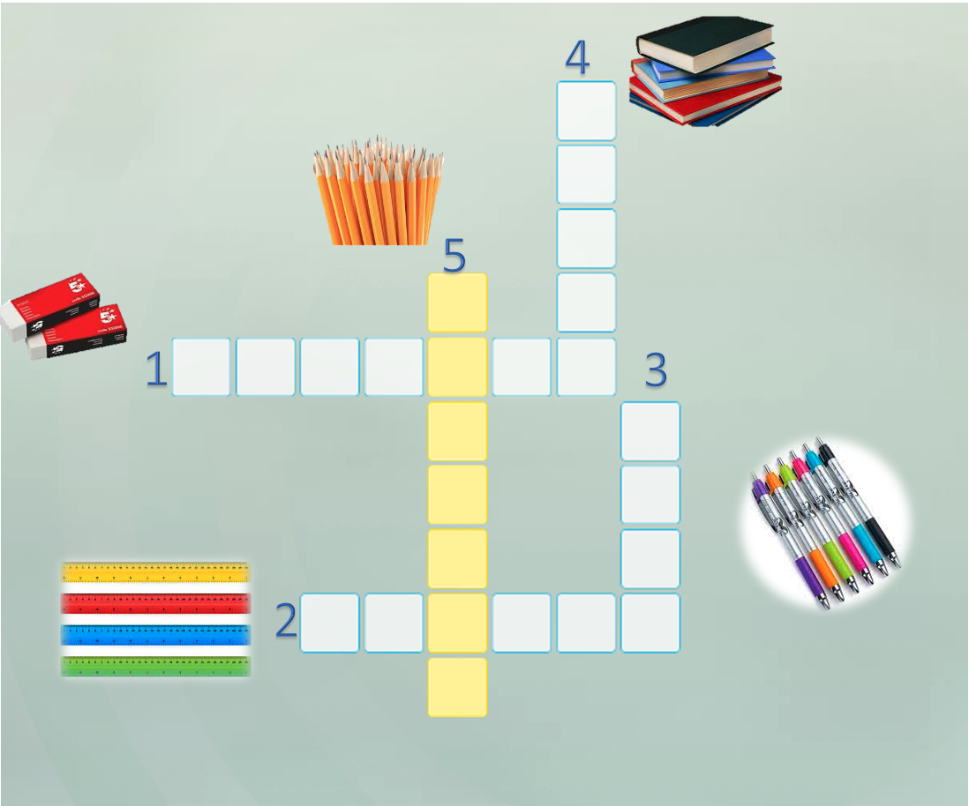
Crossword
B
O
O
K
S
P
N
C
I
S
R U B B E R
P
E
N
R U L E R S

Slide 20




Good bye.
See you again!

