Slide 1








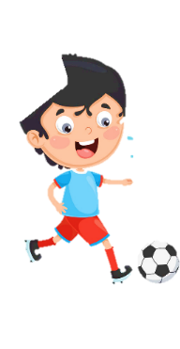












Unit 2
My school
Lesson 3 – Task 4,5,6
Notes:
Để nguyên trang bìa như này, chỉ thay đổi tên bài trong quá trình làm. Logo của sách Wonderful World

Slide 2



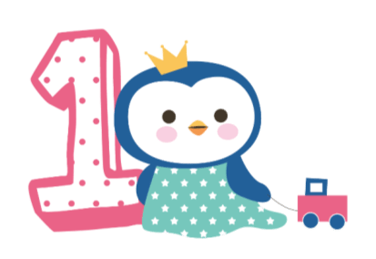



Warm up
Penguins find the way home!

Slide 3
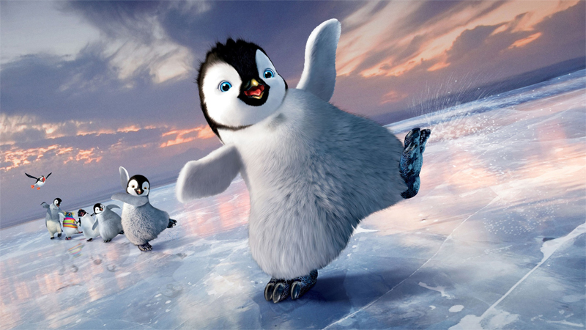
Penguins find the way home!

Slide 4

next
Notes:
Bấm vào ô màu để hiện tranh
Bấm next để đi đến phần tiếp theo

Slide 5

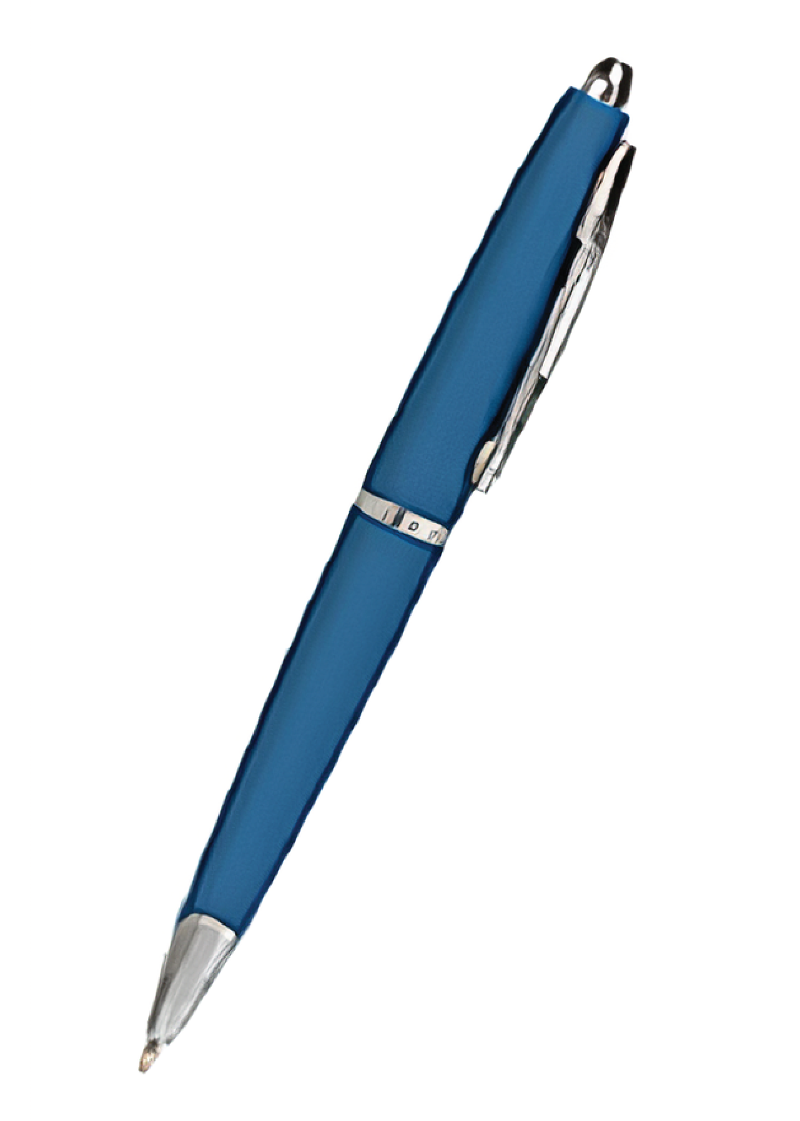

pen
back
Notes:
- Bấm back để trở lại slide cánh cụt

Slide 6
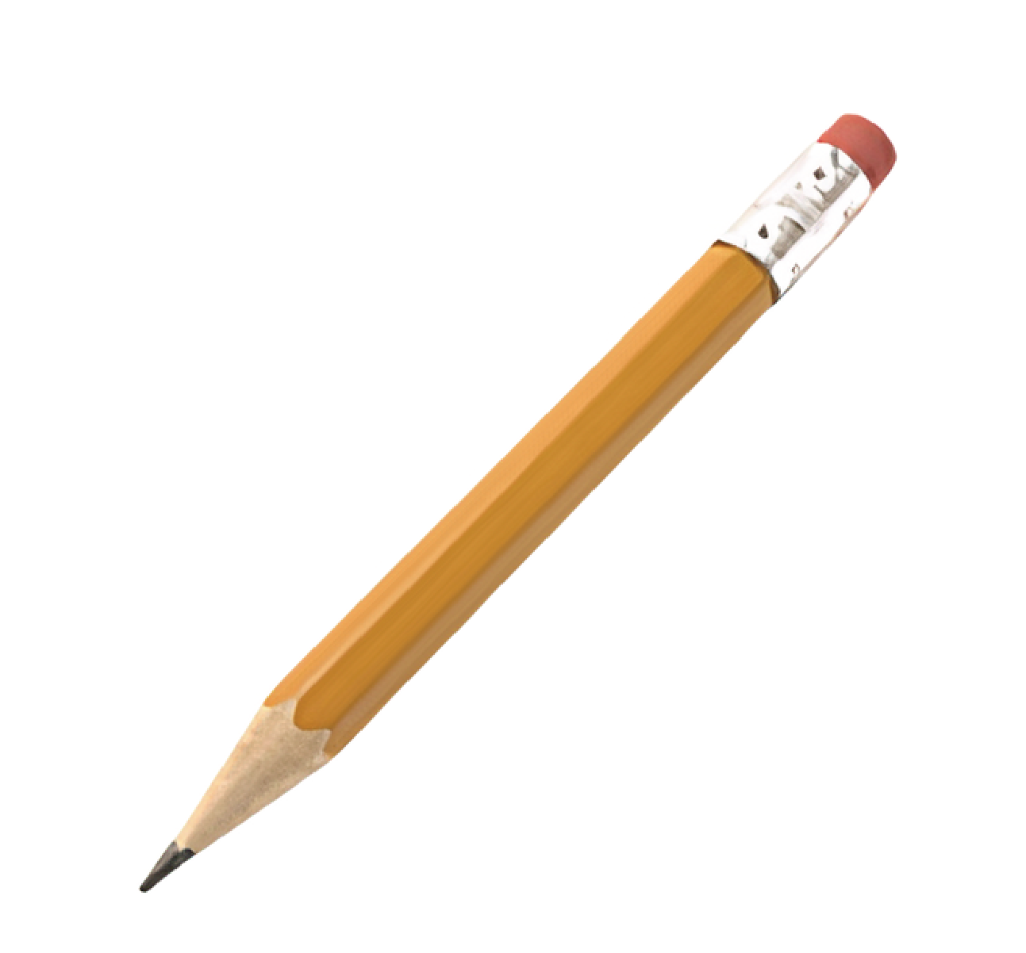
pencil
back

Slide 7
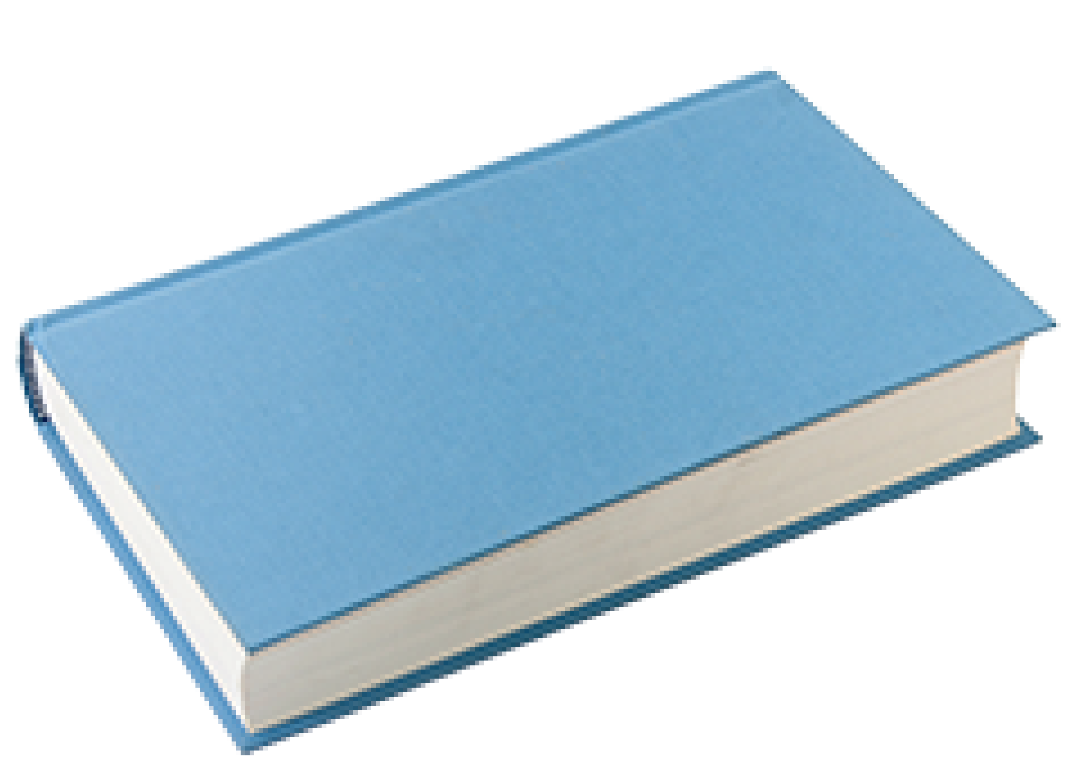
book
back

Slide 8
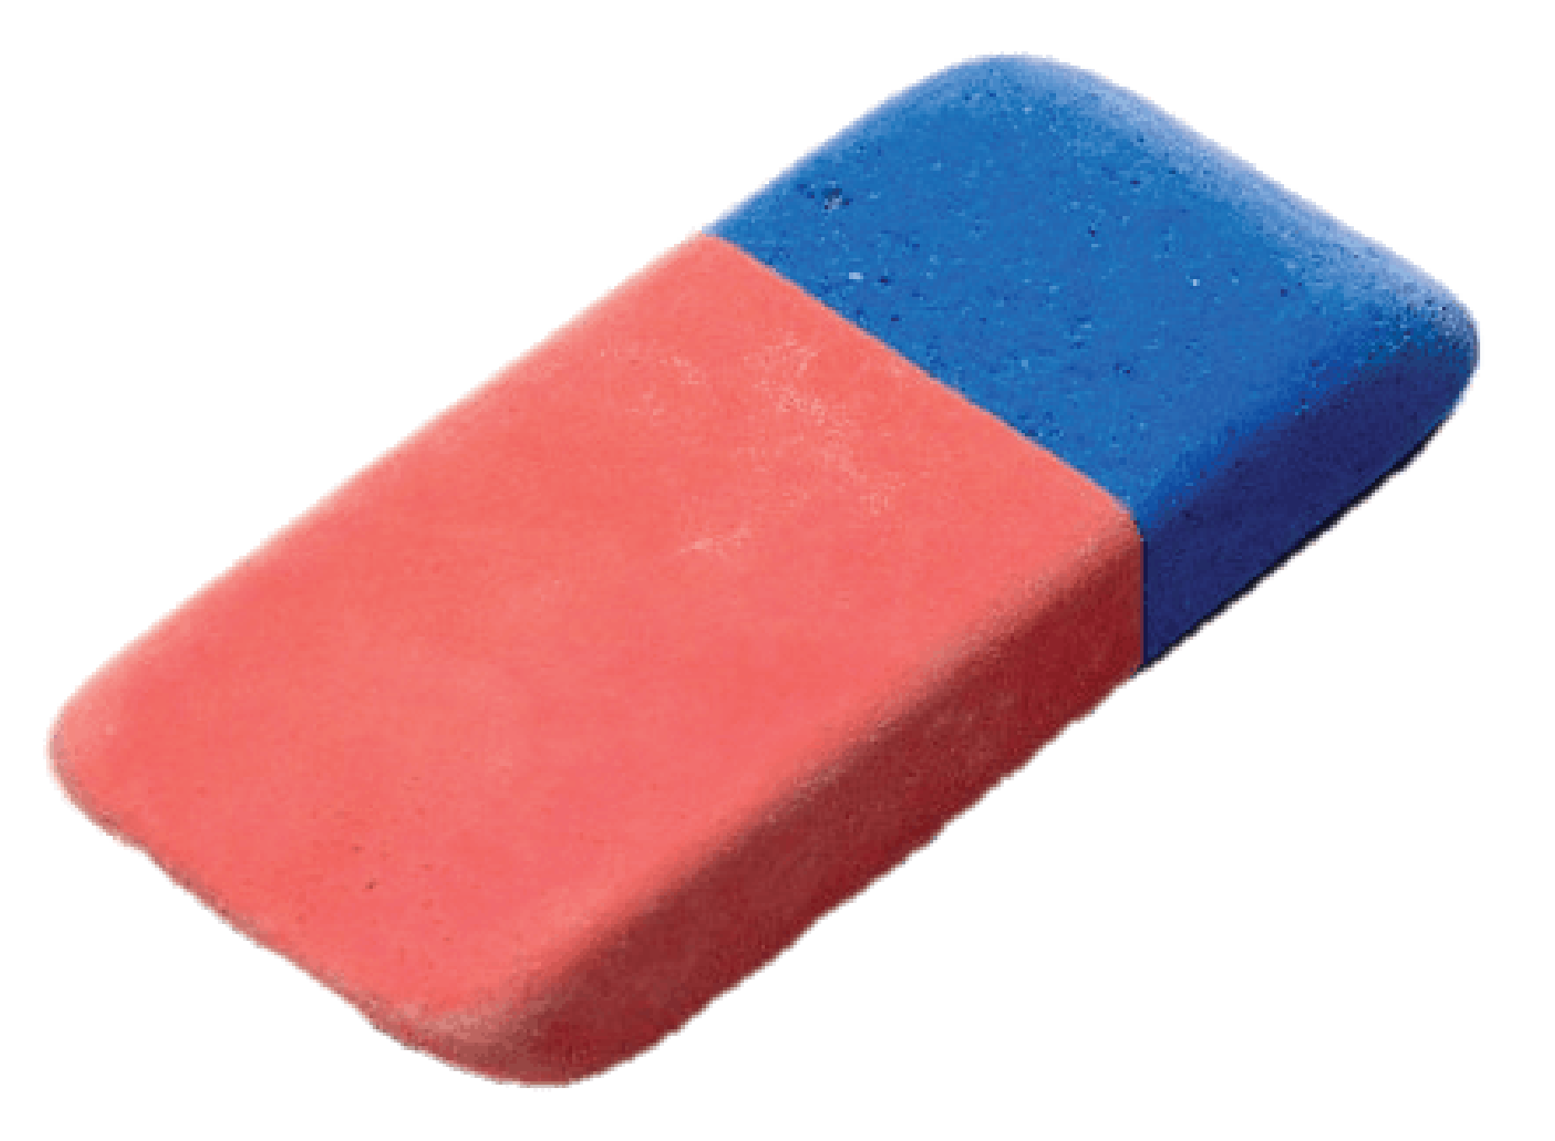
rubber
back

Slide 9
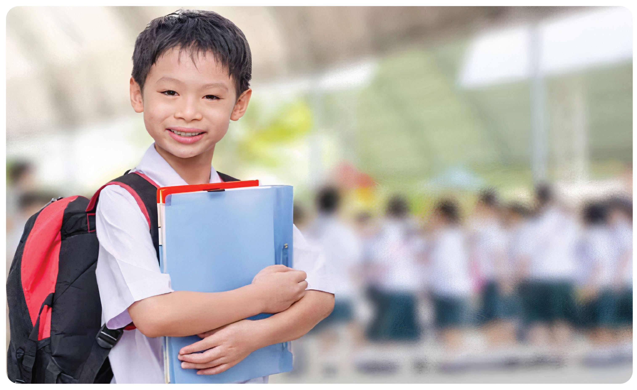
student
back

Slide 10

teacher
back

Slide 11
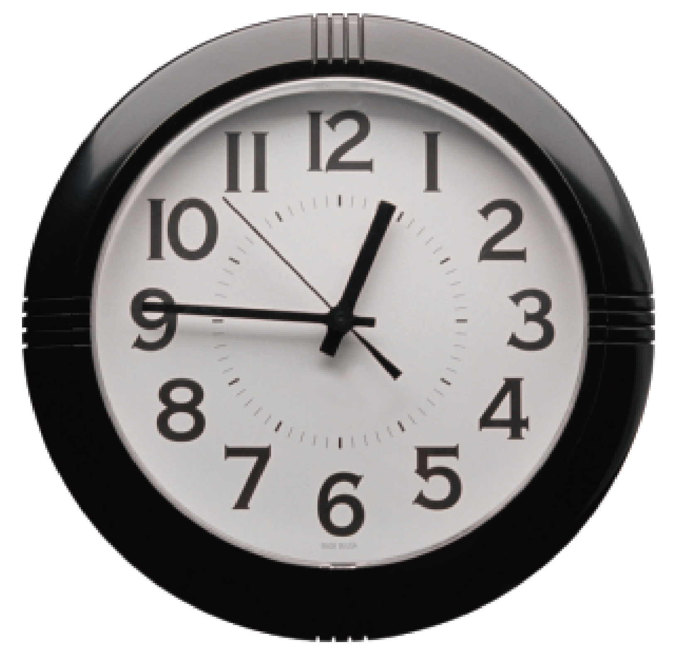
clock
back

Slide 12
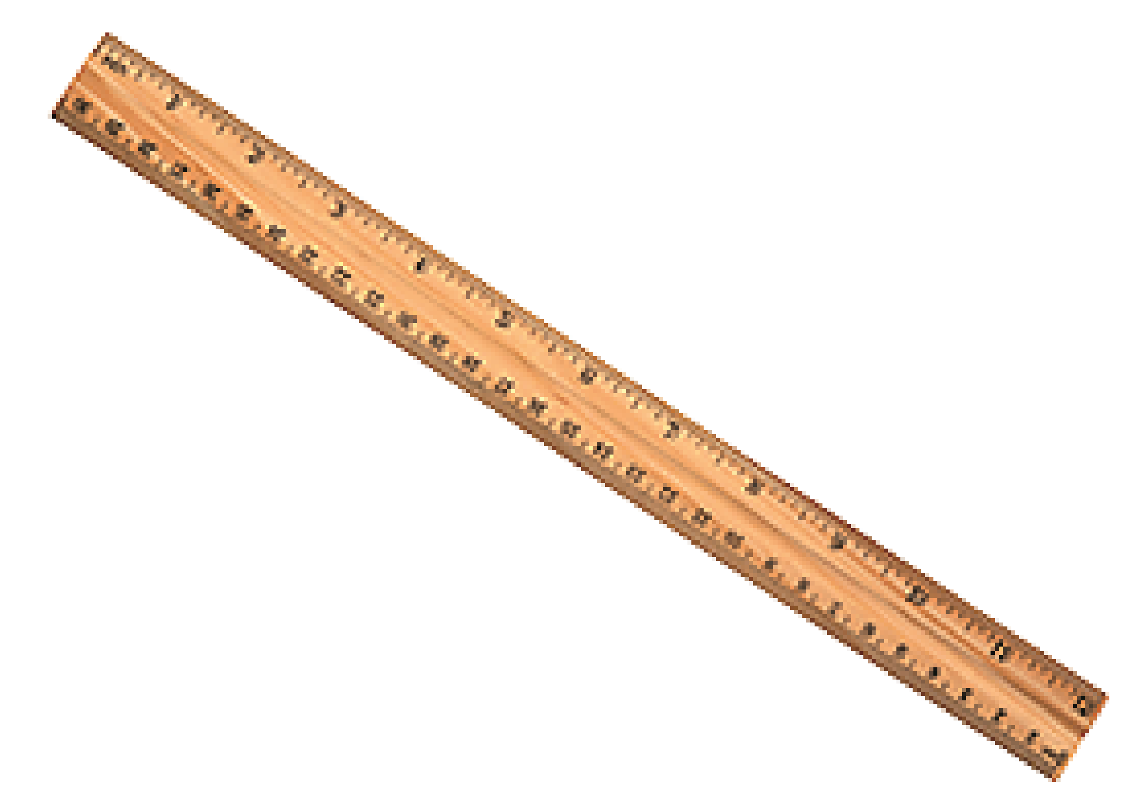
ruler
back

Slide 13

Presentation
Task 4: Listen and repeat.

Slide 14

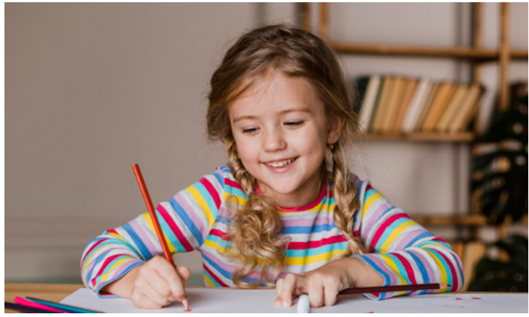
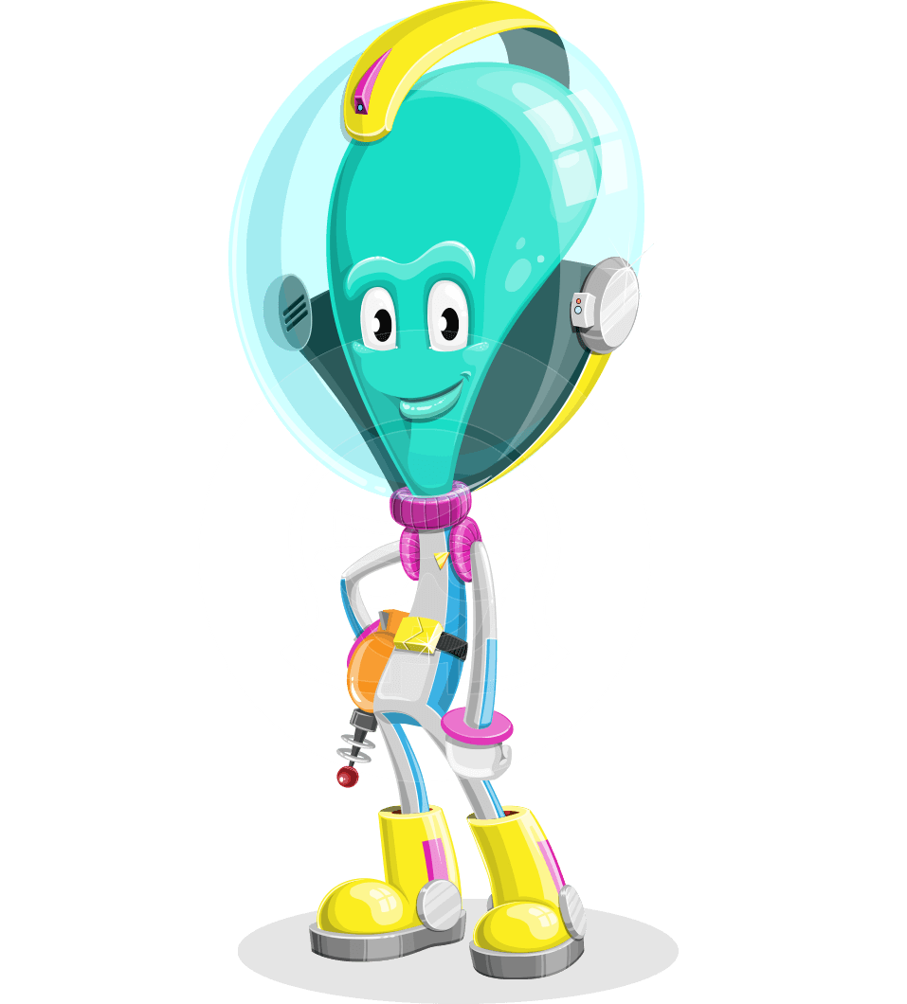
Are you a student?
Yes, I am.

Slide 15

Are you a student?
No, I’m not.

Slide 16
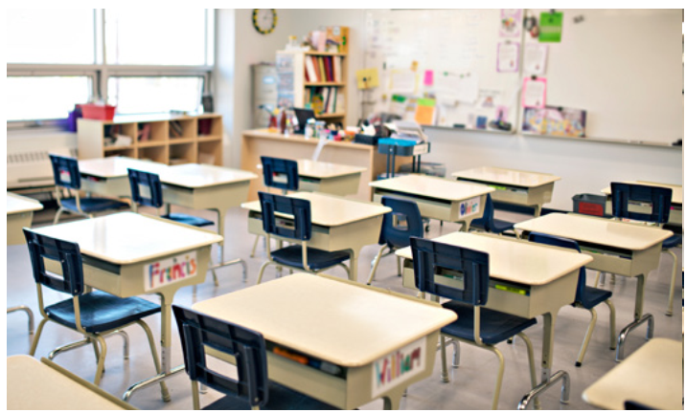

Are they desks?
Yes, they are.

Slide 17
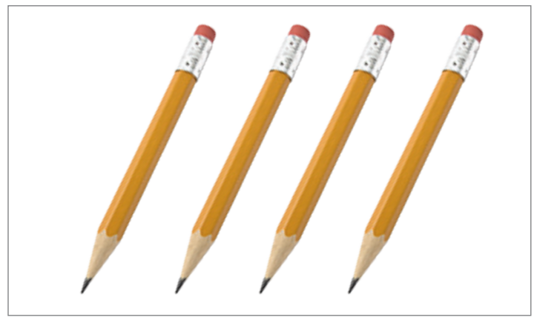
Are they pens?
No, they aren’t.

Slide 18
Are you a student?
Are you a student?
I am not = I’m not
are not = aren’t
Yes, I am.
No, I’m not.
Are they desks?
Are they pens?
Yes, they are.
No, they aren’t.

Slide 19
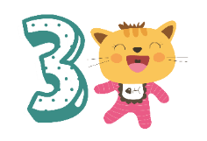
Practice
Task 5: Point and ask

Slide 20

RING THE BELL
Notes:
THIẾT KẾ HOẠT ĐỘNG TƯƠNG TÁC CHO SLIDE VỚI 8 CÂU VỚI NỘI DUNG CÂU HỎI DÙNG CHUNG LÀ:
Make a question:

Slide 21
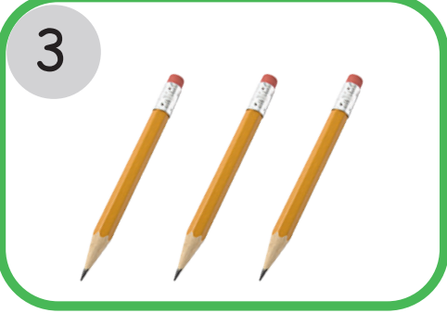
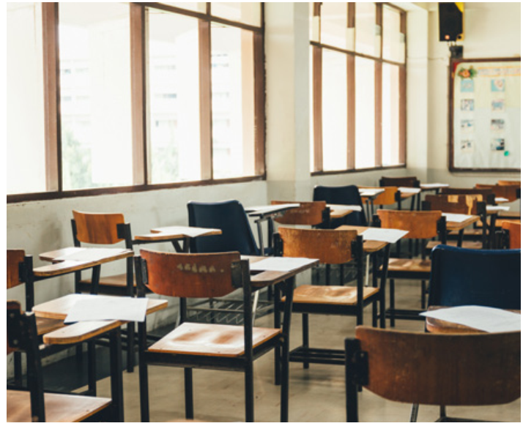

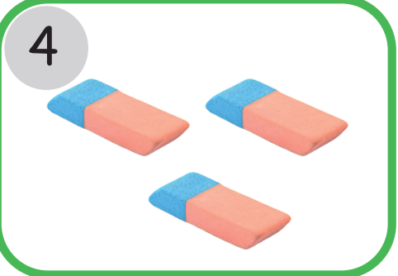

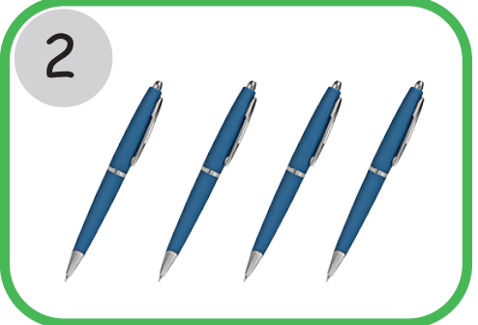
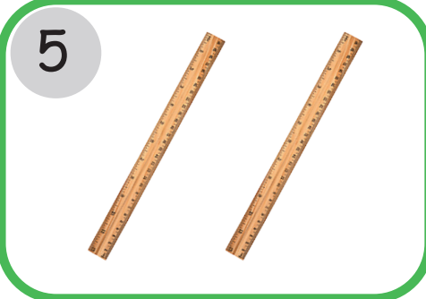
1
5
1. you/teacher
Are you a teacher?
2
6
2. they/ books
➔ Are they books?
3. they/ students
3
7
7
➔ Are they students?
4. they/ chairs
4
8
➔ Are they chairs?
Notes:
HOẠT ĐỘNG TƯƠNG TÁC:
Make a question:
you/teacher
….

Slide 22
1
5
5. they/pencils
➔ Are they pencils?
2
6
6. they/ clocks
➔ Are they clocks?
7. they/ pens
3
7
7
➔ Are they pens?
8. they/ rubbers
4
8
➔ Are they rubbers?

Slide 23
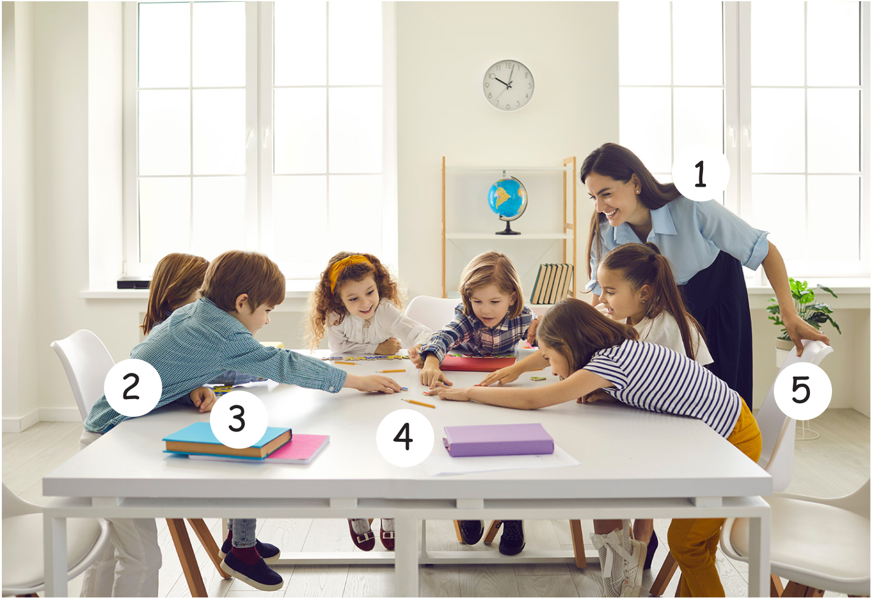

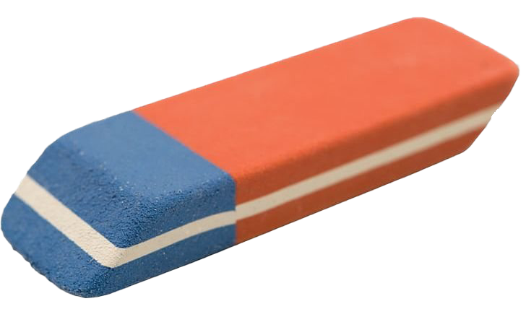
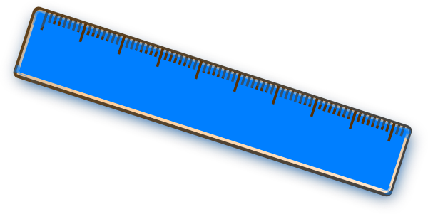
1
2
9
3
8
7
6
4
10
5

Slide 24
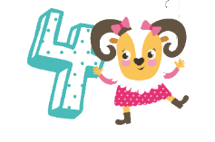
Production
Task 6: Let’s talk.
Notes:
Miming Game
-Ask sts to work in pairs
- Have one st act out as school things
- The other guesses by asking question: are they …?
- The actor answers Yes, they are/ No, they aren’t.
-Change the role after 2 minutes
- The one guesses most things correctly in time gets stickers from teacher

Slide 25
START TIMER
TIME’S UP!
Mini
game
120
110
10
2
minutes
100
20
90
30
80
40
70
50
60
Notes:
Miming Game
-Ask sts to work in pairs
- Have one st act out as school things
- The other guesses by asking question: are they …?
- The actor answers Yes, they are/ No, they aren’t.
-Change the role after 2 minutes
- The one guesses most things correctly in time gets stickers from teacher

Slide 26
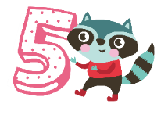
Assessment
Look, read and circle.

Slide 27

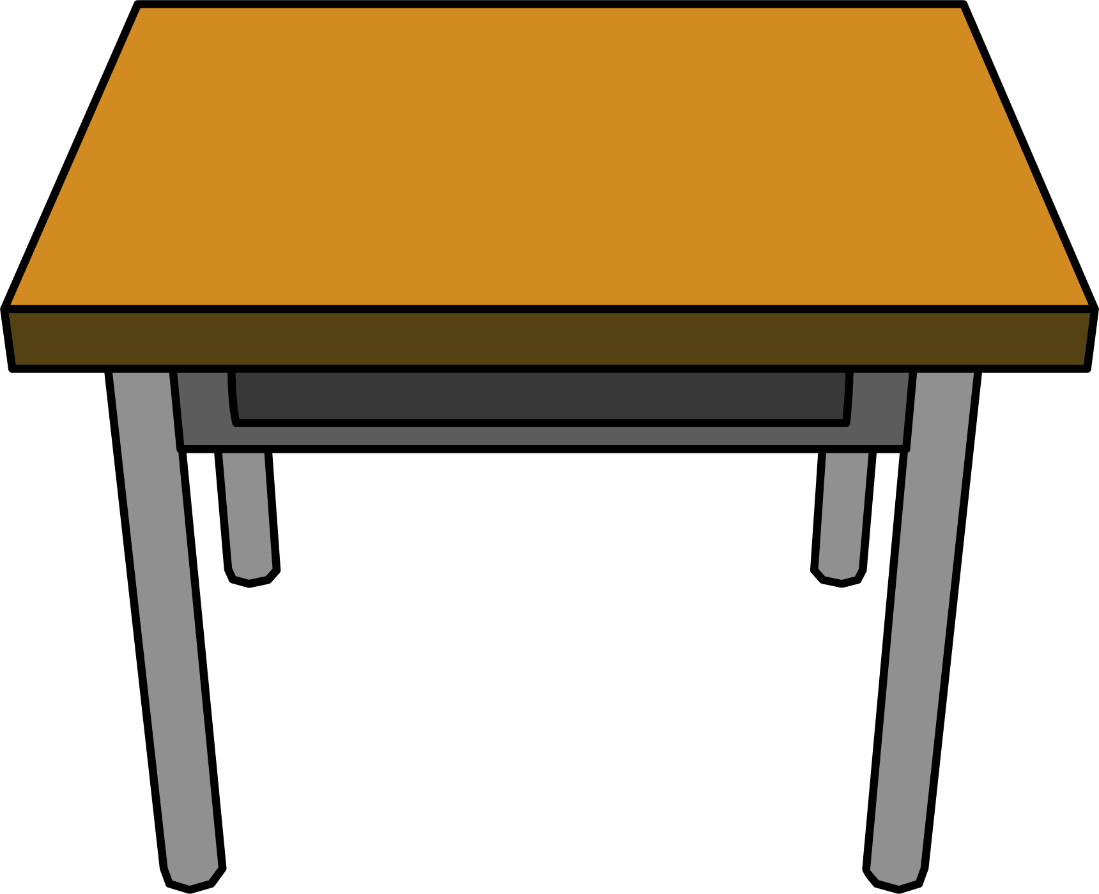
LOOK, READ AND CIRCLE
1. Are you a student?
a. Yes, I am.
b. No, I’m not.
2. Are they chairs?
a. Yes, they are.
b. No, they aren’t.
3. Are they clocks?
a. Yes, they are.
b. No, they aren’t.
4. Are you a teacher?
a. Yes, I am.
b. No, I’m not.
5. Are they rubbers?
a. Yes, they are.
b. No, they aren’t.

Slide 28




Good bye.
See you again!

