Slide 1








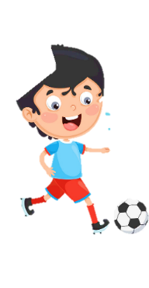












Unit 2
My school
Lesson 3 – Task 7,8,9
Notes:
Để nguyên trang bìa như này, chỉ thay đổi tên bài trong quá trình làm. Logo của sách Wonderful World

Slide 2



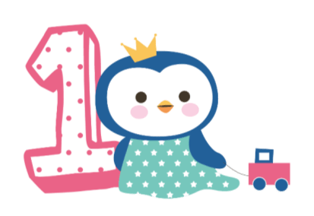



Warm up
Song: School supplies!

Slide 3

Warm-up

Slide 4

Presentation
Task 7: Listen and repeat

Slide 5

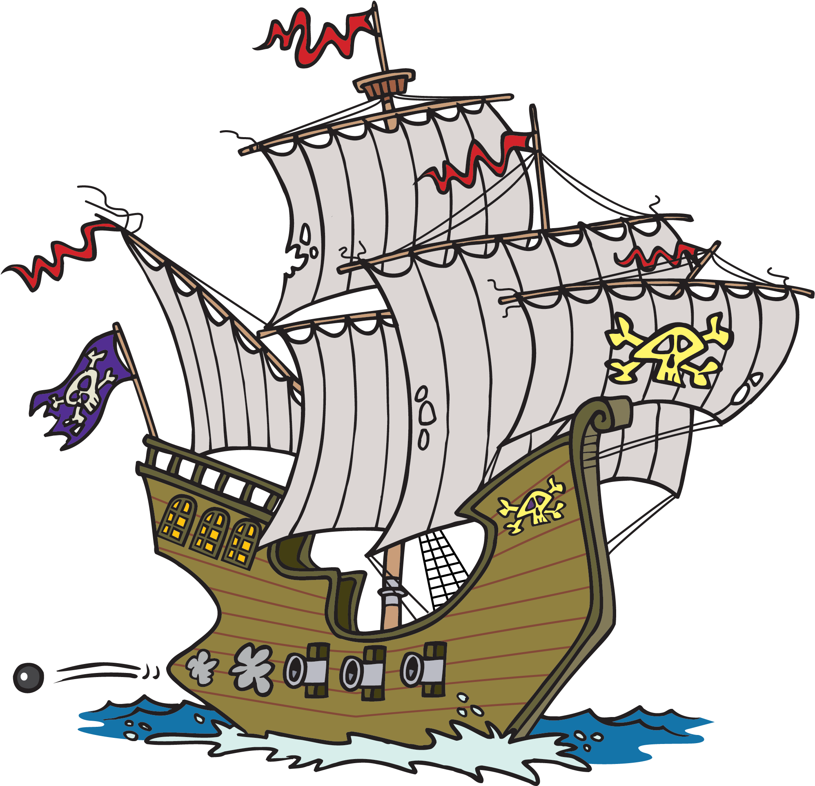

SAVE THE PIRATE
k
oo

Slide 6

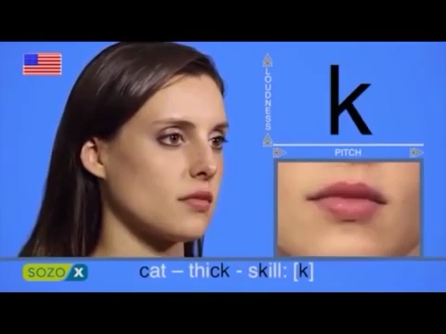
k

Slide 7
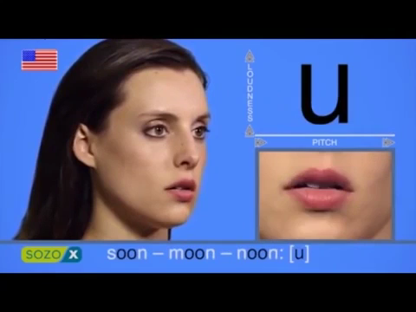
oo

Slide 8








black
book
clock
duck
desk

Slide 9
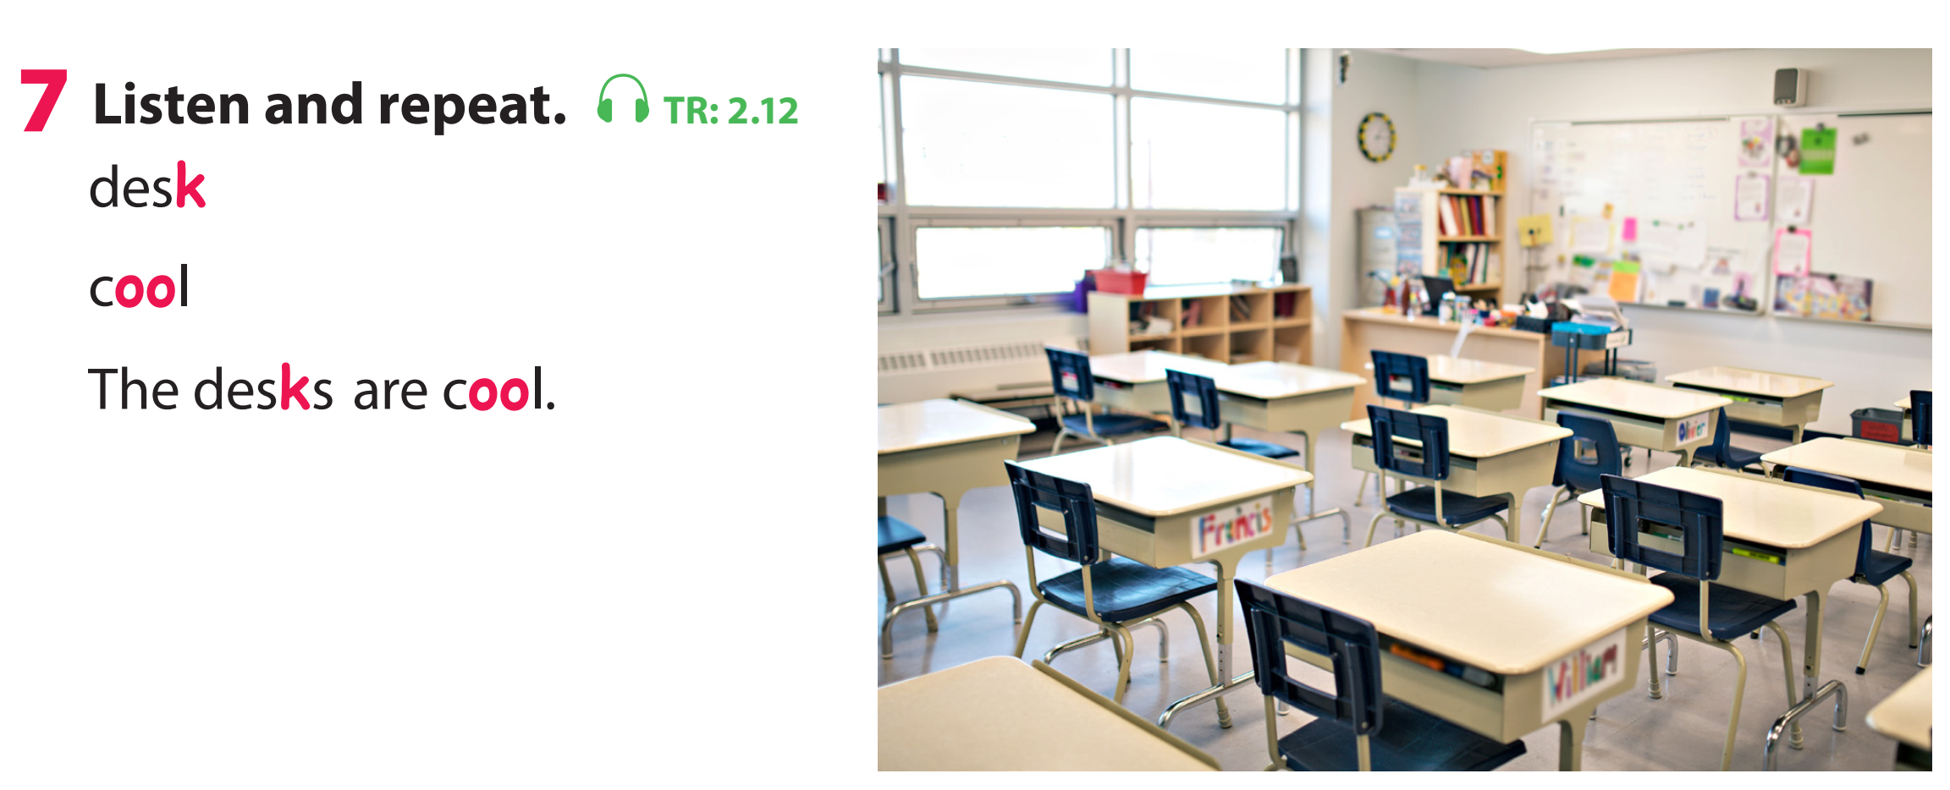
Listen and repeat
k desk
oo cool
The desks are cool.

Slide 10
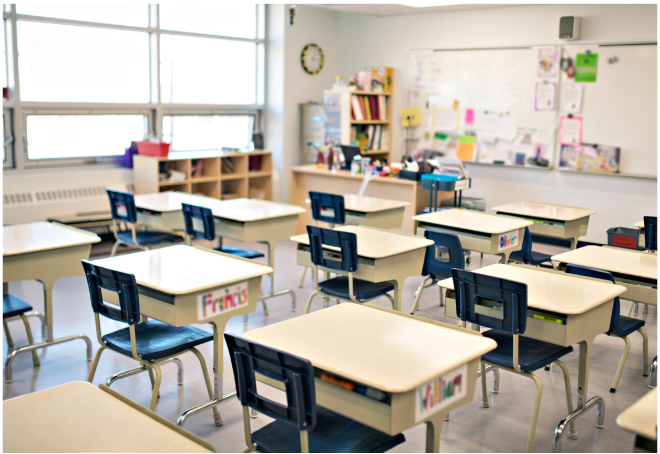

The desks are cool.

Slide 11
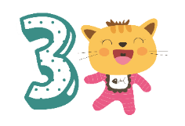
Practice
Task 8: Listen and chant.

Slide 12
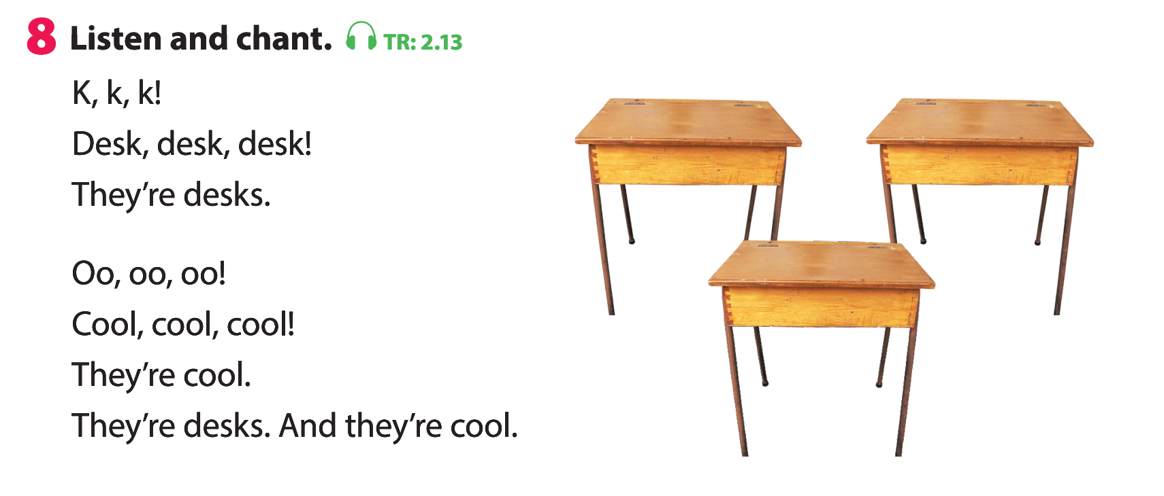

Slide 13
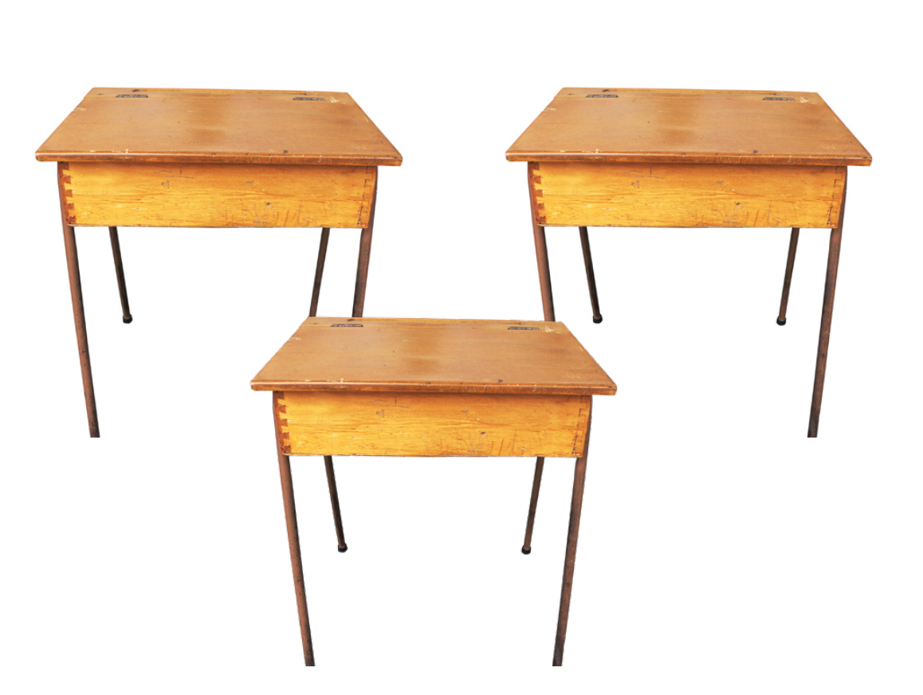
3 PRACTICE
K k k!
Desk, desk, desk
They’re desks.
Oo, oo,oo
Cool, cool, cool!
They are cool.
They’re desks.
And they’re cool.

Slide 14
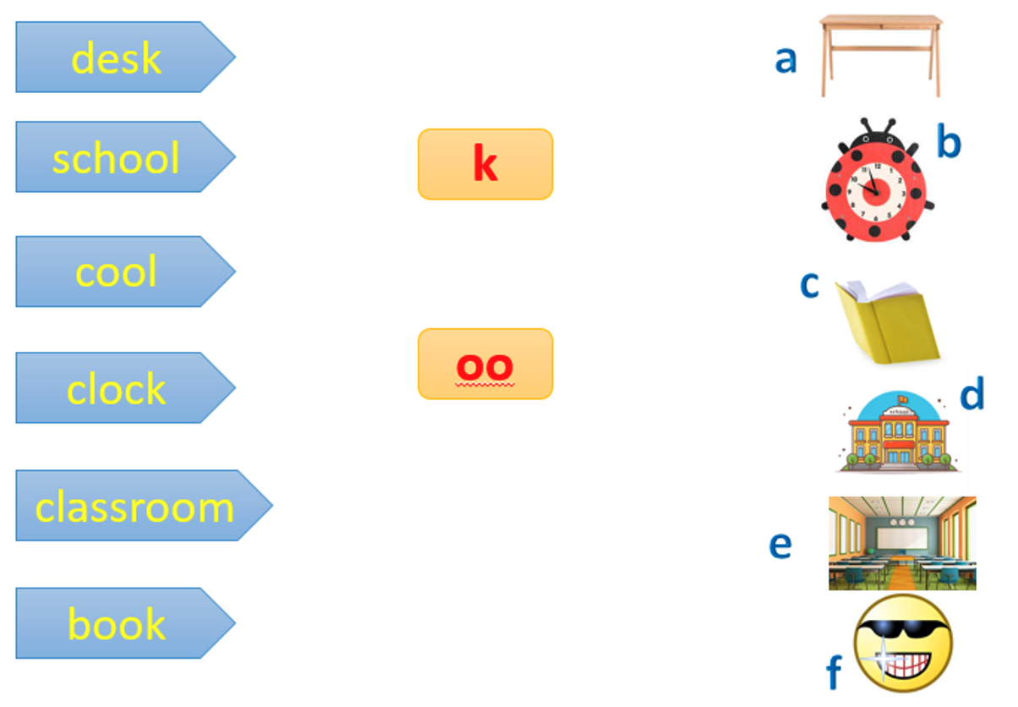
a
d
f
oo
b
e
c

Slide 15
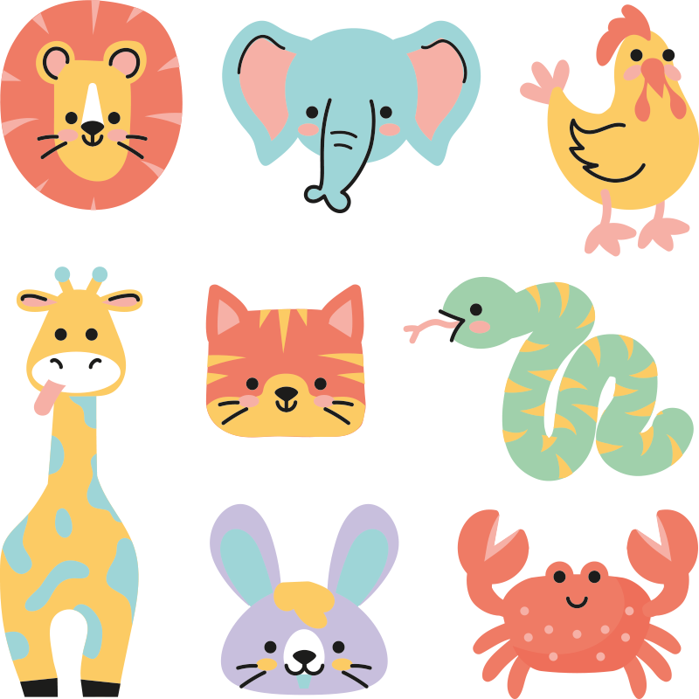
STICK THE BOARD
Next
Notes:
Click vào hình con vật để xuất hiện câu hỏi
Bấm next để tới phần kế tiếp

Slide 16

The clocks are black.
Back
Notes:
GV đăt câu hỏi cho Hs:
WHAT ARE THEY? They are clocks.
What color are the clocks? The clocks are black.
Bấm back để quay trở lại slide con vật

Slide 17
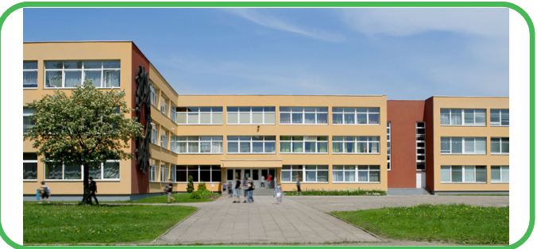
My school is cool.
Back

Slide 18
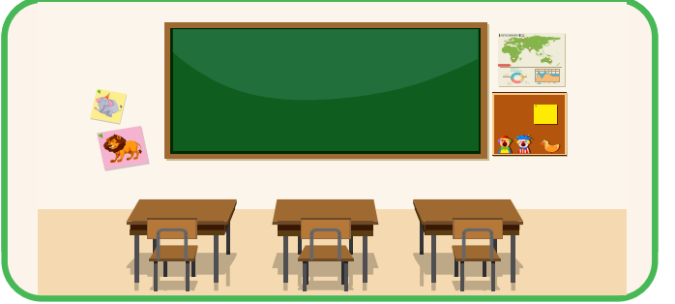
The desks are in the classroom.
Back

Slide 19

The books are red.
Back

Slide 20


The boards are cool.
Back

Slide 21


Look at the clock.
Back

Slide 22
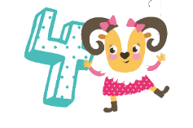
Production
My phonic corner.

Slide 23
MY PHONICS CORNERS
k | oo

Slide 24
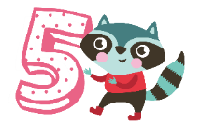
Assessment
Look circle the correct sound.

Slide 25
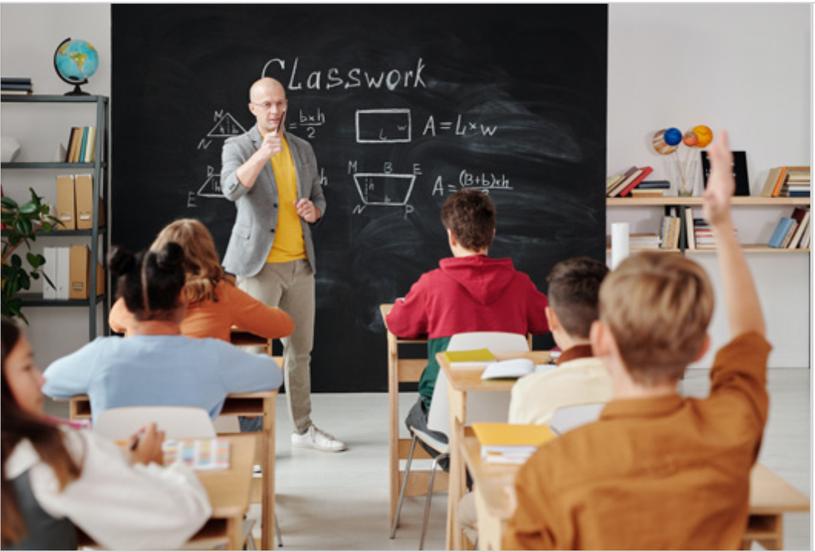

LOOK, CIRCLE THE CORRECT SOUND
1. | 2. | 3.
k oo s | k sh oo | k oo s
4. | 5. | 6.
k oo sh | sh k oo | k s oo
Notes:
THIẾT KẾ HOẠT ĐỘNG TƯƠNG TÁC ĐÁNH GIÁ HỌC SINH

Slide 26




Good bye.
See you again!

