Slide 1



















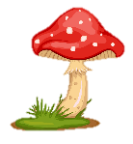
Notes:
Để nguyên trang bìa như này, chỉ thay đổi tên bài trong quá trình làm. Logo của sách Wonderful World

Slide 2
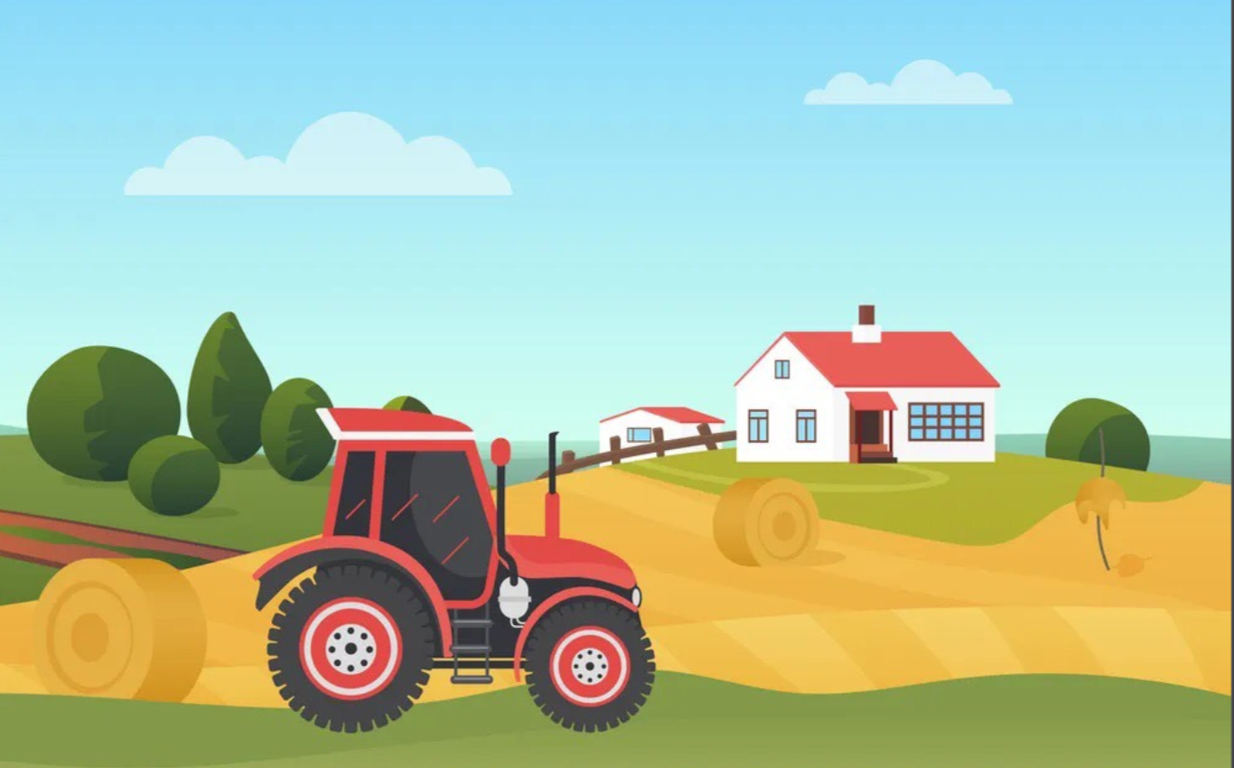


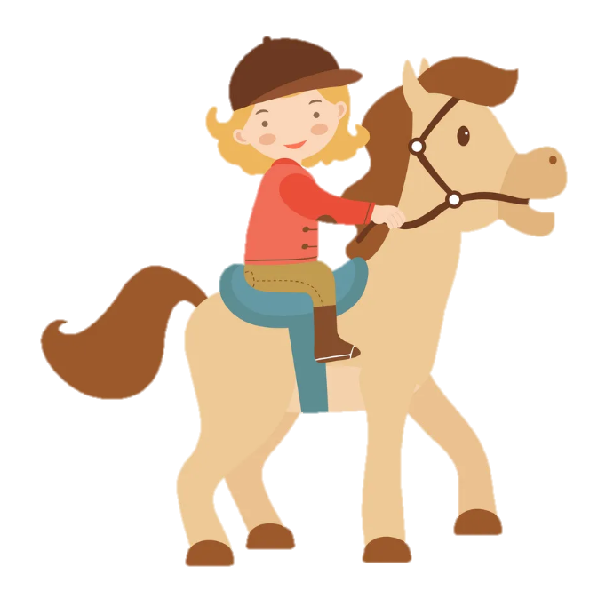
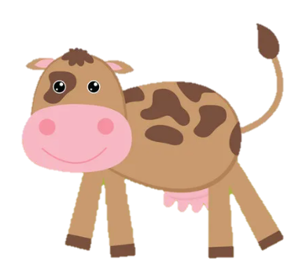
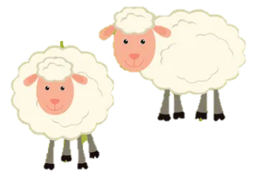
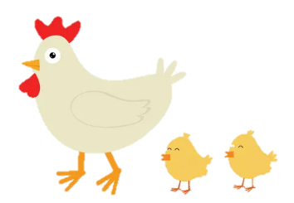
Unit 3: On the farm
Funtime and Project

Slide 3
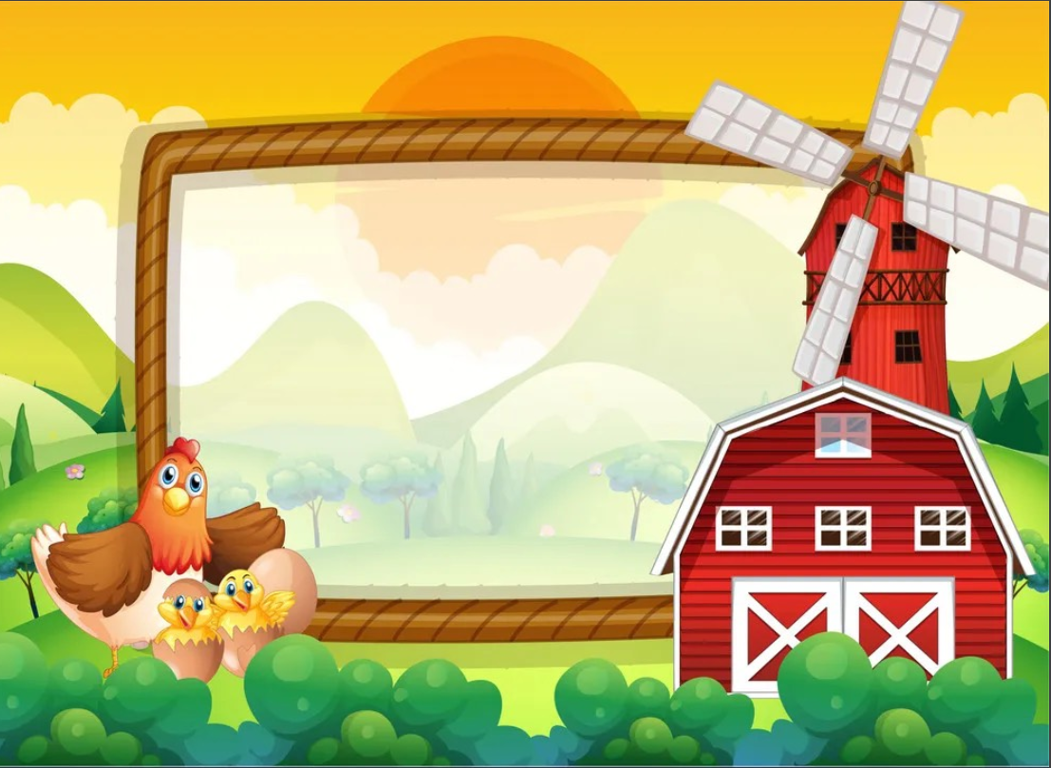
1
Warm Up

Slide 4
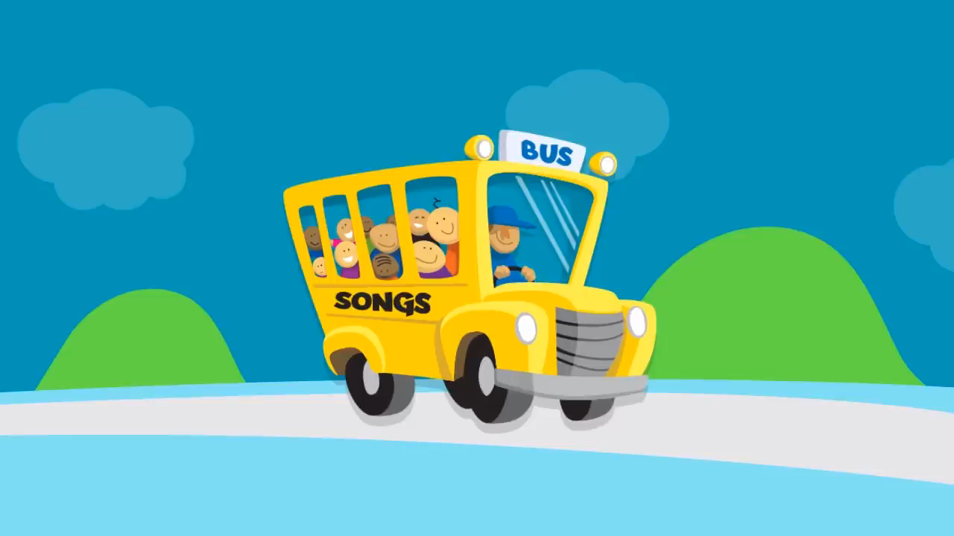
Listen and sing!

Slide 5
2
Fun time

Slide 6
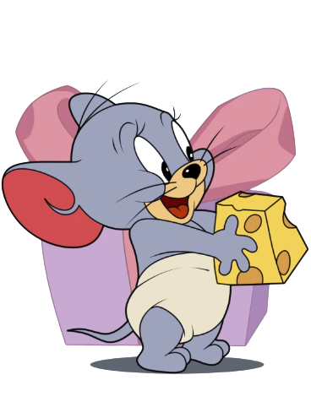
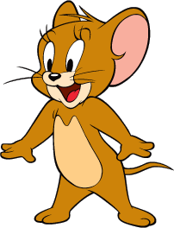
1. Find and Circle!
A | N | I | M | A | L | S | G | N | O
U | H | A | V | G | O | A | T | R | T
C | O | W | R | G | A | R | B | T | M
K | R | A | V | A | O | W | N | R | Q
A | S | H | E | E | P | U | N | O | F
U | E | V | C | H | I | C | K | E | N
I | B | E | W | O | Y | X | Y | E | M
1
2
3
4
5
6

Slide 7
3
Project

Slide 8
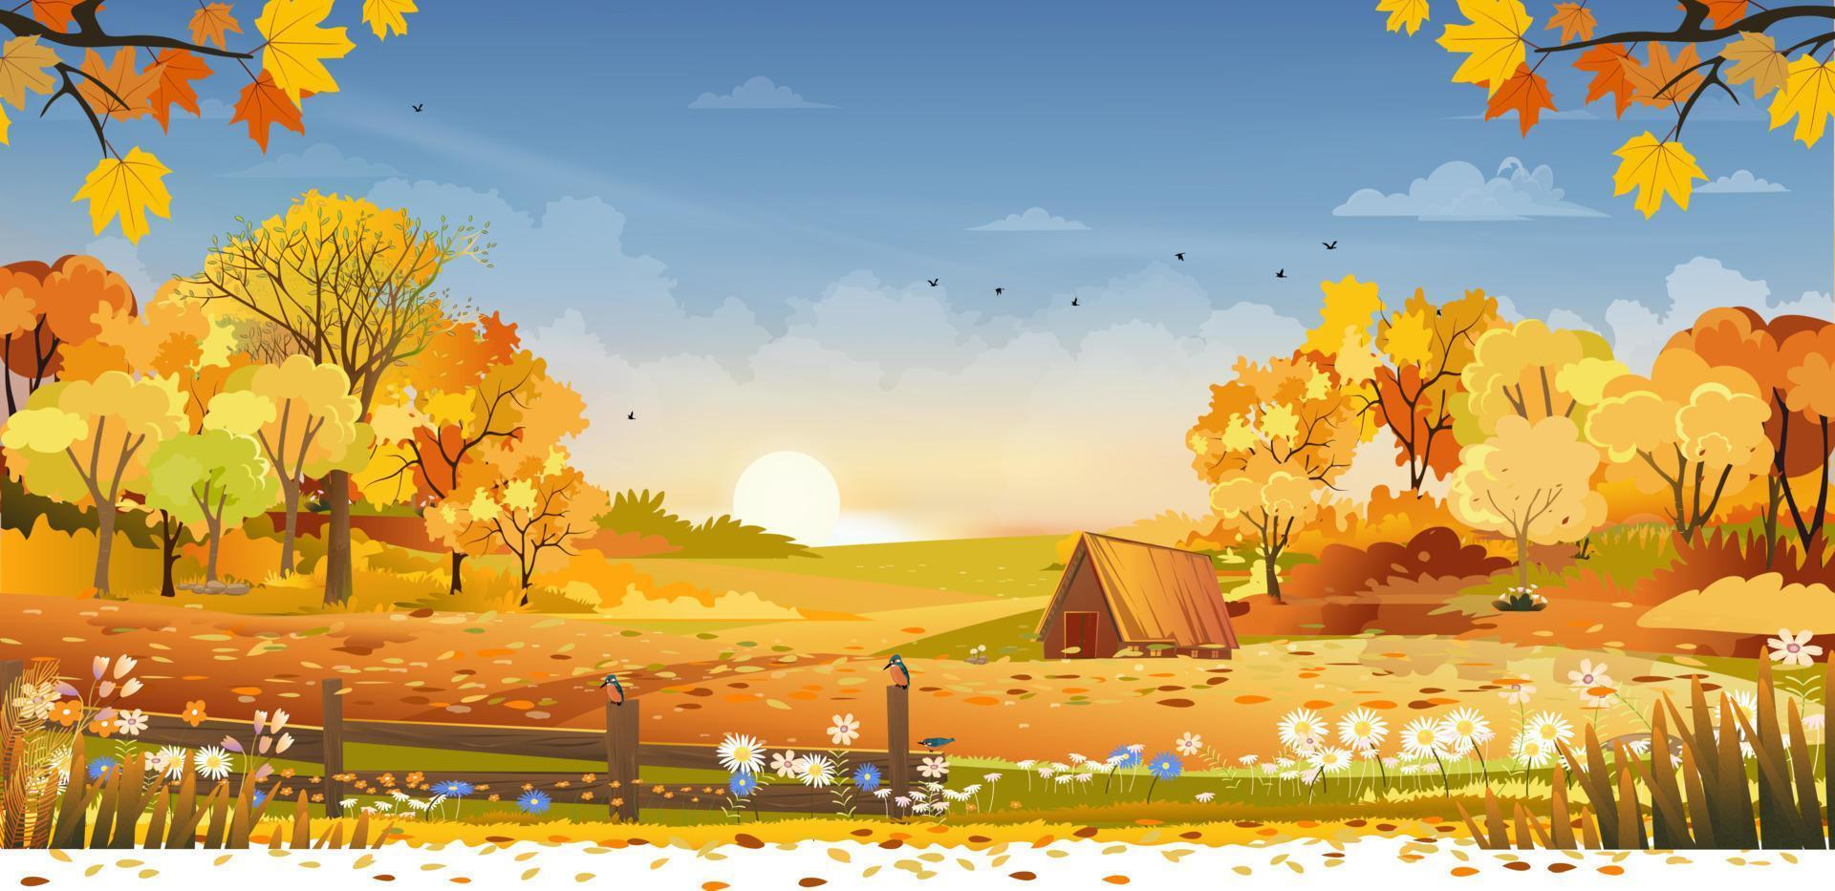
Let’s draw your dream farm!

Slide 9
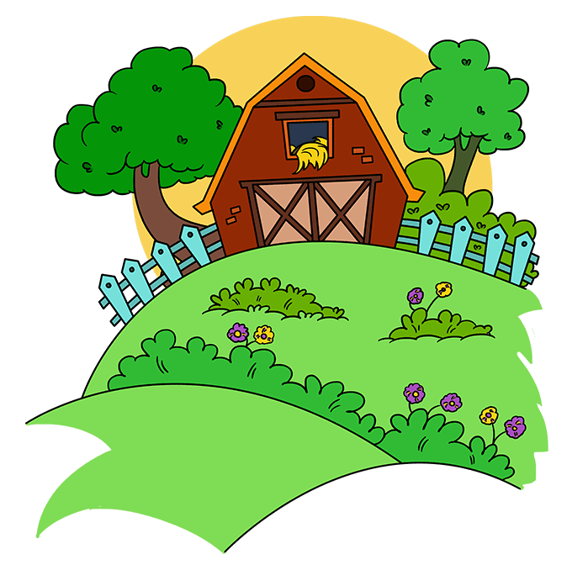
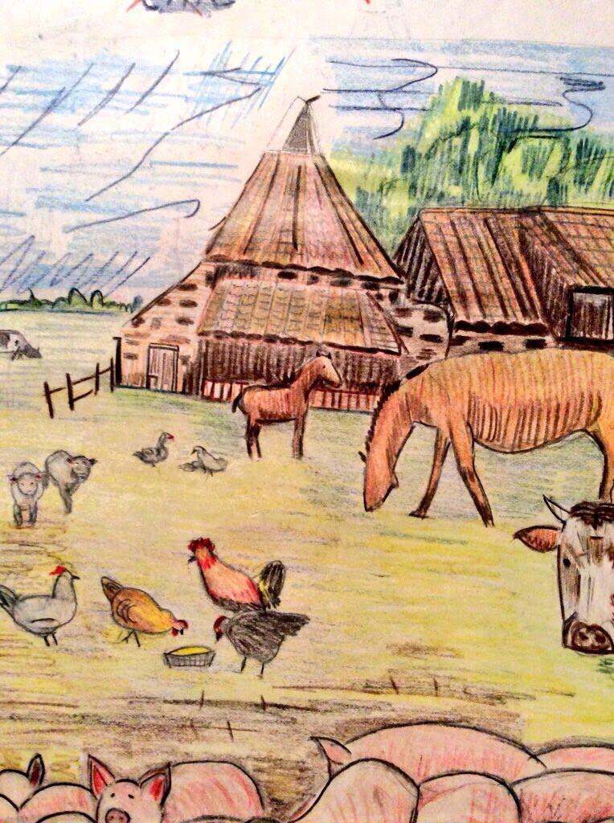
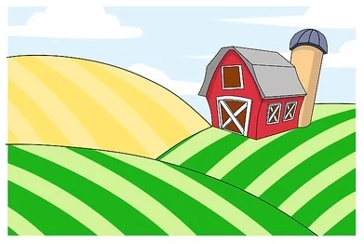
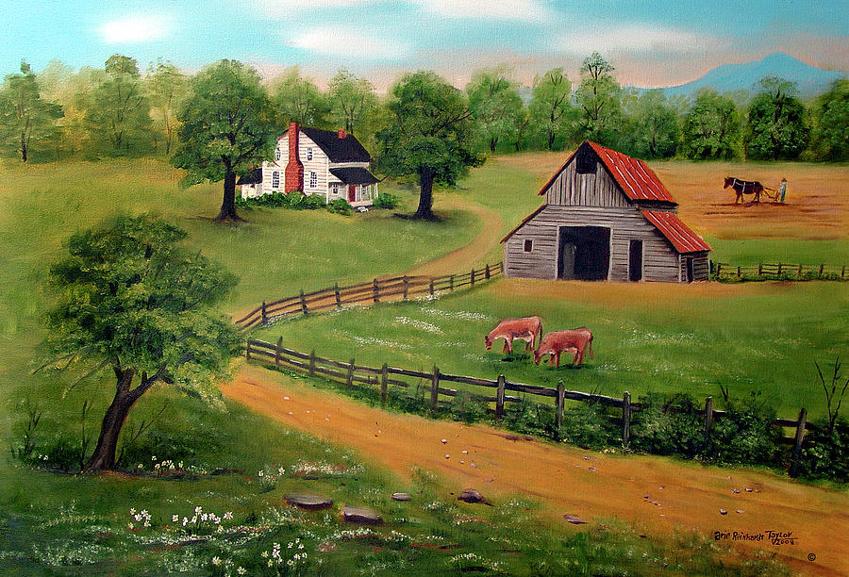
Imagine. What will your dream farm be like?

Slide 10
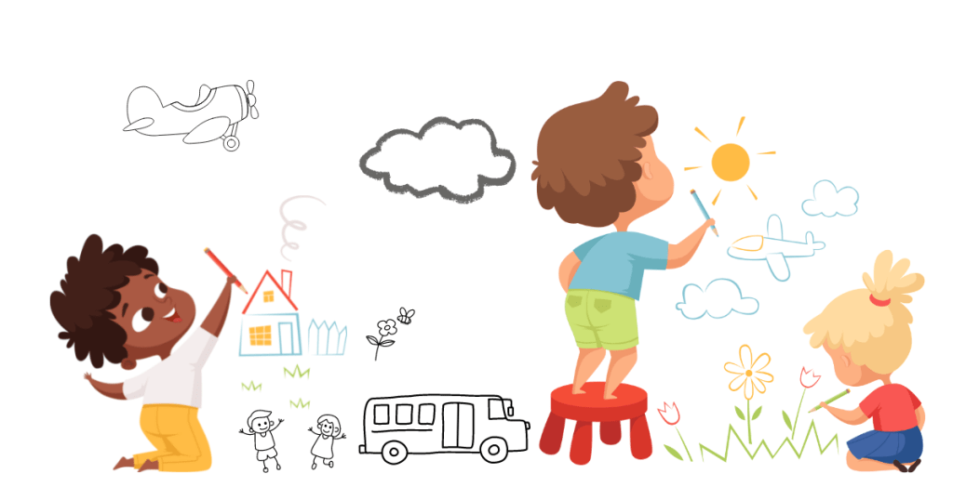
It’s time to draw!

Slide 11
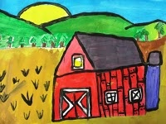
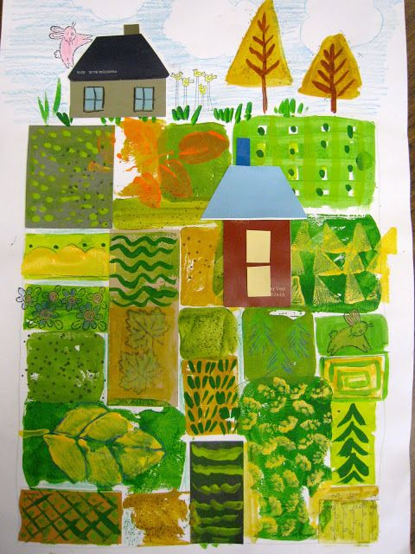
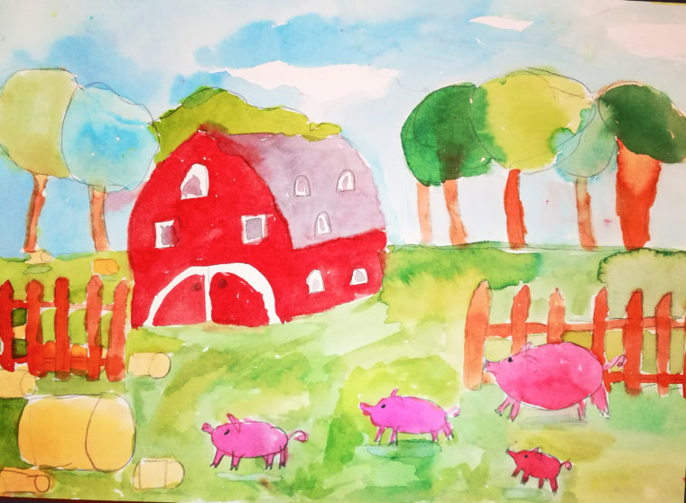
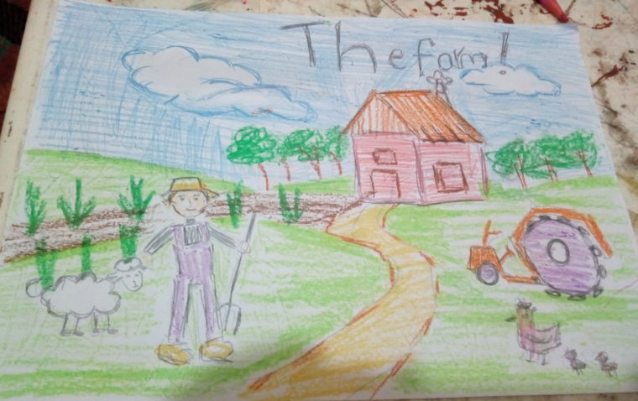
Show off your drawings!

Slide 12
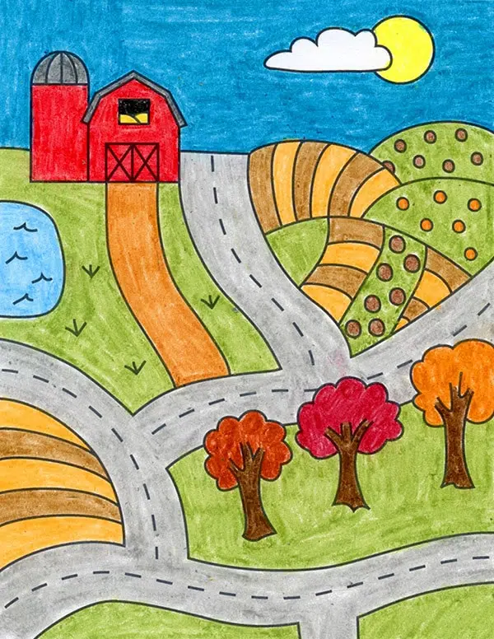
Describe your farm!
This is my farm. I have got plants on my farm.
This is my farm. I have got cows on my farm.

Slide 13
Ask and answer.
Have you got plants on the farm?
Have you got chickens on the farm?
Yes, We have.
No, We haven’t.
Have you got horses on the farm?
Yes, We have.

Slide 14
3
Wrap up
&Assessment

Slide 15

2
REMEMBER !
Have you got animals on the farm?
Yes, We have. / No, We haven’t.

Slide 16
REMEMBER !
I have got plants on my farm.
A horse hasn’t got hands.

Slide 17

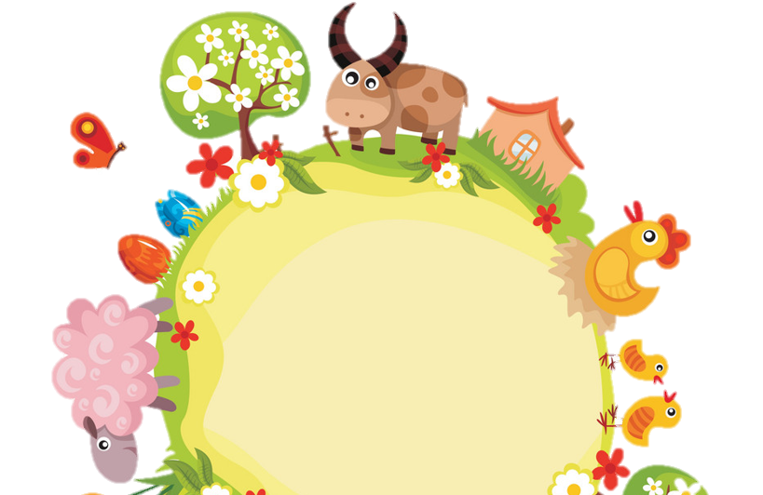
Thank you
& goodbye!

