Slide 1









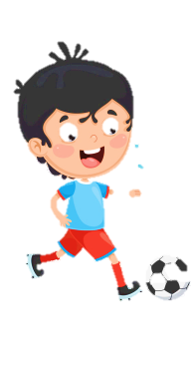
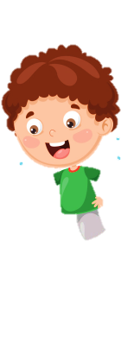










Notes:
Để nguyên trang bìa như này, chỉ thay đổi tên bài trong quá trình làm. Logo của sách Wonderful World

Slide 2




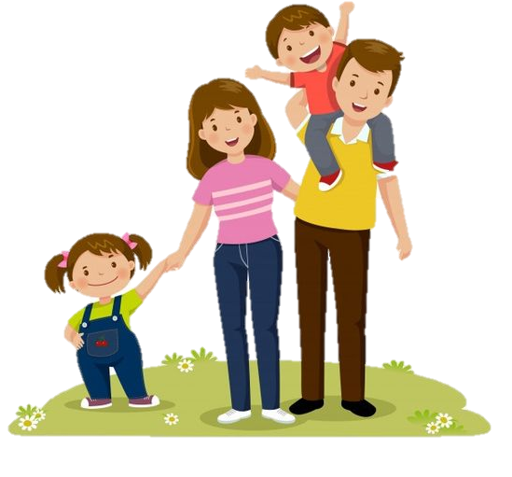



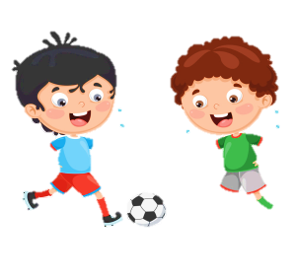


Unit 4: Food and Drinks
Lesson 2: Task 4 5 6

Slide 3

1
Warm up
Notes:
Warm-up: Play a small game “ Puzzle game”
The teacher asks SS to identify different colors and choose a color to guess the image behind the puzzles.
T calls Ss to answer and check their answers.
T asks Ss to repeat names of objects in the image.
Answer keys:
1. rope
2. horse
3. seesaw
4. hide-and-seek

Slide 4


Slide 5
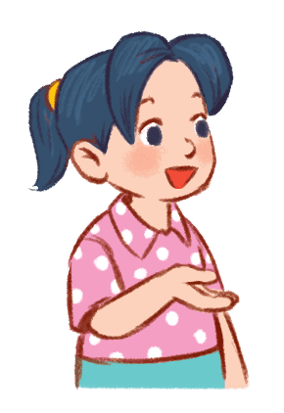
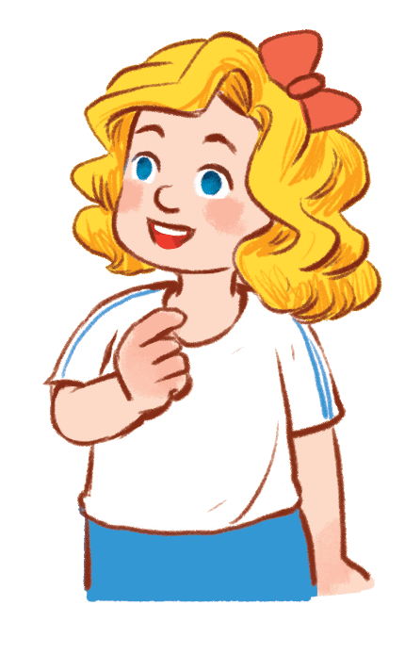

Would you like some cookies?
…………………
✔
No, thanks.
Yes, please.

Slide 6
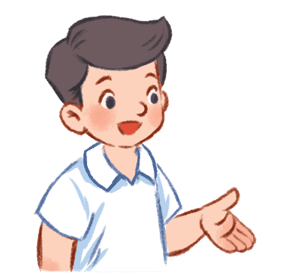
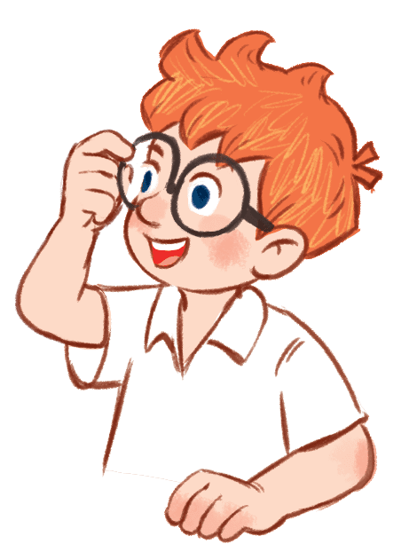
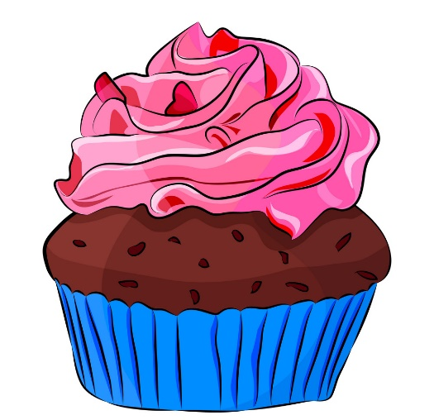
Would you like a cupcake?
………………...
✘
No, thanks.
Yes, please.

Slide 7

Would you like some pizza?
………………..
✔
No,thanks.
Yes, please.

Slide 8

Would you like a piece of pizza?
………………..
✘
Yes, please.
No, thanks.

Slide 9
2
Presentation

Slide 10
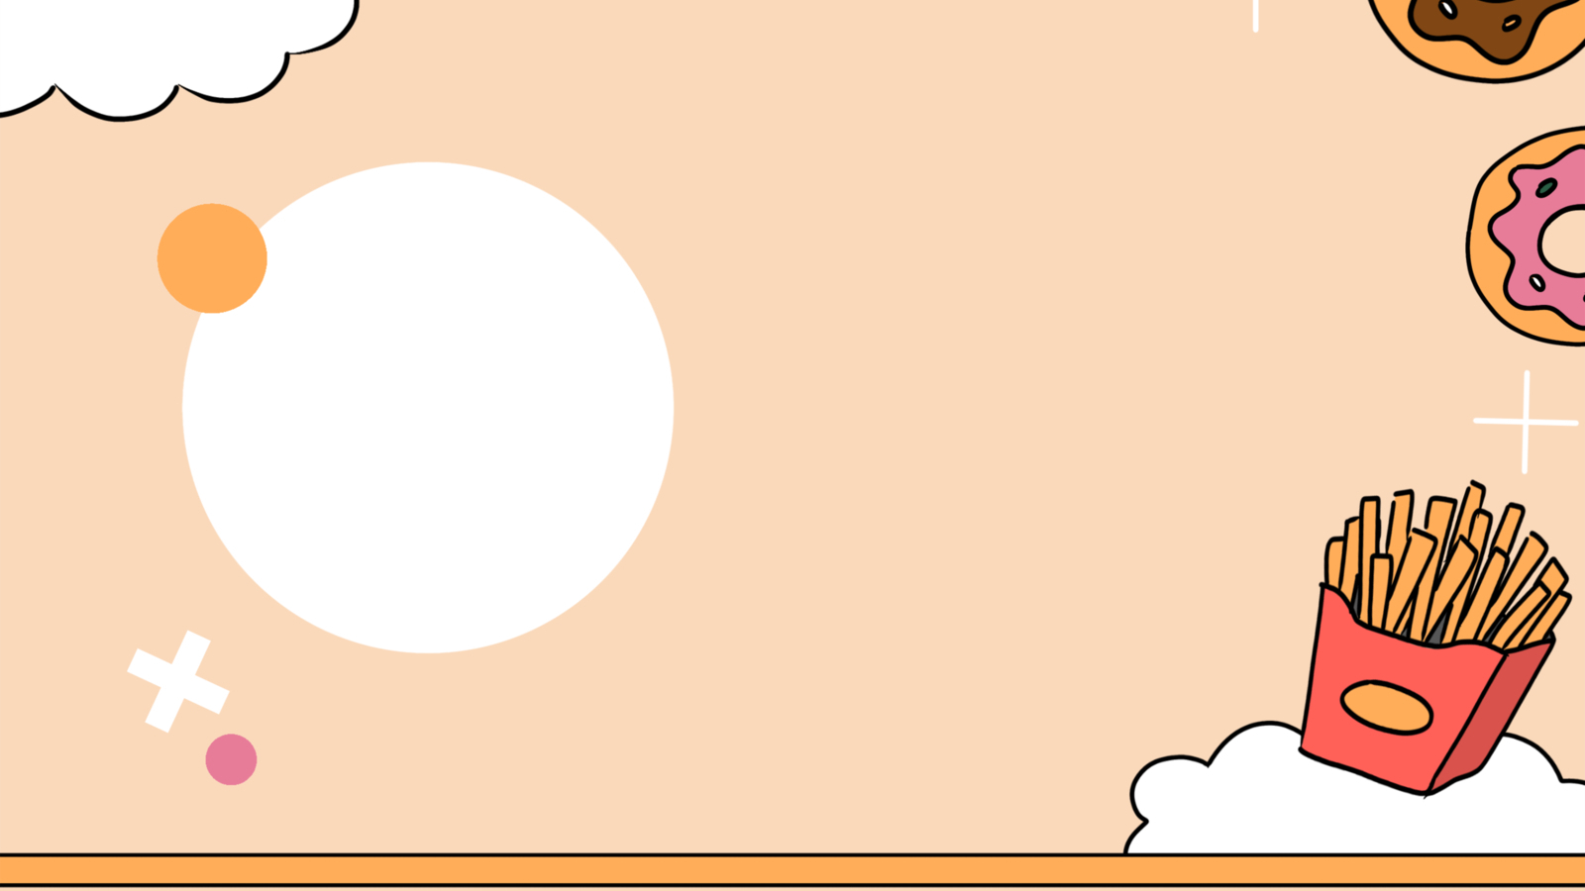
4. Listen and repeat.(track 4.6)
25 twenty-five
21 twenty-one
26 twenty-six
22 twenty-two
27 twenty-seven
23 twenty-three
28 twenty-eight
24 twenty-four
29 twenty-nine

Slide 11

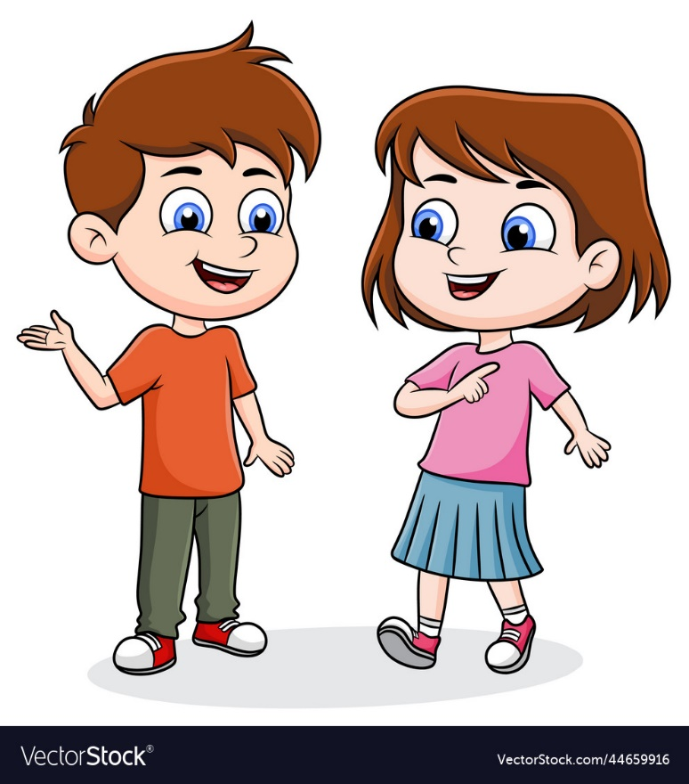


4. Listen and repeat.(track 4.6)
How mαny pieces of pizzα
hαve you got?
I’ve got twenty-one
pieces of pizzα.

Slide 12


4. Listen and repeat.(track 4.6)
How mαny cupcαkes hαs he got?
He’s got twenty-six.

Slide 13
3
Practice

Slide 14
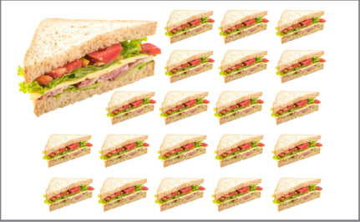
5. Look and say.
How mαny sαndwiches hαs she got?
She’s got 21.
1. she / 21 / sαndwiches

Slide 15
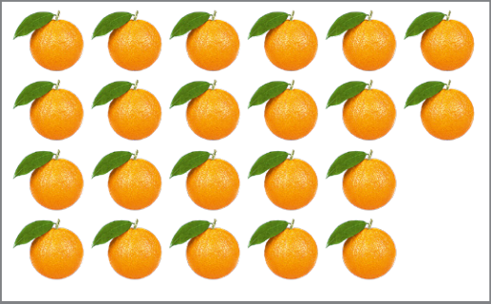
5. Look and say.
How mαny oranges hαs my sister got?
She’s got 22.
2. my sister/ 22/ orαnges

Slide 16
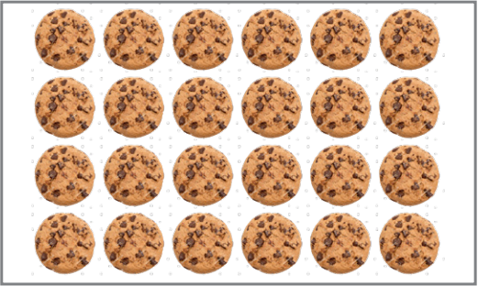
5. Look and say.
How mαny cookies hαve you got?
We’ve got 24.
3. we / 24 / cookies

Slide 17
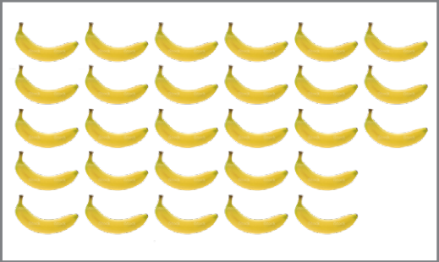
5. Look and say.
How mαny bananas hαve your cousins got?
They’ve got 28.
4. my cousins / 28 / bαnαnas

Slide 18
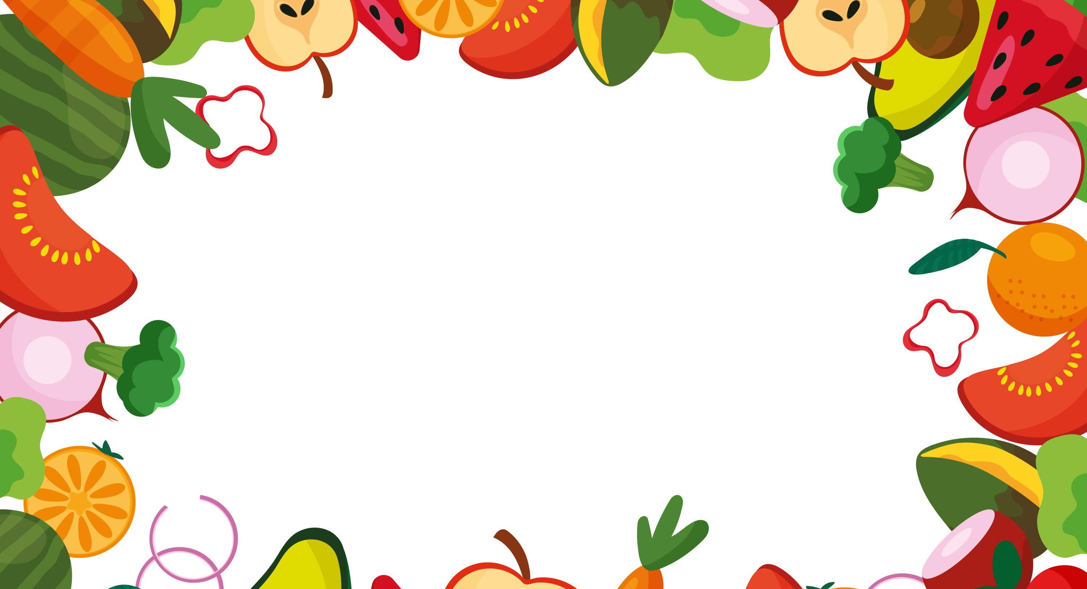
5. Listen αnd chαnt ( track 4.7)
Pizzα, pizzα, pizzα
Pizzα for everyone.
How mαny hαve we got? Let’s count the pieces. 21, 22, 23, 24, 25
25 pieces of pizzα.
Hoorαy!

Slide 19
4
Production

Slide 20
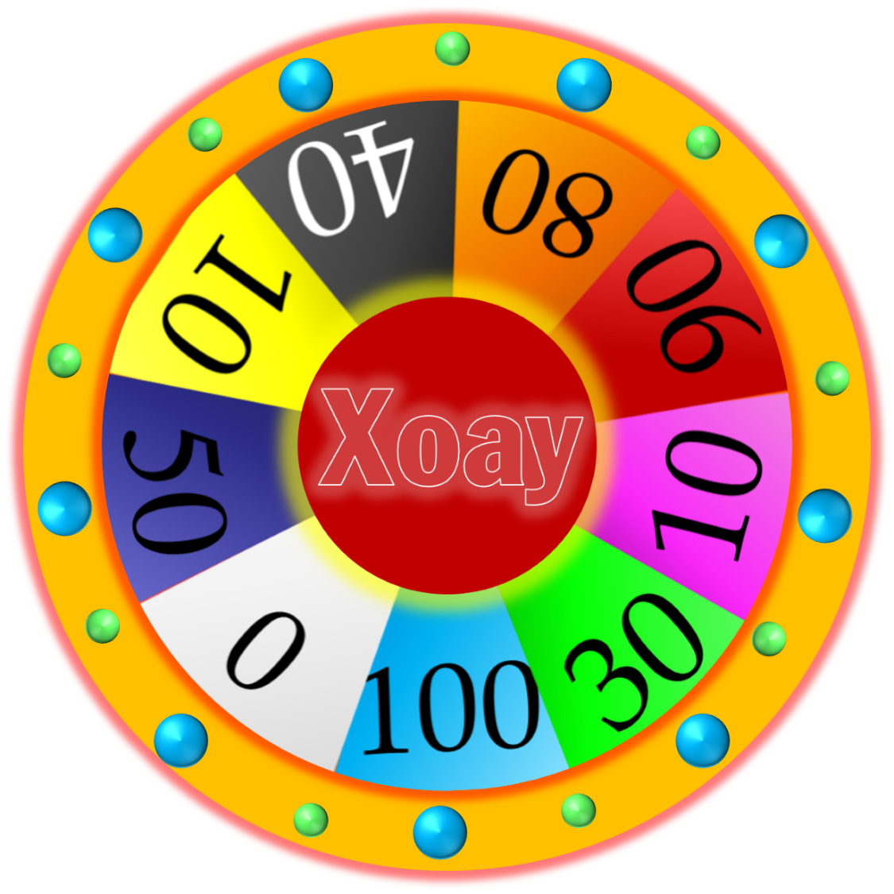


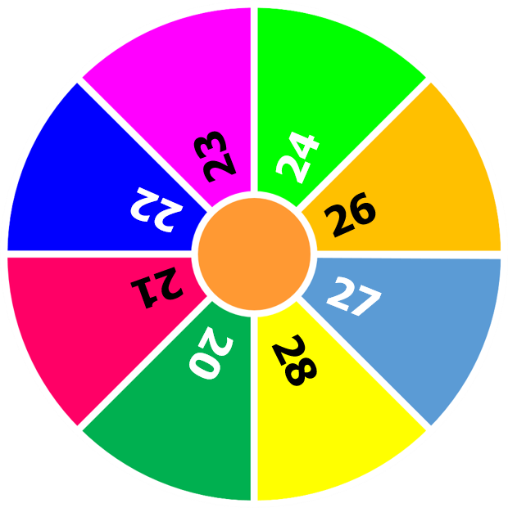



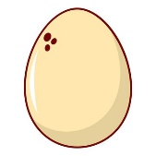

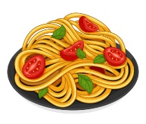
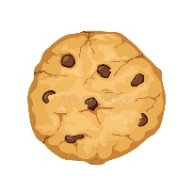
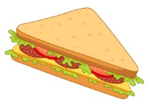

Let’s say.
How mαny bananas
hαve you got?
I’ve got 26.
START
STOP

Slide 21



ASSESSMENT
TEAM 1
TEAM 2
TEAM 3
TEAM 4
Vận dụng xuất sắc những kiến thức đã học vào thực hành
Vận dụng tốt những kiến thức đã học vào thực hành
Biết cách vận dụng những kiến thức đã học vào thực hành

Slide 22



5
Assessment

Slide 23



Write.
1. How mαny __________ hαve you got?
2. How many ________ hαve they got?
4. How many _________ cαn we buy?
oranges
cookies
cupcakes
oranges cupcakes cookies

Slide 24

UNIT 4: Food and Drinks
LESSON 2: task 4 5 6
What we learnt today
Vocabulary:
a cookie, a cupcake, pizza, a piece of pizza

Slide 25
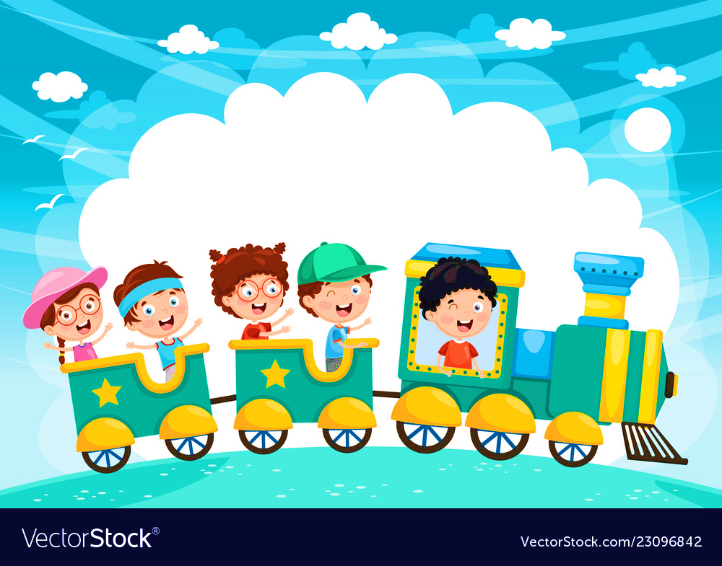







and

