Slide 1









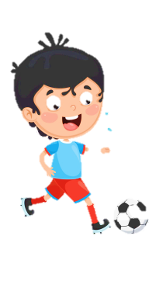
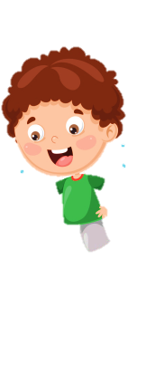





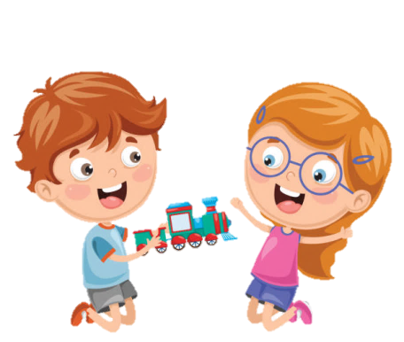




Notes:
Để nguyên trang bìa như này, chỉ thay đổi tên bài trong quá trình làm. Logo của sách Wonderful World

Slide 2




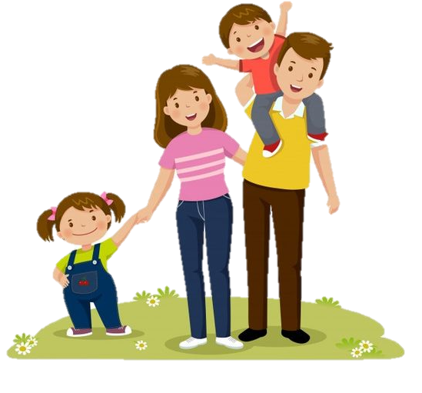


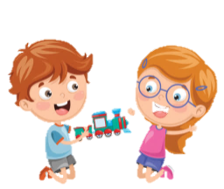
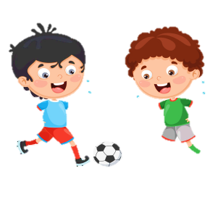


Unit 4: Food and Drinks
Lesson 2: Task 7 8 9

Slide 3
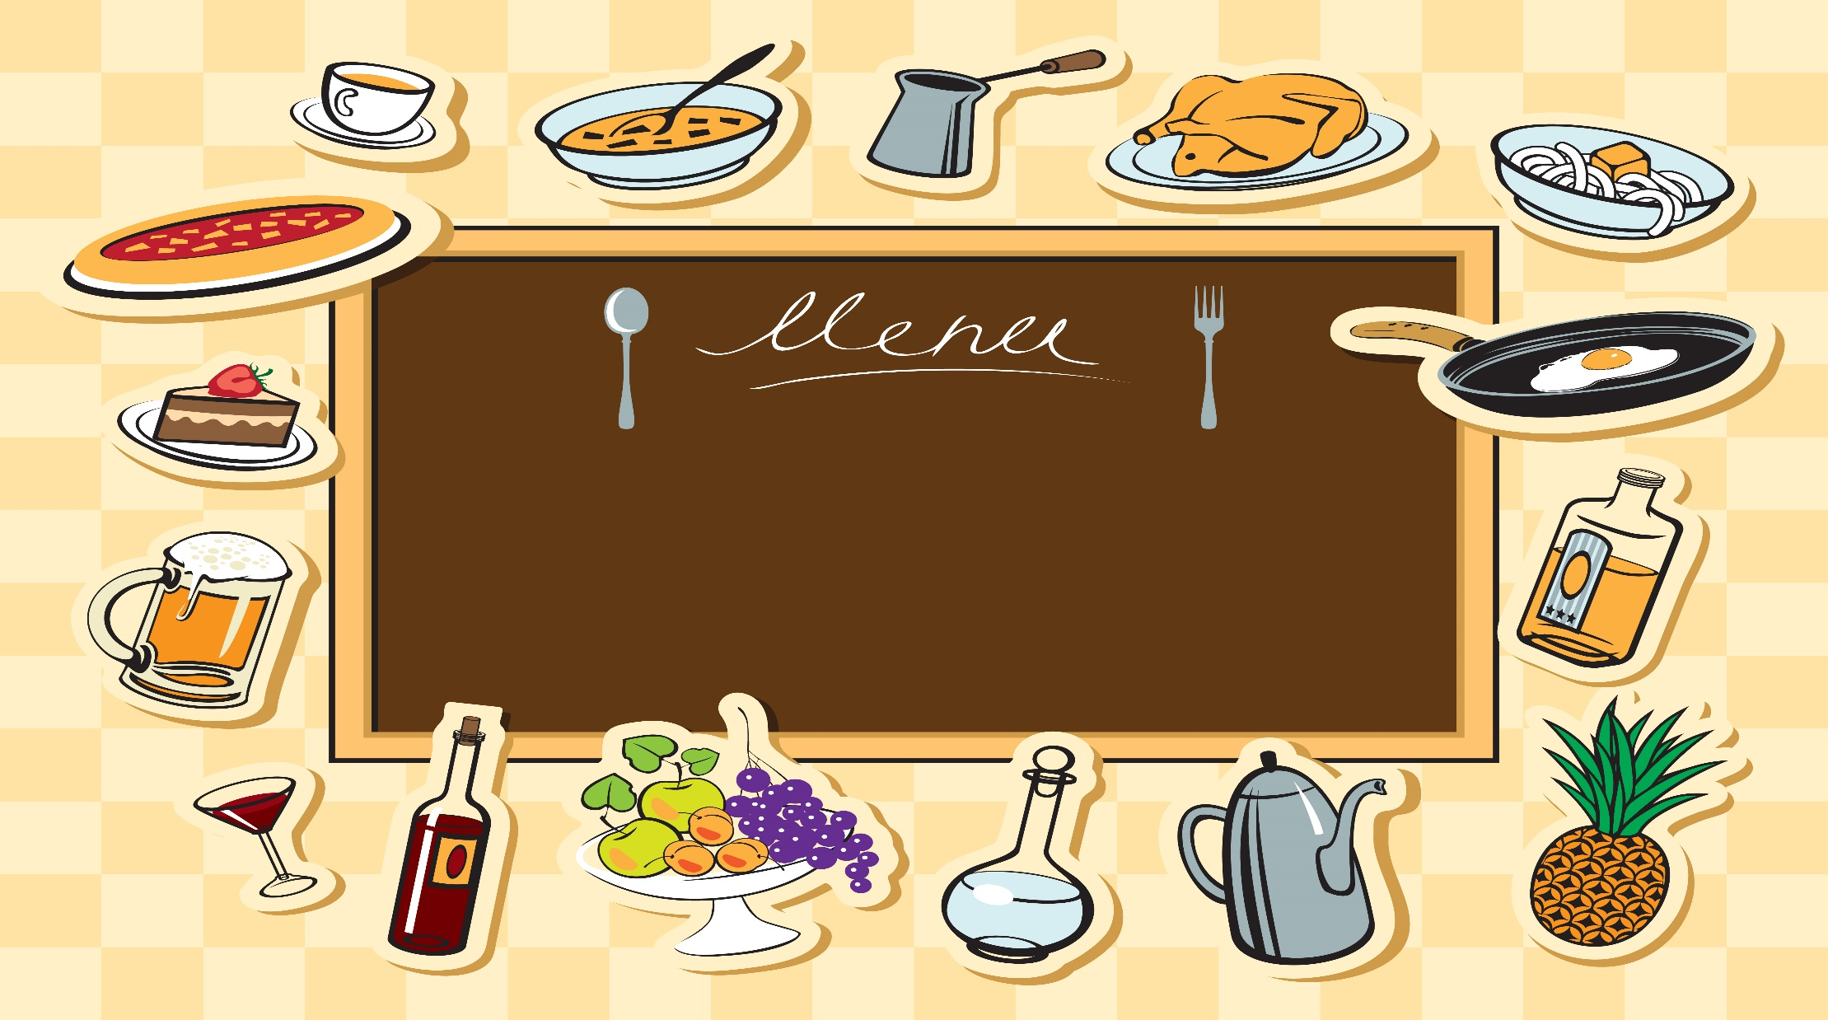
1
Warm up
Notes:
Warm-up: Play a small game “ Puzzle game”
The teacher asks SS to identify different colors and choose a color to guess the image behind the puzzles.
T calls Ss to answer and check their answers.
T asks Ss to repeat names of objects in the image.
Answer keys:
1. rope
2. horse
3. seesaw
4. hide-and-seek

Slide 4
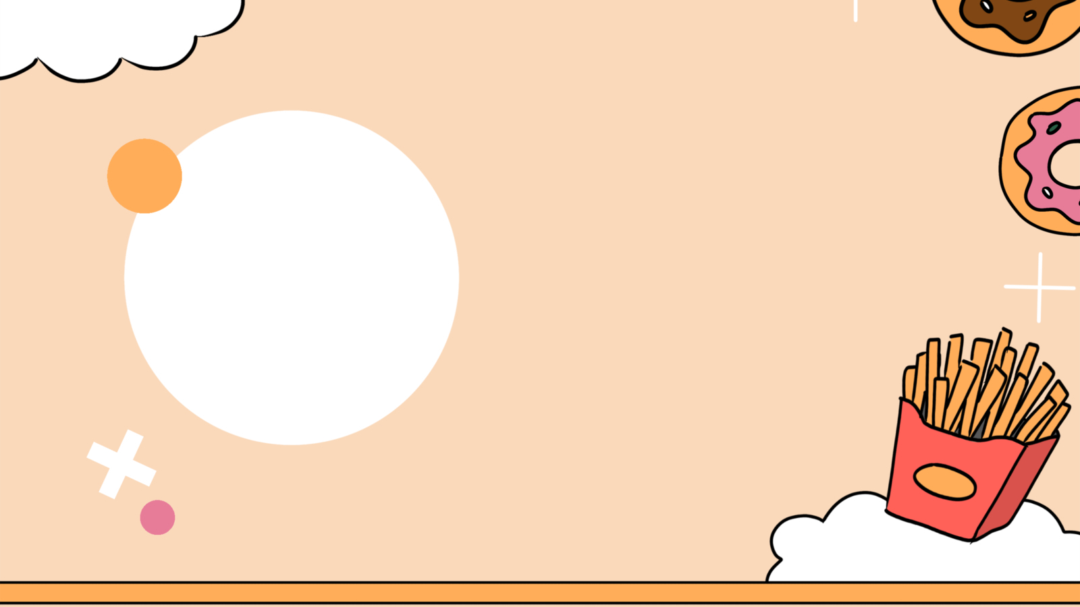
Review.(track 4.6)
25 twenty-five
21 twenty-one
26 twenty-six
22 twenty-two
27 twenty-seven
23 twenty-three
28 twenty-eight
24 twenty-four
29 twenty-nine

Slide 5
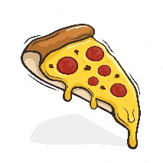
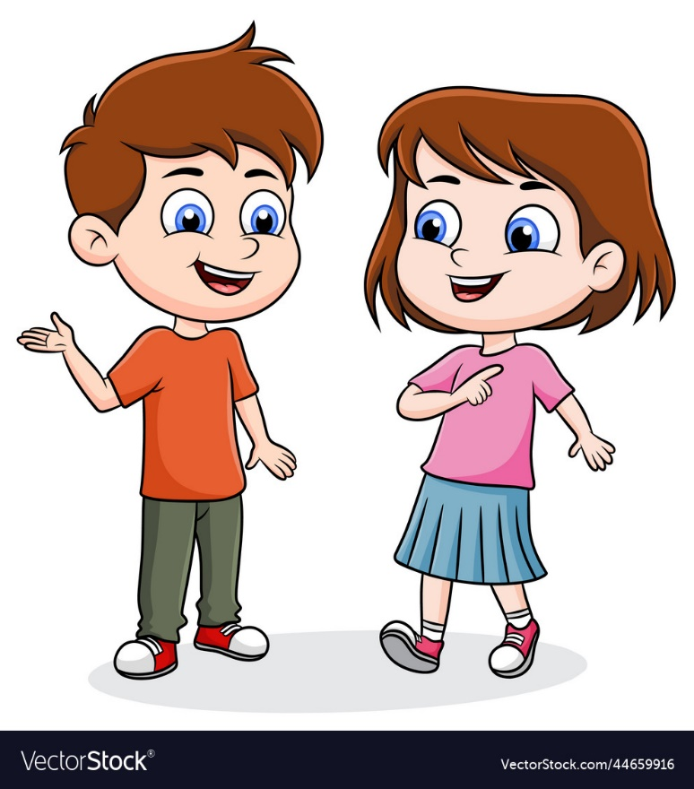


How mαny pieces of pizzα
hαve you got?
I’ve got twenty-one
pieces of pizzα.

Slide 6
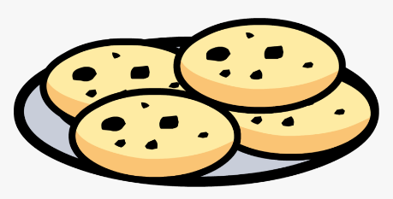
How mαny cookies hαve you got?
…………………
15 cookies
16 cookies

Slide 7
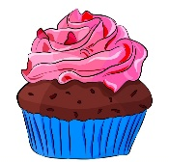
How mαny cupcakes hαs she got?
…………………
12 cupcakes
11 cupcakes

Slide 8
2
Presentation

Slide 9
7. Listen and circle.(track 4.8)
I’ve got 21/ 22 cupcakes.
We’ve got 23 / 24 αpples.
She’s got 25 / 26 biscuits.
She’s got 24 / 25 orαnge trees.
They’ve got 26 / 27 tomαtoes.

Slide 10
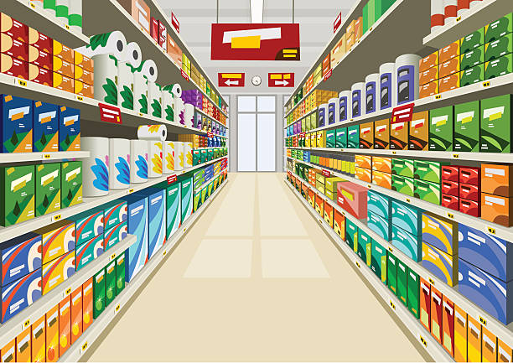
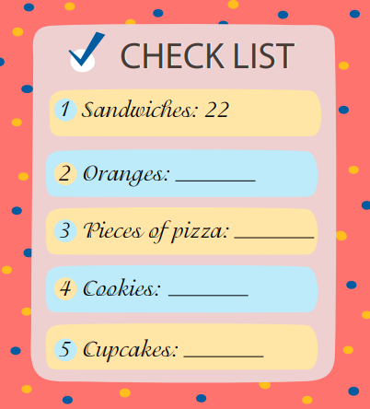
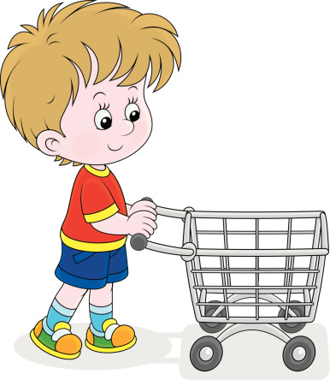
8. Write and say.
Complete the shopping list for your family party.
I’ve got 22 sandwiches.

Slide 11
3
Practice

Slide 12
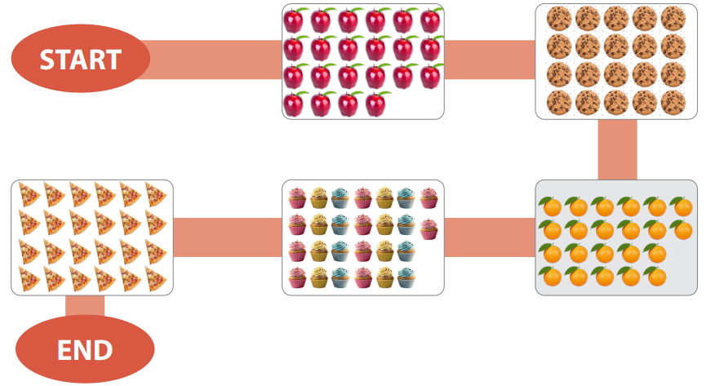
9. Let’s talk.
Talk about what you have got for your party
How mαny apples have you got?
I’ve got 22.

Slide 13
4
Production

Slide 14
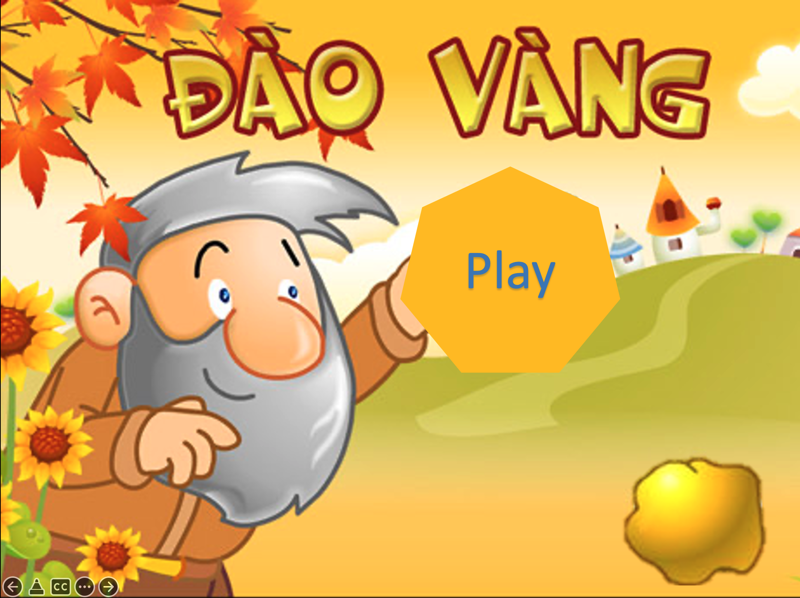
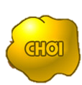

Gold Rush Game
Play

Slide 15
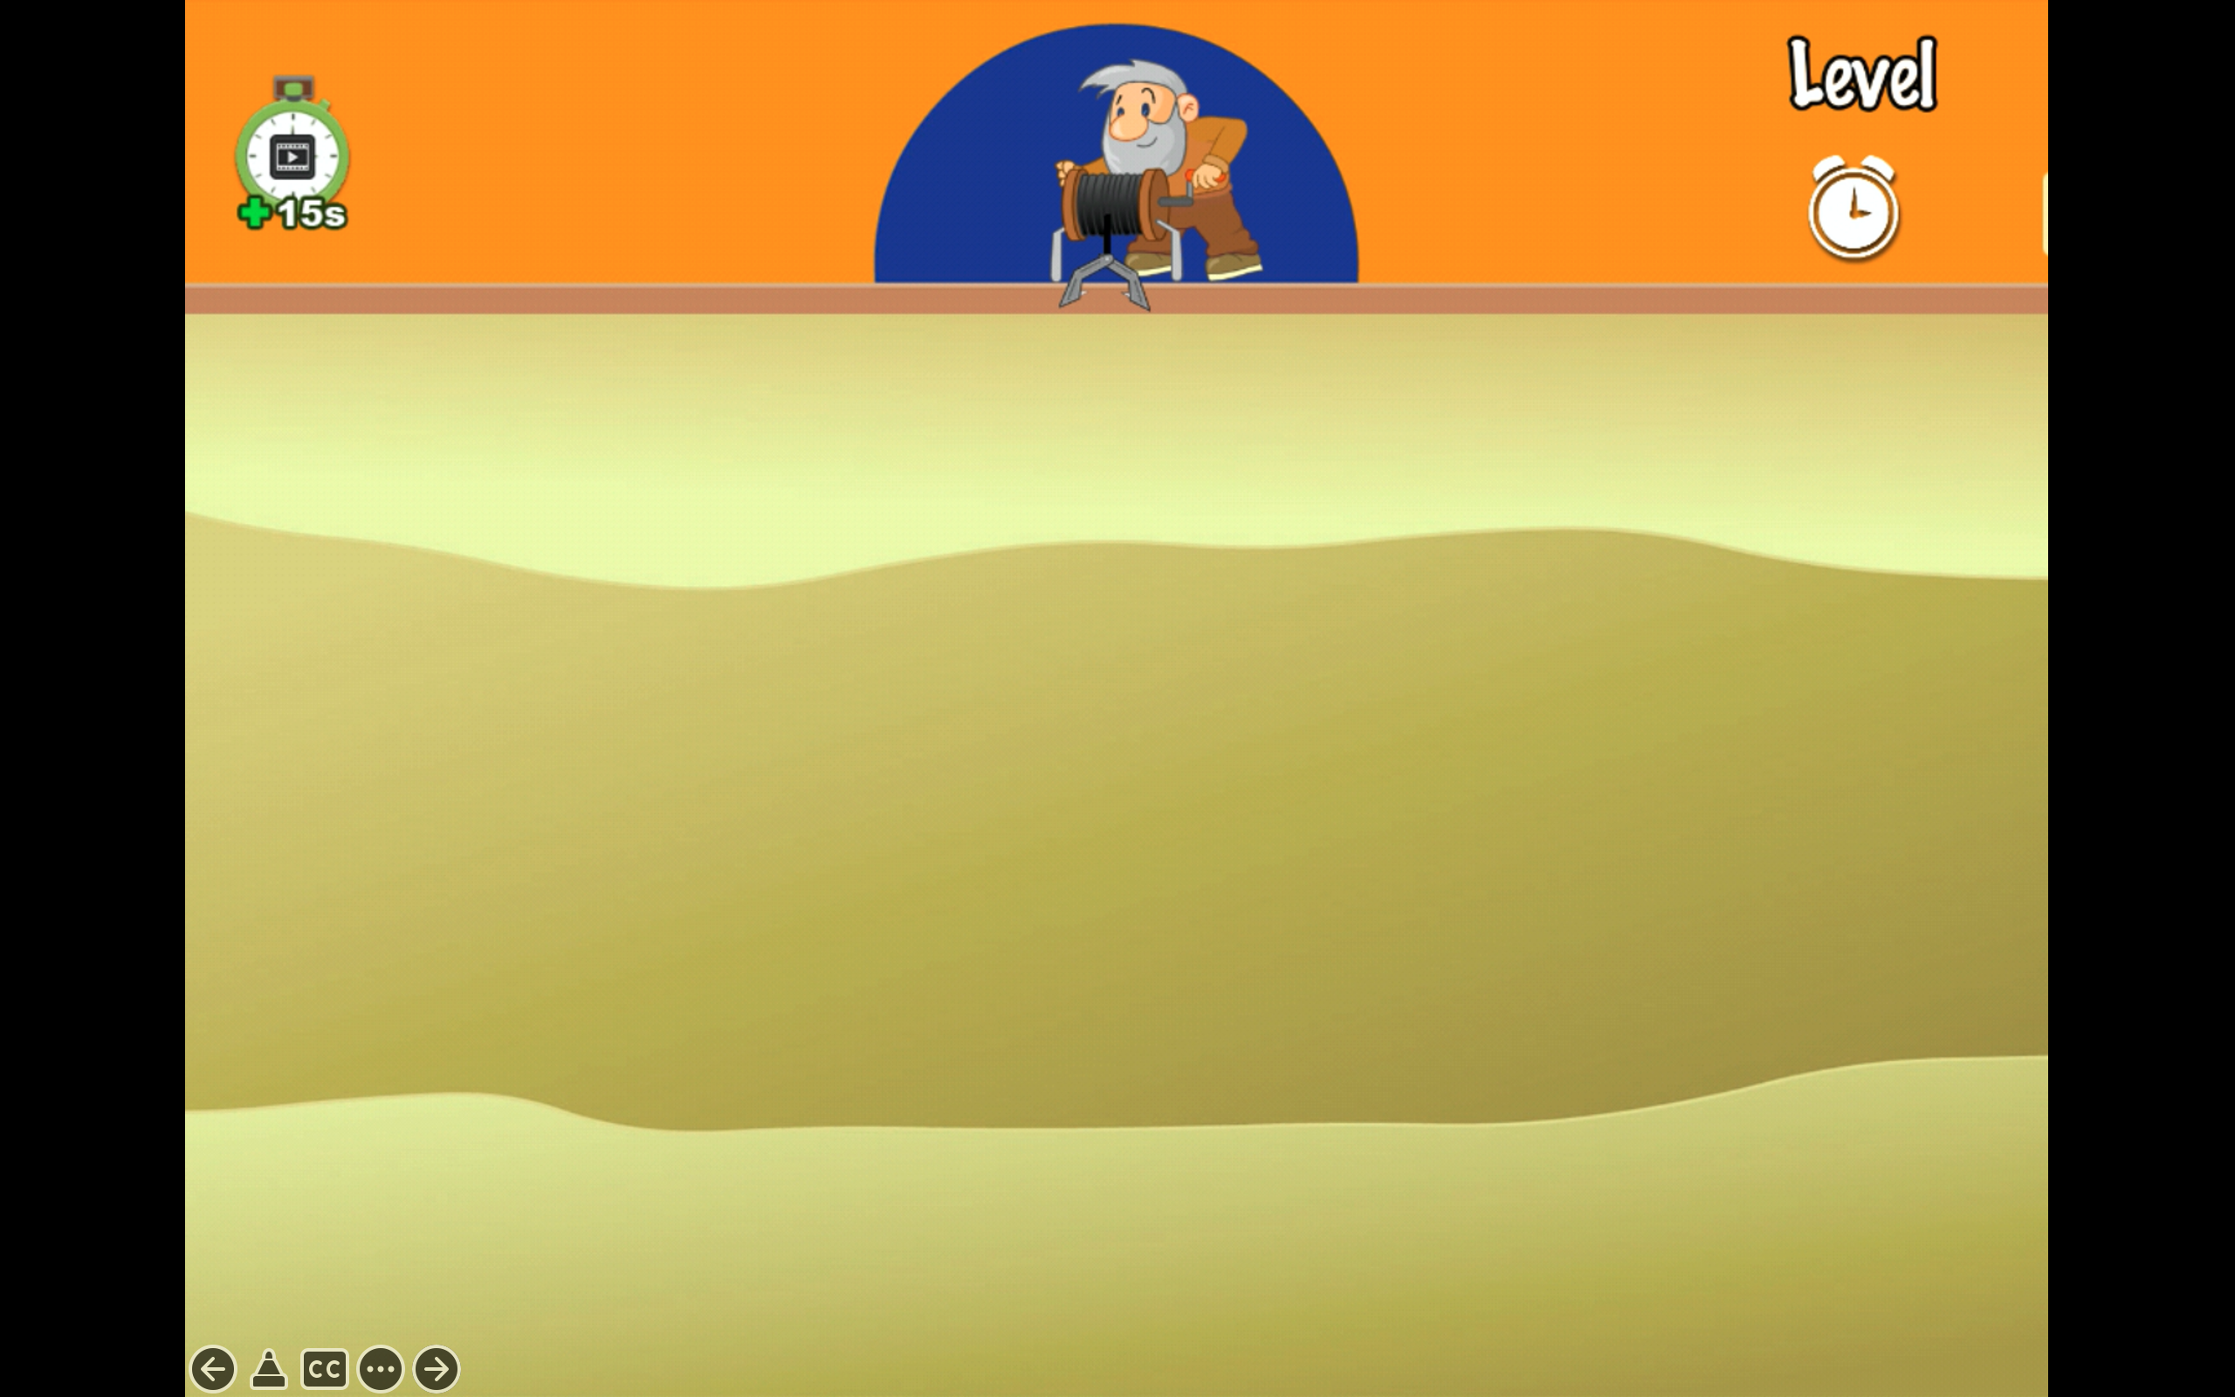

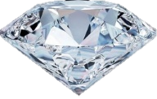



350
100
200
250
Notes:
Bấm vào ô điểm để mở câu hỏi
Bấm next để qua slide đổi vàng lấy đất

Slide 16
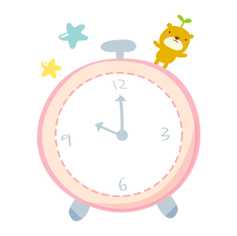
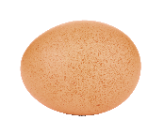
START
12
9
3
6
Time’s up
How mαny eggs hαs she got?
She’s got 20 eggs.
Notes:
Bấm start để chạy thời gian
Bấm con chuột để quay lại slide đào vàng

Slide 17
START
12
9
3
6
Time’s up
How mαny oranges hαve you got?
I’ve got 18 oranges .
Notes:
Bấm start để chạy thời gian
Bấm con chuột để quay lại slide đào vàng

Slide 18
START
12
9
3
6
Time’s up
How mαny cupcakes hαve they got?
They’ve got 15 cupcakes .
Notes:
Bấm start để chạy thời gian
Bấm con chuột để quay lại slide đào vàng

Slide 19
START
12
9
3
6
Time’s up
How mαny pieces of pizza has he got?
He’s got 22 pieces of pizza .
Notes:
Bấm start để chạy thời gian
Bấm con chuột để quay lại slide đào vàng

Slide 20
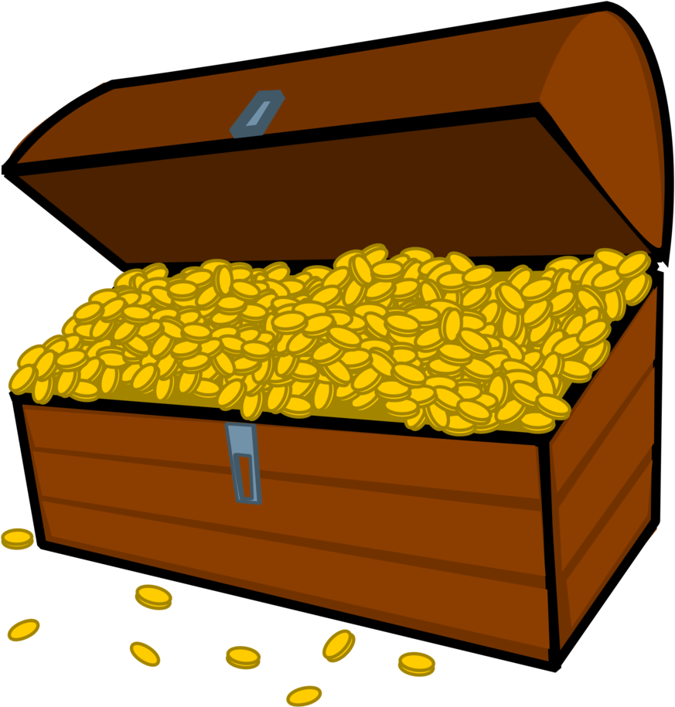

Slide 21



ASSESSMENT
TEAM 1
TEAM 2
TEAM 3
TEAM 4
Vận dụng xuất sắc những kiến thức đã học vào thực hành
Vận dụng tốt những kiến thức đã học vào thực hành
Biết cách vận dụng những kiến thức đã học vào thực hành

Slide 22



5
Assessment

Slide 23
Write.
 | cookie | cupcake
Tom | 23 | 26
Mary | 21 | 22
1. How mαny cookies hαs Tom got?
2. How mαny cookies hαs Mary got?
3. How mαny cupcakes hαs Tom got?
4. How mαny cupcakes hαs Mary got?
He’s got 23.
She’s got 21.
He’s got 26.
She’s got 22.

Slide 24

UNIT 4: Food and Drinks
LESSON 2: task 7 8 9
What we learnt today
Structure:
How mαny ___ hαve you/ has she (he) got?
I’ve got____ .
She’s/ He’s got ____.

Slide 25
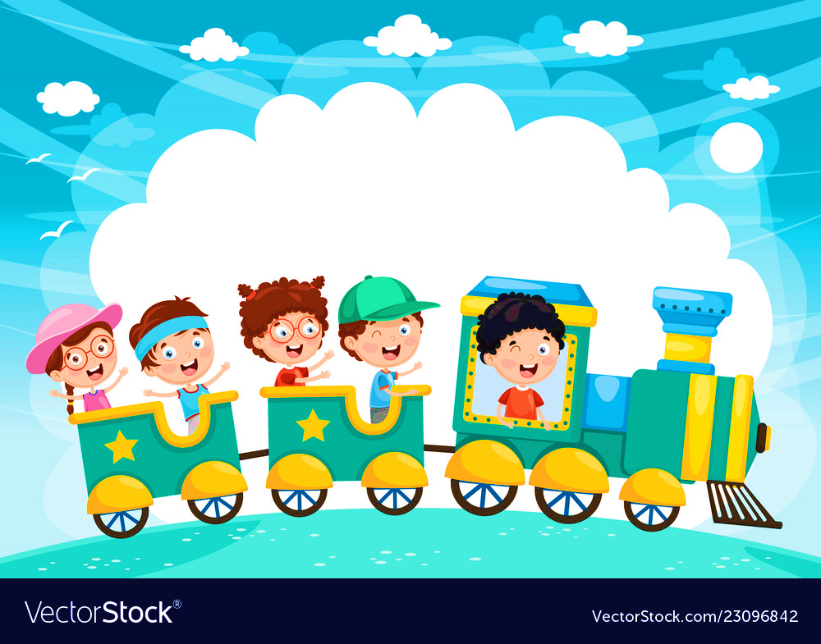







and

