Slide 1








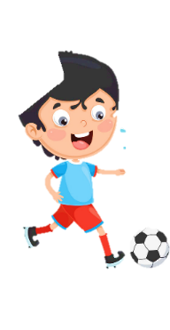



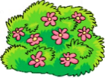



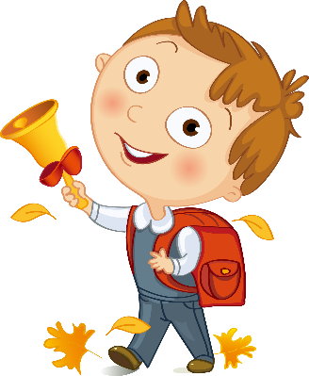




Unit 3
Animals
Lesson 3 – Task 7,8,9
Notes:
Để nguyên trang bìa như này, chỉ thay đổi tên bài trong quá trình làm. Logo của sách Wonderful World

Slide 2



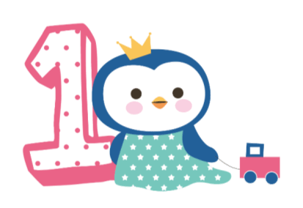



Warm up
Animals song

Slide 3
Animals song

Slide 4
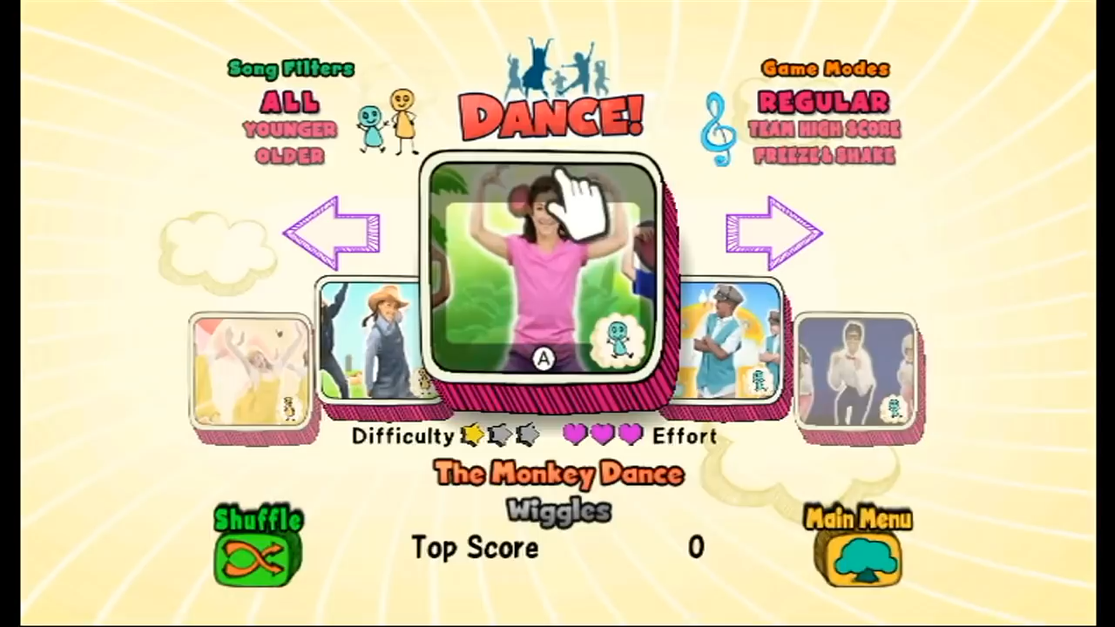

Slide 5

Presentation
Task 7: Listen and repeat

Slide 6


Listen and repeat

Slide 7

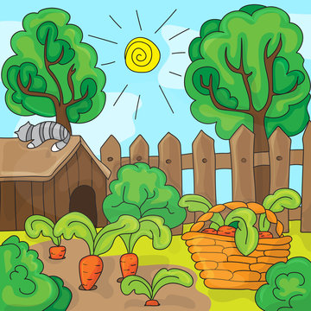
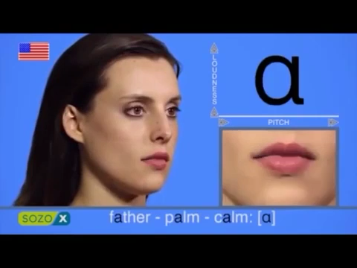
garden
a

Slide 8
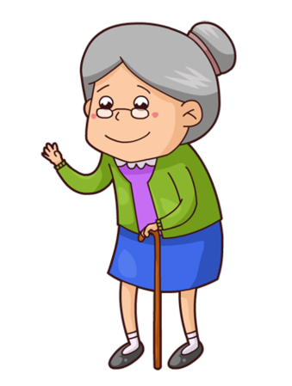
garden
a
My grandma is in the garden.

Slide 9
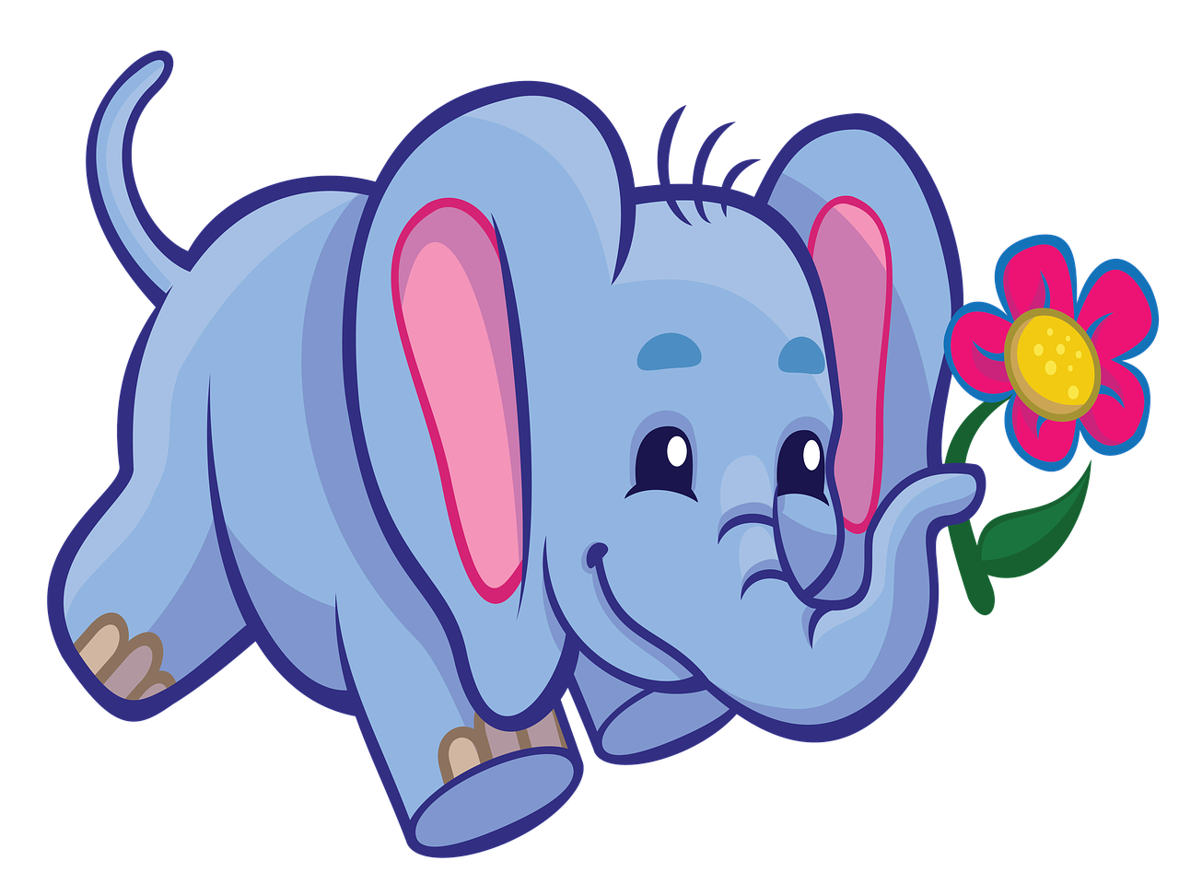
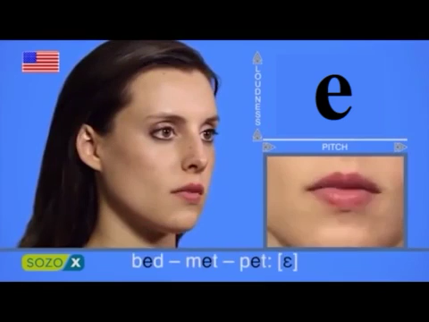
elephant
e

Slide 10

elephant
e
Those are elephants
in Africa.

Slide 11
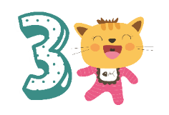
Practice
Task 8: Listen and chant

Slide 12
Listen and chant
01
02
03

Slide 13
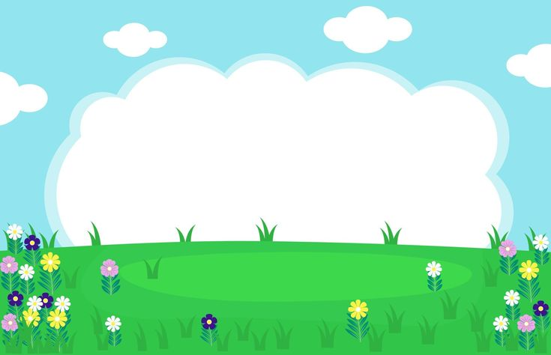
A a a!
Garden, garden, garden!
E e e!
Elephant, elephant, elephant!
That’s a garden.
That’s an elephant.
There’s an elephant in the garden.

Slide 14
A a a!
Garden, garden, garden!
E e e!
Elephant, elephant, elephant!
That’s a garden.
That’s an elephant.
There’s an elephant in the garden.

Slide 15
Look, read and match

Slide 16
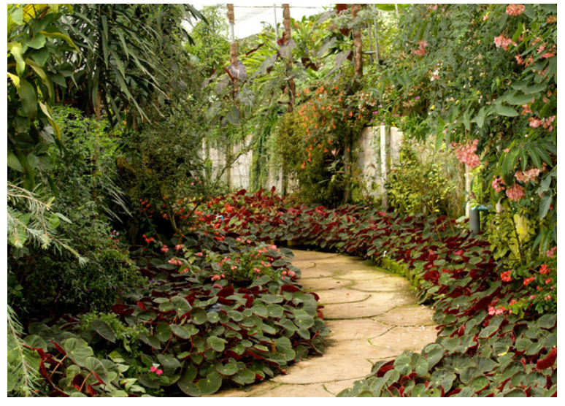
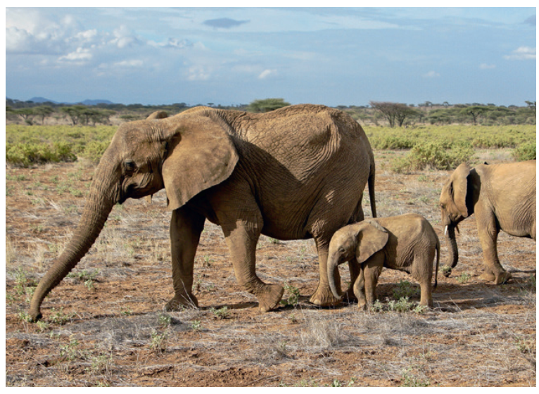
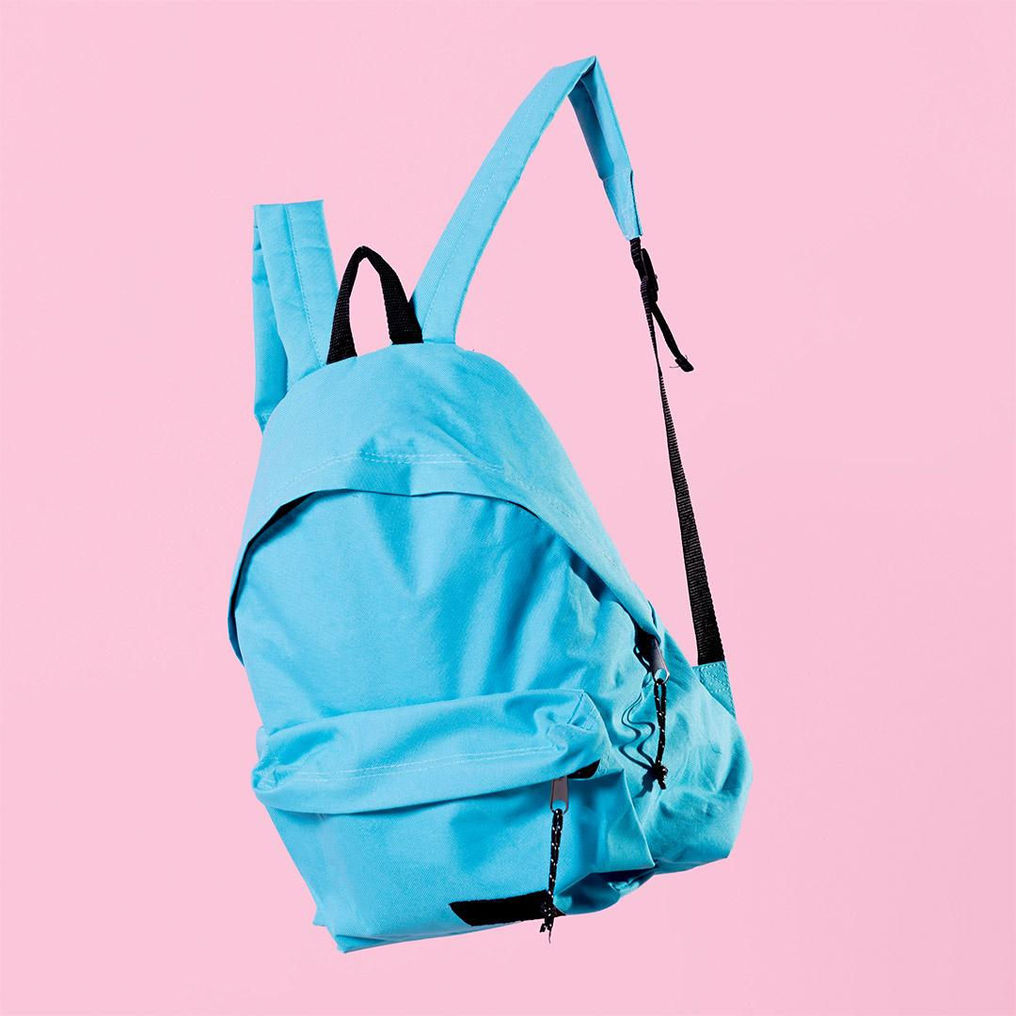
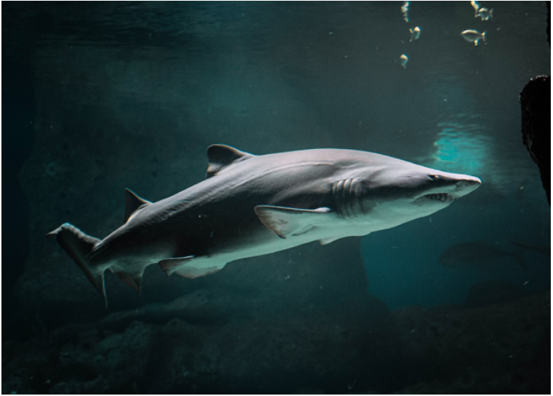
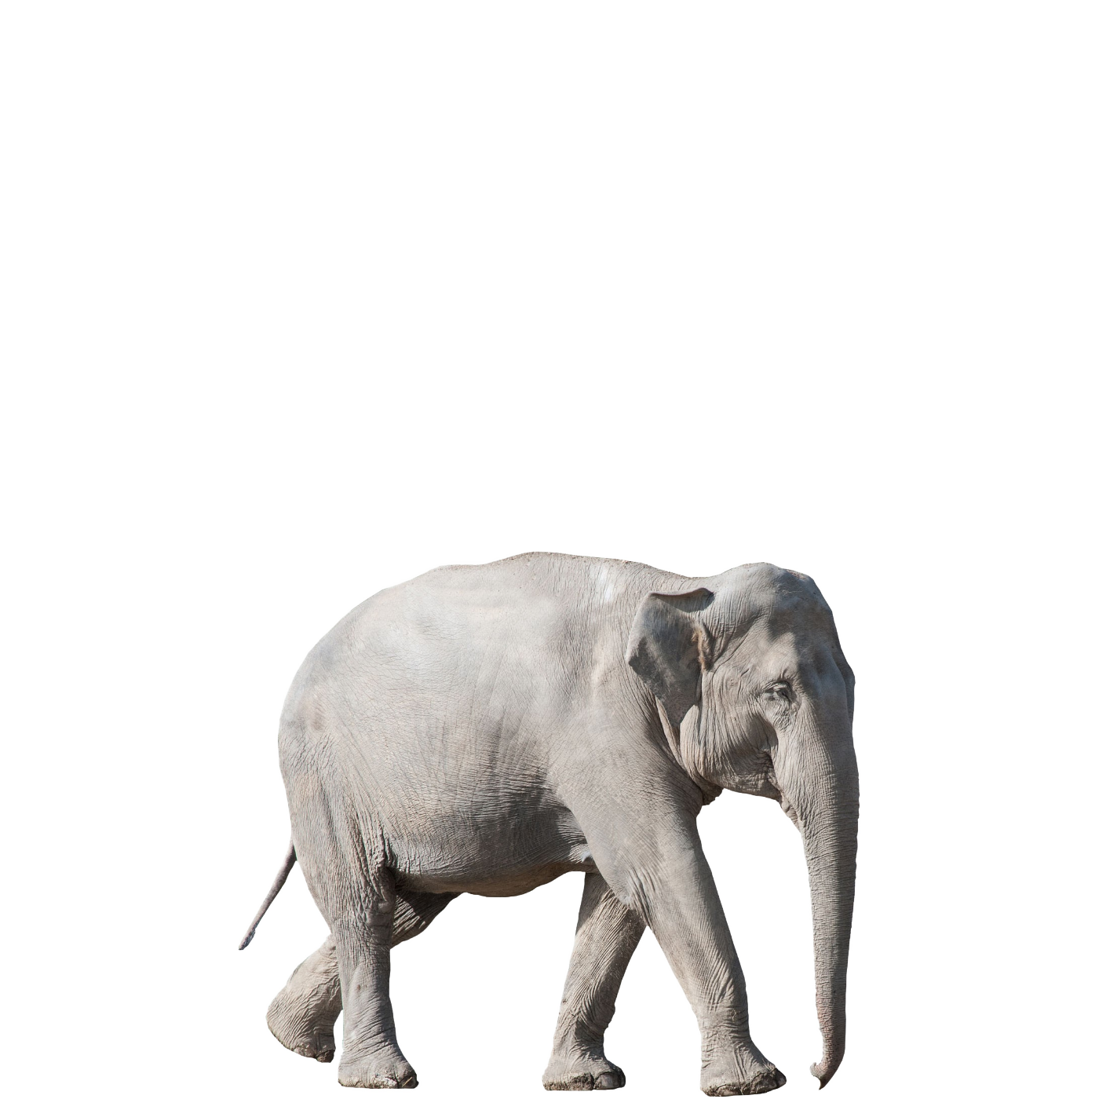
A Picture Always Reinforces the Concept
1. This is a big shark. | a
2. The giraffes aren’t in the garden. | b
3. The elephants are nice. | c
4. That’s an elephant in the garden. | d
01
Table of contents
02
03
Notes:
HOẠT ĐỘNG TƯƠNG TÁC

Slide 17
Say it

Slide 18
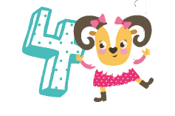
Production
Shopping list game

Slide 19
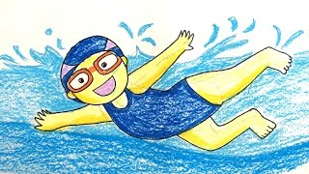
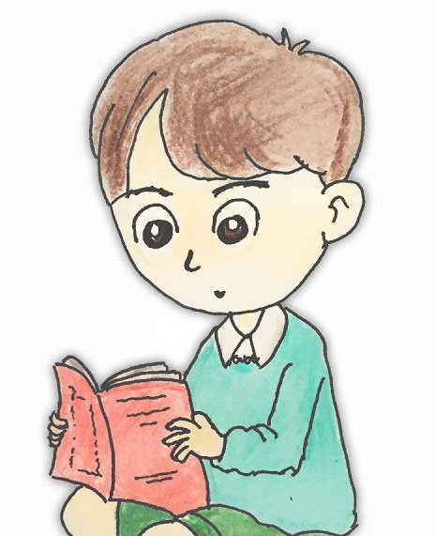
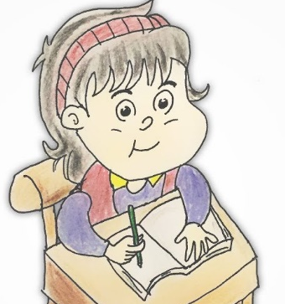
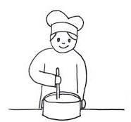

PRODUCTION
What we can do?

Slide 20
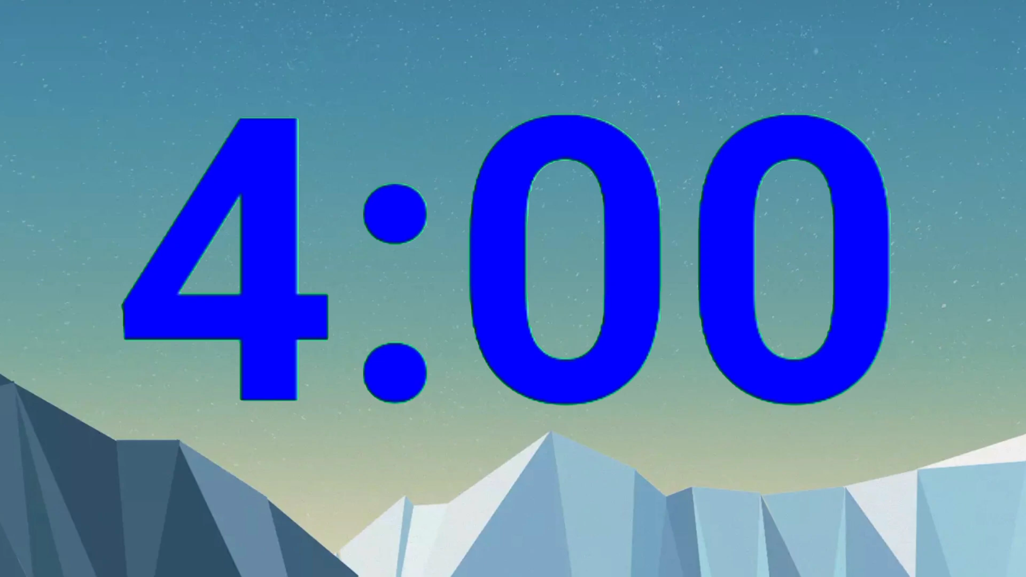

Shopping list game
/a:/
/e/
Notes:
Arrange sts to work in 2 groups
- Ask group to make shopping list of /a:/ and /e/
- Give sts time to make
- Play shopping list game
- Tick-tac-toe to decide winner says the sound. Loser says the word
- Keep playing until the loser can not say any words containing the sound /a:/ or /e/
- The group with most words wins the game

Slide 21



5 ASSESSMENT

Slide 22

Listen and number

Slide 23
Listen and number
4
shark
5
lesson
1
grandma
3
elephant
2
garden
Notes:
HOẠT ĐỘNG TƯƠNG TÁC

Slide 24


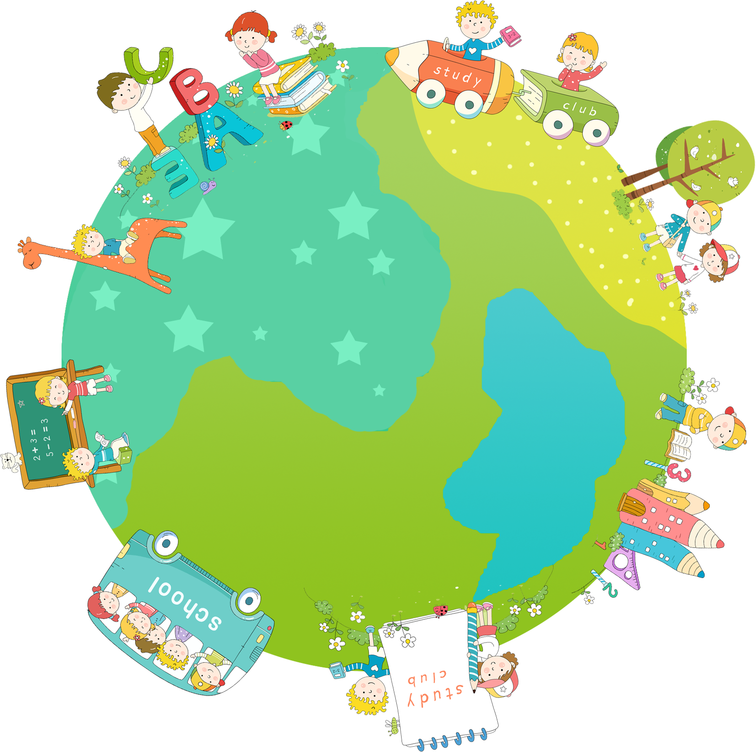

Good bye.
See you again!

