Slide 1






















Notes:
Để nguyên trang bìa như này, chỉ thay đổi tên bài trong quá trình làm. Logo của sách Wonderful World

Slide 2











Unit 5: Leisure time
Lesson 1: Task 1, 2, 3

Slide 3
1
Warm up
Guess “ Weather“
Guess “ Weather“
Notes:
Play a small game “ Guess weather”
The teacher asks SS to listen the sound and guess what weather it is.
T calls Ss to answer and check their answers.
T asks Ss to repeat names of weather.

Slide 4


Listen 1
Rain

Slide 5

Listen 2
Wind

Slide 6

Listen 3
Storm

Slide 7


Listen 4
Sunshine

Slide 8
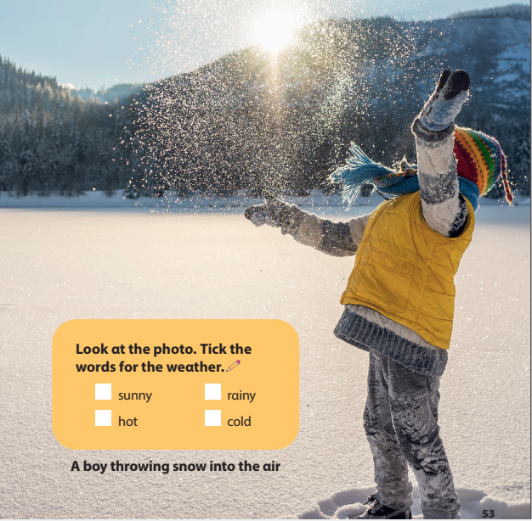
✓
✓
Notes:
Lead in: Photo time!
-T shows the picture about a boy throwing the snow into the air and gives students some questions: What can you see? What is he wearing? Is it sunny/ rainy/cold/ hot?
- T calls SS to answer and check their answers.
- T introduces that they will learn about “ Weathe” today.
- Write on the board “Leisure time” and introduce the lesson.

Slide 9
2
Presentation

Slide 10





Weather forecast
Mon
Tue
cloudy
snowy
Notes:
- Use flashcards to introduce the vocabulary and structure of the lesson.
- Say the words for students to repeat in the chorus.
- Say a word for students to repeat then point.

Slide 11
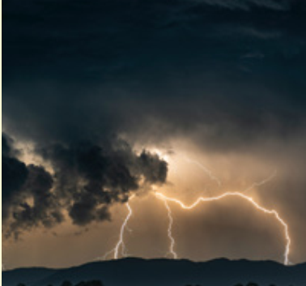
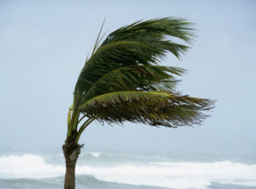
Weather forecast
Wed
Thu
stormy
windy
Notes:
- Use flashcards to introduce the vocabulary and structure of the lesson.
- Say the words for students to repeat in the chorus.
- Say a word for students to repeat then point.

Slide 12





1. Listen and point. Repeat
Notes:
- Play track 5.1 for the students to listen to, point to, and repeat the words in chorus and groups.

Slide 13


Vocabulary checking
cloudy
snowy
windy
stormy
Notes:
- Show pictures in random order and ask students to read aloud the correct words.
- Ask SS to say the words again.

Slide 14
3
Practice

Slide 15




2. Listen and read. Tick.
Jane: What’s the weather like today, Tom?
Tom: It’s cold and snowy. Look! Mum and Dad are making a snowman in the playground.
Jane: That’s interesting. Let’s go out!
Notes:
Task 2: Listen and read. Tick.
- Ask SS to identify names of charaters in the dialogue.
- play track 5.2 and let Sts listen to the dialogue, then repeat each sentences.
Note:each click can listen each sentence. Click on the speaker to listen whole dialogue.

Slide 16

The weather is _______.
cold hot windy snowy
Jane: What’s the weather like today, Tom?
Tom: It’s cold and snowy. Look! Mum and Dad are making a snowman in the playground.
Jane: That’s interesting. Let’s go out!

Slide 17



3. Look and say.
It’s snowy.
It’s cloudy.
Notes:
Task 3: Look and say :
- Look at the picture and let SS write the sentences and say these sentences like the example.
- Call SS to say aloud in front of the class.

Slide 18
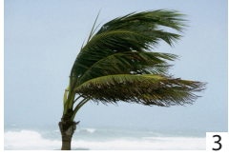
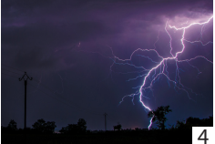
3. Look and say.
It’s windy.
It’s stormy.
Notes:
Task 3: Look and say :
- Look at the picture and let SS write the sentences and say these sentences like the example.
- Call SS to say aloud in front of the class.

Slide 19
4
Production

Slide 20




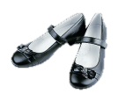

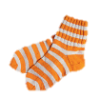


What’s the weather like?
What are you wearing when it’s ______?
Notes:
- Work in pairs.
- Ask SS to look at the board and identify what they can see.
- Guide SS to answer 2 questions on the slides.
- Work in pairs and discuss what they are wearing in different kinds of wetaher.
- Call pairs to present in front of the class.
- Check and give feedback.

Slide 21
5
Assessment

Slide 22
4. Look and fill in the blank.
What’s the ______________?
It’s _______________.
It’s _______________.
It’s _______________.
It’s _______________.
weather
windy
cloudy
stormy
snowy
Notes:
-Ask sts to do the assessment.
- Check with the class.

Slide 23
UNIT 5: LEISURE TIME
LESSON 1 – PERIOD 1
What we learnt today
Vocabulary
cloudy
windy
stormy
snowy
What’s the weather like?
It’s cloudy.
Structure

Slide 24




Thank you & goodbye!

