Slide 1









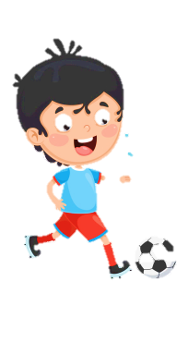
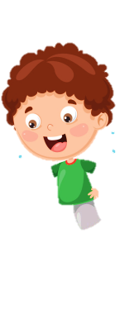





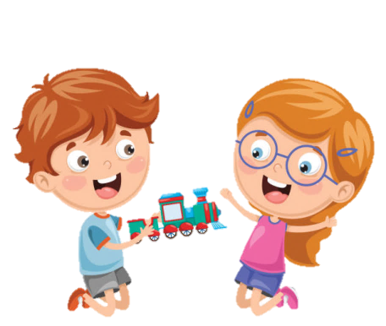





Notes:
Để nguyên trang bìa như này, chỉ thay đổi tên bài trong quá trình làm. Logo của sách Wonderful World

Slide 2







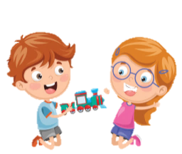
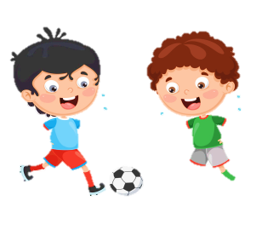


Unit 5: Leisure time
Lesson 1: Task 4, 5, 6

Slide 3
1
Warm up
Hangman
Guess “ Weather“
Notes:
Warm-up: Play a small game “ Hangman”
The teacher asks SS to guess the different letters to guess names of the weather.
T calls Ss to answer and check their answers.
T asks Ss to repeat names of weather.

Slide 4

Hangman
w
i
n
d
y

Slide 5
Hangman
s
t
o
r
m
y

Slide 6
Hangman
s
n
o
w
y

Slide 7
Hangman
c
l
o
u
d
y

Slide 8
2
Presentation

Slide 9



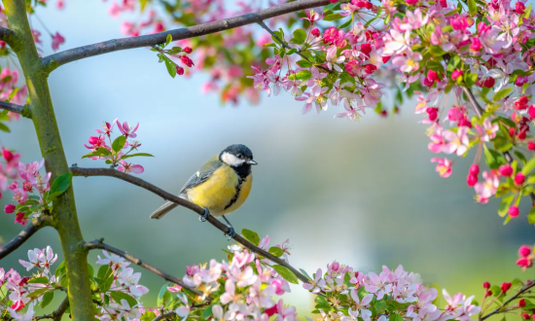

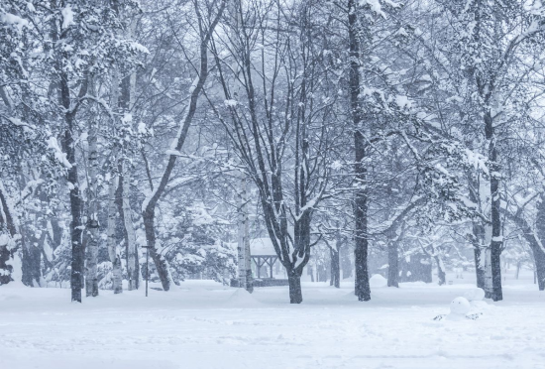
SEASONS
spring
summer
autumn
winter

Slide 10


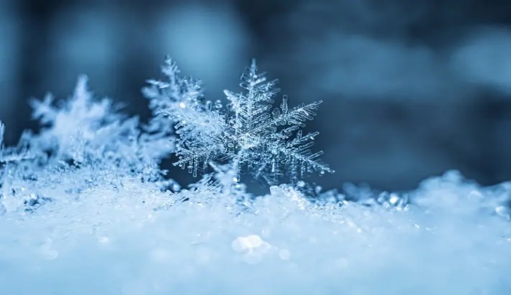
What’s the weather like in winter?
It’s cold.

Slide 11

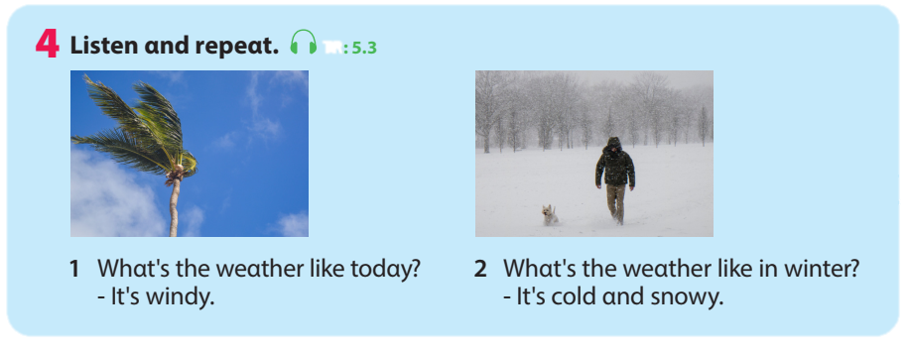


4. Listen and repeat.
What’s the weather like today?
2. What’s the weather like in winter?
- It’s windy.
- It’s cold and snowy.

Slide 12

Vocabulary and structure checking
cool
hot
autumn
Notes:
- Show pictures behind the black circle and ask students to guess the correct words. Then choose kind of weather for each season.
- Ask SS to say the words again.

Slide 13
Vocabulary and structure checking
cloudy
cold
winter

Slide 14
Vocabulary and structure checking
hot
snowy
summer

Slide 15
Vocabulary and structure checking
warm
stormy
spring

Slide 16
3
Practice

Slide 17
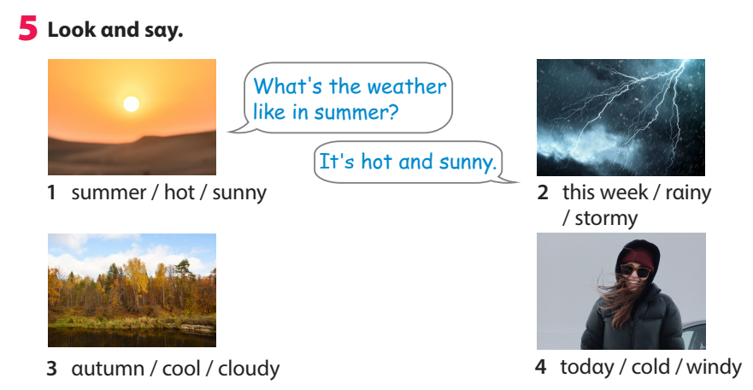
5. Look and say.
1. summer/ hot/ sunny
2. This week/ rainy/ stormy
3. autumn/ cool/ cloudy
4. today/cold/ windy
Notes:
Task 5: Look and say.
- Ask SS to identify names of pictures and words under them.
- Ask SS to look at the board and call a student to role- play with T, then ask SS to work in pairs in 3 min.
- Let SS work in pairs and present in front of the class by spinning the circle to choose which picture they say.
- Call SS to present in front the class and give them comments.

Slide 18
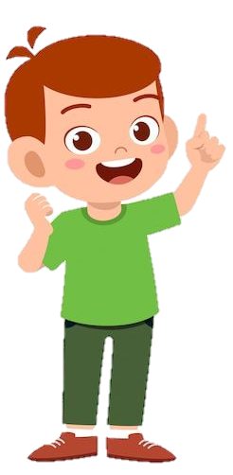
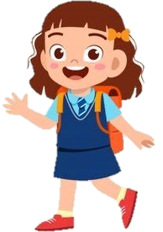
Whαt's the weαther like in summer?
It's hot αnd sunny.
1. summer/ hot/ sunny

Slide 19

5. Look and say.
1. summer/ hot/ sunny
2. This week/ rainy/ stormy
3. autumn/ cool/ cloudy
4. today/cold/ windy

Slide 20
3
2
1
4
4
SPIN
1
2
2
3
3
4
1
Notes:
Click “spin” to spin the wheel, then click once more times to stop.

Slide 21
4
Production

Slide 22
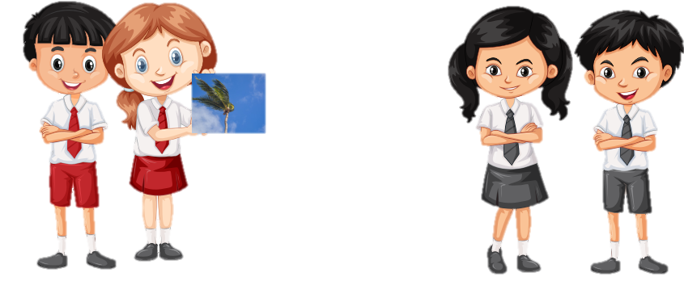
6. Let’s play.
Work in pαirs. Pick α flαshcαrd. Αsk αnd αnswer.
Whαt's the weαther like?
It's windy.
Notes:
6. Let’s play.
- Work in pairs.
- Ask SS to look at the board and call a student to make a converstion.
- Ask SS to prepare a pen and paper to draw the weather. Then ask them to work in pairs to ask and answer.
- Call pairs to present in front of the class.
- Check and give feedback.

Slide 23
5
Assessment

Slide 24
7. Think and find the answers.
winter
1. Which season is very cold?
2. Which seasons begin with letter S?
3. Which season for students to have summer holiday?
4. “What are the weather like ?” Find a mistake.
5. “What’s the weather like in summer? It’s hot and cold.” Find a mistake.
spring and summer
summer
are
cold -> sunny

Slide 25
UNIT 5: LEISURE TIME
LESSON 1 – PERIOD 2
What we learnt today
Vocabulary
spring
summer
autumn
winter
What’s the weather like in autumn?
It’s cool and cloudy.
Structure

Slide 26




Thank you & goodbye!

