Slide 1






















Unit 4
My house
Lesson 1 – Task 4,5,6
Notes:
Để nguyên trang bìa như này, chỉ thay đổi tên bài trong quá trình làm. Logo của sách Wonderful World

Slide 2
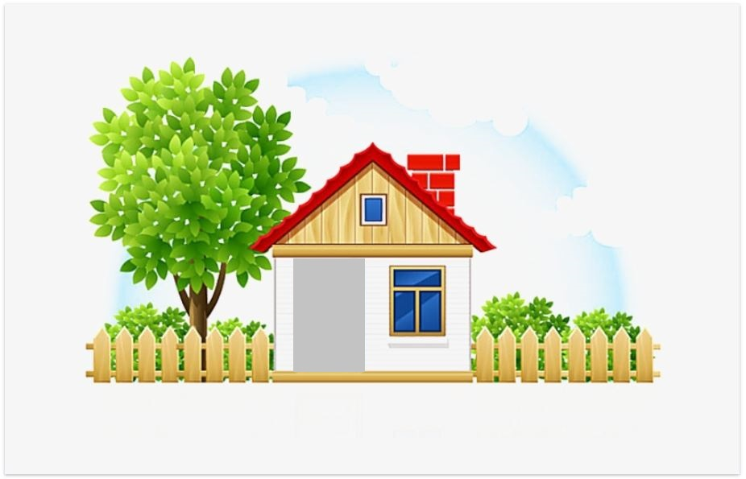



Warm up

Slide 3




Movement Game: Hip hip hooray
Hands up!
Hands down!
Hip hip hooray
Go to Wonderful World!
Notes:
+ Hands up: raise 2 hands up
+ Hands down: Put to hands down
+ Hip hip hooray (2 times): smack 2 hands on hips then put hands to mouth when saying hooray (2 times)
+ Go to Wonderful World: join 2 hands and make waves then raise both hands up and wave.

Slide 4


Slide 5

Presentation

Slide 6
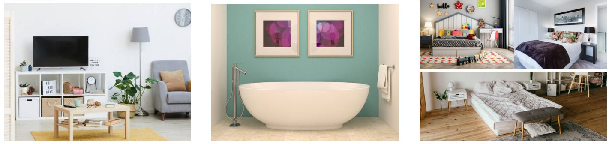

4 Listen and repeat
1
2
3
There are three bedrooms.
There’s a living room.
There’s a bathroom.
Notes:
Bấm chuột vào phía dưới hình ảnh thì sẽ hiện chữ + âm thanh

Slide 7

Slap the board

Slide 8
Listen and number
3
2
1
Notes:
Bấm chọn ảnh nào thì nó sẽ hiện lên đáp án

Slide 9

Practice

Slide 10
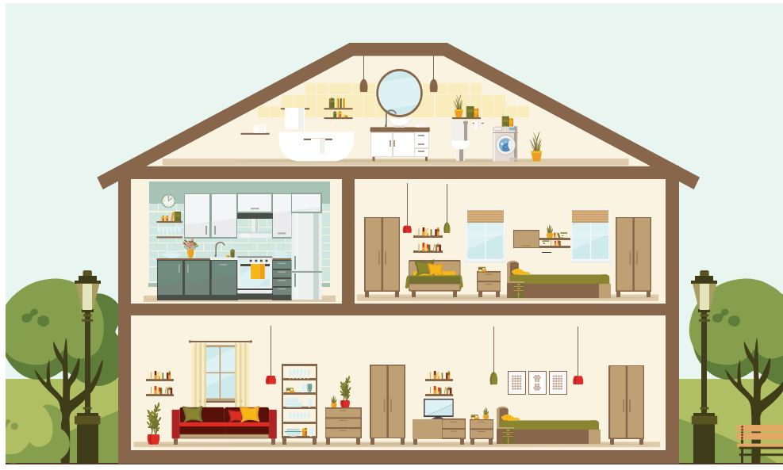
5
Say.
There is a …
There are …..s
Notes:
GV nhấn mạnh them phần cấu trúc văn phạm “ There is / There are…..”

Slide 11


a house
There’s a house.

Slide 12
two bedrooms
There are two bedrooms.

Slide 13
a bathroom
There’s a bathroom.

Slide 14
a kitchen
There’s a kitchen.

Slide 15
There is / There are…….
1.………
house
2.………
bedrooms
3.………
bathroom
4.………
kitchen
Notes:
GV yêu cầu hs hoàn thành câu dung “ There is / There are……

Slide 16
Let’s talk

Slide 17
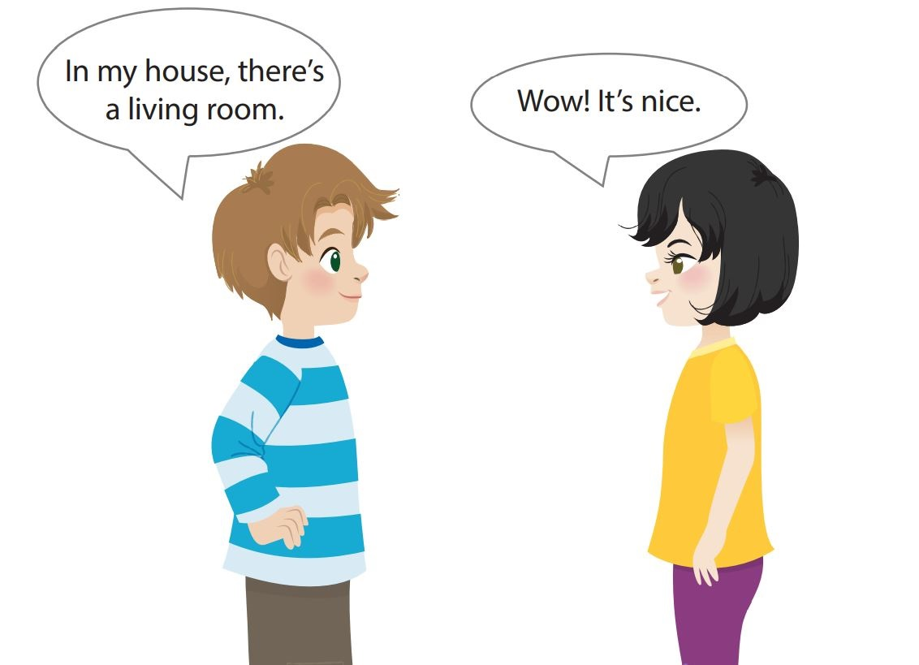
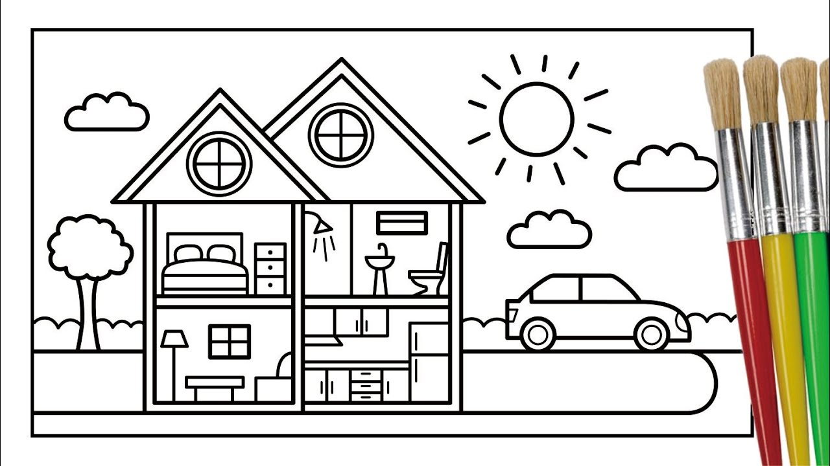
Let’s talk
bedroom
bathroom
living room
kitchen
Notes:
Context:
You’re going to visit Minh’s new house. Let’s have a look at his new house and see how many rooms there are in the house. Write the number of the room then you tell your friends about
Ask sts to work in eight groups
Hand them a set name of room cards
Ask them to look at the picture of the house
Write number of rooms on the cards
Ask sts to face the card back
Each st in group takes turn to pick up a card
Tell their friends the correct sentences
Go around to provide help.

Slide 18

Pass the card Game
Notes:
Context:
You’re going to visit Minh’s new house. Let’s have a look at his new house and see how many rooms there are in the house. Write the number of the room then you tell your friends about
Ask sts to work in eight groups
Hand them a set name of room cards
Ask them to look at the picture of the house
Write number of rooms on the cards
Ask sts to face the card back
Each st in group takes turn to pick up a card
Tell their friends the correct sentences
Go around to provide help.

Slide 19

Production

Slide 20
Color and say
bedroom
bathroom
living room
kitchen
Notes:
Gv yêu cầu hs to màu & làm việc theo cặp “2 bạn cùng miêu tả về cac phòng trong ngôi nhà của mình”

Slide 21

Assessment

Slide 22


Notes:
HOẠT ĐỘNG TƯƠNG TÁC CHO SLIDE 23,24,25

Slide 23


Choose the correct answer.
1. There’s ………………..
a
a living room
b
two bedrooms

Slide 24
Choose the correct answer.
2. In my house, there is a garden.
Wow, …………… nice
a
They’re
b
It’s

Slide 25
Choose the correct answer.
3. Look at the house
- There are ……………..
a
one kitchen
b
two bedrooms

Slide 26



Slide 27




Good bye.
See you again!

