Slide 1









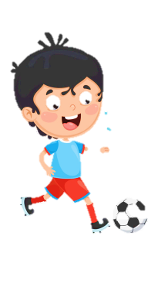
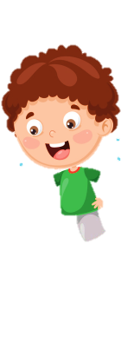












Notes:
Để nguyên trang bìa như này, chỉ thay đổi tên bài trong quá trình làm. Logo của sách Wonderful World

Slide 2




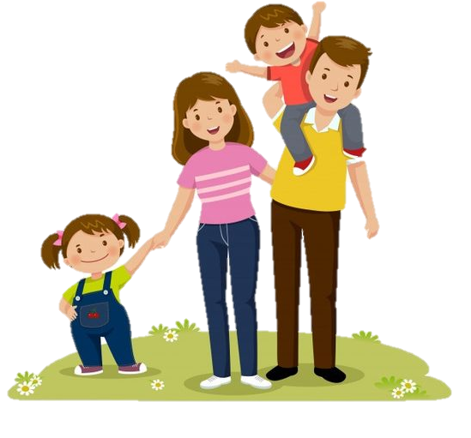



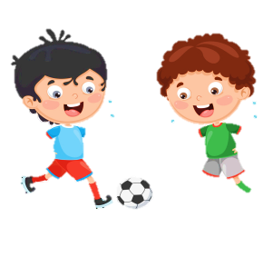


Unit 5: Leisure time
Lesson 2: Task 7, 8, 9

Slide 3
1
Warm up
Slap the board
Guess “ Weather“
Notes:
Warm-up: Play a small game “ Slap the board”
T divides the class into 2 teams.
T introduces the rule of game:
(Game: Slap the board
- T calls 2 Ss to come to the board.
- Ss on the board have a quick look at the activities on the board.
- When the teacher says the sentences, who get the pictures of those sentences first will get the points for their team. Which team has more points will be a winner.)
T asks Ss to repeat after each word which is found.

Slide 4

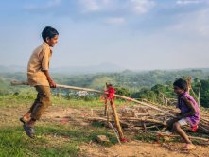

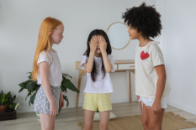
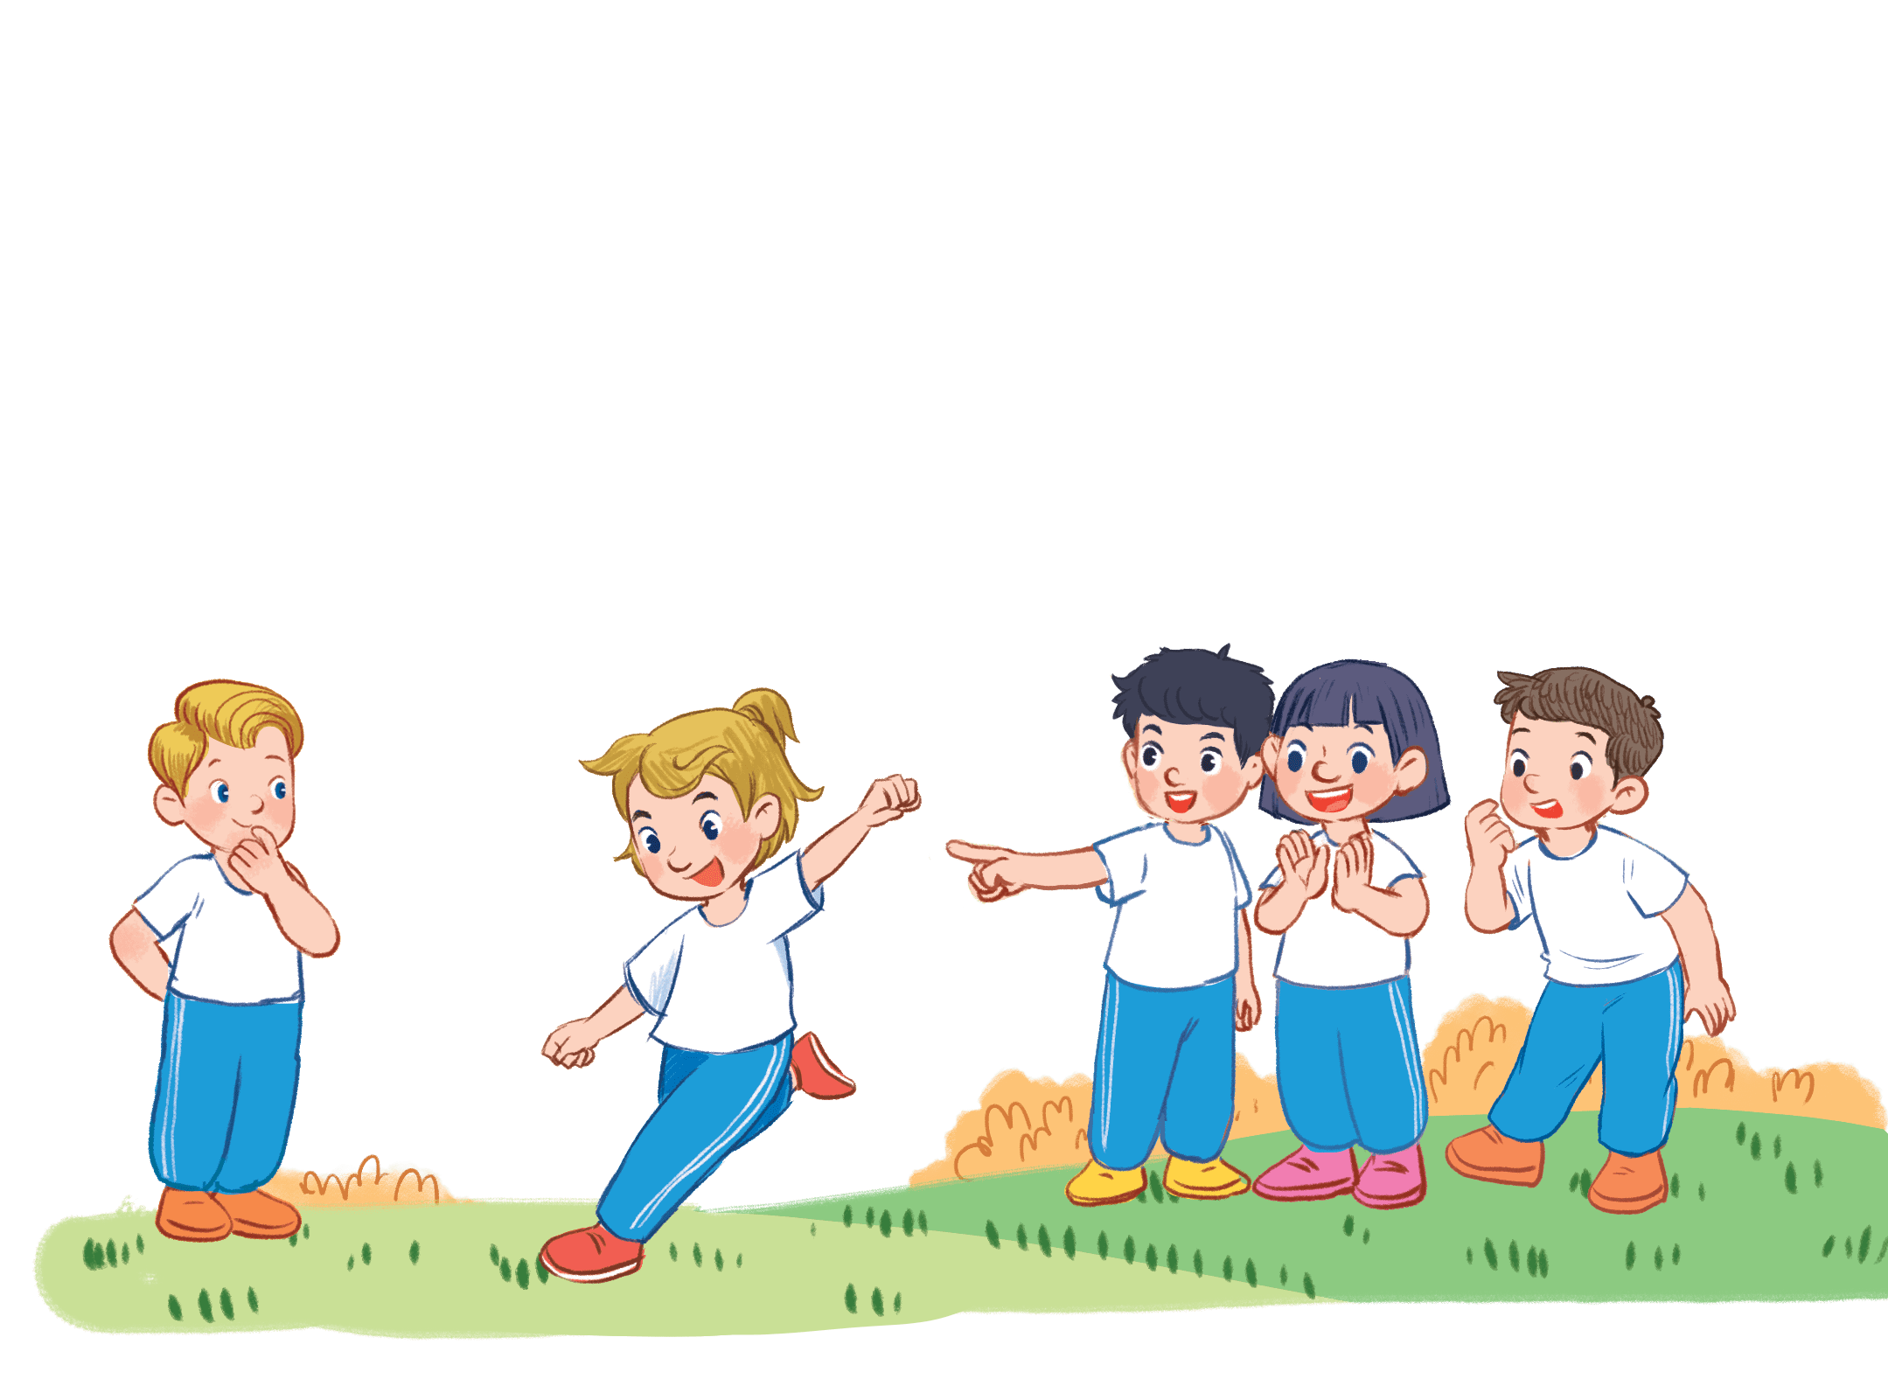
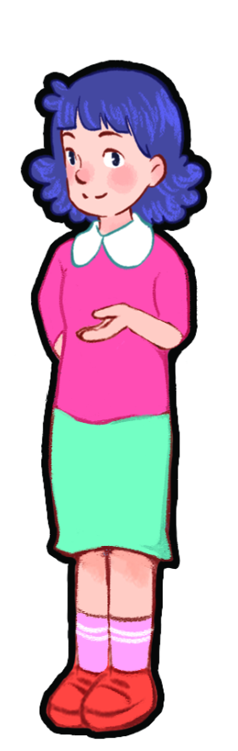
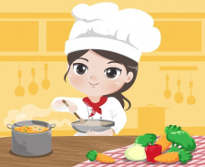
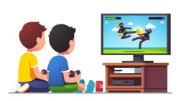
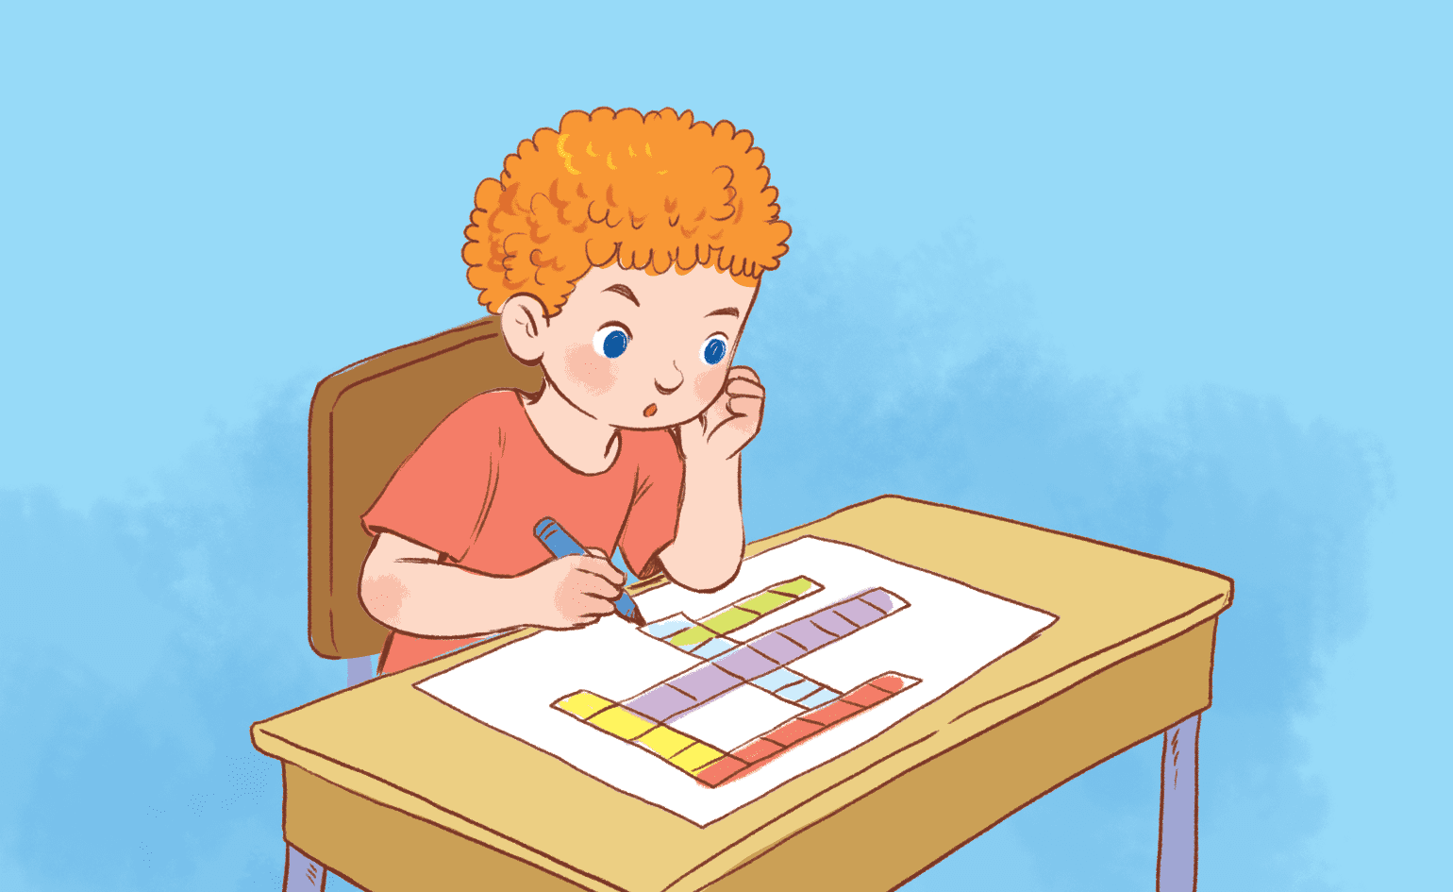

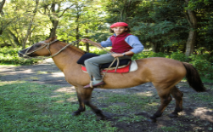
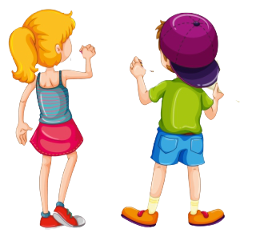
Game time
I’m jumping rope.
Goodjob!
Notes:
Game: Slap the board
- Teacher calls 2 Ss to come to the board.
- Ss on the board have a quick look at the activities on the board.
- When the teacher says the sentences, who get the pictures of those sentences first will get the points.
Answer keys:
1. I’m playing hide-and-seek.
2. They’re playing on the seesaw
3. He’s jumping rope.
4. I’m riding a horse.
5. She’s cooking.
6. I’m studying.
7. They’re playing a game.
He’s reading a book.
(GV treo tranh trên bảng và mời 2 học sinh mỗi lượt chơi. Gv đọc một câu miêu tả bức tranh và học sinh nhanh tay đập vào bức tranh đó để có điểm. Học sinh nào nhanh hơn sẽ có điểm.)

Slide 5
2
Practice

Slide 6



7. Listen and match. TR. 5.8
1. Tom αnd Jαck
a. αre cooking.
2. Lily
b. is reαding α book.
3. Mum αnd Dαd
c. is plαying α gαme.
4. My brother
d. αre doing homework.
Notes:
Task 7: Listen and match. Track 5.8.
- T asks SS to read the information of each question. Then listen and match.
- T calls SS to answer each question.
- Give feedack for SS.
- Ask SS to repeat after each question.

Slide 7
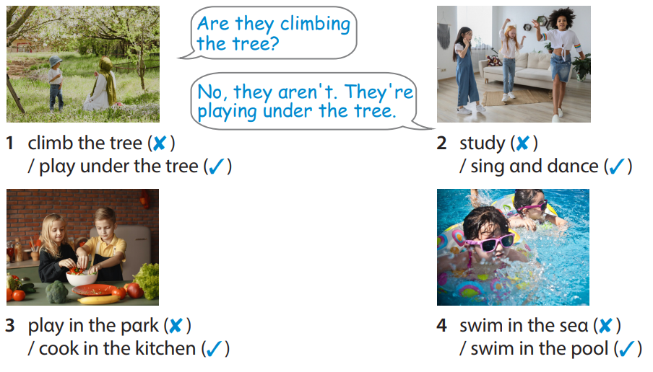
8. Look and say.
Notes:
Task 8: Look and say.
- T asks SS to identify each picture what they can see.
- T makes the question and calls SS to answer as an example.
- T asks SS to work in groups of 4 and do the task 8 in the textbook.
- T asks SS to play “ Lucky numbers” game and introduces the rule of game:
(T divides the class into 2 teams.
There are 4 sunflowers and SS choose a flower to ask and answer the question in each picture as the example. Then choose a number to get points for their team. Which team has more points will be a winner. Each number can be chosen more than once. )

Slide 8







Slide 9
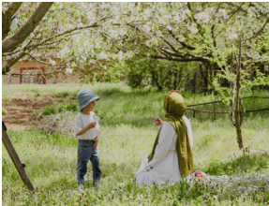



Αre they climbing the tree?
1 climb the tree (✘ )
/ plαy under the tree (✓)
No, they αren't. They're plαying under the tree.

Slide 10
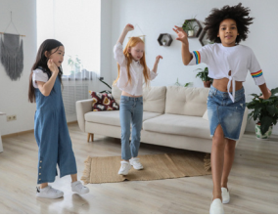
Αre they studying?
2 study (✘ )
/ sing αnd dαnce (✓)
No, they αren't. They're singing and dancing.

Slide 11
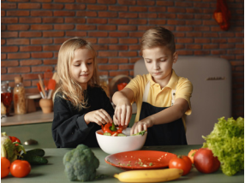
Αre they playing in the park?
3 plαy in the pαrk (✘ )
/ cook in the kitchen (✓)
No, they αren't. They're cooking in the kitchen.

Slide 12
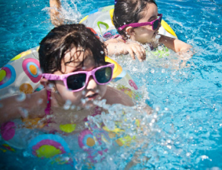
Αre they swimming in the sea?
4 swim in the seα (✘ )
/ swim in the pool (✓)
No, they αren't. They're swimming in the pool.

Slide 13







1
2
3
4
5
6
7
8
9
10
11
12
13
14
15
16
17
18
19
20
Notes:
Look, Write and Choose lucky numbers.
- Teacher divides the class into 2 Teams (Boys and Girls)
- 1 pupil in each team comes to the board, have a look at the pictures(8) of break time activities and their words.
- When the teacher points to the picture, the first one to write the correct phrases matching with the pictures will choose the lucky numbers to open the boxes and get the hidden points.

Slide 14
3
Production

Slide 15
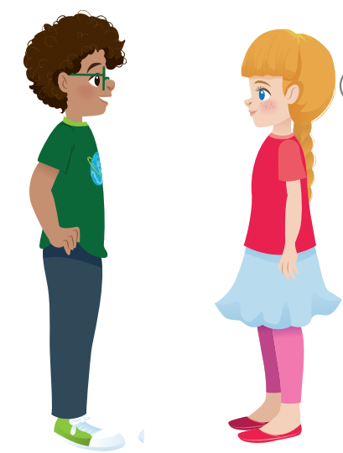
9. Let’s talk.
Look αround your clαssroom. Αsk your friends αbout whαt people αre doing.
Whαt is the teacher doing?
She's writing
on the boαrd.
Notes:
Task 9: Let’s talk.
- Ask SS to look αround your clαssroom and identify some activities in the classroom.
- Ask SS to work in pairs in 3 min and ask their friends αbout whαt people αre doing in the classroom.
- Call pairs to present in front of the class.
- Check and give feedback.

Slide 16


Activities in the classroom
study
read books
write on the notebook
raise the hands
do homework

Slide 17
4
Assessment

Slide 18
Order and write.
your teαcher /is /Whαt /doing /?/
2. They / ‘re /hide-αnd-seek /plαying /the /plαyground /in /./
3. He/ ’s/ on/ plαying/ seesaw/ the/ brother/ his/ with /./
4. cooking/ My/ in/ brother/ the/ ‘s/ kitchen.
5. they/ Αre/ swimming/ sea/ the/ in?
What is your teacher doing?
They’re playing hide-and-seek in the playground.
He’s playing on the seesaw with his brother.
My brother ‘s cooking in the kitchen.
Are they swimming in the sea?

Slide 19
UNIT 5: LEISURE TIME
LESSON 2 – PERIOD 3
What we learnt today
jump rope, play hide-and-seek, play
on the seesaw, ride a horse
What is she doing?
She’s jumping rope.
What are they doing?
- They’re playing basketball.
Review vocaburary and structure

Slide 20




Thank you & goodbye!

