Slide 1




















Notes:
Để nguyên trang bìa như này, chỉ thay đổi tên bài trong quá trình làm. Logo của sách Wonderful World

Slide 2










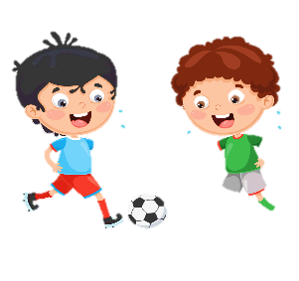


Unit 1:
MY FAMILY
AND FRIENDS
Lesson 2 – Task 6, 7, 8

Slide 3
01
WARM UP
Let’s sing.

Slide 4
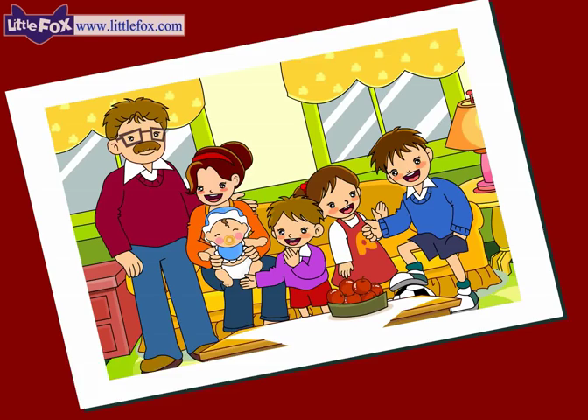
Notes:
Bài hát khởi động “Tooty Ta”

Slide 5



Slide 6

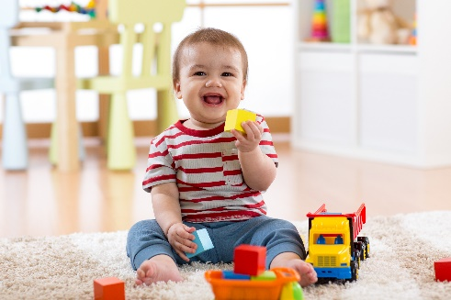
teuc
2
cute

Slide 7
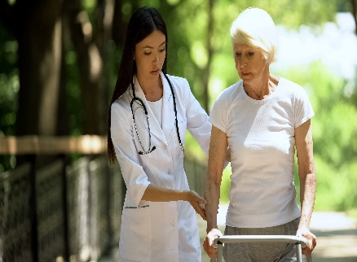
indk
4
kind

Slide 8
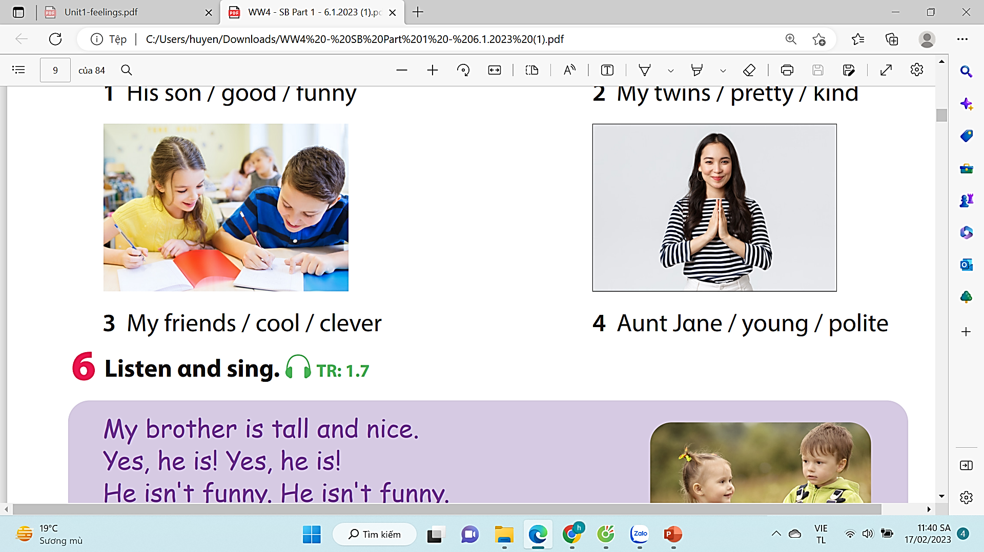
uonyg
6
young

Slide 9

levrce
5
clever

Slide 10

reyttp
5
pretty

Slide 11
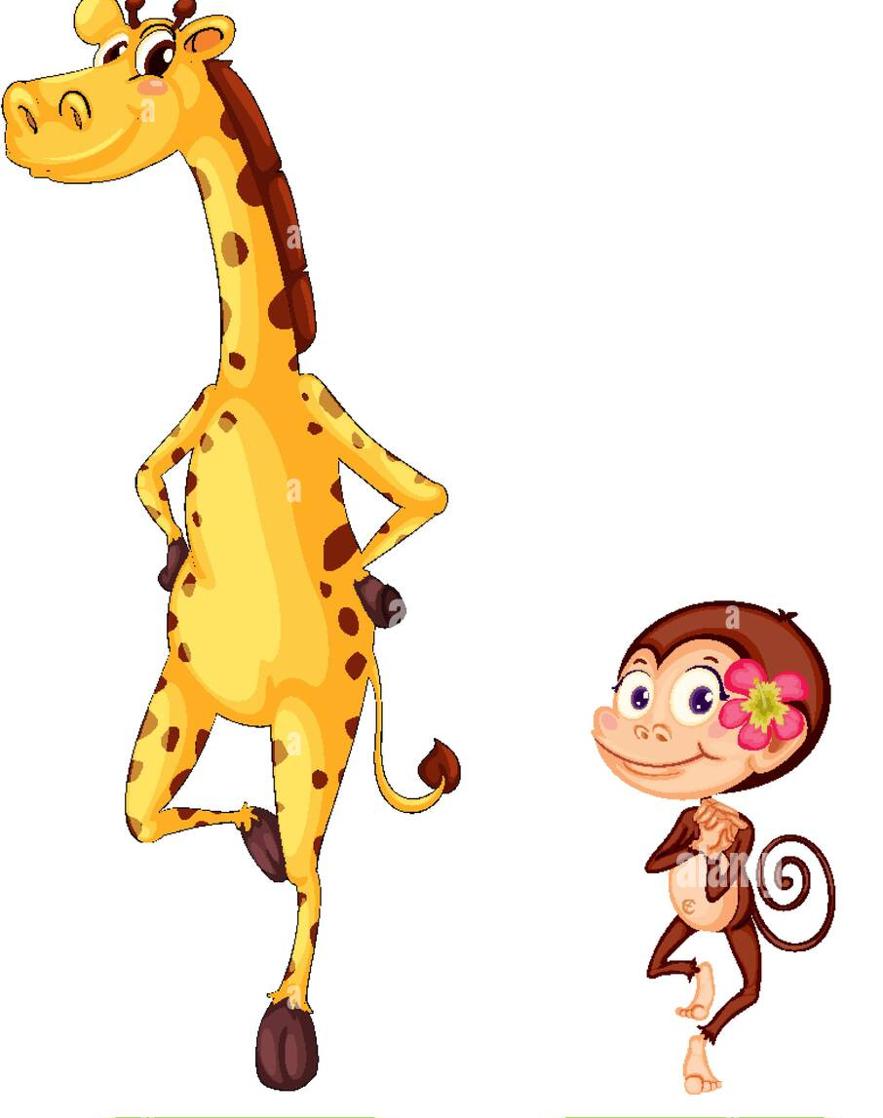
orsht
3
short

Slide 12

atll
2
tall

Slide 13
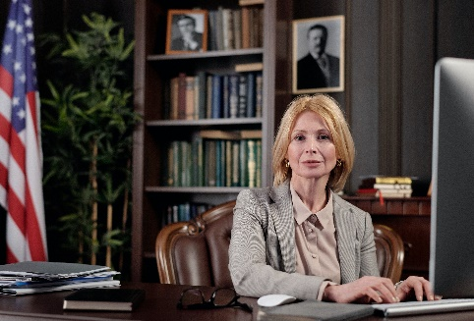
lpoeti
10
polite

Slide 14
02
PRESENTATION
Task 7: Listen and write the names

Slide 15
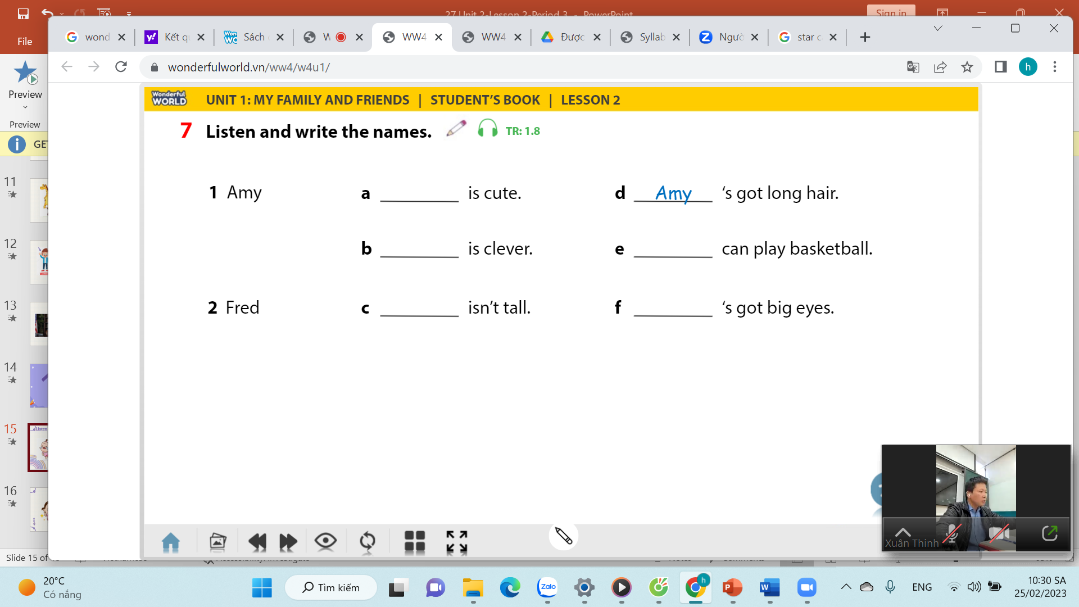
Fred
Amy
Fred
Fred
Amy
Notes:
-Let the sts read 1 by 1 the options from 1-4

Slide 16
03
PRACTICE
Task 8: Look and say.

Slide 17
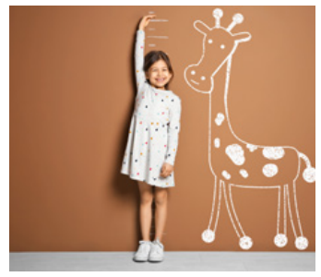



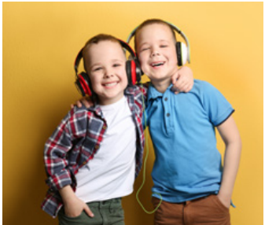
Look and say
1 My friend / ugly (✘) / pretty (✓) / tαll (✓).
2 His father / funny (✘) / polite (✓) / clever (✓).
His father isn’t funny. He’s polite and clever.
3 Her grαndmα / young (✘) / old (✓) / kind (✓)
Her grandma isn’t young. She’s old and kind.
4 His twin brother / short (✘) / tαll (✓) / cute (✓)
His twin brother isn’t short. He’s tall and cute.

Slide 18

Game Time

Slide 19









Slide 20


12
1
2
11
10
3
4
9
5
8
7
6
Notes:
Bấm spin để quay
Bấm stop để dừng
Slide cuối cùng là slide chỉ đến số 7

Slide 21
My friend/ ugly.(X)
My friend isn’t ugly.
WHEEL
CHECK
Notes:
Bấm check để kiểm tra đáp án và hiện chữ wheel
Bấm chữ wheel để quay lại vòng quay

Slide 22
12
1
2
11
10
3
4
9
5
8
7
6

Slide 23

She/ pretty/ tall.( )
She is pretty and tall.
WHEEL
CHECK

Slide 24
12
1
2
11
10
3
4
9
5
8
7
6

Slide 25
+ 2
WHEEL
CHECK

Slide 26
12
1
2
11
10
3
4
9
5
8
7
6

Slide 27
His son/ funny. (X)
His son isn’t funny.
WHEEL
CHECK

Slide 28
12
1
2
11
10
3
4
9
5
8
7
6

Slide 29
+ 1
WHEEL
CHECK

Slide 30
12
1
2
11
10
3
4
9
5
8
7
6

Slide 31
+ 3
WHEEL
CHECK

Slide 32
12
1
2
11
10
3
4
9
5
8
7
6

Slide 33
He/ polite/clever.
He is polite and clever.
WHEEL
CHECK

Slide 34
12
1
2
11
10
3
4
9
5
8
7
6

Slide 35
Her grandma/ Young ( X)
Her grandma isn’t young.
WHEEL
CHECK

Slide 36
12
1
2
11
10
3
4
9
5
8
7
6

Slide 37
+ 2
WHEEL
CHECK

Slide 38
12
1
2
11
10
3
4
9
5
8
7
6

Slide 39
She/ old/ kind ( )
She is old and kind.
WHEEL
CHECK

Slide 40
12
1
2
11
10
3
4
9
5
8
7
6

Slide 41
His twin brother/ short.( X)
His twin brother isn’t short.
WHEEL
CHECK

Slide 42
12
1
2
11
10
3
4
9
5
8
7
6

Slide 43
+ 5
EXIT
CHECK
Notes:
Bấm check để hiện từ exit

Slide 44
12
1
2
11
10
3
4
9
5
8
7
6

Slide 45
He/tall/cute( )
He is tall and cute.
WHEEL
CHECK

Slide 46
04
PRODUCTION
Task 9: Let’s talk

Slide 47
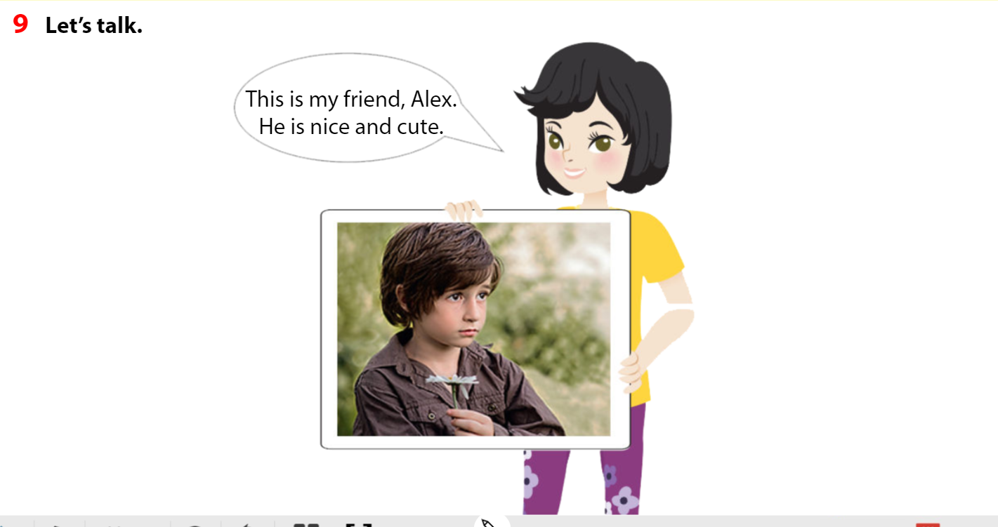

Slide 48


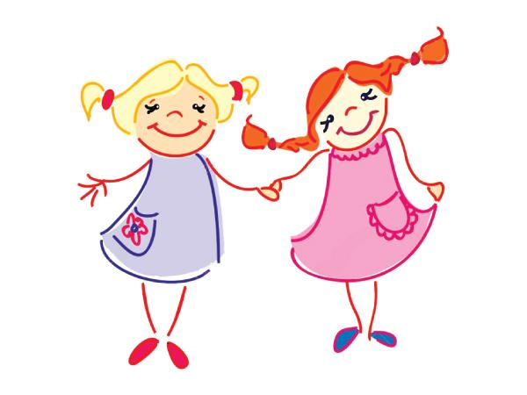

This is my friend, Hoa. She is cute and kind.
Notes:
My favourite person
- Tell students they’re going to draw their favourite person ( a family member or a friend)
- Ask student to draw . Then write the information about him/her.
E.g.: This is my ______
He/She is cute and kind.

Slide 49

05
ASSESSMENT

Slide 50
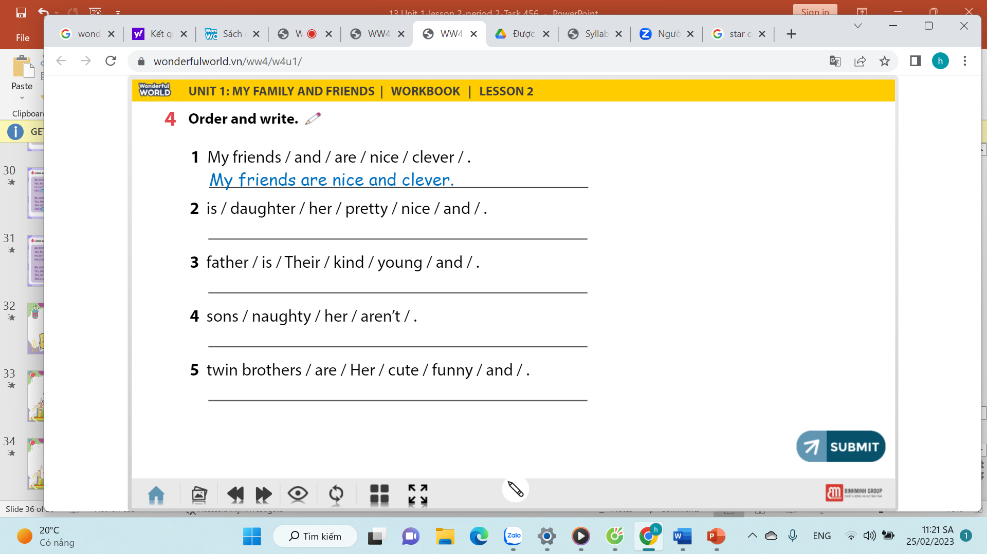
Her daughter is pretty and nice.
Their father is young and kind.
Her sons aren’t naughty.
Her twin brothers are cute and funny.
Notes:
HOẠT ĐỘNG TƯƠNG TÁC: 4 CÂU. ĐÁP ÁN LÀ CHỮ MÀU ĐỎ.

Slide 51

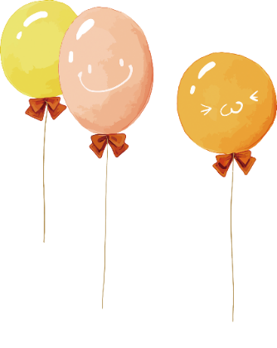
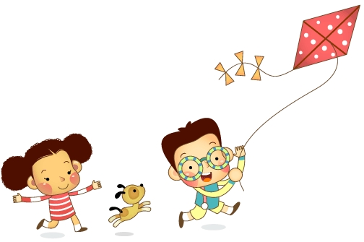
Remember
Vocabulary: review
old, young, tall, short, clever, cute, ugly, nice, pretty, funny, kind, cool, polite
Structure: review
My friend isn't ugly. She's pretty αnd tαll.

Slide 52


Wrap – up
1, Finish all the exercises.
2, Practice the new content.

Slide 53
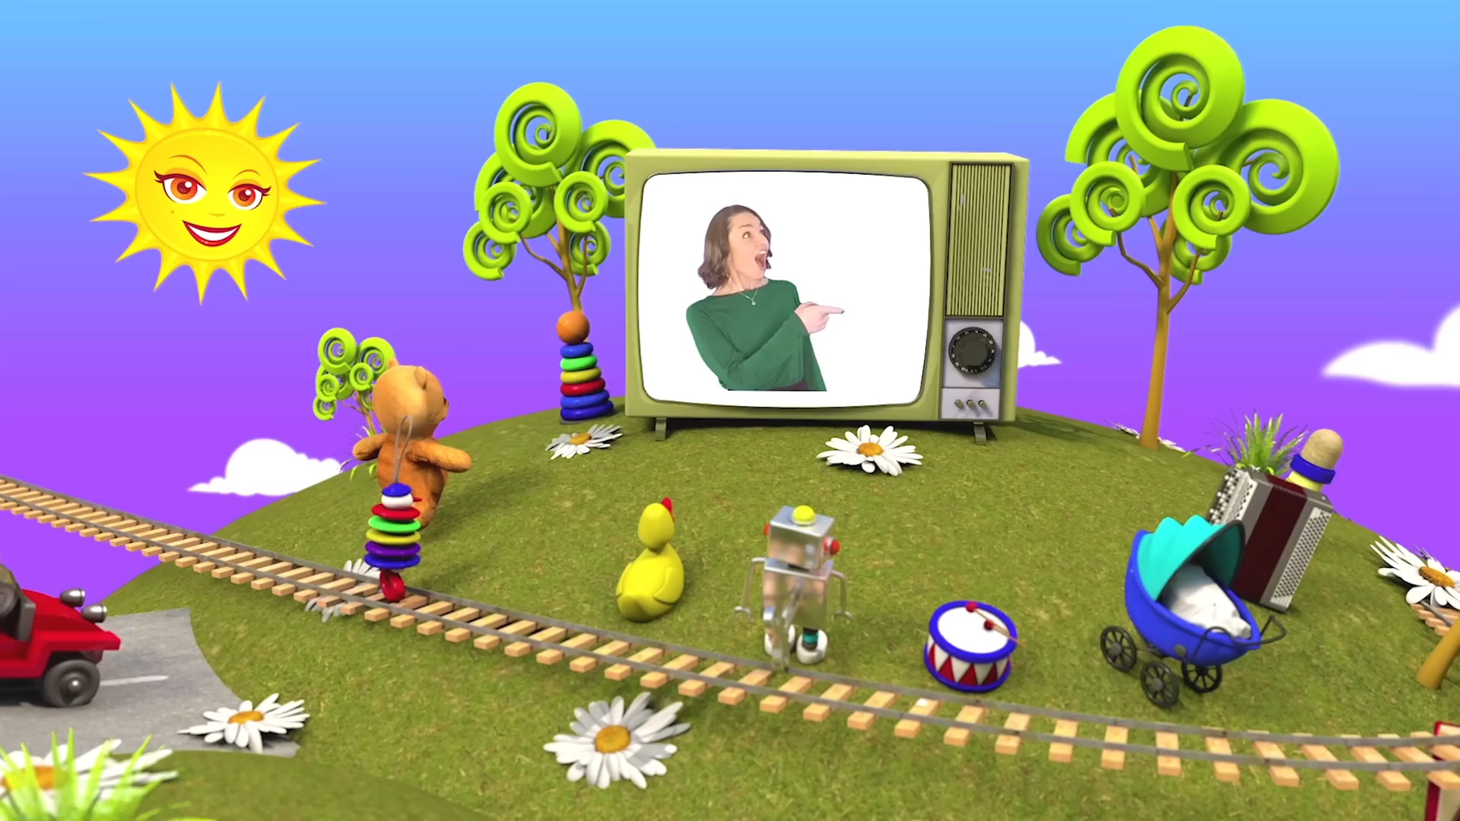

Slide 54




Thank you & goodbye!

