Slide 1





















Slide 2

UNIT 6: OUTDOOR ACTIVITIES
Lesson 1
Period 1 – Task 1,2,3 (P.64)

Slide 3
Contents
01
04
WARM-UP
03
PRODUCTION
PRACTICE
02
05
PRESENTATION
ASSESSMENT

Slide 4
01
WARM-UP

Slide 5
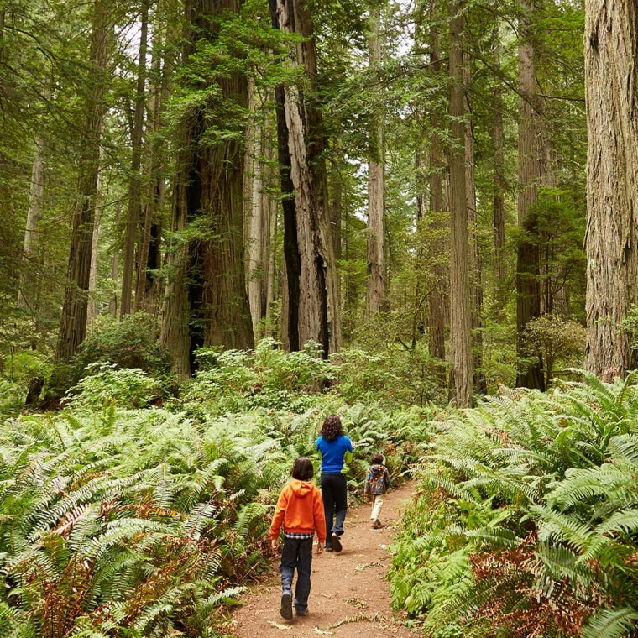
Quick Answers
1. What can you see
in the picture?
2. What are they doing?
3. Where are they?

Slide 6
02
PRESENTATION

Slide 7
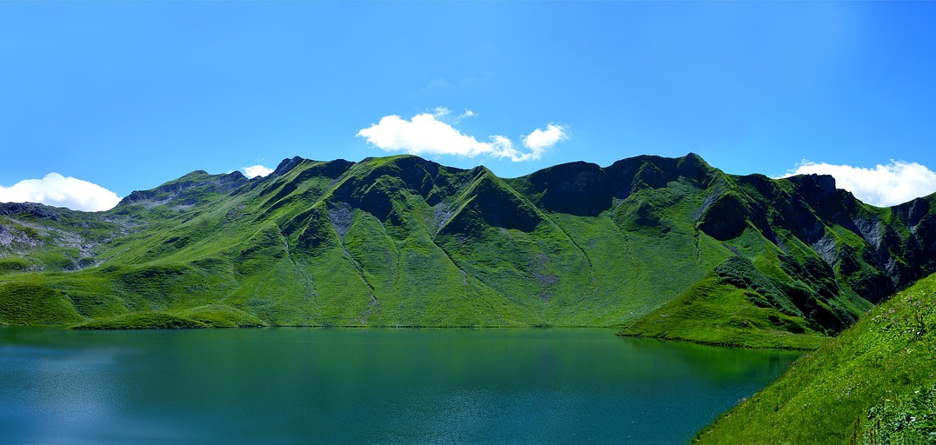
NEW WORDS
mountain

Slide 8

NEW WORDS
go fishing

Slide 9
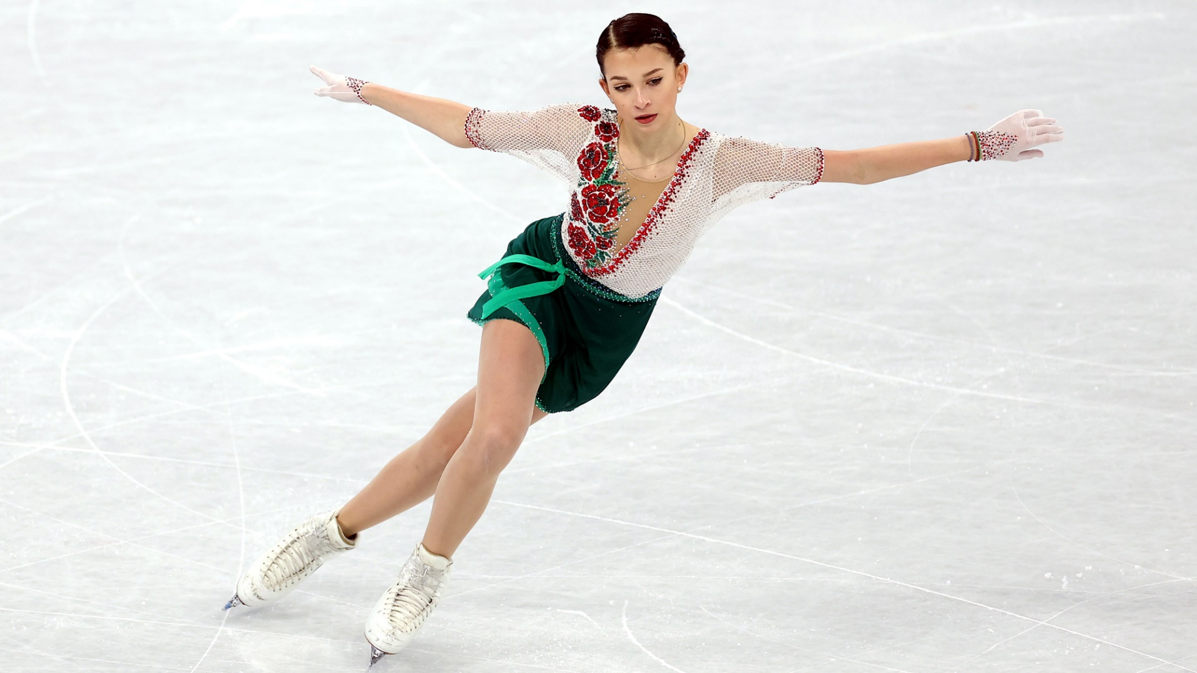
NEW WORDS
ice-skate

Slide 10
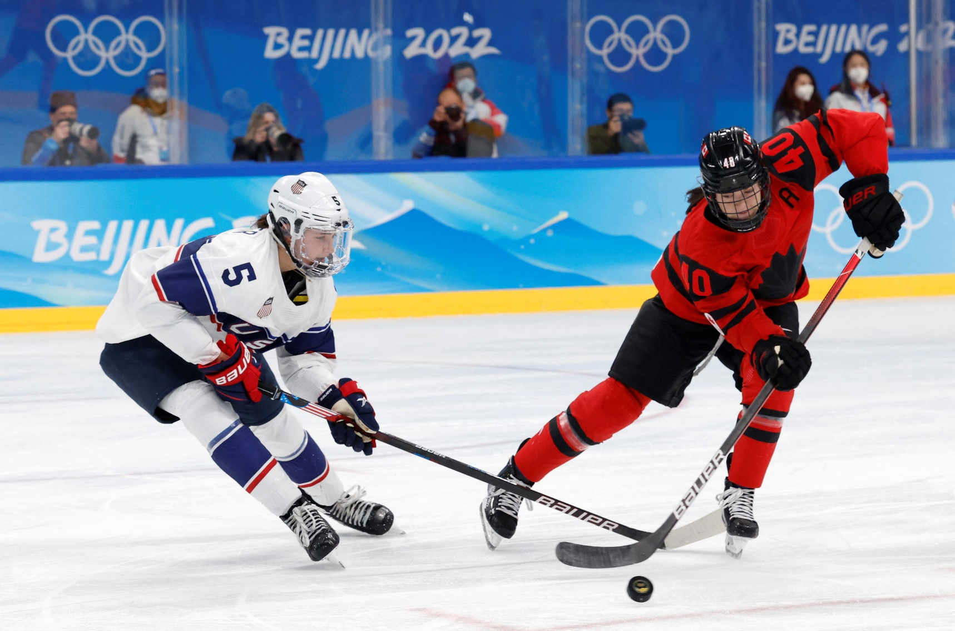
NEW WORDS
play ice hockey

Slide 11
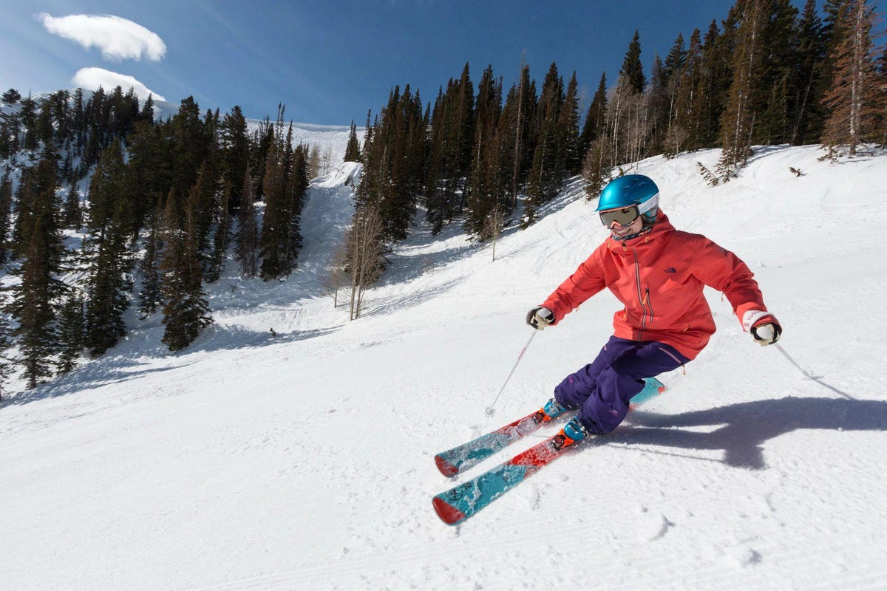
NEW WORDS
ski

Slide 12
Task 1.
Listen and point. Repeat.
Notes:
Dấu câu

Slide 13

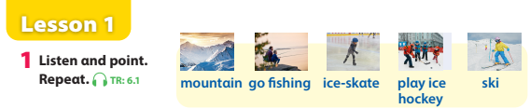
Unit 6 – Lesson 1 – Activity 1 (page 64)

Slide 14
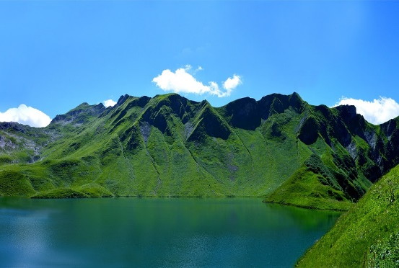




PRACTICE: MATCHING
ice-skate
mountain
go fishing
play ice hockey
ski

Slide 15
Task 2.
Listen and read. Tick.
Notes:
Dấu câu

Slide 16
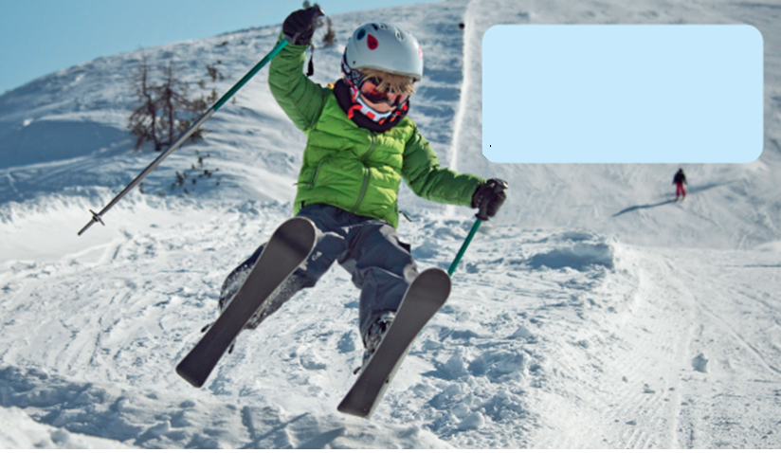
BRAINSTORMING
What is he doing?
Where is he?
What’s the weather like?

Slide 17
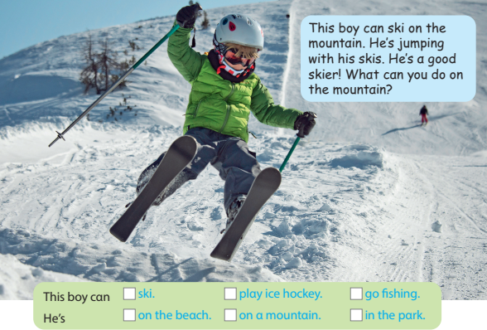

Task 2 (P.64): Listen and read. Tick.
This boy can ski on the mountain.
He’s jumping on his skis.
He’s a good skier!
What can you do on the mountain?

Slide 18
03
PRACTICE

Slide 19










1
4
HELP THE POOH
2
5
3

Slide 20
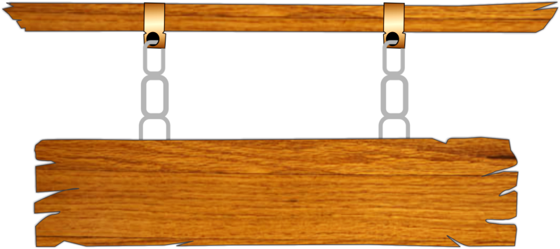


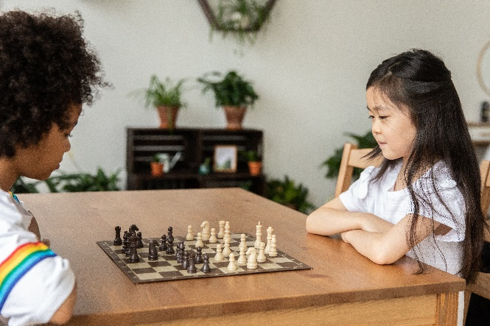


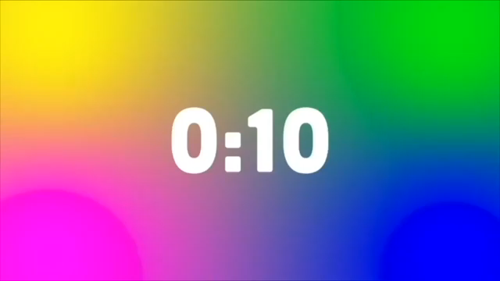
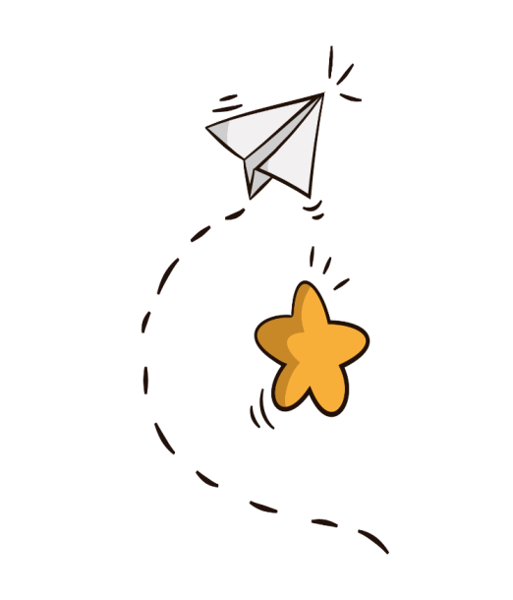


1. What are they doing?
They’re watching a film.
A
They’re playing board games.
B
They’re reading books.
C
They’re listening to music.
D
BACK

Slide 21



2.She is ……. rope.
A
listening
B
skiing
C
running
D
jumping
BACK

Slide 22
3. What is he doing?
A
He’s swimming.
B
He’s singing.
C
He’s skiing.
D
He’s playing football.
BACK

Slide 23
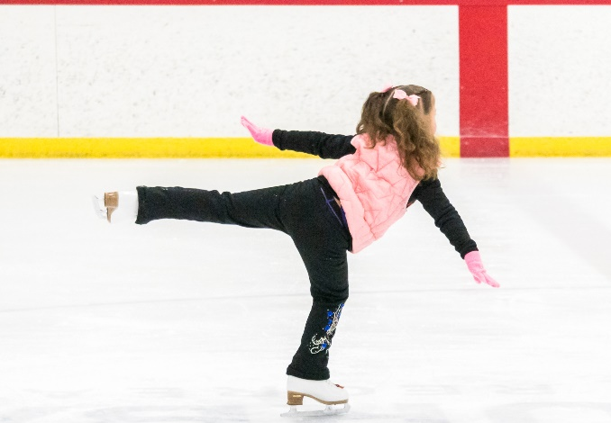
4. What is she doing?
She’s ice-skating.
A
She’s dancing.
B
He’s swimming.
C
She’s jogging.
D
BACK

Slide 24

5. What are they doing?
A
They’re reading.
B
They’re playing video games.
C
No, they aren’t.
D
Yes, they can.
BACK

Slide 25
04 Production
Notes:
Dấu câu

Slide 26
Task 3.
Look and say.
Notes:
Dấu câu

Slide 27
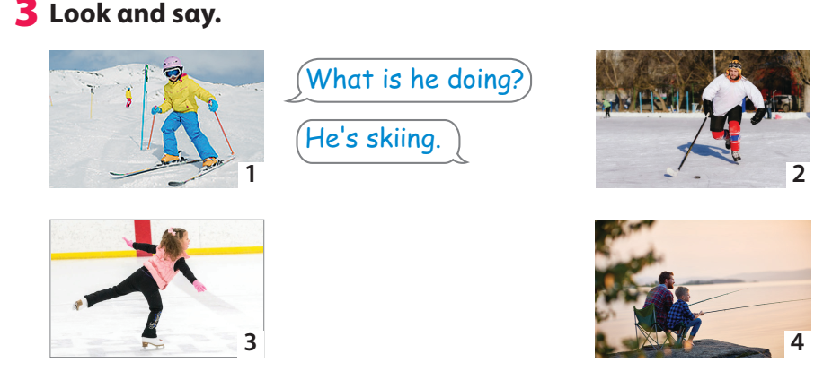
Task 3 – Look and say (page 64)
Notes:
Dấu câu

Slide 28
05 Assessment
Notes:
Đây k phải là extra, đây là hđ 3 của bài

Slide 29
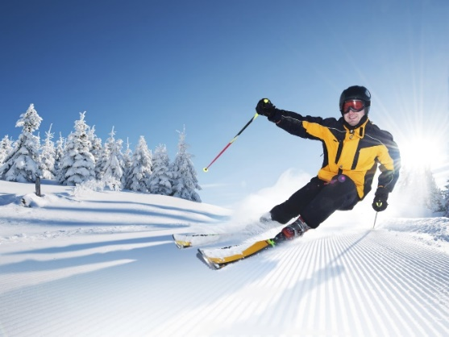
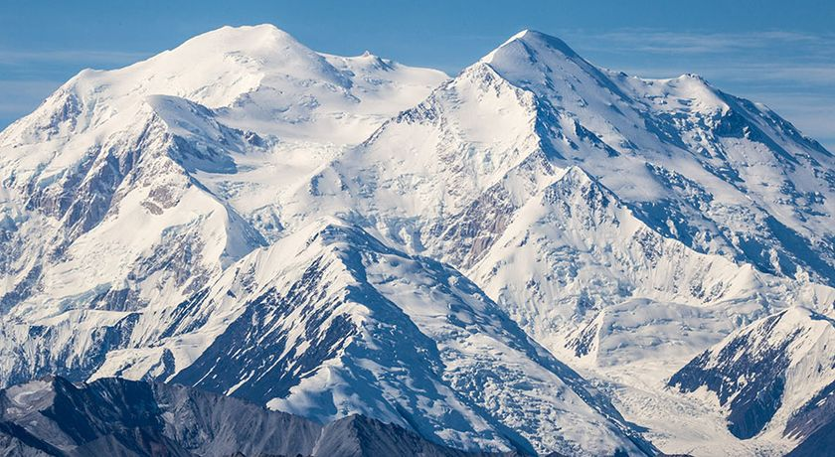
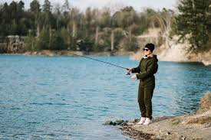
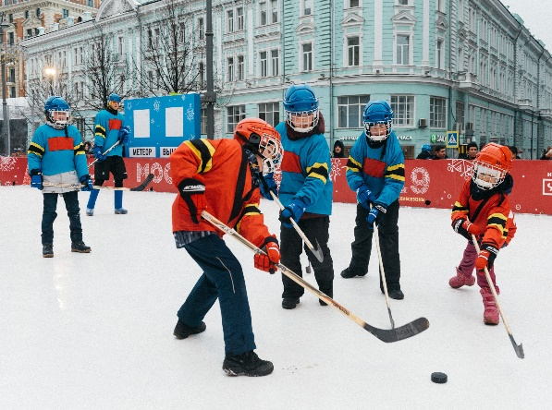
LOOK AT THE PICTURES AND
WRITE THE CORRECT ANSWERS
1
skiing
He’s ________ .
3
mountain
On the ______
4
playing ice hockey
They’re _____.
2
going fishing
She’s ______ .

Slide 30




Thank you & goodbye!

