Slide 1








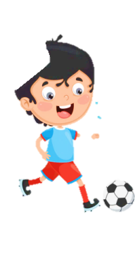
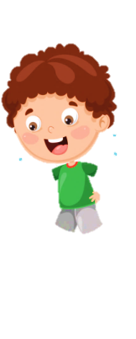











Slide 2

UNIT 6: OUTDOOR ACTIVITIES
Lesson 1
Period 2 – Task 4,5,6 (P.65)

Slide 3
Contents
01
04
WARM-UP
03
PRODUCTION
PRACTICE
02
05
PRESENTATION
ASSESSMENT

Slide 4
01
WARM-UP

Slide 5
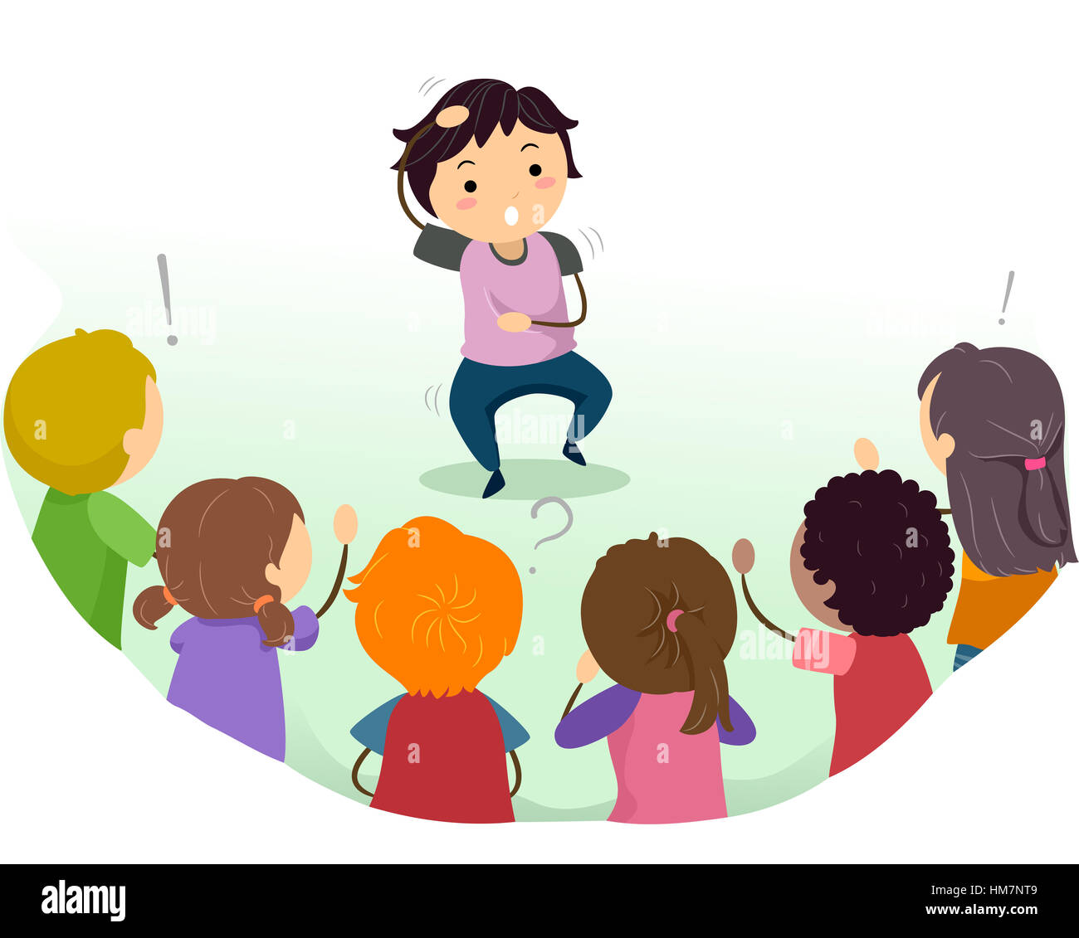
CHARADE

Slide 6
02
PRESENTATION

Slide 7





REVIEW
GOLD MINER

Slide 8
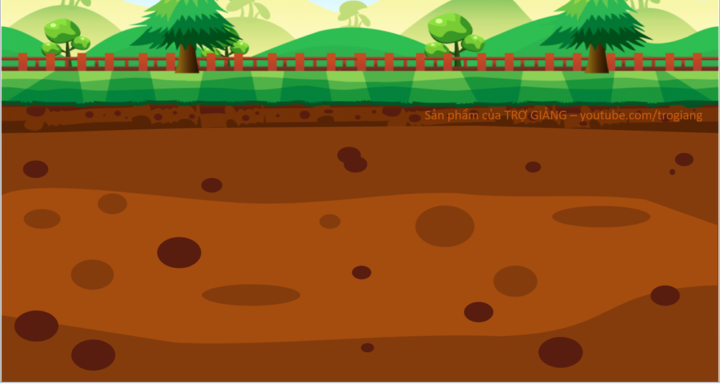
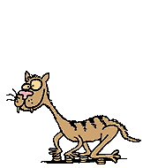







10$
100$
50$
20$
1
4
2
3

Slide 9
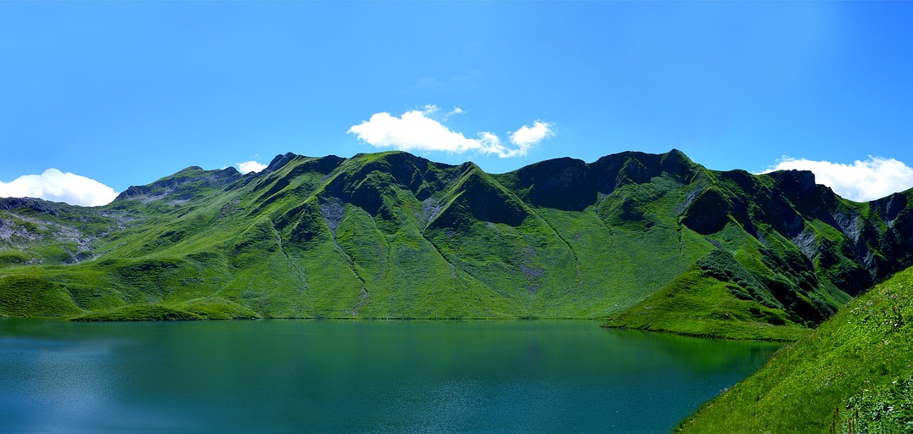

Question 1
Fill in the missing letters
o u
m _ _ntai_
n
Next

Slide 10
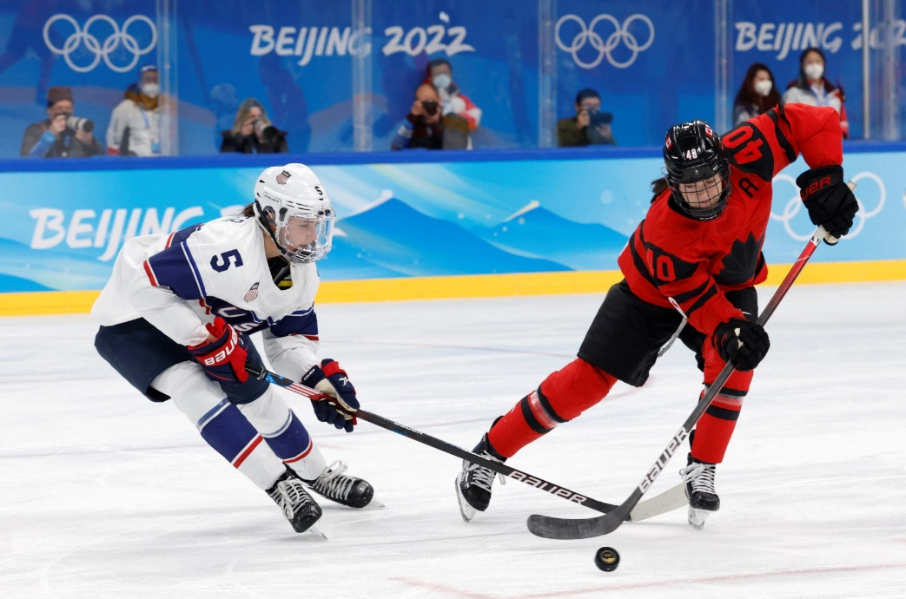
Question 2
What are they doing?
They’re playing ice hockey.
Next

Slide 11
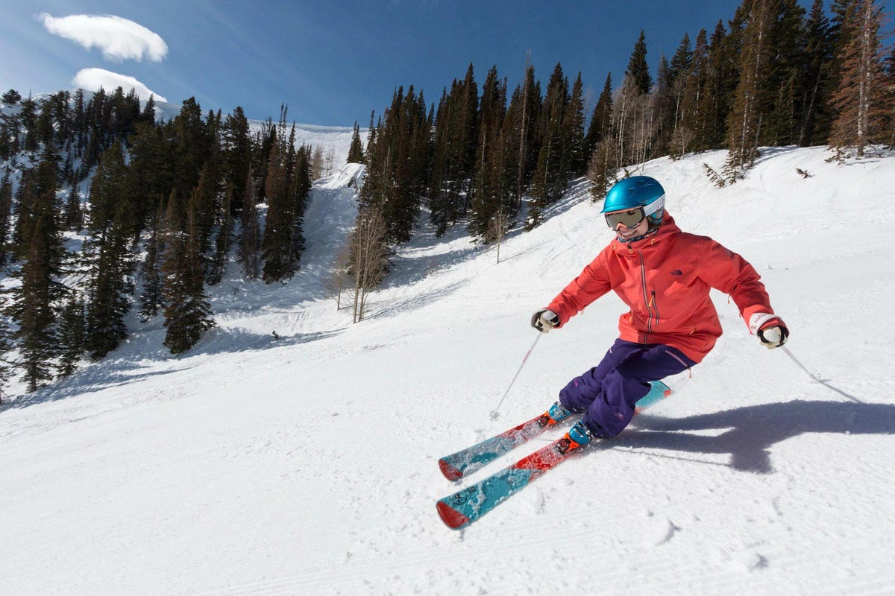
Question 3
Reorder the letters: isk
ski
Next

Slide 12
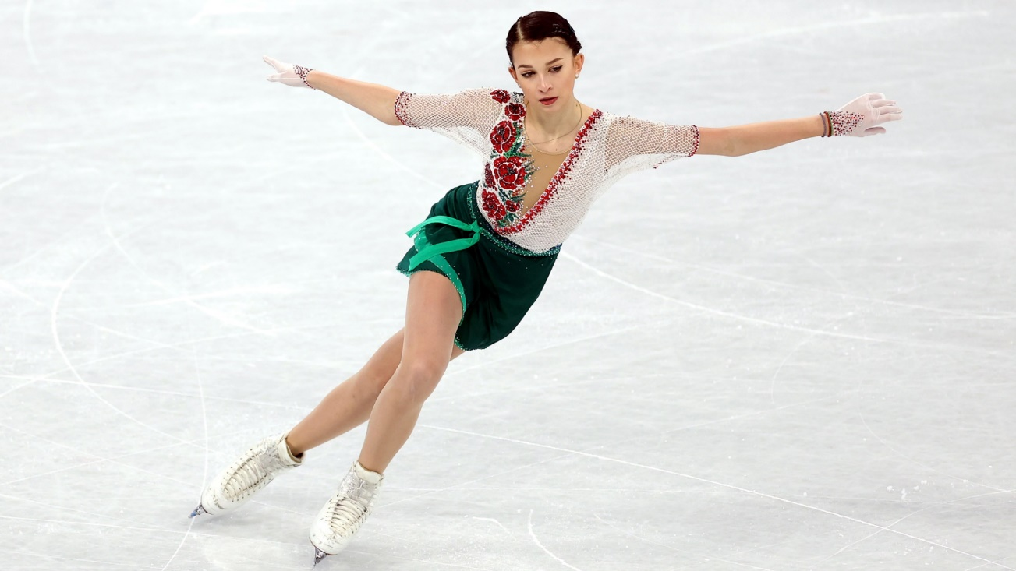
Question 4
What is she doing?
Next
She is ice-skating.

Slide 13

BRAINSTORMING

Slide 14

BRAINSTORMING
Ex: go hiking
Ex: go for a pinic
On the mountain
In the park

Slide 15

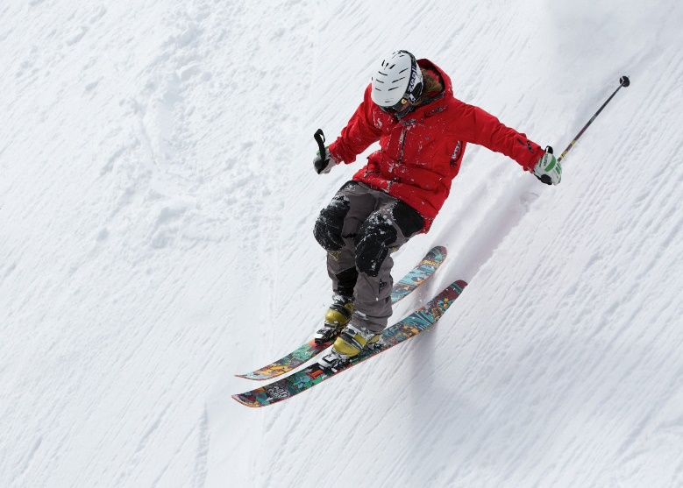
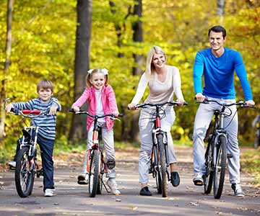
Activity 4. Listen and repeat
(page 65)
1
2
What can we do on the mountain?
What can we do in the park?
We can ski on the mountain.
We can ride a bike in the park.

Slide 16
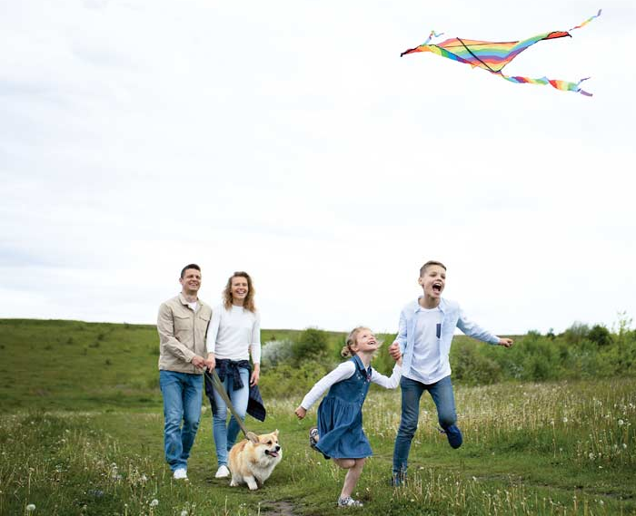
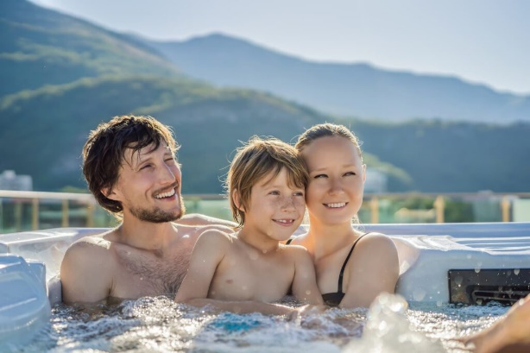
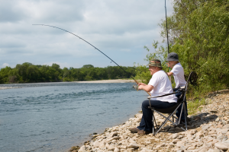
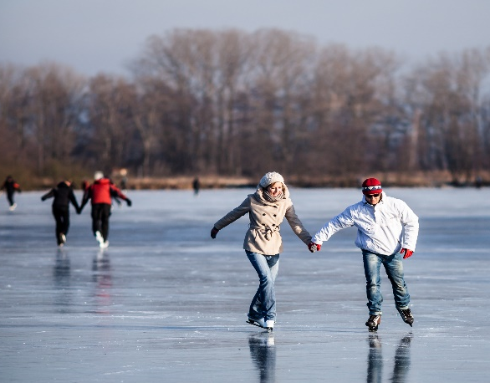
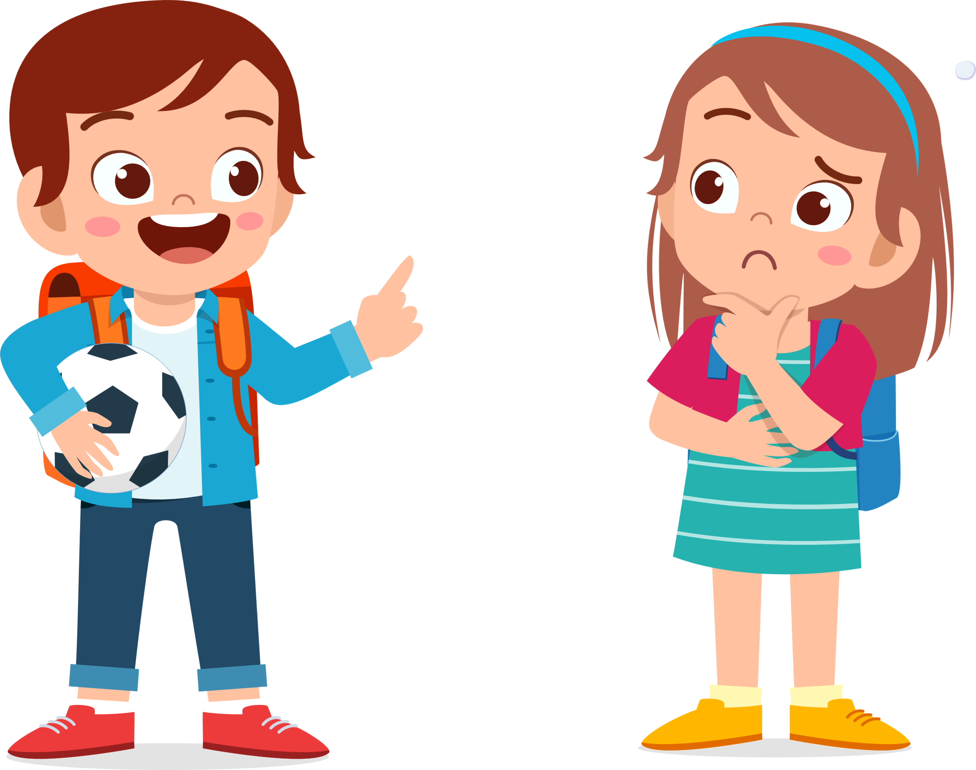
Activity 5. Look and say
(page 65)
What can we do in the field?
fly a kite/
in the field
swim/
in the pool
1
2
We can fly a kite in the field.
go fishing/
by the river
ice-skate/
on the lake
3
4

Slide 17
03
PRACTICE

Slide 18


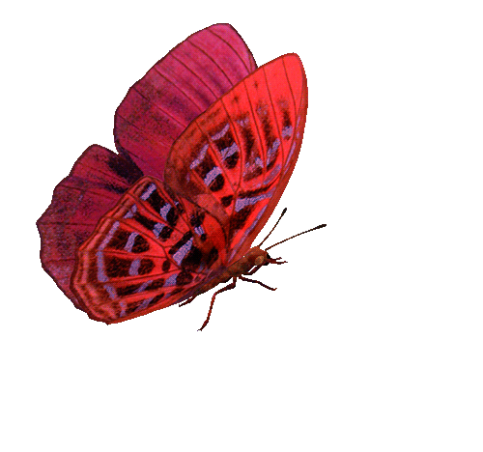



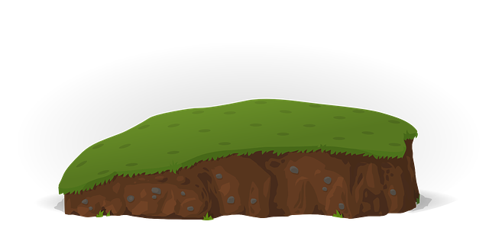



CATCHING BUTTERFLIES

Slide 19
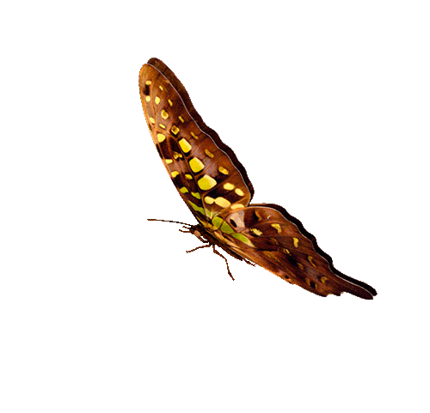

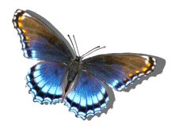



1
CONGRATULATIONS
TEAM A
5
CONGRATULATIONS
TEAM B
8
7
2
4
6
3
1
2
3
4
5
6
7
8
9
10
1
2
3
4
5
6
7
8
9
PIPI
10
TEAM A
TEAM B

Slide 20

What can they do in the field?
A. They can fly a kite.
B. They can jump rope.
C. They can take photos.
D. They can swim.
GO HOME

Slide 21
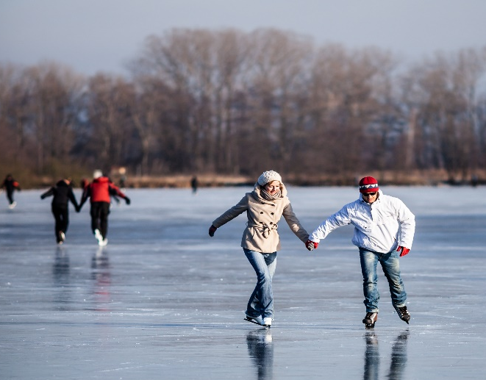
What can we do on the lake?
A. We can go fishing.
B. We can go hiking.
C. We can climb the tree.
D. We can ice-skate.
GO HOME

Slide 22
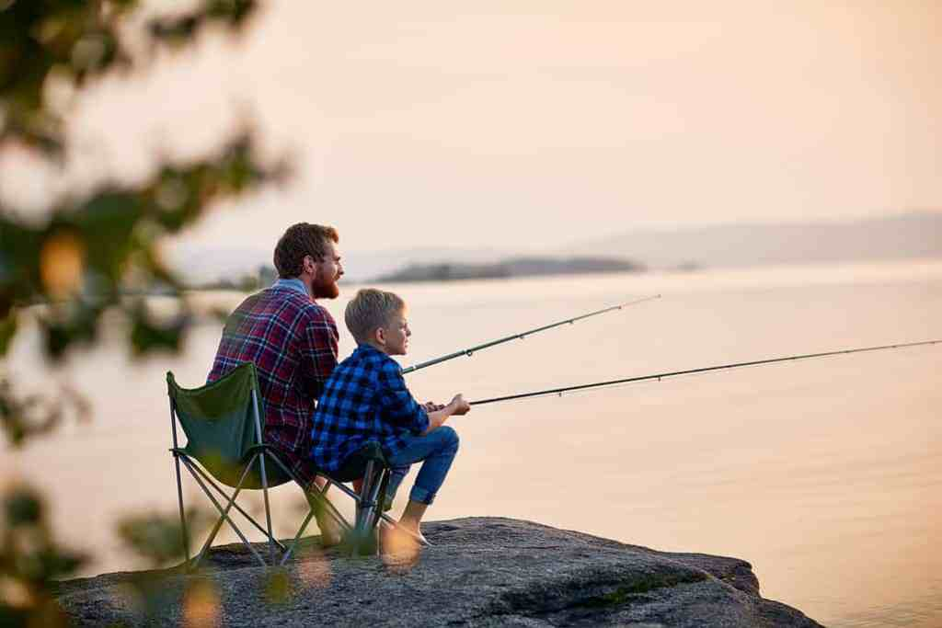
What can we do by the river?
A. We can jump rope.
B. We can go fishing.
C. We can sing a song.
D. We can dance.
GO HOME

Slide 23
What can we do in the pool?
A. We can swim.
B. We can play tennis.
C. We can go fishing.
D. We can ice-skate.
GO HOME

Slide 24
04
PRODUCTION

Slide 25
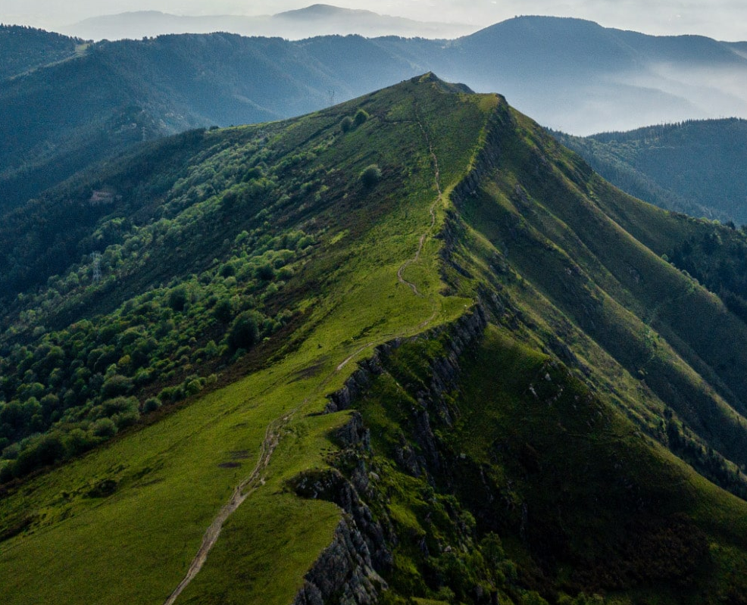
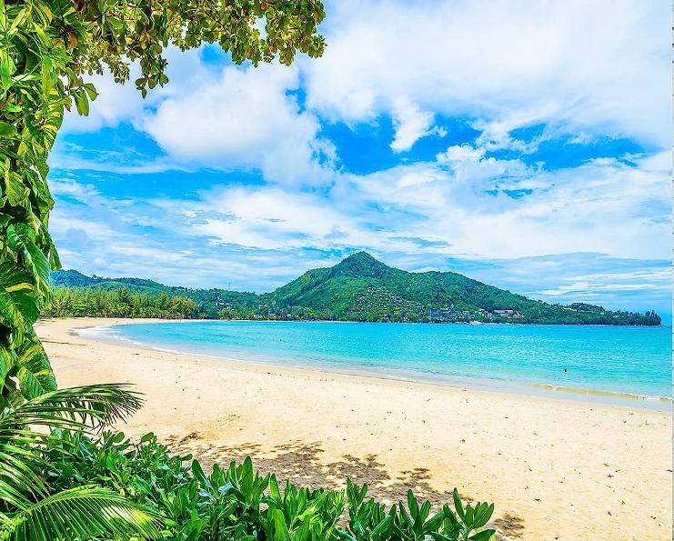
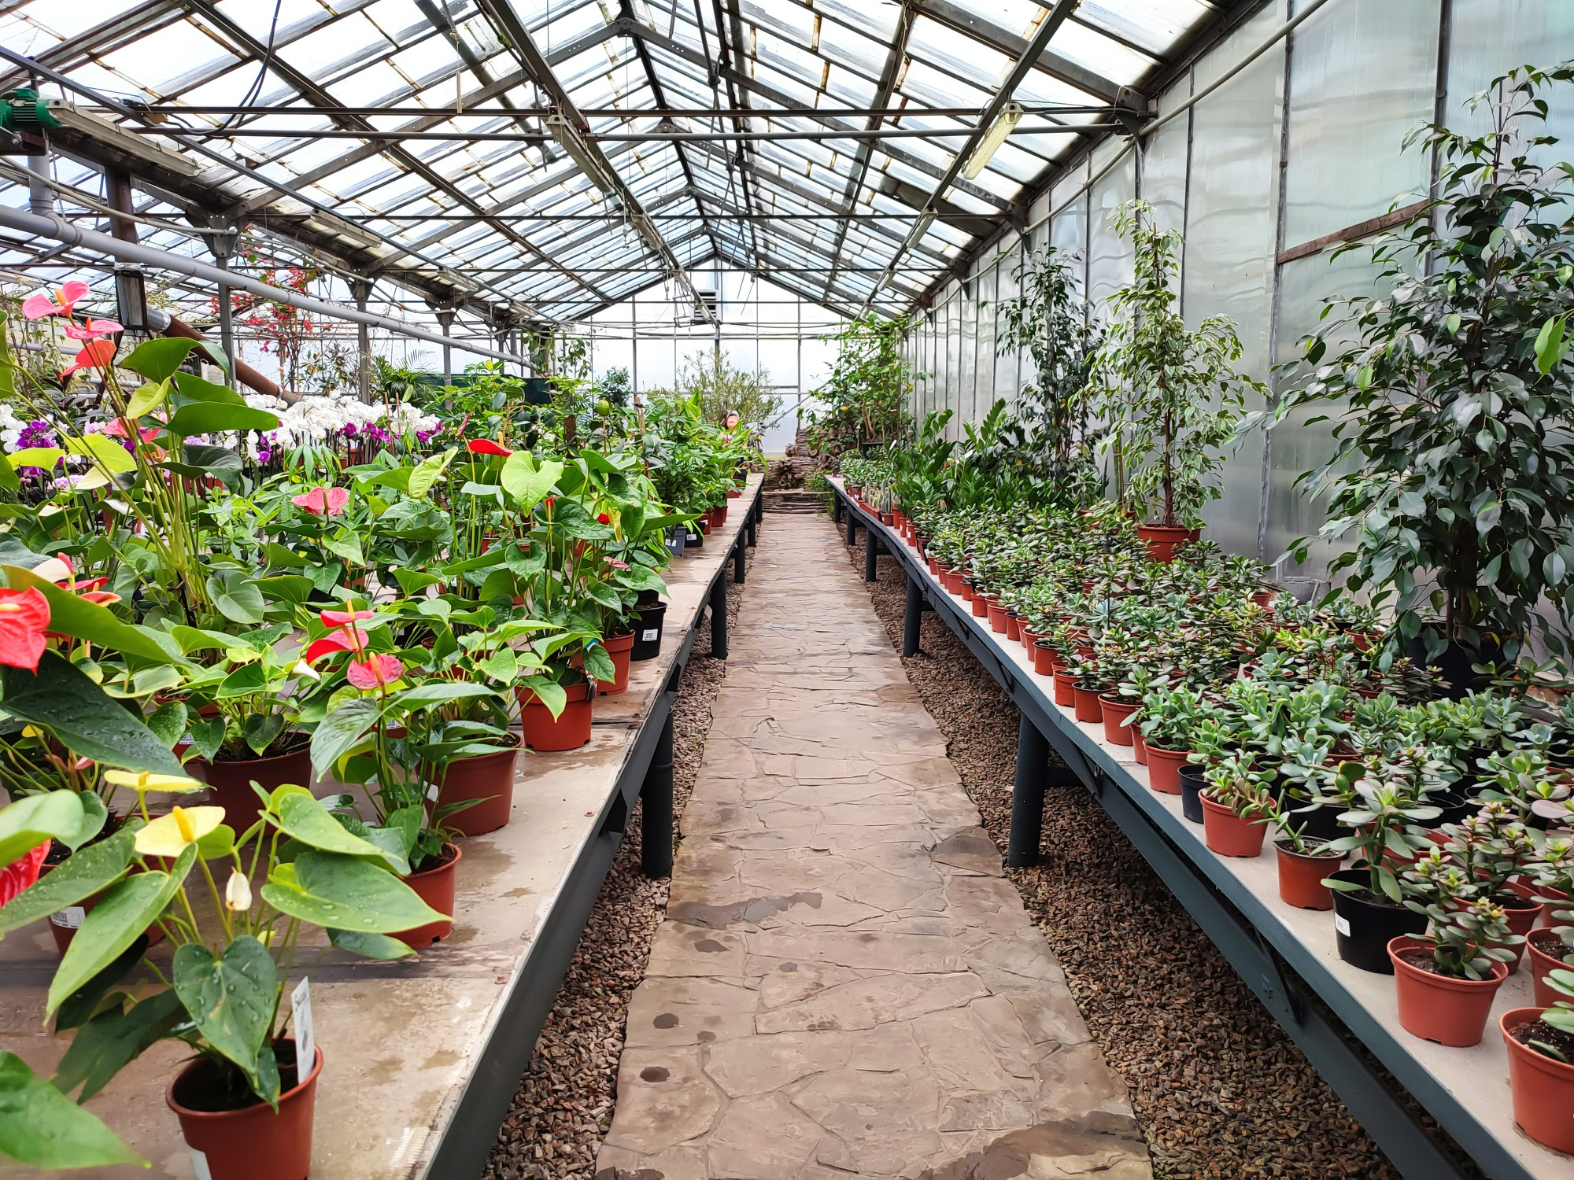
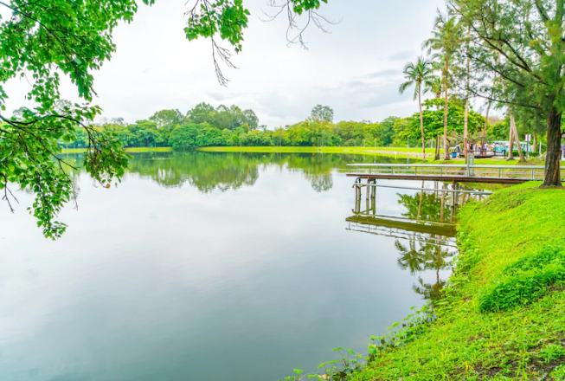
Activity 6. Let’s talk.
(page 65)
Pick a card. Ask and answer about what you can do in that place.
1
2
What can we do on the mountain?
on the mountain
near the sea
3
4
We can………
in the garden
near the lake
Notes:
Dấu câu

Slide 26
05
ASSESSMENT

Slide 27
CHOOSE THE CORRECT ANSWER
1
_____ can he do in the pool?
3
What is she doing? - ______ .
How
Do
What
How many
She can dance.
She is playing ice hockey.
She goes to school.
She is my mother.
2
I can _____ in the field.
4
They’re going fishing ____ the lake.
climb the mountain
play tennis
go fishing
fly a kite
on
under
next to
opposite

Slide 28




Thank you & goodbye!

