Slide 1





















Notes:
Để nguyên trang bìa như này, chỉ thay đổi tên bài trong quá trình làm. Logo của sách Wonderful World

Slide 2
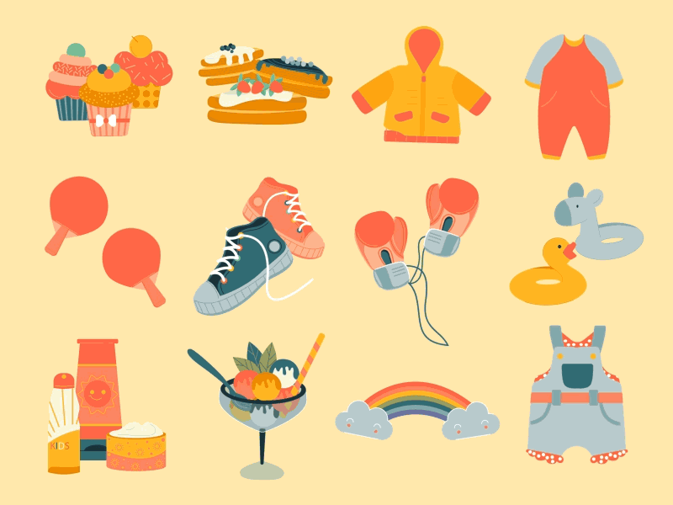



Unit 5
My clothes
Lesson 2 – Task 1,2,3

Slide 3


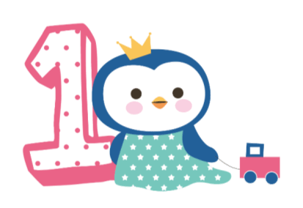



Warm up
Song: Hello song

Slide 4
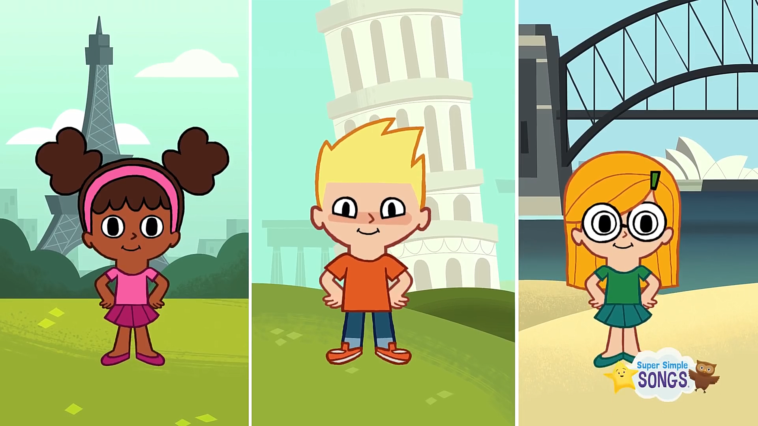

Slide 5
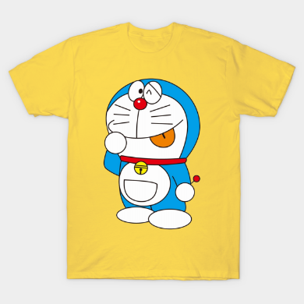
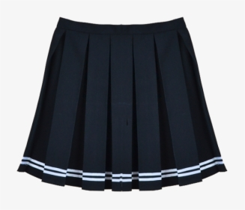
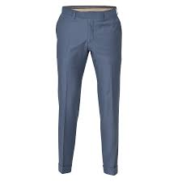
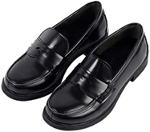
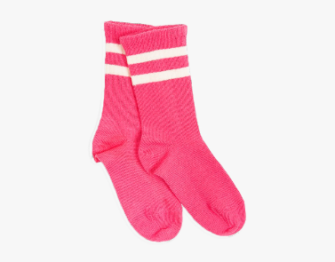
Game time!
1
2
T
s
-
k
3
s
i
s
h
r
h
i
T
r
o
u
5
s
e
r
s
4
e
o
t
s
c
k
s
Notes:
Click chuột lần đầu đáp án ra những từ cần thiết. Click lần 2 sẽ ra hình ảnh từ vựng

Slide 6


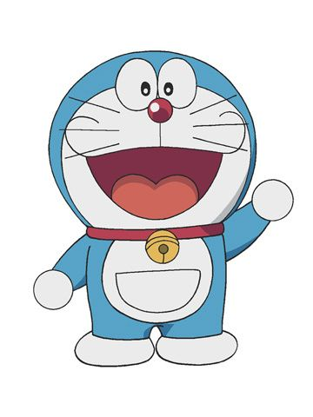
Hi! I’m Doraemon. I’m in Japan.
This is my magic bag.
What’s in my bag?
Notes:
THIẾT KẾ HOẠT ĐỘNG TƯƠNG TÁC CHO CÁC SLIDE TỪ 6 ĐẾN 10. MỖI CÂU KÈM THEO HÌNH ẢNH MINH HOẠ. HS TRẢ LỜI TỰ LUẬN

Slide 7

What’s in my bag?
boots
Notes:
Boots

Slide 8
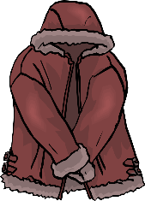
What’s in my bag?
coat
Notes:
Coat

Slide 9
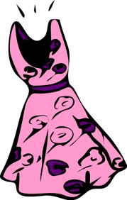
What’s in my bag?
dress
Notes:
Dress

Slide 10
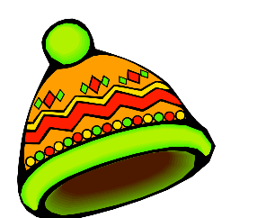
What’s in my bag?
hat

Slide 11
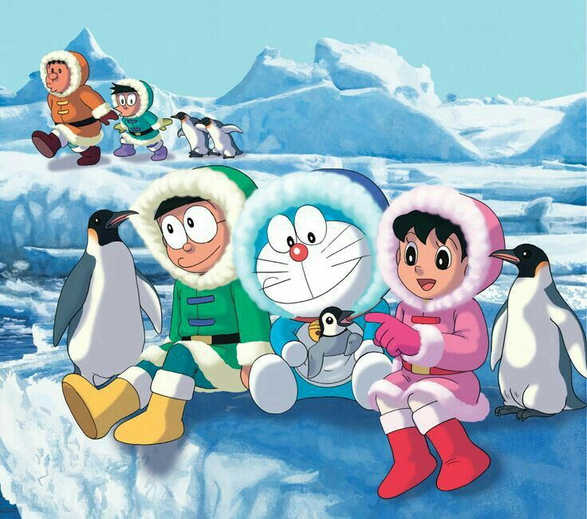

Slide 12

Presentation
Task 1 Listen and point. Repeat.

Slide 13

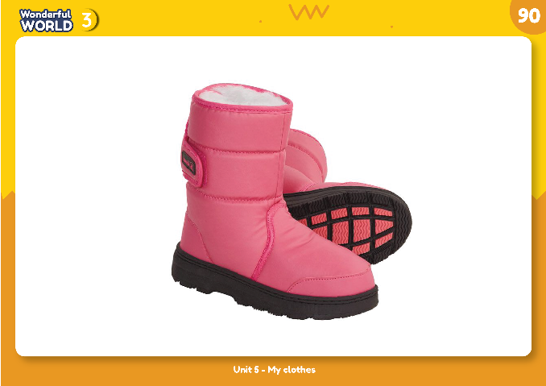
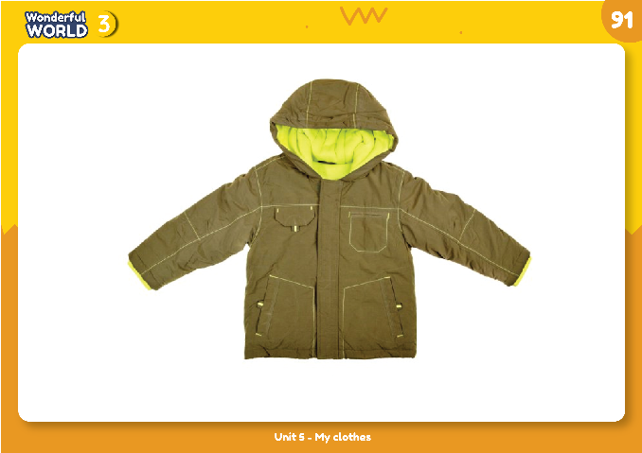
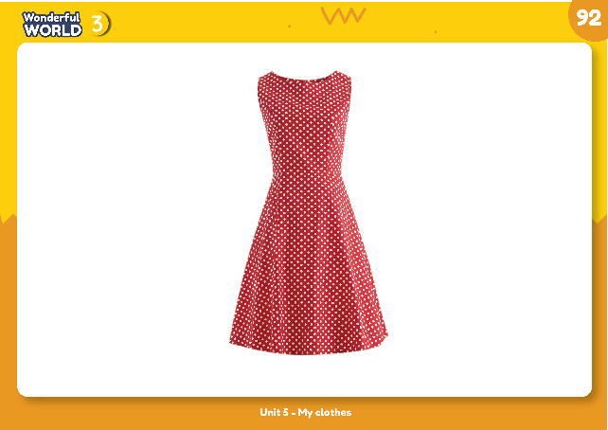
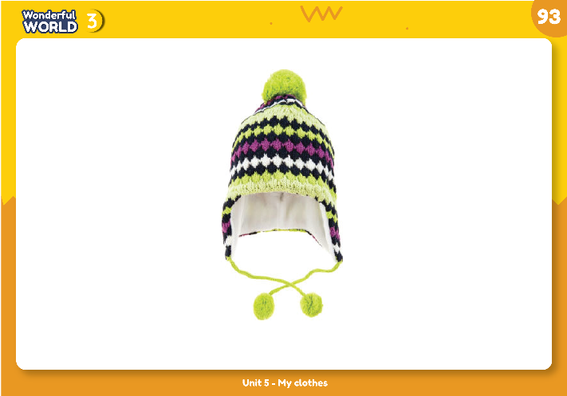
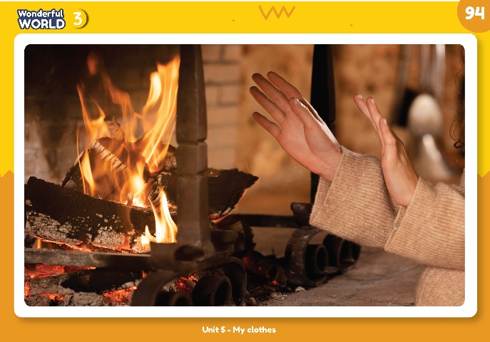
1. Listen and point. Repeat.

Slide 14
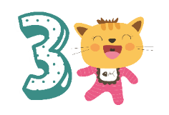
Practice
Task 2: Listen and match

Slide 15
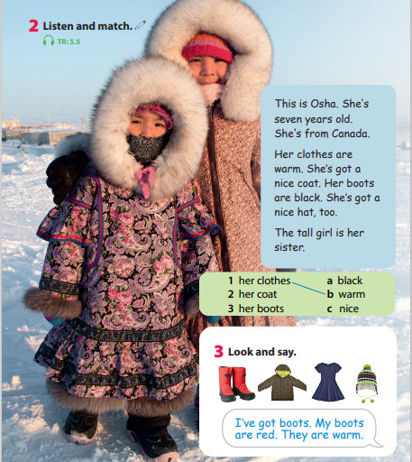

Slide 16










Game time:
Who’s faster?
1. I’ve got ________. My _________ are _______ . They are warm.
2. I’ve got ________. My _________ are _______ .
3. I’ve got ________. My _________ are _______ . They are warm.
4. I’ve got ________. My _________ are _______ .
5. I’ve got ________. My _________ are _______ . They are warm.

Slide 17













4 PRODUCTION
Draw your warm clothes.
I’ve got ___.
My ___ is/are ___.
It’s ____./ They are___.

Slide 18
worksheet

Slide 19



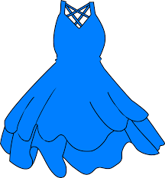
5 ASSESSMENT
1. I have got ______. They are red.
A. dress B. boots C. T-shirt
2. There isn’t a _______ in my uniform.
A. coat B. trousers C. hat
3. This is my favourite ______. It’s blue.
A. coat B. boots C. dress
*Write
4. Her coat is very w _ _ _
5. My mother has got long _ o _ts.
a
r
m
b
o

Slide 20




Good bye.
See you again!

