Slide 1





















Notes:
Để nguyên trang bìa như này, chỉ thay đổi tên bài trong quá trình làm. Logo của sách Wonderful World

Slide 2

Unit 6:
Outdoor Activities
Lesson 2: Task 7,8,9

Slide 3
1
Warm up
Outdoor activities
in real life

Slide 4
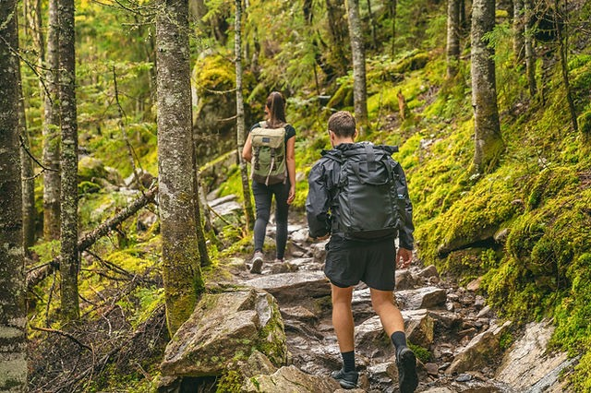
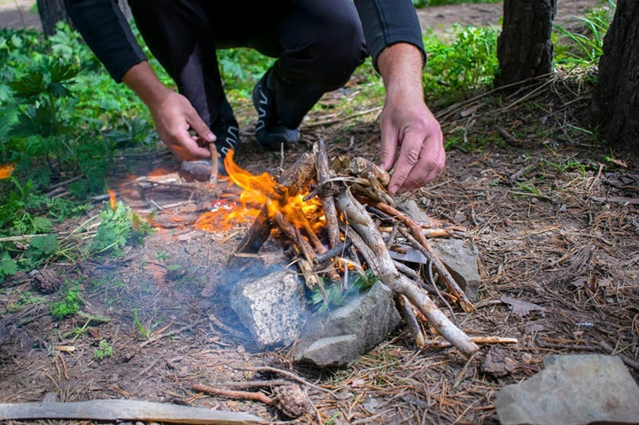
Let’s play
What can we do?
Go camping
Make a campfire
Notes:
Click colored square to show the photos. Click the photos to show the answers. Answer the questions with the answers in the pictures

Slide 5
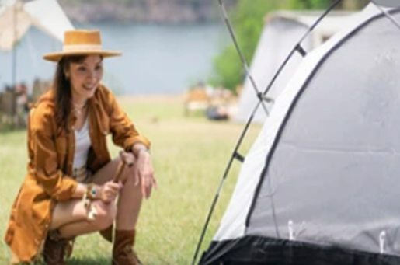
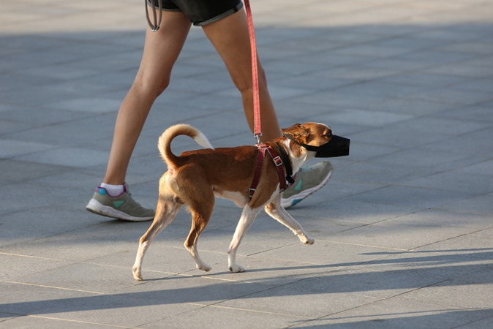
Let’s play
What can we do?
Pitch a tent
Walk the dog
Notes:
Click colored square to show the photos. Click the photos to show the answers.

Slide 6
02
Presentation
Task 7: Listen and match

Slide 7
Listen and match
1. We’re going camping today.
a. We can have fish for dinner.
2. We’re going fishing today.
b. We can have lots of fun.
3. We’re skiing today.
c. We can go to the mountain.
4. We’re walking the dog today.
d. We can make a campfire.
Notes:
Click the speaker to play track

Slide 8
Practice
03
Task 8: Look and say

Slide 9
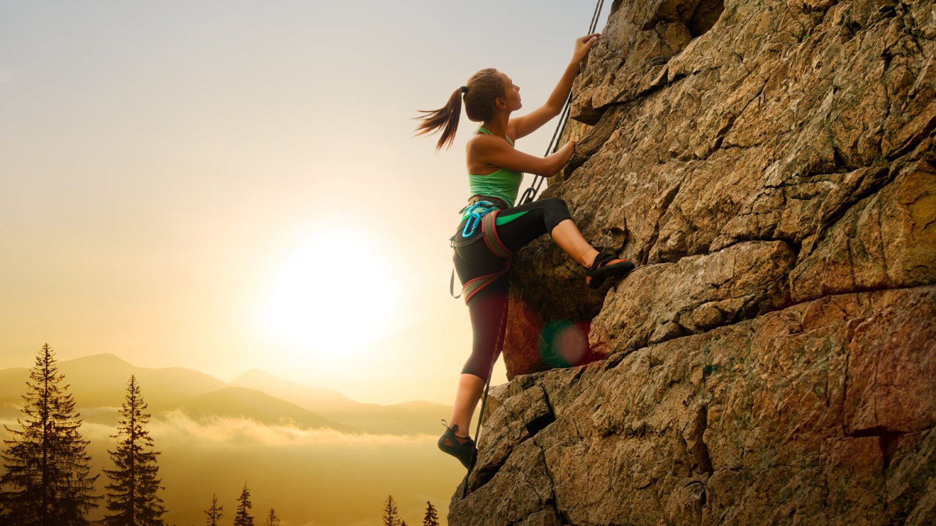
Look and say
1. Sunny/ go camping (✓)/ go skiing (x).
It’s sunny. We can go camping, but we can’t go swimming.

Slide 10
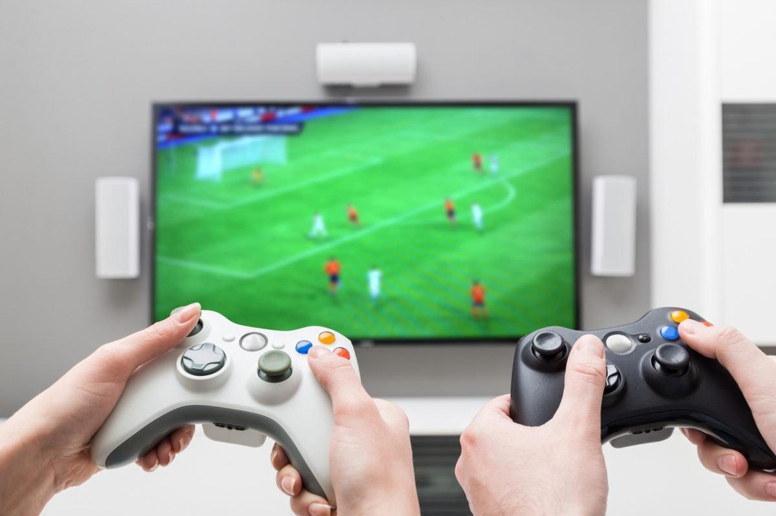
Look and say
2. Rainy/ play video games (✓)/ play football (x).
It’s rainy. We can play video games, but we can’t play football.

Slide 11
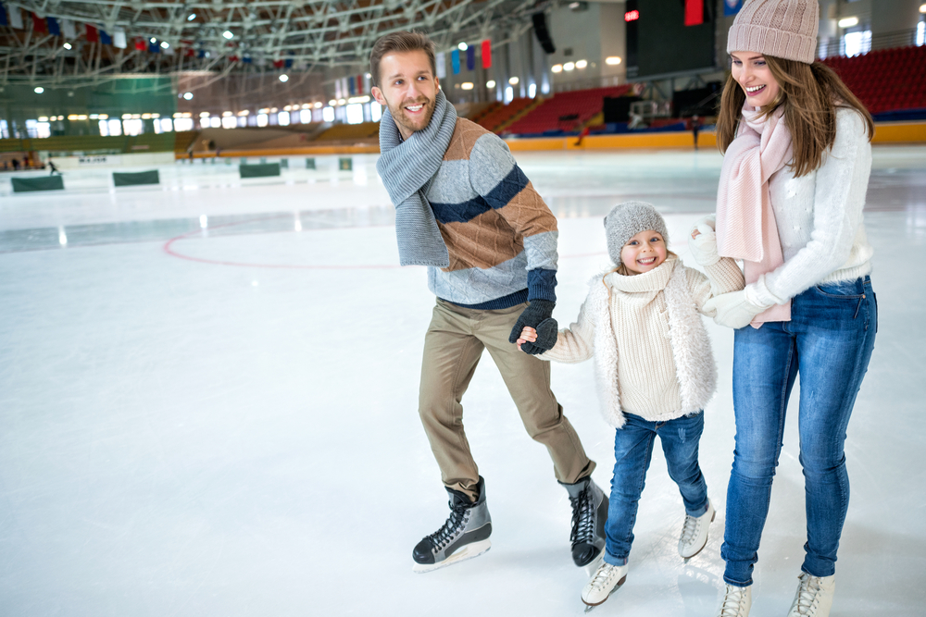
Look and say
3. Snowy/ ice-skate (✓)/ go fishing(x).
It’s snowy. We can ice-skate, but we can’t go fishing.

Slide 12
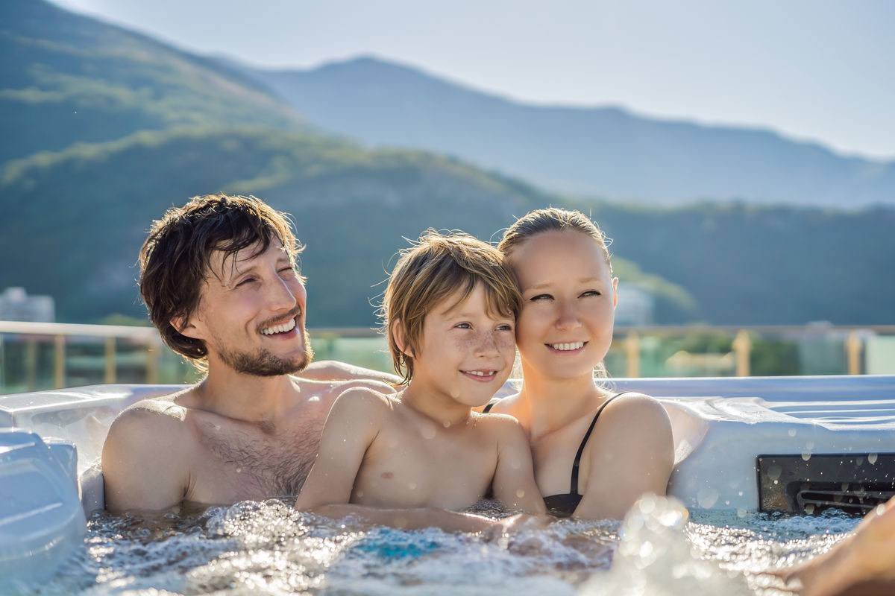
Look and say
4. Hot/ swim(✓)/ ski(x)
It’s hot. We can swim, but we can’t ski.

Slide 13
Let’s play
Finding honey

Slide 14










1
Finding honey
4
5
2
6
3
Notes:
Bổ sung âm thanh các co vật trogn slide này ;

Slide 15
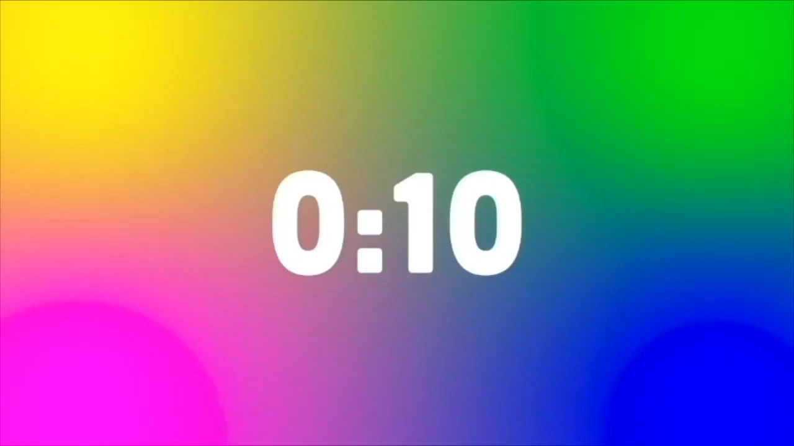
Back
What can we do _________ the mountain?
We can go _______ on the mountain.
on
climbing
Notes:
Bổ sung hiệu ứng reo hò trong các slide này – đồng hồ ko hoạt động.

Slide 16
Back
Can we ______________ in the park?
Yes, we can.
walk the dog

Slide 17
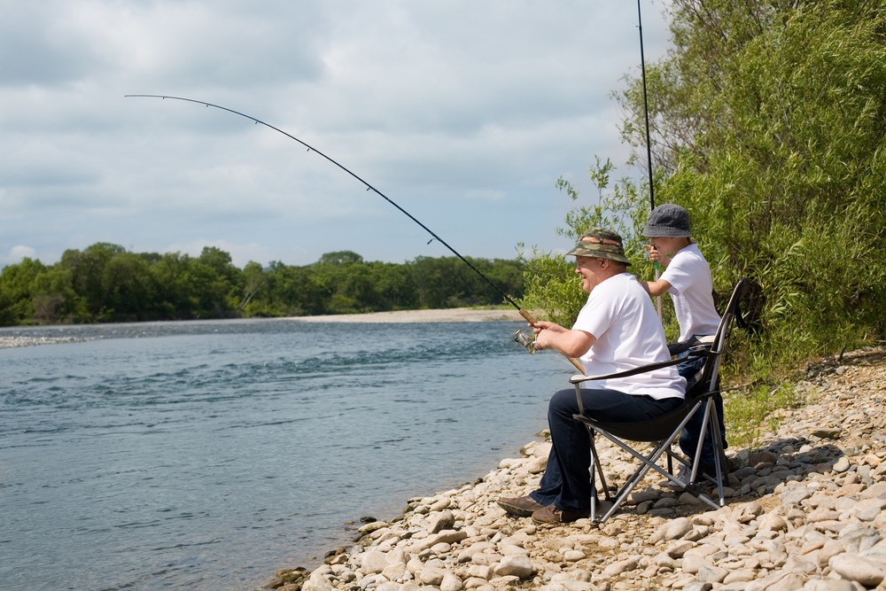
Back
What can we do by the river?
We can go ______, but we can’t _____ a campfire
fishing
make

Slide 18
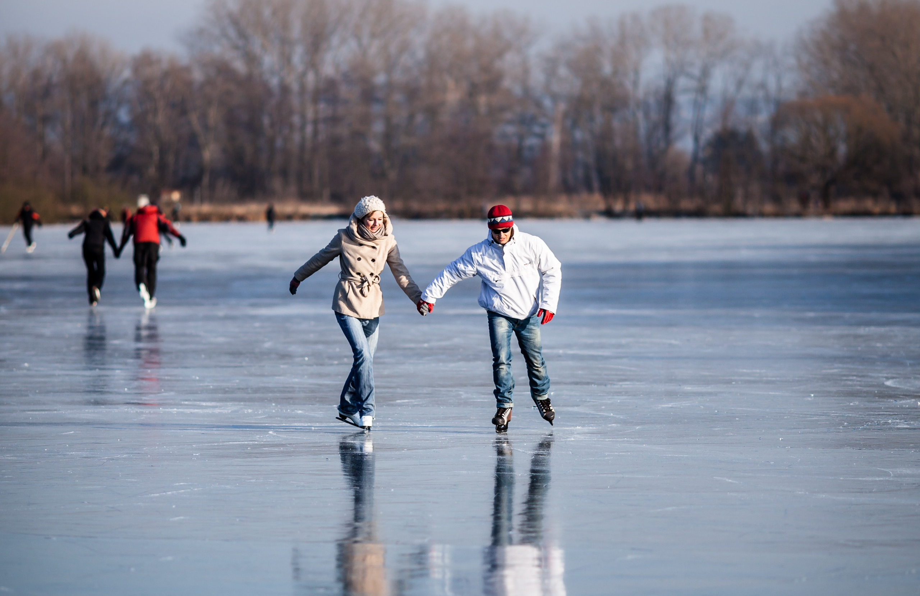
Back
Can we go swimming in winter?
No, we can’t. We can _______
ski

Slide 19
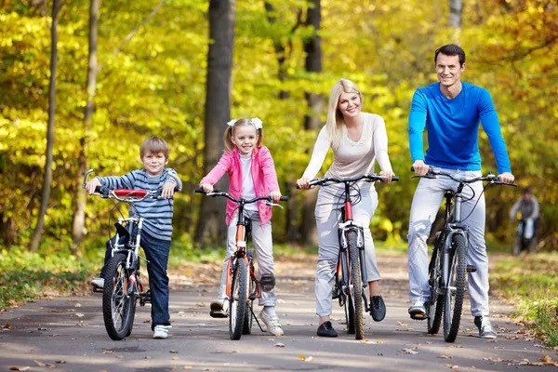
Back
What can we do _______ the park?
We can ride_________, but we can’t go climbing.
in
the bike

Slide 20
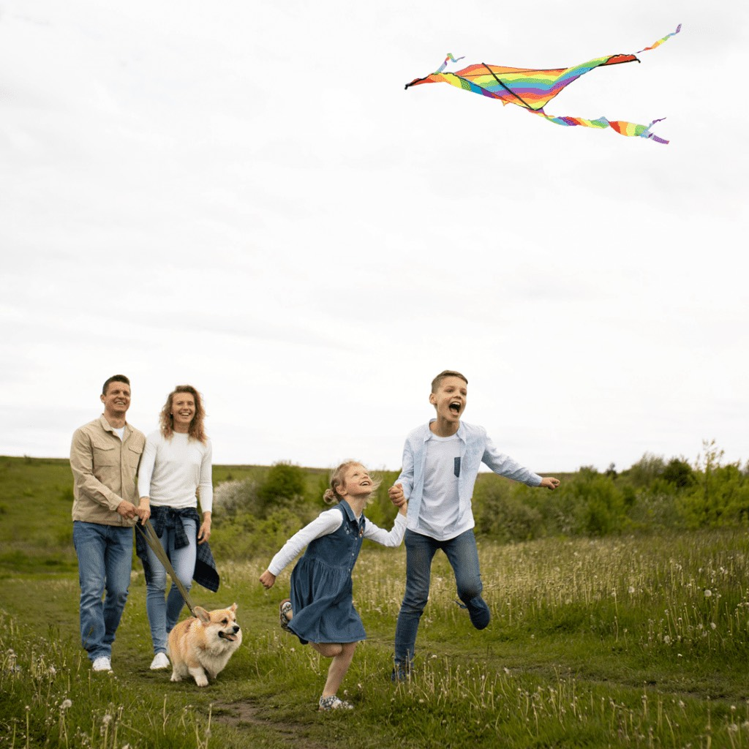
Back
What can we do _______ the field?
We can _________.
in
fly a kite
Notes:
Thiếu các hiệu ứng âm thanh trong các phần game này – cho font chữ to và đậm lên – HS từ xa có thể khó nhìn

Slide 21
Production
04
Task 9: Let’s talk

Slide 22
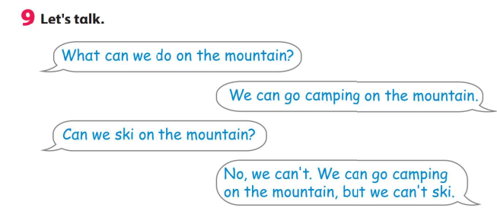

Slide 23
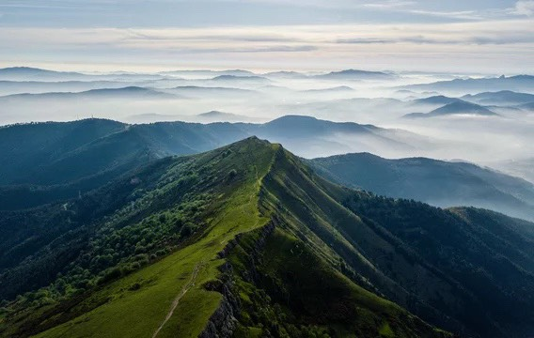
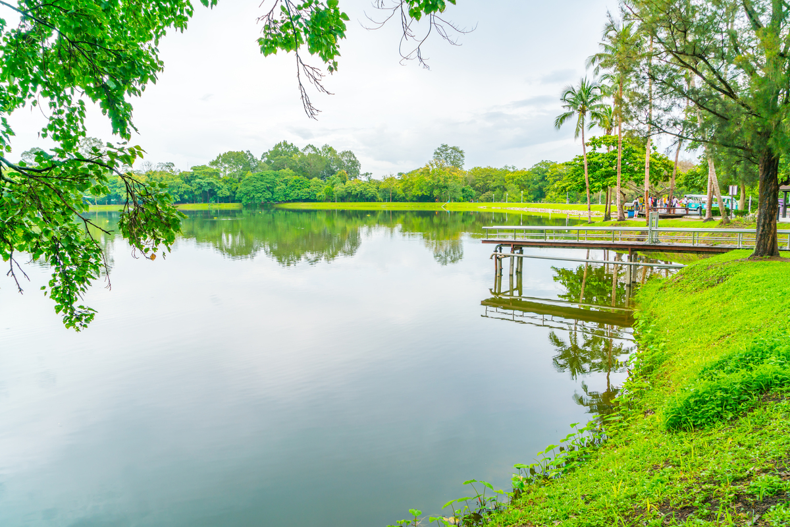
What can we do _________?
on the mountain
near the lake

Slide 24
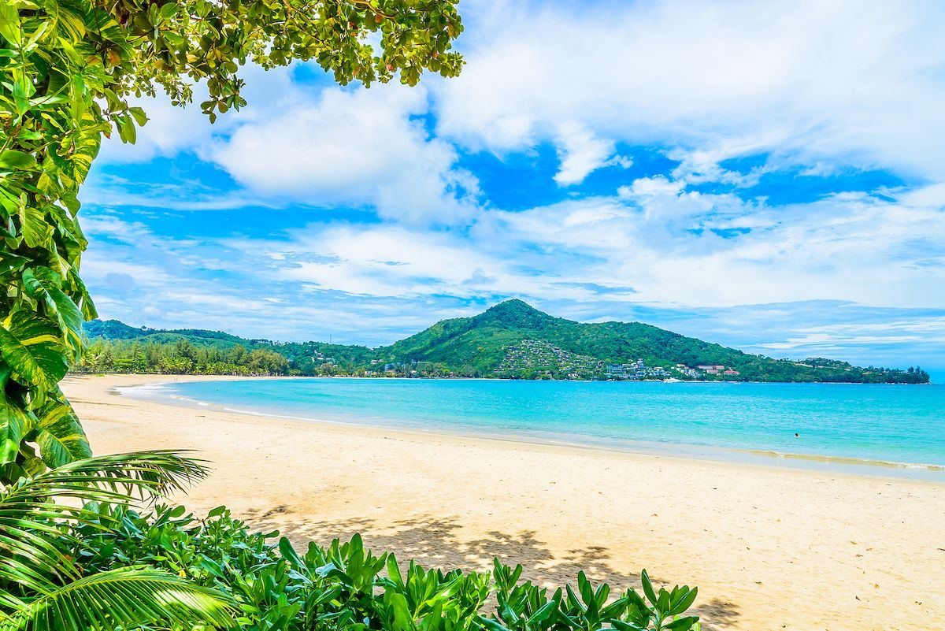
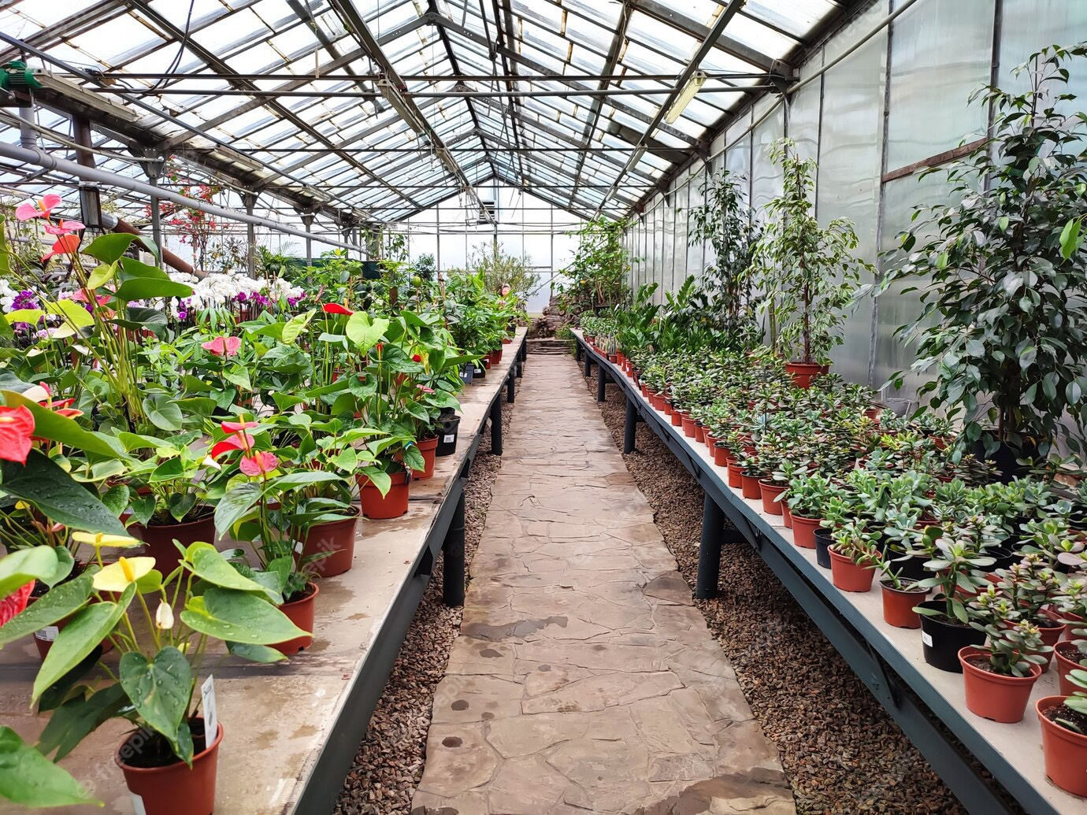
What can we do _________?
near the sea
in the garden

Slide 25
Wrap up
05

Slide 26
Rearrange the phrases
climbing/ in the garden,/ we/ grow/ can’t/ can/ plants/ but/ we/ go/.
We can grow plants in the garden, but we can’t go climbing.
Notes:
Click the question to show the answer.

Slide 27
Rearrange the phrases
What can we do on the mountain?
-________________________
( a campfire/ and/ make/ pitch/ a tent/ can/ we/.)
We can pitch a tent and make a campfire.
Notes:
Click the question to show the answer.

Slide 28
Wrap up
1. What can we do on the mountain?
- We can go camping.
2. We can walk the dog in the park, but we can’t make a campfire.
3. Can we swim in the pool?
Yes, we can.

Slide 29




Thank you & goodbye!

