Slide 1





















Notes:
Để nguyên trang bìa như này, chỉ thay đổi tên bài trong quá trình làm. Logo của sách Wonderful World

Slide 2





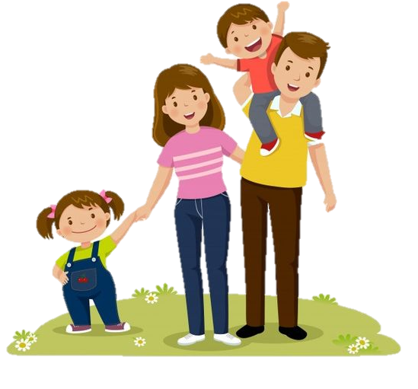
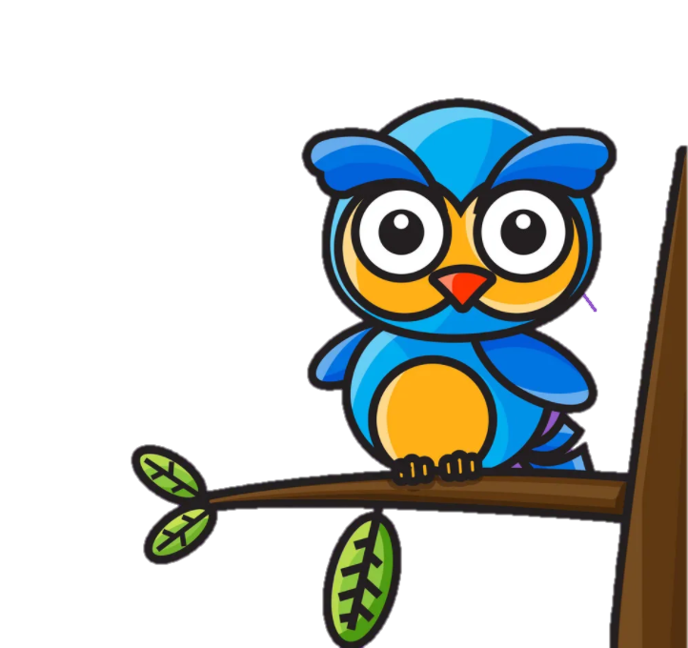


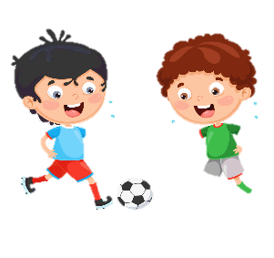


Unit 1:
MY FAMILY
AND FRIENDS
Lesson 3 – Task 1, 2, 3

Slide 3
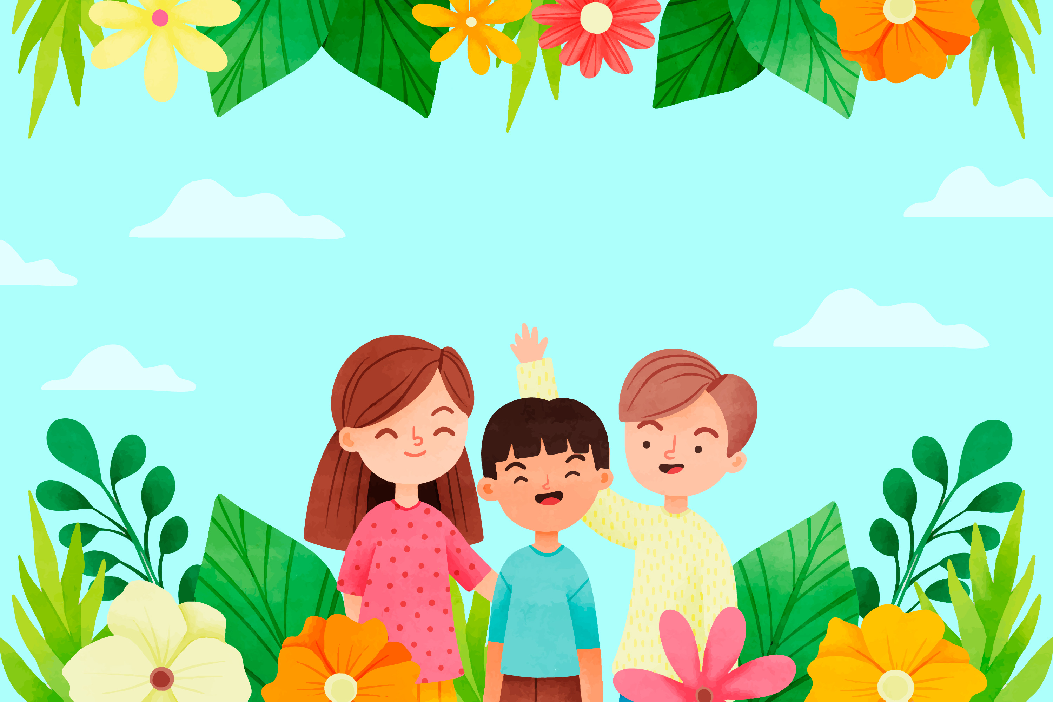
Warm Up
1
Let’s sing.

Slide 4


Slide 5
Presentation
1
Task 1: Listen and point. Repeat.

Slide 6
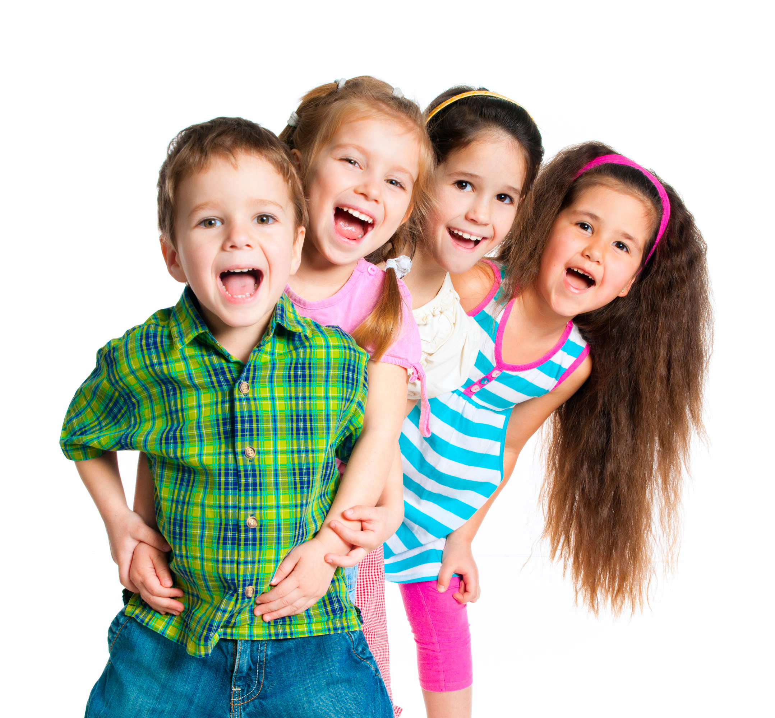
cheerful

Slide 7
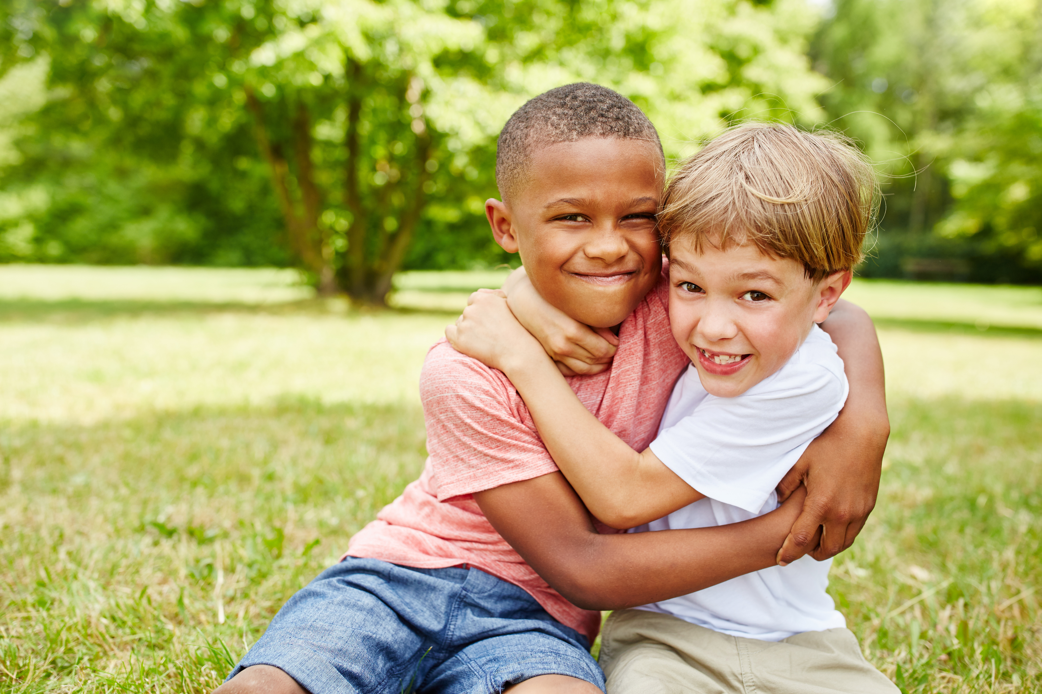
friendly

Slide 8
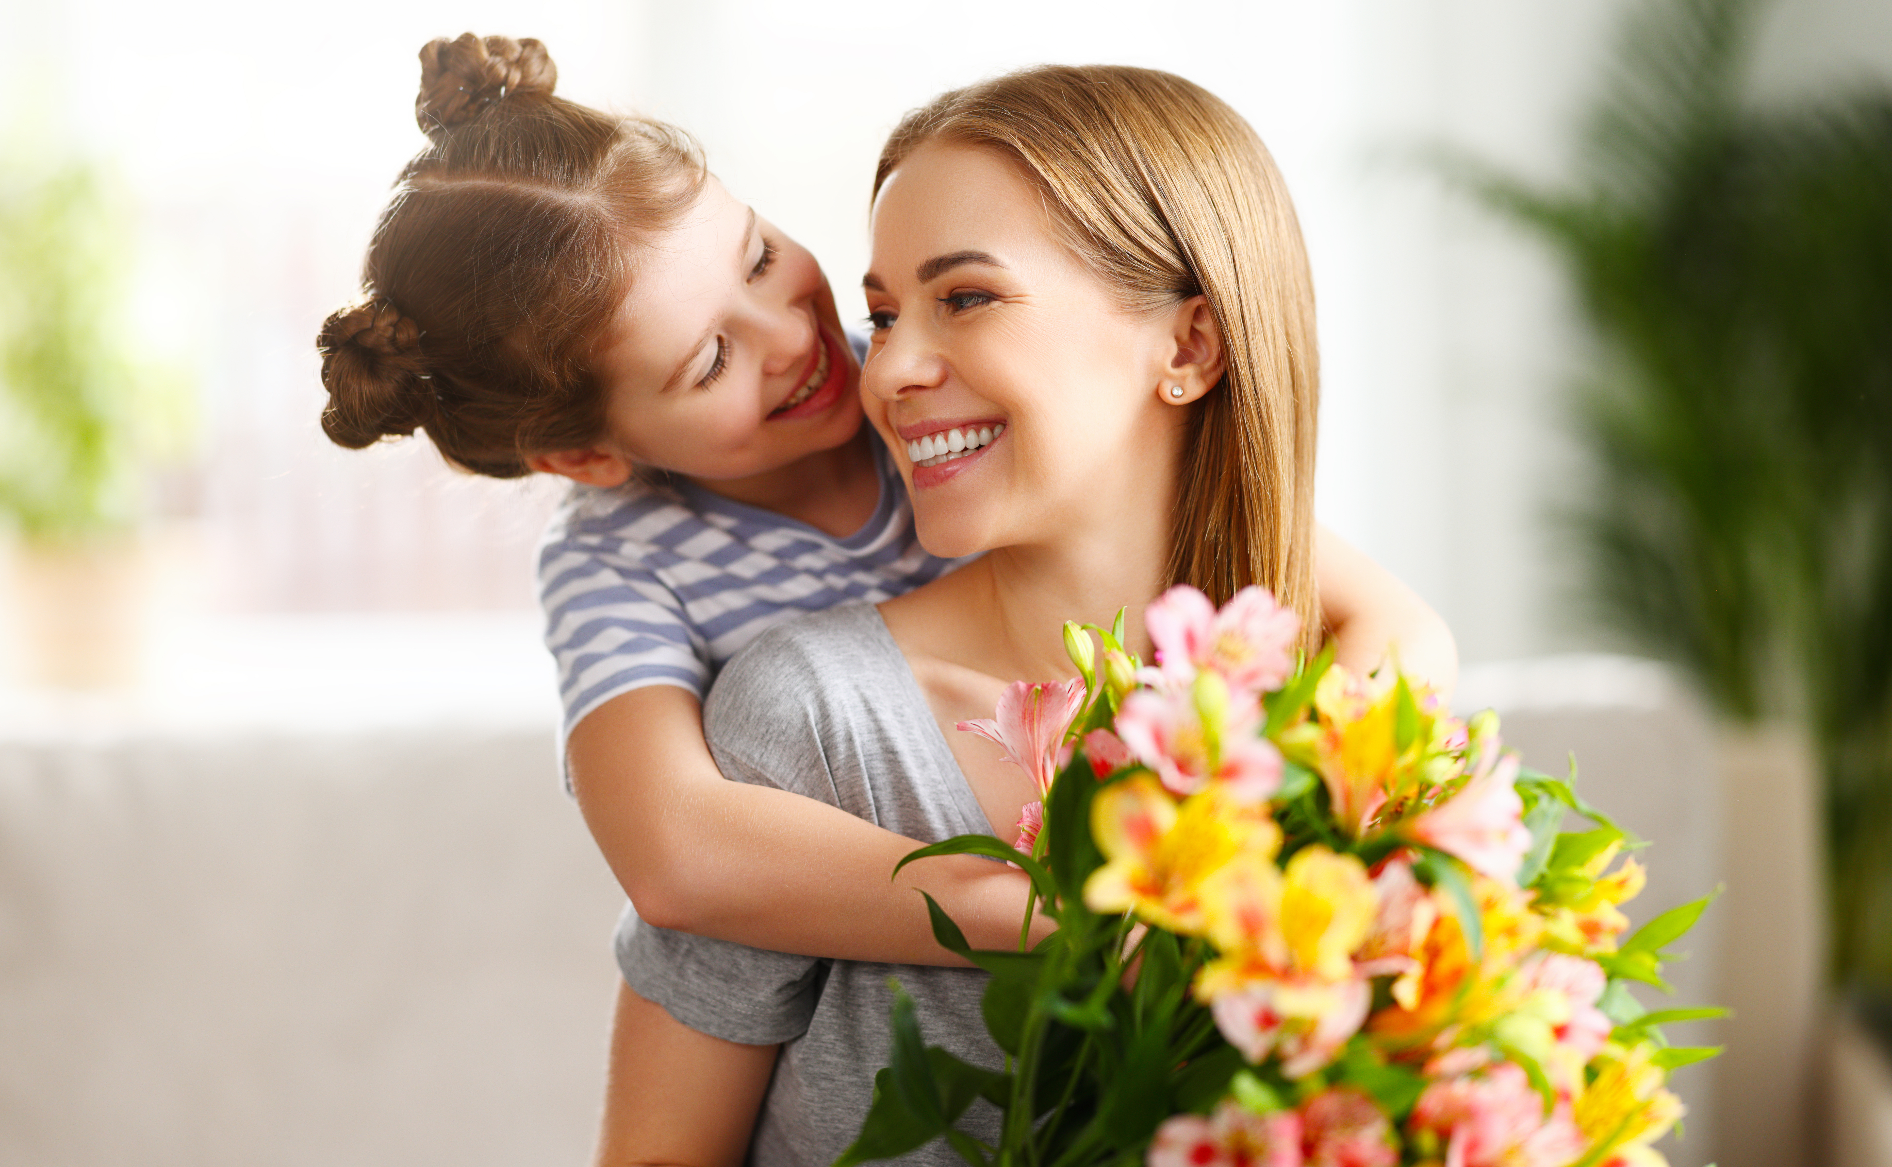
pleasant

Slide 9
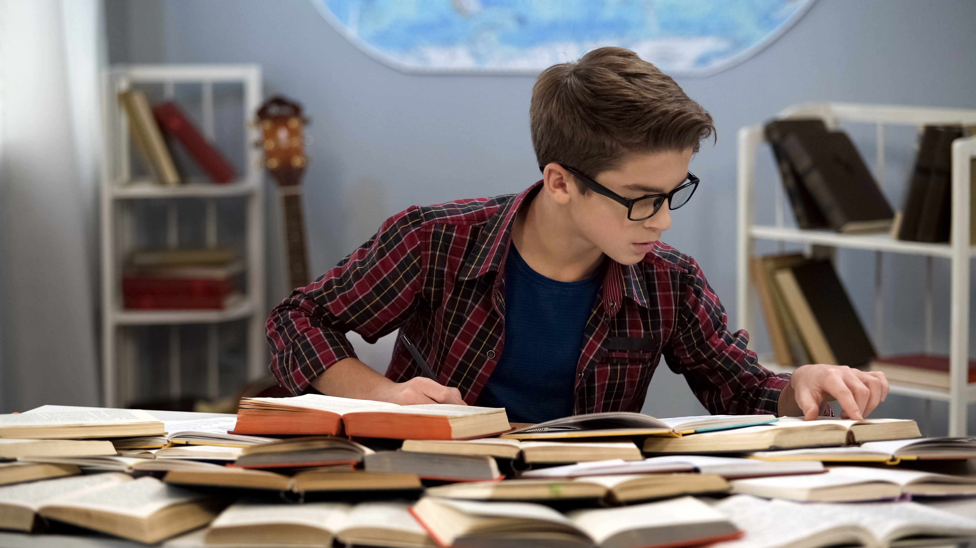
hard-working
Notes:
Remember to tell students that “ Dad” and “father” is the same meaning.

Slide 10



Listen and point. Repeat
cheerful
friendly
hard-working
pleasant

Slide 11
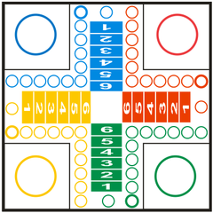
Game :Horserace
Look and answer
PLAY

Slide 12
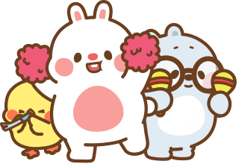

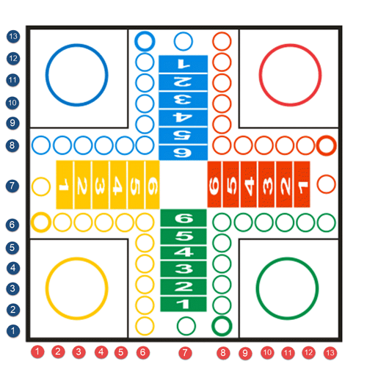




1
1
2
2
3
4
1
2
2
1
5
6
2
7
8
1
Next
Notes:
Nên có hướng dẫn cho giáo viên

Slide 13
Next
a
clever
b
hard-working
c
pleasant

Slide 14

Next
a
friendly
b
cheerful
c
polite

Slide 15
Next
a
pretty
b
pleasant
c
friendly

Slide 16
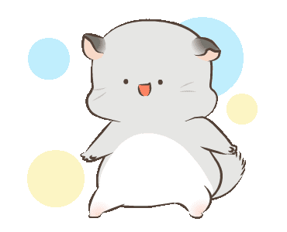
Next
a
hard-working
b
kind
c
cheerful

Slide 17
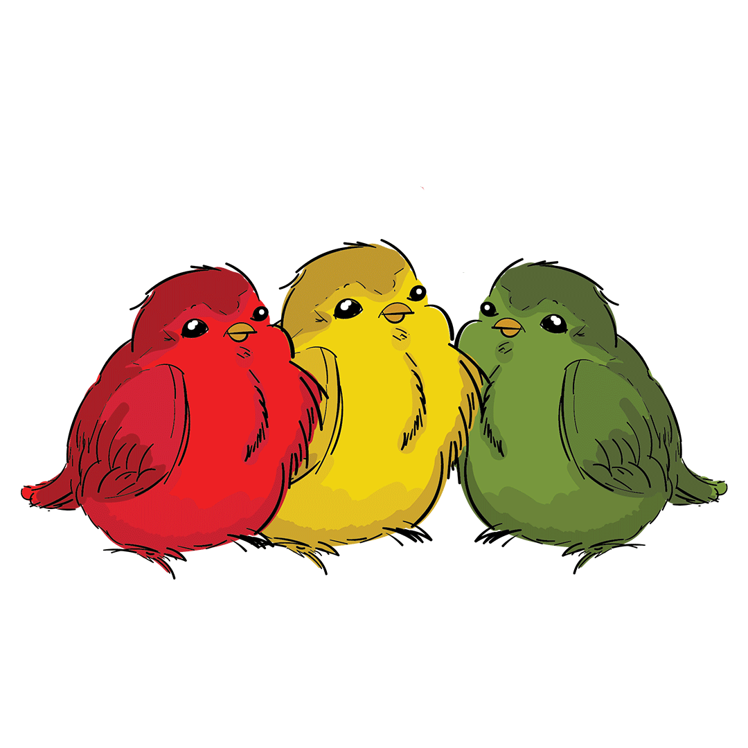
Next
cheerful
a
b
c
Notes:
Click vào ảnh để chọn

Slide 18
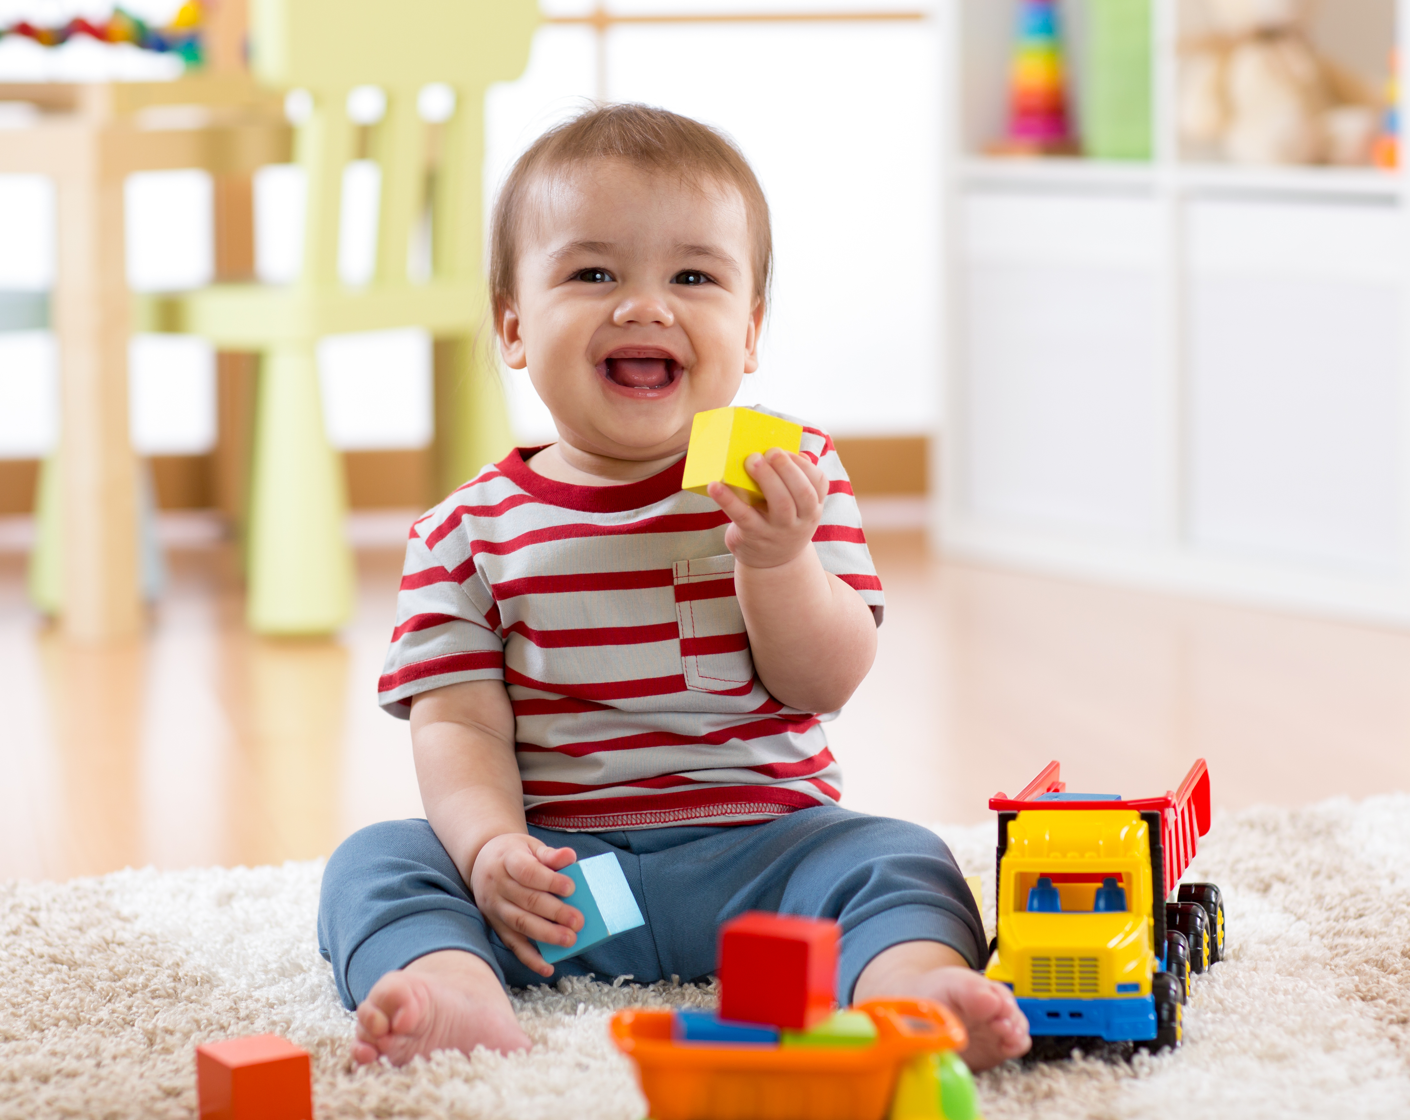
Next
hard-working
a
b
c
Notes:
Click vào ảnh để chọn

Slide 19

Next
pretty and pleasant
a
b
c
Notes:
Click vào ảnh để chọn

Slide 20
Next
friendly
a
b
c
Notes:
Click vào ảnh để chọn

Slide 21
Practice
3
Task 2: Listen and match.

Slide 22
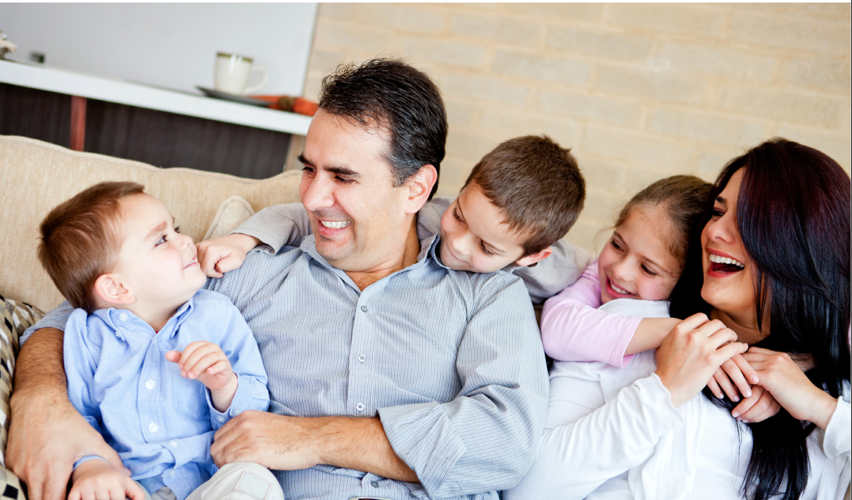
Listen and match.
1. My twin brother is_____. a. cheerful and funny
2. My sister is ______. b. pleasant and kind
3. My father and mother are ___. c. friendly and hard-working
a
c
b

Slide 23

Production
4
Task 3: Let’s play.

Slide 24

Let’s play.
My father is kind and cool.
Slap the board
cheerful
cute
young
friendly
kind
cool
hard-working
polite
clever
pleasant
tall
pretty
funny
old
short
Notes:
Nên có hướng dẫn cho giáo viên

Slide 25
Look and match.
1
2
3
4
friendly
hard-working
cheerful
pleasant

Slide 26
UNIT 1: Family and Friends
LESSON 3 – PERIOD 1
What we learnt today
Vocabulary:
cheerful
friendly
hard-working
pleasant
Structure:
My fαther is kind αnd cool.

Slide 27


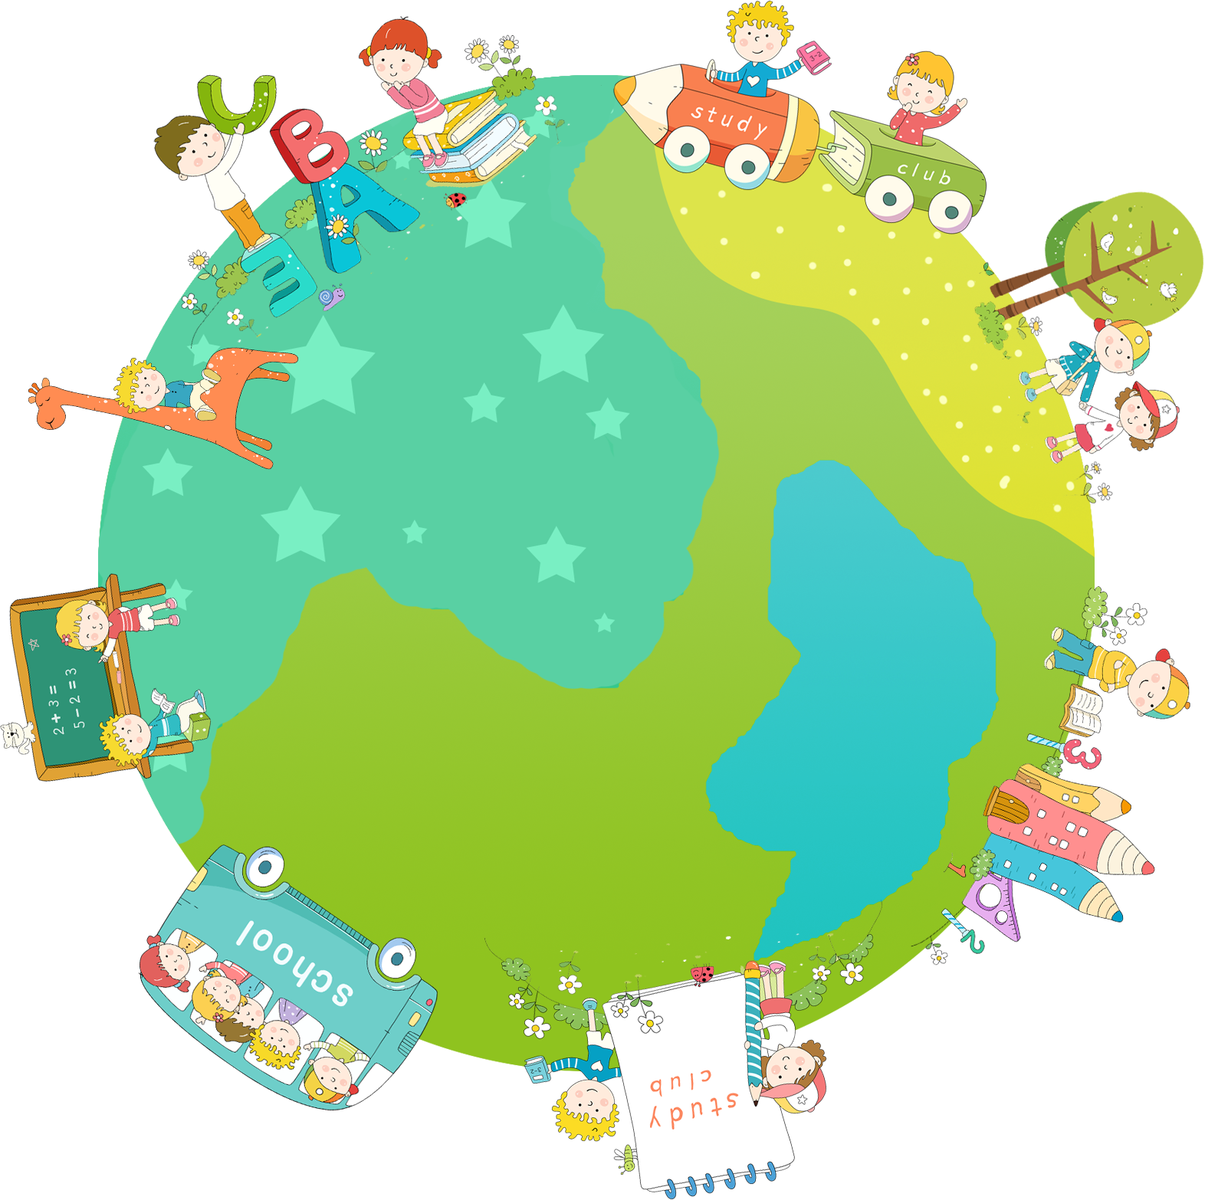

Thank you & goodbye!

