Slide 1









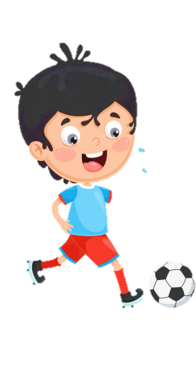
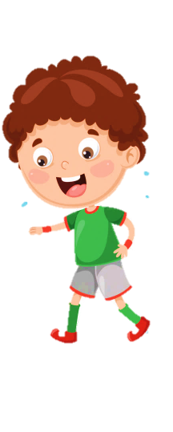












Slide 2
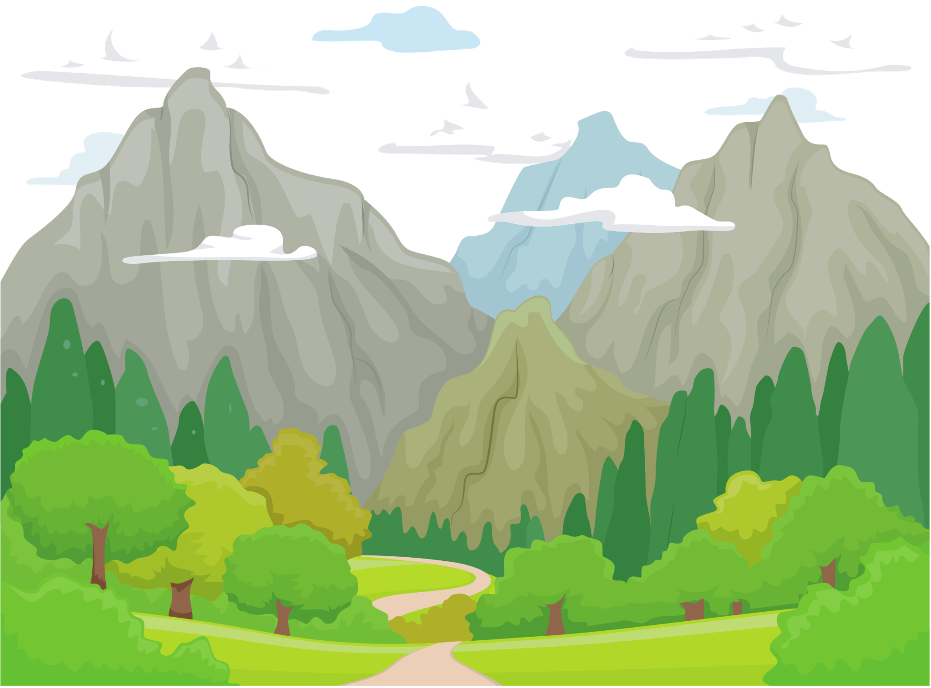



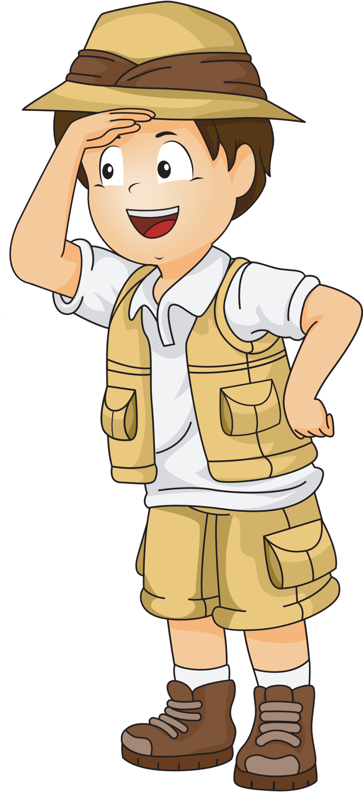
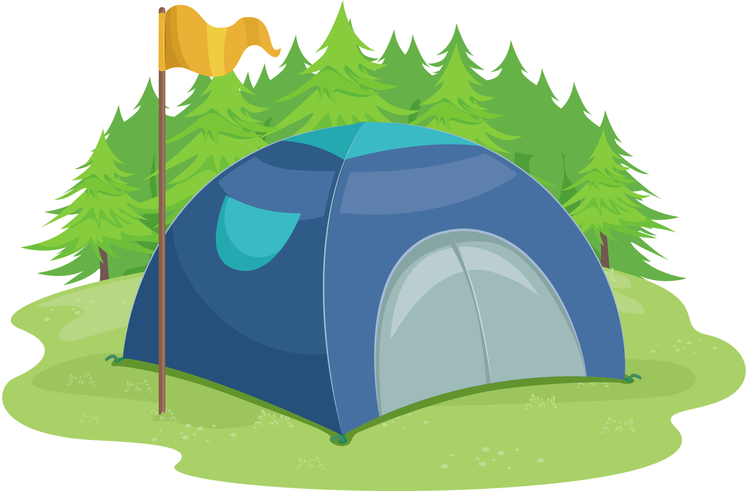








UNIT 6
OUTDOOR
ACTIVITIES
Task 4 5 6

Slide 3


WARM UP
1

Slide 4







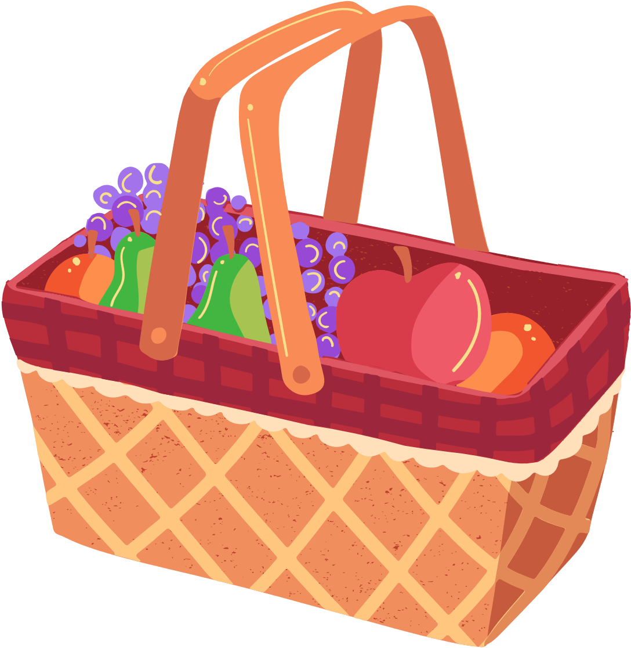
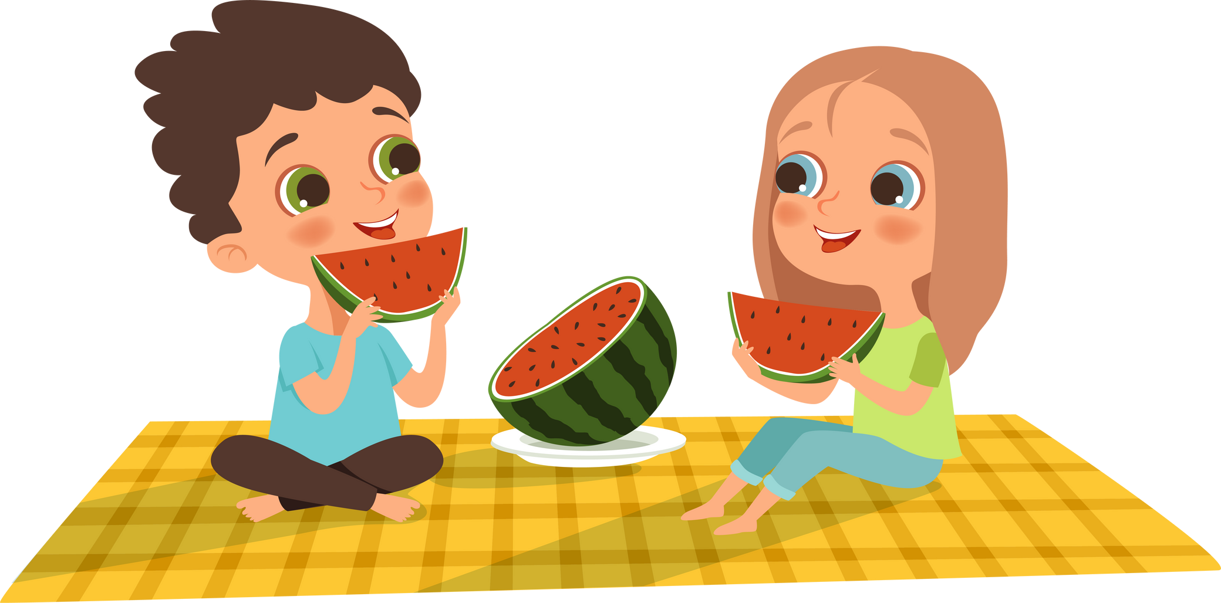


Listen and tick
We ................. have a picnic in the park today because it's.................. .
can
rainy
can't
warm

Slide 5


Listen and tick
We ................. go hiking on the mountain today because it's.................... .
can
snowy
can't
warm

Slide 6




Slide 7








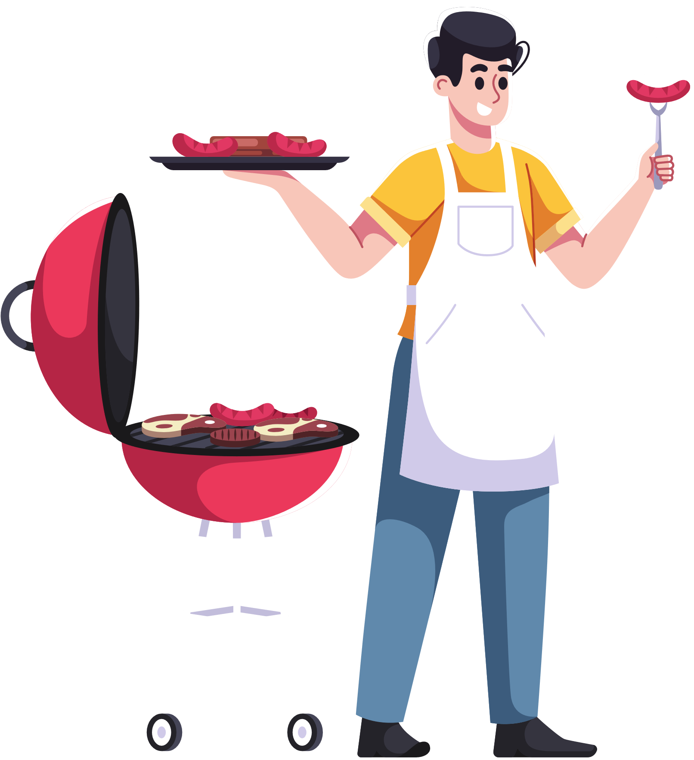
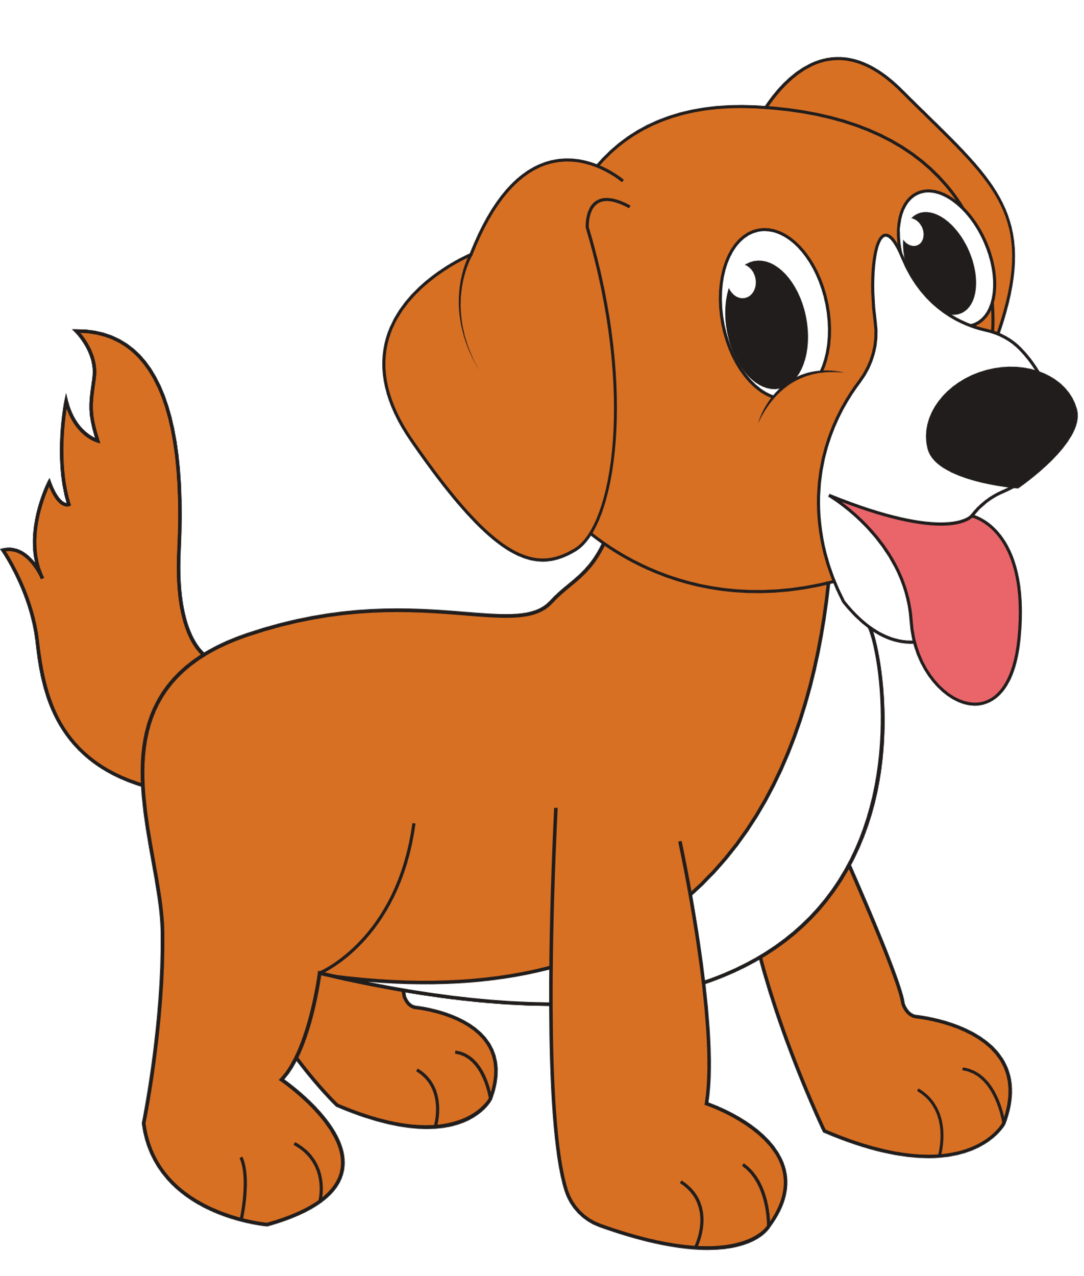




PRACTICE
2

Slide 8



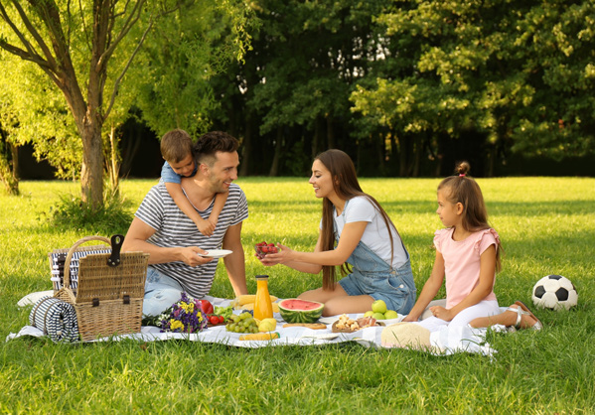
4 Listen and repeat
We can have a picnic in the park today because it’s warm.

Slide 9
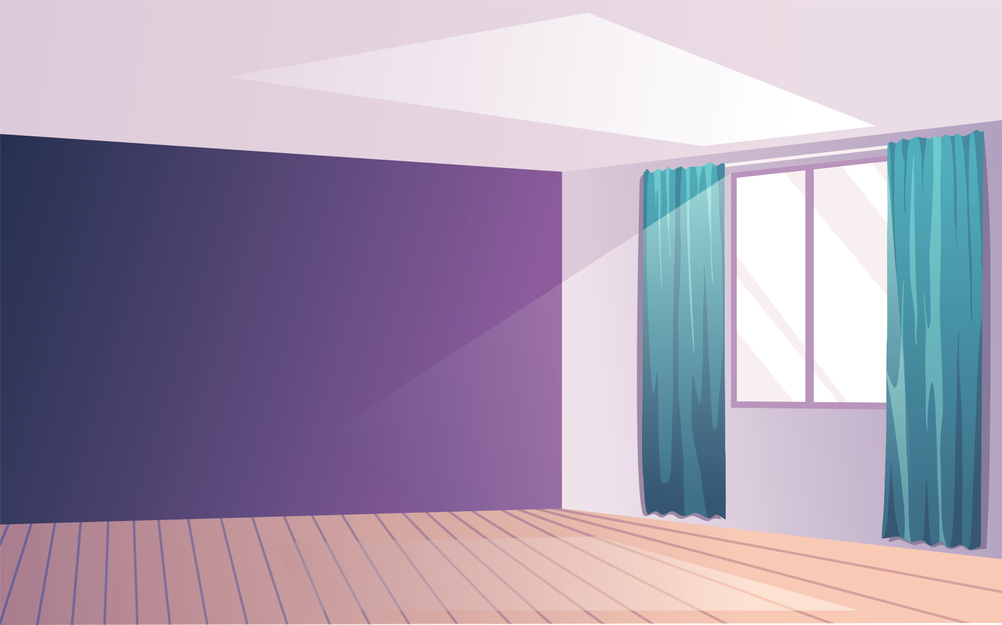
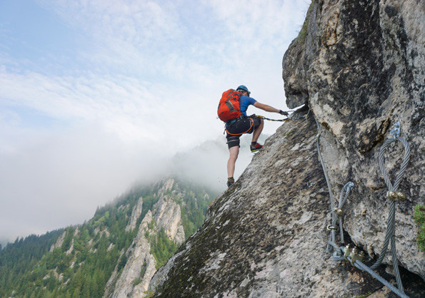



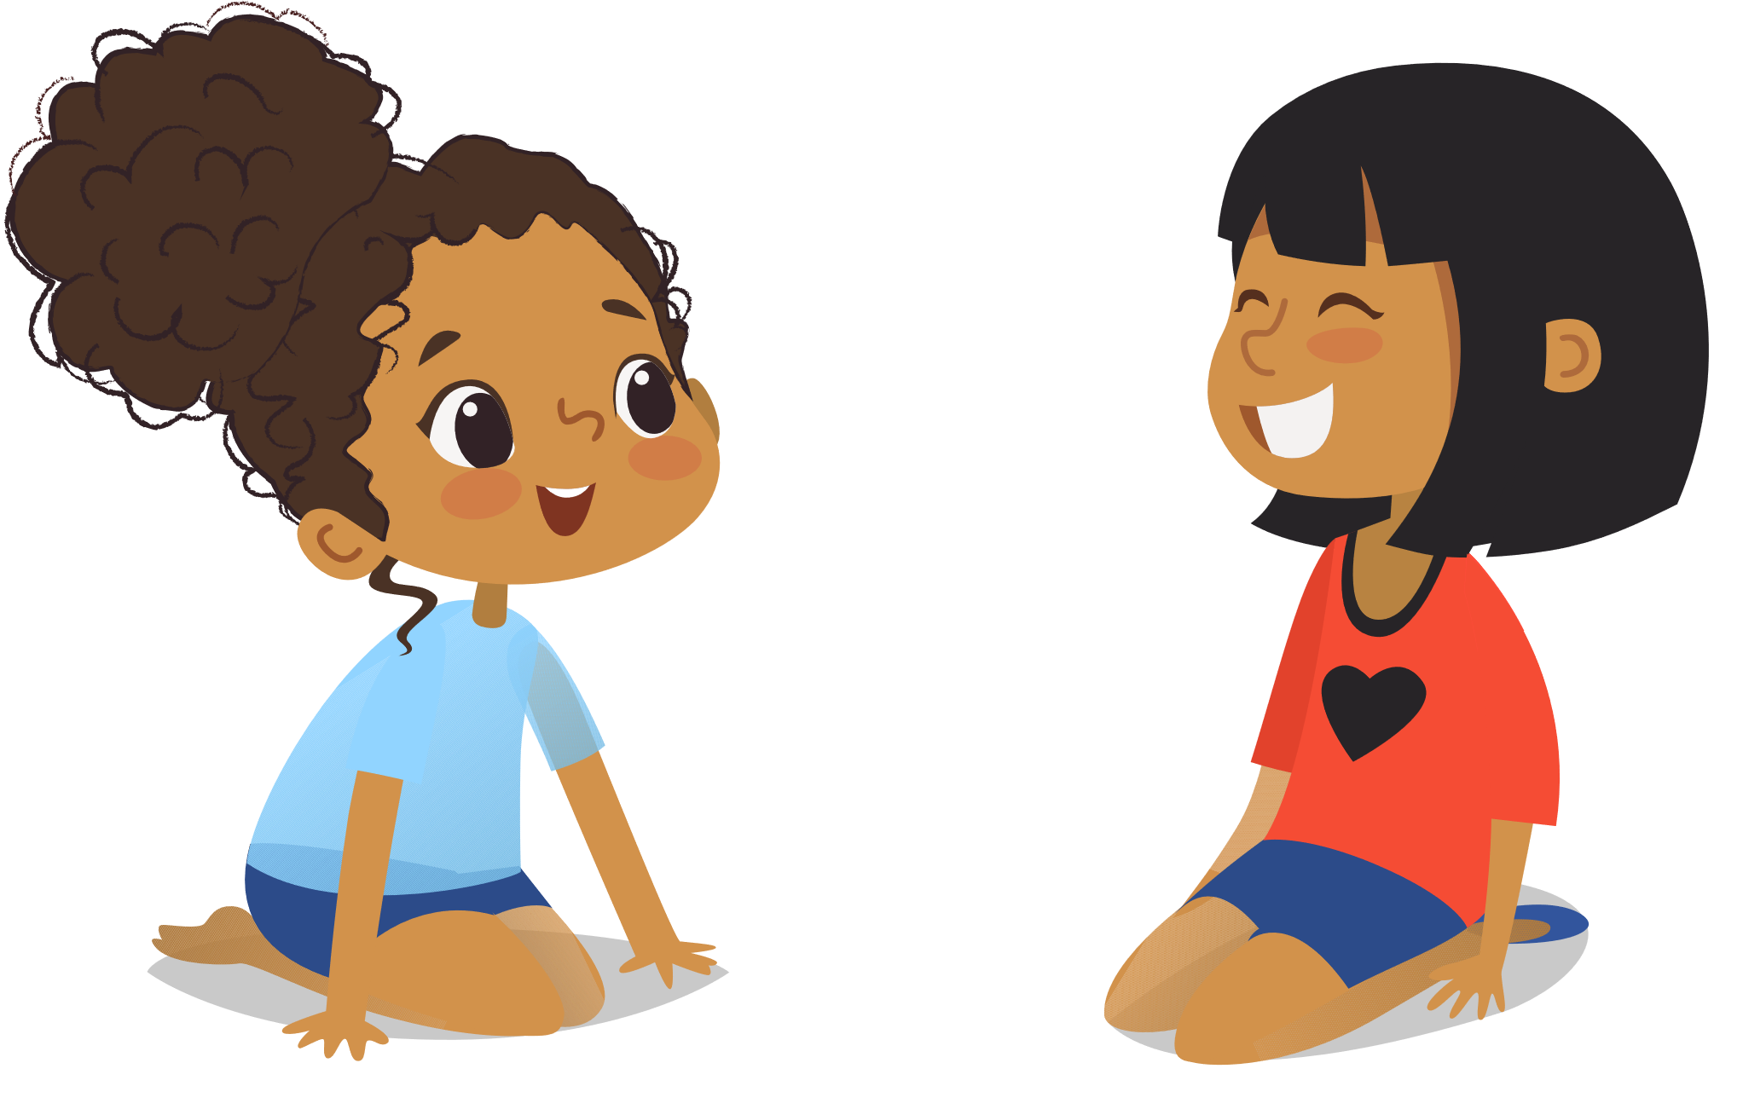





4 Listen and repeat.
We can’t go hiking on the mountain today because it’s snowy.

Slide 10

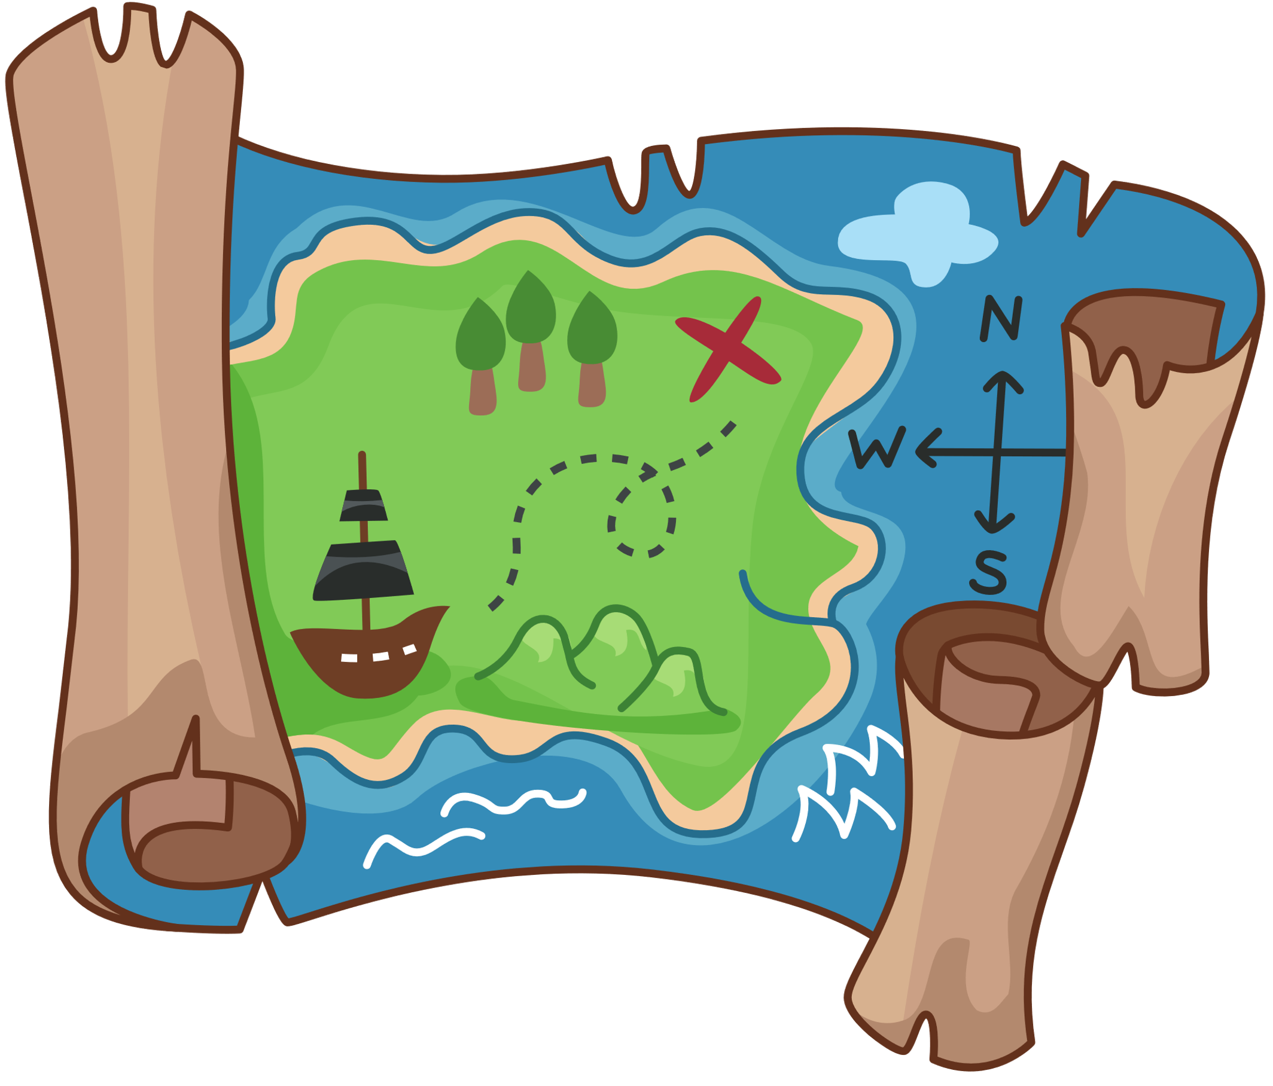



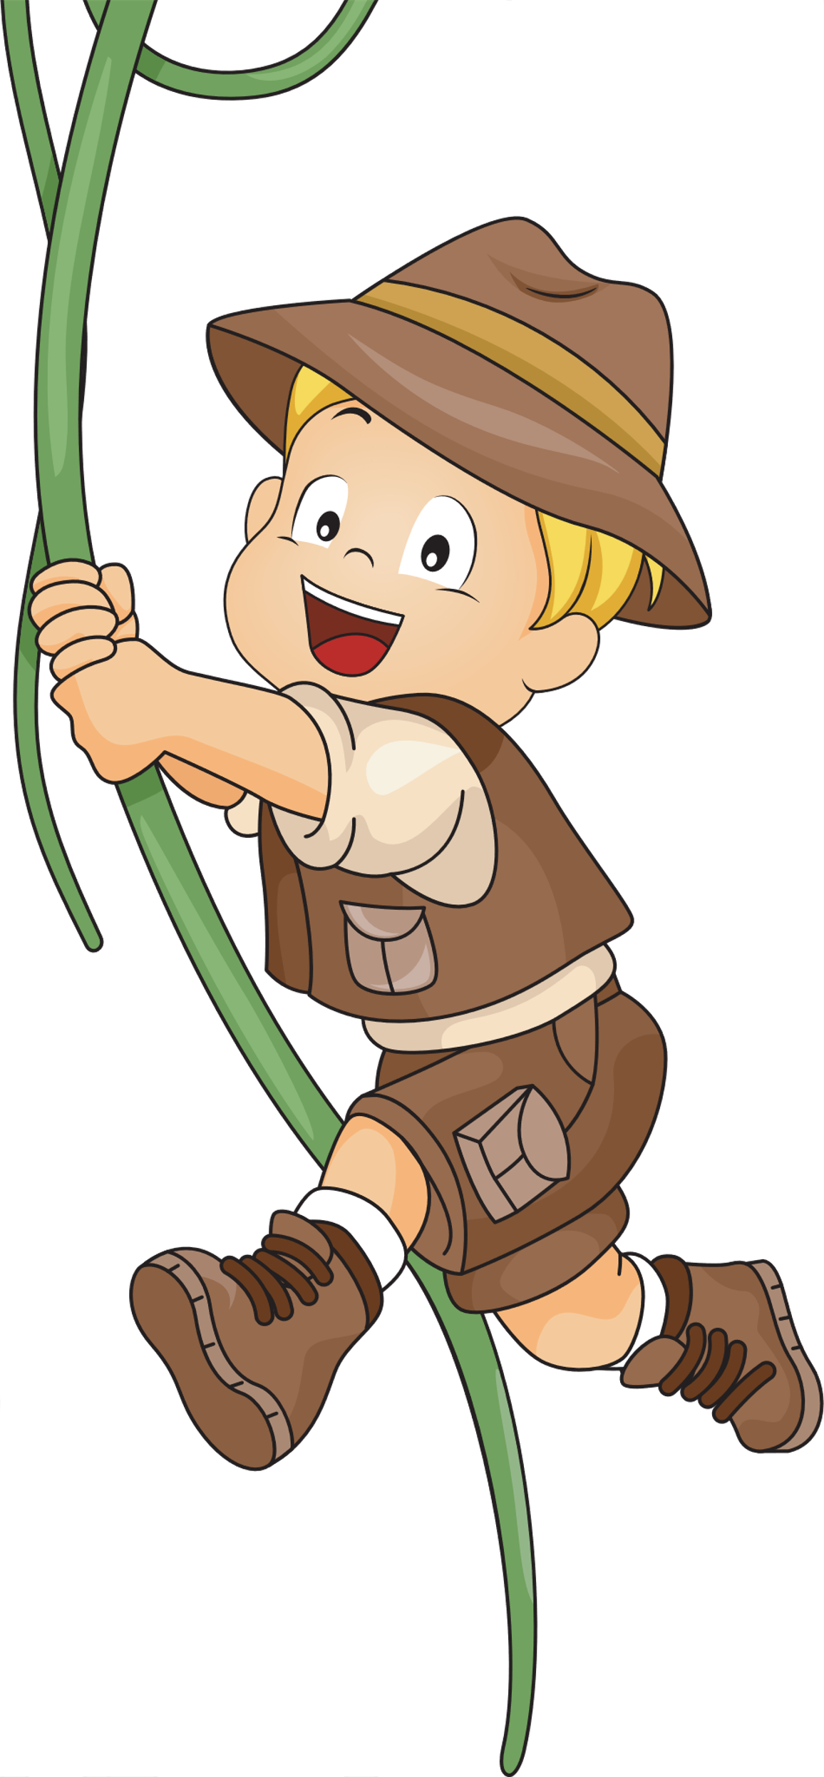


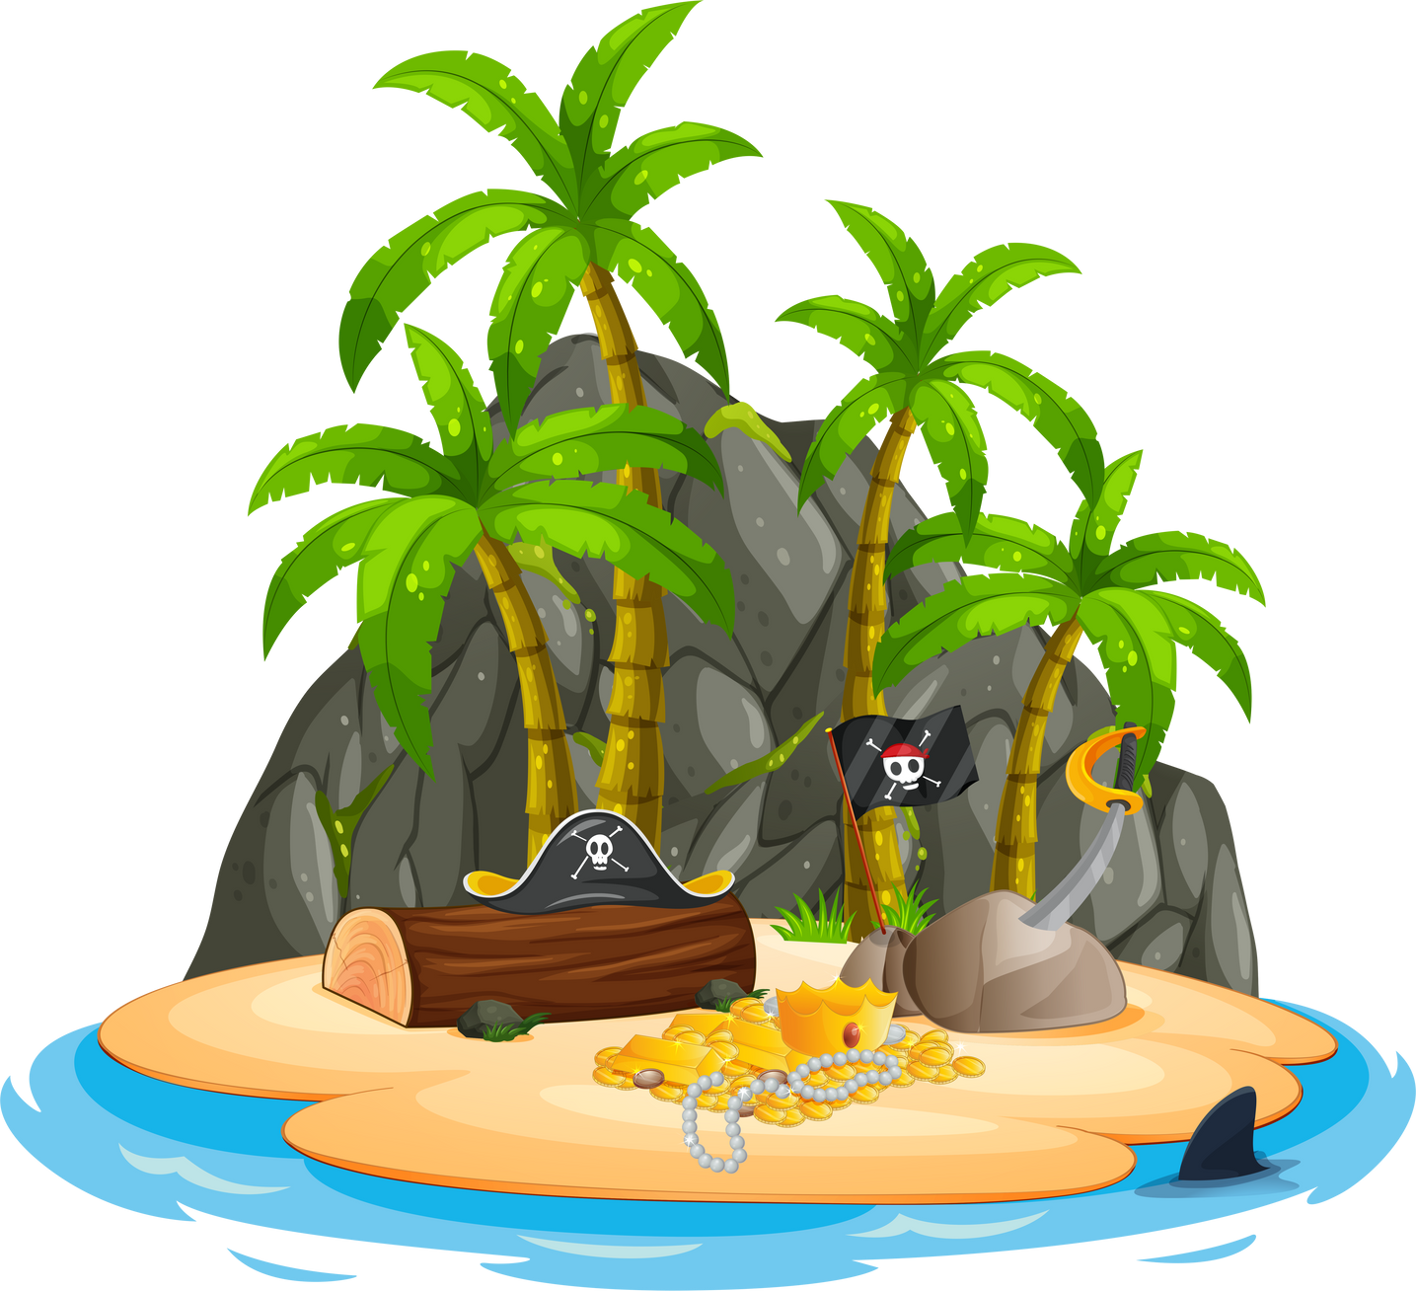






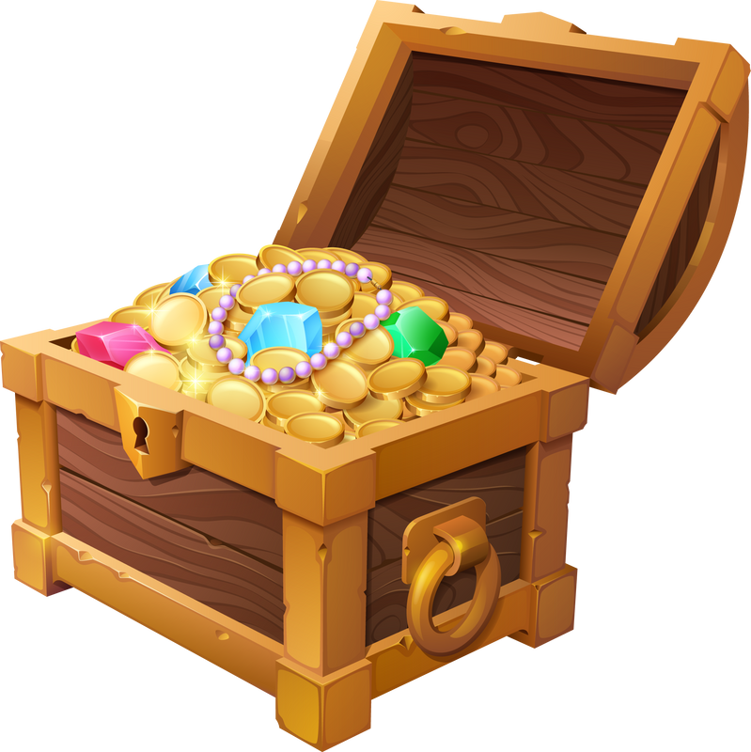



5 Look and say.
TREASURE
HUNT

Slide 11





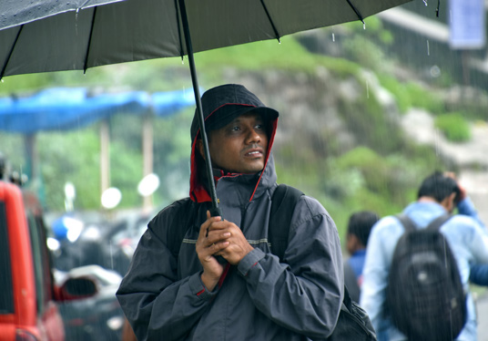



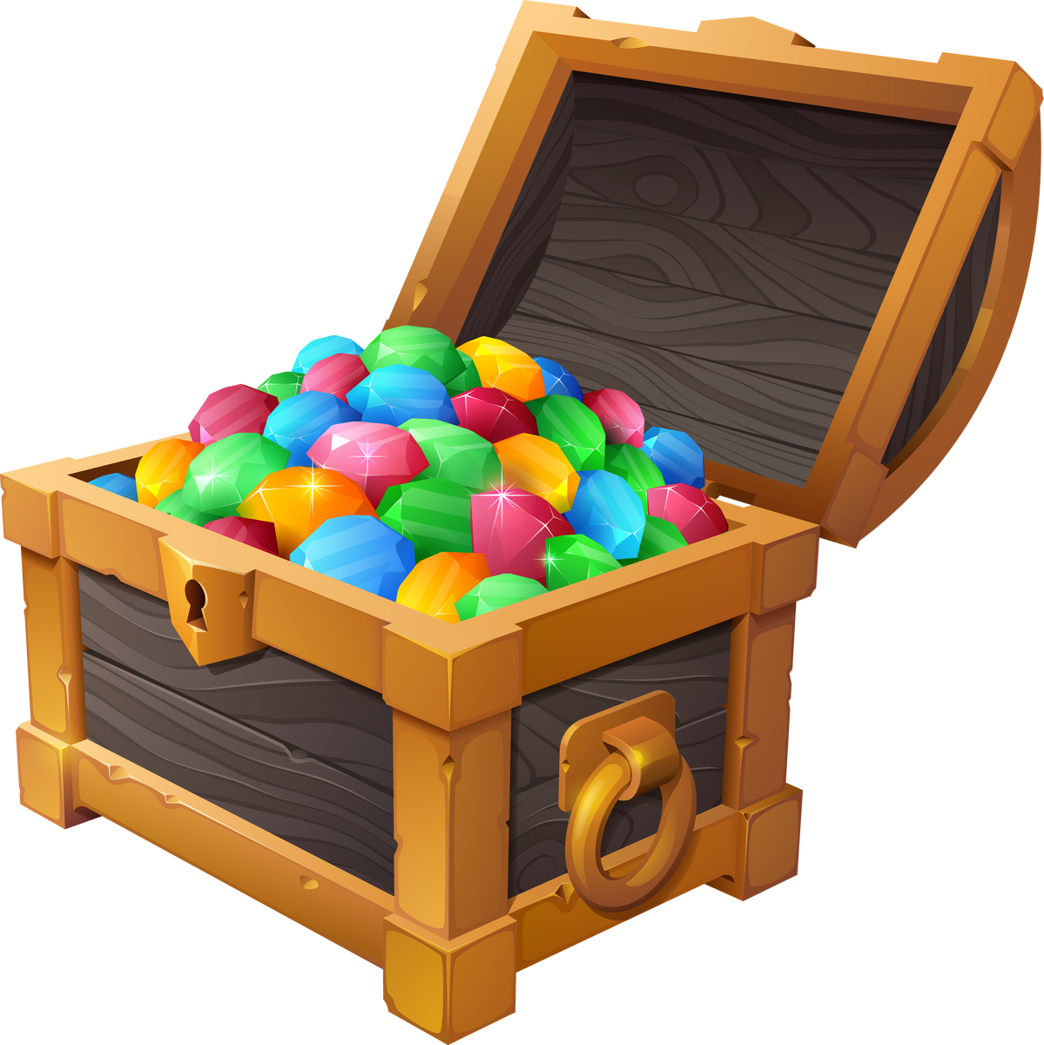




5 Look and Say
We can't have a picnic today because it's rainy.
#1
have a picnic/ rainy
NEXT
Notes:
Nhấn vào giương vàng để lấy số sao nếu hs trả lời đúng.

Slide 12
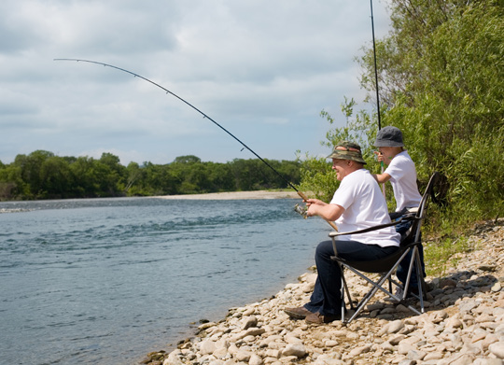



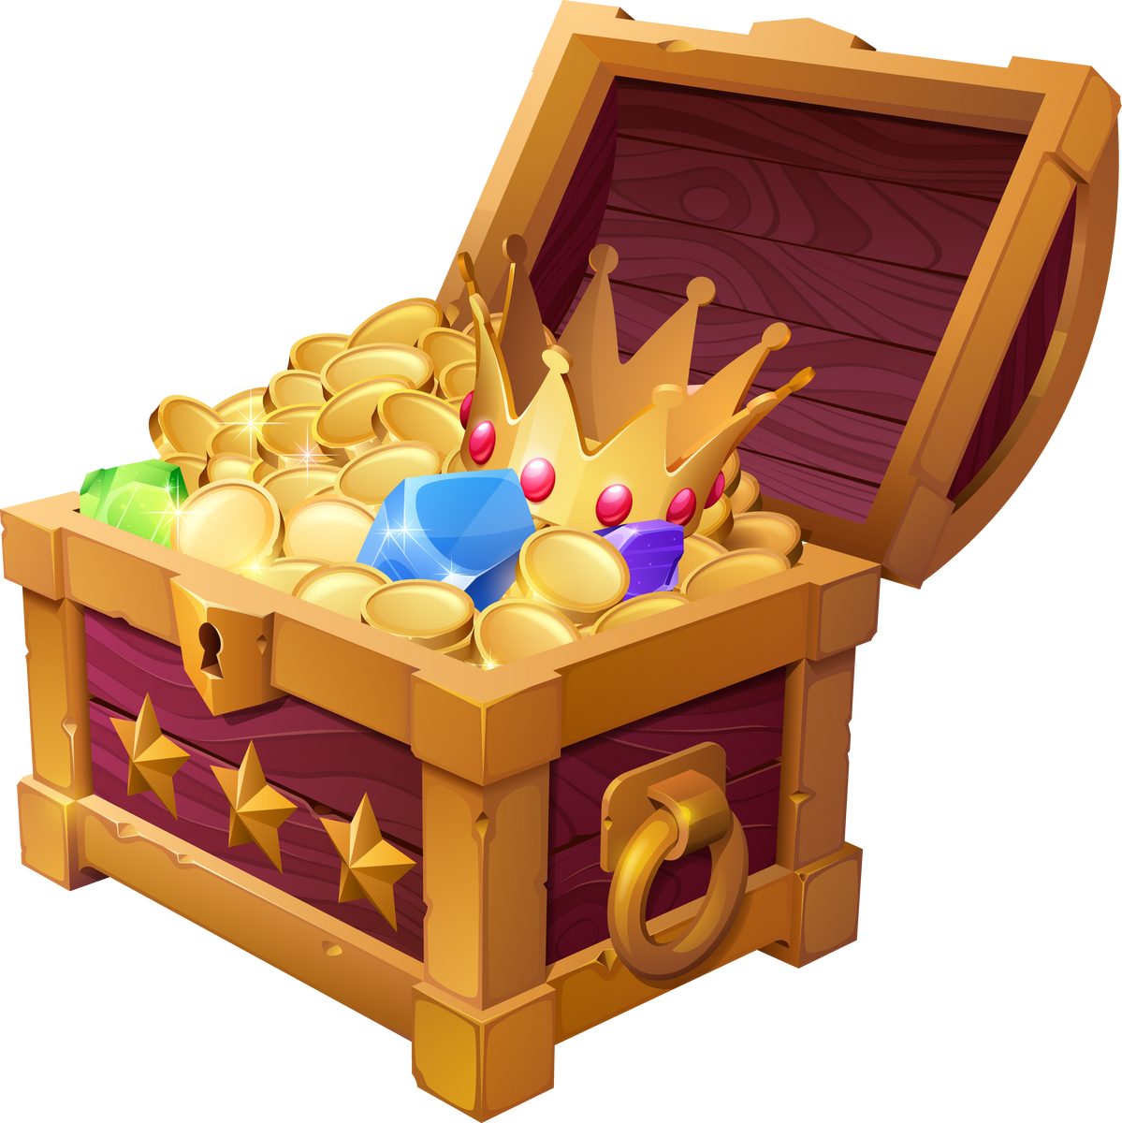
5 Look and Say
We can go fishing because it's cool.
#2
go fishing/ cool
NEXT
Notes:
Nhấn vào giương vàng để lấy số sao nếu hs trả lời đúng.

Slide 13
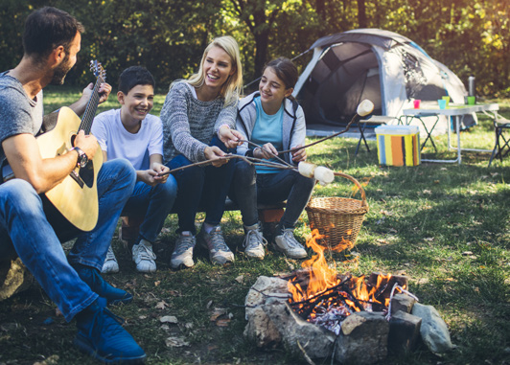

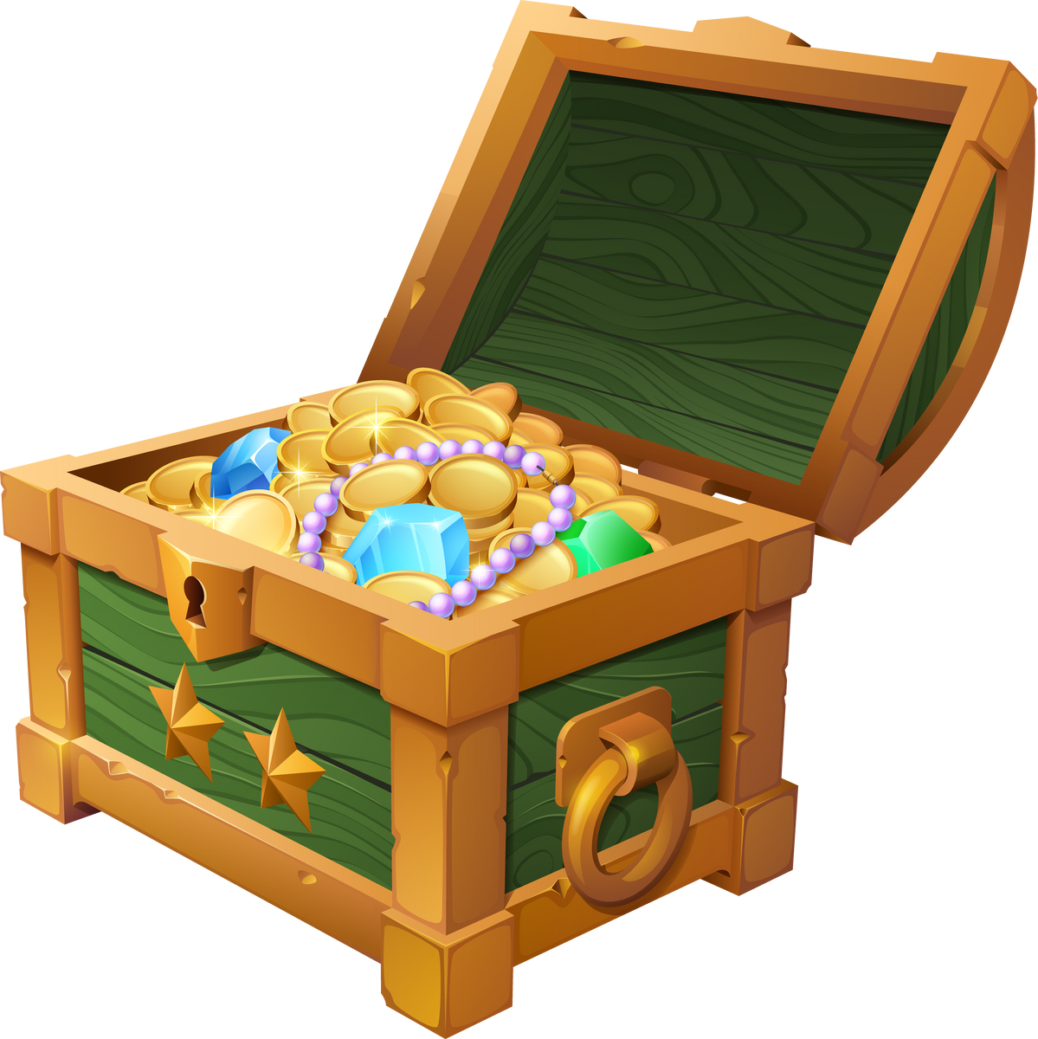
5 Look and Say
We can make a campfire today because it's dry.
#3
make a campfire/ dry
NEXT
Notes:
Nhấn vào giương vàng để lấy số sao nếu hs trả lời đúng.

Slide 14
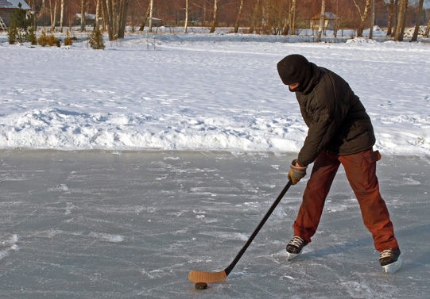

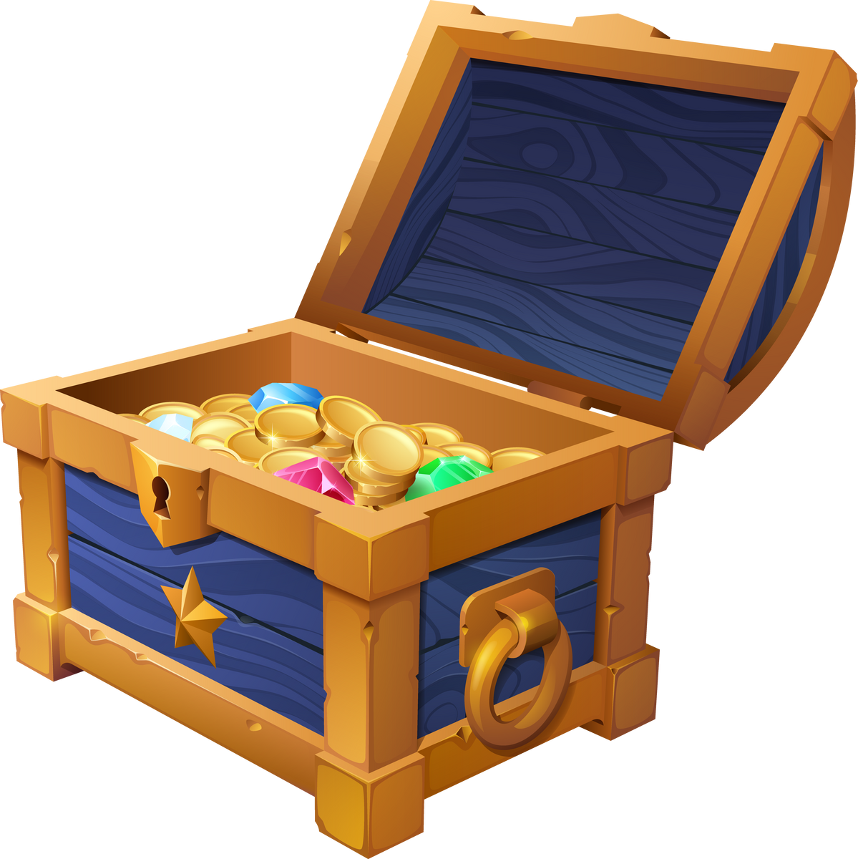
5 Look and Say
We can't play ice-hockey because it's hot.
#4
play ice-hockey/hot
NEXT
Notes:
Nhấn vào giương vàng để lấy số sao nếu hs trả lời đúng.

Slide 15
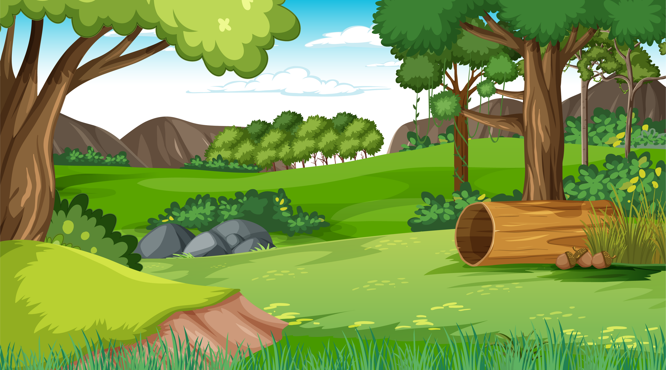

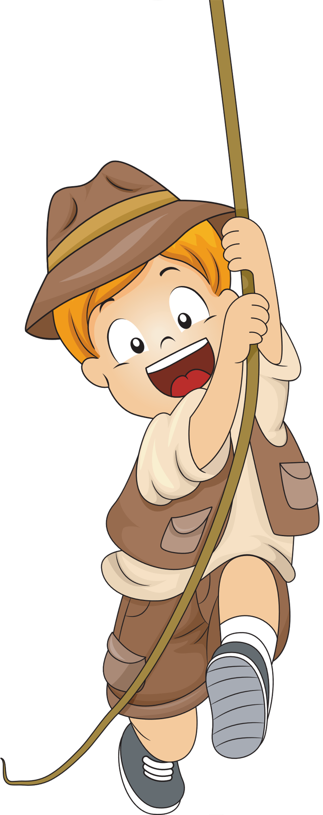
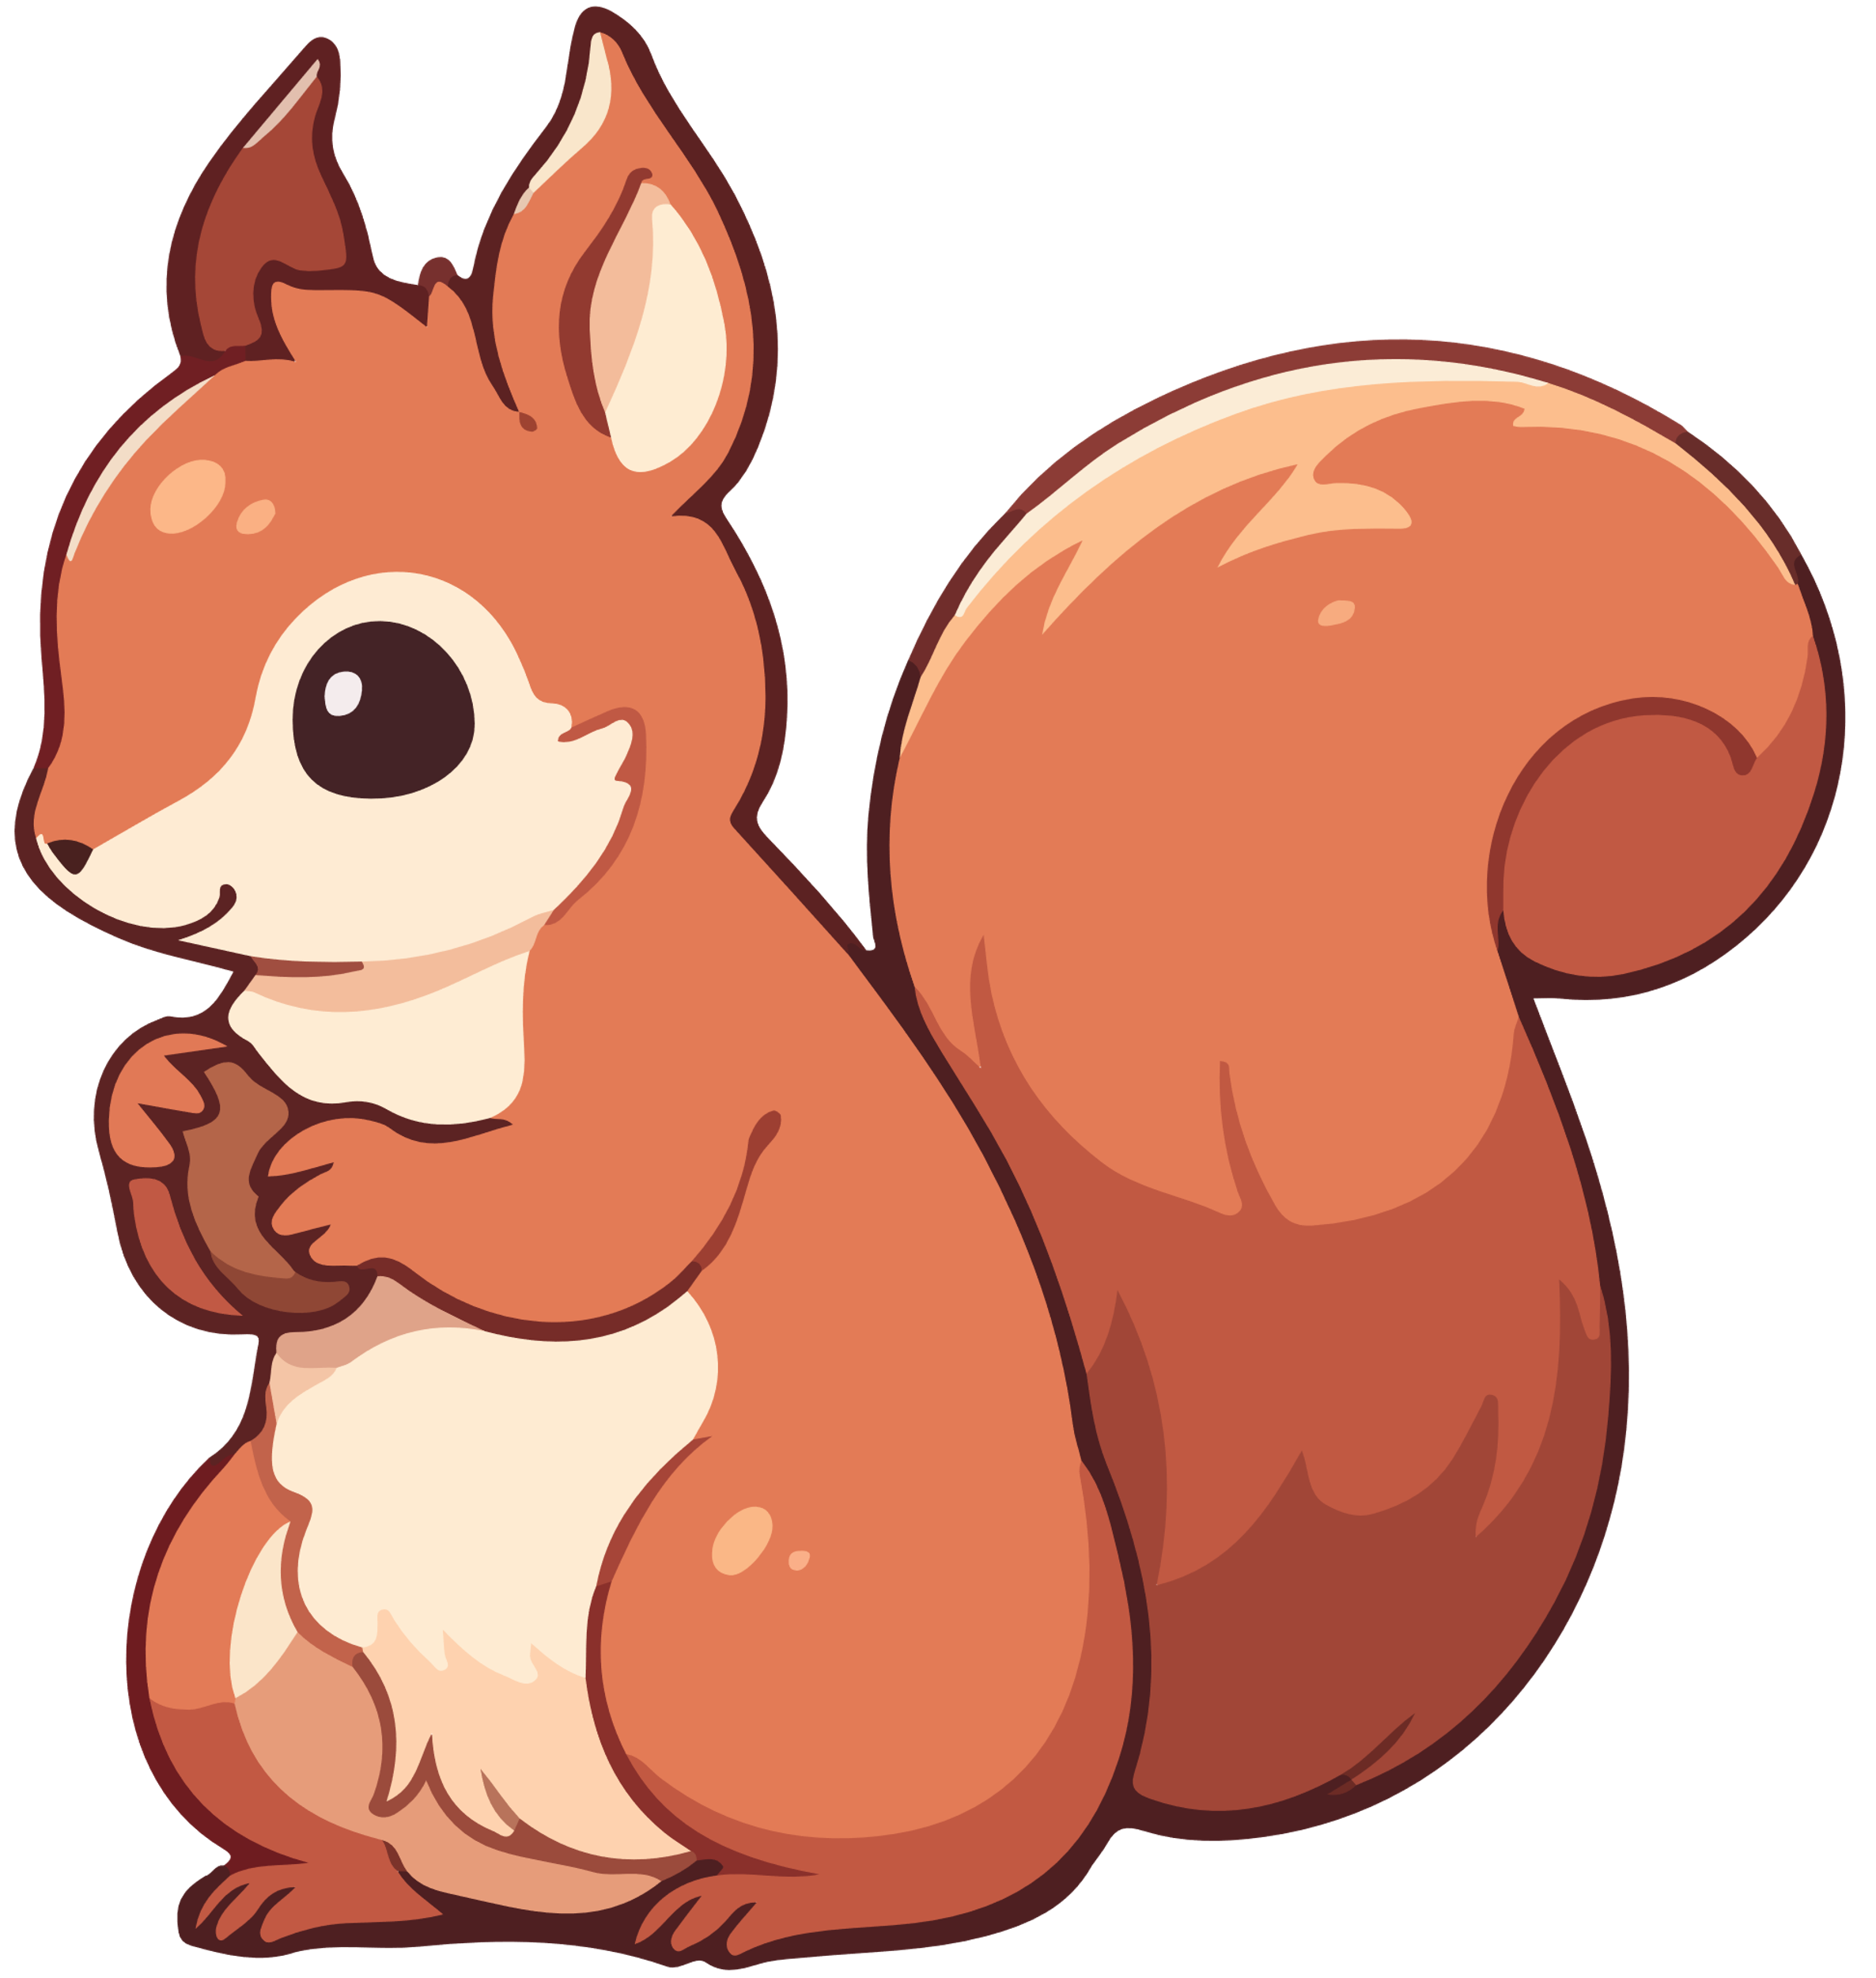
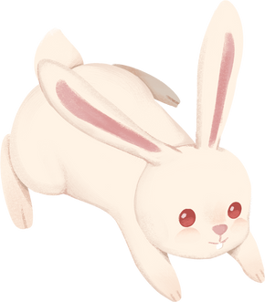
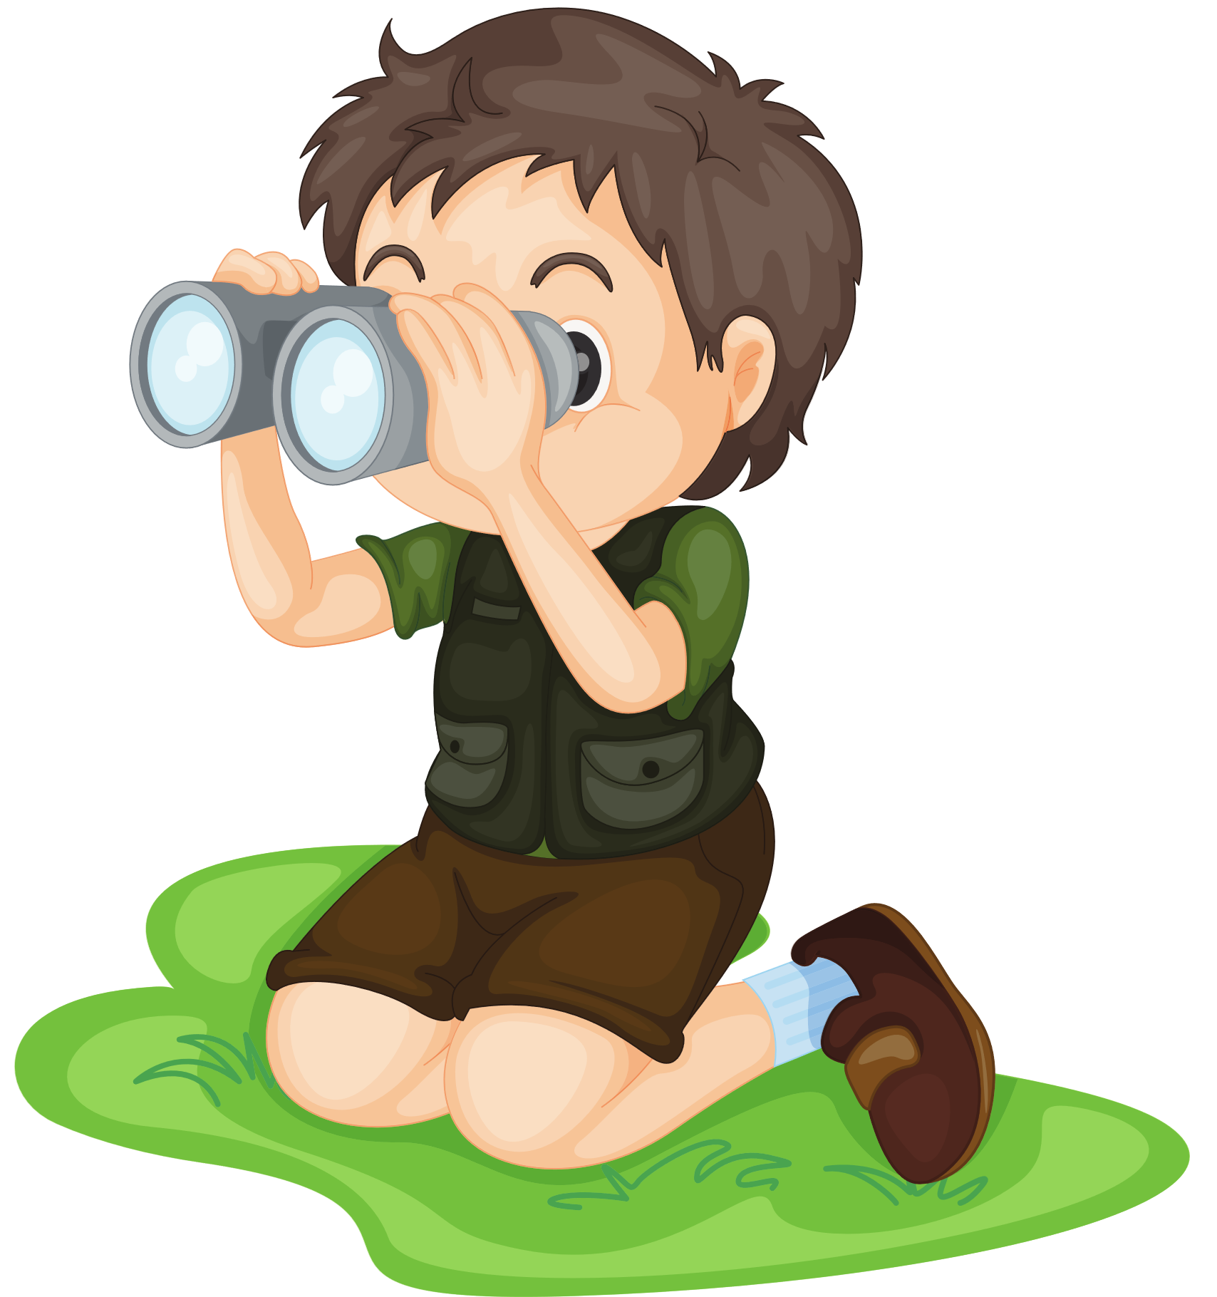
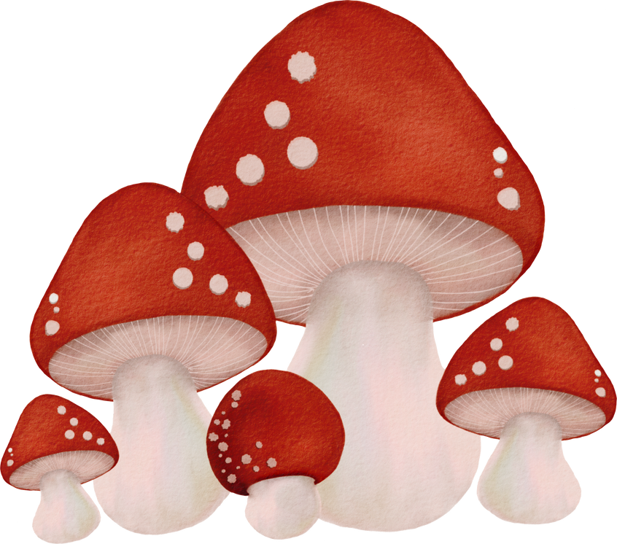
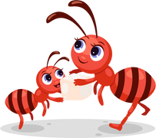
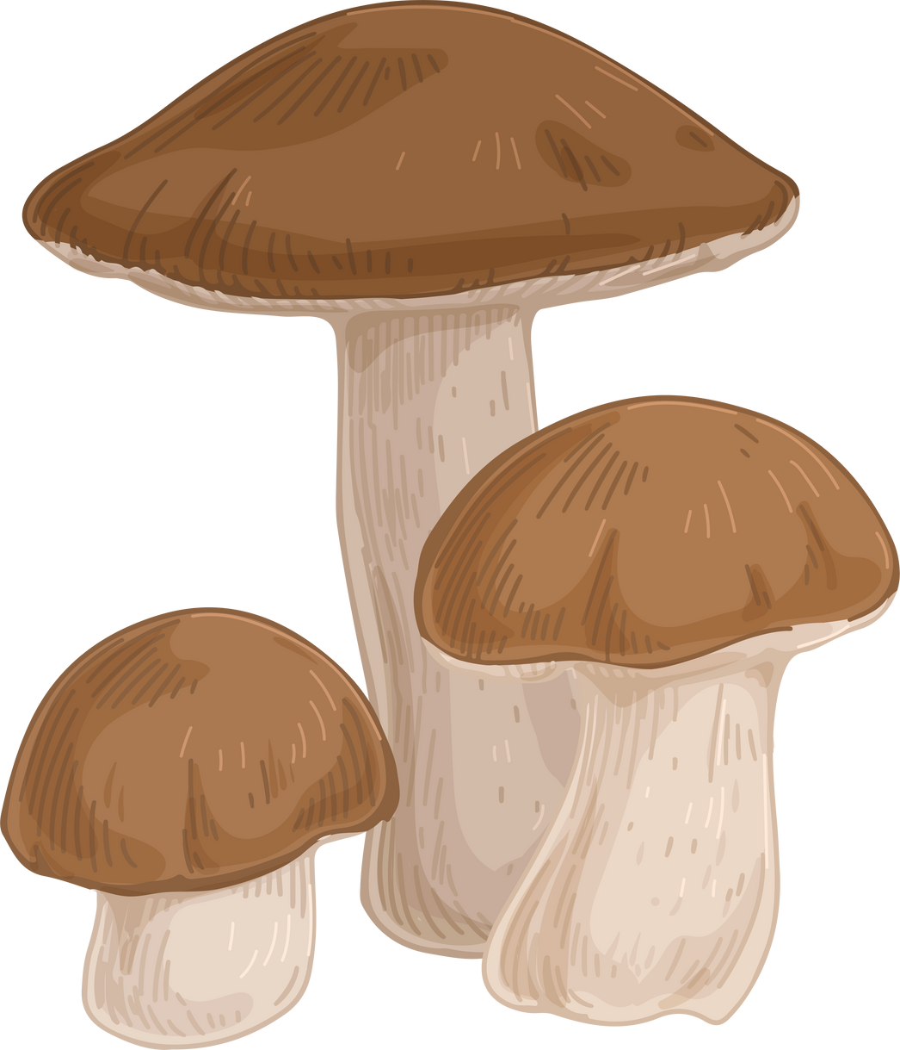
3
PRACTICE
Production

Slide 16
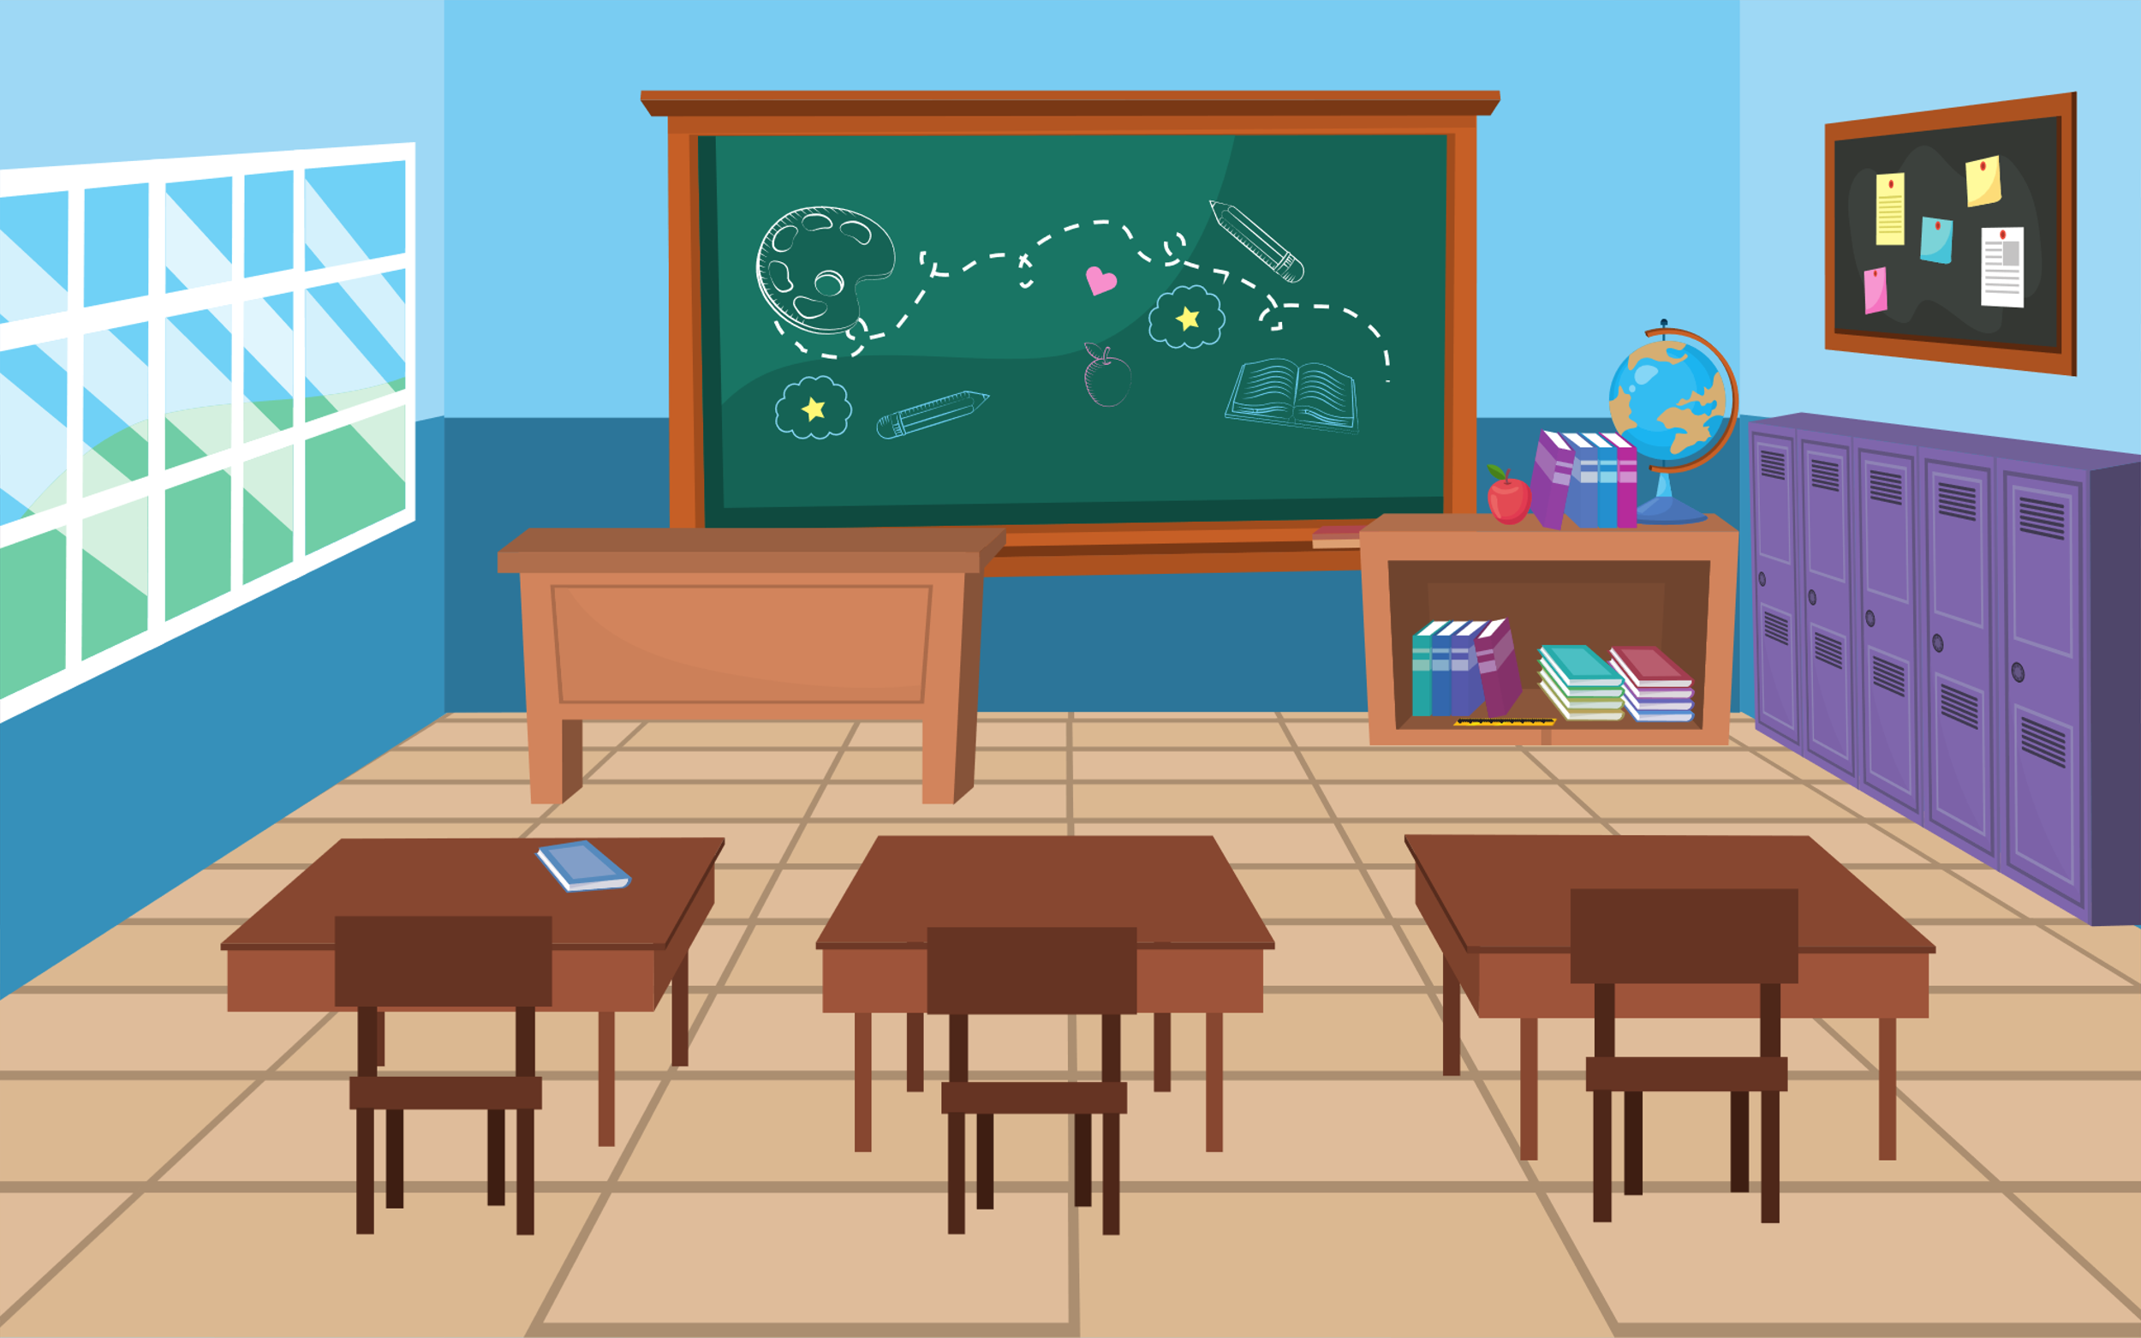




6 Let’s play
We can have a picnic today.
because it's warm.
Notes:
Sts work in pairs. A S says a part of sentence, another S says the reason.

Slide 17


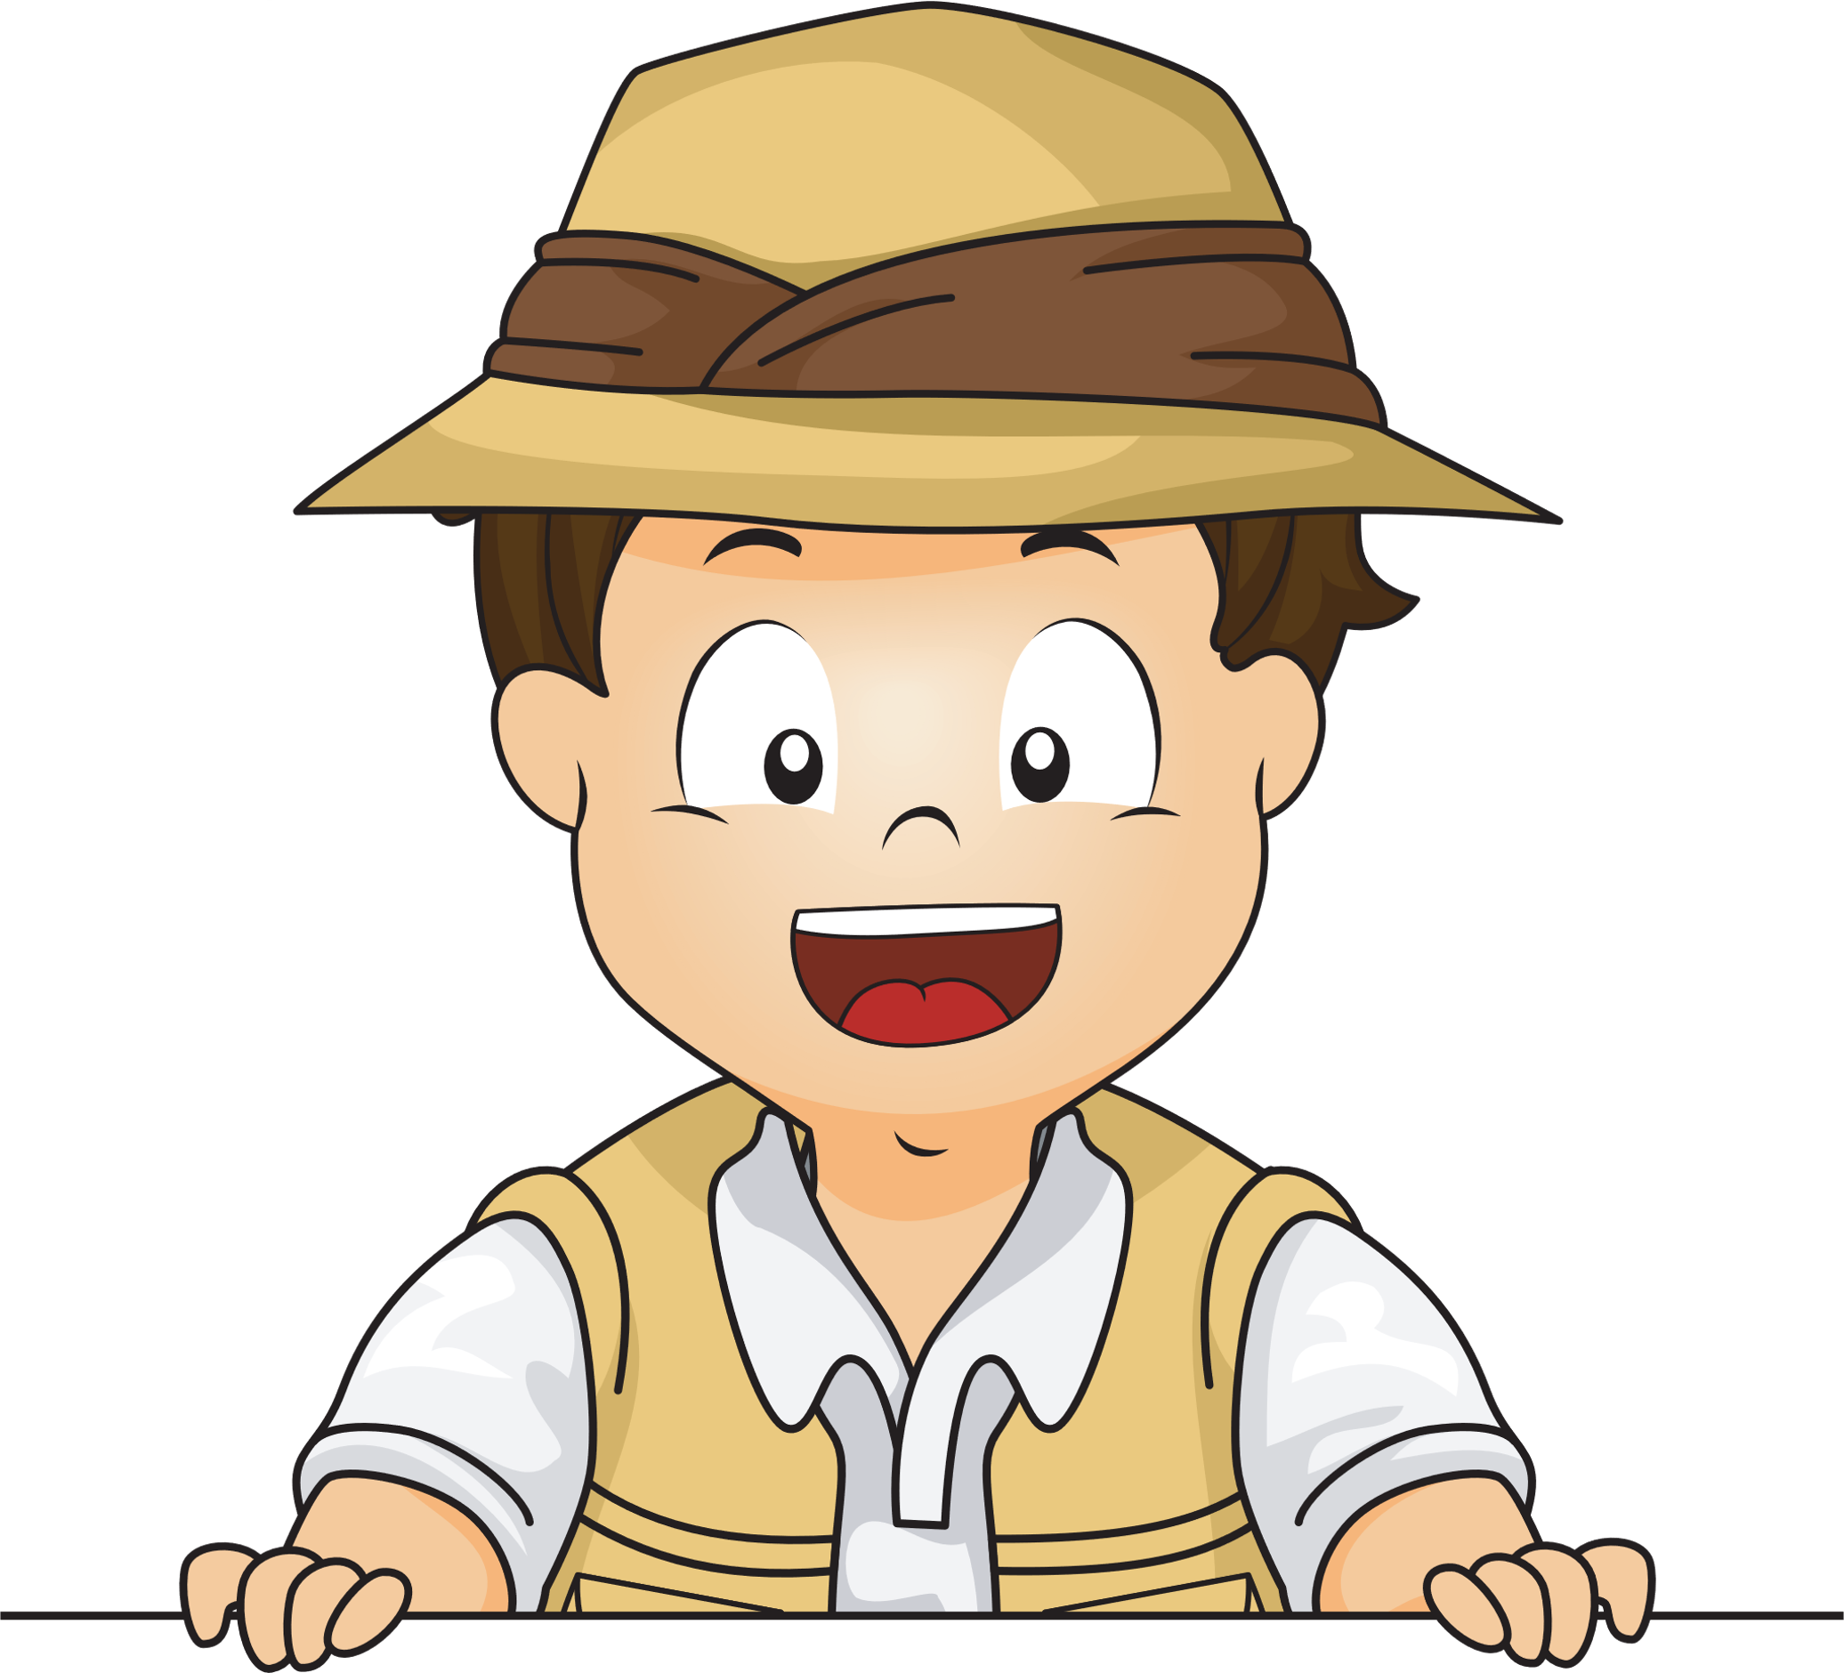


4
Assessment

Slide 18



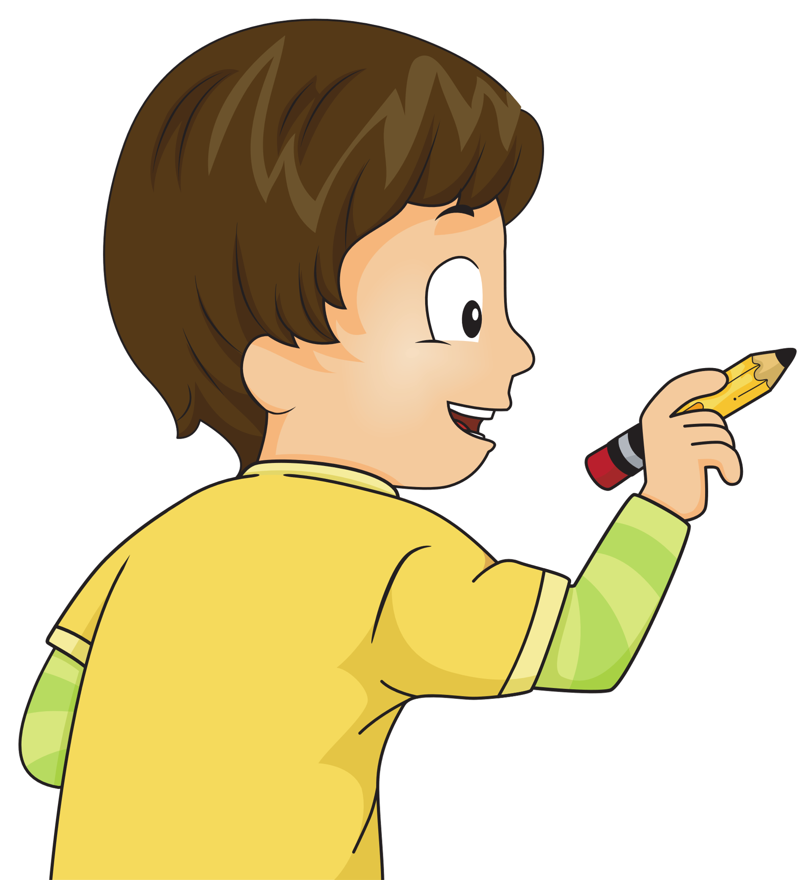
Read and circle
  1. We can/can’t go hiking because it’s dry.
  2. We can/ can’t have a picnic in the park because it’s windy.
  3. We can/ can’t play football because it’s rainy.
  4. We can/ can’t ride a bike in the forest because it’s sunny.
  5, We can / can’t play ice-hockey because it’s hot.

Slide 19

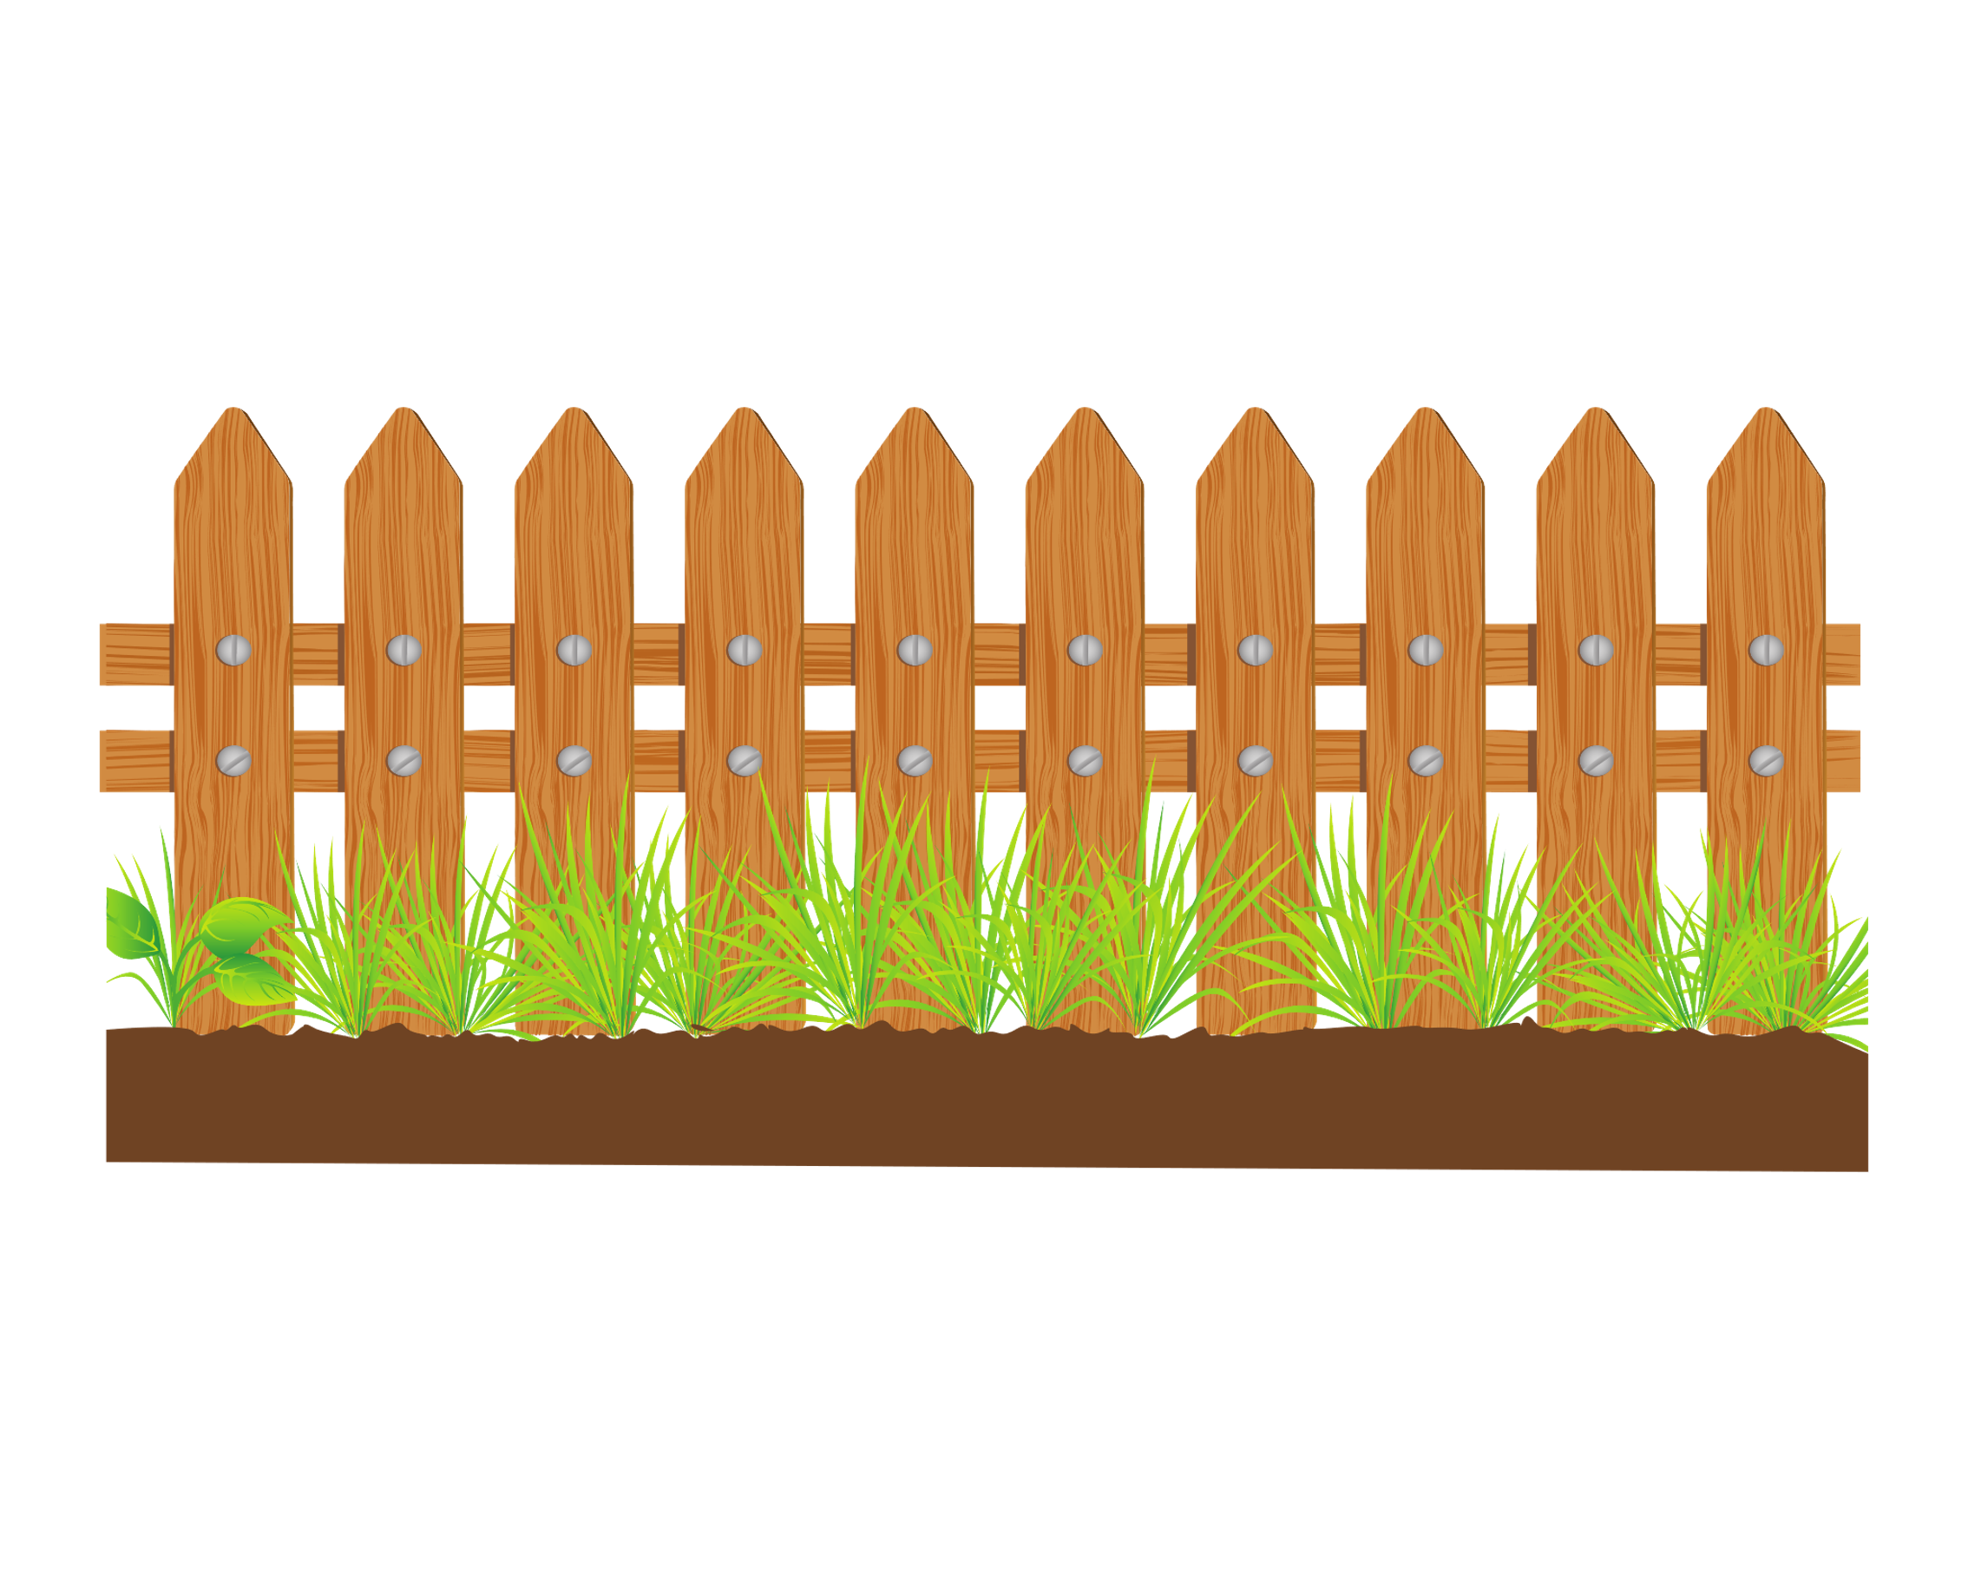


STRUCTURE
We can have a picnic in the park because it’s warm.
VOCABULARY
We can’t go hiking on the mountain because it’s snowy.
Review Vocabulary:
Beach ; forest ; go hiking
have a picnic.

Slide 20
















